Slide 1
TRANSITION
From Interaction to Evaluation and Diagnosis
MultiAgentBench + MAST, connected through a Werewolf anchor case
Agent interaction
Process evaluation
Failure attribution
MultiAgentBench
MAST
Measures task progress and coordination quality in interactive MAS.
Turns poor behavior into concrete failure modes.

Slide 2
INTRODUCTION
Final outcome is not enough
Same result, different interaction process.
Final result
Possible process A
Possible process B
Success
Efficient coordination
Lucky trial-and-error
Failure
Weak model ability
Poor communication
Low score
Ignored evidence
No verification
Core claim
If interaction changes behavior, evaluation must observe the process, not just the final label.

Slide 3
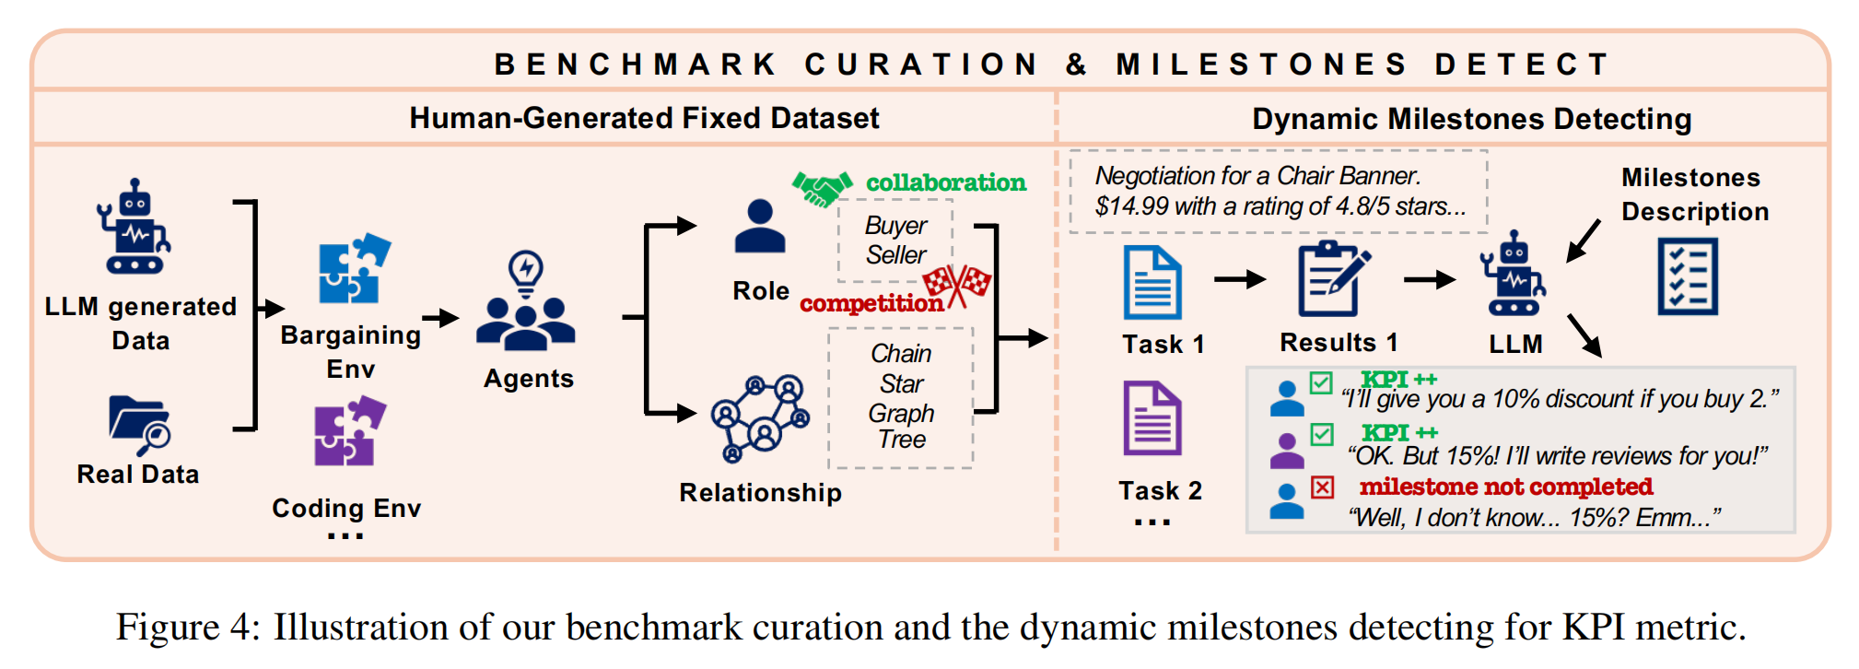
MULTIAGENTBENCH
MultiAgentBench: From milestones to process metrics
Milestone KPI
Communication Score
Planning Score
Tracks intermediate progress and each agent's contribution.
Rates sharing, clarity, and goal alignment from traces.
Rates role organization, strategy, and adaptation.

Slide 4
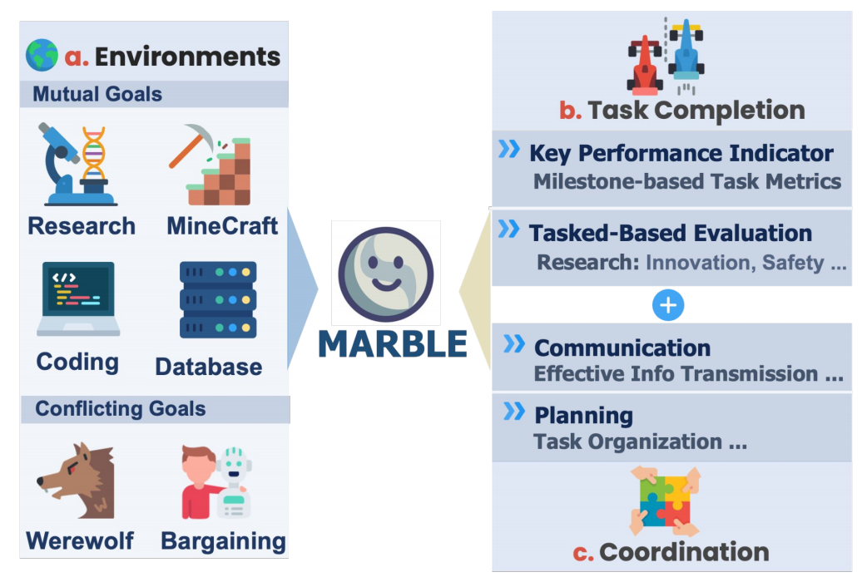
PAPER 1
MARBLE: measuring environments
Environment | Characteristics
Research | Collaborate to generate and refine a research proposal; Test: knowledge synthesis, collaboration
Minecraft | Coordinate to build target structures in a shared world; Test: spatial execution, action coordination
Database | Diagnose database errors through specialized expert roles; Test: root-cause reasoning, role-based collaboration
Coding | Jointly solve programming tasks through coding and debugging; Test: code generation, modular collaboration.
Bargaining | Negotiate over prices under conflicting interests; Test: strategic concession-making, competitive communication.
Werewolf | Play a hidden-role social deduction game; Test: social inference, trust dynamics, deception, and alliance formation.
03

Slide 5
WEREWOLF 1/3
Werewolf: why it is a useful anchor case
The final outcome is produced by multi-turn communication under hidden information.
Private info
Public claims
Trust update
Role action
Voting
Belief
Action
Group behavior
Seer checks and speeches change suspicion.
Guard, Witch, and voters respond to discussion.
Coordination can produce bloc voting or confusion.
MultiAgentBench treats Werewolf as a conflicting-goal social simulation, not a static QA task.

Slide 6
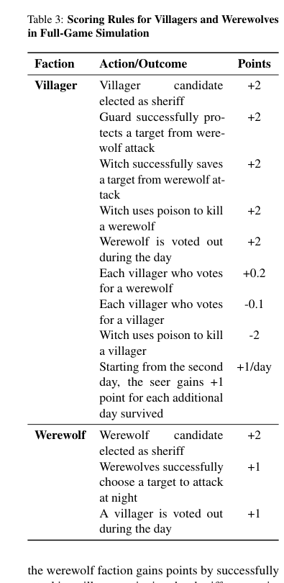
WEREWOLF 2/3
How MultiAgentBench evaluates Werewolf
Partial-day
One day-night cycle. Tasks: protect Seer, exile a werewolf, rescue or poison.
Full-game
The point is not only who wins. The benchmark also observes role actions and coordination quality.
Entire match from Night 0. Outcome: win rate, result score, net score.
Collaboration
Communication Score + Planning Score from logs and internal reasoning.

Slide 7
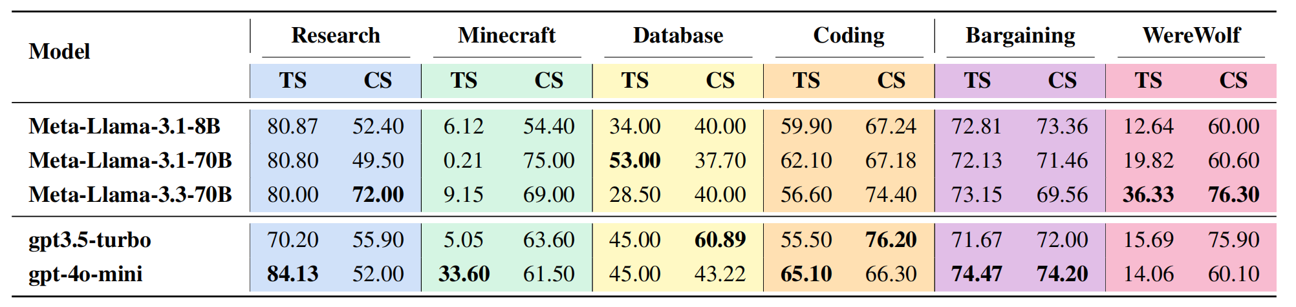
PAPER 1 ANSWER
MultiAgentBench takeaway
What it tells us
Why this matters
Limit
Whether interaction quality is high or low.
Task score and coordination score can diverge.
A low score still does not identify the root cause.

Slide 8
BRIDGE
Evaluation tells us what, not why
A low communication score is an observation, not yet an explanation.
Seer's claim ignored
Private info withheld
Vote not verified
Can result in SAME low score
Score
Trace
Failure mode
This is where MAST enters: it names the failure mechanism, so evaluation becomes actionable.
7

Slide 9
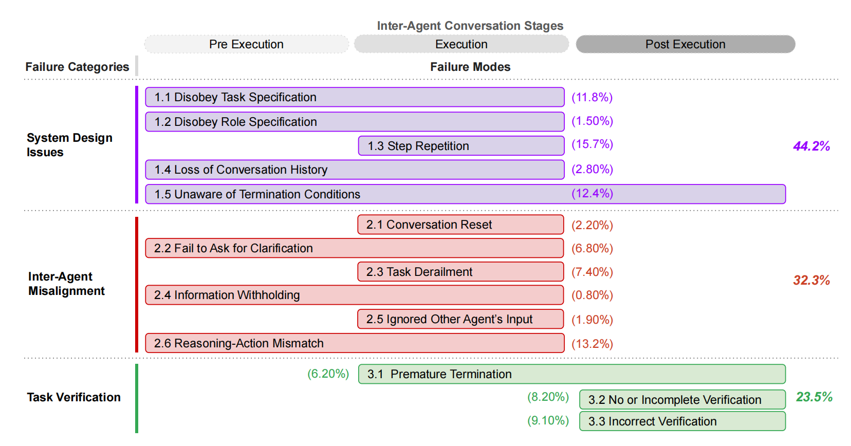
PAPER 2
MAST: from scoring to diagnosis
System Design
Roles, prompts, memory, workflow, termination.
Inter-Agent Misalignment
Information flow and coordination break down.
Task Verification
Outputs and claims are not properly checked.

Slide 10
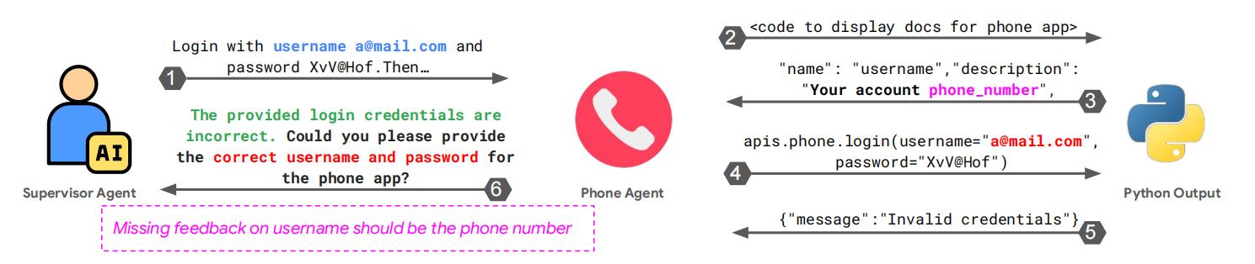
MAST
Communication-related failure modes
Fail to ask for clarification
Information withholding
Ignored other agent's input
Unclear evidence is not resolved
Useful private information is not shared
Shared evidence is not incorporated
Task derailment
Reasoning-action mismatch
No / incomplete verification
Discussion drifts away from the objective
Action contradicts stated reasoning
Claims or outputs are not checked
Paper example: a failure is diagnosed from the trace, not from the final answer alone.

Slide 11
Note: this applies MAST's taxonomy to a Werewolf-style trace; it is not claiming MAST itself benchmarked Werewolf.
WEREWOLF 3/3
Applying MAST to the Werewolf trace
Mini trace
Outcome
Seer: Player 3 is suspicious. Villagers do not discuss it. Group votes Player 5 on vague suspicion.
Player 5 is a villager. Werewolves gain advantage. Communication score is low.
Observed behavior
MAST attribution
Seer's claim not discussed
Ignored other agent's input
No one asks for evidence
Fail to ask for clarification
Vote without cross-checking
No / incomplete verification
Group says 6 is more suspicious, but votes 5
Reasoning-action mismatch

Slide 12
THE WHOLE PICTURE
Final synthesis
Support Coordination
Multi-Agent System
Emergence From Interactions
Evaluation & Failure Attribution
Become Strategic Under Competition
Agent-level
System-level
When individuals turn into a system, complexity emerges, and so does potential.

Slide 13
Thanks!
06

