Slide 1
Generating Hard instances of Lattice Problems

Slide 2
Generating Hard Instances of Lattice Problems
by
M. Ajtai

Slide 3
Structure
Average case complexity and its applications
Definition and history of lattice problems
definition of average case problem.
Main theorem
Proof
Trap door

Slide 4
Generating Hard Instances
There are many hard problems.
Can we generate hard instances of those problems ? (good for cryptography).
We need a distribution over the instances which, at least on the average, gives hard instances.

Slide 5
Distribution of Hard Instances
Even if worst cases are hard, the average case may be easy.
Examples: Coloring number of a random graph, minimal-monotone-SAT, 3-SAT(?).
Definition: An instance distribution is a function Λ(n), which obtains for each n, a distribution of instances.

Slide 6
Reduction to Average Case
To show Λ generates hard instances of a problem P, we reduce a hard problem to it.
An average case oracle for P, solves P on Λ(n), for all n, with probability ≥1/2.
A (random) algorithm is a reduction from L to the average case of P, if it solves any instance of L with probability ≥1/2, using an average case oracle for P.

Slide 7
Trash
Λ(n)
Oracle
n
Trash
Oracle
Instance
Solution

Slide 8
Hard Average Problems
A problem is hard on the average, if we can reduce some hard (preferably NP-complete) problem, to its average case.
Graph isomorphism can be reduced to its average case.
But no graph isomorphism cryptosystem exists - we need a trap door.

Slide 9
Lattices
The vectors must form a basis in R^{n}
The lattice L(a₁,..,a_{n}) in the Euclidean space, R^{n},is the additive group generated by {a₁,..,a_{n}}.
L(a₁,..,a_{n}) is a discrete subgroup of R^{n}.
{a₁,..,a_{n}} is a lattice bases of L(a₁,..,a_{n}).
L has many other bases.

Slide 12
Measuring Stuff in a Lattice L
Unit(L): “The tiler volume”.
sv(L): The length of the shortest non-zero vector in L.
A basis length is the maximal norm of the basis vectors.
bl(L): The length of the shortest basis of L.

Slide 13
Lattice Problems..
SVP: Given a lattice L(a₁,..,a_{n}), find the length of the shortest vector.
Unique-SVP: Given a lattice L(a₁,..,a_{n}), find a shortest vector, given that it is unique.
Given a lattice L(a₁,..,a_{n}), find a shortest basis.

Slide 14
Lattice Problems - History
[Dirichlet, Minkowsky] Upper bounds on sv(L).
[LLL] Approximation algorithm for SVP, factor 2^{n/2}
[Schnorr] Improved factor, (1+ε)^{n} for both CVP and SVP
[Ajtai96]: Average-case/worst-case equivalence for SVP.
[Ajtai-Dwork96]: Cryptosystem

Slide 15
Lattice Problems - History
[Ajtai97]: SVP is NP-hard.
[Micc98]: SVP is hard to approximate within some constant.
[GG]: Approximating SVP to within √n is in coAM∩NP.

Slide 16
The Ajtai-Dwork Cryptosystem

Slide 17
We will Show..
We reduce shortest-bases-approximation of factor n^{10+c} to the average case SVP-approximation of factor n^{c}.
SVP and Unique-SVP approx. are reducible to shortest basis, so similar results apply to them.

Slide 18
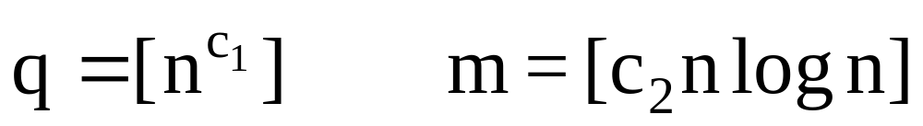
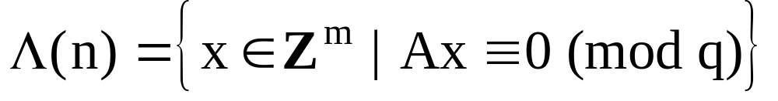
Average-Case Distribution
Pick an n*m matrix, with coefficients uniformly ranging over [0,…,q-1].

Slide 19
1
q

Slide 20
2v₁+v₄
v₂
(2,0,0,1)∈Λ
v₃
(1,1,1,0)∈Λ
v₁
q(a,b,c,d)∈Λ
v₄
1
q

Slide 21
Reduction From the
Shortest Basis Problem
1. Start with a given bases.
2. Try to halve it using the oracle.
3. If succeeded - go back to section 2.
It remains to show how to halve a bases, using the oracle, given that it is n^{8+c} times longer than the shortest bases.

Slide 22
Halving the Basis
1. We generate an instance with distribution Λ(n).
2. The solution of this instance will obtain a “random” vector in L, considerably shorter than the current bases length.
3. Doing it n times will form a short linear basis.
4. We transform it to a lattice basis.

Slide 23
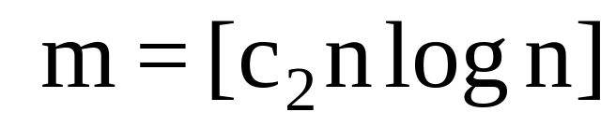
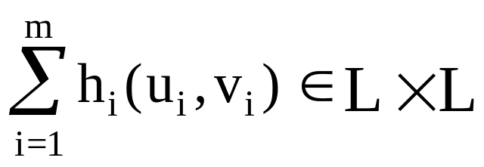
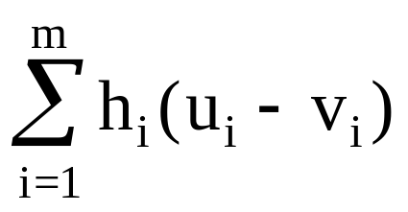
Generating a Short Vector
We find a lattice L₁, so close pairs (u,v)∈L₁xL are easy to find.
We find m such (u,v) pairs.
We find small coefficients h₁,…,h_{n}, such that
is our short vector.

