Slide 1
Why is reducing data silos important?
Presentation by Teo Jun Wei

Slide 2
What is Data Silos?
Data controlled by one asset class department
Isolated from the rest of the company

Slide 3
Effects on Company
Data from 1 asset class department is not readily available to another department
However, data can be useful for different asset class departments
Opportunity costs incurred for asset class departments to generate the most meaningful data insights to make the best data-driven decisions for the company and investment

Slide 4
Data Warehouse and Why We Need it?
Large collection of data used to help the company make data-driven decisions
Serves as a central repository, accessible to business users
Data from various departments are now readily available for all to use and generate increase business value
Designed to store and analyze large amounts of structured and semi-structured data

Slide 5
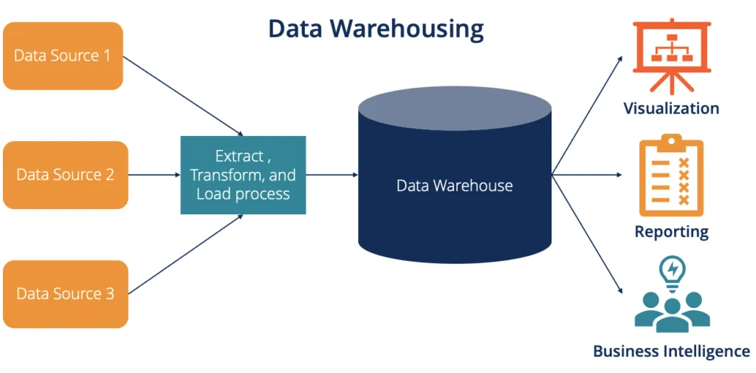
Workflow
Data is gathered from various data sources
Data is harmonized and cleaned to store meaningful information efficiently in data warehouse
Data from the data warehouse can be used for various business purposes

Slide 6
Use Case Definition
In an investment company, data from various asset classes are stored and maintained by the individual asset class departments
Data stored by each asset class is used to help generate insights to make data-driven decisions for asset specific investments
I am tasked to help investment company to consolidate data and reduce data silos

