Slide 1
Week 10 Summary
Junwoo Hwang
30.01.2023, 13:30

Slide 2
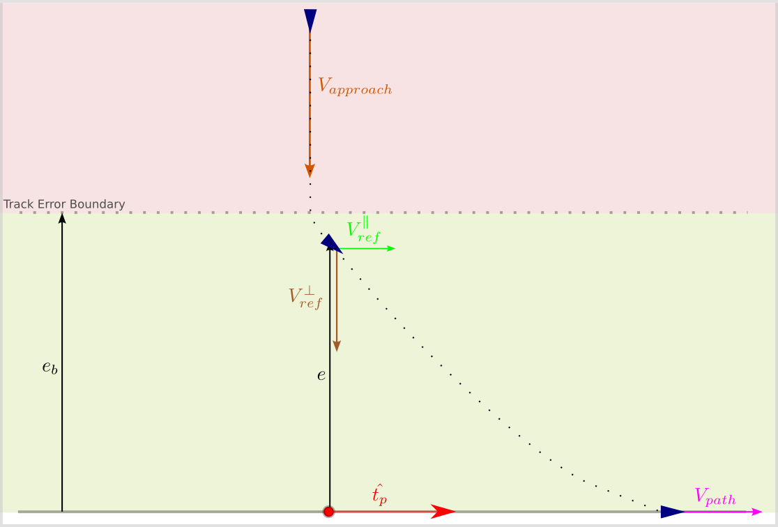
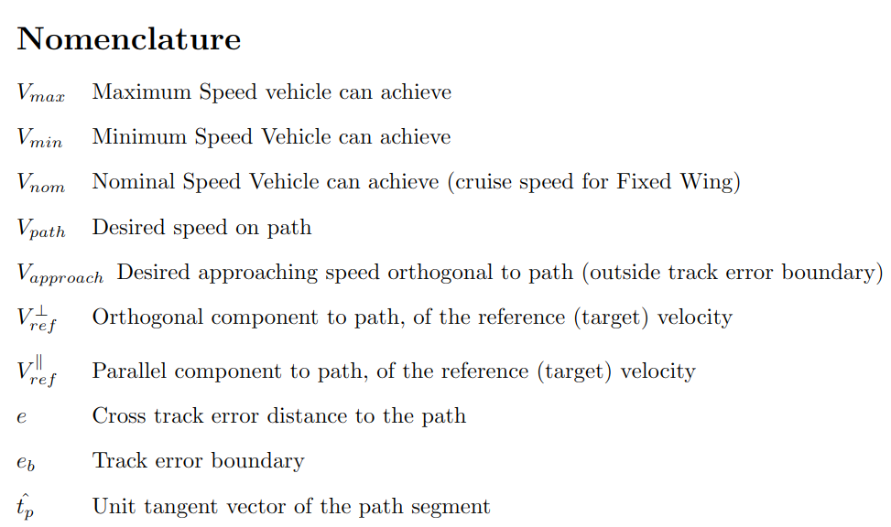
Nomenclature

Slide 3
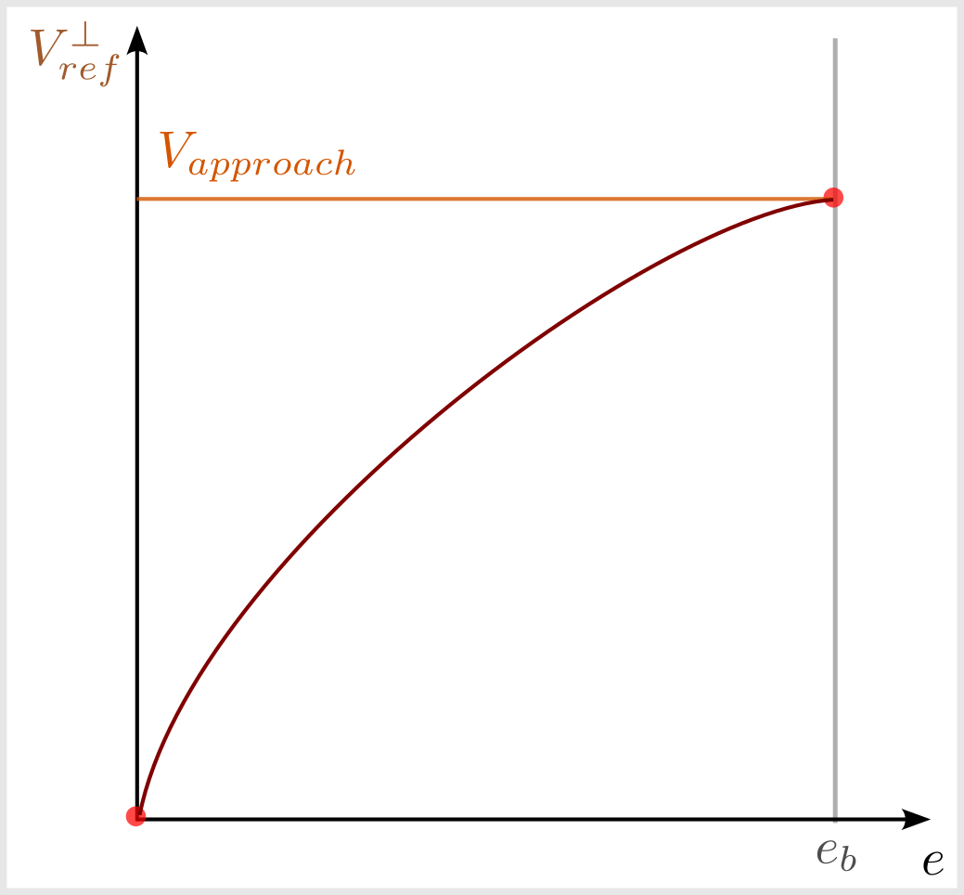
Orthogonal velocity curve

Slide 4
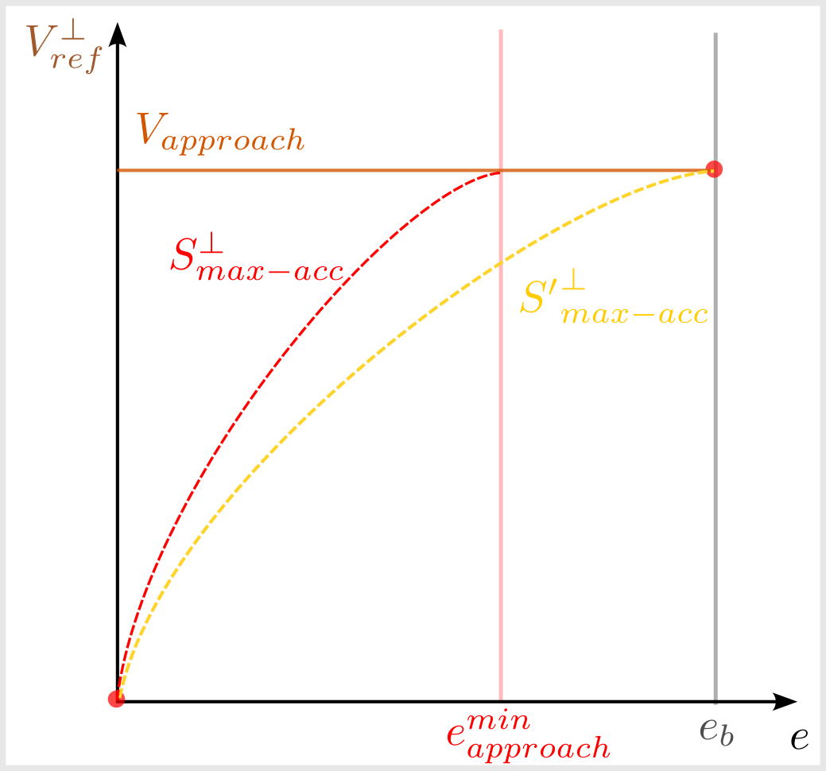
Orthogonal velocity curve with Acceleration limit

Slide 5
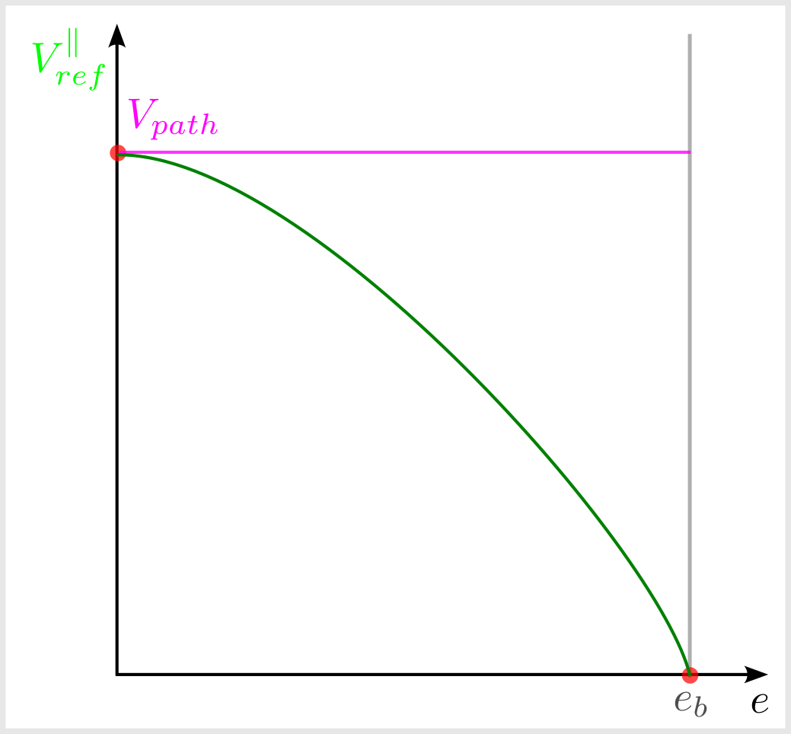
Parallel Velocity Curve

Slide 6
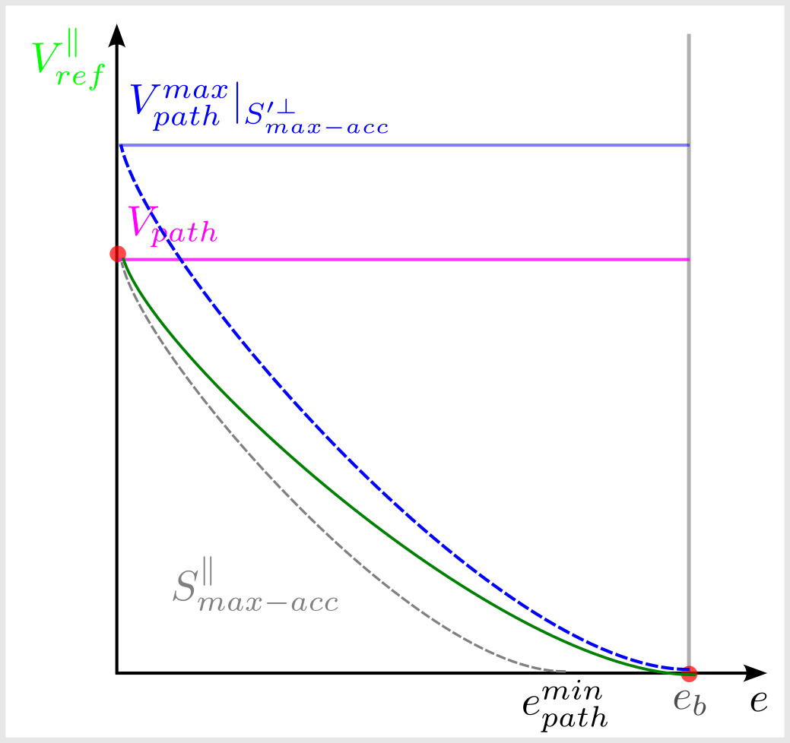
Parallel Velocity Curve with Acceleration Limit

Slide 7
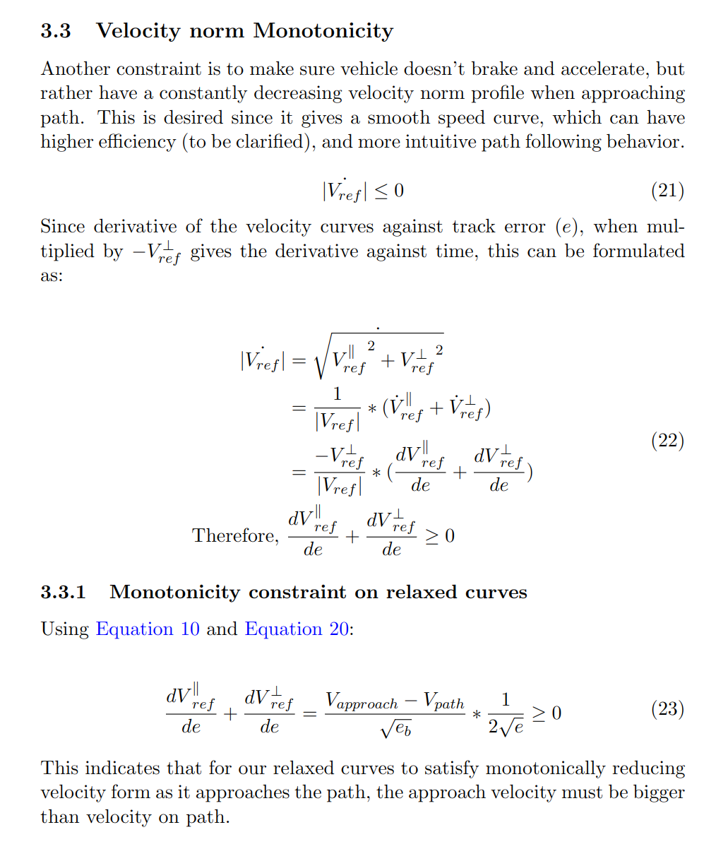
Monotonicity Constraint

