Slide 1
G
GitHub × Azure Cloud Demo
From issue to production, recorded on real GitHub and Azure
GitHub Copilot
GitHub Actions
Microsoft Foundry
Container Apps
AKS
32 demo videos · about 21 minutes · every screen is a real run
Click a video in slideshow mode to play it · The narration is an AI voice generated with Azure AI Speech
Notes:
[How to use this deck] Every slide carries a short demo video. In slideshow mode, click a video to play it; the demo map jumps to each video. The narration is an AI voice generated with Azure AI Speech.

Slide 2
The whole picture: from one issue to production
One line of flow with no stored secrets
GitHub
Microsoft Azure
C
GitHub Copilot
C
Container Apps
Issue to PR · code review
Scale-to-zero · revision canary
PR
Deploy
AI
Managed Identity
R
Repo · Security
A
ACR
F
Foundry
Rulesets · CodeQL · Dependabot
Build and store container images
gpt-6.1-sol · keyless calls
CI
Push
Deploy
Workload Identity
A
GitHub Actions
E
Entra ID
A
AKS
OIDC token
Parallel CI · environment approval · OIDC deploy
OIDC federation · no secrets
HPA · rolling update · Workload Identity
GitHub × Azure Cloud Demo
2
Notes:
[Key message] From issue to PR, verification, deployment, runtime and model calls, there is no stored secret in any step.

Slide 3
Six demos, one flow: build · protect · deploy · run · scale
Each demo can also be shown on its own
1
2
3
4
5
6
GitHub Copilot
GitHub Repo
GitHub Actions
Foundry
Container Apps
AKS
Keyless model calls
HPA · rolling · Workload Identity
Issue → PR → review
Rulesets · security · PR checks
Parallel CI · OIDC deploy
Scale-to-zero · canary
The order follows an app from creation to production
GitHub × Azure Cloud Demo
3
Notes:
[Key message] The six demos are one flow from creating an app to running it in production. If time is short, pick a single demo.

Slide 4
Demo map: 32 videos · about 21 minutes
Click a tile to jump to its video
1 · Copilot
2 · Repo
3 · Actions
4 · Foundry
5 · ACA
6 · AKS
7 · Connect
1.1
Setup
2.1
As code
3.1
Parallel CI
4.1
Deploy
5.1
Deploy
6.1
Deploy
7.1
ACA call
0:39
0:42
0:28
0:31
0:17
0:39
0:39
1.2
Assign
2.2
Dev env
3.2
OIDC
4.2
Keyless
5.2
Scale to 0
6.2
HPA
7.2
AKS call
0:27
0:31
1:04
0:37
0:46
0:42
0:43
1.3
Agent PR
2.3
Risky PR
3.3
Deploy
4.3
Effort
5.3
Canary
6.3
Rolling
0:42
1:02
1:01
0:36
0:46
0:49
1.4
Approve CI
2.4
Updates
3.4
Trust
4.4
Roles
5.4
Canary UI
6.4
Pod ID
0:29
0:18
0:50
0:28
0:27
0:25
1.5
Review
2.5
4.5
Foundry
5.5
Scale out
6.5
Portal
Settings
0:49
0:40
0:28
0:58
1:00
5.6
Portal
0:48
GitHub × Azure Cloud Demo
4
Notes:
This is the map slide. A tile jumps to its video slide, and the Demo map button on each video slide brings you back.

Slide 5
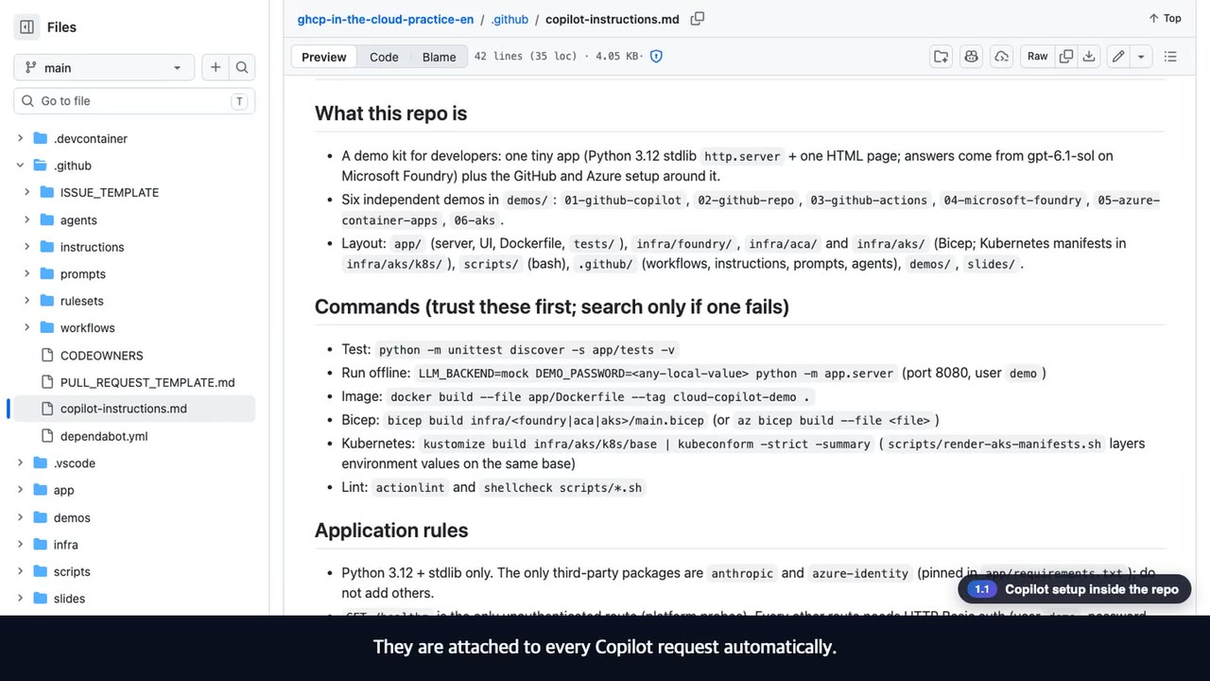
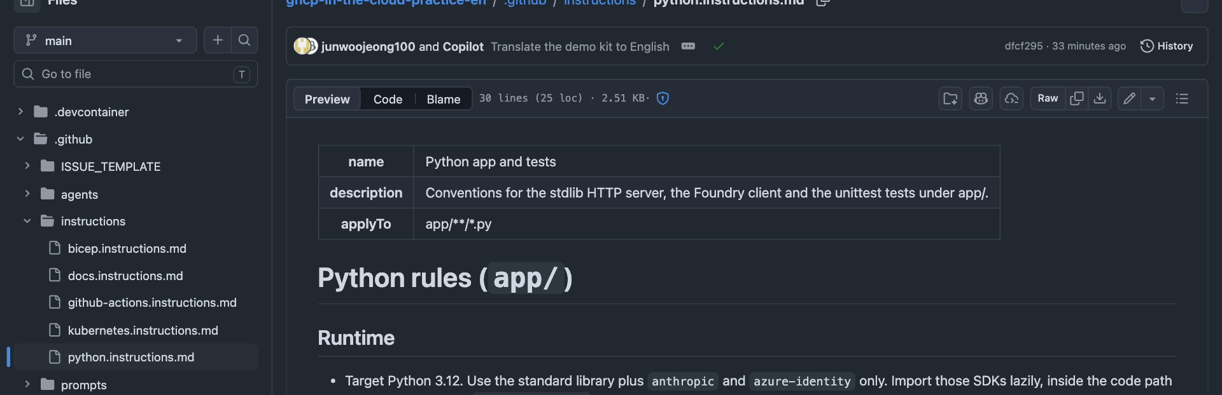
1
1.1 · GitHub Copilot
◀ Demo map
Copilot setup inside the repo
Every file that tells Copilot about the team's rules lives in the repository
What to check in the video
1
Repo-wide instructions are attached to every Copilot request
2
applyTo globs give Python, Bicep and workflows their own rules
3
Prompts, agents and the issue form are reviewed in PRs like code
copilot-instructions.md
instructions/
agents/
▶ 0:39
Click to play
5
Notes:
[Key message] Every file that tells Copilot about the team's rules lives in the repository
[Video narration] Every file that tells Copilot about the team's rules lives in the repository. First, the repository-wide instructions. They are attached to every Copilot request automatically. Path-specific instructions target files with globs, so Python, Bicep and workflows each get different rules. Slash prompts and dedicated agents live in the same repository. Even a read-only reviewer agent is just one file. The issue form asks for the context, the acceptance criteria and the constraints, so people write issues that an agent can succeed with.
[Check while presenting] Q. What if the instructions are ignored? Check that the file is on the default branch and that the applyTo glob matches.

Slide 6
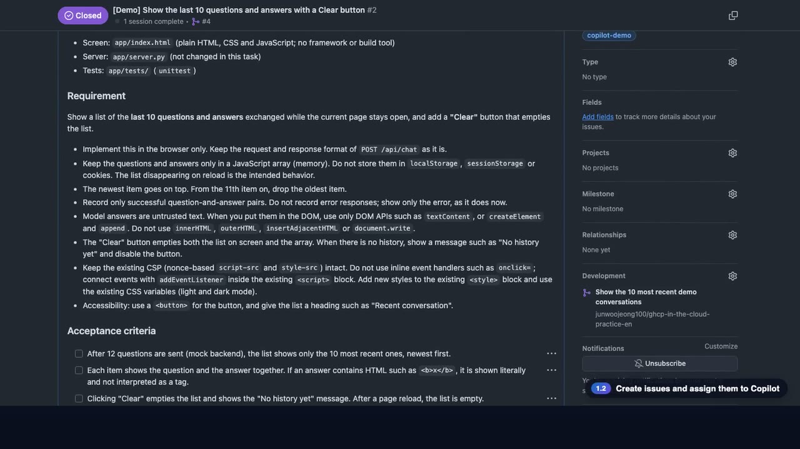
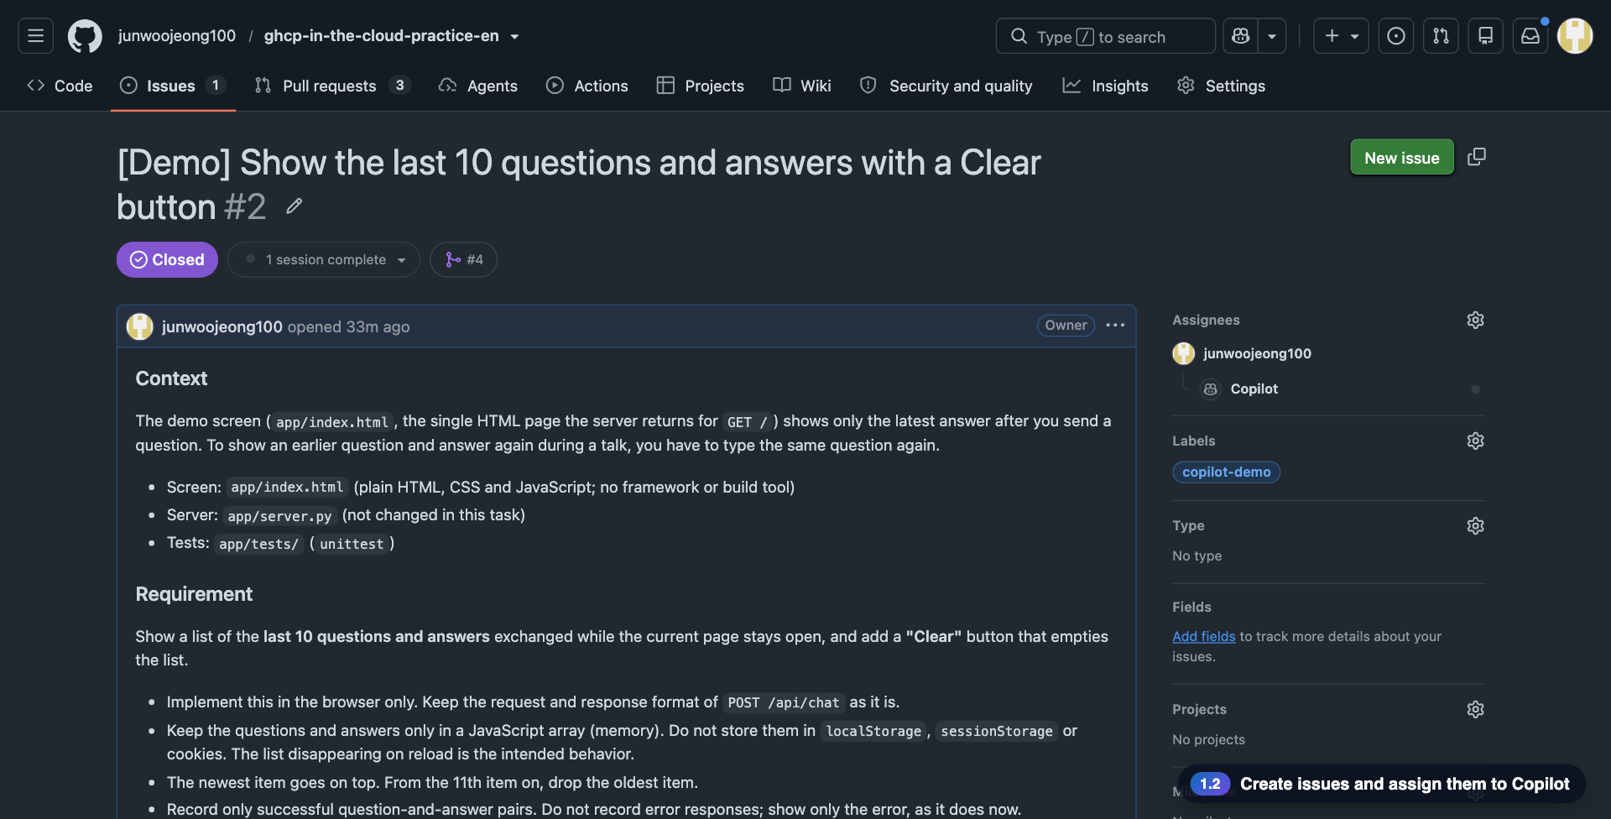
1
1.2 · GitHub Copilot
◀ Demo map
Issue → Copilot assignment
A script creates the issues and hands them to Copilot, and the agent starts right away
What to check in the video
1
By default it is a dry run: it only previews the issues
2
--apply --assign-copilot creates them and assigns Copilot
3
The issue timeline shows Copilot starting work
create-demo-issues.sh
--assign-copilot
▶ 0:27
Click to play
6
Notes:
[Key message] A script creates the issues and hands them to Copilot, and the agent starts right away
[Video narration] Issues are created by a script. Run it as is and it only previews the issues and the commands, and changes nothing. With the apply and assign-copilot options, it creates two issues and assigns them to Copilot. On the issue page, Copilot appears as the assignee, and a moment later the timeline records that the agent started working.
[Check while presenting] Q. Copilot is not in the assignee list? Check the paid plan, write access and the cloud agent policy.

Slide 7
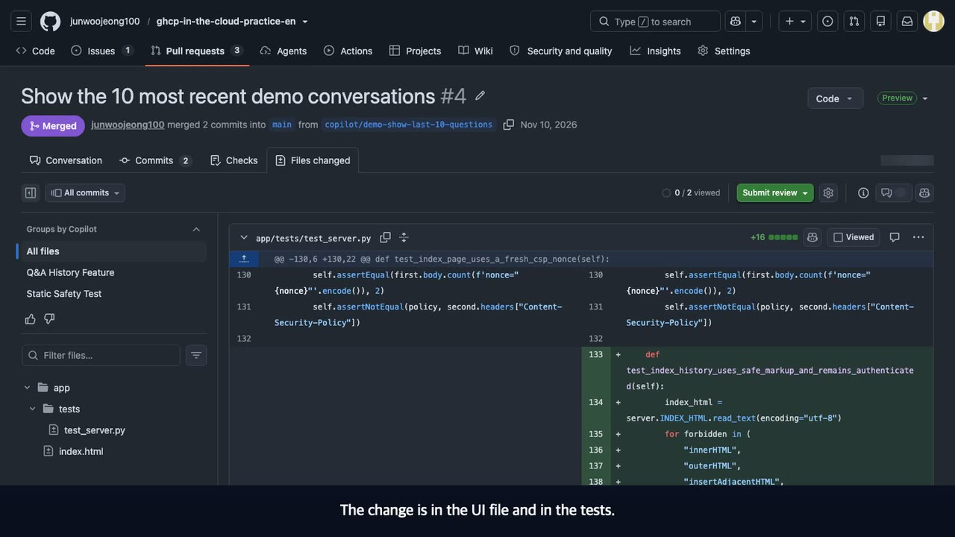
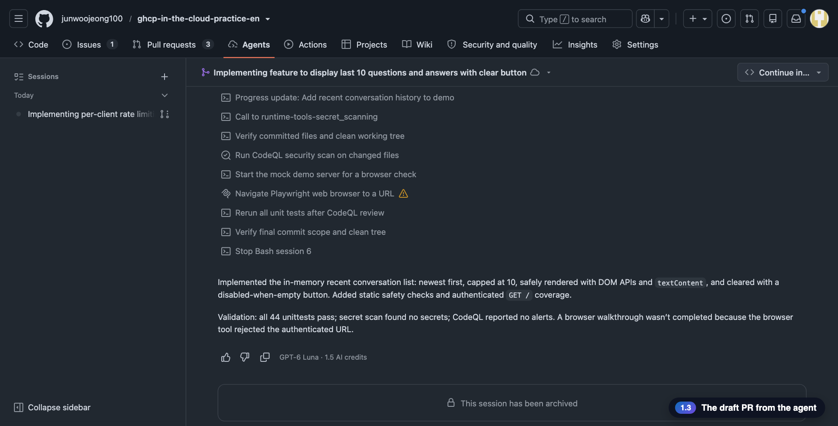
1
1.3 · GitHub Copilot
◀ Demo map
The draft PR from the agent
In about five minutes a draft PR with the implementation and tests arrives, and the work is kept in a session
What to check in the video
1
The PR is linked to the issue and changes the UI and the tests
2
Session log: unit tests, secret scan, CodeQL; browser check incomplete
3
Its workflows wait on action required until a person approves
draft PR
agent session
action required
▶ 0:42
Click to play
7
Notes:
[Key message] In about five minutes a draft PR with the implementation and tests arrives, and the work is kept in a session
[Video narration] The agent opened a draft pull request in about five minutes. It is linked to the issue, and the plan and the implementation are kept as commits. The change is in the UI file and in the tests. The agent did not just implement the feature; it brought tests too. The agent's work is kept in its session, about four and a half minutes of it. You can see the unit tests, a secret scan and the CodeQL scan. It also tried a browser check, and its summary says that one could not be completed. One thing to know: workflows on an agent's pull request do not run until a person approves them. We look at that state in the next scene.
[Check while presenting] Results differ on every run. Do not promise a specific piece of code.

Slide 8
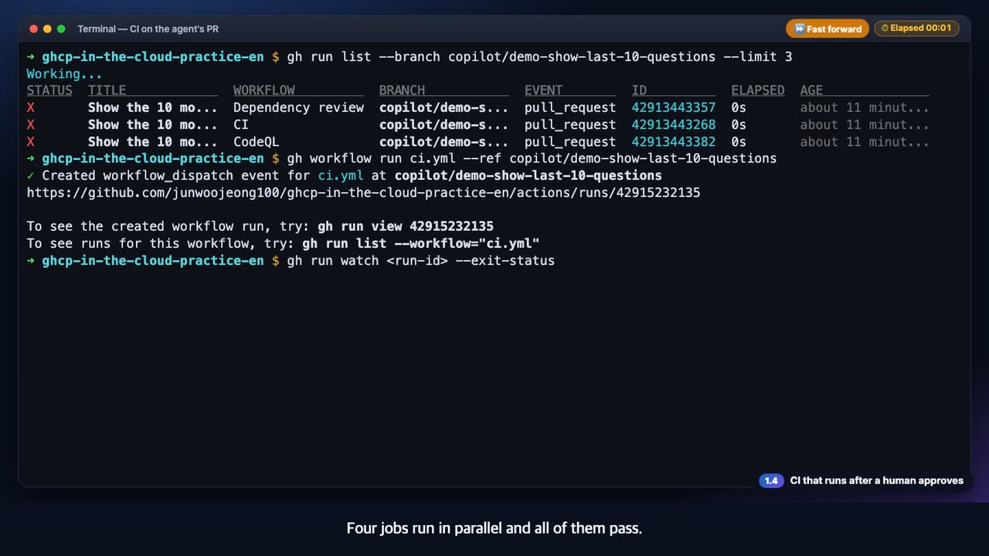
1
1.4 · GitHub Copilot
◀ Demo map
CI that runs after a human approves
The agent's code has to pass the same CI as a person's code
What to check in the video
1
Before approval, CI, CodeQL and Dependency review are all waiting
2
On the web use Approve and run workflows; with the CLI, dispatch the same CI with workflow_dispatch
3
Four jobs run in parallel and all of them pass
gh run list
gh workflow run
gh run watch
▶ 0:29
Click to play
8
Notes:
[Key message] The agent's code has to pass the same CI as a person's code
[Video narration] In the run list, CI, CodeQL and the dependency check of the agent's pull request are all waiting. They are waiting for a person's approval. On the web, it is one click on Approve and run workflows. Here, we dispatch the same CI directly on this branch. Four jobs run in parallel and all of them pass. Code written by an agent goes through the same checks as code written by a person.
[Check while presenting]

Slide 9
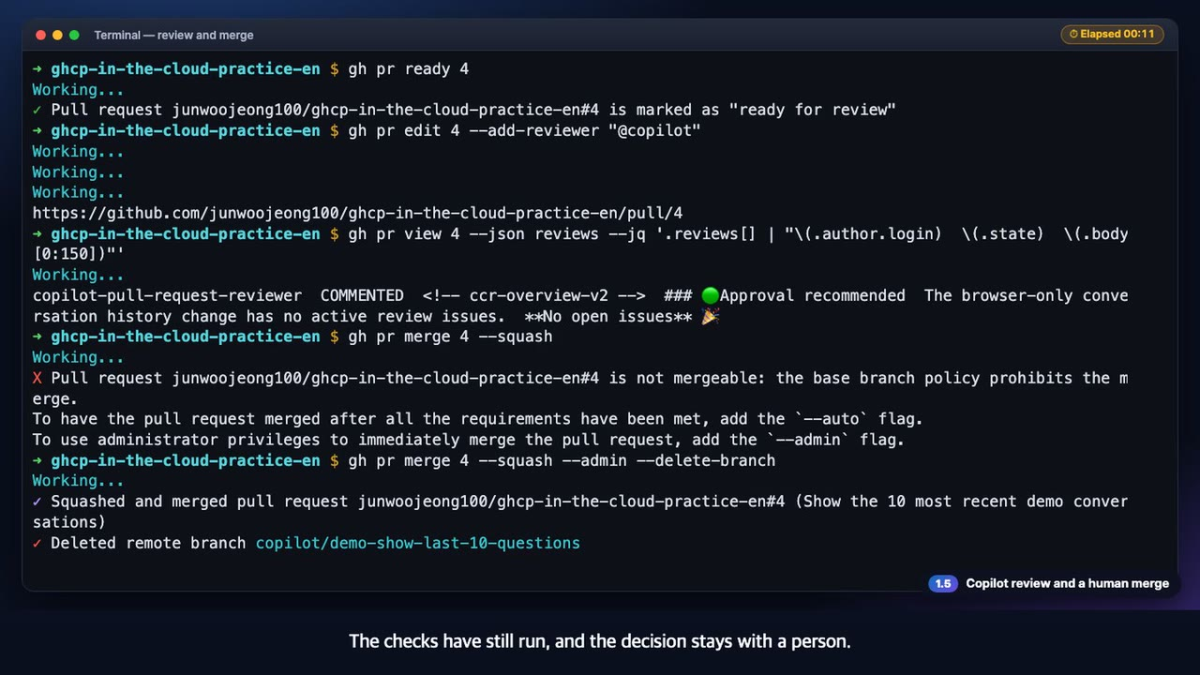
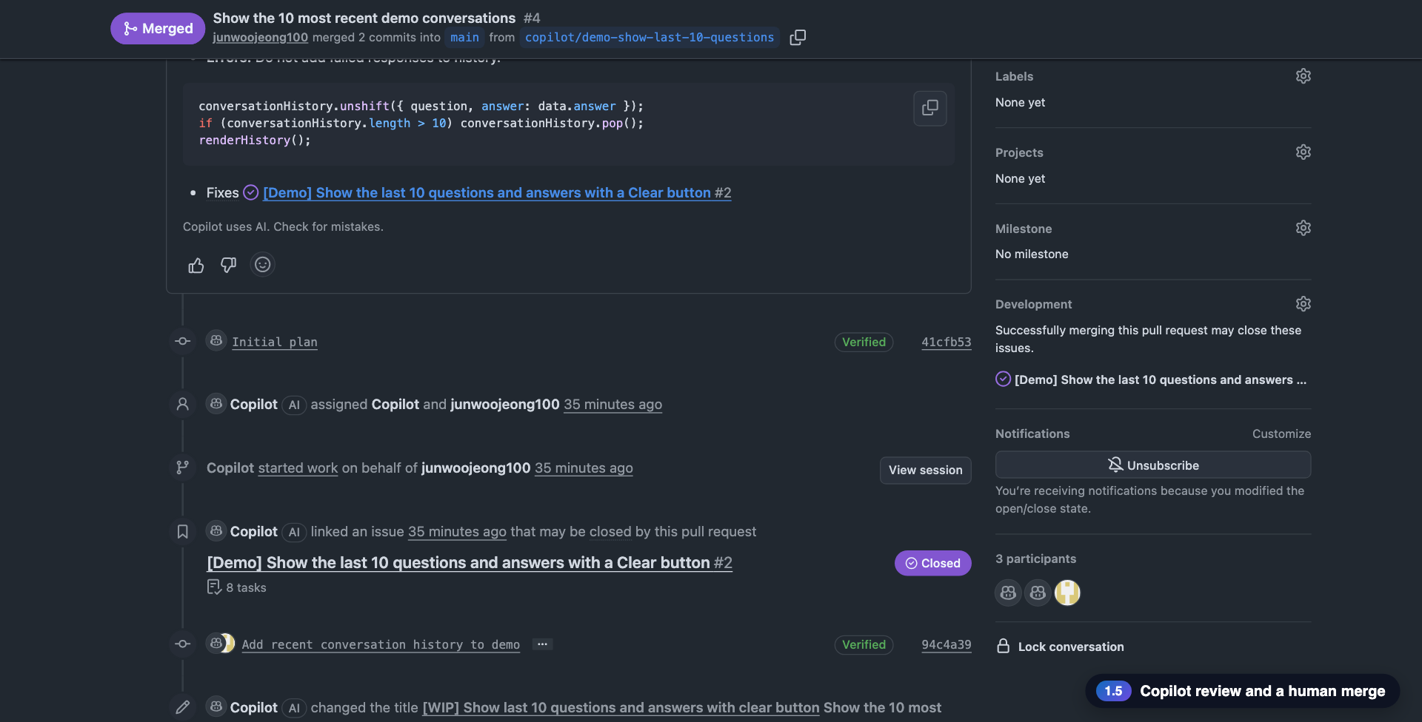
1
1.5 · GitHub Copilot
◀ Demo map
Copilot review and a human merge
Copilot is only the first reviewer; the merge is a person's decision inside the ruleset
What to check in the video
1
Only a person marks the PR ready, then asks Copilot to review
2
Copilot says 'Approval recommended', no open issues
3
The ruleset blocks a plain merge; a one-person repo uses the admin bypass
gh pr ready
--add-reviewer @copilot
--admin
▶ 0:49
Click to play
9
Notes:
[Key message] Copilot is only the first reviewer; the merge is a person's decision inside the ruleset
[Video narration] Verification is done, so I switch the draft to Ready for review. The agent cannot do this step. Then I ask Copilot for a code review. The review is posted. It recommends approval and found no open issues in this change. But a Copilot review does not count as an approval. A plain merge is blocked, because the ruleset on main prohibits it. This is a one-person repository, so I merge with an administrator bypass. The checks have still run, and the decision stays with a person. The pull request is merged and the linked issue is closed. From issue to pull request, verification, review and merge, a human stayed in control the whole time.
[Check while presenting] A Copilot review does not count as an approval. In a team repository, leave the bypass list empty.

Slide 10
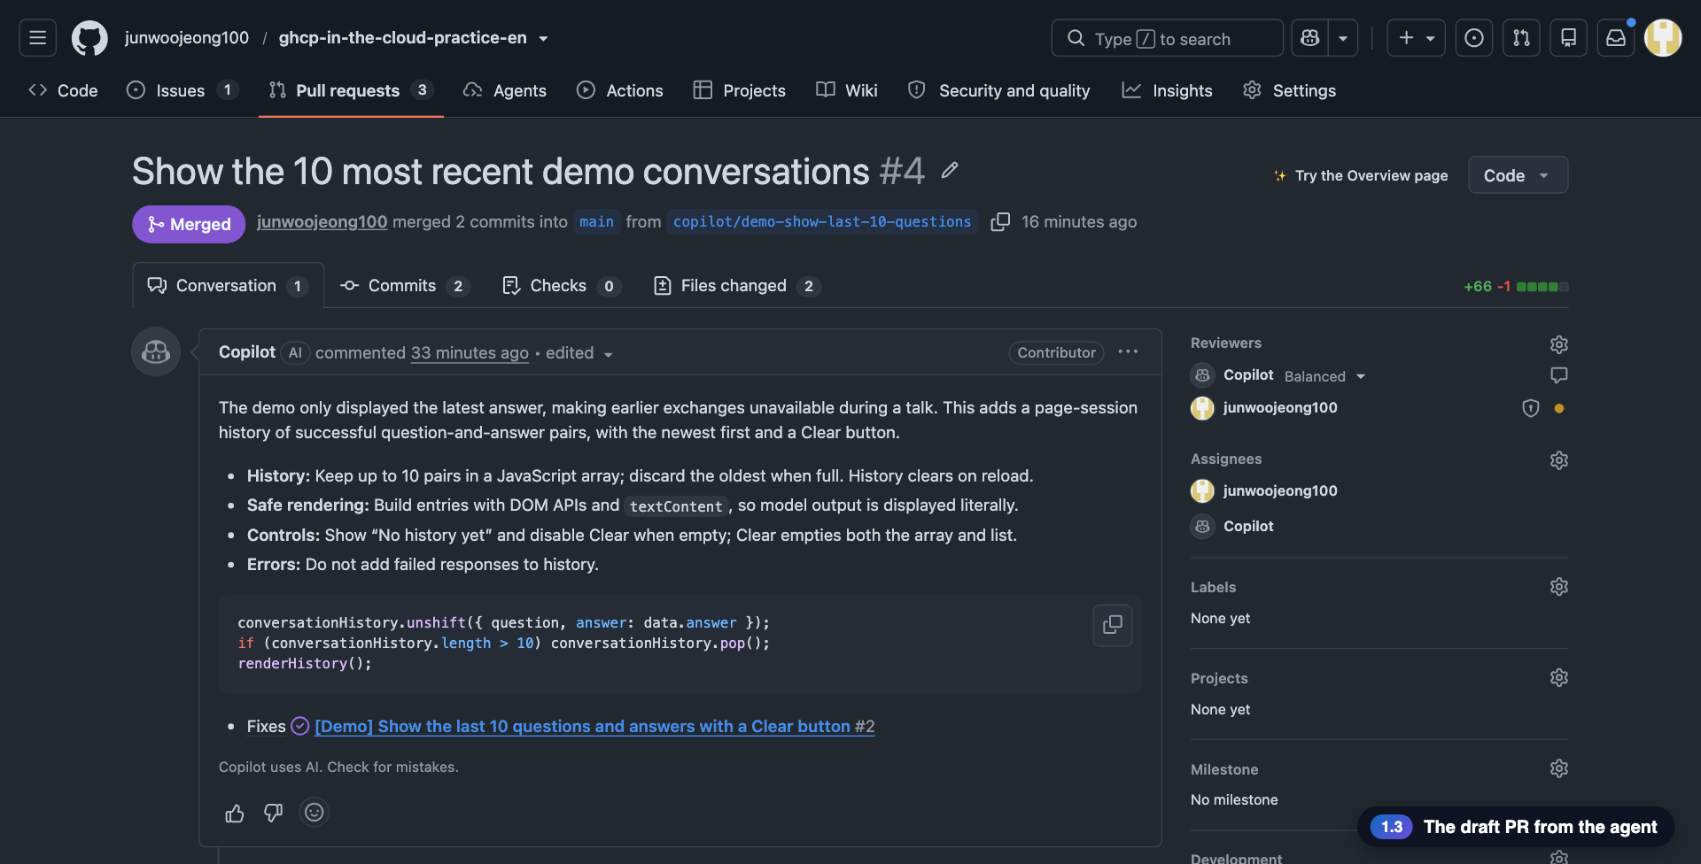
Key screens: from issue to merge
The PR Copilot made, its work log, and the last steps a person takes
Issue assigned to Copilot
The draft PR from the agent
The agent session log
Copilot code review
GitHub × Azure Cloud Demo
10
Notes:
Screen gallery: the issue, the draft PR, the session log and the review, in that order.

Slide 11
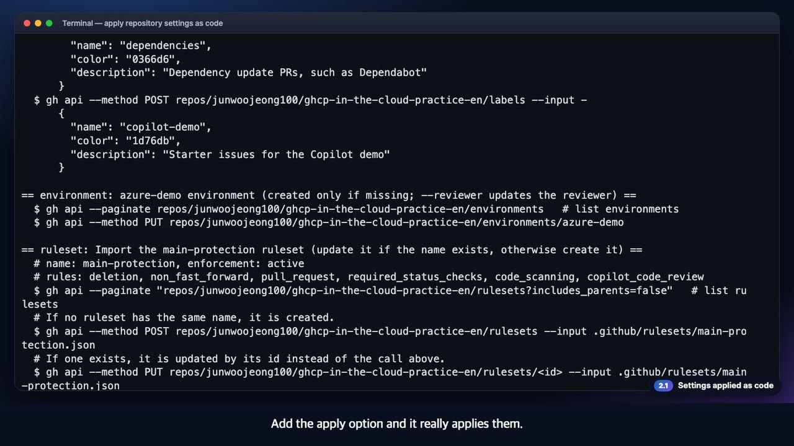
2
2.1 · GitHub Repo
◀ Demo map
Settings applied as code
Protection for main and the security settings are applied by one script, with the same result every time
What to check in the video
1
Dry run → --apply: security, labels, environment, ruleset and merge options
2
Ruleset main-protection: no deletion or force push, PR required, required checks, code scanning, Copilot review
3
Checking through the API shows enforcement=active
apply-repo-settings.sh
main-protection
▶ 0:42
Click to play
11
Notes:
[Key message] Protection for main and the security settings are applied by one script, with the same result every time
[Video narration] Repository protection is applied by one script. Run it as is and it changes nothing; it only previews the calls it would make. Add the apply option and it really applies them. Security features, labels, the deployment approval environment, the ruleset and the merge options turn to done, one after another. Checking the applied ruleset through the API: protection on main is active, and it contains deletion blocking, force-push blocking, required pull requests, required checks, code scanning and Copilot review. Settings are code, so you can run the script any number of times and get the same result.
[Check while presenting] The administrator bypass is a compromise for a one-person repository. Remove it in a team repository.

Slide 12
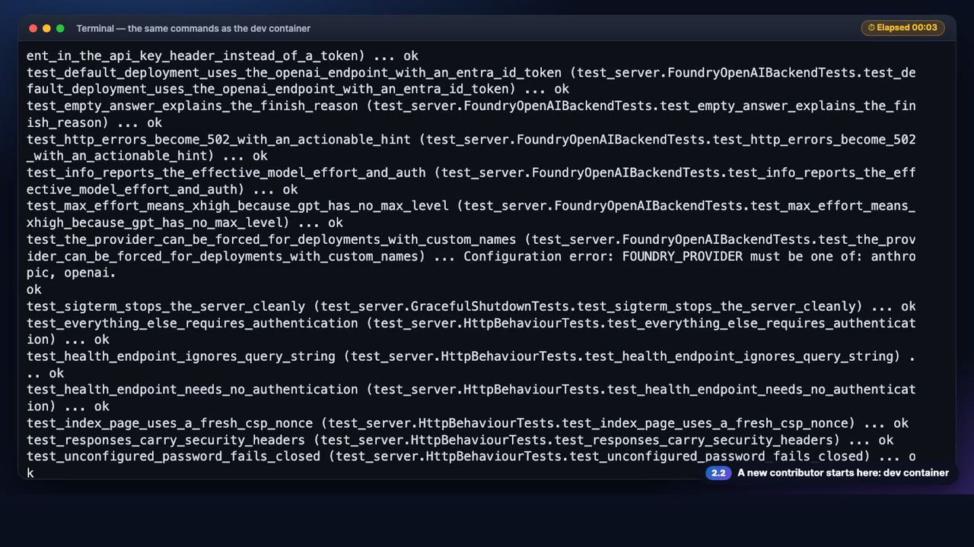
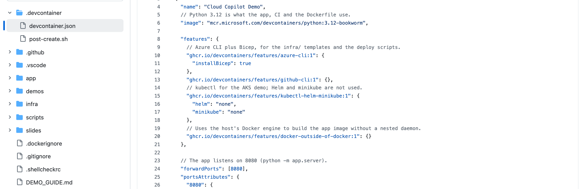
2
2.2 · GitHub Repo
◀ Demo map
A new contributor's start
The dev container builds the environment and the same commands run right away
What to check in the video
1
Codespaces uses this configuration to provide Python, the Azure CLI and kubectl
2
All 43 unit tests pass
3
Only healthz is open without authentication; every other route returns 401
.devcontainer/
unittest
▶ 0:31
Click to play
12
Notes:
[Key message] The dev container builds the environment and the same commands run right away
[Video narration] A new contributor who opens the repo in Codespaces gets an environment with Python and the Azure CLI, exactly as this dev container file defines it. Let's run the same commands in a terminal. All unit tests pass. Start the app in mock mode and it runs without Azure. healthz is open without credentials, and every other route returns 401 when called without them.
[Check while presenting] This recording ran the same commands locally instead of creating a Codespace.

Slide 13
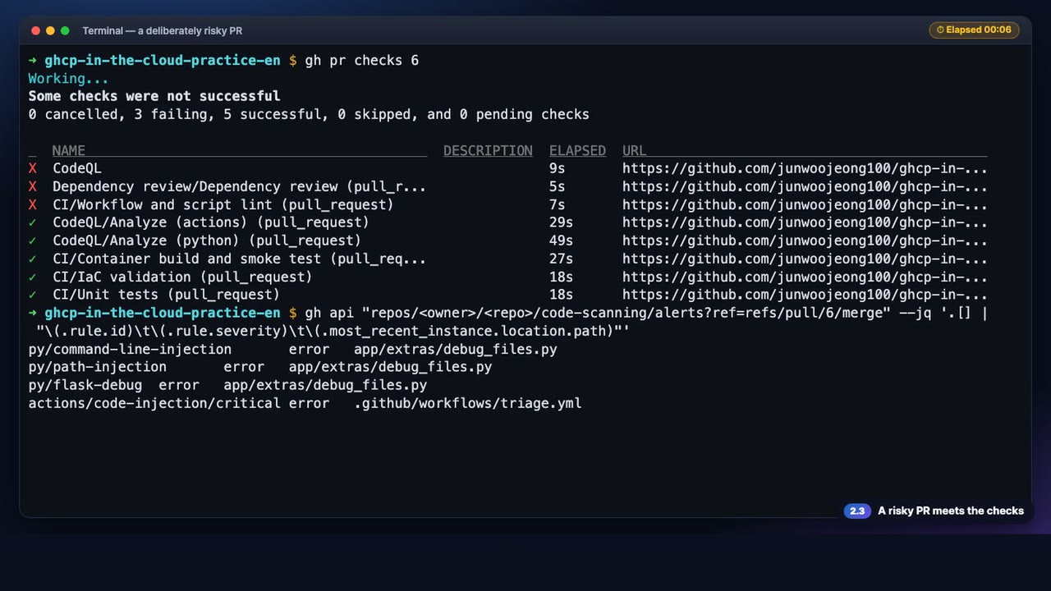
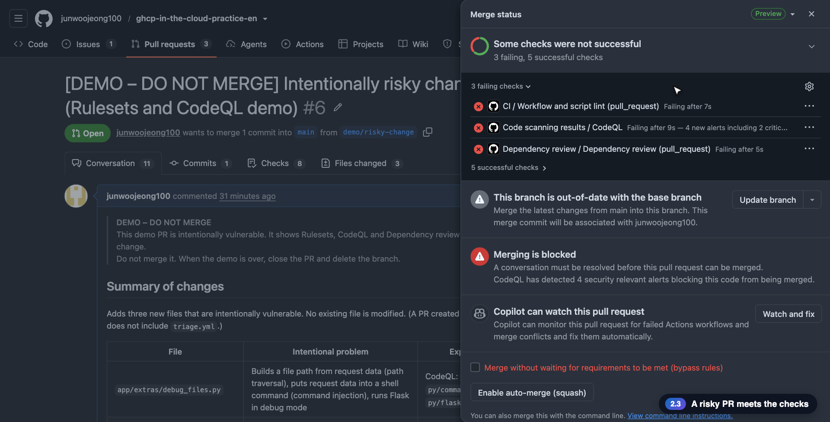
2
2.3 · GitHub Repo
◀ Demo map
A risky PR
The automatic checks stop a deliberately risky PR
What to check in the video
1
3 of 8 checks fail: CodeQL, Dependency review, lint
2
The merge status panel shows that the merge is blocked
3
Alerts: command injection, path traversal, debug mode
make-risky-pr.sh
CodeQL
Dependency review
▶ 1:02
Click to play
13
Notes:
[Key message] The automatic checks stop a deliberately risky PR
[Video narration] Now we open a pull request that is risky on purpose. It contains vulnerable Python code, a vulnerable dependency and a workflow that uses untrusted input. As soon as the pull request opens, CodeQL, dependency review and the Copilot review run automatically. In the checks list, three have failed. CodeQL reports alerts for command injection, path traversal, debug mode, and code injection in the workflow. The GitHub page shows the same state. The merge status panel lists the failed checks and says that the security alerts CodeQL found are blocking the merge. Under Security, code scanning lists the alerts from this pull request, with their severity. We will not merge this pull request. We confirmed that the checks stopped it, as intended, so we close it and delete the branch.
[Check while presenting] This PR is closed, not merged. Do not use the bypass option even when it is offered.

Slide 14
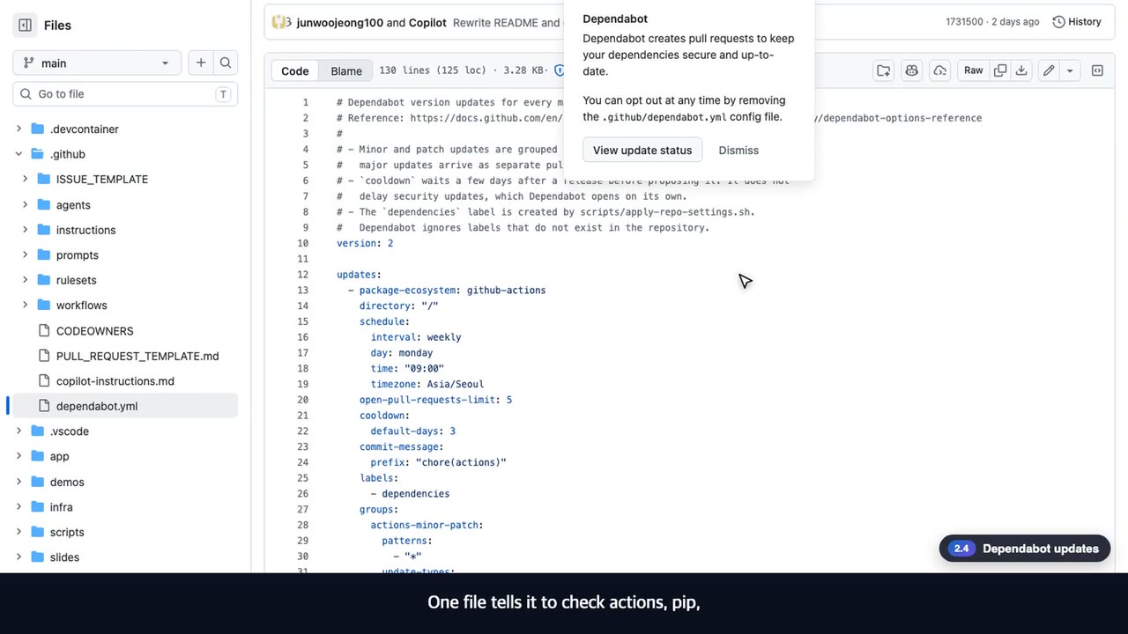
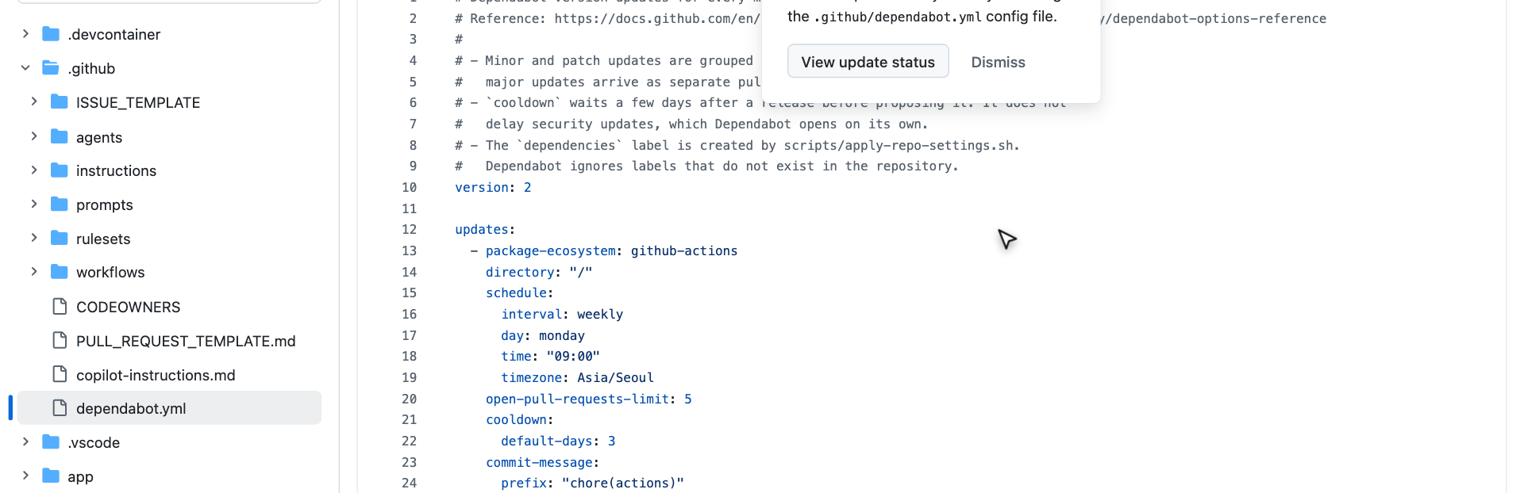
2
2.4 · GitHub Repo
◀ Demo map
Dependabot
Dependency update checks are defined in one file and run automatically
What to check in the video
1
pip · docker · devcontainers · GitHub Actions are checked every week
2
The check history is kept in Actions
3
No outdated dependency means no PR, which is the correct result
dependabot.yml
▶ 0:18
Click to play
14
Notes:
[Key message] Dependency update checks are defined in one file and run automatically
[Video narration] Dependency updates are handled by Dependabot. One file tells it to check actions, pip, Docker and the dev container every week. The checks are already running. If nothing is outdated, no pull request is the correct result.
[Check while presenting]

Slide 15
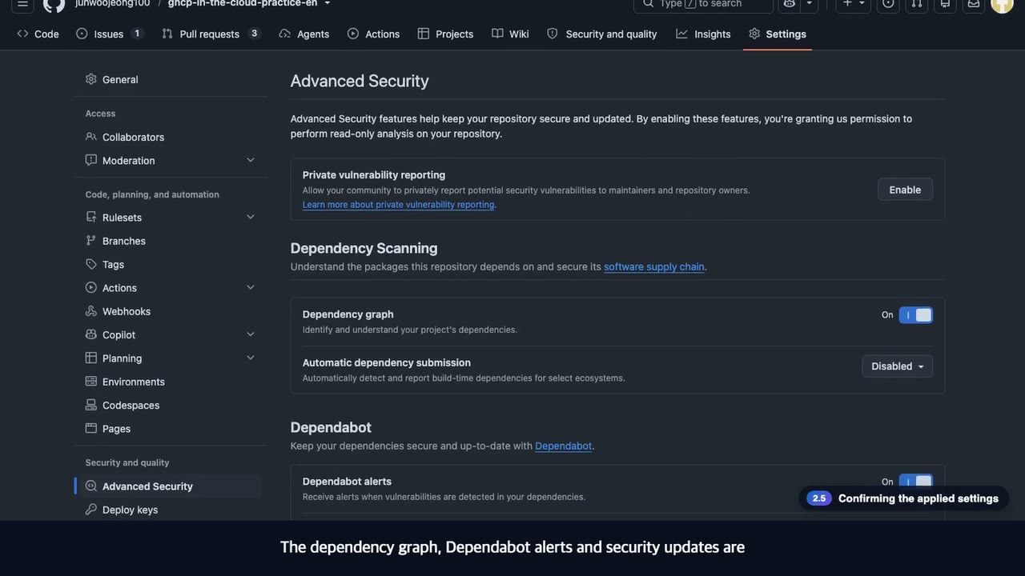
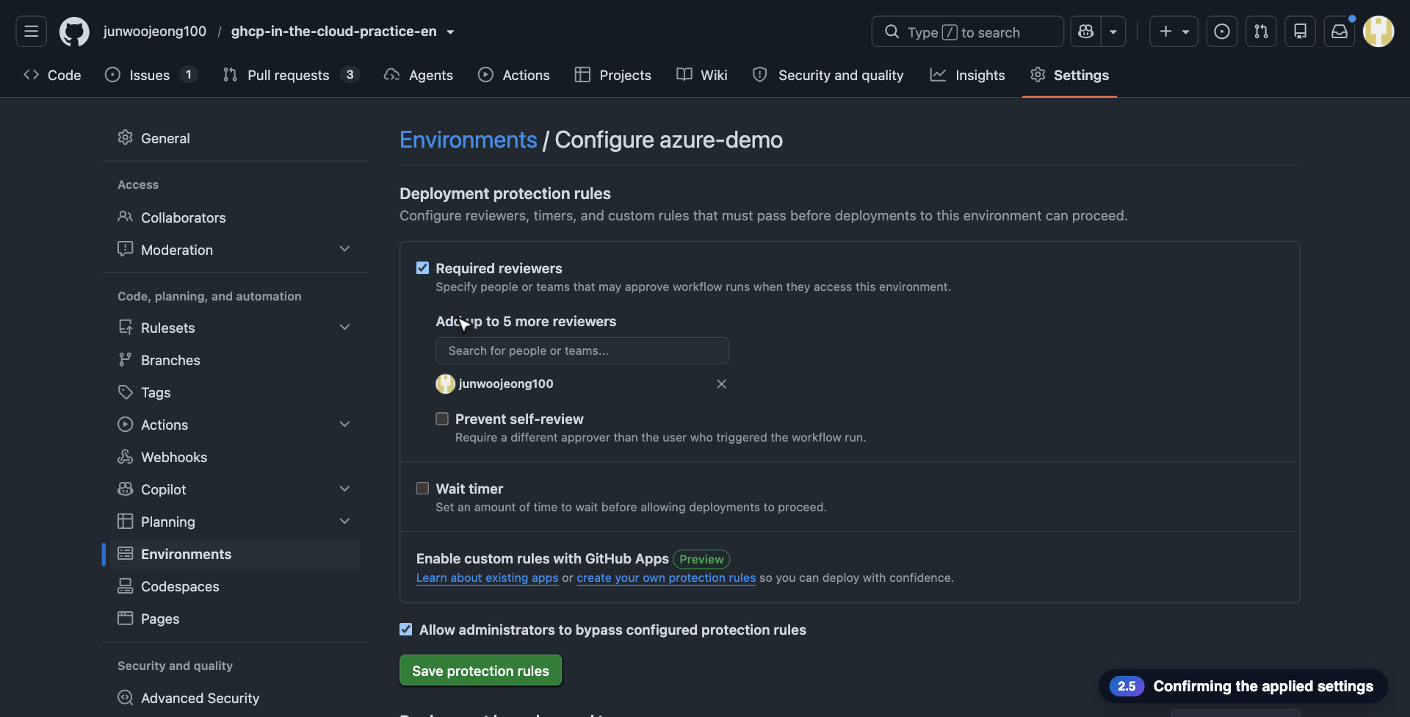
2
2.5 · GitHub Repo
◀ Demo map
The applied settings
The protection rules the script created are visible in the GitHub settings
What to check in the video
1
Ruleset main-protection (Active): PR, code scanning, Copilot review
2
Environment azure-demo: a reviewer must approve each deployment
3
Dependency graph, Dependabot alerts and security updates are on
Rulesets
Environments
Advanced Security
▶ 0:40
Click to play
15
Notes:
[Key message] The protection rules the script created are visible in the GitHub settings
[Video narration] Now we check on GitHub what the script applied. The ruleset main-protection is active, and it targets the main branch only. The rule list has deletion blocking, force-push blocking, required pull requests, required status checks, code scanning and Copilot review. The deployment environment azure-demo has a protection rule, so a deployment starts only after a named person approves. Security features are on too. The dependency graph, Dependabot alerts and security updates are enabled, and version updates are handled by the dependabot.yml we just saw.
[Check while presenting]

Slide 16
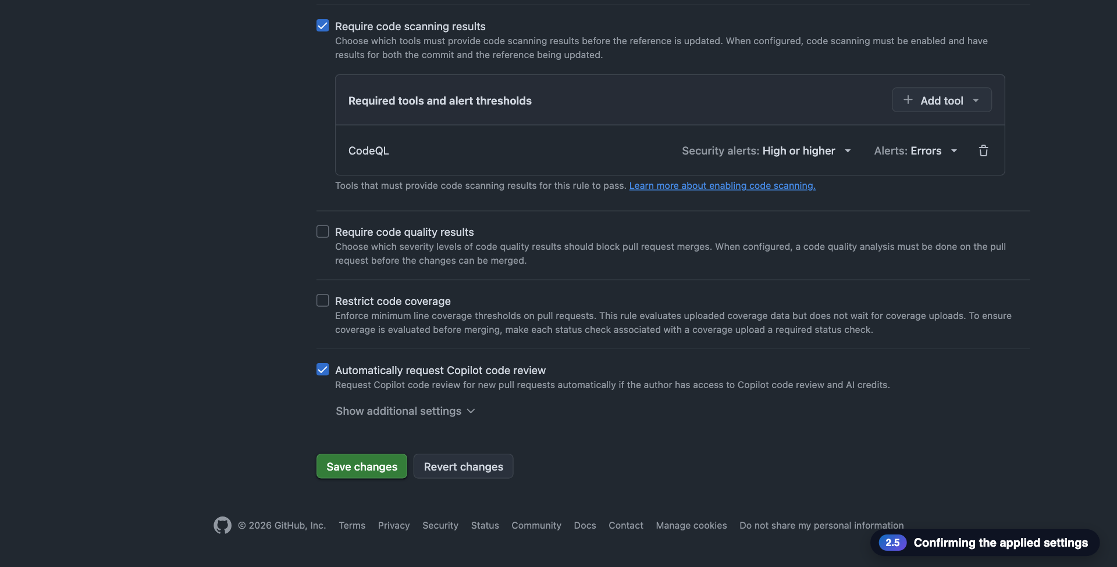
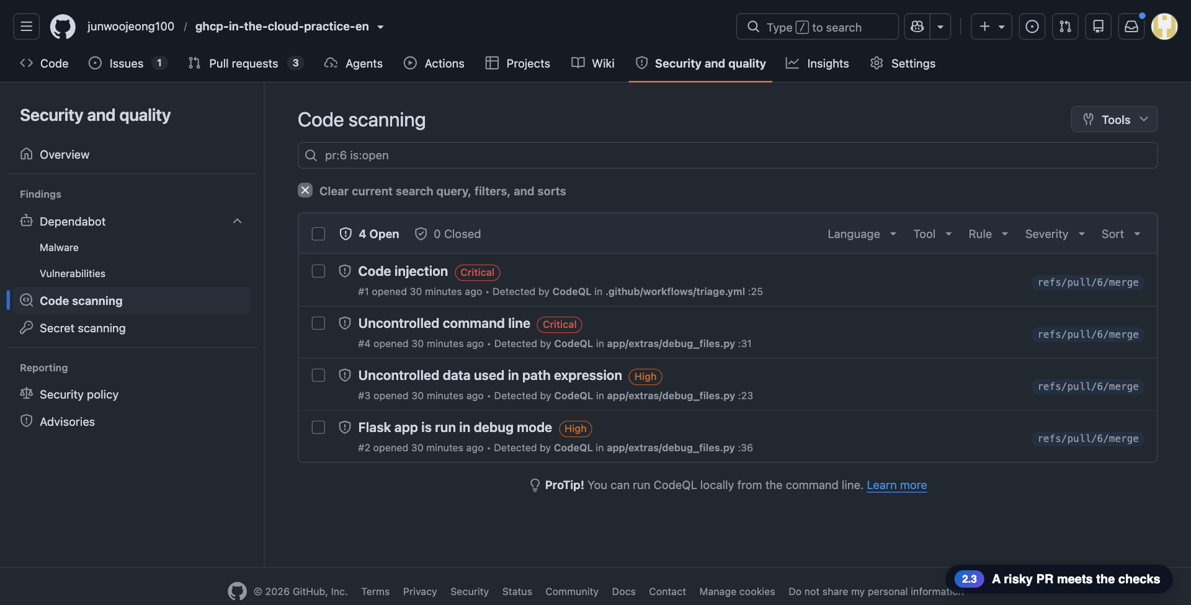
Key screens: the settings that protect the repo
The rules the script applied, and a deliberately risky PR being stopped
Ruleset main-protection (Active)
Environment azure-demo · required reviewer
Merge status: the merge is blocked
CodeQL alerts on the risky PR
GitHub × Azure Cloud Demo
16
Notes:
Screen gallery: the ruleset, the deployment environment, the blocked merge and the code scanning alerts.

Slide 17
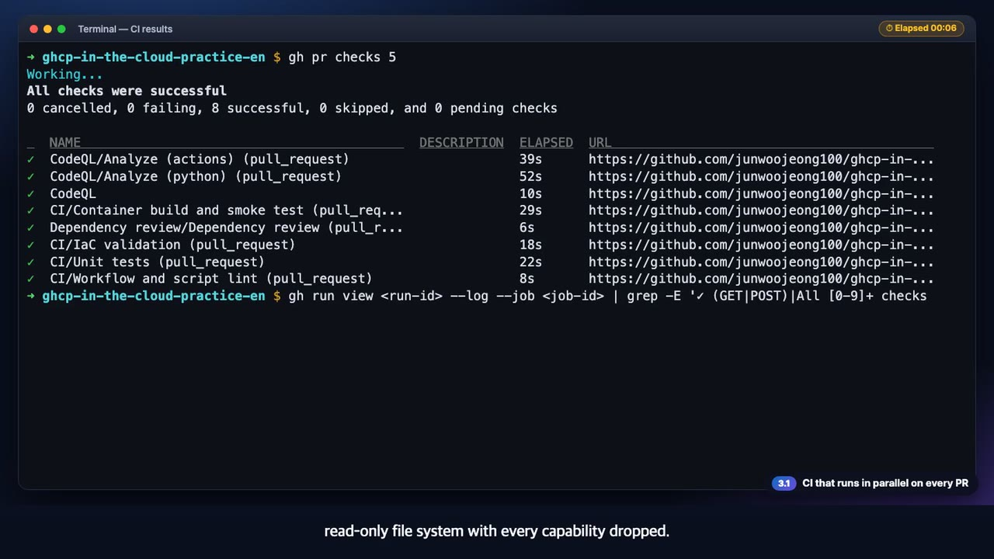
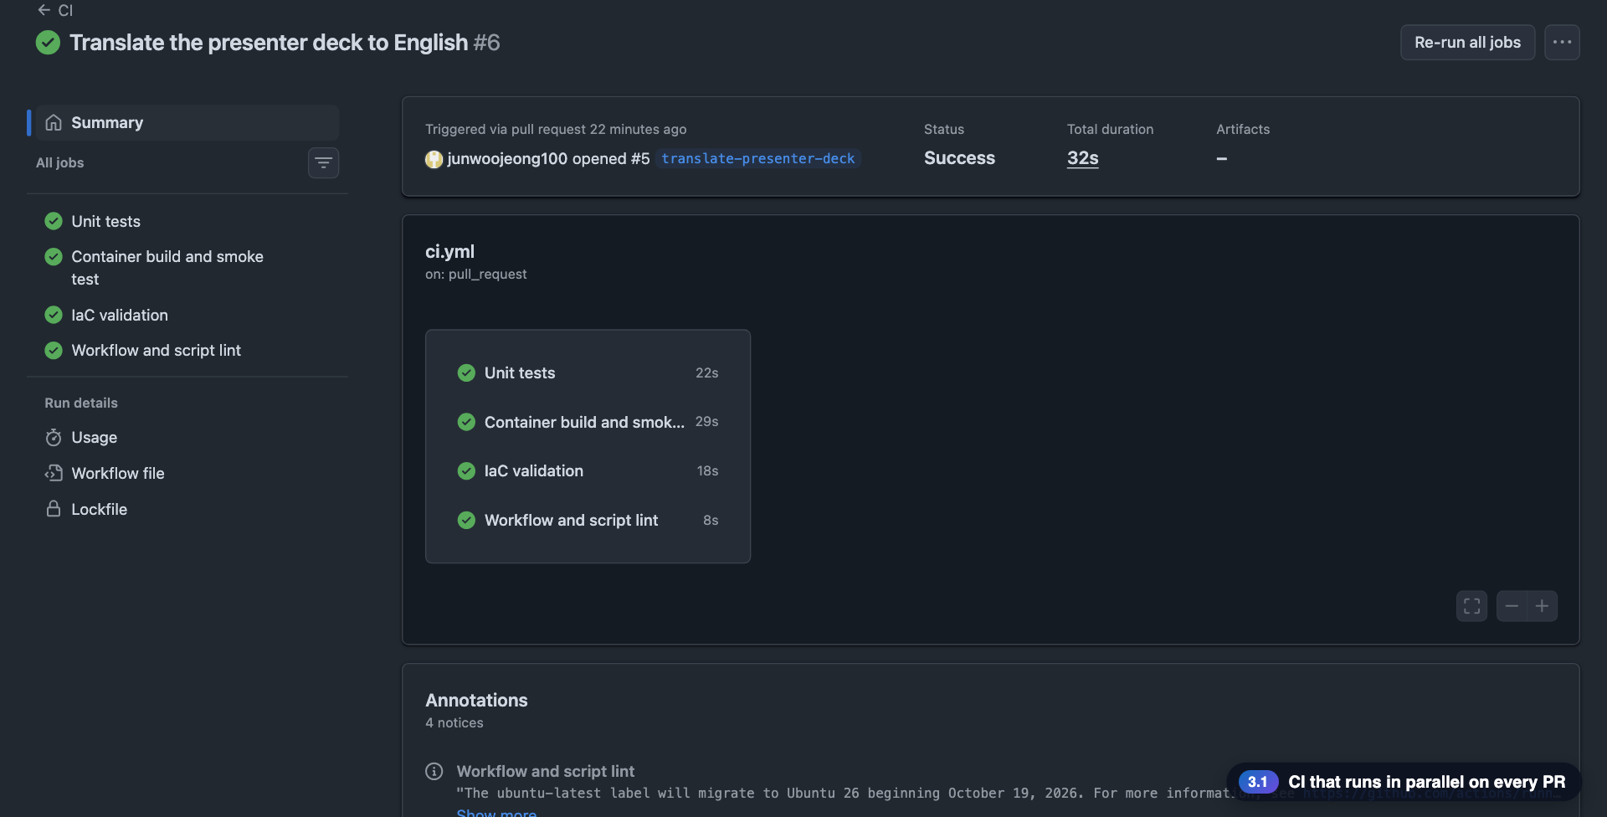
3
3.1 · GitHub Actions
◀ Demo map
Parallel CI on every PR
Four jobs run at the same time, and all eight checks must be green
What to check in the video
1
Unit tests · Container build and smoke test · IaC validation · Workflow and script lint
2
Including CodeQL and Dependency review, all 8 checks passed
3
The smoke test runs 14 checks on a read-only file system with every capability dropped
gh pr checks
smoke-test.sh
▶ 0:28
Click to play
17
Notes:
[Key message] Four jobs run at the same time, and all eight checks must be green
[Video narration] When you open a pull request, CI runs four jobs at once: unit tests, container build with a smoke test, infrastructure validation, and workflow and script lint. Including CodeQL and the dependency check, all eight checks passed. These job names are exactly the required checks in the ruleset. The container smoke test runs fourteen checks, on a read-only file system with every capability dropped.
[Check while presenting] The check names must match the required checks of the ruleset.

Slide 18
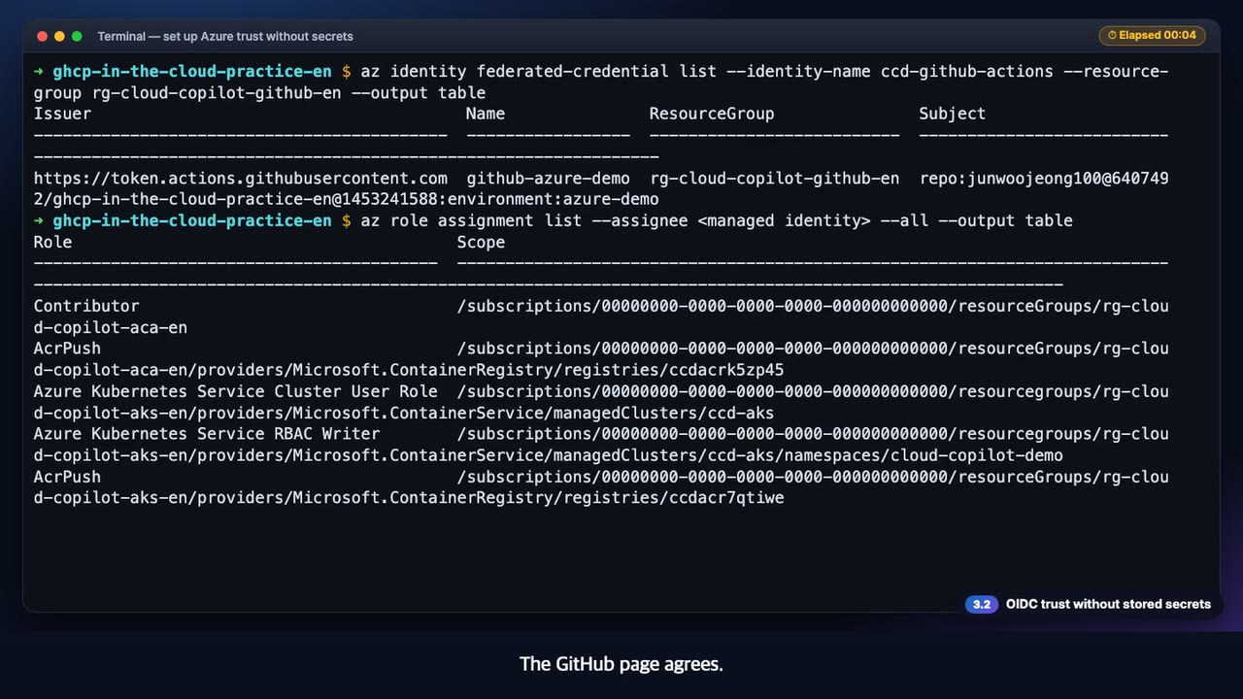
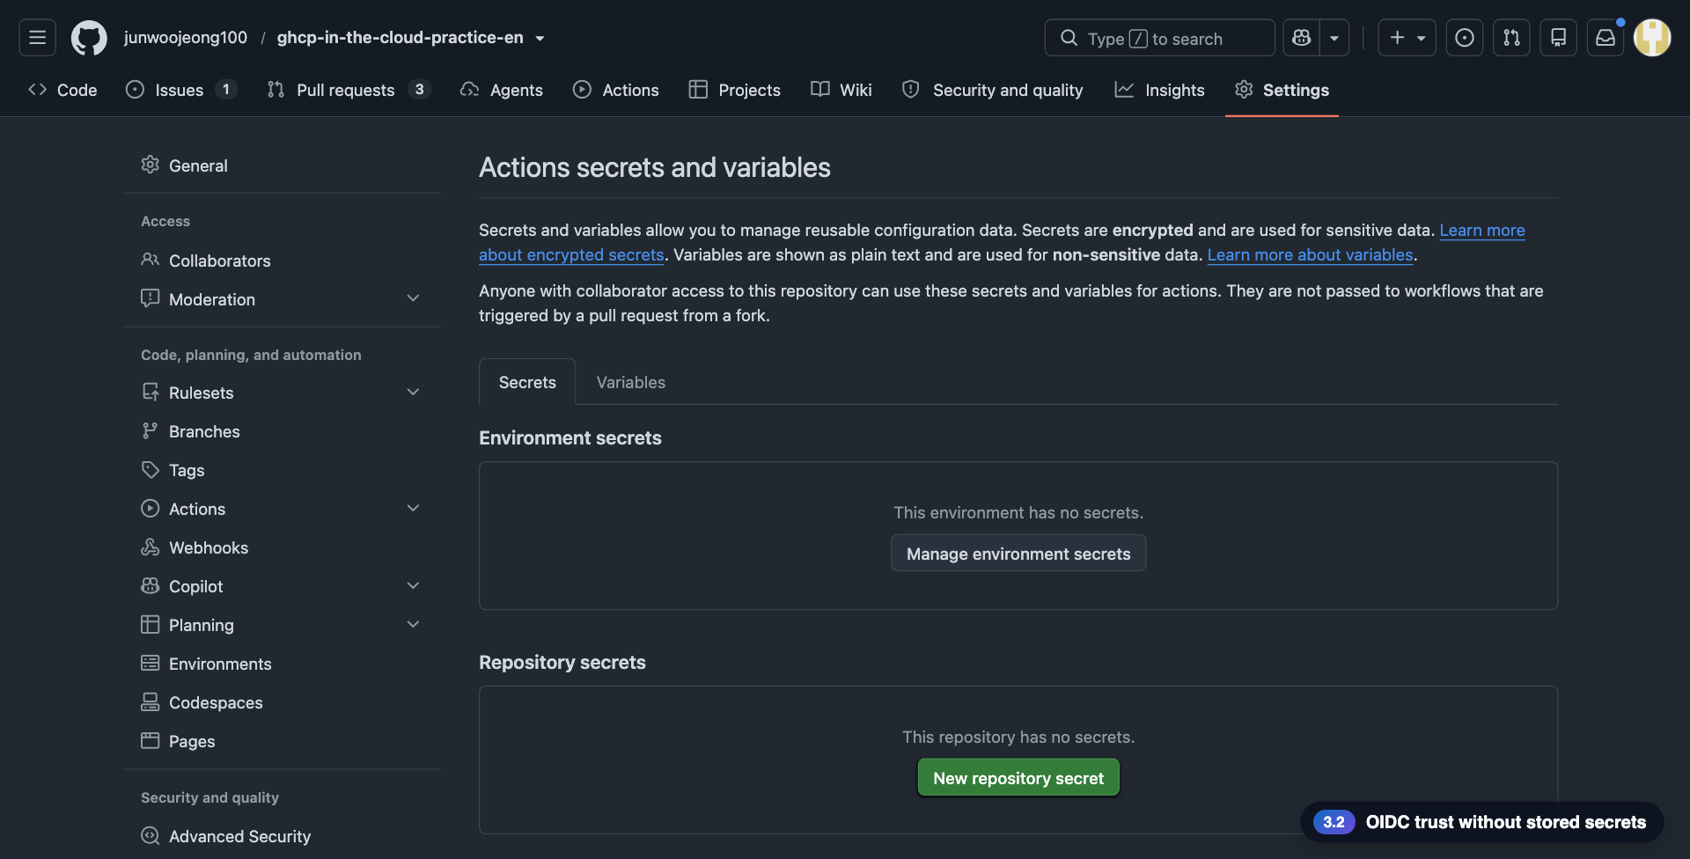
3
3.2 · GitHub Actions
◀ Demo map
OIDC without secrets
There is no stored secret in GitHub or in Azure
What to check in the video
1
One script creates the identity, the credential and minimal roles
2
GitHub shows 0 repository and 0 environment secrets; only identifiers
3
Trust is narrowed to the single azure-demo environment
setup-github-oidc.sh
federated credential
▶ 1:04
Click to play
18
Notes:
[Key message] There is no stored secret in GitHub or in Azure
[Video narration] The trust used for deployment is created by one script. The preview only shows the managed identity and the roles it would create, and the variables it would store. With apply, it creates the managed identity and the federated credential, and grants roles only on the target resources. The script asks GitHub for the exact subject format of this repository, because recent repositories put numeric IDs in the subject. There are zero secrets, in the repository and in the environment. The only stored values are identifiers. The trust is narrowed to one environment of this repository, azure-demo, and the roles exist only on the resource group, the registry and the namespace. The GitHub page agrees. There are no environment secrets and no repository secrets. The workflow only uses the token it gets through OIDC.
[Check while presenting] The subject format follows GitHub's sub_claim_prefix: recent repositories carry numeric IDs.

Slide 19
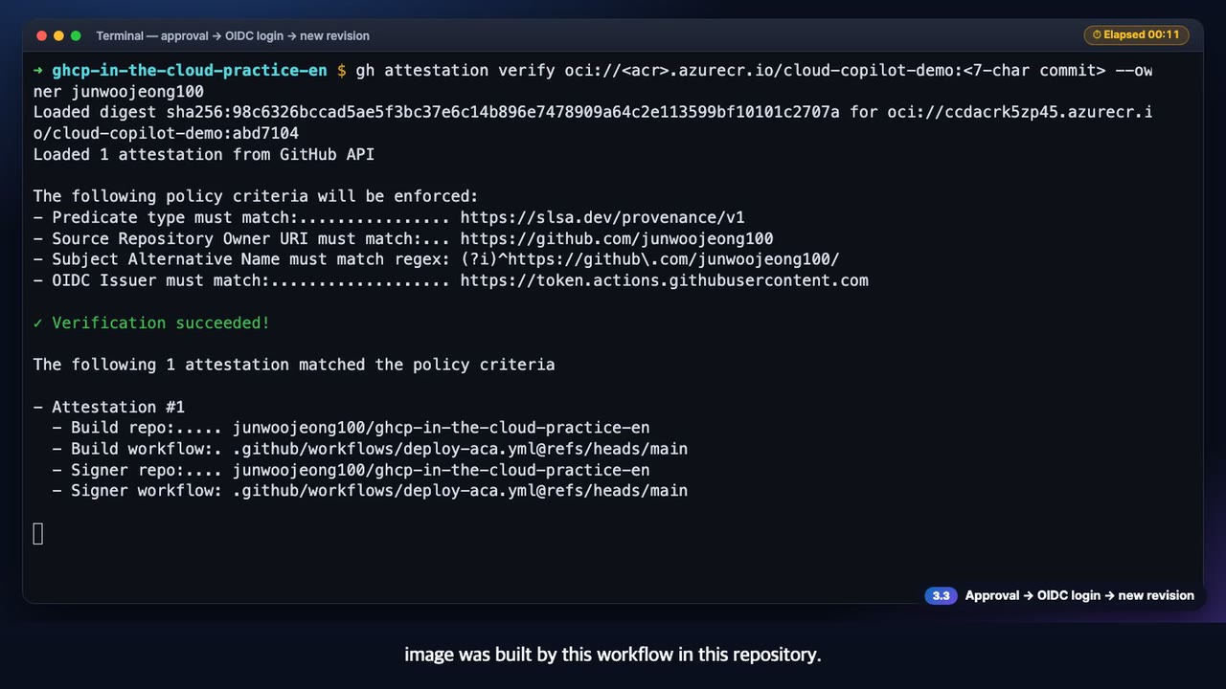
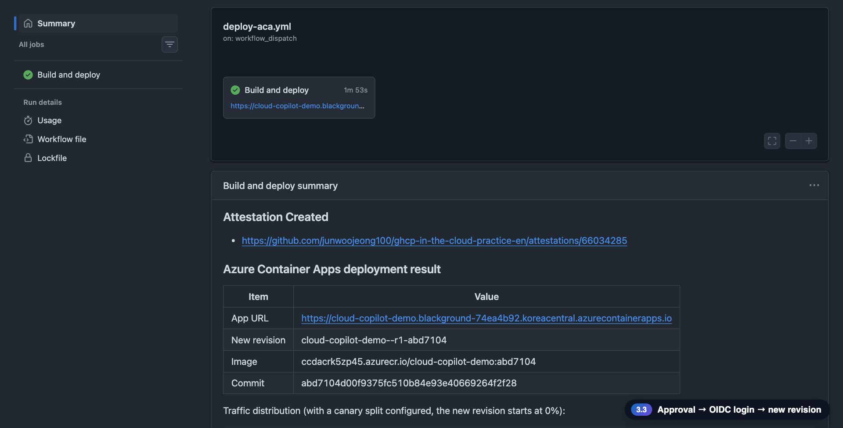
3
3.3 · GitHub Actions
◀ Demo map
Approval → OIDC → new revision
Nothing touches Azure before the approval, and after it the deployment needs no secrets
What to check in the video
1
The deploy workflow stops at waiting until a person approves
2
OIDC sign-in → build and push to ACR → new revision
3
The build provenance (attestation) is verified with gh
deploy-aca.yml
azure-demo
gh attestation verify
▶ 1:01
Click to play
19
Notes:
[Key message] Nothing touches Azure before the approval, and after it the deployment needs no secrets
[Video narration] When we run the deploy workflow, it stops at the environment approval. The status is waiting, and until someone approves, nothing touches Azure. After the approval, it signs in to Azure with OIDC and no secrets, builds and pushes the image, and then deploys a new revision. When the deployment finishes, the app's info endpoint returns the version of the new commit. That value is the image tag. We also verify the build provenance. It checks the signed attestation that this image was built by this workflow in this repository.
[Check while presenting] If AADSTS700213 appears, compare the subject claim in the log with the credential's subject.

Slide 20
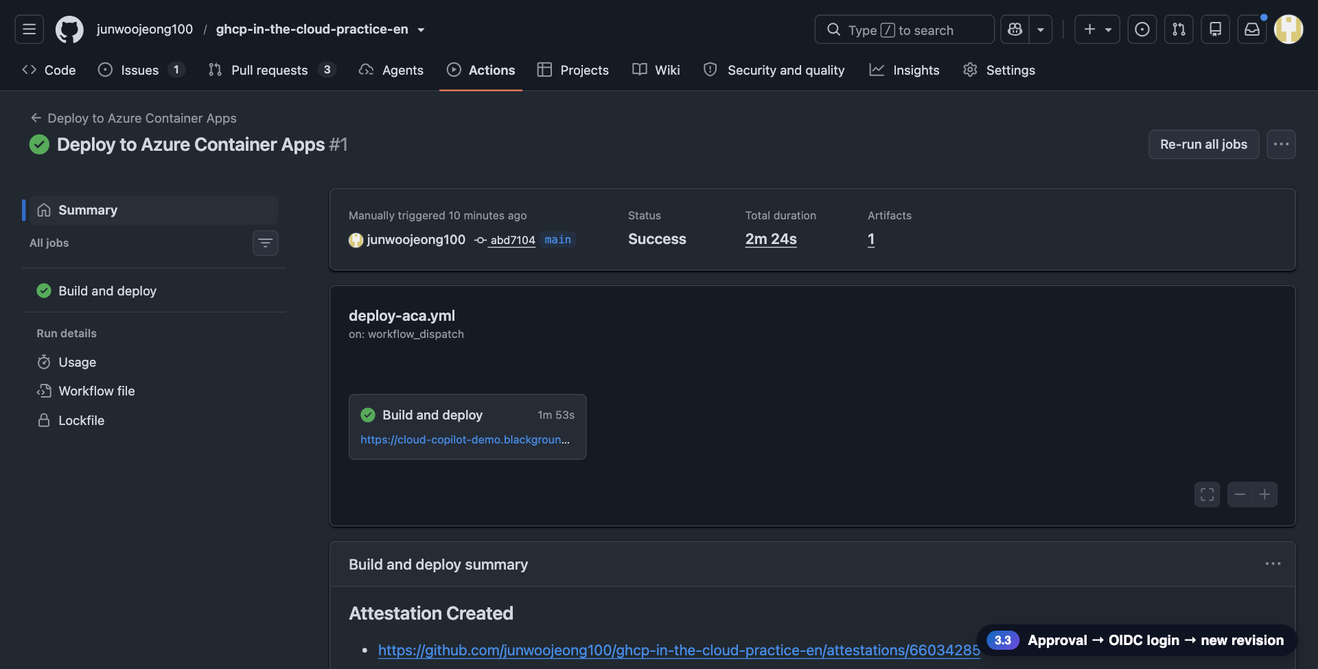
Key screens: parallel CI and deployment without secrets
Eight checks passed, zero stored secrets, deployment after approval
Parallel CI run
No repository or environment secrets
The deploy workflow run
Deployment summary
GitHub × Azure Cloud Demo
20
Notes:
Screen gallery: the CI run, zero secrets, the deploy run and its summary.

Slide 21
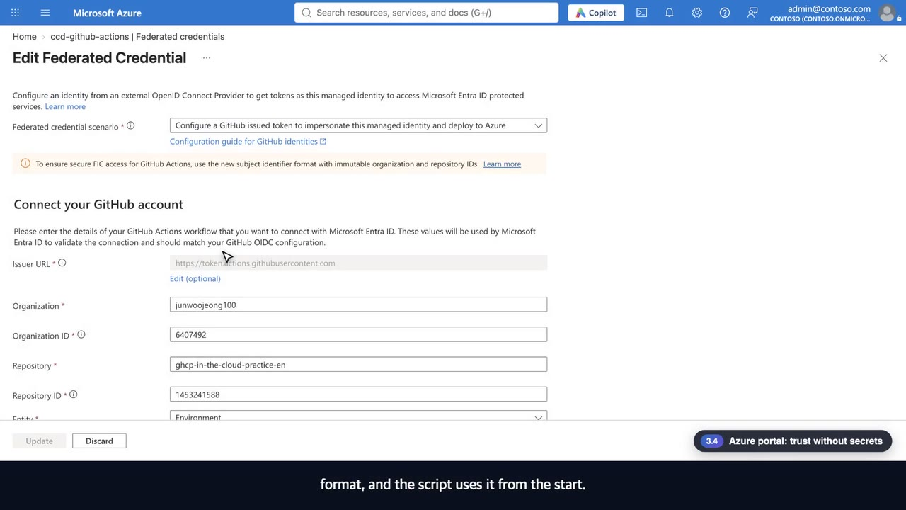
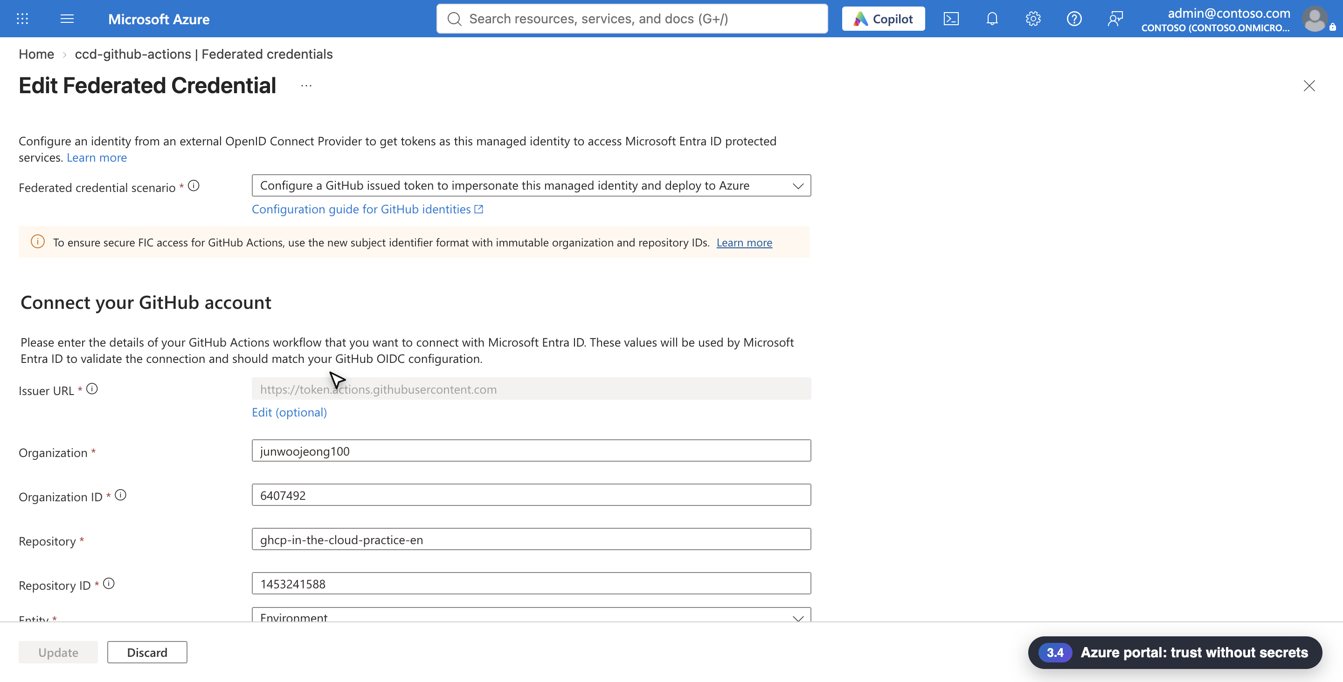
3
3.4 · Azure portal
◀ Demo map
Trust without secrets
The portal shows the same trust: one repository, one environment, roles only on the target resources
What to check in the video
1
One federated credential; the issuer is GitHub's token service
2
Immutable format with organization and repository IDs
3
Roles only on target resources: Contributor, AcrPush, AKS roles
Federated credentials
Azure role assignments
▶ 0:50
Click to play
21
Notes:
[Key message] The portal shows the same trust: one repository, one environment, roles only on the target resources
[Video narration] In the Azure portal, here is the federated credential of the managed identity for GitHub Actions. There is one credential, and its issuer is GitHub's token service. Open it and the organization and the repository carry numeric IDs, and the trusted subject is the single environment azure-demo. The portal recommends this immutable ID format, and the script uses it from the start. The roles given to this managed identity exist only on the target resources: Contributor on the container app resource group, AcrPush on the registry, and the AKS cluster roles.
[Check while presenting] The subject carries the numeric organization and repository IDs, as the portal recommends.

Slide 22
Microsoft Foundry on one page: the app calls a model by deployment name, with no key
One account holds the project and the model deployments, and access is controlled by Entra ID and roles
F
Foundry resource (AIServices)
services.ai.azure.com
Project
A
ID
ccd-project
App
Token
Microsoft Entra ID
Entra ID token
Deployment name = model choice
DefaultAzure
Credential
No secrets
az login · Managed ·
Workload Identity
Cognitive Services User
gpt-6.1-sol
Other models
This demo's deployment
Add a deployment from the catalog
The app knows only the deployment name (FOUNDRY_MODEL), not the model ID. Swapping a model is a deployment plus an environment variable change.
GitHub × Azure Cloud Demo
22
Notes:
[Key message] The same app code calls Foundry the same way locally, on Container Apps and on AKS. The only difference is who it signs in as.

Slide 23
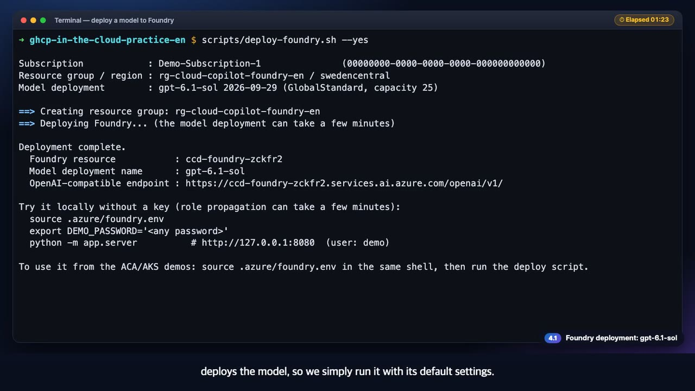
4
4.1 · Microsoft Foundry
◀ Demo map
Deployment
We chose gpt-6.1-sol for this demo, and one script deploys it in under two minutes
What to check in the video
1
We chose gpt-6.1-sol as the model for this demo
2
One script deploys the Foundry resource, the project and the model in under two minutes
3
The connection file holds names only and no API key
deploy-foundry.sh
gpt-6.1-sol
▶ 0:31
Click to play
23
Notes:
[Key message] We chose gpt-6.1-sol for this demo, and one script deploys it in under two minutes
[Video narration] For this demo we chose gpt-6.1-sol as the model. One script creates the Foundry resource and the project, and deploys the model, so we simply run it with its default settings. The Foundry resource and the model are deployed in under two minutes. The deployment list shows gpt-6.1-sol, and the connection file has only a resource name and a deployment name. There is no API key.
[Check while presenting] The script deploys gpt-6.1-sol by default. Set MODEL_NAME and MODEL_VERSION to deploy a different model.

Slide 24
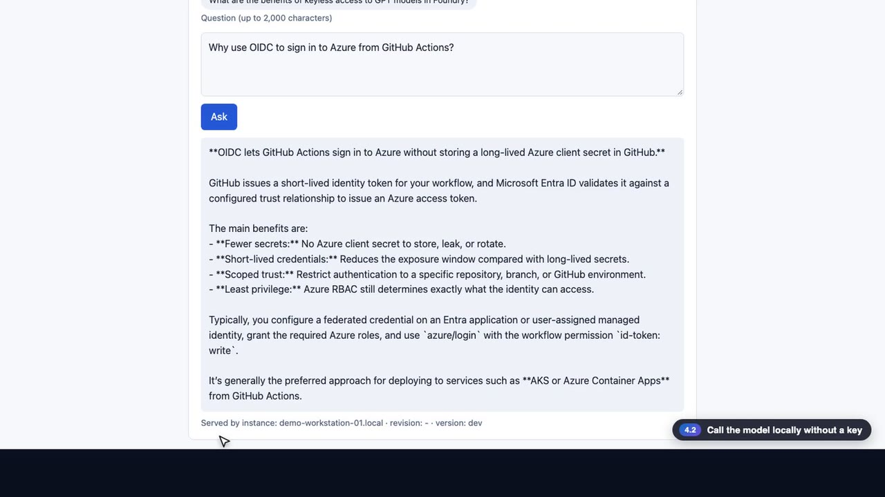
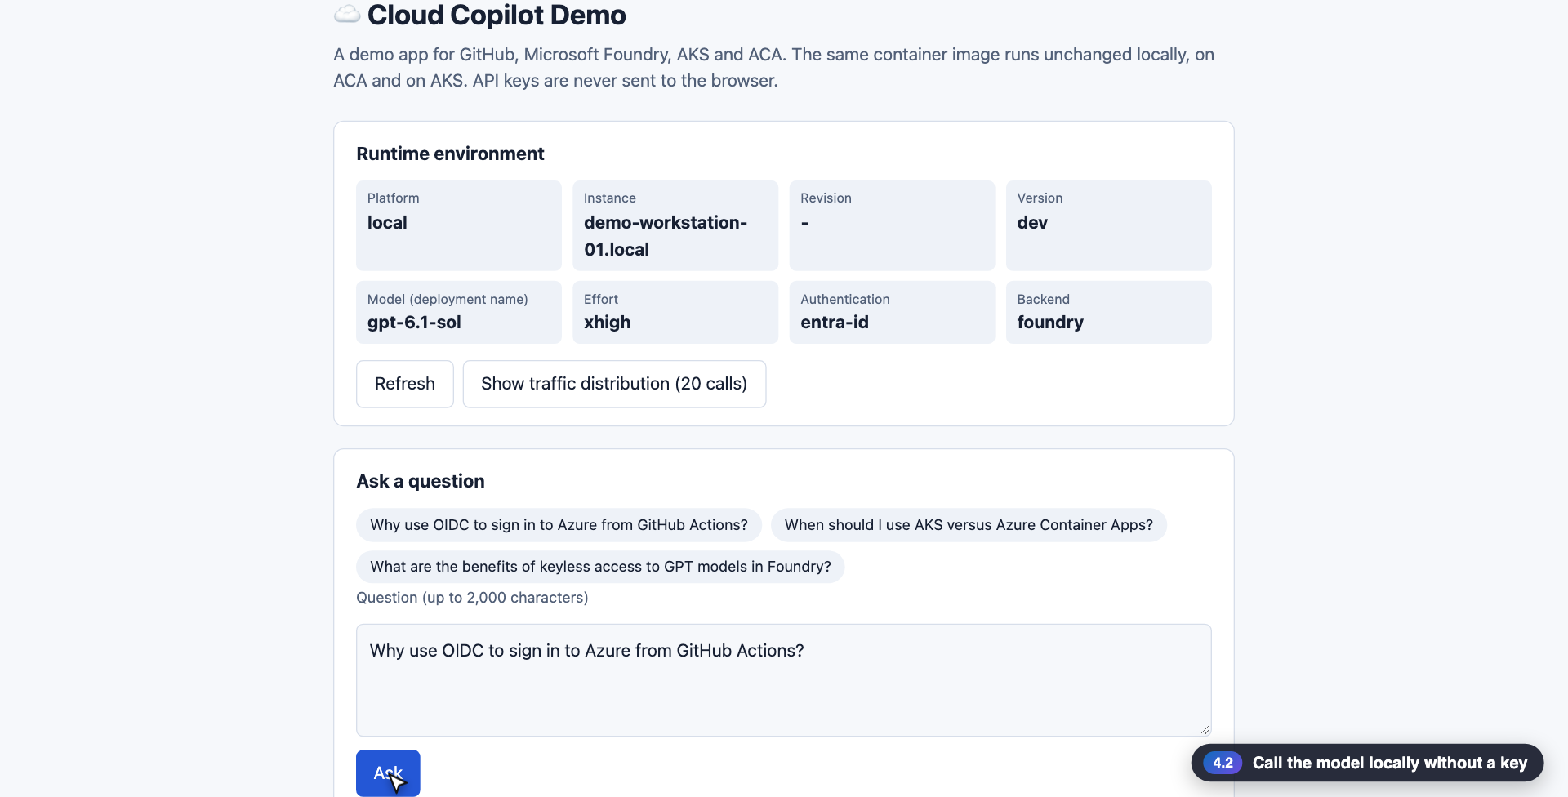
4
4.2 · Microsoft Foundry
◀ Demo map
Keyless local call
There is no key in the code. The model is called with the token of the az login account
What to check in the video
1
DefaultAzureCredential gets an Entra ID token and makes the call
2
Click an example question and gpt-6.1-sol answers (high effort takes a while)
3
The recent conversation list was built by the Copilot agent
DefaultAzureCredential
entra-id
▶ 0:37
Click to play
24
Notes:
[Key message] There is no key in the code. The model is called with the token of the az login account
[Video narration] We run the app locally. There is no key in the code; it calls Foundry with the token of the account I signed in with through az login. Ask a question in the browser and gpt-6.1-sol answers. Effort is high, so it takes a while to think deeply. Below the answer you see the instance and version that responded, and the exchange is recorded in the recent conversation too. The Copilot agent built that feature earlier.
[Check while presenting]

Slide 25
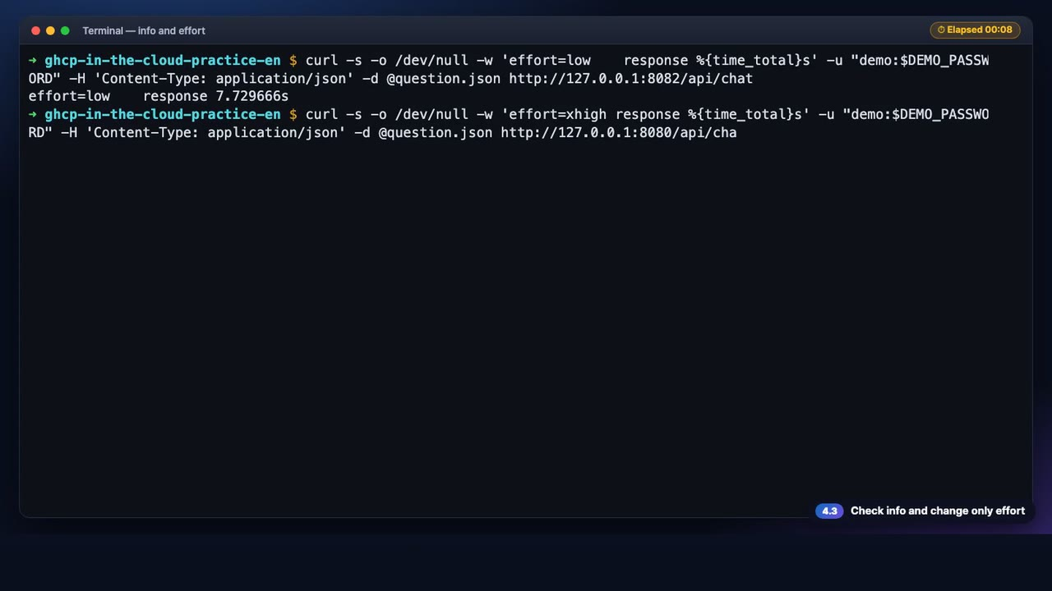
4
4.3 · Microsoft Foundry
◀ Demo map
info and effort
Model settings are environment variables, not code
What to check in the video
1
/api/info: backend · model · auth (entra-id) · effort (xhigh)
2
GPT has no max level, so the app sends the highest one, xhigh
3
The same question took about 8 s at low and 17 s at xhigh in this recording
/api/info
FOUNDRY_EFFORT
▶ 0:36
Click to play
25
Notes:
[Key message] Model settings are environment variables, not code
[Video narration] The info endpoint reports backend foundry, model gpt-6.1-sol, auth entra-id and effort xhigh. GPT has no max level, so the app sends the highest one, xhigh. We sent the same question to a server started with effort low and to the default server. In this recording, low took about eight seconds and xhigh about seventeen. The code is the same; only an environment variable differs.
[Check while presenting] Response times differ on every run. Do not promise numbers.

Slide 26
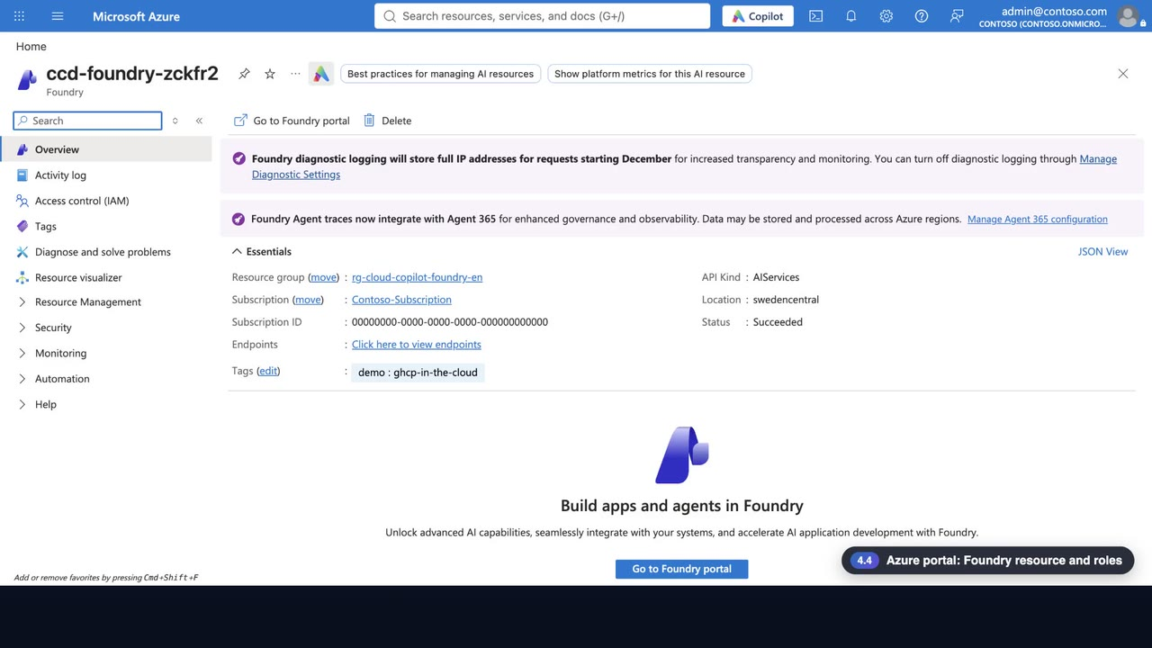
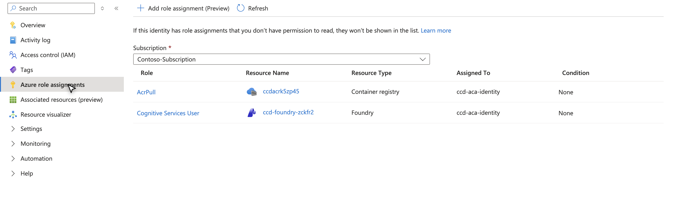
4
4.4 · Azure portal
◀ Demo map
Foundry resource and roles
The app's managed identity has one Foundry role: calls are authorized by a role, not an API key
What to check in the video
1
Foundry resource: kind AIServices · Sweden Central
2
Roles of the app's managed identity: Cognitive Services User + AcrPull
3
The permission to call the model is this role, not a key
AIServices
Cognitive Services User
AcrPull
▶ 0:28
Click to play
26
Notes:
[Key message] The app's managed identity has one Foundry role: calls are authorized by a role, not an API key
[Video narration] This is the Foundry resource in the Azure portal. Its kind is AIServices, and it was created in Sweden Central. The roles of the Container Apps app's managed identity are just Cognitive Services User on the Foundry account and AcrPull for pulling images. This role, not an API key, is what allows model calls.
[Check while presenting]

Slide 27
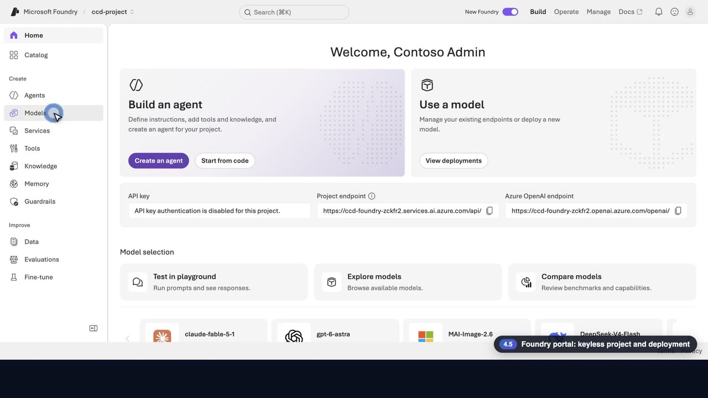
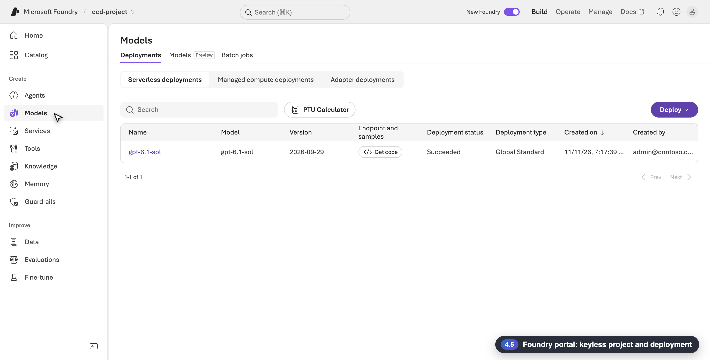
4
4.5 · Foundry portal
◀ Demo map
Keyless project and deployment
The Foundry portal shows the same facts: key authentication is off and the deployment is gpt-6.1-sol
What to check in the video
1
Project home: API key authentication is disabled
2
Models › Deployments: gpt-6.1-sol · Global Standard · Succeeded
3
The name that FOUNDRY_MODEL points to is this deployment name
API key disabled
gpt-6.1-sol
▶ 0:28
Click to play
27
Notes:
[Key message] The Foundry portal shows the same facts: key authentication is off and the deployment is gpt-6.1-sol
[Video narration] This is the project home in the Foundry portal. The app calls the model only with an Entra ID token, never with a key. The models page has the deployment gpt-6.1-sol. It is a Global Standard deployment and its state is succeeded. The name that the app's FOUNDRY_MODEL points to is exactly this deployment name.
[Check while presenting]

Slide 28
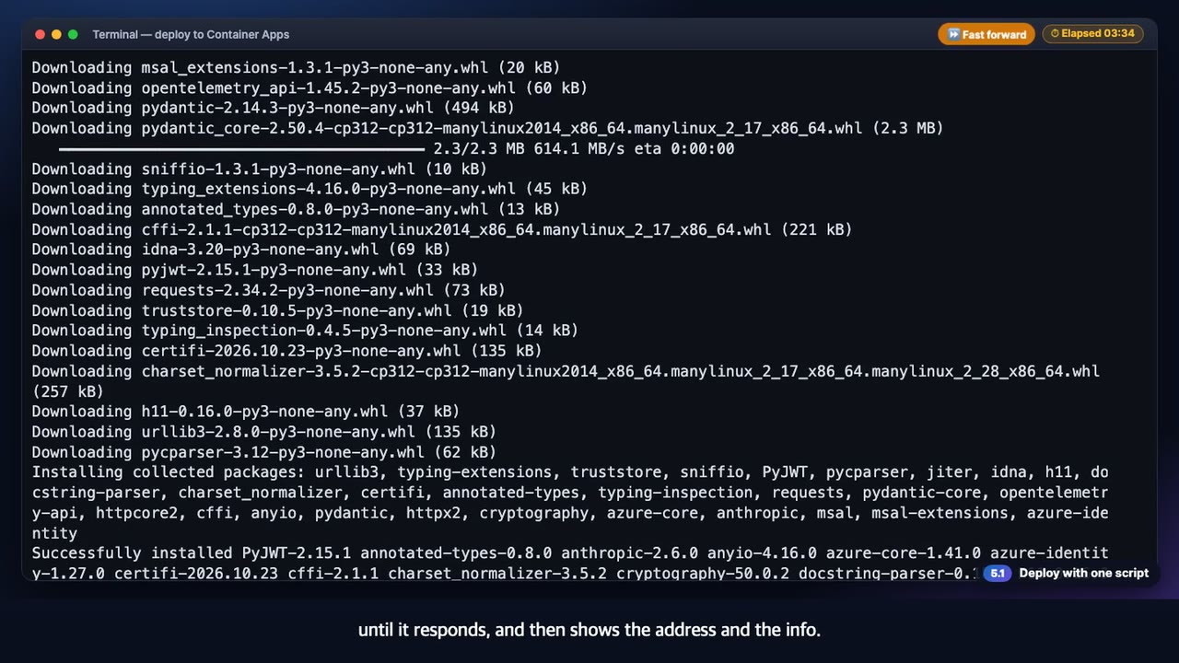
5
5.1 · Azure Container Apps
◀ Demo map
Deployment
Deployment is one script, and it is safe to run again
What to check in the video
1
Creates the registry, the identity and the environment, then builds the image in ACR
2
Waits until the app answers, then shows the address and /api/info
3
Running it again is safe (idempotent)
deploy-aca.sh
▶ 0:17
Click to play
28
Notes:
[Key message] Deployment is one script, and it is safe to run again
[Video narration] Deploying to Container Apps is one script. It creates the registry and the environment, builds the image in the registry, deploys the app, waits until it responds, and then shows the address and the info.
[Check while presenting]

Slide 29
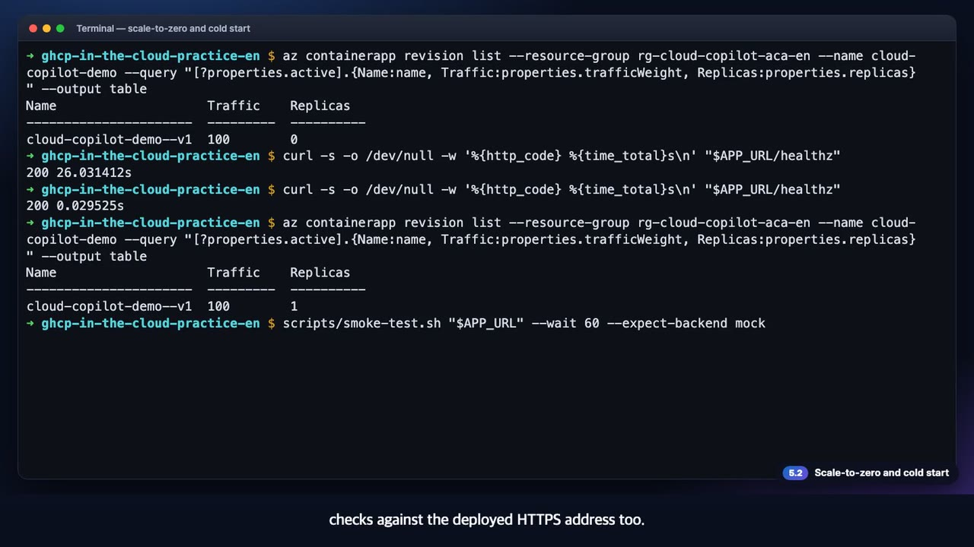
5
5.2 · Azure Container Apps
◀ Demo map
Scale-to-zero
With no requests there are zero replicas, and the first request pays the cold start
What to check in the video
1
Idle: Replicas 0
2
The first request took 26 s and the second 0.03 s
3
The 14 smoke checks also pass on the HTTPS address
revision list
curl
▶ 0:46
Click to play
29
Notes:
[Key message] With no requests there are zero replicas, and the first request pays the cold start
[Video narration] We sent no request after the deployment, so there are zero replicas. No compute is running. The first request took twenty-six seconds, because a replica had to be started. The second request finished in 0.03 seconds, and the replica count is now one. The same smoke test passes all fourteen checks against the deployed HTTPS address too.
[Check while presenting] If latency matters, set MIN_REPLICAS to 1 or more.

Slide 30
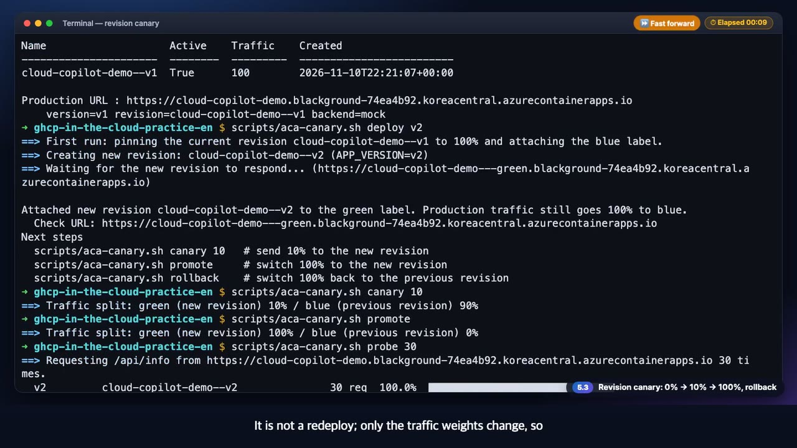
5
5.3 · Azure Container Apps
◀ Demo map
Revision canary
Ship the new version at 0%, try it at 10%, and promote or roll back by changing weights only
What to check in the video
1
deploy → canary 10 → promote → rollback
2
Rollback is a traffic-weight change, not a redeploy
3
probe counts the answers per version
aca-canary.sh
▶ 0:46
Click to play
30
Notes:
[Key message] Ship the new version at 0%, try it at 10%, and promote or roll back by changing weights only
[Video narration] New versions ship as revisions. Status shows the current split, and deploy v2 creates a new revision with zero percent of the traffic, so users are not affected. Canary 10 sends only ten percent of the traffic to the new version. We look at this state in a browser in the next scene. If all is well, promote switches to one hundred percent. Thirty probe calls are all answered by v2. If there is a problem, roll back. It is not a redeploy; only the traffic weights change, so the previous revision gets one hundred percent right away.
[Check while presenting]

Slide 31
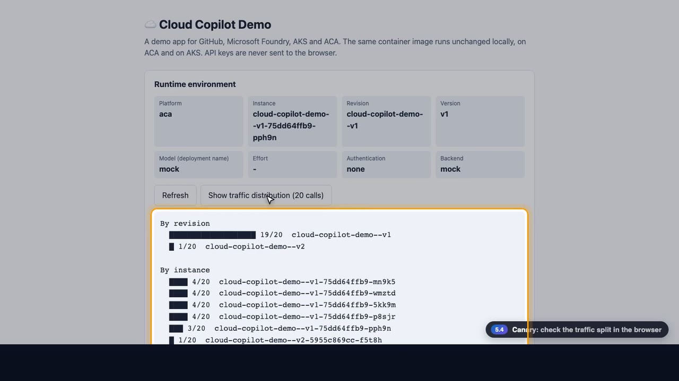
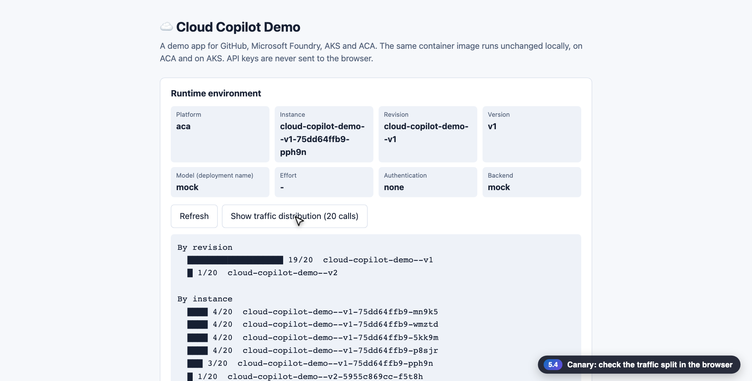
5
5.4 · Azure Container Apps
◀ Demo map
Canary in the browser
The 10% canary is visible right in the UI
What to check in the video
1
Chips: platform aca · instance · revision · app version
2
Show traffic distribution: 20 calls counted per revision, per instance and per version
3
Most calls reach v1 and a few reach v2
Show traffic distribution
▶ 0:27
Click to play
31
Notes:
[Key message] The 10% canary is visible right in the UI
[Video narration] Here is the app in a browser while the canary is at ten percent. The chips at the top show the platform, aca, the replica that answered, the revision and the app version. Show traffic distribution sends twenty requests and draws the answers per revision, per instance and per version as bars. The new version is receiving only a small share of the traffic.
[Check while presenting] A 10% split is probabilistic, so with few calls the share drifts.

Slide 32
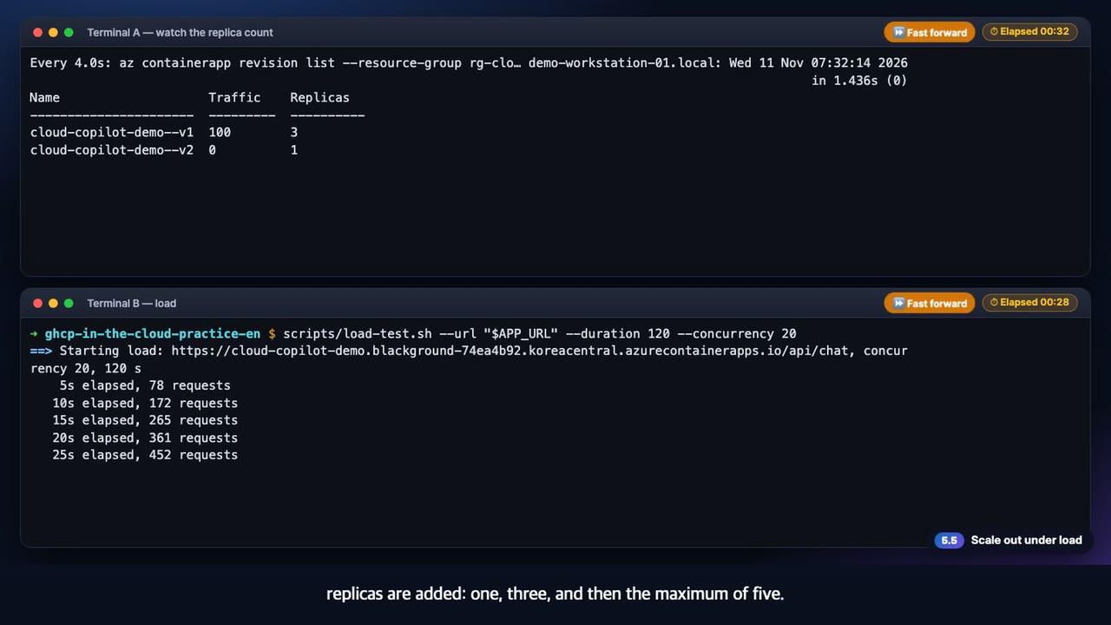
5
5.5 · Azure Container Apps
◀ Demo map
Scale out
When concurrent requests pile up, replicas are added on their own
What to check in the video
1
HTTP scale rule: add replicas above 5 concurrent requests per replica (max 5)
2
Two minutes of load: replicas 1 → 3 → 5, and all 1,935 requests returned HTTP 200
3
A few minutes after the load ends, the replicas shrink again
load-test.sh
watch
▶ 0:58
Click to play
32
Notes:
[Key message] When concurrent requests pile up, replicas are added on their own
[Video narration] The top terminal watches the replica count every four seconds, and the bottom one applies load for two minutes with twenty concurrent requests. The mock answer takes about a second, so requests pile up. When the concurrency passes five per replica, replicas are added: one, three, and then the maximum of five. At the end, about nineteen hundred requests all returned HTTP 200, with a median of about one second. Once the load is gone, the replicas shrink again after a few minutes.
[Check while presenting] The replica count depends on load and response time (this recording: 20 concurrent requests, 1 s mock answer).

Slide 33
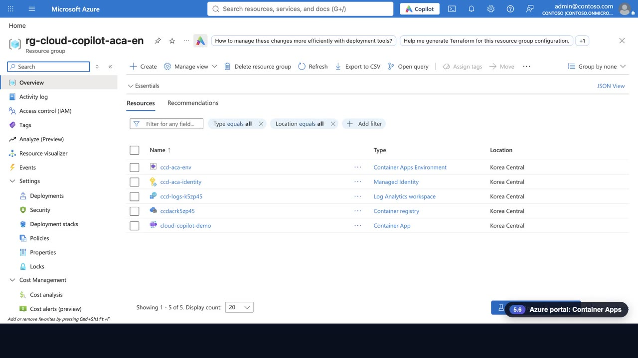
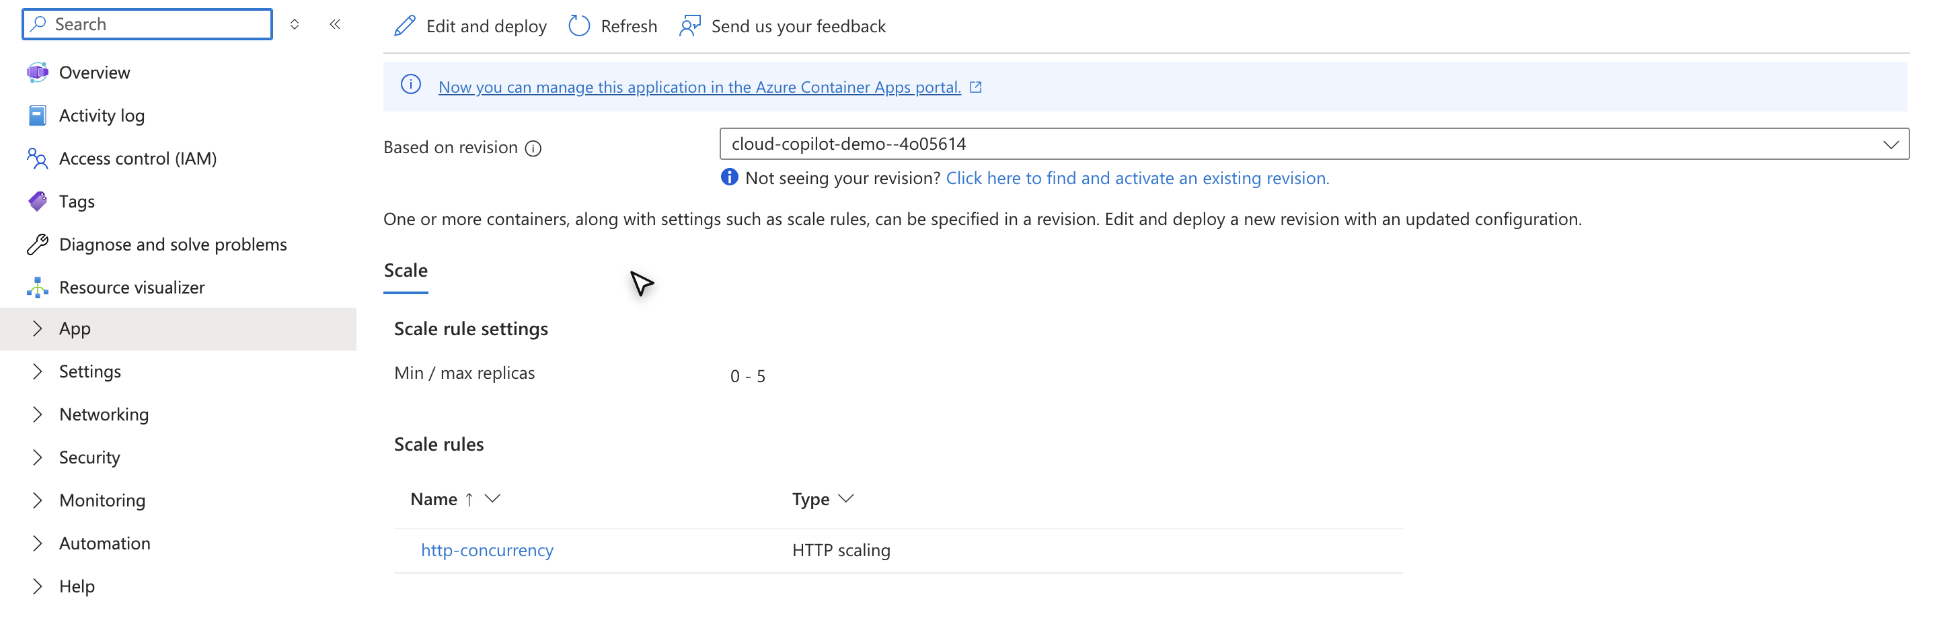
5
5.6 · Azure portal
◀ Demo map
Container Apps
The portal shows revisions, traffic and the replica range at a glance
What to check in the video
1
The resource group holds the app, the environment, the registry, the identities and a workspace
2
Revisions: one active revision with 100% of the traffic; inactive revisions can come back at 0%
3
Scale: replicas 0 to 5 · HTTP concurrency rule
Revisions
Scale rules
▶ 0:48
Click to play
33
Notes:
[Key message] The portal shows revisions, traffic and the replica range at a glance
[Video narration] The Azure portal shows the same result. The resource group holds the container app, the app environment, the registry, the managed identities and a Log Analytics workspace. This is the revisions page. There is one active revision with one hundred percent of the traffic, and it has zero replicas now because there are no requests. The Inactive tab keeps the earlier revisions, so you can bring one back with zero percent traffic anytime. The Scale page has a minimum of zero and a maximum of five replicas with an HTTP rule. Scale-to-zero and scale-out are exactly this setting.
[Check while presenting] The replica count depends on the request volume at that moment.

Slide 34
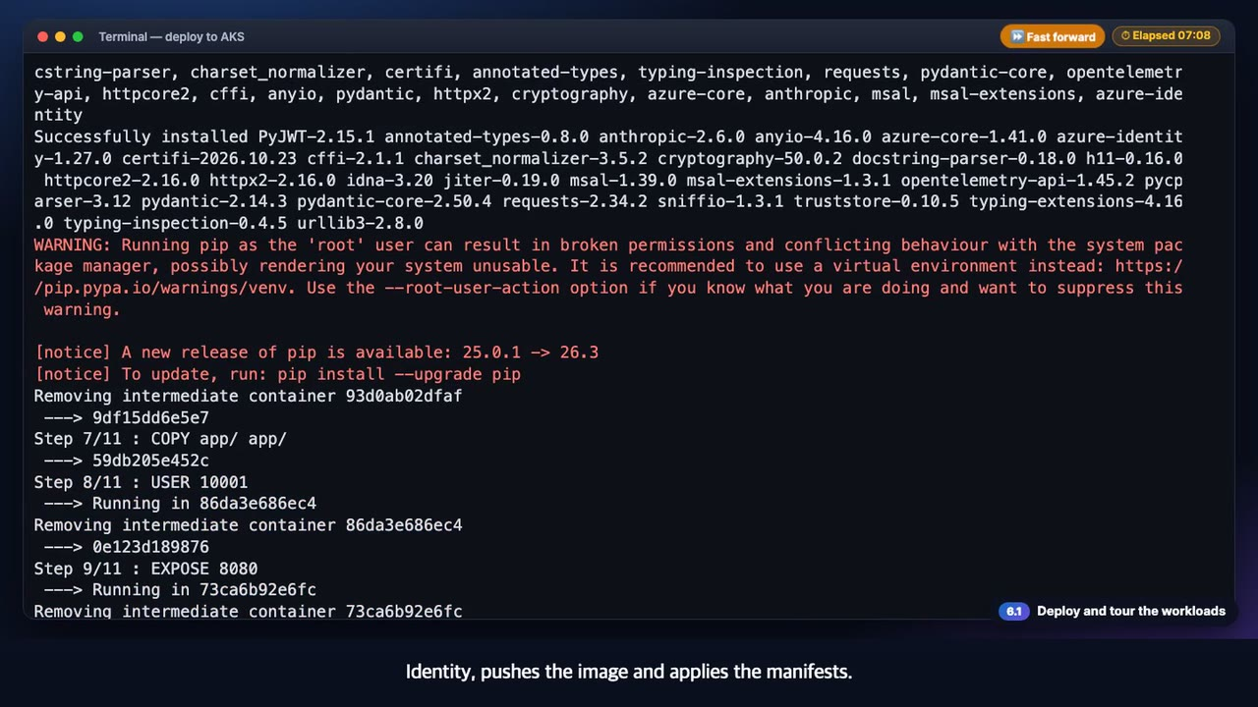
6
6.1 · AKS
◀ Demo map
Deployment and workloads
The script creates the cluster, the registry and the Workload Identity, and runs the same image
What to check in the video
1
The deployment takes 5 to 10 minutes (sped up in the video)
2
One node · Deployment · HPA (2–5) · PDB · ClusterIP service
3
Port-forward and the 14 smoke checks pass
deploy-aks.sh
kubectl get
▶ 0:39
Click to play
34
Notes:
[Key message] The script creates the cluster, the registry and the Workload Identity, and runs the same image
[Video narration] An AKS deployment takes five to ten minutes. It creates the cluster, the registry and the Workload Identity, pushes the image and applies the manifests. The waiting part is sped up. On one node you see the deployment, the HPA, the PDB, the service and the pods at once. Connect with port forwarding and run the smoke test, and the same fourteen checks pass.
[Check while presenting]

Slide 35
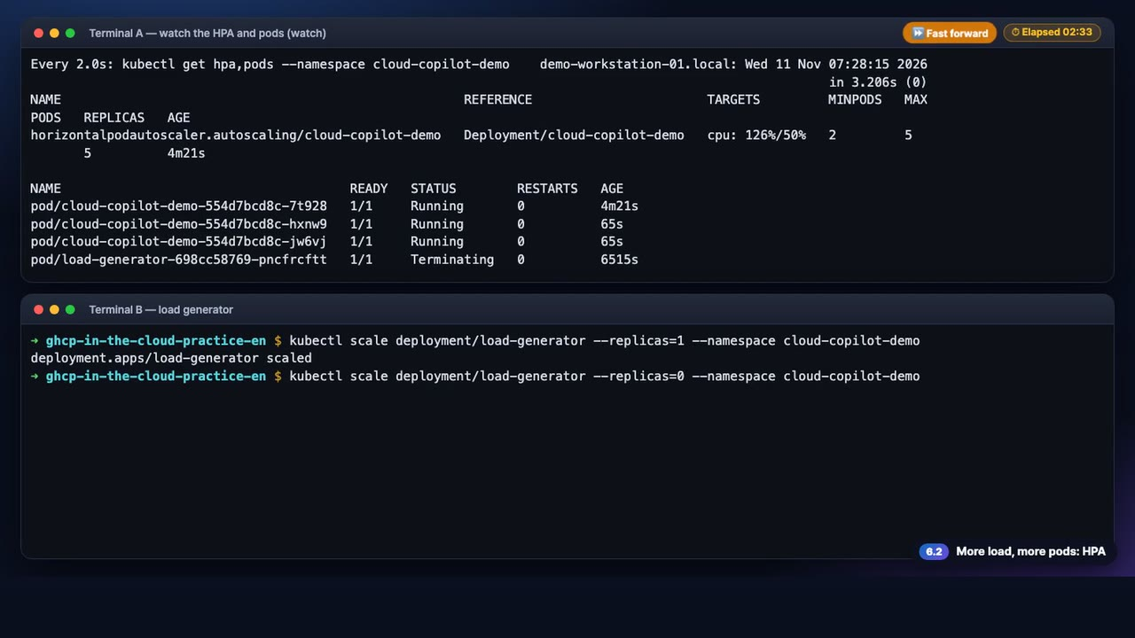
6
6.2 · AKS
◀ Demo map
HPA
When the load rises, the pods grow from 2 up to 5 automatically
What to check in the video
1
CPU target 50%: with the load generator on, utilization reached 212%
2
kubectl --watch accepts one resource type, so the watch command shows the HPA and the pods together
3
When the load stops, the pods shrink again after the stabilization window
watch
kubectl scale
▶ 0:42
Click to play
35
Notes:
[Key message] When the load rises, the pods grow from 2 up to 5 automatically
[Video narration] The top pane watches the HPA and the pods. The kubectl watch option accepts only one resource type, so we used the watch command to see both. Start the load generator in the bottom pane, and CPU utilization passes the target, so the pods grow from two up to five. Turn the load off and, after the stabilization window, the pods shrink again.
[Check while presenting] 'kubectl get hpa,pods --watch' is rejected: error: you may only specify a single resource type (checked in this run).

Slide 36
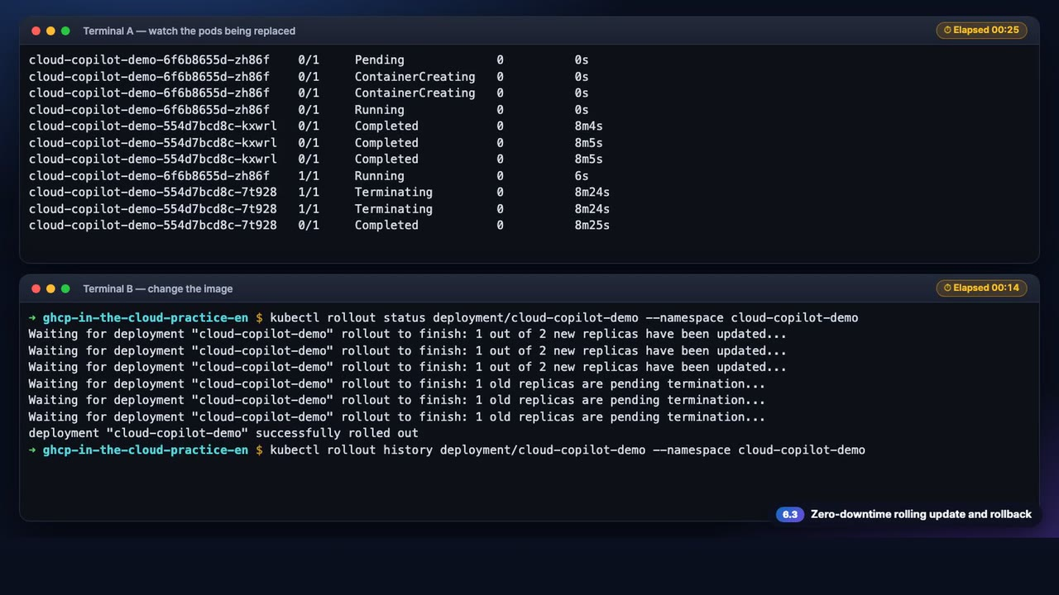
6
6.3 · AKS
◀ Demo map
Rolling update
The old pod goes away only after the new one is ready, so nothing is interrupted
What to check in the video
1
maxSurge 1 · maxUnavailable 0 + readiness probe
2
rollout status ends with successfully rolled out, and the history keeps the revisions
3
rollout undo brings the old version back in one line
kubectl set image
rollout undo
▶ 0:49
Click to play
36
Notes:
[Key message] The old pod goes away only after the new one is ready, so nothing is interrupted
[Video narration] The v2 image was pushed beforehand. When we change the image to v2, a new pod is created first, and the old pod is removed only after the new one is ready. The rollout succeeds, and the history keeps the revisions. If something is wrong, a single rollout undo brings the old version back.
[Check while presenting]

Slide 37
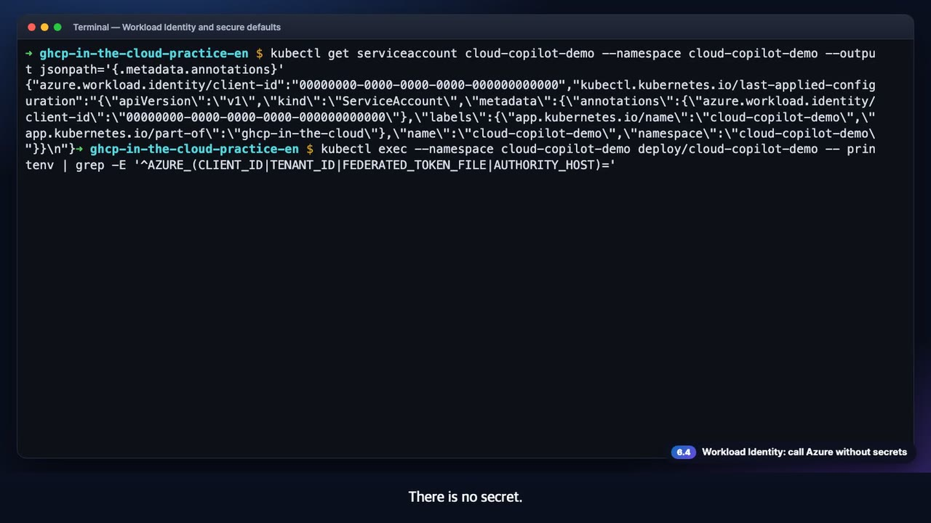
6
6.4 · AKS
◀ Demo map
Workload Identity
A pod holds no secret: its service account token is exchanged for an Entra ID token
What to check in the video
1
The service account annotation points to the client ID of the managed identity
2
Four values are injected: CLIENT_ID · TENANT_ID · TOKEN_FILE · AUTHORITY_HOST
3
A privileged pod is refused by Pod Security restricted
workload identity
restricted
▶ 0:25
Click to play
37
Notes:
[Key message] A pod holds no secret: its service account token is exchanged for an Entra ID token
[Video narration] The service account's annotation points to the client ID of the managed identity. Only four values are injected into the pod: the client ID, the tenant ID, the token file and the authority host. There is no secret. If we try to create a privileged pod, the Pod Security restricted policy rejects it.
[Check while presenting]

Slide 38


6
6.5 · Azure portal
◀ Demo map
AKS
The OIDC issuer and Workload Identity are on, so pods get tokens without secrets
What to check in the video
1
Node pools: Running, Azure CNI Overlay, autoscaling
2
Security configuration: OIDC issuer and Workload Identity on
3
Workloads: both cloud-copilot-demo pods ready, as in kubectl
Node pools
Security configuration
Workloads
▶ 1:00
Click to play
38
Notes:
[Key message] The OIDC issuer and Workload Identity are on, so pods get tokens without secrets
[Video narration] This is the overview of the AKS cluster. It is running, the networking is Azure CNI Overlay, and the container registry that supplies the images is attached. The node pool autoscales, and its nodes are ready. When pods increase, nodes can increase too. In the security configuration, the OIDC issuer and Workload Identity are on. That is why a pod can get an Entra ID token without secrets. This is the workloads page of the Kubernetes resources. Both pods of the cloud-copilot-demo deployment are ready, and the load generator is scaled down to zero. It is the same state we saw with kubectl.
[Check while presenting]

Slide 39

Key screens: the Azure portal and the Foundry portal
What the CLI created is visible in the portals too
Container Apps revisions
AKS security configuration (OIDC · Workload Identity)
The OIDC federated credential
Foundry deployment gpt-6.1-sol
GitHub × Azure Cloud Demo
39
Notes:
Screen gallery: the container app revisions, the AKS security configuration, the federated credential and the Foundry deployment.

Slide 40


7
7.1 · Foundry × Container Apps
◀ Demo map
Model call with a Managed Identity
The same image calls the Foundry model with a managed identity
What to check in the video
1
foundry.env was loaded and deploy-aca.sh ran again
2
Chips: backend=foundry · model=gpt-6.1-sol · auth=entra-id
3
One role, Cognitive Services User, on the managed identity is enough
foundry.env
managed identity
▶ 0:39
Click to play
40
Notes:
[Key message] The same image calls the Foundry model with a managed identity
[Video narration] Load the Foundry environment file and run the same deploy script again, and the app calls the Foundry model instead of the mock. The image is rebuilt with the new code. This is the Container Apps page. The backend is foundry, the model is gpt-6.1-sol, and the auth is entra-id. The app's Managed Identity makes the call without a secret.
[Check while presenting]

Slide 41


7
7.2 · Foundry × AKS
◀ Demo map
Model call with Workload Identity
An AKS pod calls the model with the same code, through Workload Identity
What to check in the video
1
A new tag (v3) is used, because nodes do not pull an image again for an unchanged tag
2
Chips: platform=aks · model=gpt-6.1-sol · auth=entra-id
3
The code is the same; only who it signs in as changes
IMAGE_TAG=v3
workload identity
▶ 0:43
Click to play
41
Notes:
[Key message] An AKS pod calls the model with the same code, through Workload Identity
[Video narration] AKS works the same way. Pushing again with the same tag would not make the nodes pull the image, so we deployed with a new tag. The pod calls with its Workload Identity, and the page shows platform aks and model gpt-6.1-sol. Between the same image and the same code, the only difference is who it signs in as.
[Check while presenting]

Slide 42
Key screens: one app, the same screen in three places
Platform · instance · revision · model are shown at the top of the page
Local (az login token)
Container Apps (Managed Identity)
AKS (Workload Identity)
Canary traffic distribution
GitHub × Azure Cloud Demo
42
Notes:
Screen gallery: the same UI locally, on ACA and on AKS; the chips tell you where it runs.

Slide 43
What we learned by running it: where the guide did not work, and what we changed
Green items are fixed in the kit, amber items are worth knowing to save time
✓
OIDC subject format (AADSTS700213)
The setup script reads GitHub's sub_claim_prefix, so recent repositories work (the Azure portal gives the same advice)
✓
Default model is gpt-6.1-sol
The kit deploys gpt-6.1-sol by default, and MODEL_NAME selects another model
✓
GPT has no effort max
The app converts it to the highest level, xhigh
!
CI on an agent's PR needs approval
The runs wait with action required until a person approves; the CLI can dispatch the same workflow
!
A canary split outlives the next deploy
The pinned split kept serving the old revision after the workflow rolled out a new one; reset it with az containerapp ingress traffic set
!
kubectl get hpa,pods --watch is rejected
It accepts one resource type only, so we used the watch command
!
The same AKS image tag is not pulled again
Deploy with a new tag (v3) so the pods actually change
GitHub × Azure Cloud Demo
43
Notes:
[Key message] These are the places where running the guide end to end on a real subscription needed a change or a note. The three green items are in the kit already.

Slide 44
Summary: people stay in control, connections need no keys, the same app runs anywhere
1
2
3
A person from issue to merge
Everything as code
Model calls without keys
Copilot opens the PR, CI and review verify it, and a person approves.
Rulesets, CodeQL and OIDC deployment as files and scripts. Zero stored secrets.
With a Managed Identity or a Workload Identity, the same image calls the Foundry model.
Next step: create a practice repository from the template and run demo 1 yourself
github.com/junwoojeong100/ghcp-in-the-cloud
GitHub × Azure Cloud Demo
44
Notes:
Wrap-up: repeat the three key messages and invite the audience to create a practice repository from the template and run it themselves. The narration in the videos is an AI voice generated with Azure AI Speech.

Slide 45
Appendix: run it yourself, create a practice repo and follow the demo order
Every step is a script, and the default is a preview (dry run)
1
1. Prepare
2
2. Demo order
3
3. Cleanup
Create a practice repository from the template (gh repo create --template), then sign in with gh auth login and az login. Docker is not needed (images build in ACR).
Follow the READMEs in demos/01 → 06. Scripts: apply-repo-settings.sh · setup-github-oidc.sh · deploy-foundry.sh · deploy-aca.sh · deploy-aks.sh
scripts/cleanup.sh all --yes deletes the resource groups tagged demo=ghcp-in-the-cloud (untagged groups are never deleted). Run it when the demo is over (AKS and ACR cost money).
GitHub × Azure Cloud Demo
45
Notes:
Appendix: how to run it yourself. The scripts default to a dry run, so nothing changes until you add --apply or --yes.

