Slide 1
Operating System Principles: Devices, Device Drivers, and I/O CS 111 Operating Systems Peter Reiher

Slide 2
Outline
Devices and device drivers
I/O performance issues
Device driver abstractions

Slide 3

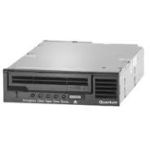


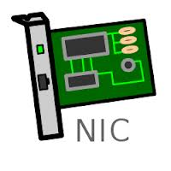
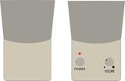


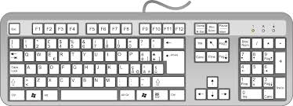
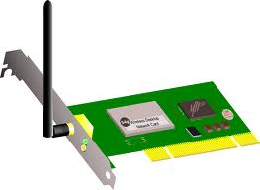



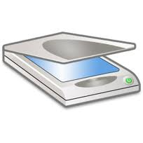
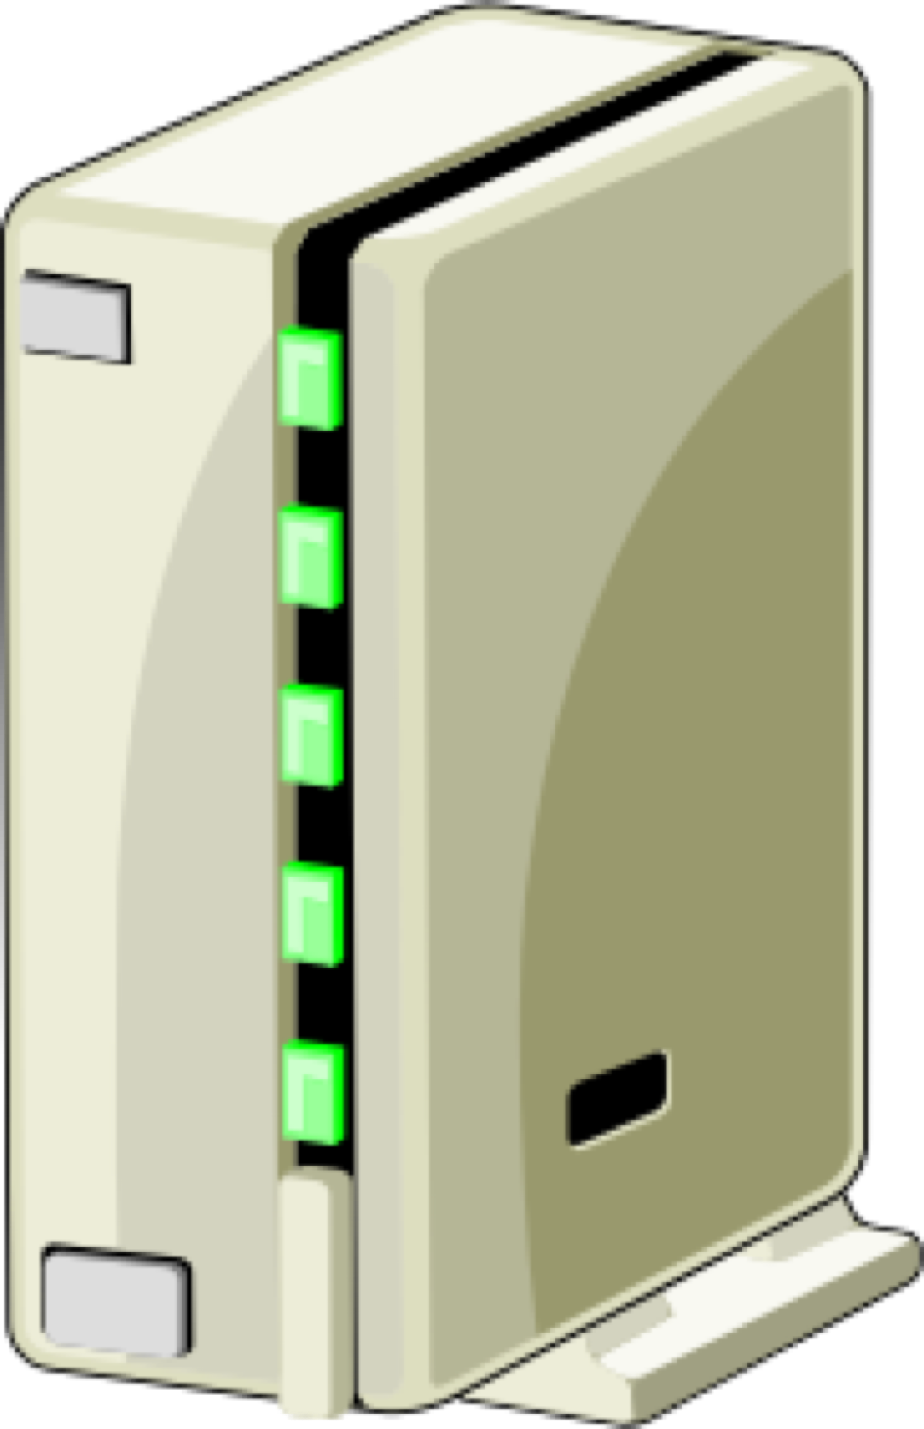
So You’ve Got Your Computer . . .
It’s got memory, a bus, a CPU or two
But there’s usually a lot more to it than that
And who knows what else?

Slide 4
Welcome to the Wonderful World of Peripheral Devices!
Our computers typically have lots of devices attached to them
Each device needs to have some code associated with it
To perform whatever operations it does
To integrate it with the rest of the system
In modern commodity OSes, the code that handles these devices dwarfs the rest

Slide 5
Peripheral Device Code and the OS
Why are peripheral devices the OS’ problem, anyway?
Why can’t they be handled in user-level code?
Maybe they sometimes can, but . . .
Some of them are critical for system correctness
E.g., the disk drive holding swap space
Some of them must be shared among multiple processes
E.g. screen; Which gets often rather complex
Some of them are security-sensitive
Perhaps more appropriate to put the code in the OS

Slide 6
Where the Device Driver Fits in
At one end you have an application
Like a web browser
At the other end you have a very specific piece of hardware
Like an Intel Gigabit CT PCI-E Network Adapter
In between is the OS
When the application sends a packet, the OS needs to invoke the proper device driver
Which feeds detailed instructions to the hardware

Slide 7
Device Drivers
Generally, the code for these devices is pretty specific to them
It’s basically code that drives the device
Makes the device perform the operations it’s designed for
So typically each system device is represented by its own piece of code
The device driver
A Linux 2.6 kernel came with over 3200 of them . . .

Slide 8
Typical Properties of Device Drivers
Highly specific to the particular device
System only needs drivers for devices it hosts
Inherently modular
Usually interacts with the rest of the system in limited, well defined ways
Their correctness is critical
Device behavior correctness and overall correctness
Generally written by programmers who understand the device well
But are not necessarily experts on systems issues

Slide 9
Abstractions and Device Drivers
OS defines idealized device classes
Disk, display, printer, tape, network, serial ports
Classes define expected interfaces/behavior
All drivers in class support standard methods
Device drivers implement standard behavior
Make diverse devices fit into a common mold
Protect applications from device eccentricities
Abstractions regularize and simplify the chaos of the world of devices

Slide 10
What Can Driver Abstractions Help With?
Encapsulate knowledge of how to use the device
Map standard operations into operations on device
Map device states into standard object behavior
Hide irrelevant behavior from users
Correctly coordinate device and application behavior
Encapsulate knowledge of optimization
Efficiently perform standard operations on a device
Encapsulate fault handling
Understanding how to handle recoverable faults
Prevent device faults from becoming OS faults

Slide 11
How Do Device Drivers Fit Into a Modern OS?
There may be a lot of them
They are each pretty independent
You may need to add new ones later
So a pluggable model is typical
OS provides capabilities to plug in particular drivers in well defined ways
Then plug in the ones a given machine needs
Making it easy to change or augment later

Slide 12
Layering Device Drivers
The interactions with the bus, down at the bottom, are pretty standard
How you address devices on the bus, coordination of signaling and data transfers, etc.
Not too dependent on the device itself
The interactions with the applications, up at the top, are also pretty standard
Typically using some file-oriented approach
In between are some very device specific things

Slide 13
A Pictorial View
User space
System
Call
App 1
App 2
App 3
Kernel
space
Device
Drivers
Device
Call
USB bus controller
PCI bus controller
Hardware
USB
bus
PCI
bus

Slide 14
Device Drivers Vs. Core OS Code
Device driver code is in the OS, but . . .
What belongs in core OS vs. a device driver?
Common functionality belongs in the OS
Caching
File systems code not tied to a specific device
Network protocols above physical/link layers
Specialized functionality belongs in the drivers
Things that differ in different pieces of hardware
Things that only pertain to the particular piece of hardware

Slide 15
Devices and Interrupts
Devices are primarily interrupt-driven
Drivers aren’t schedulable processes
They work at different speed than the CPU
Typically slower
They can do their own work while CPU does something else
They use interrupts to get the CPU’s attention

Slide 16
Devices and Busses
Devices are not connected directly to the CPU
Both CPU and devices are connected to a bus
Sometimes the same bus, sometimes a different bus
Devices communicate with CPU across the bus
Bus used both to send/receive interrupts and to transfer data and commands
Devices signal controller when they are done/ready
When device finishes, controller puts interrupt on bus
Bus then transfers interrupt to the CPU
Perhaps leading to movement of data

Slide 17
CPUs and Interrupts
Interrupts look very much like traps
Traps come from CPU
Interrupts are caused externally to CPU
Unlike traps, interrupts can be enabled/disabled by special CPU instructions
Device can be told when they may generate interrupts
Interrupt may be held pending until software is ready for it

Slide 18
The Changing I/O Landscape
To quote a recent Nobel Prize winner, “the times they are a’changing”
Storage paradigms
Old: swapping, paging, file systems, data bases
New: NAS, distributed object/key-value stores
I/O traffic
Old: most I/O was disk I/O
New: network and video dominate many systems
Performance goals:
Old: maximize throughput, IOPS
New: low latency, scalability, reliability, availability

Slide 19
Device Performance
The importance of good device utilization
How to achieve good utilization

Slide 20
Good Device Utilization
Key system devices limit system performance
File system I/O, swapping, network communication
If device sits idle, its throughput drops
This may result in lower system throughput
Longer service queues, slower response times
Delays can disrupt real-time data flows
Resulting in unacceptable performance
Possible loss of irreplaceable data
It is very important to keep key devices busy
Start request n+1 immediately when n finishes

Slide 21
Poor I/O Device Utilization
I/O device
IDLE
BUSY
process
process waits to run
process does computation in preparation for I/O operation
process issues read system call, blocks awaiting completion
device performs requested operation
completion interrupt awakens blocked process
process runs again, finishes read system call
process does more computation
Process issues read system call, blocks awaiting completion

Slide 22
How To Do Better
The usual way:
Exploit parallelism
Devices operate independently of the CPU
So a device and the CPU can operate in parallel
But often devices need to access RAM
As does the CPU
How to handle that?

Slide 23
What’s Really Happening on the CPU?
Modern CPUs try to avoid going to RAM
Working with registers
Caching on the CPU chip itself
If things go well, the CPU doesn’t use the memory bus that much
If not, life will be slow, anyway
So one way to parallelize activities is to let a device use the bus instead of the CPU

Slide 24
Direct Memory Access (DMA)
Allows any two devices attached to the memory bus to move data directly
Without passing it through the CPU first
Bus can only be used for one thing at a time
So if it’s doing DMA, it’s not servicing CPU requests
But often the CPU doesn’t need it, anyway
With DMA, data moves from device to memory at bus/device/memory speed

Slide 25
Keeping Key Devices Busy
Allow multiple requests to be pending at a time
Queue them, just like processes in the ready queue
Requesters block to await eventual completions
Use DMA to perform the actual data transfers
Data transferred, with no delay, at device speed
Minimal overhead imposed on CPU
When the currently active request completes
Device controller generates a completion interrupt
OS accepts interrupt and calls appropriate handler
Interrupt handler posts completion to requester
Interrupt handler selects and initiates next transfer

Slide 26
Interrupt Driven Chain Scheduled I/O
xx_read/write() {
allocate a new request descriptor
fill in type, address, count, location
insert request into service queue
if (device is idle) {
disable_device_interrupt();
xx_start();
enable_device_interrupt();
}
await completion of request
extract completion info for caller
}
xx_start() {
get next request from queue
get address, count, disk address
load request parameters into controller
start the DMA operation
mark device busy
}
xx_intr() {
extract completion info from controller
update completion info in current req
wakeup current request
if (more requests in queue)
xx_start()
else
mark device idle
}

Slide 27
Multi-Tasking & Interrupt Driven I/O
device
1A
2A
1B
2B
process 1
1A
1B
1C
process 2
2A
2B
process 3
P₁ runs, requests a read, and blocks
P₂ runs, requests a read, and blocks
P₃ runs until interrupted
Awaken P₁ and start next read operation
P₁ runs, requests a read, and blocks
P₃ runs until interrupted
7. Awaken P₂ and start next read operation
8. P₂ runs, requests a read, and blocks
9. P₃ runs until interrupted
10. Awaken P₁ and start next read operation
11. P₁ runs, requests a read, and blocks

Slide 28
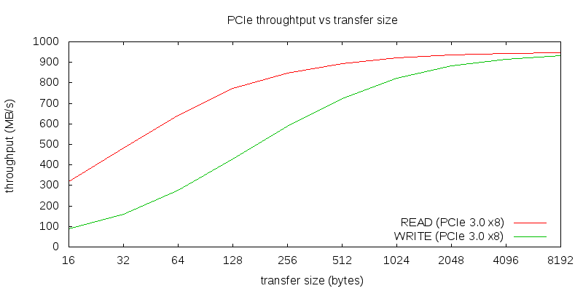
Bigger Transfers are Better

Slide 29
(Bigger Transfers are Better)
Disks have high seek/rotation overheads
Larger transfers amortize down the cost/byte
All transfers have per-operation overhead
Instructions to set up operation
Device time to start new operation
Time and cycles to service completion interrupt
Larger transfers have lower overhead/byte
This is not limited to software implementations

Slide 30
I/O and Buffering
Most I/O requests cause data to come into the memory or to be copied to a device
That data requires a place in memory
Commonly called a buffer
Data in buffers is ready to send to a device
An existing empty buffer is ready to receive data from a device
OS needs to make sure buffers are available when devices are ready to use them

Slide 31
OS Buffering Issues
Fewer/larger transfers are more efficient
They may not be convenient for applications
Natural record sizes tend to be relatively small
Operating system can consolidate I/O requests
Maintain a cache of recently used disk blocks
Accumulate small writes, flush out as blocks fill
Read whole blocks, deliver data as requested
Enables read-ahead
OS reads/caches blocks not yet requested

Slide 32
Deep Request Queues
Having many I/O operations queued is good
Maintains high device utilization (little idle time)
Reduces mean seek distance/rotational delay
May be possible to combine adjacent requests
Can sometimes avoid performing a write at all
Ways to achieve deep queues:
Many processes making requests
Individual processes making parallel requests
Read-ahead for expected data requests
Write-back cache flushing

Slide 33
Double-Buffered Output
application
buffer
#1
buffer
#2
device

Slide 34
Performing Double-Buffered Output
Have multiple buffers queued up, ready to write
Each write completion interrupt starts the next write
Application and device I/O proceed in parallel
Application queues successive writes
Don’t bother waiting for previous operation to finish
Device picks up next buffer as soon as it is ready
If we're CPU-bound (more CPU than output)
Application speeds up because it doesn’t wait for I/O
If we're I/O-bound (more output than CPU)
Device is kept busy, which improves throughput
But eventually we may have to block the process

Slide 35
Double-Buffered Input
application
buffer
#1
buffer
#2
device

Slide 36
Performing Double Buffered Input
Have multiple reads queued up, ready to go
Read completion interrupt starts read into next buffer
Filled buffers wait until application asks for them
Application doesn't have to wait for data to be read
When can we do chain-scheduled reads?
Each app will probably block until its read completes
So we won’t get multiple reads from one application
We can queue reads from multiple processes
We can do predictive read-ahead

Slide 37
Scatter/Gather I/O
Many device controllers support DMA transfers
Entire transfer must be contiguous in physical memory
User buffers are in paged virtual memory
User buffers may be spread all over physical memory
Scatter: read from device to multiple pages
Gather: writing from multiple pages to device
Three basic approaches apply
Copy all user data into contiguous physical buffer
Split logical request into chain-scheduled page requests
I/O MMU may automatically handle scatter/gather

Slide 38
“Gather” Writes From Paged Memory
process virtual address space
user I/O
buffer
physical memory
DMA I/O stream

Slide 39
“Scatter” Reads Into Paged Memory
process virtual address space
user I/O
buffer
physical memory
DMA I/O stream

Slide 40
Memory Mapped I/O
DMA may not be the best way to do I/O
Designed for large contiguous transfers
Some devices have many small sparse transfers
E.g., consider a video game display adaptor
Instead, treat registers/memory in device as part of the regular memory space
Accessed by reading/writing those locations
For example, a bit-mapped display adaptor
1Mpixel display controller, on the CPU memory bus
Each word of memory corresponds to one pixel
Application uses ordinary stores to update display
Low overhead per update, no interrupts to service
Relatively easy to program

Slide 41
Trade-off: Memory Mapping vs. DMA
DMA performs large transfers efficiently
Better utilization of both the devices and the CPU
Device doesn't have to wait for CPU to do transfers
But there is considerable per transfer overhead
Setting up the operation, processing completion interrupt
Memory-mapped I/O has no per-op overhead
But every byte is transferred by a CPU instruction
No waiting because device accepts data at memory speed
DMA better for occasional large transfers
Memory-mapped better frequent small transfers
Memory-mapped devices more difficult to share

Slide 42
Generalizing Abstractions for Device Drivers
Every device type is unique
To some extent, at least in hardware details
Implying each requires its own unique device driver
But there are many commonalities
Particularly among classes of devices
All disk drives, all network cards, all graphics cards, etc.
Can we simplify the OS by leveraging these commonalities?
By defining simplifying abstractions?

Slide 43
Providing the Abstractions
The OS defines idealized device classes
Disk, display, printer, tape, network, serial ports
Classes define expected interfaces/behavior
All drivers in class support standard methods
Device drivers implement standard behavior
Make diverse devices fit into a common mold
Protect applications from device eccentricities
Interfaces (as usual) are key to providing abstractions

Slide 44
Device Driver Interface (DDI)
Standard (top-end) device driver entry-points
“Top-end” – from the OS to the driver
Basis for device-independent applications
Enables system to exploit new devices
A critical interface contract for 3rd party developers
Some entry points correspond directly to system calls
E.g., open, close, read, write
Some are associated with OS frameworks
Disk drivers are meant to be called by block I/O
Network drivers are meant to be called by protocols

Slide 45
DDIs and sub-DDIs
Network
receive,
transmit
set MAC
stats
Common DDI
Disk
request
revalidate
fsync
Life Cycle
initialize, cleanup
open, release
Basic I/O
read, write,
seek, ioctl,
select
Serial
receive character
start write
line parms

Slide 46
Standard Driver Classes & Clients
system calls
file & directory
operations
direct device
access
networking & IPC
operations
CD FS
DOS FS
UNIX FS
disk class
tape class
display class
serial class
PPP
TCP/IP
X.25
block I/O
data Link
provider
device driver interfaces (*-ddi)
CD
drivers
disk
drivers
tape
drivers
display
drivers
serial
drivers
NIC
drivers

Slide 47
Drivers – Simplifying Abstractions
Encapsulate knowledge of how to use a device
Map standard operations into operations onto device
Map device states into standard object behavior
Hide irrelevant behavior from users
Correctly coordinate device and application behavior
Encapsulate knowledge of optimization
Efficiently perform standard operations on a device
Encapsulation of fault handling
Knowledge of how to handle recoverable faults
Prevent device faults from becoming OS faults

Slide 48
Kernel Services for device drivers
common DDI
sub-class DDI
device driver
run-time
loader
DKI – driver/kernel interface
memory
allocation
buffering
I/O resource
management
synchronization
error reporting
DMA
configuration

Slide 49
Driver/Kernel Interface
Specifies bottom-end services OS provides to drivers
Things drivers can ask the kernel to do
Analogous to an ABI for device driver writers
Must be very well-defined and stable
To enable 3rd party driver writers to build drivers
So old drivers continue to work on new OS versions
Each OS has its own DKI, but they are all similar
Memory allocation, data transfer and buffering
I/O resource (e.g. ports, interrupts) mgt, DMA
Synchronization, error reporting
Dynamic module support, configuration, plumbing

Slide 50
Criticality of Stable Interfaces
Drivers are largely independent from the OS
They are built by different organizations
They might not be co-packaged with the OS
OS and drivers have interface dependencies
OS depends on driver implementations of DDI
Drivers depends on kernel DKI implementations
These interfaces must be carefully managed
Well defined and well tested
Upwards-compatible evolution

Slide 51
Linux Device Driver Abstractions
An example of how an OS handles device drivers
Basically inherited from earlier Unix systems
A class-based system
Several super-classes
Block devices
Character devices
Some regard network devices as a third major class
Other divisions within each super-class

Slide 52
Why Classes of Drivers?
Classes provide a good organization for abstraction
They provide a common framework to reduce amount of code required for each new device
The framework ensure all devices in class provide certain minimal functionality
But a lot of driver functionality is very specific to the device
Implying that class abstractions don’t cover everything

Slide 53
Character Device Superclass
Devices that read/write one byte at a time
“Character” means byte, not ASCII
May be either stream or record structured
May be sequential or random access
Support direct, synchronous reads and writes
Common examples:
Keyboards
Monitors
Most other devices

Slide 54
Block Device Superclass
Devices that deal with a block of data at a time
Usually a fixed size block
Most common example is a disk drive
Reads or writes a single sized block (e.g., 4K bytes) of data at a time
Random access devices, accessible one block at a time
Support queued, asynchronous reads and writes

Slide 55
Why a Separate Superclass for Block Devices?
Block devices span all forms of block-addressable random access storage
Hard disks, CDs, flash, and even some tapes
Such devices require some very elaborate services
Buffer allocation, LRU management of a buffer cache, data copying services for those buffers, scheduled I/O, asynchronous completion, etc.
Important system functionality (file systems and swapping/paging) implemented on top of block I/O
Block I/O services are designed to provide very high performance for critical functions

Slide 56
Network Device Superclass
Devices that send/receive data in packets
Originally treated as character devices
But sufficiently different from other character devices that some regard as distinct
Only used in the context of network protocols
Unlike other devices
Which leads to special characteristics
Typical examples are Ethernet cards, 802.11 cards, Bluetooth devices

Slide 57
Identifying Device Drivers
The major device number specifies which device driver to use for it
Might have several distinct devices using the same drivers
E.g., multiple disk drives of the same type
Or one disk drive divided into logically distinct pieces
Minor device number distinguishes between those

Slide 58
Accessing Linux Device Drivers
Major number is 14
Minor number is 0
Done through the file system
Special files
Files that are associated with a device instance
UNIX/LINUX uses <block/character, major, minor>
Major number corresponds to a particular device driver
Minor number identifies an instance under that driver
Opening a special file opens the associated device
Open/close/read/write/etc. calls map to calls to appropriate entry-points of the selected driver
A block special device
brw-r----- 1 root operator 14, 0 Apr 11 18:03 disk0
brw-r----- 1 root operator 14, 1 Apr 11 18:03 disk0s1
brw-r----- 1 root operator 14, 2 Apr 11 18:03 disk0s2
br--r----- 1 reiher reiher 14, 3 Apr 15 16:19 disk2
br--r----- 1 reiher reiher 14, 4 Apr 15 16:19 disk2s1
br--r----- 1 reiher reiher 14, 5 Apr 15 16:19 disk2s2

