Slide 1
Operating System Principles: Distributed Systems CS 111 Operating Systems Peter Reiher

Slide 2
Outline
Introduction
Distributed system paradigms
Remote procedure calls
Distributed synchronization and consensus
Distributed system security

Slide 3
Goals of Distributed Systems
Scalability and performance
Apps require more resources than one computer has
Grow system capacity /bandwidth to meet demand
Improved reliability and availability
24x7 service despite disk/computer/software failures
Ease of use, with reduced operating expenses
Centralized management of all services and systems
Buy (better) services rather than computer equipment
Enable new collaboration and business models
Collaborations that span system (or national) boundaries
A global free market for a wide range of new services

Slide 4
Transparency
Ideally, a distributed system would be just like a single machine system
But better
More resources
More reliable
Faster
Transparent distributed systems look as much like single machine systems as possible

Slide 5
Deutsch's “Seven Fallacies of Network Computing”
1. The network is reliable
2. There is no latency (instant response time)
3. The available bandwidth is infinite
4. The network is secure
5. The topology of the network does not change
6. There is one administrator for the whole network
7. The cost of transporting additional data is zero
Bottom Line: true transparency is not achievable

Slide 6
Heterogeneity in Distributed Systems
Distributed systems aren’t uniform
Heterogeneous clients
Different instruction set architectures
Different operating systems and versions
Heterogeneous servers
Different implementations
Offered by competing service providers
Heterogeneous networks
Public and private
Managed by different orgs in different countries
Another problem for achieving transparency
And sometimes correctness

Slide 7
Fundamental Building Blocks Change
The old model:
Programs run in processes
Programs use APIs to access system resources
API services implemented by OS and libraries
The new model:
Clients and servers run on nodes
Clients use APIs to access services
API services are exchanged via protocols
Local is a (very important) special case

Slide 8
Changing Paradigms
Network connectivity becomes “a given”
New applications assume/exploit connectivity
New distributed programming paradigms emerge
New functionality depends on network services
Applications demand new kinds of services:
Location independent operations
Rendezvous between cooperating processes
WAN scale communication, synchronization

Slide 9
Distributed System Paradigms
Parallel processing
Relying on special hardware
Single system images
Make all the nodes look like one big computer
Somewhere between hard and impossible
Loosely coupled systems
Work with difficulties as best as you can
Typical modern approach to distributed systems
Cloud computing
A recent variant

Slide 10
Loosely Coupled Systems
Characterization:
A parallel group of independent computers
Serving similar but independent requests
Minimal coordination and cooperation required
Motivation:
Scalability and price performance
Availability – if protocol permits stateless servers
Ease of management, reconfigurable capacity
Examples:
Web servers, app servers, cloud computing
Notes:
Connected via LAN or network,

Slide 11
Horizontal Scalability
Each node largely independent
So you can add capacity just by adding a node “on the side”
Scalability can be limited by network, instead of hardware or algorithms
Or, perhaps, by a load balancer (directs requests to machine)
Reliability is high
Failure of one of N nodes just reduces capacity

Slide 12
Horizontal Scalability Architecture
If I need more web server capacity,
WAN to clients
load balancing switch
with fail-over
…
web
server
web
server
web
server
web
server
web
server
app
server
app
server
app
server
app
server
app
server
…
content
distribution
server
HA
database
server
Notes:
Don’t want load balancing switch to be a single point of failure; may have a backup to take over in case of failure of first
Often more than just a simple round robin, contains information about servers to allow for better cache utilization
Requests: want them to be independent/idempotent
Content distribution sever: contains inventory, customer information.
Web servers individually do not save everything but rather talks to the content distribution server
Could be a bottleneck

Slide 13
Elements of Loosely Coupled Architecture
Farm of independent servers
Servers run same software, serve different requests
May share a common back-end database
Front-end switch
Distributes incoming requests among available servers
Can do both load balancing and fail-over
Service protocol
Stateless servers and idempotent operations
Successive requests may be sent to different servers
Notes:
Blade servers (5000 servers in one room), not meant for home use
Meant to load up in a rack in the smallest space possible
Disks dual ported – two comps can access it

Slide 14
Horizontally Scaled Performance
Individual servers are very inexpensive
Blade servers may be only $100-$200 each
Scalability is excellent
100 servers deliver approximately 100x performance
Service availability is excellent
Front-end automatically bypasses failed servers
Stateless servers and client retries fail-over easily
The challenge is managing thousands of servers
Automated installation, global configuration services
Self monitoring, self-healing systems
Scaling limited by management, not HW or algorithms
Notes:
Want all servers to be on the same version (global configuration)
Air conditioning for blade servers: management

Slide 15
Cloud Computing
The most recent twist on distributed computing
Set up a large number of machines all identically configured
Connect them to a high speed LAN
And to the Internet
Accept arbitrary jobs from remote users
Run each job on one or more nodes
Entire facility probably running mix of single machine and distributed jobs, simultaneously
Notes:
- Virtualization to provide transparency between jobs

Slide 16
Distributed Computing and Cloud Computing
In one sense, these are orthogonal
Each job submitted might or might not be distributed
Many of the hard problems of the distributed jobs are the user’s problem, not the system’s
E.g., proper synchronization and locking
But the cloud facility must make communications easy
Notes:
- Locking in a distributed system?

Slide 17
What Runs in a Cloud?
In principle, anything
But general distributed computing is hard
So much of the work is run using special tools
These tools support particular kinds of parallel/distributed processing
1. Either embarrassingly parallel jobs OR
2. Those using a method like map-reduce
Things where the user need not be a distributed systems expert

Slide 18
Embarrassingly Parallel Jobs
Problems where it’s really, really easy to parallelize them
Probably because the data sets are easily divisible
And exactly the same things are done on each piece
So you just parcel them out among the nodes and let each go independently
Everyone finishes at more or less same time

Slide 19
MapReduce
Perhaps the most common cloud computing software tool/technique
A method of dividing large problems into compartmentalized pieces
Each of which can be performed on a separate node
With an eventual combined set of results

Slide 20
The Idea Behind MapReduce
There is a single function you want to perform on a lot of data
Such as searching it for a string
Divide the data into disjoint pieces
Perform the function on each piece on a separate node (map)
Combine the results to obtain output (reduce)

Slide 21
An Example
We have 64 megabytes of text data
Count how many times each word occurs in the text
Divide it into 4 chunks of 16 Mbytes
Assign each chunk to one processor
Perform the map function of “count words” on each

Slide 22
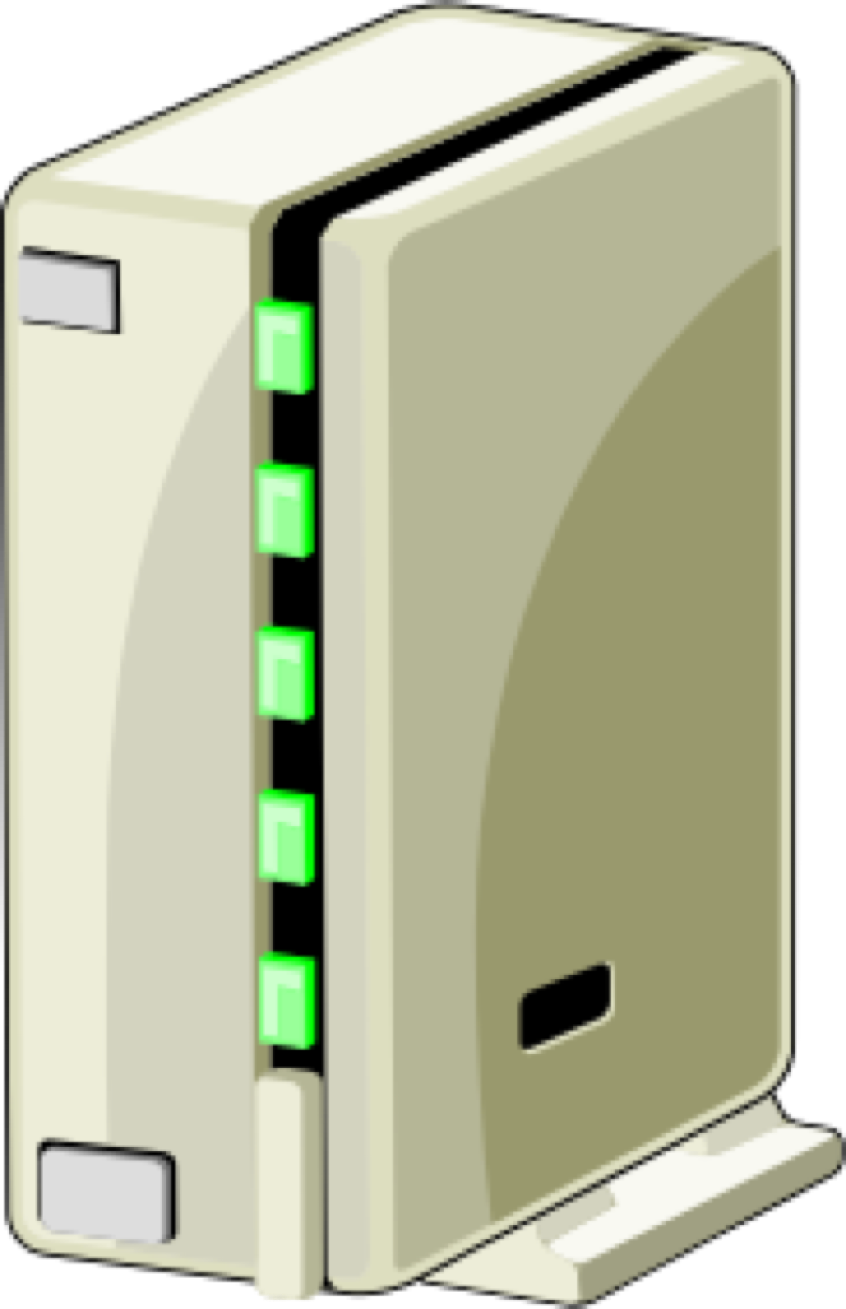
The Example Continued
1
2
3
4
Foo 1
Bar 4
Baz 3
Zoo 6
Yes 12
Too 5
Foo 7
Bar 3
Baz 9
Zoo 1
Yes 17
Too 8
Foo 2
Bar 6
Baz 2
Zoo 2
Yes 10
Too 4
Foo 4
Bar 7
Baz 5
Zoo 9
Yes 3
Too 7
That’s the map stage

Slide 23
On To Reduce
We might have two more nodes assigned to doing the reduce operation
They will each receive a share of data from a map node
The reduce node performs a reduce operation to “combine” the shares
Outputting its own result

Slide 24
Continuing the Example
Foo 1
Bar 4
Baz 3
Zoo 6
Yes 12
Too 5
Foo 7
Bar 3
Baz 9
Zoo 1
Yes 17
Too 8
Foo 2
Bar 6
Baz 2
Zoo 2
Yes 10
Too 4
Foo 4
Bar 7
Baz 5
Zoo 9
Yes 3
Too 7

Slide 25
The Reduce Nodes Do Their Job
Write out the results to files
And MapReduce is done!
Foo 14
Bar 20
Baz 19
Zoo 16
Yes 42
Too 24

Slide 26
But I Wanted A Combined List
No problem
Run another (slightly different) MapReduce on the outputs
Have one reduce node that combines everything

Slide 27
Synchronization in MapReduce
Each map node produces an output file for each reduce node
It is produced atomically
The reduce node can’t work on this data until the whole file is written
Forcing a synchronization point between the map and reduce phases

Slide 28
Remote Procedure Calls
RPC, for short
One way of building a distributed system
Procedure calls are a fundamental paradigm
Primary unit of computation in most languages
Unit of information hiding in most methodologies
Primary level of interface specification
A natural boundary between client and server
Turn procedure calls into message send/receives
A few limitations
No implicit parameters/returns (e.g. so no global variables)
No call-by-reference parameters
Much slower than procedure calls (TANSTAAFL)
Notes:
Procedure call that called may be on a different machine
Nice for interface specification

Slide 29
Remote Procedure Call Concepts
Interface Specification
Methods, parameter types, return types
eXternal Data Representation
Machine independent data-type representations
May have optimizations for like client/server
Client stub
Client-side proxy for a method in the API
Server stub (or skeleton)
Server-side recipient for API invocations
Notes:
eXternal Data Representation may be different from format of machines, but is standardized format which is used and must be converted to and from

Slide 30
RPC Tool Chain
RPC
interface
specification
RPC
generation
tool
External Data
Representation
access functions
server
RPC
skeleton
Client RPC
stubs
client
application
code
server
implementation
code
client
server

Slide 31
Key Features of RPC
Client application links against local procedures
Calls local procedures, gets results
All RPC implementation inside those procedures
Client application does not know about RPC
Does not know about formats of messages
Does not worry about sends, timeouts, resents
Does not know about external data representation
All of this is generated automatically by RPC tools
The key to the tools is the interface specification

Slide 32
RPC Is Not a Complete Solution
Requires client/server binding model
Expects to be given a live connection
Threading model implementation
A single thread service requests one-at-a-time
Numerous one-per-request worker threads
Limited failure handling
Client must arrange for timeout and recovery
Higher level abstractions improve RPC
e.g. Microsoft DCOM, Java RMI, DRb, Pyro

Slide 33
Distributed Synchronization and Consensus
Why is it hard to synchronize distributed systems?
What tools do we use to synchronize them?
How can a group of cooperating nodes agree on something?

Slide 34
What’s Hard About Distributed Synchronization?
Spatial separation
Different processes run on different systems
No shared memory for (atomic instruction) locks
They are controlled by different operating systems
Temporal separation
Can’t “totally order” spatially separated events
Before/simultaneous/after lose their meaning
Independent modes of failure
One partner can die, while others continue

Slide 35
Leases – More Robust Locks
Obtained from resource manager
Gives client exclusive right to update the file
Lease “cookie” must be passed to server on update
Lease can be released at end of critical section
Only valid for a limited period of time
After which the lease cookie expires
Updates with stale cookies are not permitted
After which new leases can be granted
Handles a wide range of failures
Process, client node, server node, network

Slide 36
Lock Breaking and Recovery
Revoking an expired lease is fairly easy
Lease cookie includes a “good until” time
Based on server’s clock
Any operation involving a “stale cookie” fails
This makes it safe to issue a new lease
Old lease-holder can no longer access object
Was object left in a “reasonable” state?
Object must be restored to last “good” state
Roll back to state prior to the aborted lease
Implement all-or-none transactions

Slide 37
Distributed Consensus
Achieving simultaneous, unanimous agreement
Even in the presence of node & network failures
Required: agreement, termination, validity, integrity
Desired: bounded time
Provably impossible in fully general case
But can be done in useful special cases, or if some requirements are relaxed
Consensus algorithms tend to be complex
And may take a long time to converge
They tend to be used sparingly
E.g., use consensus to elect a leader
Who makes all subsequent decisions by fiat

Slide 38
Typical Consensus Algorithm
Each interested member broadcasts his nomination.
All parties evaluate the received proposals according to a fixed and well known rule.
After allowing a reasonable time for proposals, each voter acknowledges the best proposal it has seen.
If a proposal has a majority of the votes, the proposing member broadcasts a claim that the question has been resolved.
Each party that agrees with the winner’s claim acknowledges the announced resolution.
Election is over when a quorum acknowledges the result.

Slide 39
Security for Distributed Systems
Security is hard in single machines
It’s even harder in distributed systems
Why?

Slide 40
Ensuring Single Machine Security
All key resources are kept inside of the OS
Protected by hardware (mode, memory management)
Processes cannot access them directly
All users are authenticated to the OS
By a trusted agent that is (essentially) part of the OS
All access control decisions are made by the OS
The only way to access resources is through the OS
We trust the OS to ensure privacy and proper sharing

Slide 41
Distributed Security Is Harder
Your OS cannot guarantee privacy and integrity
Network transactions happen outside of the OS
Authentication is harder
All possible agents may not be in local password file
The wire connecting the user to the system is insecure
Eavesdropping, replays, man-in-the-middle attacks
Even with honest partners, hard to coordinate distributed security
The Internet is an open network for all
Many sites on the Internet try to serve all comers
Core Internet makes no judgments on what’s acceptable
Even supposedly private systems may be on Internet

Slide 42
Goals of Network Security
Secure conversations
Privacy: only you and your partner know what is said
Integrity: nobody can tamper with your messages
Positive identification of both parties
Authentication of the identity of message sender
Assurance that a message is not a replay or forgery
Non-repudiation: he cannot claim “I didn't say that”
Availability
The network and other nodes must be reachable when they need to be

Slide 43
Elements of Network Security
Cryptography
Symmetric cryptography for protecting bulk transport of data
Public key cryptography primarily for authentication
Cryptographic hashes to detect message alterations
Digital signatures and public key certificates
Powerful tools to authenticate a message’s sender
Filtering technologies
Firewalls and the like
To keep bad stuff from reaching our machines

Slide 44
Symmetric Encryption
Simple fast algorithms
Encryption and decryption use the same key
Requires sender and receiver to both know the key
If you know who shares the key, you also get authentication
Symmetric encryption provides privacy
In order to decrypt the data, you must know the key
Symmetric encryption provides integrity
In order to generate false messages, you must know the key
Symmetric encryption relies on key secrecy
Challenging to achieve in many circumstances
Large step between theoretical key secrecy and actual key secrecy in real systems

Slide 45
Tamper Detection: Cryptographic Hashes
Check-sums often used to detect data corruption
Add up all bytes in a block, send sum along with data
Recipient adds up all the received bytes
If check-sums agree, the data is probably OK
Check-sum (parity, CRC, ECC) algorithms are weak
Cryptographic hashes are very strong check-sums
Unique –two messages vanishingly unlikely to produce same hash
Particularly hard to find two messages with the same hash
One way – cannot infer original input from output
Well distributed – any change to input changes output

Slide 46
Using Cryptographic Hashes
Start with a message you want to protect
Compute a cryptographic hash for that message
E.g., using the Secure Hash Algorithm 3 (SHA-3)
Transmit the hash securely
Recipient does same computation on received text
If both hash results agree, the message is intact
If not, the message has been corrupted/compromised

Slide 47
Secure Hash Transport
Why must hash be transmitted securely?
Cryptographic hashes aren’t keyed, so anyone can produce them (including a bad guy)
How to transmit hash securely?
Typically encrypt it with symmetric cryptography
Unless secrecy required, cheaper than encrypting entire message
If you have a secure channel, could transmit it that way
But if you have secure channel, why not use it for everything?

Slide 48
Public Key Cryptography
Uses two keys instead of one
A secret key known only to the owner encrypts
The public key known to everyone (potentially) decrypts
Or you can reverse the keys and operations
With different effects
The two keys are related by mathematical properties
But must be hard to derive from each other

Slide 49
Practical Use of PK
Public key cryptography algorithms are computationally expensive
10x to 100x as expensive as symmetric ones
We use PK only when we can’t use symmetric cryptography
When is that?
Typically to communicate to someone we don’t share a symmetric key with
We can share a new symmetric key using PK (session key)
Not very expensive, since the symmetric key is small

Slide 50
A Principle of Key Use
Both symmetric and PK cryptography rely on a secret key for their properties
The more you use one key, the less secure
The key stays around in various places longer
There are more opportunities for an attacker to get it
There is more incentive for attacker to get it
Brute force attacks may eventually succeed
Therefore:
Use a given key as little as possible
Change them often
Within the limits of practicality and required performance

Slide 51
Putting It Together: Secure Socket Layer (SSL)
A general solution for securing network communication
Built on top of existing socket IPC
Establishes secure link between two parties
Privacy – nobody can snoop on conversation
Integrity – nobody can generate fake messages
Certificate-based authentication of server
Typically, but not necessarily
Client knows what server he is talking to
Optional certificate-based authentication of client
If server requires authentication and non-repudiation
PK used to distribute a symmetric session key
New key for each new socket
Rest of data transport switches to symmetric crypto
Giving safety of public key and efficiency of symmetric

Slide 52
Digital Signatures
message
message
cryptographic
hash
insecure
transmission
cryptographic
hash
asymmetric
encryption
asymmetric
encryption
compare
digital
signature
private
key
public
key

Slide 53
Digital Signatures
Encrypting a message with private key signs it
Only you could have encrypted it, it must be from you
It has not been tampered with since you wrote it
Encrypting everything with your private key is a bad idea
Asymmetric encryption is extremely slow
If you only care about integrity, you don’t need to encrypt it all
Compute a cryptographic hash of your message
Encrypt the cryptographic hash with your private key
Faster than encrypting whole message

Slide 54
Signed Load Modules
How do we know we can trust a program?
Is it really the new update to Windows, or actually evil code that will screw me?
Digital signatures can answer this question
Designate a certification authority
Perhaps the OS manufacturer (Microsoft, Apple, ...)
They verify the reliability of the software
By code review, by testing, etc.
They sign a certified module with their private key
We can verify signature with their public key
Proves the module was certified by them
Proves the module has not been tampered with

Slide 55
An Important Public Key Issue
If I have a public key
I can authenticate received messages
I know they were sent by the owner of the private key
But how can I be sure who that person is?
How do I know that this is really my bank's public key?
Could some swindler have sent me his key instead?
I can get Microsoft’s public key when I first buy their OS
So I can verify their load modules and updates
But how to handle the more general case?
I would like a certificate of authenticity
Guaranteeing who the real owner of a public key is

Slide 56
What Is a PK Certificate?
Essentially a data structure
Containing an identity and a matching public key
And perhaps other information
Also containing a digital signature of those items
Signature usually signed by someone I trust
And whose public key I already have

Slide 57
Using Public Key Certificates
If I know public key of the authority who signed it
I can validate the signature is correct
I can tell the certificate has not been tampered with
If I trust the authority who signed the certificate
I can trust they authenticated the certificate owner
E.g., we trust drivers licenses and passports
But first I must know and trust signing authority
Which really means I know and trust their public key

Slide 58
A Chicken and Egg Problem
I can learn the public key of a new partner using his certificate
But to use his certificate, I need the public key of whoever signed it
So how do I get that public key?
Ultimately, out of band
Which means through some other means
Commonly by having the key in a trusted program, like a web browser
Or hand delivered (as in project 4)

Slide 59
Conclusion
Distributed systems offer us much greater power than one machine can provide
They do so at costs of complexity and security risk
We handle the complexity by using distributed systems in a few carefully defined ways
We handle the security risk by proper use of cryptography and other tools

