Slide 1

By: Dr. Nur Syazana Rashidi
ENGINEERING MATHEMATICS 2
Lecture 2
TOPIC : FIRST ORDER DIFFERENTIAL EQUATION
(SEPARABLE EQUATION)
Notes:
As we’ll see after this , different types of differential equations might require different technique. Actually to solve this first order DE, there are 4 methods that we should know for this course which are separable, homogeneous, linear & exact equation.
So today. We will start with separable differential equation.
Which is The simplest form of differential equation to solve.
And we will see in a also why it is called a separable equation.

Slide 2
2.1 : SEPARABLE EQUATIONS
The differential equation ;
y’ = f(x,y)
is said to be separable if the equation can be written as the product of a function of x, u(x) and a function of y,v(y) i.e.
y’ = u(x)v(y)
Notes:
A first-order differential equation is said to be separable if, after solving it for the derivative, dy/dx = F(x, y) , the right-hand side can then be factored as “a formula of just x ” times “a formula of just y ‘, F(x, y) = u(x)v(y).
A first-order differential equation is said to be separable if, after solving it for the derivative,
dy/dx = F(x, y) ,
the right-hand side can then be factored as “a formula of just x ” times “a formula of just y ”,
F(x, y) = u(x)v(y) .
If this factoring is not possible, the equation is not separable.
More concisely, a first-order differential equation is separable if and only if it can be written
as
dy/dx = u(x)v(y) where u and v are known functions.

Slide 3
Solution of Separable Equations
The equation y’ = u(x)v(y) can be written in the form ;
Then, we integrate on both sides of the eqution:
where A is constant
Notes:
We saw that this is a separable equation
If we simply try to integrate both sides with respect to y on left side
And x on the right

Slide 4
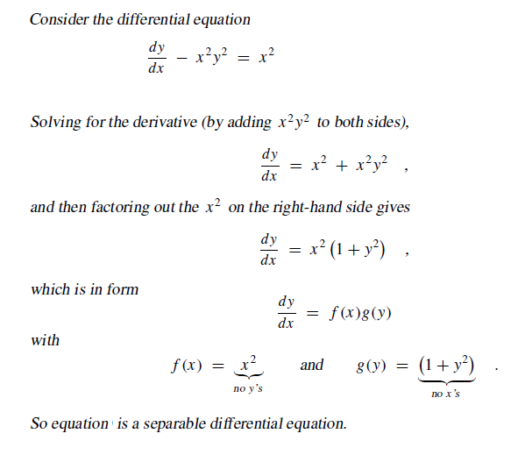
DETERMINE THE SEPARABLE VARIABLE

Slide 5
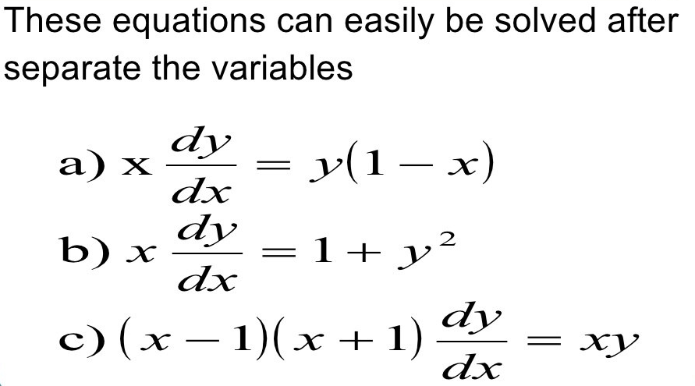
Example of DE with separable variable

Slide 6
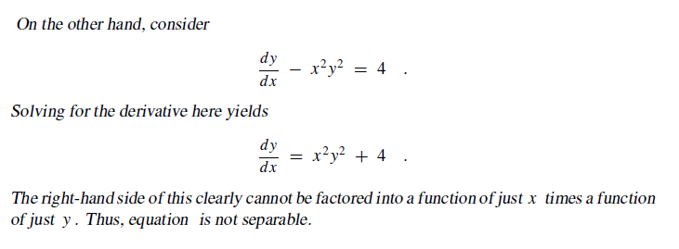
DETERMINE THE NON-SEPARABLE VARIABLE

Slide 7
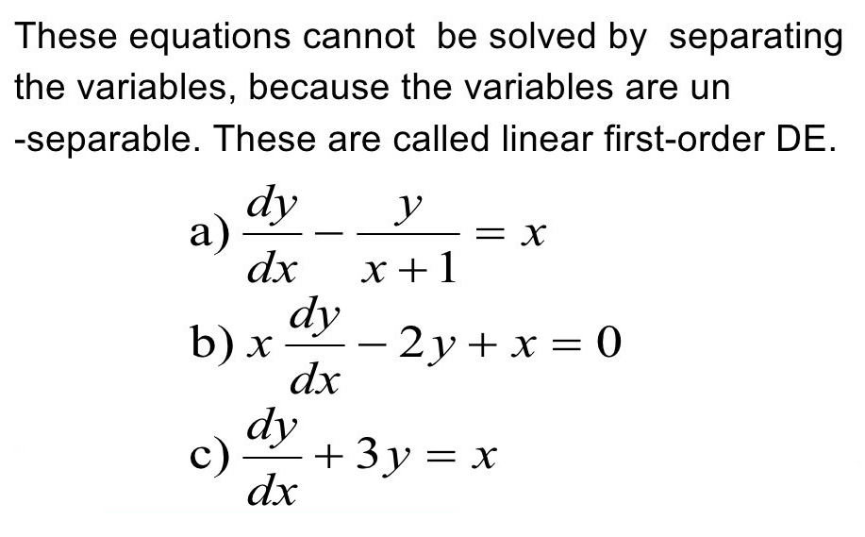
Example of DE with non-separable variable

Slide 8




Example of Solving DE with separable variable
Notes:
2) In example before (with same question) we saw that this is a separable equation, and can be written as
3)If we simply try to integrate both sides with respect to x , the right-hand side would become
4) Unfortunately, the y here is really y(x) , some unknown formula of x ; so this equation is just
the integral of some unknown function of x —something we cannot effectively evaluate. To
eliminate the y’s on the right-hand side, we could, before attempting the integration, divide
through by 1 + y2 , obtaining

Slide 9


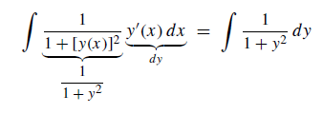
Cont…
Notes:
1)The right-hand side can now be integrated with respect to x . What about the left-hand side?
The integral of that with respect to x is
2) After all, dy/dx is not a fraction; it denotes the derivative y′(x) where y(x) is some unknown formula of x .
But y is also shorthand for that same unknown formula y(x) . So this integral is more precisely written as
3) Fortunately, this is just the right form for applying the generic substitution y = y(x) to
convert the integral with respect to x to an integral with respect to y . No matter what y(x) might be, we know

Slide 10
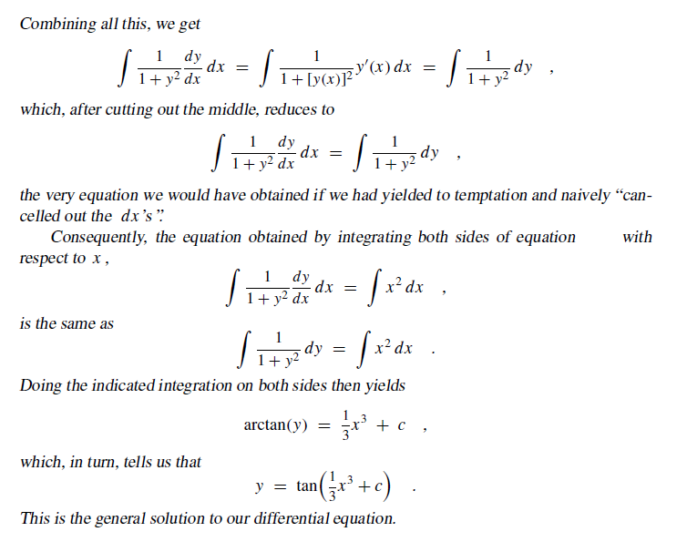
Cont…

Slide 11
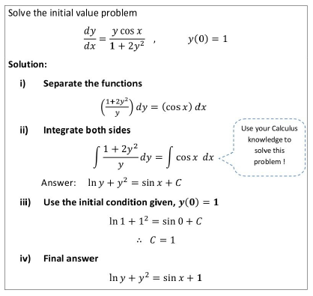
Example
Notes:
-So first we need to do is separate the variables
-Next is integrate it
-Using the IVP substitute into equation after integrating to get C (constant value)
-The answer is the answer after integrating plus value of constant which is 1

Slide 12
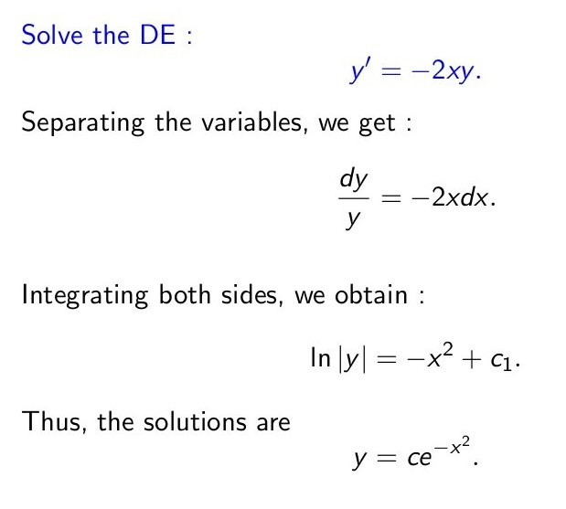
Example
Notes:
-This can be written as dy/dx = -2xy
-Now in this problem what we need to do is separate the variables
-On one side we only want to have y variables and on the other side of the equation we only want to have x variables
-So since we have a fraction separated by an equal sign lets cross multiply
-one over y dy times y and the other side it’s going to be 2x multiply by dx now that we’ve separated the variables we can integrate both sides
-And anti-derivative of 1 over y is ln y and anti-derivative of -2x is -2x squared divided by 2 and become negative x squared.
-The final answer is y=ce power of –x squared

Slide 13
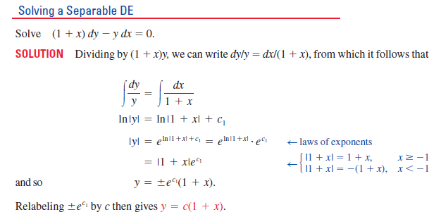
Example
Notes:
-This can be written as dy/dx = -2xy
-Now in this problem what we need to do is separate the variables
-On one side we only want to have y variables and on the other side of the equation we only want to have x variables
-So since we have a fraction separated by an equal sign lets cross multiply
-one over y dy times y and the other side it’s going to be 1/1+x multiply by dx
-Now that we’ve separated the variables and we can continue to integrate both sides
-So the anti derivative of……and antiderivative of……………

Slide 14
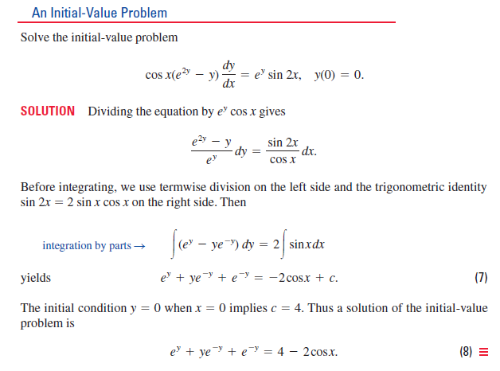
Example
Notes:
-Now in this problem what we need to do is separate the variables
-On one side we only want to have y variables and on the other side of the equation we only want to have x variables
-Now that we’ve separated the variables and we can continue to integrate both sides
-So the anti derivative of……and antiderivative of……………
-We can solve the ye-y by substitution integration (that will learn in Math 1)

Slide 15
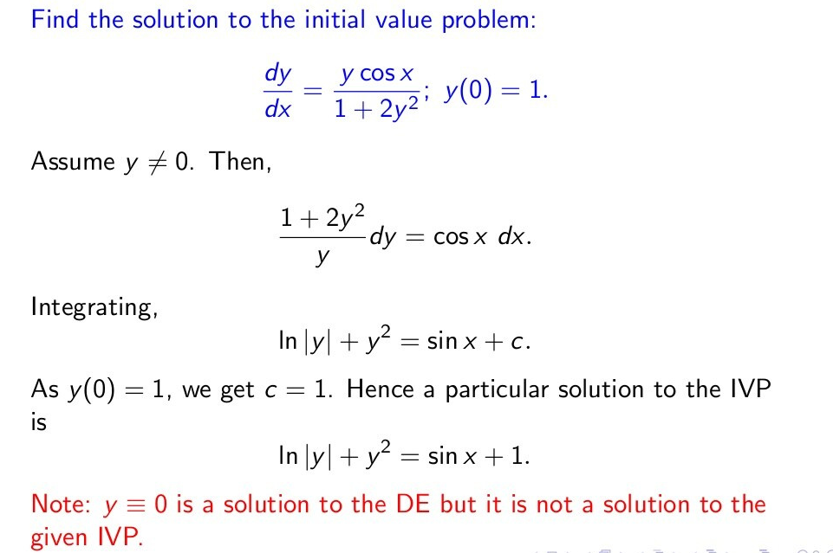
Example
Notes:
-Now in this problem of separate the variables which given the initial value problem
-On one side we only want to have y variables and on the other side of the equation we only want to have x variables
-Now that we’ve separated the variables and we can continue to integrate both sides

Slide 16
THANK YOU

