Slide 1

By: Dr. Nur Syazana Rashidi
ENGINEERING MATHEMATICS 2
Lecture 3
TOPIC : FIRST ORDER DIFFERENTIAL EQUATION
(HOMOGENEOUS EQUATION)

Slide 2
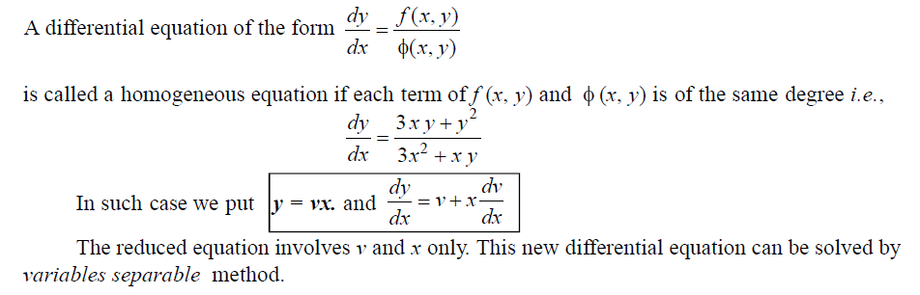
2.2 : HOMOGENEOUS EQUATIONS
Notes:
A differential equation of the form f(x,y)dy = g(x,y)dx is said to be homogeneous differential equation if the degree of f(x,y) and g(x, y) is same. A function of form F(x,y) which can be written in the form k^{n} F(x,y) is said to be a homogeneous function of degree n, for k≠0.

Slide 3

HOMOGENEOUS EQUATIONS
A first order Differential Equation is Homogeneous when it can be in this form:

Slide 4
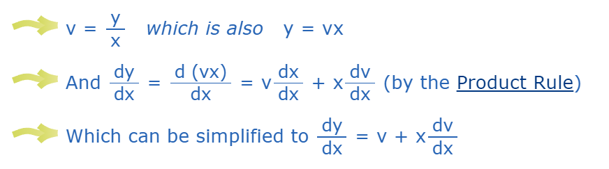
HOMOGENEOUS EQUATIONS
We can solve it using Separation of Variables but first we create a new variable v =y/x
Notes:
Using y = vx and dydx = v + xdvdx we can solve the Differential Equation.
Step1: Put y=vx so that dy/dx= v+x dv/dx
Step 2: Separate the variables.
Step 3: Integrate both the sides
Step 4: Put v=y/x and simply.

Slide 5
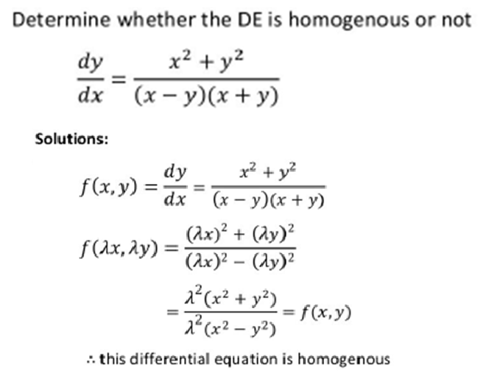
DETERMINE HOMOGENEOUS EQUATIONS
Notes:
In order to become homogeneous equation DE, the equation should have the same degree.
For example in this question..

Slide 6
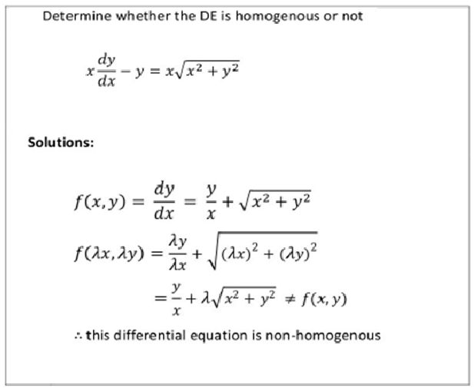
DETERMINE NON-HOMOGENEOUS EQUATIONS

Slide 7
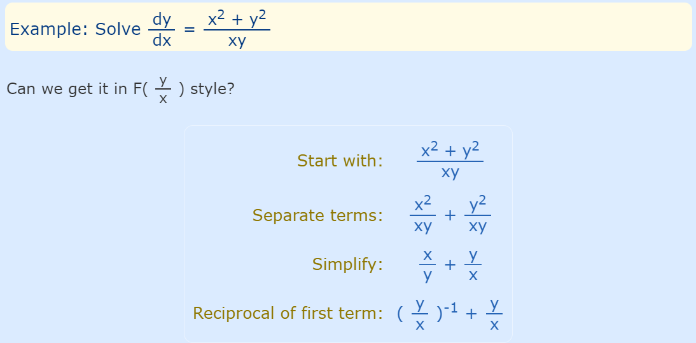
Example 1

Slide 8
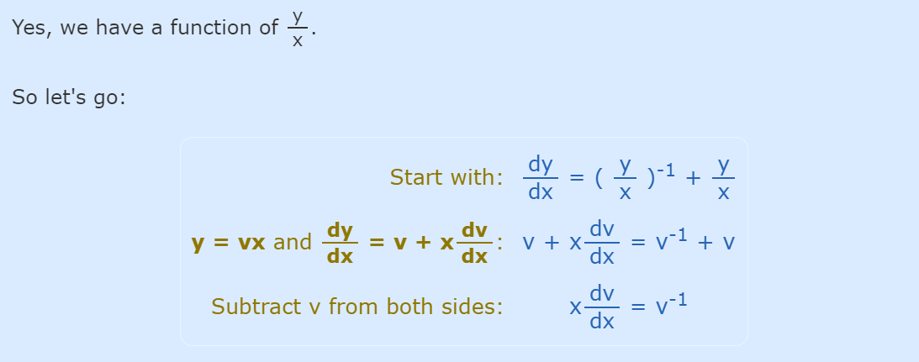
…Cont
Notes:
Substitute v=y/x

Slide 9
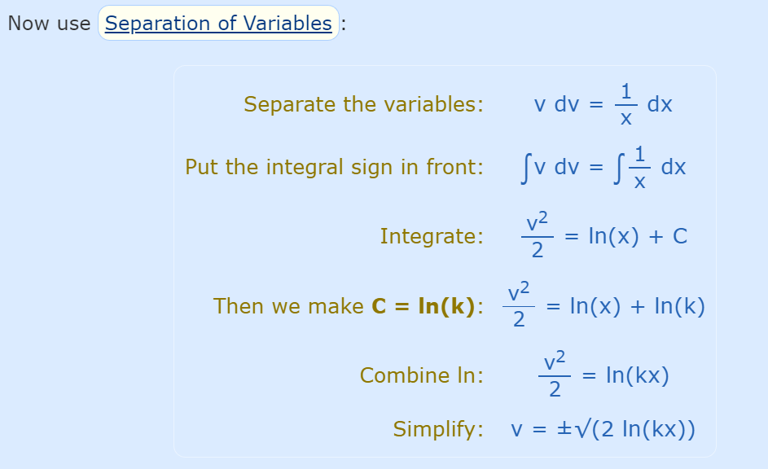
…Cont

Slide 10
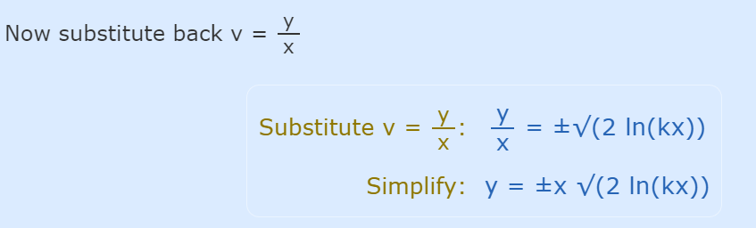
…Cont

Slide 11
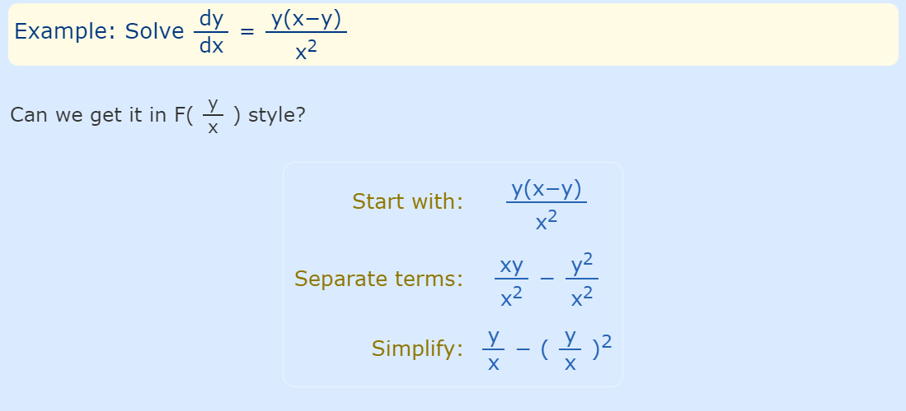
Example 2

Slide 12
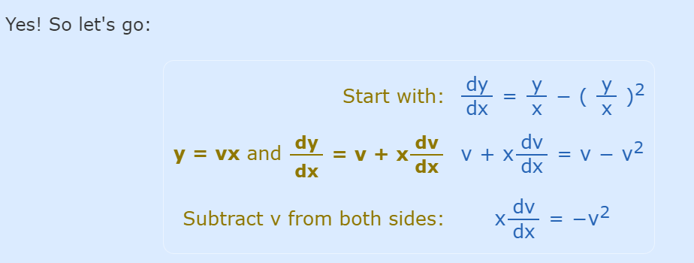
…Cont

Slide 13
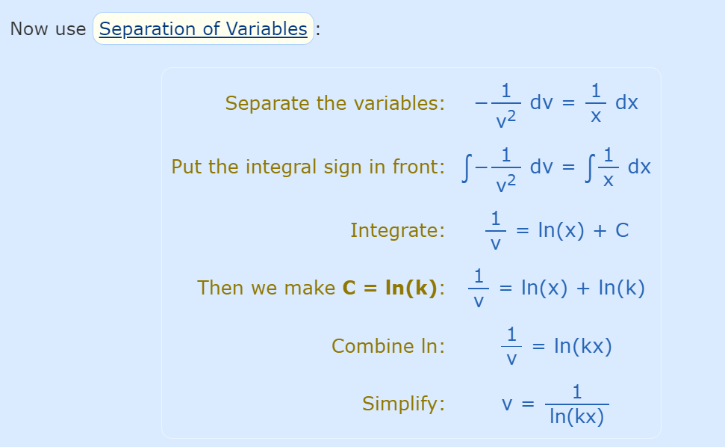
…Cont

Slide 14
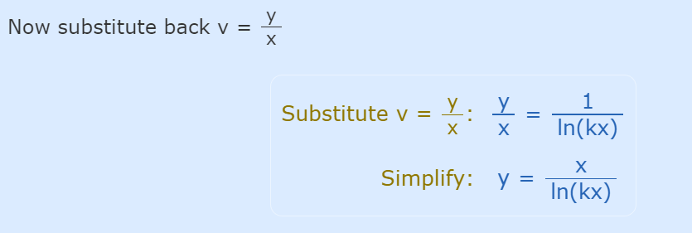
…Cont

Slide 15
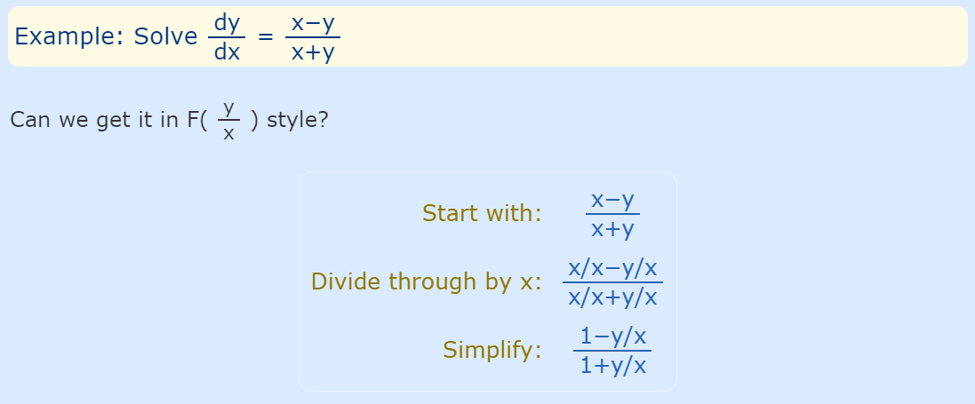
Example 3

Slide 16
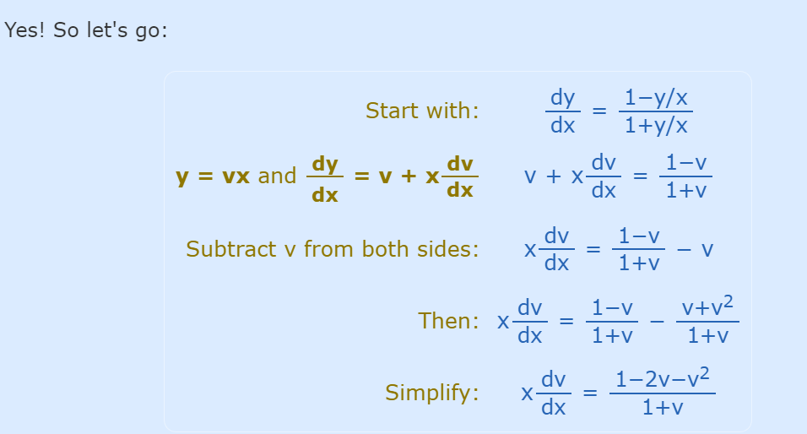
…Cont

Slide 17
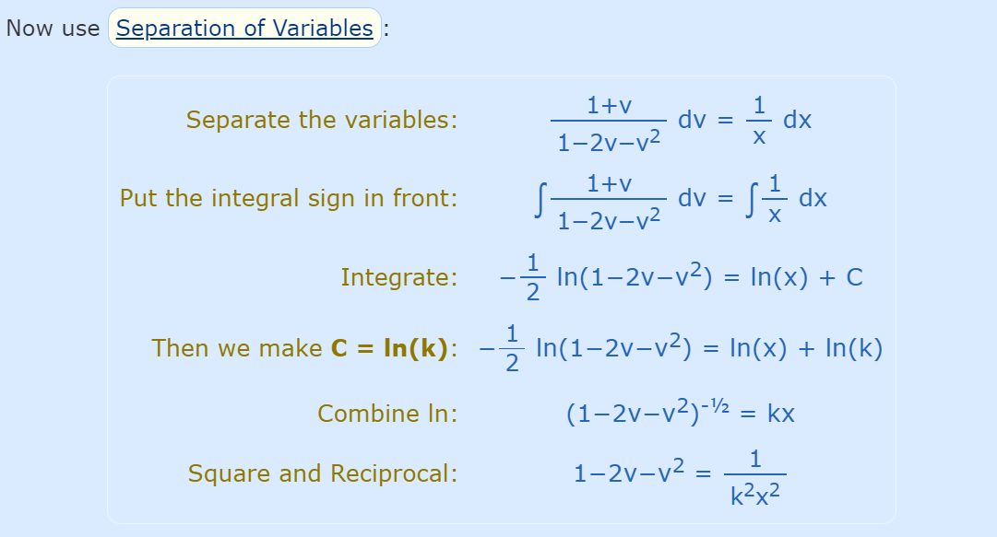
…Cont

Slide 18
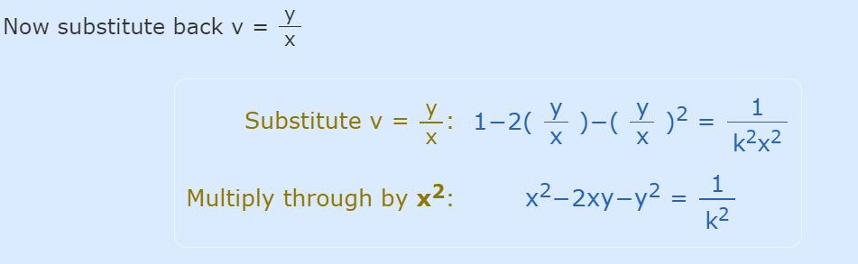
…Cont

Slide 19
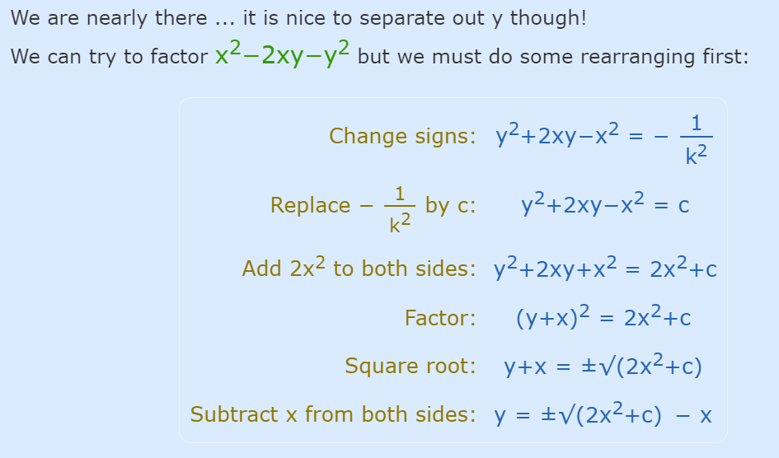
…Cont

Slide 20
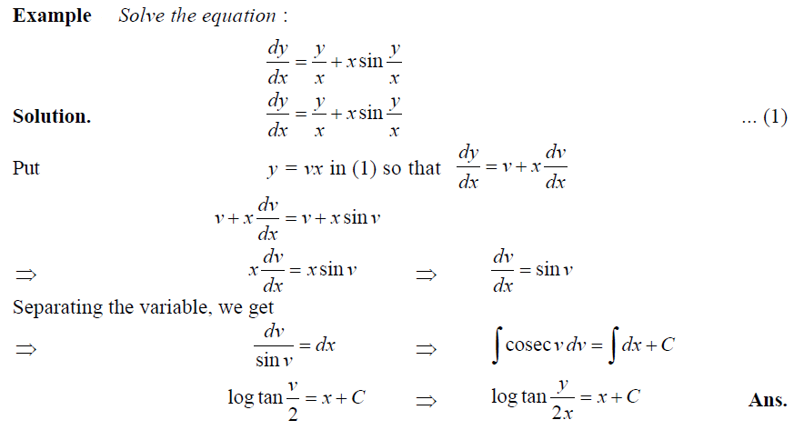
Example

Slide 21
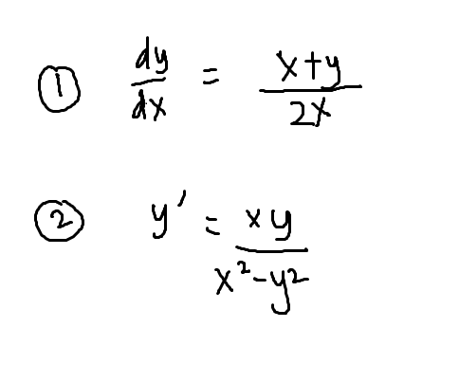
QUIZ
Solve the homogeneous differential equation

Slide 22
THANK YOU

