Slide 1

CHAPTER 1: MICROPRECESSOR-BASED SYSTEMS
By the end of this topic, you should be able to:
Understand System Block Diagram, Microprocessor Operation, Hardware/Software Requirements.
Know Evolution of Microprocessors, Special Gates for Microcomputer, Octal Buffer and Octal Bus Transceiver.

Slide 2
Introduction
At the heart of the modern computer is the microprocessor—also commonly called the central processing unit (CPU)—a tiny, square sliver of silicon that’s etched with a microscopic network of gates and channels through which electricity flows.
This network of gates (transistors) and channels (wires or lines) is a very small version of the kind of circuitry that we’ve all seen when cracking open a television remote or an old radio.
In short, the microprocessor isn’t just the “heart” of a modern computer—it’s a computer in and of itself.

Slide 3
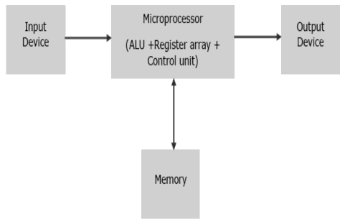
System Block Diagram of a Basic Microcomputer
The microprocessor follows a sequence: Fetch, Decode, and then Execute.
Initially, the instructions are stored in the memory in a sequential order.
The microprocessor fetches those instructions from the memory, then decodes it and executes those instructions till STOP instruction is reached.
Later, it sends the result in binary to the output port.
Between these processes, the register stores the temporarily data and ALU performs the computing functions.

Slide 4
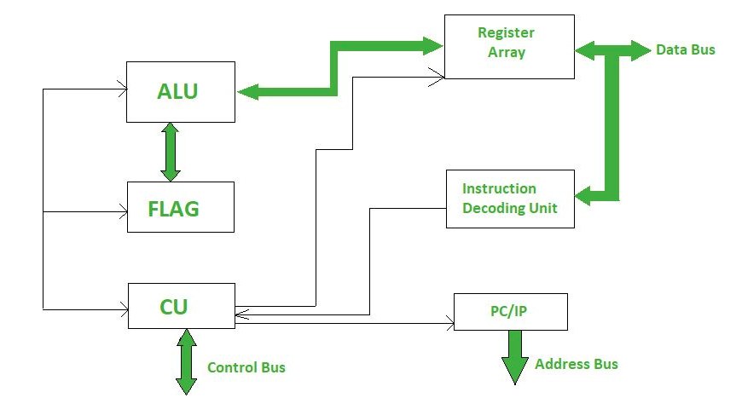
Microprocessor Operation
A Microprocessor takes a bunch of instructions in machine language and executes them, telling the processor what it has to do.
Microprocessor performs three basic things while executing the instruction:
It performs some basic operations like addition, subtraction, multiplication, division and some logical operations using its Arithmetic and Logical Unit (ALU). New Microprocessors also perform operations on floating point numbers also.
Data in Microprocessor can move from one location to another.
It has a Program Counter (PC) register that stores the address of next instruction based on the value of PC, Microprocessor jumps from one location to another and takes decision.
A typical Microprocessor structure looks like this.

Slide 5
Hardware/Software Requirements
Each computer system consists of hardware, system software and application software.
The interface between hardware and software is mainly given by a set of machine instructions including the interrupt- as well as the I/O-functions
Complex Instruction Set Computer (CISC):
CISC or Complex Instruction Set Computer is a computer architecture where instructions are such that a single instruction can execute multiple low level operations like loading from memory, storing into memory or an arithmetic operation etc.
It has multiple addressing nodes within single instruction.
CISC makes use of very few registers.
Example: Intel 386, Intel 486, Pentium, Motorola 68000 and etc.
Reduced Instruction Set Computer (RISC):
RISC or Reduced Instruction Set Computer is a computer architecture where instruction are simple and designed to get executed quickly.
Instructions get completed in one clock cycle this is because of the optimization of instructions and pipelining (a technique that allows for simultaneous execution of parts, or stages, of instructions to more efficiently process instructions).
RISC makes use of multiple registers to avoid large interactions with memory. It has few addressing nodes.

Slide 6
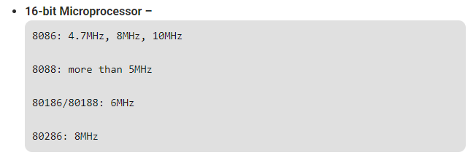
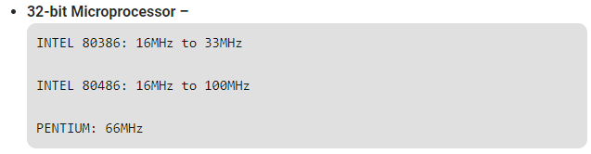
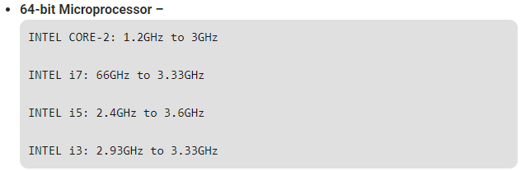
Evolution of Microprocessors

Slide 7
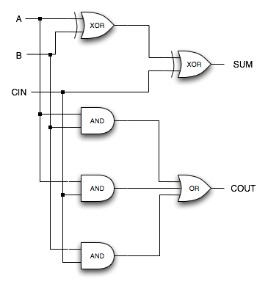
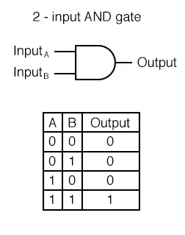
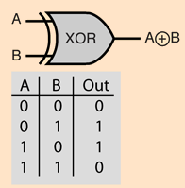
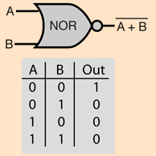
Special Gates for Microcomputer
The fundamental building blocks of any microprocessor are gates. Gates are collections of transistors that electrically mimic a particular logic function.
For example, a 2-input AND gate will take two input signals and output a 1 only if the two inputs are both 1s.
An XOR gate will output a 1 only if the two inputs are different. A NOR gate will output a 1 only if all inputs are 0s.
Combinations of these gates are used to implement everything in a microprocessor, including functional units like adders, multipliers, etc.

Slide 8
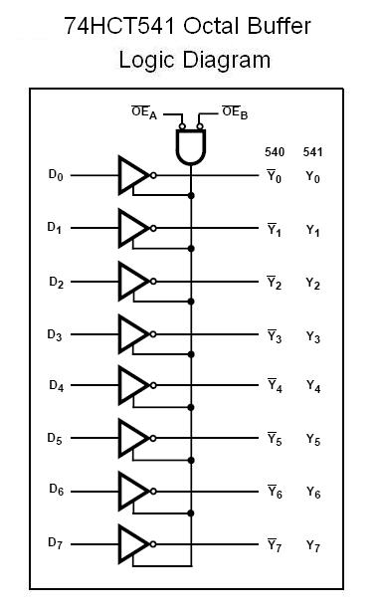
Octal Buffer
An octal buffer or line driver designed specifically to improve both the performance and density of 3-state memory address drivers, clock drivers, and bus-oriented receivers and transmitters.
The device can be used as two 4-bit buffers or one 8-bit buffer, with active-low output-enable (OE) inputs.
Buffer: a temporary memory area in which data is stored while it is being processed or transferred, especially one used while streaming video or downloading audio.

Slide 9
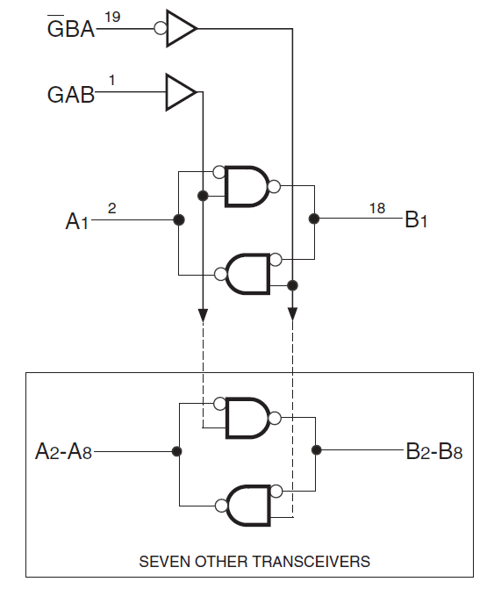
Octal Bus Transceiver
It is used to buffer and drive the data lines in a high-speed microprocessor system.
It is a transceiver so it can provide two-way communication.
The higher the speed, the more power is required to provide the switching currents.

Slide 10
THANK YOU

