Slide 1


Lesson 4: Introduction to Flutter
TMA3084 - Software Engineering Laboratory
Lab Demo: Mr. Raynold Anak Kabai
Lecturer: Madam Nurfauza Binti Jali

Slide 2








Table of contents
00 OVERVIEW
01 Flutter Basics
02 Flutter SDK
03 Android Studio
About Flutter and the framework layers
Install and configure, Mac, iOS from Windows
What it is, prerequisites, installation, tips
04 First Project
05 Physical Phone
06 Debug Mode
New project, run it, virtual device
Run on Android phone and iPhone
Emulator debugging with breakpoints
07 Widgets
08 GitHub & CI/CD
09 Lab Exercise 2.2
Widgets, MaterialApp, Material 3
Team repository, branches, pull requests
Creating a simple Flutter app

Slide 3


What is Flutter?
01 UNDERSTANDING FLUTTER
About Flutter
Before Flutter
With Flutter
Google's SDK for creating beautiful and fast apps from a single codebase
Builds high-performance apps for iOS, Android, and Web with one set of code
iOS apps: Objective-C or Swift (Xcode)
Android apps: Java or Kotlin
Separate teams for iOS and Android
Multiple languages to learn for both platforms
Write once, run anywhere (Android and iOS)
Publish on Google Play and the Apple Store
Saves time, cost, and effort
Works with existing code, free and open source
Beautiful, fast, modern apps

Slide 4
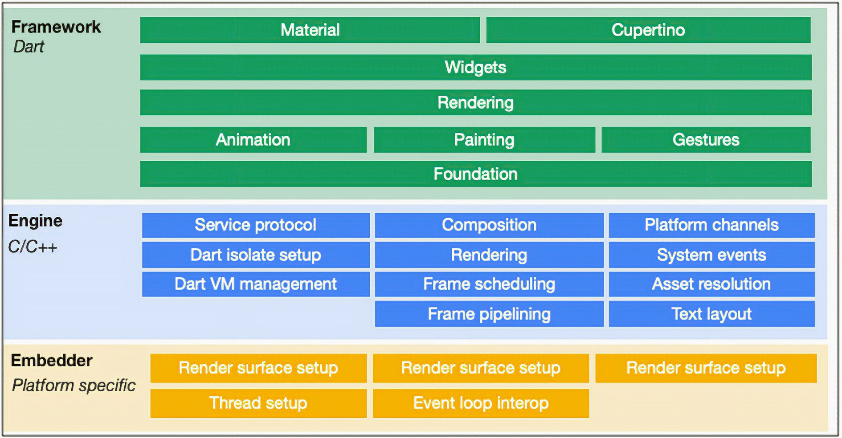
Layers of the Flutter framework
01 FLUTTER FRAMEWORK
Each layer is built upon the one below it. Together they create beautiful, fast, and flexible apps.
1
Framework Layer
Widgets, rendering, and animation libraries
2
Engine Layer
Written in C++: graphics rendering (Skia), text layout, low-level APIs
3
Embedder Layer
Integrates Flutter into iOS, Android, Web, or Desktop

Slide 5
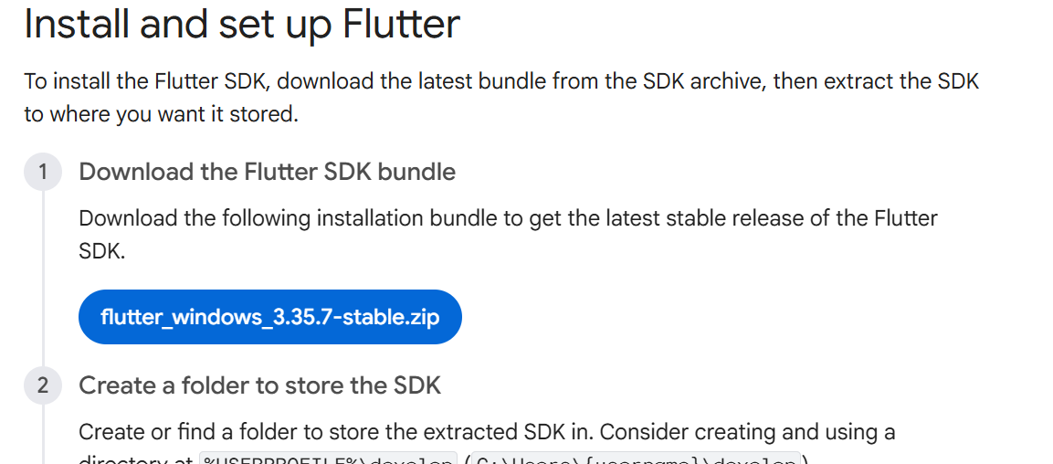
Installing and configuring the Flutter SDK
02 FLUTTER SDK
3.13+
3.0+
Flutter version
Dart version
1
Download the Flutter SDK bundle
2
Extract it to a folder without spaces
docs.flutter.dev/install/manual
3
Add flutter/bin to your PATH
4
Run flutter doctor and fix every red item
flutter --version
flutter doctor

Slide 6

Installing Flutter on Mac
02 FLUTTER SDK
1
Download the macOS Flutter SDK (Apple silicon or Intel) and extract it
Terminal
export PATH="$PATH:$HOME/dev/flutter/bin"
sudo xcodebuild -runFirstLaunch
sudo gem install cocoapods
flutter doctor
2
Add flutter/bin to your PATH
3
Install Xcode from the App Store and complete its first launch
Goal
flutter doctor shows green ticks for Flutter, Xcode, and CocoaPods
4
Install CocoaPods for iOS plugins
5
Run flutter doctor and fix every red item

Slide 7


Testing on an iPhone with Windows OS
02 FLUTTER SDK
Windows PC
GitHub
macOS runner
TestFlight
iPhone
Write and test Dart code
Push a branch and open a pull request
A cloud Mac builds the iOS app
Apple delivers the build
Install and test the app
What you need
While you wait for the build
A Mac to compile iOS: your own, a remote Mac, or a cloud CI runner
An iPhone and an Apple ID
Apple Developer Program membership for TestFlight
Run the same Dart code on the Android emulator or Chrome
Check the layout on small phone widths
Push often so CI builds every pull request

Slide 8



What is Android Studio?
03 ANDROID STUDIO
Software prerequisites
64-bit OS
8 GB RAM
Windows, macOS, or Linux
Minimum; 16 GB recommended
The official Integrated Development Environment (IDE) for Android app development
8 GB disk
1280 x 800
Based on IntelliJ IDEA
Includes the Android emulator and SDK manager
Runs the Flutter and Dart plugins
Free space minimum
Minimum screen resolution
Install the Flutter SDK first, then add the Flutter and Dart plugins

Slide 9
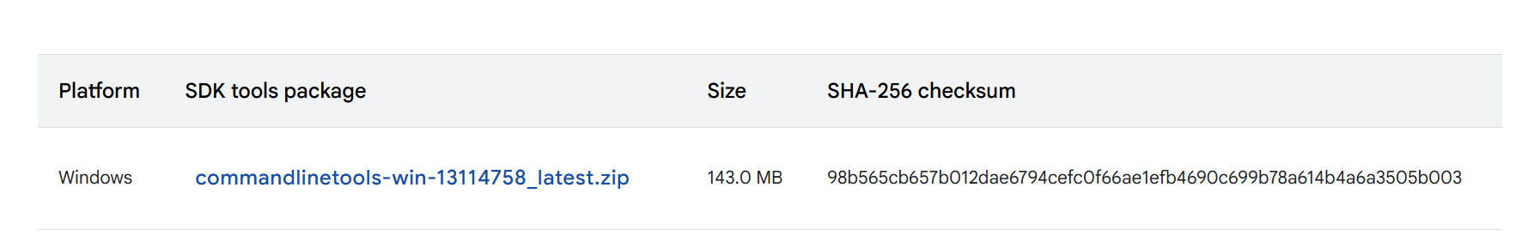

Installing Android Studio
03 ANDROID STUDIO
Download the installer from the official page
developer.android.com/studio
Download
Run the installer
Follow the setup wizard

Slide 10
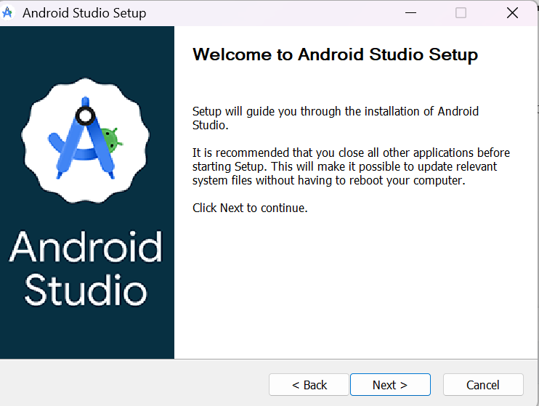
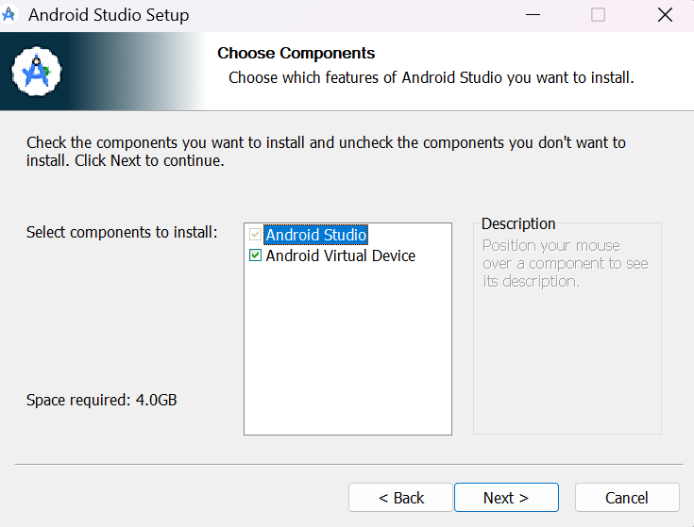
Setup wizard: welcome and components
03 ANDROID STUDIO
1
Welcome to Android Studio Setup
2
Choose components to install

Slide 11
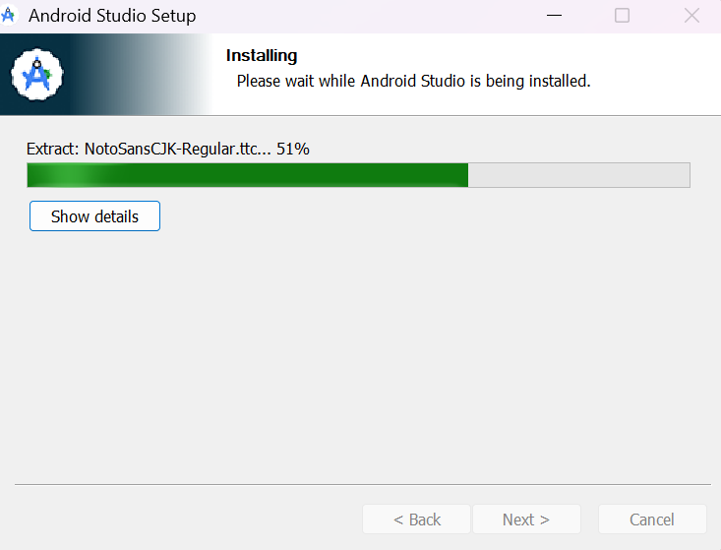
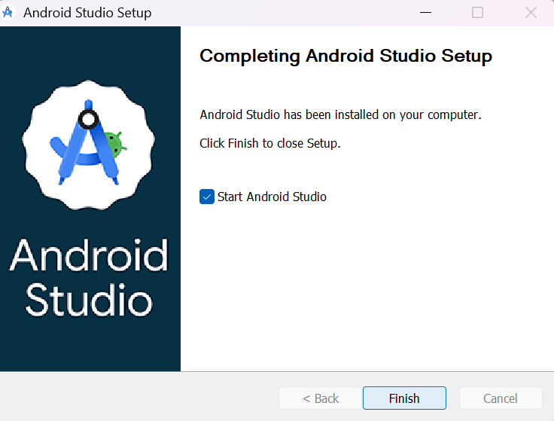
Setup wizard: install and finish
03 ANDROID STUDIO
3
Wait for the installation to finish
4
Click Finish and start Android Studio

Slide 12
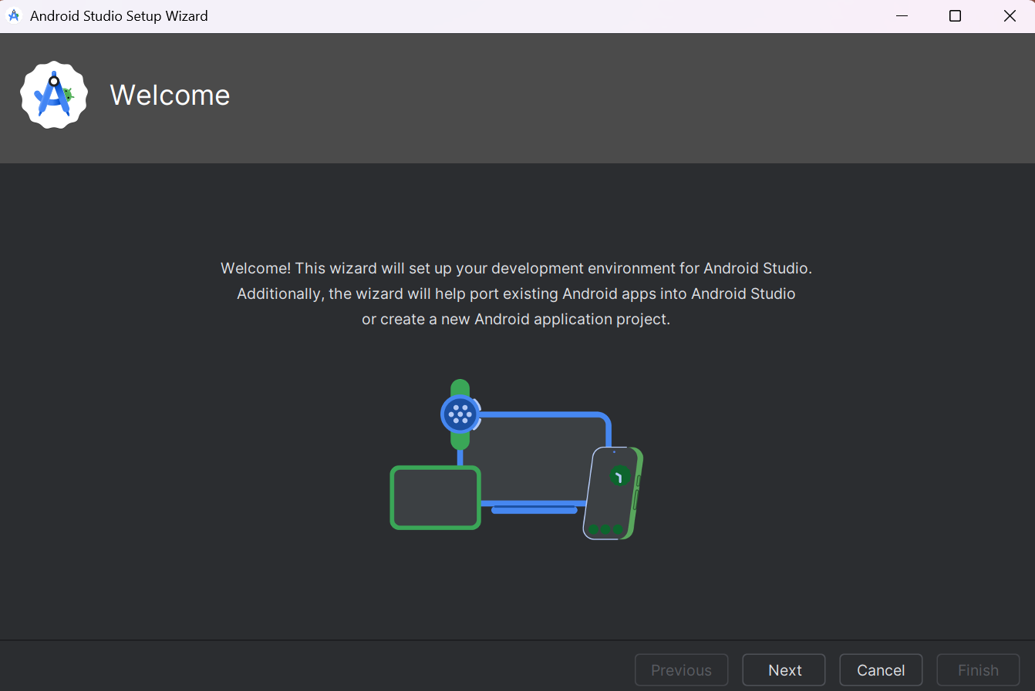
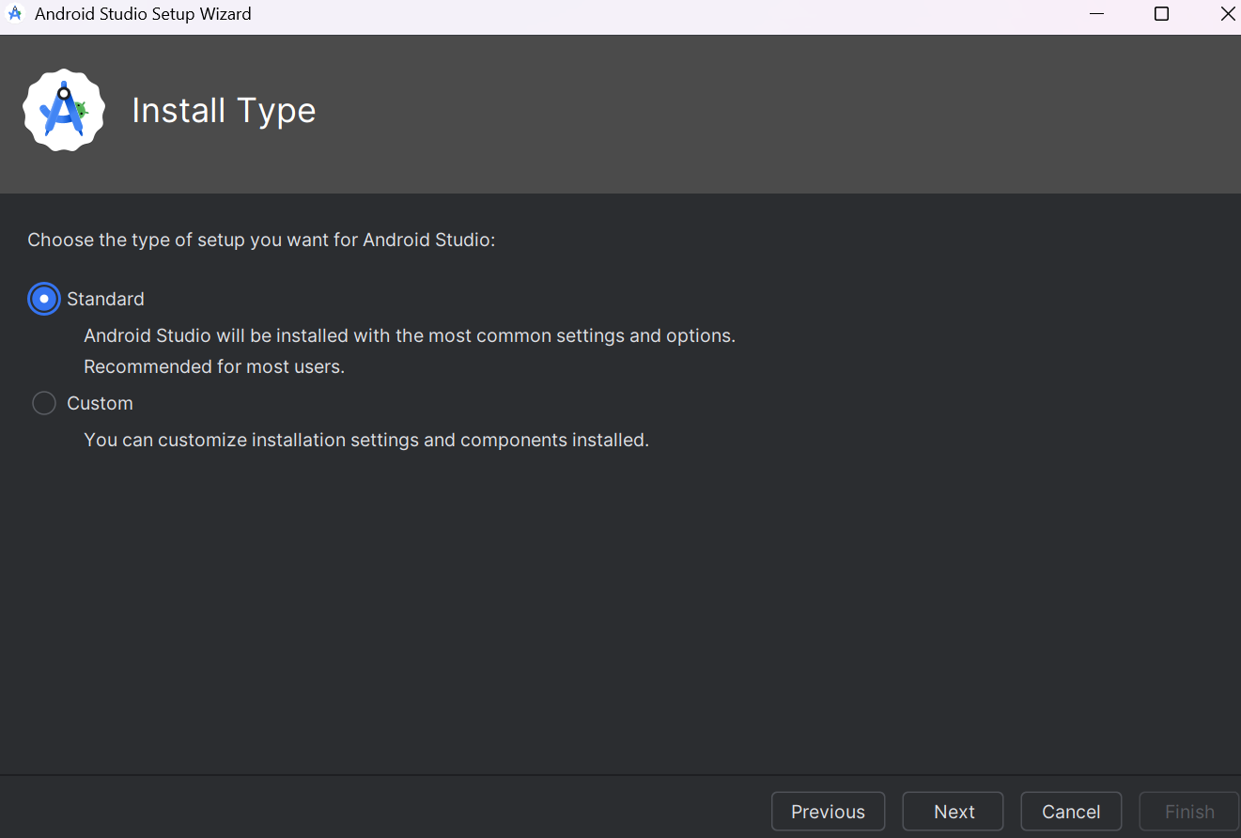
First-run wizard: welcome and install type
03 ANDROID STUDIO
5
Welcome screen
6
Choose the Standard install type

Slide 13
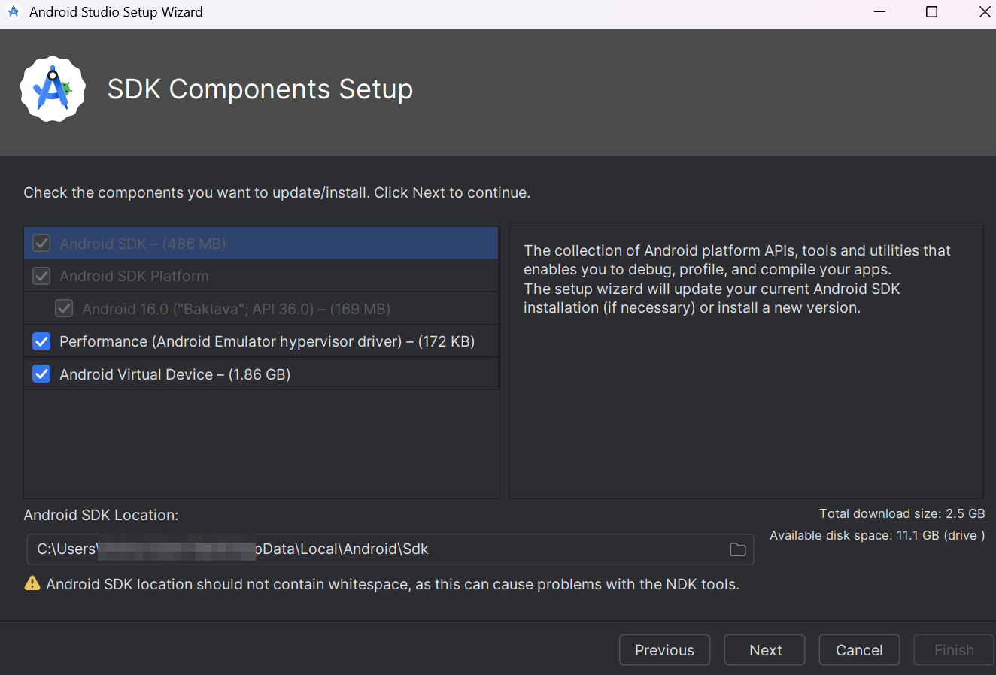
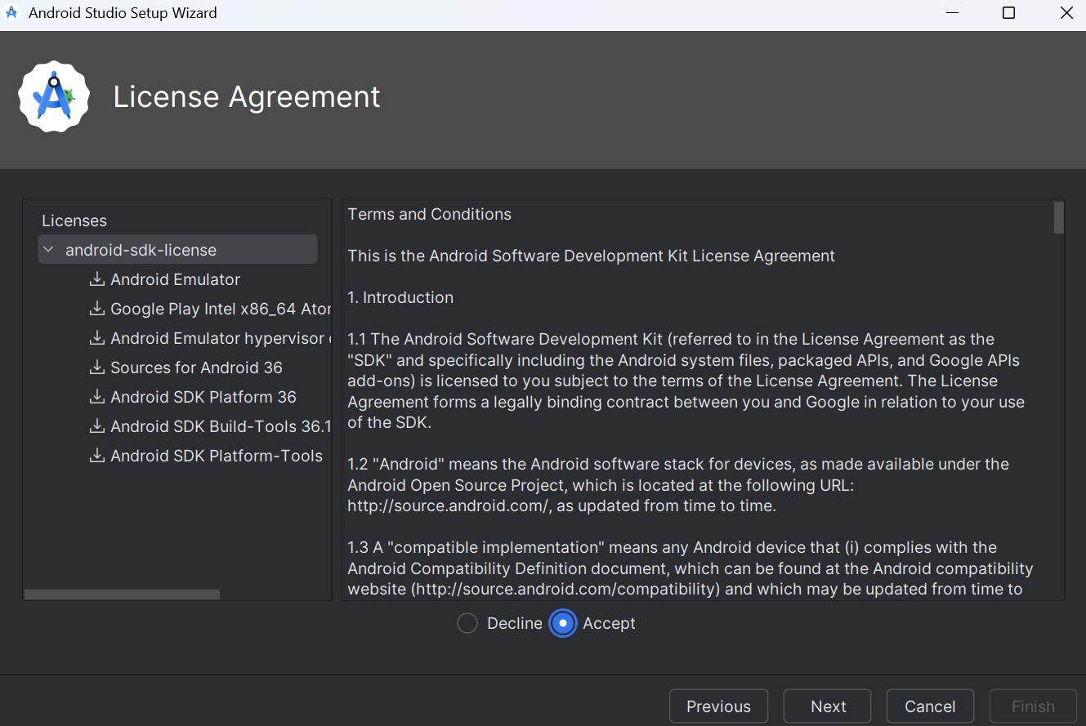
First-run wizard: SDK and licences
03 ANDROID STUDIO
7
SDK components setup
8
Accept the licence agreement

Slide 14
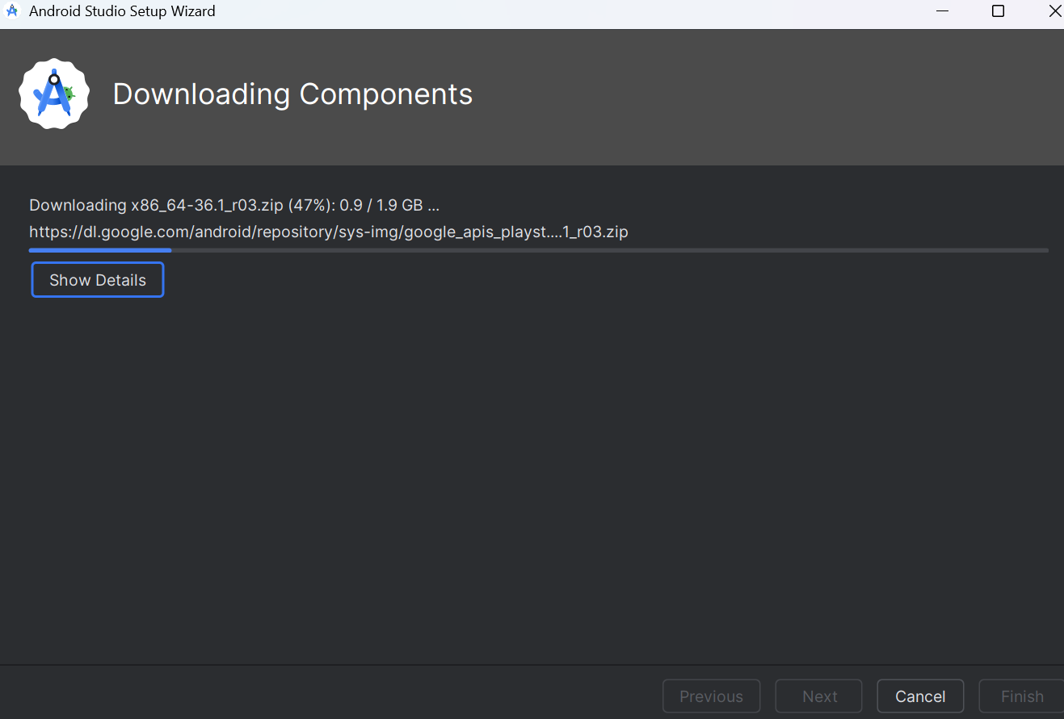
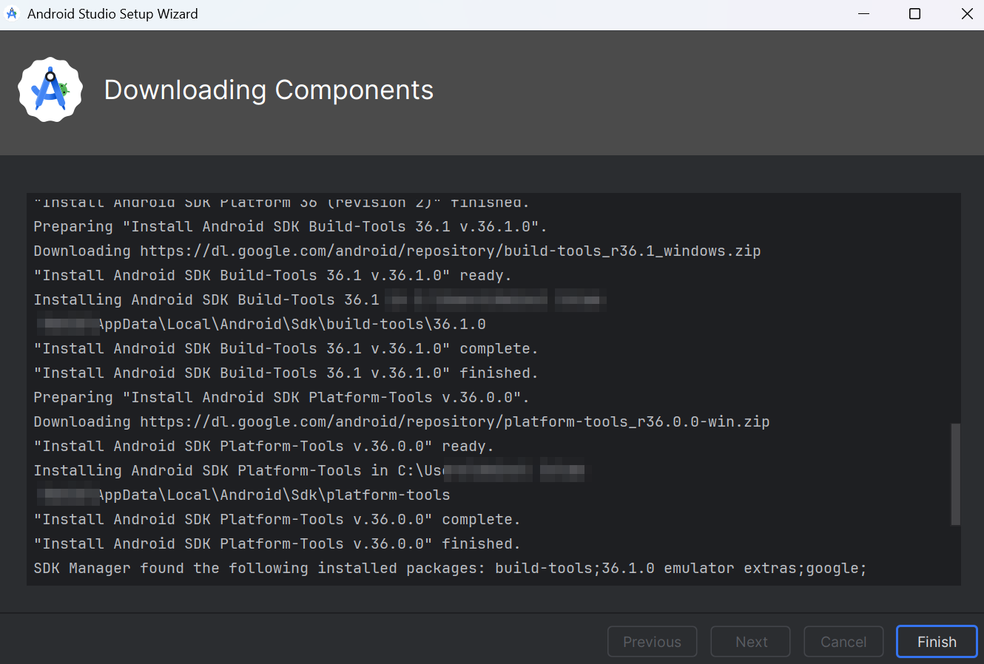
First-run wizard: downloads
03 ANDROID STUDIO
9
Components start downloading
10
Wait for the log to finish, then click Finish

Slide 15







Android Studio sugar and spice
03 ANDROID STUDIO
Hot Reload
Hot Restart
Run
Quick Fix
Ctrl + \
Ctrl + Shift + \
Shift + F10
Alt + Enter
Update the UI and keep the app state
Restart the app with fresh state
Launch on the selected device
Fix errors and wrap widgets
Reformat Code
Search Everywhere
Flutter Inspector
Dart DevTools
Ctrl + Alt + L
Shift twice
Tool window
Tool window
Clean up Dart formatting
Find files, classes, and actions
Explore the live widget tree
Profile performance and memory

Slide 16
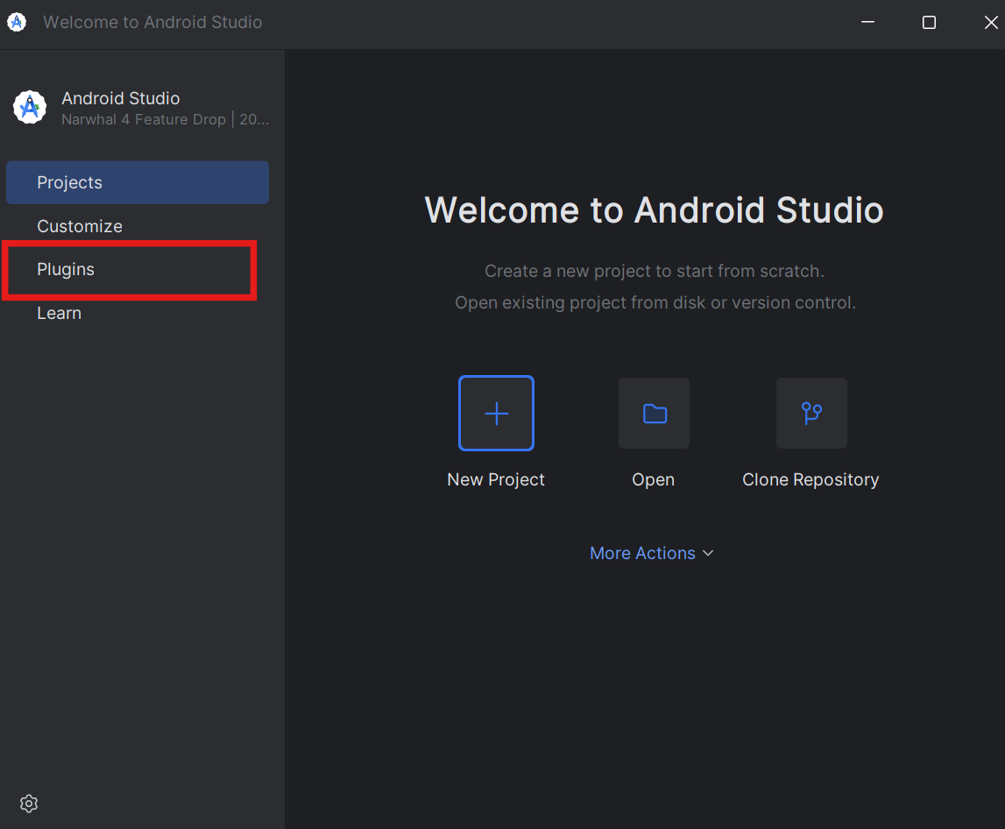
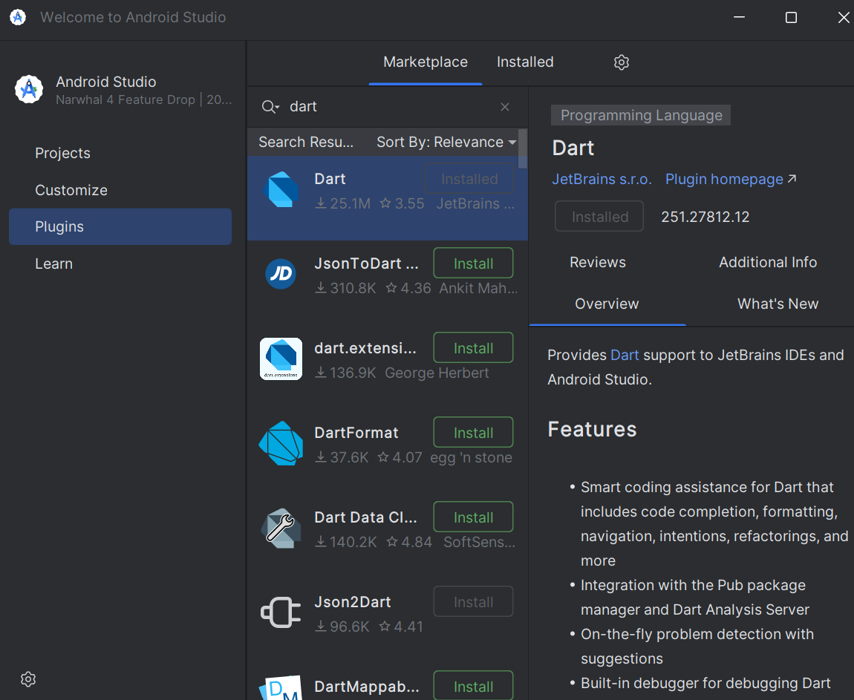
Install the Dart plugin
04 FIRST PROJECT
1
Open Android Studio and select Plugins
2
Search for Dart and install it

Slide 17
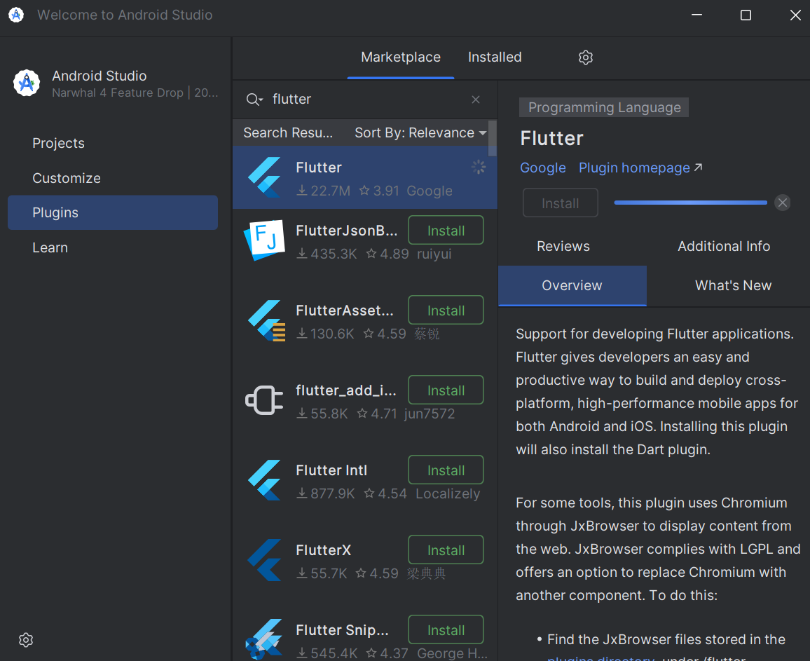
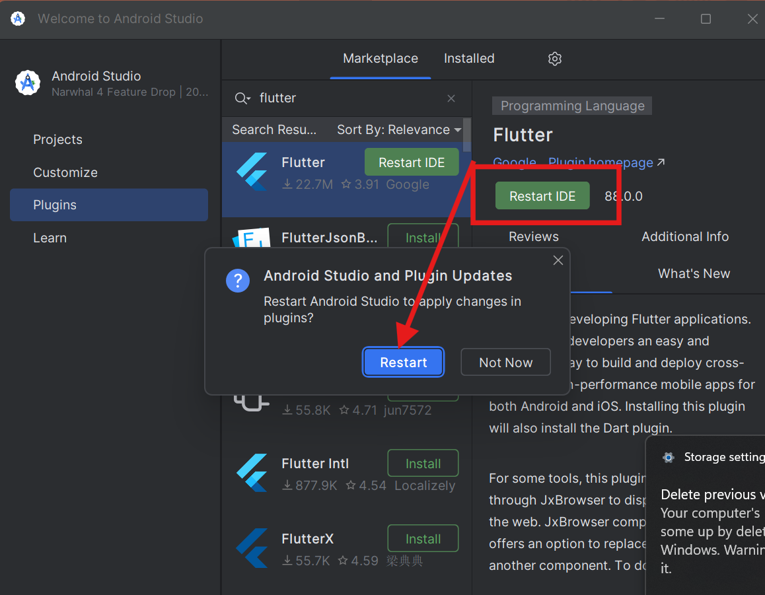
Install the Flutter plugin
04 FIRST PROJECT
3
Search for Flutter and install it
4
Click Restart IDE

Slide 18
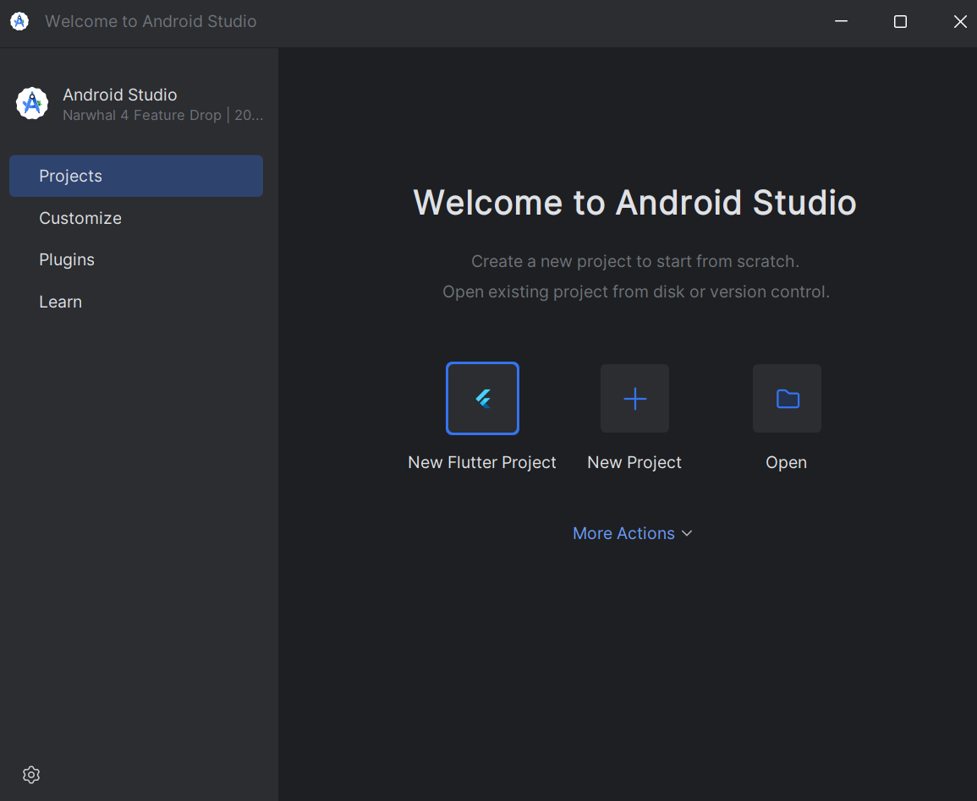
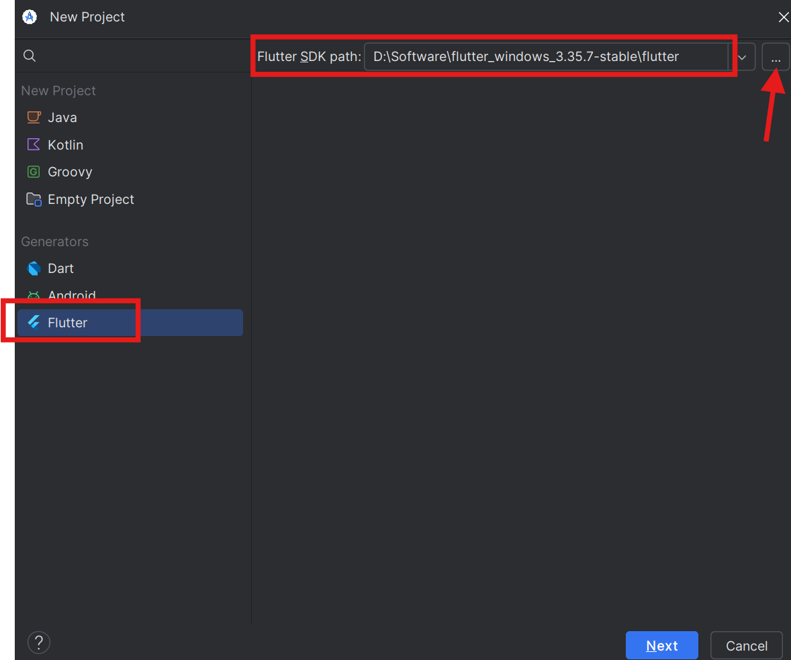
Creating a new Flutter project
04 FIRST PROJECT
1
Select New Flutter Project
2
Choose Flutter and set the SDK path

Slide 19
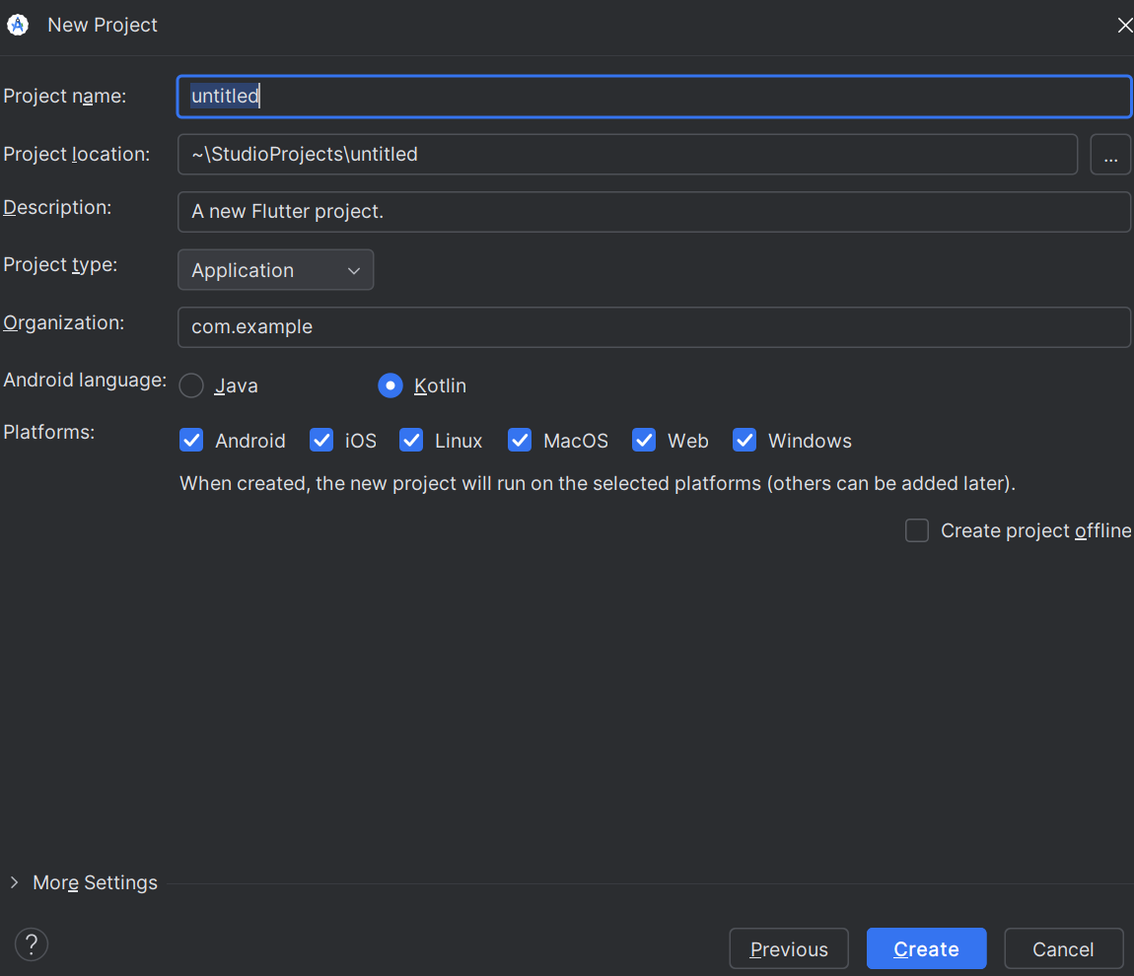

Project overview
04 FIRST PROJECT
Project name
A valid Dart package name, such as untitled
Organization
A reverse-domain name, such as com.example
Platforms
Android, iOS, Web, Linux, macOS, Windows
Package name
com.example.untitled

Slide 20
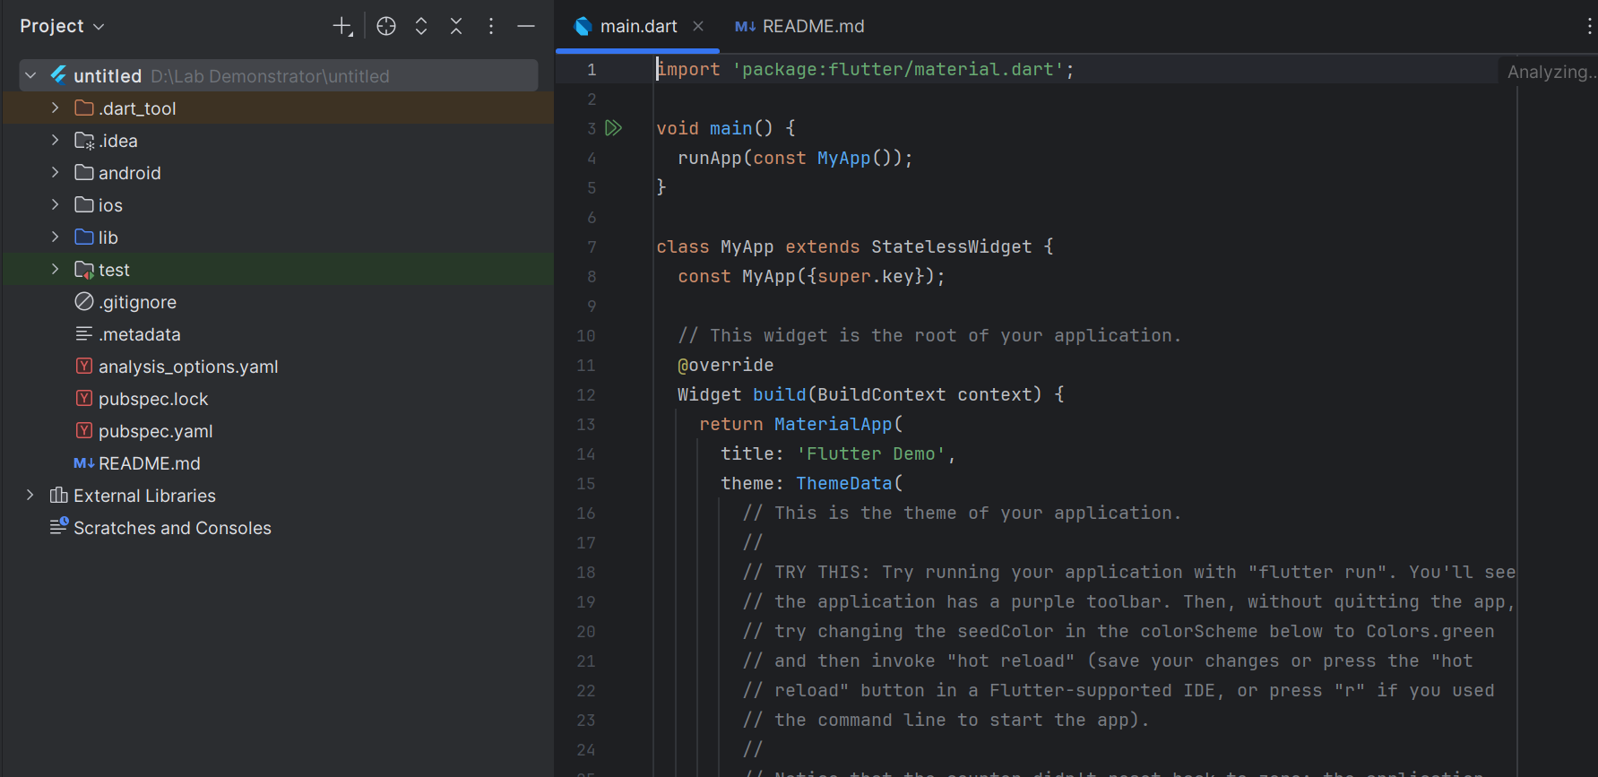
Project setup done
04 FIRST PROJECT

Slide 21
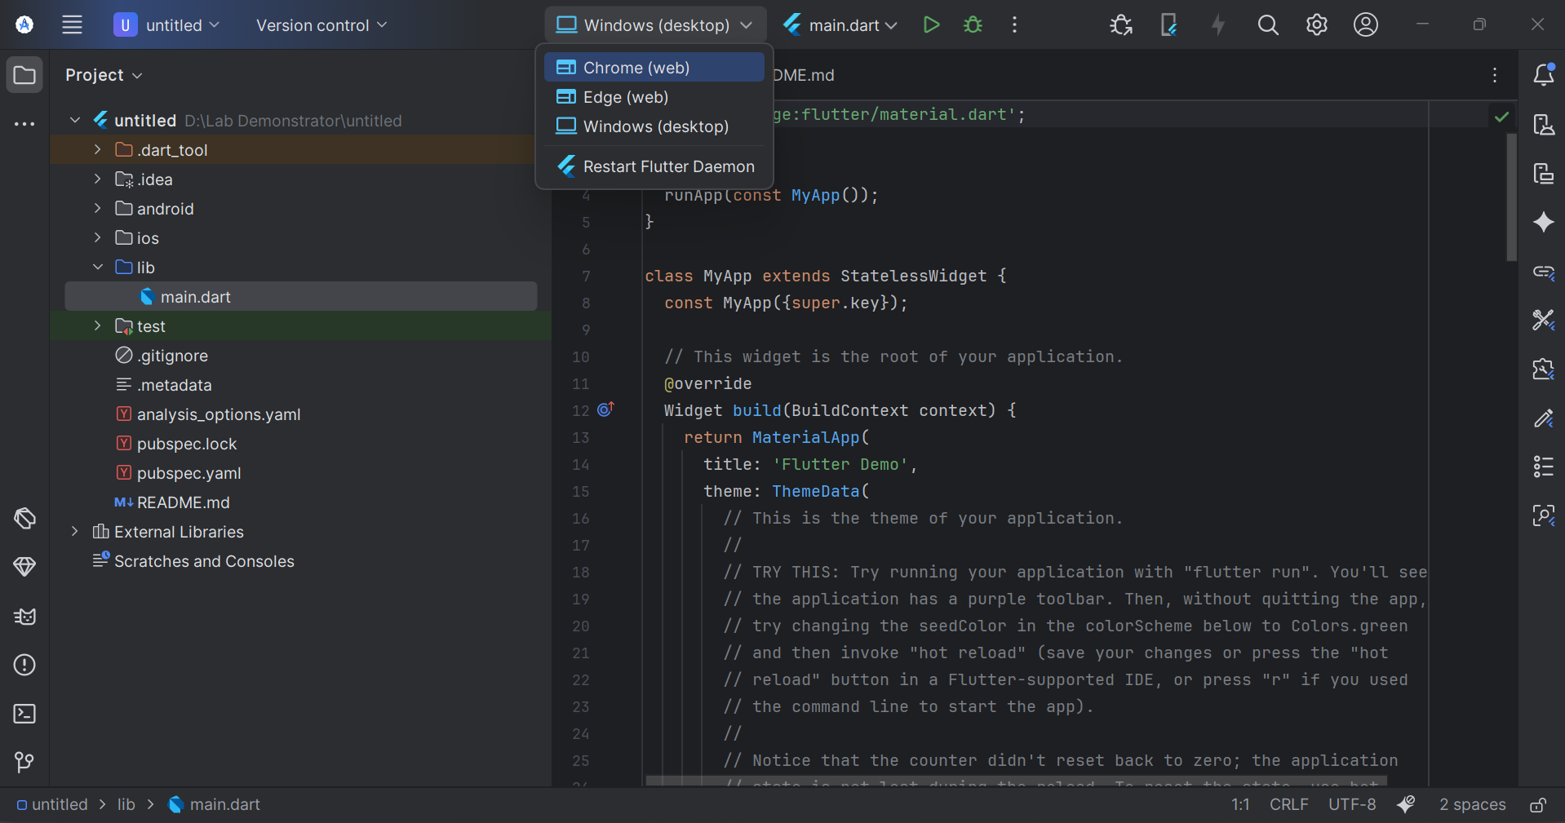
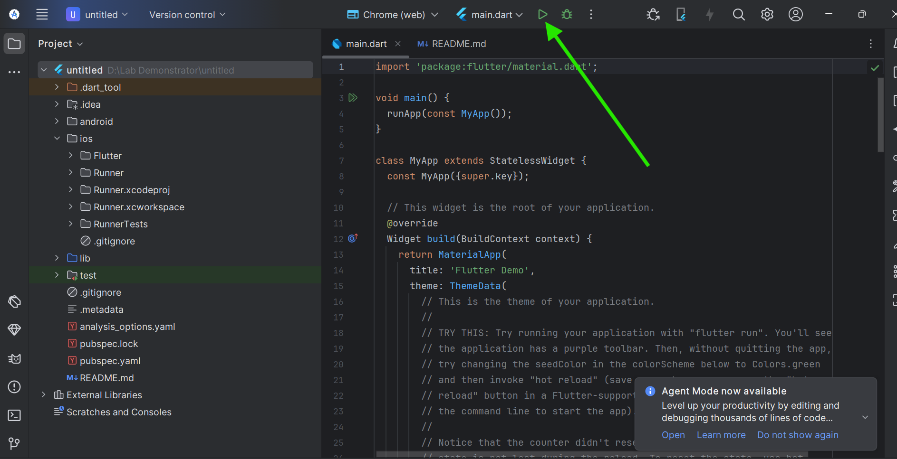
Run a Flutter app
04 FIRST PROJECT
1
Choose a run target, such as Chrome (web)
2
Click Run

Slide 22
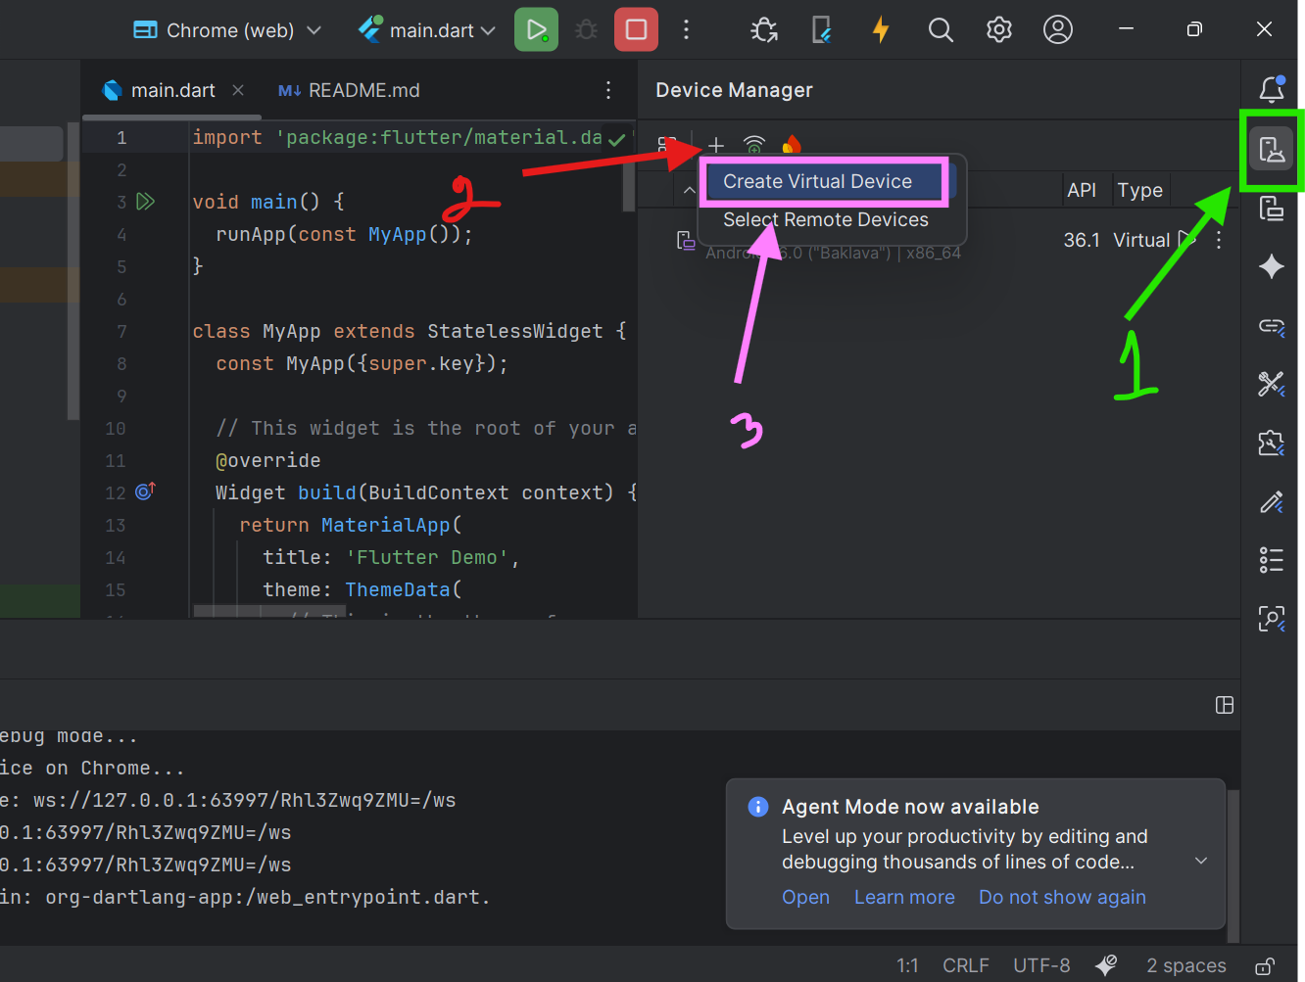
Set up an Android Virtual Device
04 FIRST PROJECT
1
Click Device Manager
2
Click the Plus icon
3
Click Create Virtual Device
4
Select your device and download it

Slide 23

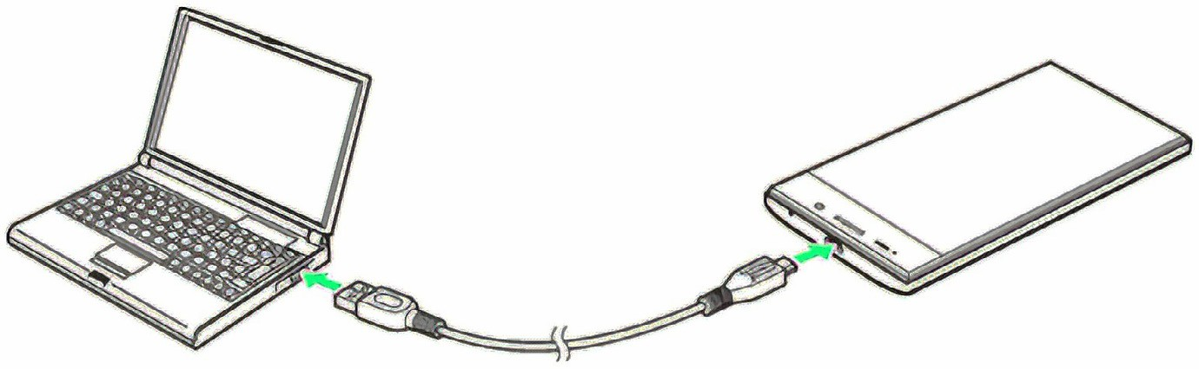
Why use a physical device?
05 PHYSICAL PHONE
Check the UI and workflow before release
Test on real Android and iPhone devices before publishing to the app stores
Lower RAM and CPU load than an emulator on your computer
Emulators struggle on computers with limited hardware

Slide 24
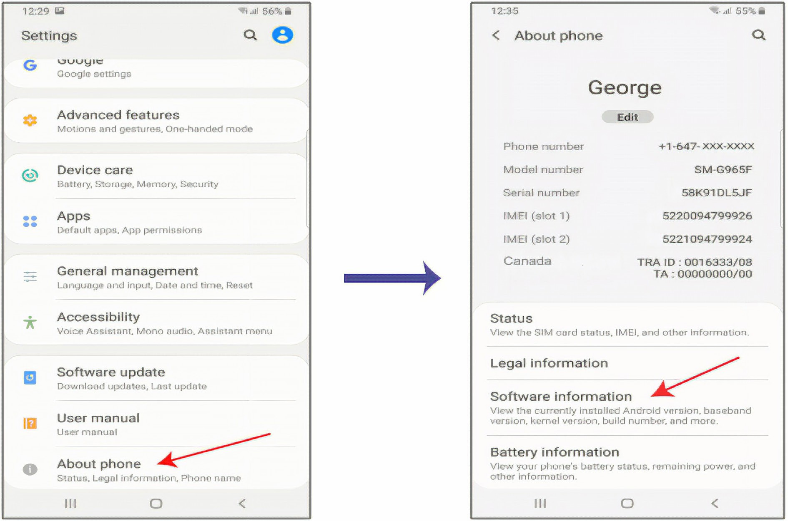
Configure your phone
05 PHYSICAL PHONE
Open Settings, then About phone, then Software information

Slide 25
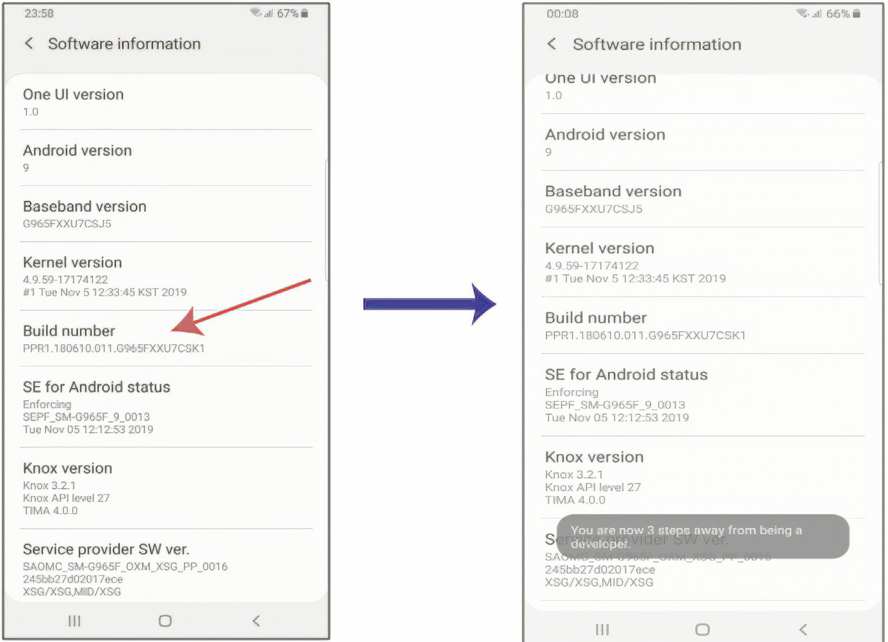
Turn on Developer mode
05 PHYSICAL PHONE
Tap Build number 7 times until the message “Developer mode has been turned on” appears
7

Slide 26
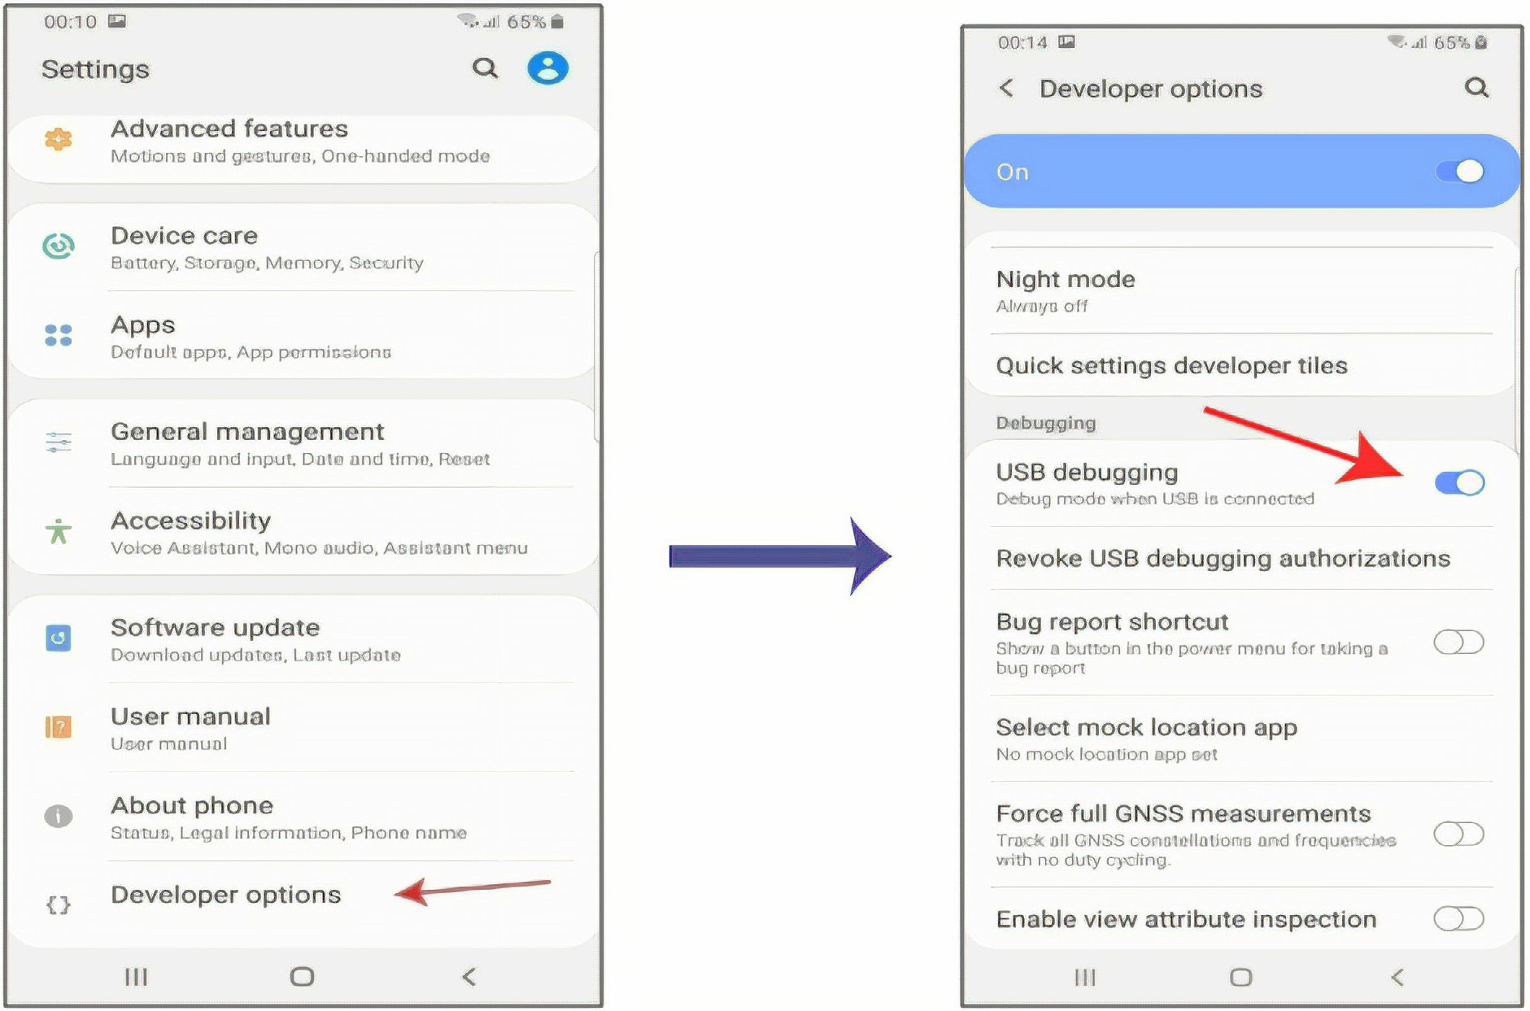
Enable USB debugging
05 PHYSICAL PHONE
Open Settings, select Developer options, make sure it is On, then enable USB debugging

Slide 27
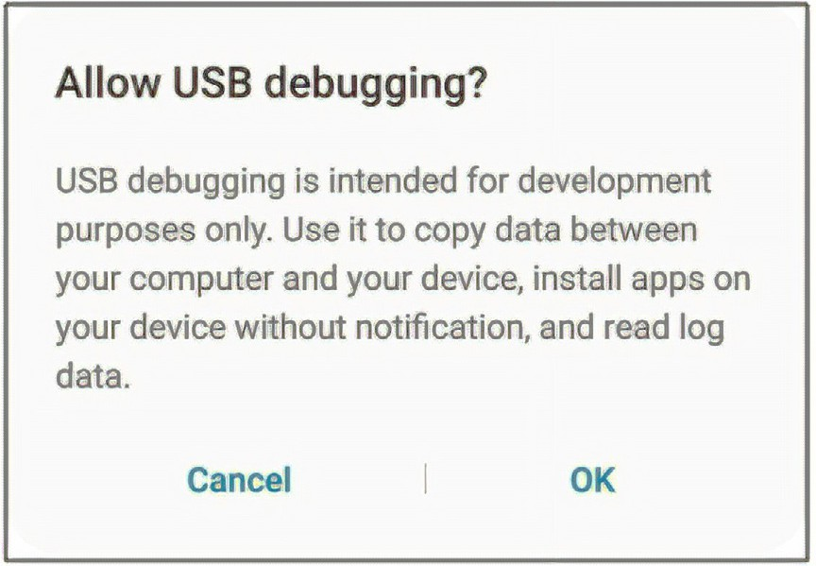
Allow USB debugging
05 PHYSICAL PHONE
Select OK on the “Allow USB debugging?” message. Your phone is then ready to connect to your computer by USB cable.
Check your USB cable
Some cables only carry power, not data. A charging phone does not prove the cable transfers data. Use the original cable that came with your device.

Slide 28
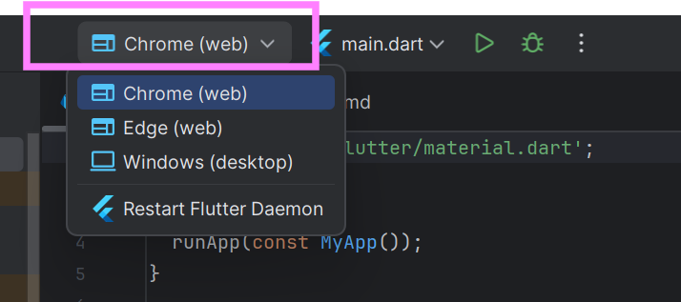
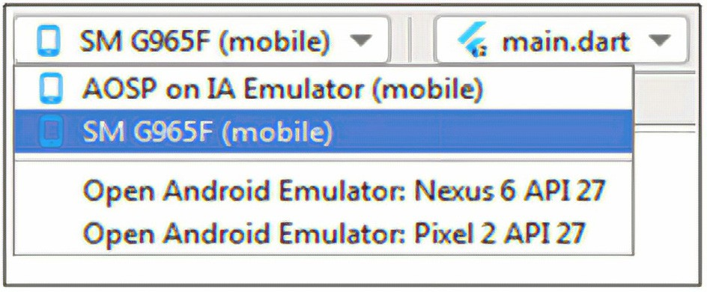
Select your device
05 PHYSICAL PHONE
Open the device menu in the toolbar and pick your connected phone
Your phone appears in the list once USB debugging is on and the cable carries data

Slide 29
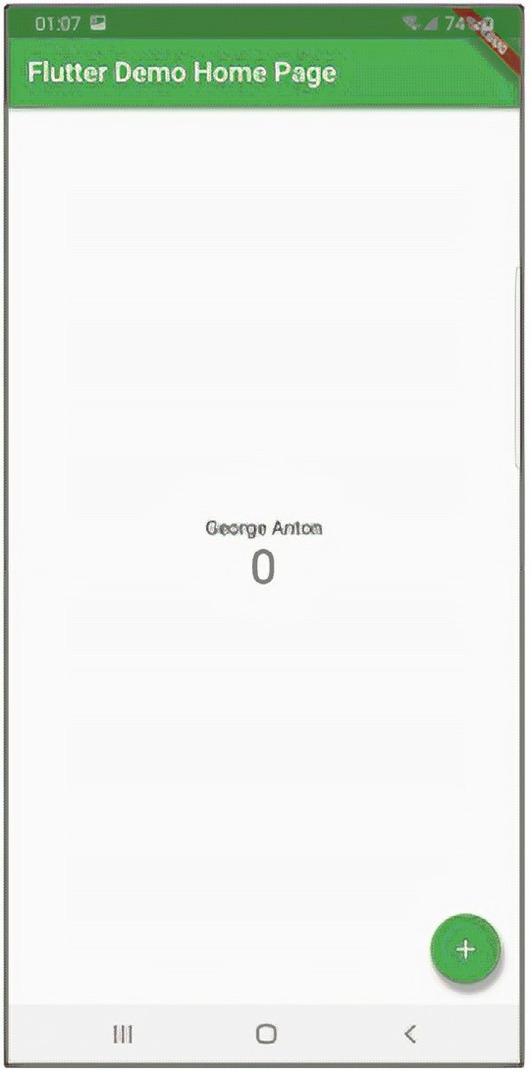
Run on your Android phone
05 PHYSICAL PHONE
1
Connect the phone with a data USB cable
2
Select the phone in the device menu
3
Click Run in Android Studio
4
The Flutter app opens on your phone

Slide 30
Run on an iPhone: requirements
05 PHYSICAL PHONE
Your computer must run macOS to run a Flutter app on a connected iPhone from Android Studio
Apple ID
An iPhone
Xcode
Registered with Apple. A developer account is not required for this step.
Flutter apps run on iPhone or iPad, not on a watch or other Apple devices.
Installed with Flutter on a Mac. Keep it current to match your iPhone software version.

Slide 31
Run on an iPhone: steps
05 PHYSICAL PHONE
1
Connect the iPhone to the Mac
Tap Trust on the iPhone when asked
2
Turn on Developer Mode
Settings, Privacy & Security, Developer Mode, then restart
3
Sign in with your Apple ID in Xcode
Set a signing team for the Runner target
4
Select the iPhone and click Run
Trust the developer profile in Settings on first launch

Slide 32





Emulator debug mode
06 DEBUG MODE
1
Start an emulator
void _incrementCounter() {
setState(() {
_counter++;
});
}
Pick it in the device menu
2
Set a breakpoint
Click the gutter beside a line
3
Click Debug
Shift + F9 starts the app in debug mode
Resume
Step Over
Step Into
Step Out
Stop
4
Step through the code
F9
F8
F7
Shift + F8
Ctrl + F2
Inspect variables when it pauses
Flutter Inspector and Debug console open beside the editor

Slide 33

Introduction to Flutter widgets
07 WIDGETS
Flutter builds its UI directly in code, not in XML
Column
Widgets are the basic building blocks of every Flutter app
Row
Almost everything is a widget: Text, Image, Icon, Button, Row, Column
Row
A widget is an immutable object that describes part of the user interface
Row
Combine widgets to create more complex layouts
Three Rows inside a Column, with an Image in each Row

Slide 34
Widget types and the widget tree
07 WIDGETS
StatelessWidget
MaterialApp
Fixed content
Scaffold
StatefulWidget
AppBar
Center
Content that changes
Text
Column
Layout widgets
Icon
Text
Row, Column, Stack

Slide 35
Creating a Flutter app using widgets
07 WIDGETS
lib/main.dart
My First App
import 'package:flutter/material.dart';
void main() => runApp(const MyApp());
class MyApp extends StatelessWidget {
const MyApp({super.key});
@override
Widget build(BuildContext context) {
return MaterialApp(
home: Scaffold(
appBar: AppBar(title: const Text('My First App')),
body: const Center(child: Text('Hello, Flutter!')),
),
);
}
}
Hello, Flutter!

Slide 36








Layout widgets: Column and Row
07 WIDGETS
Column of three Rows
Column(
children: [
Row(children: [
Icon(Icons.home), Icon(Icons.search), Icon(Icons.person),
]),
Row(children: [
Icon(Icons.star), Icon(Icons.favorite), Icon(Icons.settings),
]),
Row(children: [
Icon(Icons.map), Icon(Icons.camera), Icon(Icons.mail),
]),
],
)

Slide 37
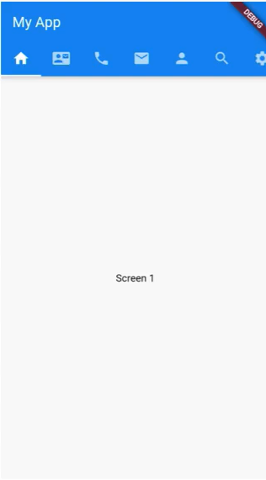
What is a MaterialApp widget?
07 WIDGETS
What is MaterialApp?
1
AppBar
The starting point of every Flutter app
Tells Flutter to use Material Design, Google's standard for clean, modern UI
Acts as the root that contains all other widgets
Top navigation bar
2
Scaffold
Main page layout
3
Body
Why it is important
Where your content goes
Makes your app look modern and consistent on both Android and iOS
4
BottomNavigationBar, FloatingActionButton
More ready-made parts

Slide 38
Material 3: useMaterial3 and ColorScheme
07 WIDGETS
lib/main.dart
Colours generated from one seed
return MaterialApp(
title: 'Flutter Lab',
debugShowCheckedModeBanner: false,
theme: ThemeData(
useMaterial3: true,
colorScheme: ColorScheme.fromSeed(
seedColor: Colors.teal,
),
),
darkTheme: ThemeData(
useMaterial3: true,
colorScheme: ColorScheme.fromSeed(
seedColor: Colors.teal,
brightness: Brightness.dark,
),
),
home: const HomePage(),
);
primary
secondary
tertiary
surface
error

Slide 39
Team repository setup
08 GITHUB & CI/CD
Part 2: Team repository, branching, and pull requests
team-repo/
src/
docs/
process_forms/
.gitignore
README.md
Never commit
# .gitignore
build/
.dart_tool/
key.properties
*.jks
google-services.json
Flutter app
Documents
Forms
Build outputs, API keys, and keystores stay out of the repository

Slide 40
Branching strategy
08 GITHUB & CI/CD
main
feature/12-login-ui
feature/15-quiz-list
Merged by pull request
main
feature/<issue-id>-<short-name>
Short-lived
Always stable and ready to demo
One branch per issue
Merge back through a pull request

Slide 41

Pull request workflow
08 GITHUB & CI/CD
Open PR
Request review
Approve
Merge
Push the feature branch and open a pull request
Ask a teammate to review the changes
The reviewer approves or asks for changes
Merge into main and delete the branch
Terminal
git switch -c feature/12-login-ui
git push -u origin feature/12-login-ui

Slide 42

Branch protection on main
08 GITHUB & CI/CD
Settings > Branches > Branch protection rule
main
Require a pull request before merging
Require at least 1 approval
No direct push
At least one peer approval before merge
Block direct pushes to main
Allow force pushes

Slide 43
Issues, labels, milestones, and board
08 GITHUB & CI/CD
To do
In progress
In review
Done
Design login screen
Build home page
Add quiz list
Create repository
Set up Firebase
Labels
Sprint tracking on the GitHub Projects board
Milestones
M1
M2
M3
M4
feature
bug
docs

Slide 44


Traceability to SRS requirement IDs
08 GITHUB & CI/CD
Link every issue to an SRS requirement ID so each requirement can be traced to code
FR-01
Issue #12
Branch
Pull request
SRS requirement
Title starts with FR-01
feature/12-login-ui
Closes #12
Traceability links
Title: FR-01 Login screen
Commit: git commit -m "FR-01 add login form"
PR: Closes #12

Slide 45
Project evidence: M1 Scope and Requirements
08 GITHUB & CI/CD
Weeks 4-5
Team repository created
Required folders: /src, /docs, /process_forms
Issue board set up
Issues, labels, and a Projects board
Evidence for M1
Show the repository, the issue board, and the milestones
Milestones set up
M1 to M4 created in GitHub

Slide 46
Creating a simple Flutter app
09 LAB EXERCISE 2.2
1
2
3
4
Create the project
Open an issue
Submit a PR
Review and merge
Make the Flutter project inside the team repository /src folder
Each member opens an issue and creates a feature branch
Each member submits a pull request for the feature
A teammate reviews and merges the PR
Terminal
flutter create --project-name simple_app src
git switch -c feature/21-home-screen

Slide 47

Any Questions?

Slide 48
Thank you
Mr. Raynold Anak Kabai

