Slide 1
Chest X-Ray Radiology Report Generation
AI in Healthcare
Fall 2024

Slide 2
Introduction
Project Details
Generating Radiology Reports using Vision and Text (LLAMA 3 + Swin Transformer)
X-Ray – Most common medical image examination
Issues
Shortage of Radiologists [1], [2]
Backlog of reporting process
Solution
AI Assisted Radiology Report Generation

Slide 3
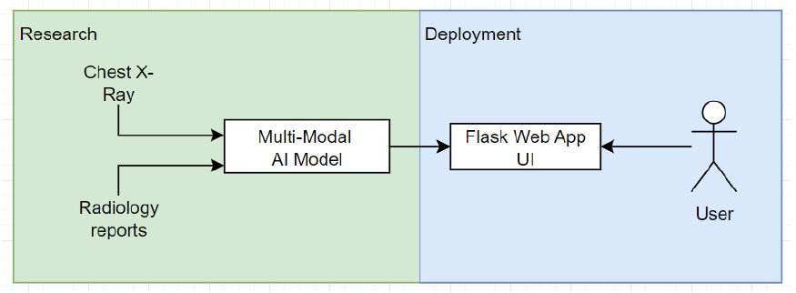
Method
Data
MIMIC CXR JPG [3] – Chest Xray Images with Radiology Reports
Models
R2GenGPT [4]
Shallow version, with LLAMA 3 instead of LLAMA 2
Diagram of the training and deployment process

Slide 4
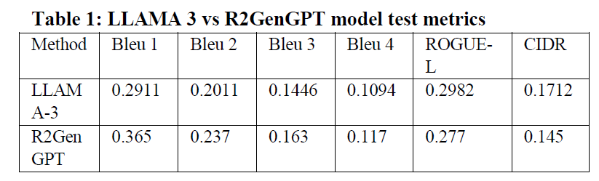
Results
LLAMA 3 did not outperform in BLEU, but performed better in ROGUE-L CIDR
Rogue is more Recall oriented
Bleu is more Precision oriented

Slide 5
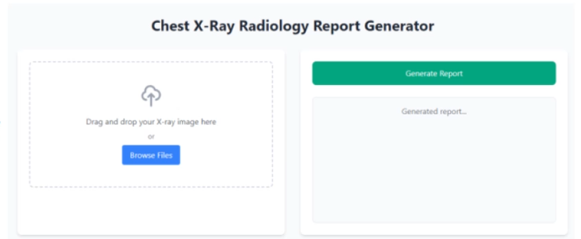
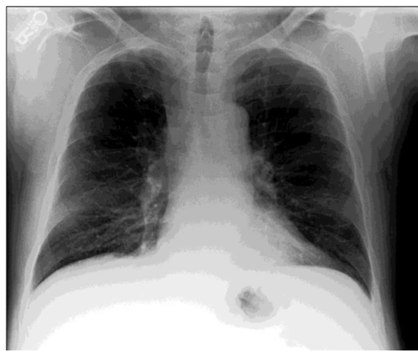
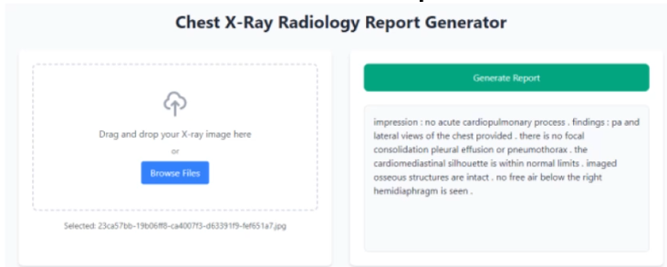
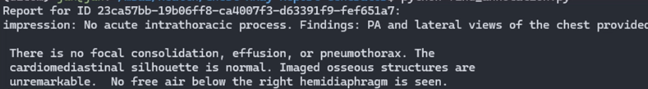
Results using GUI
Simple User Interface
Input
Outputs
Sample Image
Ground Truth

Slide 6
Future Directions
Train other versions “delta”, “deep”, for a better comparison
Use other LLM like Alpaca
Get users to test out the GUI, and improve on UI based on feedback
-End-

Slide 7
References
[1] Gregory N. Nicola. 2024. How will we solve our radiology workforce shortage? (March 2024). American College of Radiology. Retrieved November 11, 2024 from https://www.acr.org/Practice-Management-Quality-Informatics/ACR-Bulletin/Articles/March-2024/How-Will-We-Solve-Our-Radiology-Workforce-Shortage
[2] Omofoye, T. S., Vlahos, I., Marom, E. M., Bassett, R., Blasinska, K., Ye, X., Tan, B. S., & Yang, W. T. (2023). Backlogs in formal interpretation of radiology examinations: a pilot global survey. Clinical Imaging, 106, 110049. https://doi.org/10.1016/j.clinimag.2023.110049
[3] Johnson, A. E. W., Pollard, T. J., Greenbaum, N. R., Lungren, M. P., Deng, C., Peng, Y., Lu, Z., Mark, R. G., Berkowitz, S. J., & Horng, S. (2019b). MIMIC-CXR-JPG, a large publicly available database of labeled chest radiographs. arXiv (Cornell University). https://doi.org/10.48550/arxiv.1901.07042
[4] Wang, Z., Liu, L., Wang, L., & Zhou, L. (2023). R2GenGPT: Radiology Report Generation with Frozen LLMs. Meta-Radiology, 1(3), 100033. https://doi.org/10.1016/j.metrad.2023.100033
https://github.com/wang-zhanyu/R2GenGPT

