Slide 1
Analysis and Prediction of Pneumonia using Chest X-Rays
In this tutorial, we will go through the steps required to use deep learning to predict Pneumonia with Chest X-Ray data.
Content will be as follows:
Data setup and Data class
Short Data Visualization
Model Training and Validation
Model Testing
Test Results Visualization

Slide 2
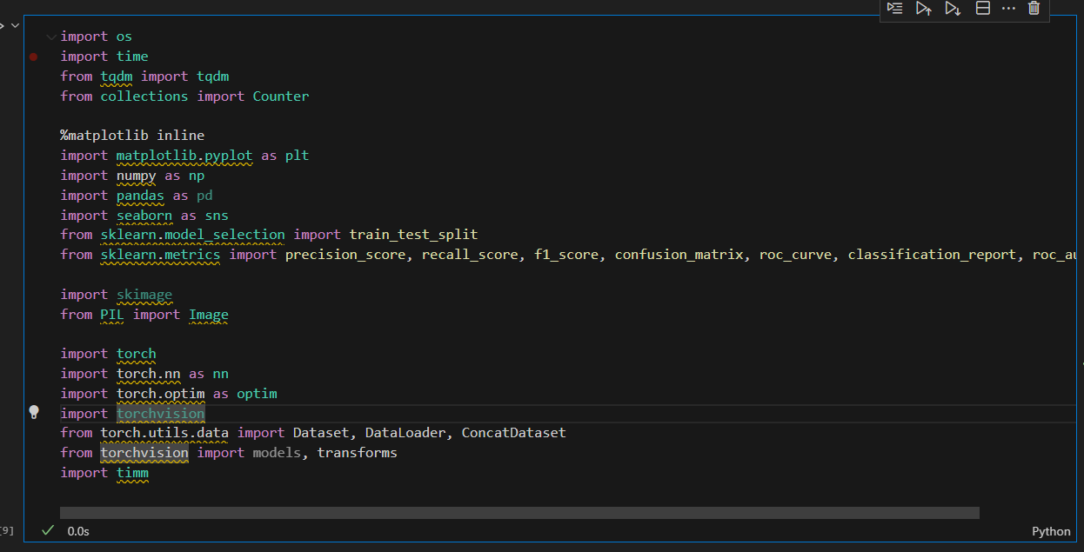
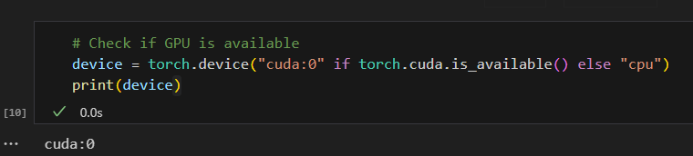
First, we will import the necessary libraries and check if GPU is available. “cuda” means GPU is available, “cpu” means gpu is not available

Slide 3
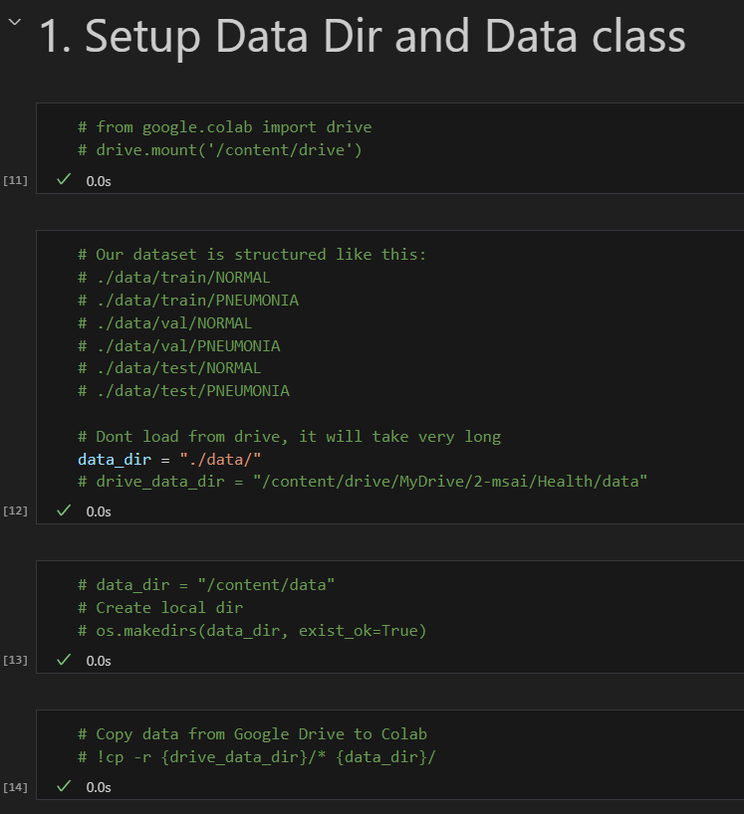
1. Data setup and Data class
If you are using Google Colab, make sure to upload the data to your drive, then mount the drive, and then use the command to copy the data files from drive to Colab’s local directory. This is because loading data from drive is slower, compared to using the data that is on the Colab’s directory.
Otherwise, you may just use data_dir and point it to your data folders.
The official dataset can be found on Kaggle, and it is around 1.24GB zipped.
https://www.kaggle.com/datasets/paultimothymooney/chest-xray-pneumonia

Slide 4
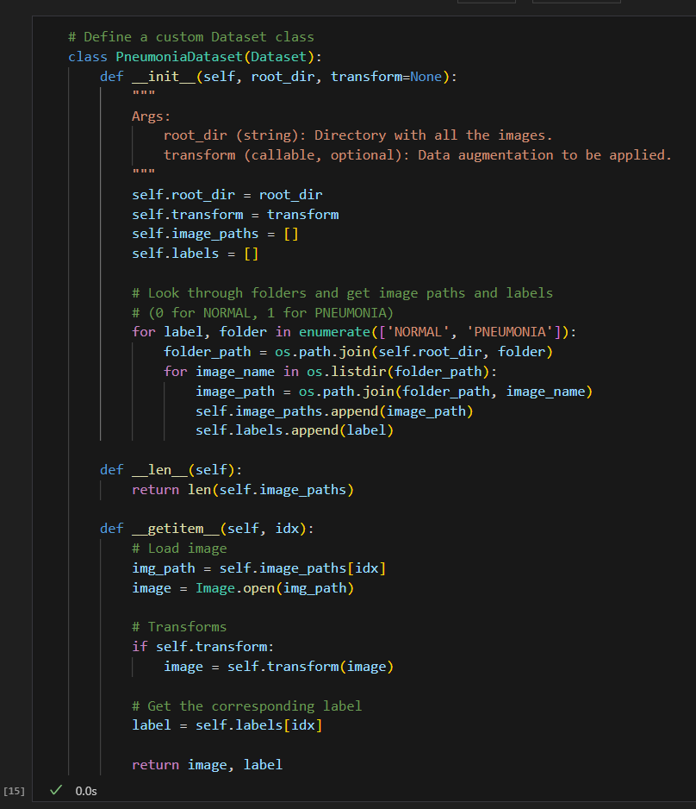
1. Data setup and Data class
Then, a custom subclass of Pytorch’s Dataset will be created. The purpose of this is to load and do preprocessing for the input images before it is fed into the model.
Here, we have a binary class dataset, with labels “NORMAL” and “PNEUMONIA”
In the __getitem__ method, it will retrieve the image, and then apply data transformation/augmentation
It will return both the preprocessed image and its respective label

Slide 5
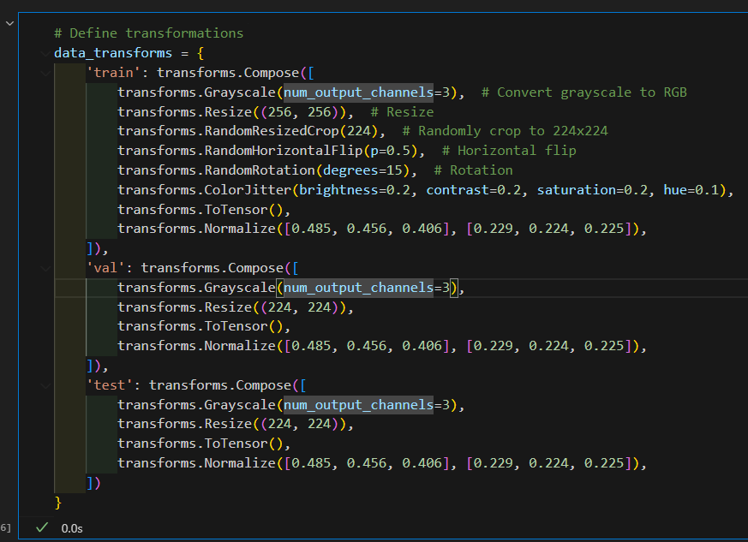
1. Data setup and Data class
We take a look at what kind of preprocessing is required for this dataset.
For training, we will include steps such as converting grayscale to RGB, resizing, cropping, horizontal flipping, rotation, color adjustment, conversion to tensor, and normalization.
For validation and testing, we will only do RGB conversion, resizing, conversion to tensor, normalization.
For training, we want to add more diversity to the dataset, more variations means more data for the model to train on.
But for val and testing, we only want to see how well it generalizes to unseen data. More augmentation would make it inconsistent on how the model is being tested.

Slide 6
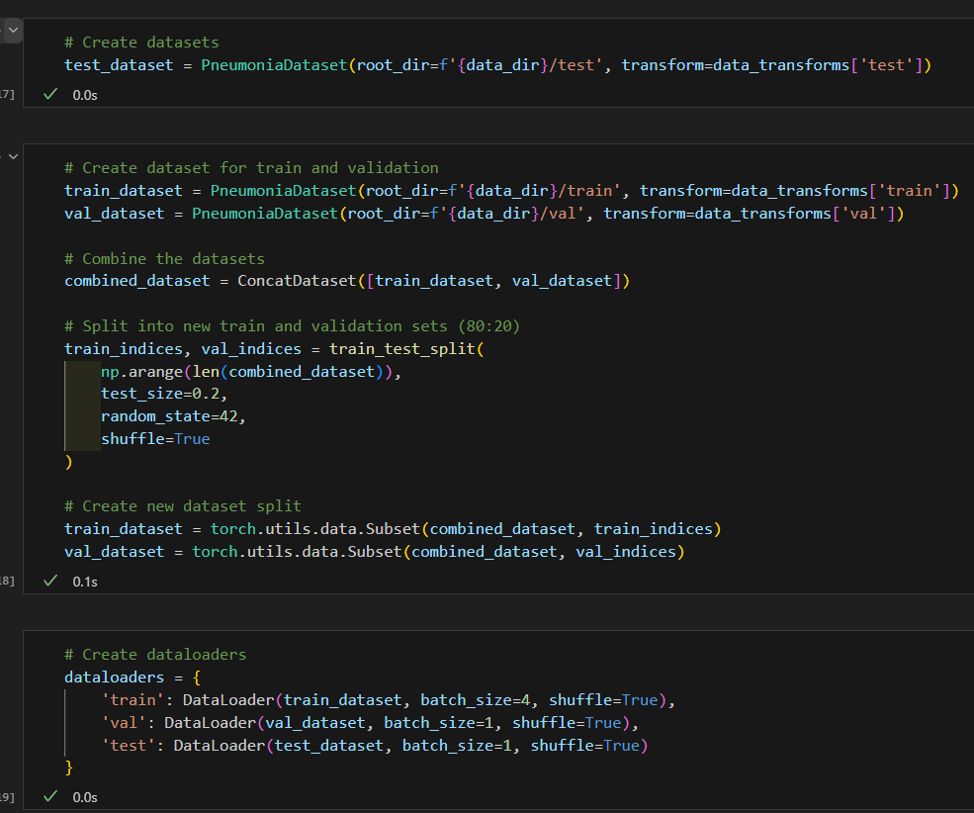
1. Data setup and Data class
Here, we will create the custom dataset, and also the data loaders.
You will see that at first, the train and val data is being combined, then shuffled and split again into 80/20. This is because in the original validation set, there were only 8 NORMAL and 8 PNEUMONIA images, which is extremely low compared to the training dataset.
We use batch size of 4 for training, but this value can be adjusted based on how much GPU memory you have.
In the next section we will show the data distribution and some of the original x ray images.

Slide 7
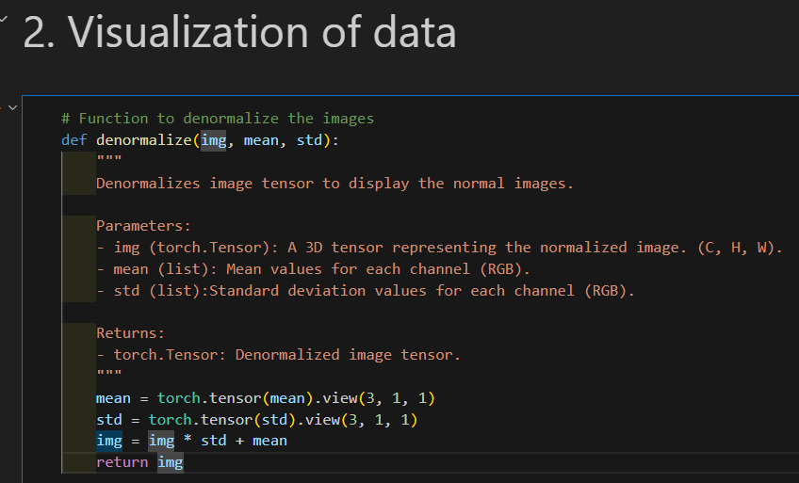
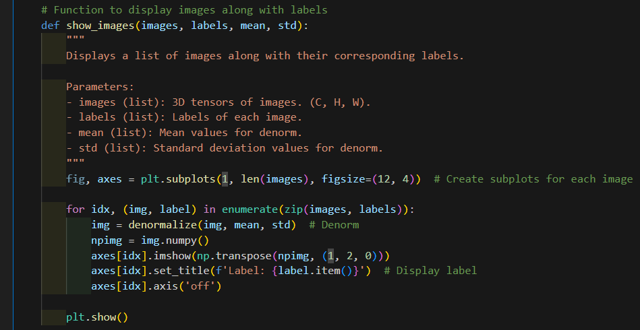
2. Visualization of data
Here we will define 2 functions, one to denormalize the image, and the other to display the images on matplotlib.
Since the data already went through preprocessing in the dataset class, if we just display the images using the dataloader, it will show normalized images, therefore we need to denormalize it first.

Slide 8
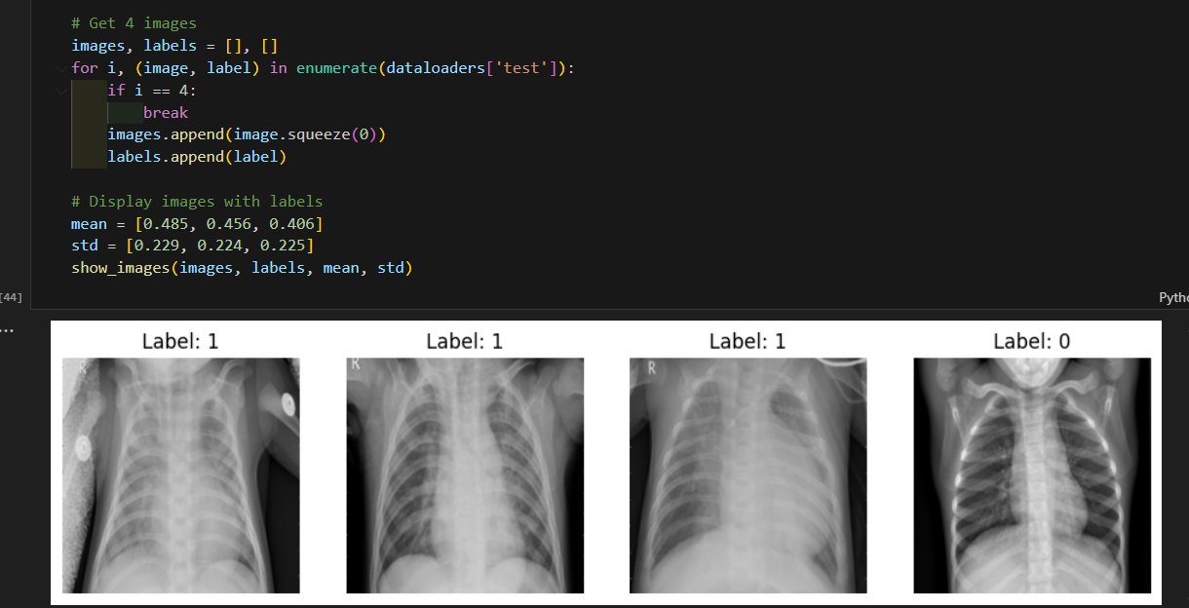
2. Visualization of data
4 images are displayed here from the test dataset. There are 3 PNEUMONIA and 1 NORMAL images.
Are you able to spot the difference between positive and negative pneumonia?
I am not a doctor or an expert so I am unable to tell. But I will provide the enlarged images in the next 2 slides for you to inspect.

Slide 9
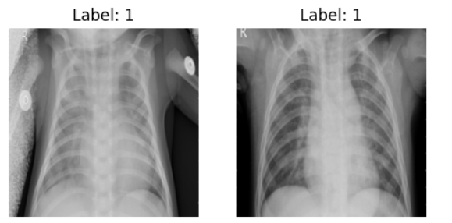

Slide 10
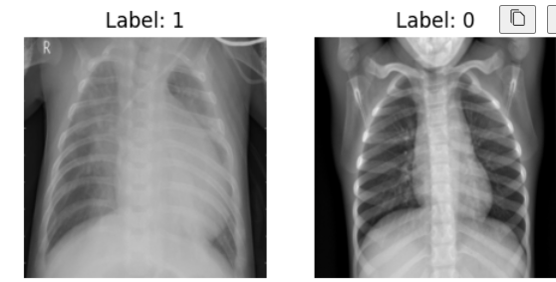

Slide 11
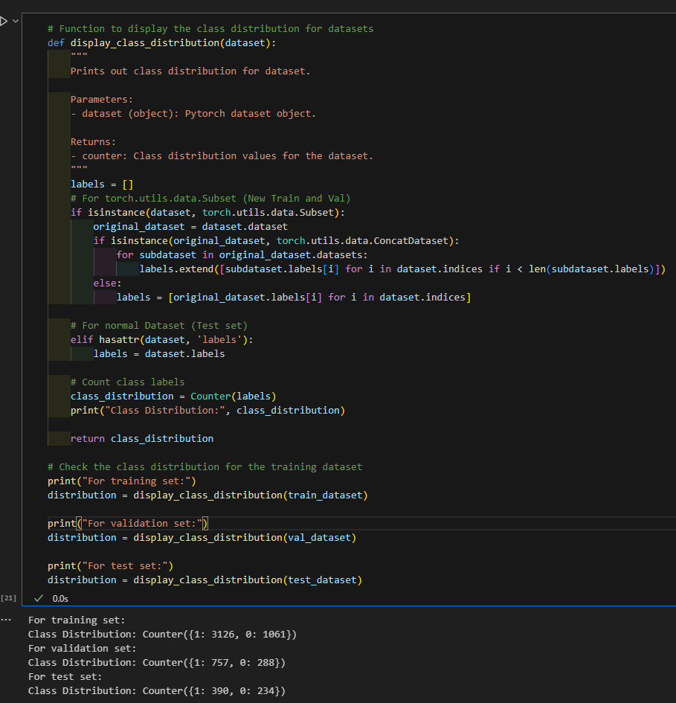
2. Visualization of data
A function will be created to calculate the class distribution of the train, val, test datasets.
As seen,
Training: 3126 Positive, 1061 Negative
Validation: 757 Positive, 288 Negative
Testing: 390 Positive, 234 Negative
It is still quite imbalance as there is a 2.5 ~ 3x positive compared to negative

Slide 12
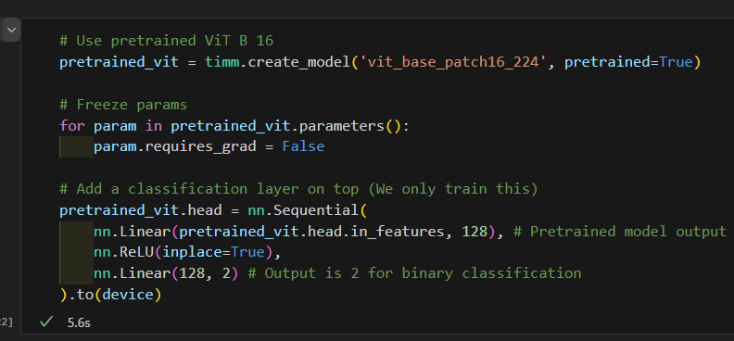
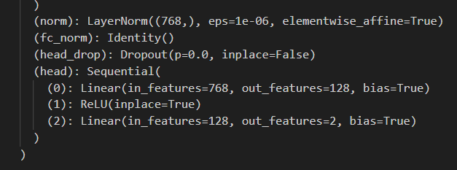
3. Training model
Next, we will start to prepare to train the model.
We will do transfer learning, using a pretrained Vision Transformer, adding a classification layer to the pretrained model.
By freezing the weights of the pretrained model, it will not be trained and it will save time.
The pretrained model’s head layer will be replaced by the custom layer created. Then the output layer will have 2 classes, for binary classification.
By printing out the model architecture, we can see that our custom layer was created correctly, with the final out_features=2, for binary classification.

Slide 13
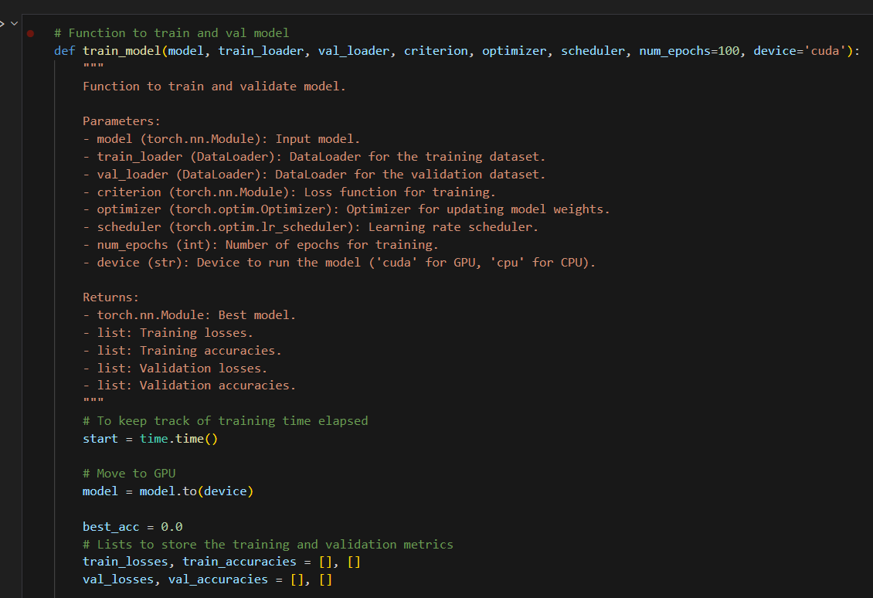
3. Training model
A function will be created for training the model.
Using time to keep track of the time taken for the model to train for one epoch.
Then, storing the training and validation losses and accuracies, so that we can plot the training results later.

Slide 14
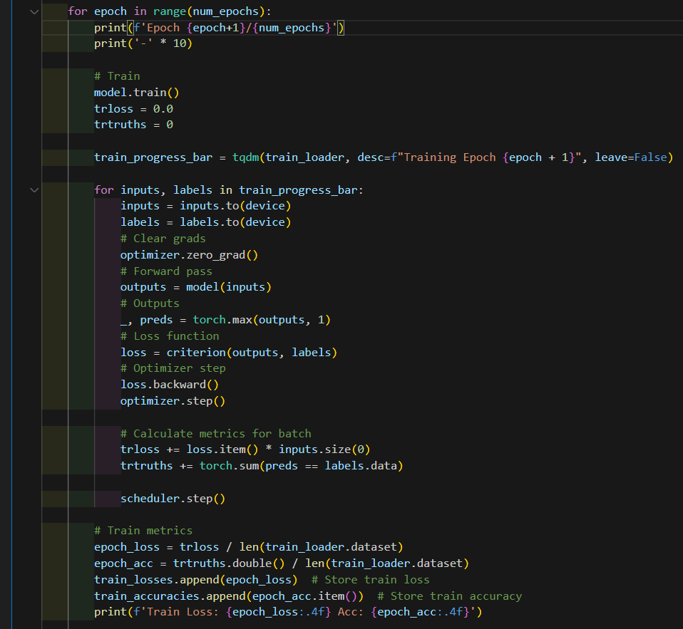
3. Training model
Using a for loop for each epoch, the model is set to training mode using model.train().
Then for each input image and label, it will be sent to the device (GPU or CPU).
Gradients will be cleared first, then the forward pass will happen through model(inputs).
The model will output the prediction probabilities.
Loss will be calculated, and then backward pass happens, followed by the optimizer.
Then the training loss and accuracy will be calculated for each epoch.

Slide 15
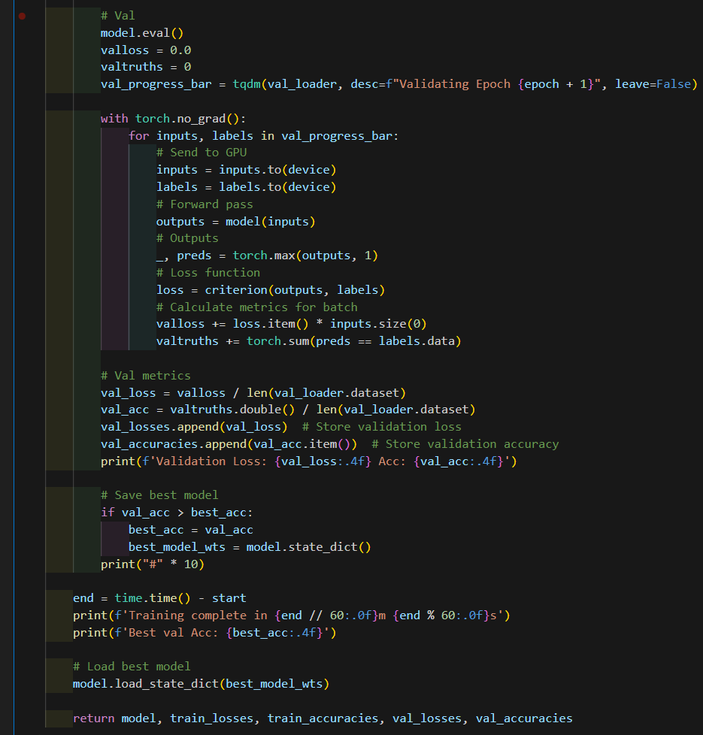
3. Training model
For the validation, the model will be set to evaluation mode using model.eval(). This will prevent the model’s weight from changing.
Similar to the training section, the model will take the input, output probabilities, and then the validation losses and accuracies will be calculated and stored.
Then, the best model with best validation accuracy will be stored.

Slide 16
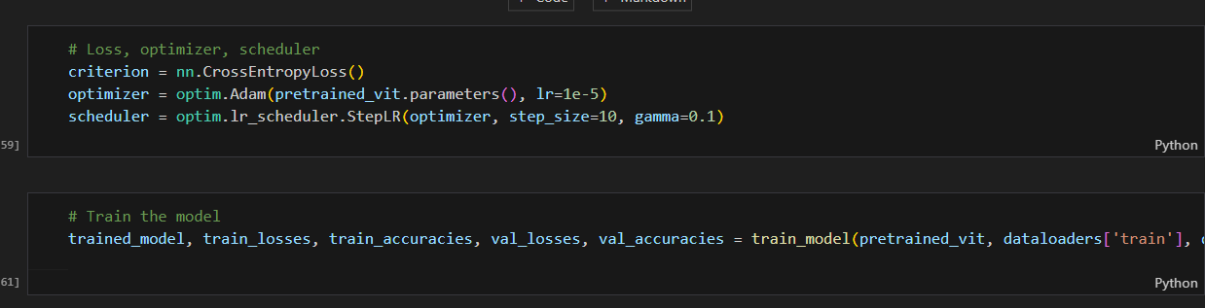
3. Training model
Here, we will use Cross Entropy Loss for binary classification, and with the Adam optimizer, with a learning rate of 1e-5.
Since this is a transformer architecture, we don’t want a large learning rate. Optimizer is to adjust the model’s parameters. And also because we are using a pre-trained model, so we want small updates to reach optimal solution.
Then we use a scheduler to control how the learning rate changes over time. This is to allow the model to make larger parameter adjustments, then slowly minimize the changes as the training goes on. This will allow fast convergence initially, then slows down for fine-tuning.

Slide 17
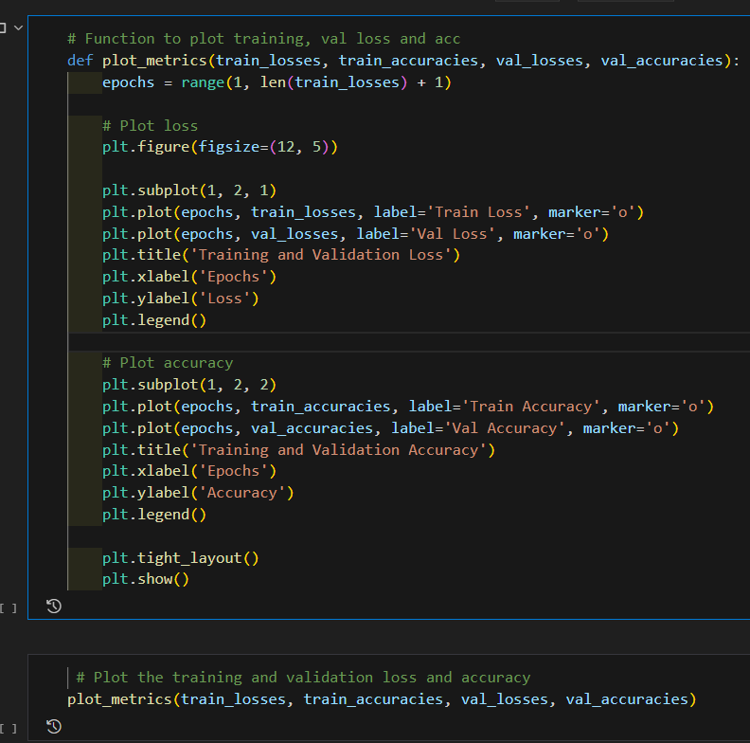
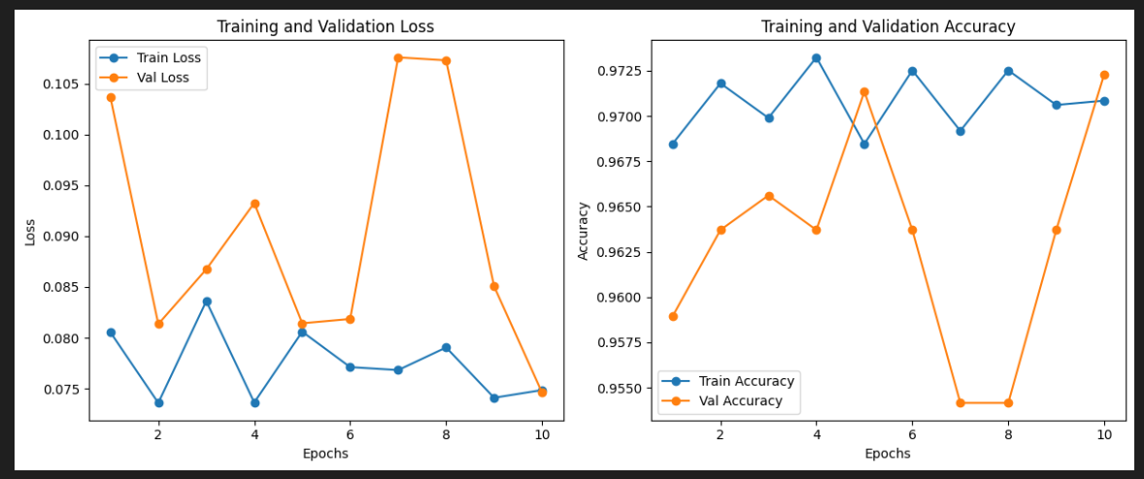
3. Training model
After training, we will plot the training, validation loss and accuracy over epochs. Fortunately, the model training starts off strong, with a high accuracy of more than 0.9. We don’t see much training here as we are probably using a pretrained vision transformer. We will explore the usage of another architecture later

Slide 18
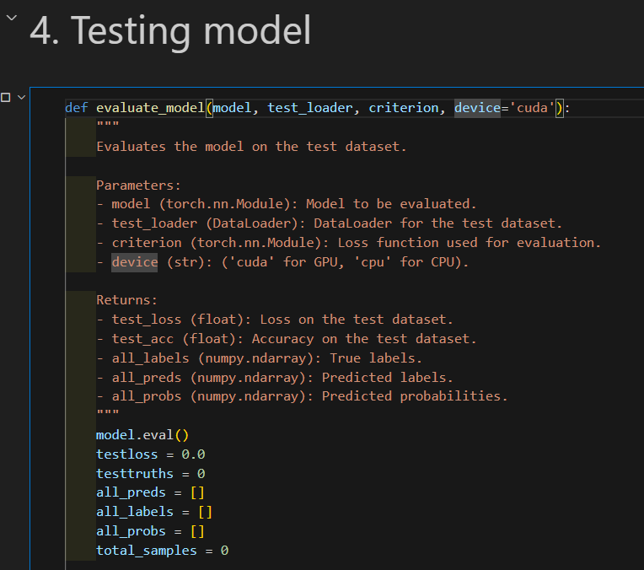
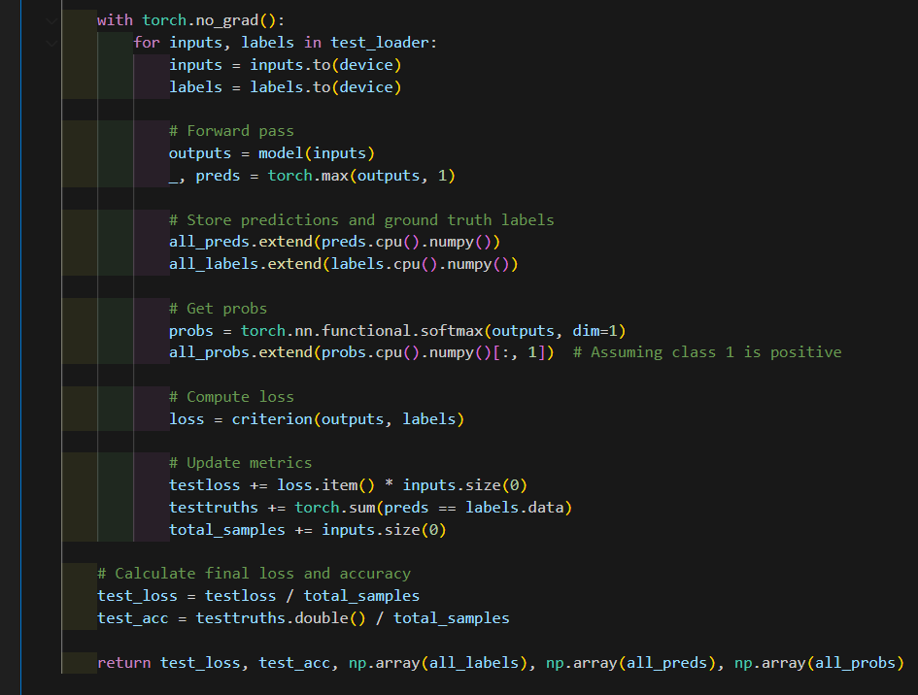
4. Testing model
Then, a function is created for testing on the test dataset.
This function is similar to the validation section. First the model is set to evaluation mode. Then, test data will be fed to the model for inference, and the output probabilities and labels will be stored

Slide 19
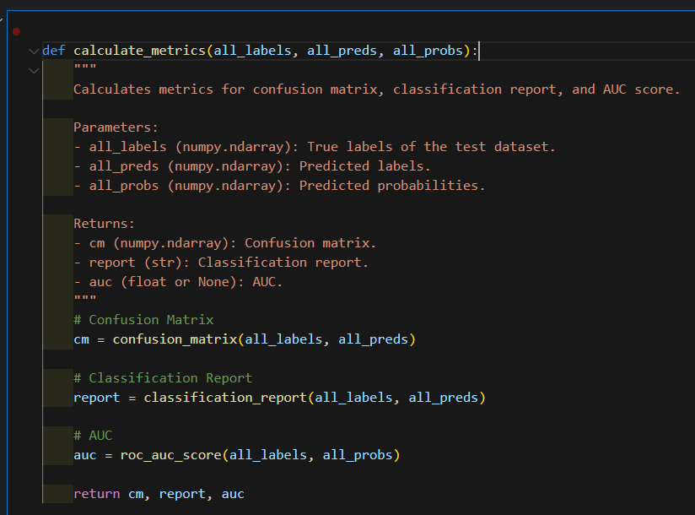
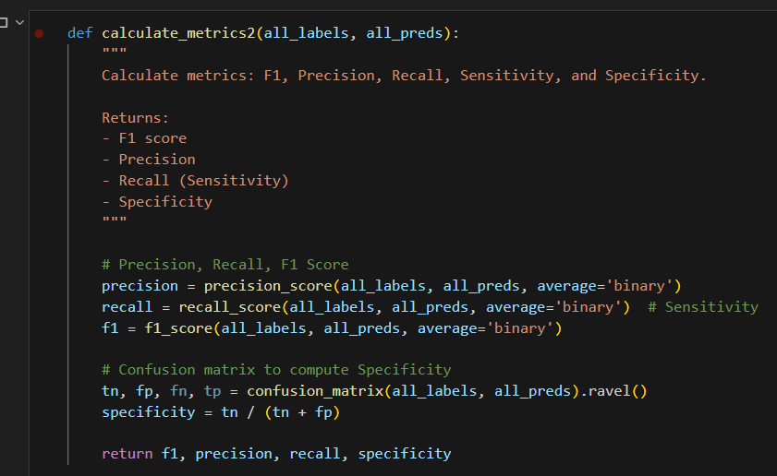
4. Testing model
Two functions will also be created to calculate metrics such as confusion matrix, classification report, ROC, F1, Precision, Recall, Sensitivity, Specificity.
Note that Recall = Sensitivity.

Slide 20
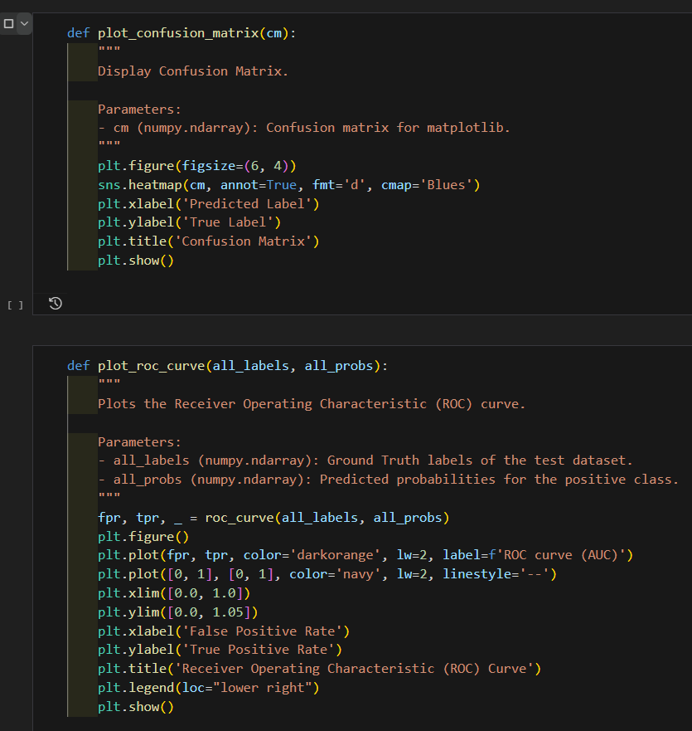
4. Testing model
Simple functions created to display the plots for the metrics as well

Slide 21
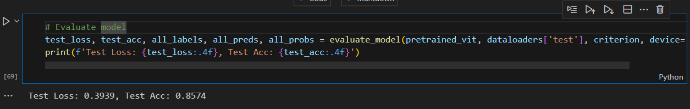
4. Testing model
Then the evaluate function will be run to view the test accuracy and losses.
As we can see the test accuracy is much lower than the training and validation accuracy. Here it is 0.85, compared to validation which was higher than 0.90

Slide 22
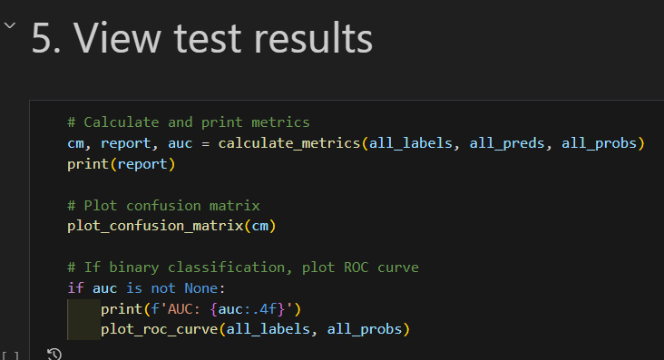
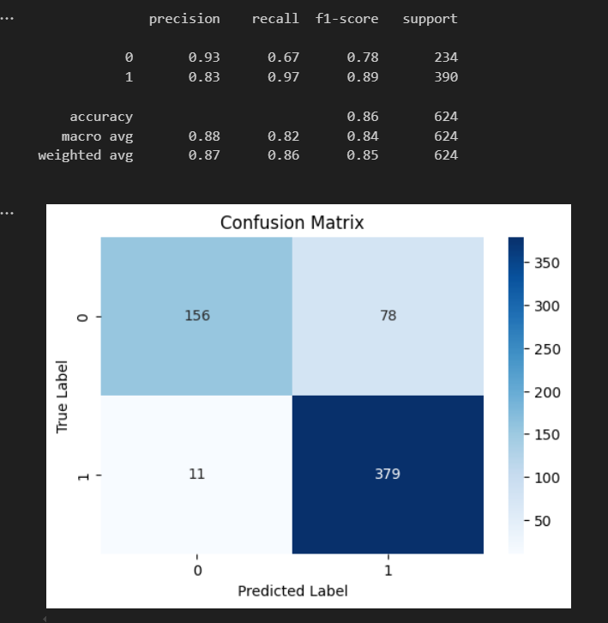
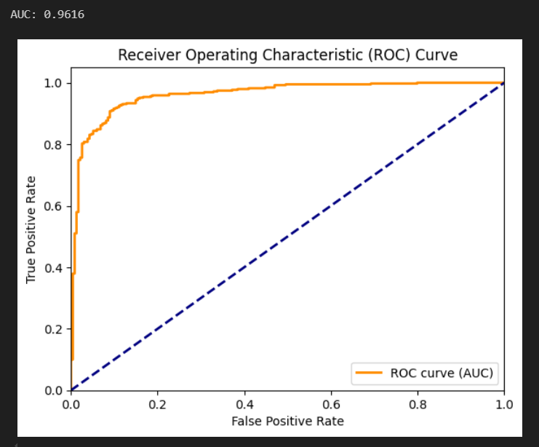
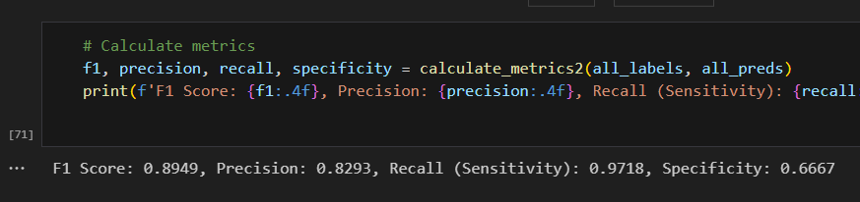
5. View test results
Finally we run the functions to view all the plots for the metrics. This is for classification report, confusion matrix, ROC/AUC graph.
On the left, we have classification report, as we can see the negative class has a low accuracy score, this could be due to the class imbalance.
Then, we can see the ROC AUC is quite high, which is good.
For F1, we get a 0.89, which is decent, however, the specificity is quite low, a 0.66 due to the high FP, compared to sensitivity of 0.97.

Slide 23
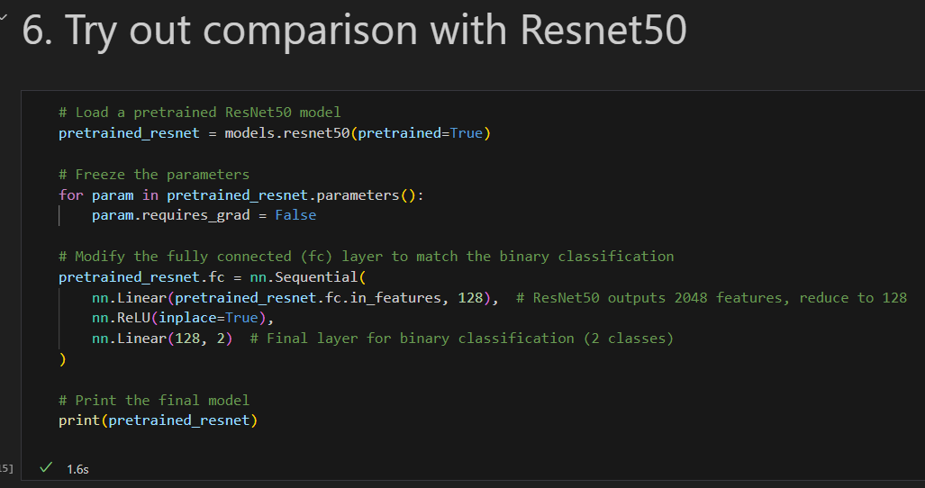
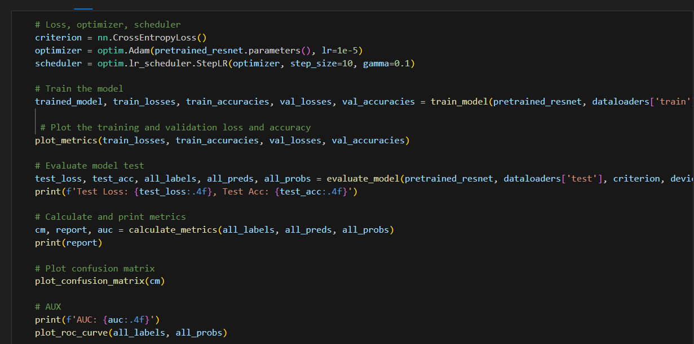
6. Resnet50 Training, Val, Testing
We will try out using an older architecture, Resnet50, this is to view the training process improving.
The same process is done for Resnet50, where we replace the final layer with our own custom layer, with 2 output classes for binary classification.
We will use the same hyper parameters, to keep comparison fair. We can reuse the functions created earlier for this training model.

Slide 24
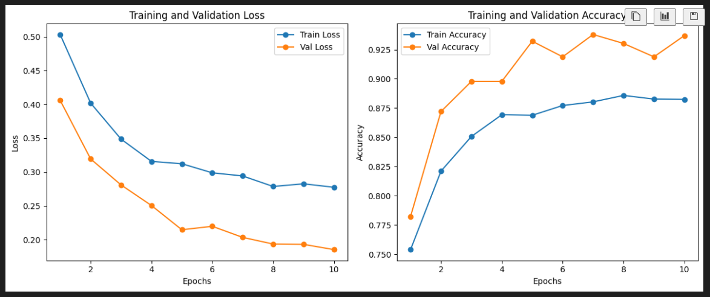
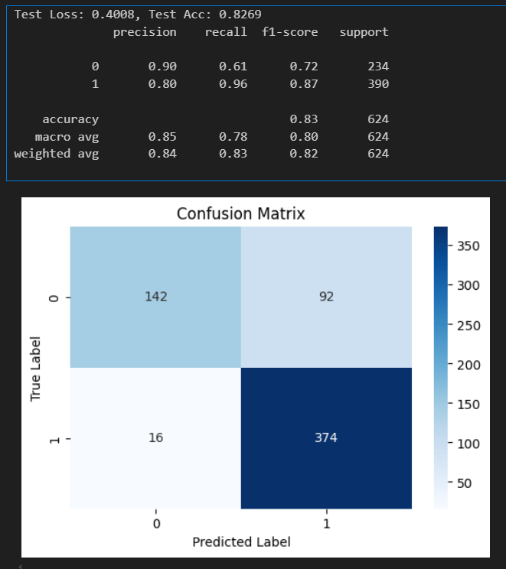
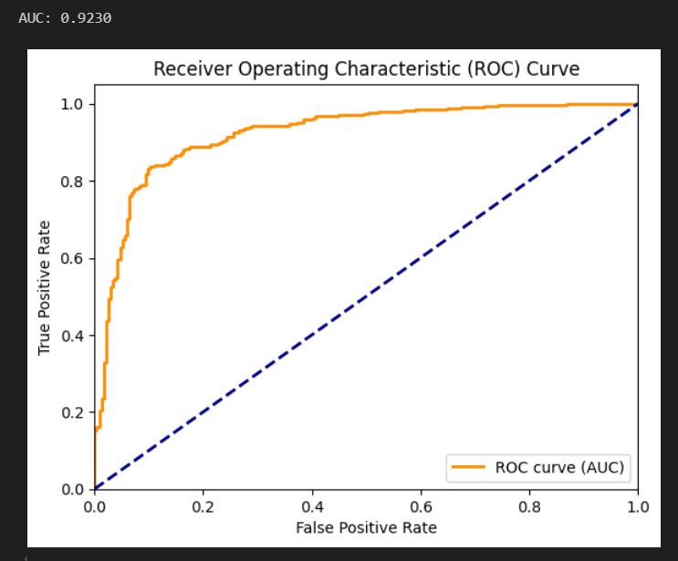
6. Resnet50 Training, Val, Testing
Here, we can see the training and validation accuracy and losses. The losses are decreasing, showing that the model is training well.
However, the accuracy on the test set is lower than the vision transformer.

Slide 25
7. Conclusion
So to conclude, we have gone through the basic data preprocessing, model training and hyperparameter settings, model evaluation and testing, metrics results presentation, and model comparison

Slide 26
References
https://pytorch.org/vision/main/models/generated/torchvision.models.resnet50.html
https://scikit-learn.org/stable/modules/model_evaluation.html
https://www.v7labs.com/blog/vision-transformer-guide

