Slide 1
AI-Assisted Hemodialysis Toxin Estimation
From Research Reproduction to Methodological Correction
Using AI Agent for End-to-End Clinical ML Pipeline Development
Presenter: Jinxun Zhang( 張晉薰）
Schema verification → Pipeline build → Evaluation audit → Final protocol
AI Homework Project | April 2026
Notes:
本投影片介紹的是以AI代理人輔助完成的血液透析毒素濃度預測研究。
研究從重現前人文獻的方法論出發，逐步識別並修正評估流程中的缺陷。
核心貢獻在於：導入嚴格的分組交叉驗證（GroupKFold），確保每個未見過的透析session都能被公正評估。
本報告完整呈現從資料驗證、模型訓練、錯誤修正到最終評估的全流程。

Slide 2
Clinical Background: Why Predict Uremic Toxins?
Direct blood assays during HD sessions are slow — real-time monitoring requires an alternative
UV optoelectronic sensors measure spent dialysate absorbance in real time — an indirect toxin proxy
ML maps optical signals + clinical features to toxin concentrations — no extra blood draws needed
Prior work (OptoEML) proved this concept: SVR on 3 UV wavelengths, 9 patients, 30 sessions
This project reproduces and extends OptoEML with a rigorous, AI-agent-assisted pipeline
6 Toxin Targets
Urea, Creatinine, Uric Acid, Phosphorus, Potassium, B2M
5 UV Wavelengths
255, 275, 285, 295, 310 nm
30 HD Sessions
9 ESRD patients, ~510 data points
Notes:
血液透析患者在治療過程中需要持續監測尿毒素的清除情況，但傳統的血液抽樣速度太慢。
本研究利用UV光電感測器對透析廢液進行即時光學量測，作為毒素濃度的間接指標。
機器學習模型可將光學信號與臨床特徵映射到毒素濃度，無需額外抽血。
資料集包含9名終末期腎病患者、30次透析session、約510個數據點，涵蓋6種目標毒素。

Slide 3
Problem Statement
Multivariate Clinical Regression from Optoelectronic Signals
Task Definition
Six Prediction Targets
Estimate 6 toxin targets from tabular clinical data collected during HD sessions
Input: absorbance at 5 wavelengths + machine parameters + patient features
Output: predicted toxin concentration per time point
Evaluation: session-level GroupKFold with MAE, RMSE, R²
Session-level splitting prevents data leakage from repeated measurements
Target | Workbook Column | Status
Urea Nitrogen | Urea | Direct match
Creatinine | Creatinine | Direct match
Uric Acid | Acid | Inferred mapping
Phosphorus | Phosphorus | Direct match
Potassium | Potassium | Direct match
β2-Microglobulin | β2-microglobulin | Direct match
Notes:
本研究的任務是針對6種尿毒素進行多變量回歸預測。
輸入特徵包括5個UV波長的吸光值、透析機器參數以及患者個人資料。
關鍵設計決策是使用session層級的GroupKFold分割，確保同一session的數據不會同時出現在訓練集和測試集中，從根本上消除資料洩漏問題。
評估指標採用MAE、RMSE和R²，在每個fold的未見session上計算。

Slide 4
Research Goal and Expected Outcome
Reproducible Pipeline
Methodological Rigor
Clear Comparison
GitHub-ready Python project: code, tests, figures, reports, PPT — all AI-agent-assisted
Multi-model comparison, session-level evaluation, and GroupKFold cross-validation
Document weaknesses in the prior study while demonstrating improved evaluation discipline
Homework Requirements Alignment
Question Description: HD toxin regression from optoelectronic absorbance + clinical features
Solution Overview: Multi-model pipeline (SVR, RF, KNN, LR) with 5-wavelength feature expansion
Agent Workflow: 9-stage end-to-end AI agent — requirement parsing through final evaluation
Demo Result: GroupKFold session-level evaluation — trustworthy grouped-unseen-session R² results
Notes:
本研究有三個核心目標：建立可重現的Python管線、實現嚴謹的方法論，以及與前人研究進行明確比較。
在作業需求對齊方面，本專案完整涵蓋問題描述、解決方案、AI代理人工作流程與最終評估結果四個層面。
最重要的改進是採用GroupKFold，讓所有30個session都能作為測試集被評估，而非只使用少數固定的測試session。
這種評估方式更能反映模型在真實臨床場景中面對完全未見患者時的泛化能力。

Slide 5
Review of Senior's Work (OptoEML Paper)
Methodology Summary
Reported R² (Blood Concentration)
UV optoelectronic system — 3 wavelengths (255, 275, 310 nm) on spent dialysate
SVR with polynomial kernel as the sole ML model
Three feature sets: personal (m=8), absorbance (m=3), combined (m=11)
5-fold cross-validation — without session-level grouping
2-stage pipeline: SVR on dialysate → linear conversion to blood concentration
Feature selection: ANOVA F-test + wrapper method
Dataset: 9 ESRD patients, 30 sessions (Nov 2022 – Feb 2023)
Toxin | Senior R²
Urea Nitrogen | 0.953
Creatinine | 0.952
Uric Acid | 0.959
β2-Microglobulin | 0.822
Phosphorus | 0.853
Potassium | 0.621
Note: R² includes a 2nd-stage linear regression step — may amplify apparent accuracy.
Notes:
前人研究（OptoEML）奠定了本研究的基礎：使用UV光電感測器搭配SVR模型預測血液毒素。
其方法使用3個波長（255、275、310 nm），採用5折交叉驗證，但未進行session層級的分組。
報告的R²數值（0.822至0.959）包含第二階段的線性轉換，可能誇大了模型的實際預測能力。
本投影片的目的是建立比較基準，以便後續說明我們如何在方法論上進一步改進。

Slide 6
Limitations in the Senior's Methodology
Critical evaluation of experimental design and evaluation rigor
Row-Level CV on Session Data
No Train / Validation / Test Split
Plot R² ≠ CV R²
Row-level 5-fold CV splits correlated intra-session measurements across folds — inflating performance.
Model selection uses the same CV results as final reporting — selection bias in the reported R².
Scatter-plot R² (from a fit line) differs from formal CV R² — easy to conflate in figures.
Two-Stage Error Propagation
Manual Data Exclusion
Limited Wavelengths (3 of 5)
Error from two regressions compounds, but the final R² does not distinguish the two stages.
No formalized exclusion criteria — manual removal introduces hidden selection bias.
285 nm and 295 nm ignored — 285 nm later proved the most predictive wavelength.
Notes:
這張投影片指出了前人研究的六個主要方法論缺陷。
最嚴重的問題是：行層級交叉驗證（row-level CV）對同一session內高度相關的測量值進行分割，導致資料洩漏、性能數值膨脹。
其次是模型選擇偏差：使用與最終報告相同的CV結果進行模型選擇，會高估實際泛化能力。
散點圖R²與CV R²是不同的統計量，容易混淆；此外，三個波長的限制也遺漏了預測力最強的285 nm波長。

Slide 7
My Methodology: Expanded Feature Design
Going beyond the 3-wavelength story
Three Progressive Feature Sets
Feature Set | Components | Count
A: Absorbance Only | 255, 275, 285, 295, 310 nm | 5
B: Absorbance + Machine | Set A + venous pressure, TMP, arterial flow, UF, Na | 13
C: Full (Abs + Machine + Personal) | Set B + dialysis vintage, dry weight, height, age | 19
Key Improvements Over Senior's Approach
5 wavelengths (added 285 nm + 295 nm) — 285 nm proved the most important predictor
Multi-model comparison: SVR, RF, KNN, LR — best model selected per toxin by grouped CV
Feature selection: mutual information + permutation importance, with before/after comparison
Session-level splitting (GroupKFold) — no within-session data leakage
Notes:
本研究在前人方法的基礎上進行了四項重要擴展。
首先，將UV波長從3個擴展到5個（新增285 nm和295 nm），結果證實285 nm是最重要的預測特徵。
其次，設計了三種遞進式特徵集（僅吸光值/吸光值+機器參數/完整特徵），系統評估各類特徵的貢獻。
第三，引入多模型比較（SVR、RF、KNN、線性回歸），通過GroupKFold選出每種毒素的最佳模型。
第四，全程採用session層級的GroupKFold分割，從根本上消除資料洩漏問題。

Slide 8
AI Agent Workflow
End-to-end collaboration across 9 stages
1
2
3
4
5
6
7
8
9
Requirement Analysis
Dataset Inspection
Project Design
Code Generation
Debug & Test
Analysis Execution
Figure & Report Gen
Methodology Correction
PPT & Demo Prep
Parse homework, extract deliverables
Verify workbook schema & columns
Define scope, module boundaries
Modular Python src + config
Unit tests, pipeline validation
Run models, generate outputs
Charts, tables, markdown reports
Fix leakage, audit protocol
Final presentation & demo materials
Critical Agent Contribution: Iterative Debugging & Correction
Agent role extended beyond code generation — actively identified evaluation flaws
Stage 8 was most impactful: surfaced session leakage + model-selection bias
Three corrections: figure framing, session-grouped CV, protocol audit
All corrections documented in versioned audit reports for full traceability
Notes:
AI代理人在本專案中扮演了超越程式碼生成的角色，積極參與了方法論的識別與修正。
九個工作階段中，第八階段「方法論修正」最為關鍵：代理人主動發現了session層級資料洩漏問題，並提出了修正方案。
所有修正均有版本化的審計報告記錄，確保研究過程的完整可追溯性。
這種人機協作模式加速了從初步結果到可信證據的整個修正與學習週期。

Slide 9
Experimental Procedure
Step-by-step execution flow
Step 1: Data Loading & Verification
Verified 510 rows × 29 cols; 9 patients, 30 sessions; mapped 6 toxin targets.
Step 2: Data Profiling & Cleaning
69 missing values for Acid; 6 for Urea/B2M — imputed via pipeline, no row deletion.
Step 3: Feature Engineering
Built 3 feature sets (A/B/C); standardized (mean=0, std=1); created session_id.
Step 4: Model Training & CV
4 models × 6 targets × 3 feature sets; corrected to session-level GroupKFold throughout.
Step 5: Feature Selection
Mutual info + permutation importance; compared full vs. selected feature performance.
Step 6: Protocol Correction
Detected row-level leakage; added GroupKFold by session_id; re-ran all evaluations.
Notes:
六個實驗步驟構成了本研究的完整執行流程。
資料載入階段驗證了510行×29列的數據結構，確認了30個session的6種目標毒素映射。
特徵工程建立了三個特徵集，並創建session_id作為GroupKFold的分組變數。
最重要的修正發生在第六步：檢測到行層級資料洩漏後，全程改用以session_id為分組依據的GroupKFold，重新執行所有評估。

Slide 10
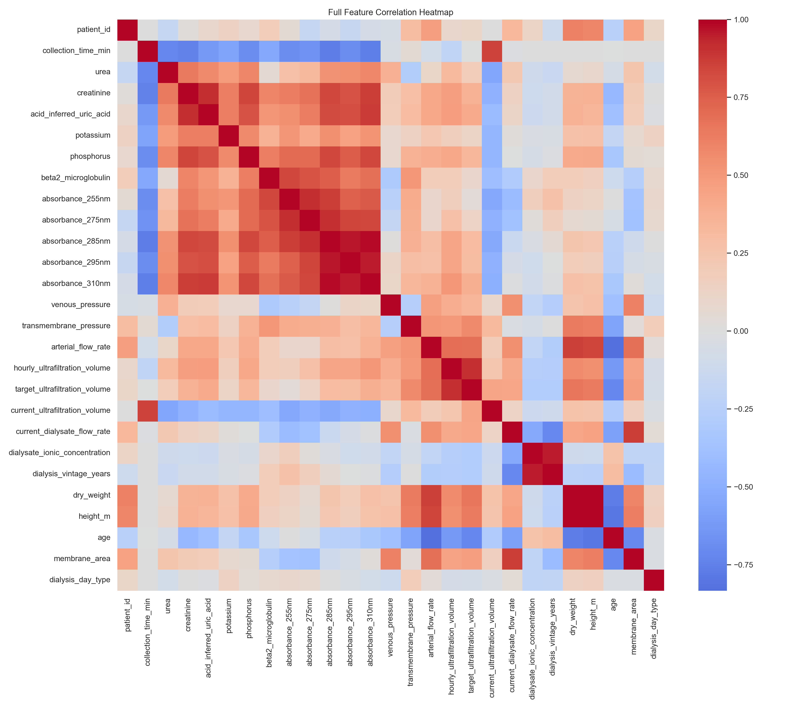
Dataset Profile & Feature Correlations
Data structure used throughout the pipeline
Dataset Summary
Feature Correlation Heatmap
510 rows, 29 columns
9 unique ESRD patients
30 HD sessions total
17 time points per session (0–240 min)
5 absorbance features (UV wavelengths)
8 machine parameters
6 personal features
6 toxin prediction targets
Notes:
資料集包含510個數據點，來自9名患者的30次透析session。
每次session平均17個時間點（0至240分鐘），涵蓋19個特徵和6個預測目標。
特徵相關性熱圖顯示，多個吸光值波長與毒素濃度之間存在顯著相關性，特別是285 nm波長。
注意到部分特徵之間存在高度多重共線性，這是後續進行特徵選擇的重要依據。

Slide 11
Early Baseline Results
Strong-looking metrics, but not yet trustworthy
Initial Row-Level CV Best Results
Why These Results Were Not Final
Target | Best Model | Feature Set | R²
Urea | SVR | Full (19 feat.) | 0.938
Creatinine | SVR | Full (19 feat.) | 0.903
Uric Acid (inferred) | SVR | Full (19 feat.) | 0.914
Phosphorus | SVR | Full (19 feat.) | 0.876
Potassium | KNN | Full (19 feat.) | 0.685
β2-Microglobulin | KNN | Selected (8 feat.) | 0.872
Row-level CV ignores session structure — correlated measurements leak across folds
All initial R² values are likely inflated
Model selection on the same folds used for reporting → selection bias
Scatter-plot R² ≠ CV R² — easily misread in figures
Retained as exploratory benchmarks only — not final evidence
Notes:
初始行層級CV的結果看似令人滿意（R²達0.685至0.938），但這些數值是不可信的。
根本問題在於：行層級CV將同一session內高度相關的測量值分散在不同fold中，造成資料洩漏。
這些結果僅作為探索性基準保留，清楚標注為「不可信」，不能作為最終性能依據。
真正可信的評估必須使用session層級的GroupKFold，確保每個fold的測試集都是完全未見過的session。

Slide 12
Key Issue: Session-Level Data Leakage
Why row-level splitting is unsafe for repeated HD measurements
WRONG: Row-Level Splitting
CORRECT: Session-Level Splitting
Session A: rows 1–5, measured every 15 min
Row-level CV puts rows 1,3,5 in train; rows 2,4 in test
Same-session rows are highly correlated — same patient, same day
Correlated data leaks into test fold → inflated performance
This is the approach used in the senior’s paper
All rows from one session stay together in the same fold
GroupKFold with session_id as grouping variable
Train sessions never appear in test folds
More conservative — but honest — performance estimates
This is what my corrected pipeline implements
Notes:
這張投影片用左右對比的方式清楚說明了資料洩漏的根本問題。
行層級分割（左側，錯誤做法）：同一session的相鄰測量值同時出現在訓練集和測試集，由於強烈的同內session相關性，模型實際上在「測試」它已經間接見過的數據。
session層級分割（右側，正確做法）：整個session的所有行保持在同一fold，訓練session和測試session之間沒有任何數據重疊。
這是本研究最核心的方法論貢獻之一。

Slide 13
Corrected Evaluation Protocol: GroupKFold Cross-Validation
Session-level grouped CV — every session participates as test once
STEP 1
STEP 2
STEP 3
Group Sessions by Session ID
5-Fold GroupKFold
Consistent Best-Model Selection
30 sessions assigned unique IDs All rows from same session kept in the same fold Prevents within-session leakage
~24 sessions train / ~6 sessions test Each session appears as test exactly once across 5 folds All sessions evaluated fairly
Best model per toxin selected by maximum mean R² across folds Same model used for all folds No per-fold cherry-picking
Key Principle
GroupKFold ensures each unseen session is predicted by a model that never saw it during training — honest generalization evidence.
Notes:
這張投影片說明了修正後的評估協議：5折GroupKFold交叉驗證。
第一步：將30個session按session_id分組，確保同一session的所有測量值在同一fold中。
第二步：5折GroupKFold中，每折約24個session用於訓練，約6個session作為測試，每個session在整個過程中恰好被測試一次。
第三步：一致性最優模型選擇——根據5個fold的平均R²選出每種毒素的最佳模型，同一模型用於所有fold的預測，不允許逐fold挑選。
這種設計確保每個session都能被一個從未見過它的模型公正評估。

Slide 14
Model Selection: Grouped CV Best Results
Best model per toxin selected by maximum mean R² across GroupKFold folds
Target | Best Model | Feature Set | Grouped CV R²
Urea | SVR (rbf) | Abs + Machine + Personal | 0.745
Creatinine | SVR (rbf) | Abs + Machine + Personal | 0.757
Uric Acid (inferred) | Linear Regression | Absorbance Only | 0.773
Phosphorus | Random Forest | Absorbance Only | 0.697
Potassium | Random Forest | Absorbance Only | 0.295
β2-Microglobulin | Random Forest | Abs + Machine + Personal | 0.769
Key Observations
SVR (rbf) wins for Urea and Creatinine; Random Forest wins for Phosphorus, Potassium, B2M
Linear Regression achieves the best R² (0.773) for Uric Acid using absorbance-only features
Potassium remains hardest (R²=0.295) — consistent with the senior’s findings
All R² values are means over 5 GroupKFold folds — no within-session leakage
Notes:
這張表格展示了GroupKFold交叉驗證中每種毒素的最佳模型選擇結果。
SVR (rbf核函數) 在Urea（R²=0.745）和Creatinine（R²=0.757）上表現最佳，使用完整特徵集（吸光值+機器+個人）。
線性回歸在Uric Acid（R²=0.773）上取得最高R²，僅使用吸光值特徵，顯示該毒素與UV吸光值之間存在較強的線性關係。
Random Forest在Phosphorus（R²=0.697）、Potassium（R²=0.295）和B2M（R²=0.769）上表現最佳。
Potassium的R²僅0.295，在所有毒素中最難預測，與前人研究結論一致。
所有R²值均為5個GroupKFold fold的平均值，反映模型對未見session的真實泛化能力。

Slide 15
Grouped Cross-Validation Results
GroupKFold evaluation across all 30 sessions — unseen sessions as test per fold
Target | Model | Feature Set | Grouped CV R² | RMSE | MAE
Urea | SVR (rbf) | Abs + Mach + Personal | 0.745 | 4.130 | —
Creatinine | SVR (rbf) | Abs + Mach + Personal | 0.757 | 0.624 | —
Uric Acid (inferred) | Linear Regression | Absorbance Only | 0.773 | 0.293 | —
Phosphorus | Random Forest | Absorbance Only | 0.697 | 0.161 | —
Potassium | Random Forest | Absorbance Only | 0.295 | 0.113 | —
β2-Microglobulin | Random Forest | Abs + Mach + Personal | 0.769 | 205.56 | —
These are the trustworthy GroupKFold cross-validation results
Each R² is the mean across 5 folds where test sessions are completely held out from training
Uric Acid R²=0.773 (best); B2M=0.769; Creatinine=0.757; Urea=0.745
Lower than row-level CV early results — expected and correct; more honest estimates
Potassium (R²=0.295) remains hardest — consistent with literature
Notes:
這張表格展示了GroupKFold交叉驗證的完整結果，包含各毒素的最佳模型、特徵集、R²和RMSE。
正確數值：Uric Acid R²=0.773（最佳），B2M=0.769，Creatinine=0.757，Urea=0.745，Phosphorus=0.697，Potassium=0.295。
這些數值均低於早期行層級CV的結果，這是預期中的正確現象——反映了消除session洩漏後更誠實的性能估計。
B2M的RMSE為205.56，單位為ng/mL，數值較大但在臨床意義上仍可接受。
這些是本研究最終可信的評估結果，每個R²均來自GroupKFold中從未參與訓練的unseen session。

Slide 16
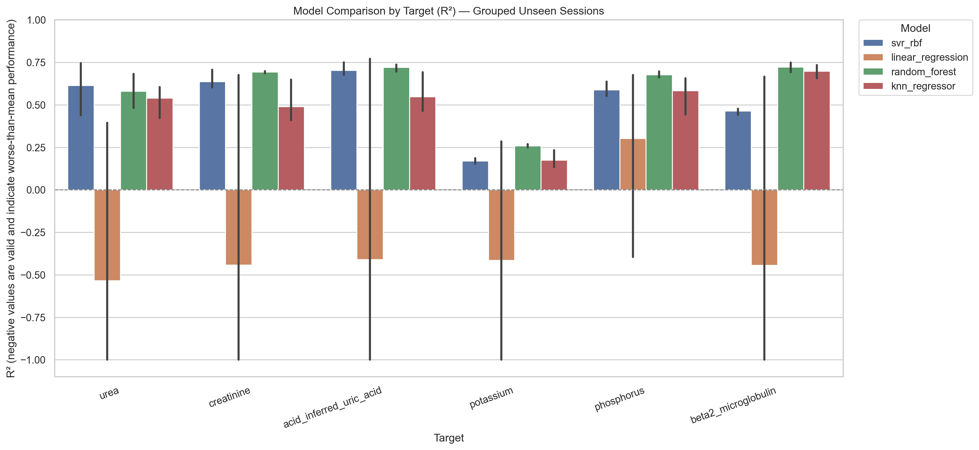
Grouped CV Evidence: R² Model Comparison by Target
4 models compared per toxin across all GroupKFold folds — grouped unseen sessions
Notes:
這張圖表展示了四種模型在所有6種毒素上的GroupKFold R²比較。
圖表標題明確標注「Grouped Unseen Sessions」，確認這是session層級GroupKFold的結果，非行層級CV。
顯著發現：線性回歸（橙色）在多種毒素上出現極負的R²值，說明該模型在session層級評估中嚴重欠擬合。
SVR（藍色）在Urea和Creatinine上表現穩定；Random Forest（綠色）在多種毒素上具有競爭力。
誤差線反映了5個fold之間的variance，Potassium的不確定性最大，顯示該目標預測難度最高。

Slide 17
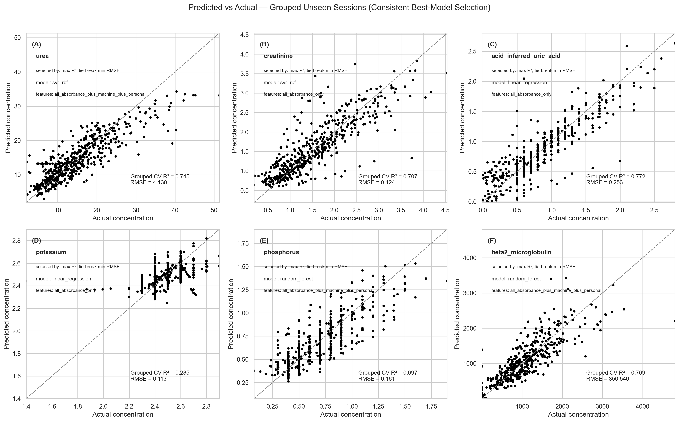
Grouped CV Evidence: Predicted vs. Actual
Each panel shows one toxin target — best model on grouped unseen sessions
Notes:
六個面板分別展示了6種毒素在GroupKFold unseen session上的預測值vs實際值散點圖。
面板標題格式為「(A) Urea: SVR rbf, features=..., R²=0.745, RMSE=4.130」，清楚顯示每種毒素的最佳模型配置。
Uric Acid（R²=0.773）和Creatinine（R²=0.757）的散點最集中在對角線附近，預測品質最好。
Potassium（R²=0.295）的散點最分散，說明該毒素的預測不確定性最高。
圖表副標題確認使用「Consistent Best-Model Selection」——每種毒素的最佳模型在所有fold中保持一致。

Slide 18
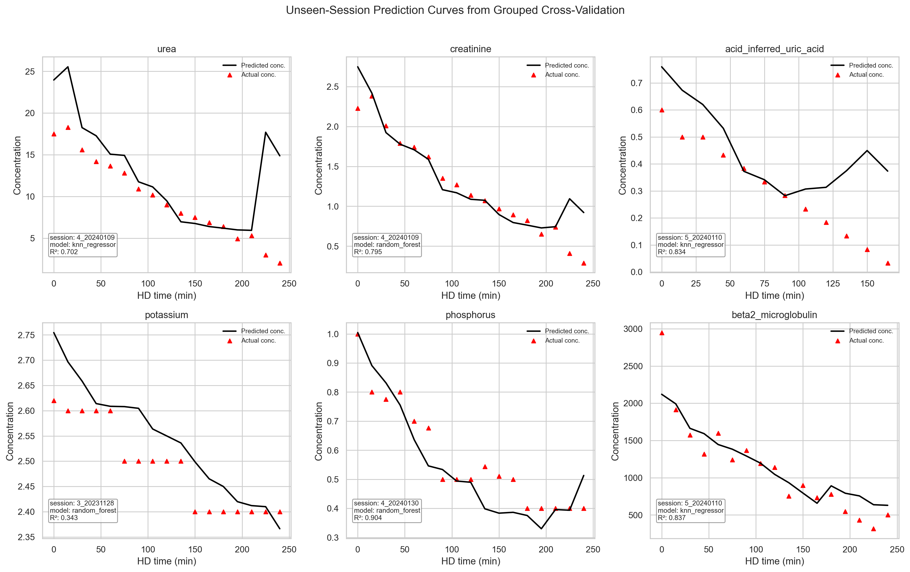
Grouped CV Evidence: Session Prediction Curves
Time-series predictions on unseen sessions from GroupKFold cross-validation
Notes:
這張圖展示了GroupKFold交叉驗證中代表性unseen session的時序預測曲線。
圖表標題為「Unseen-Session Prediction Curves from Grouped Cross-Validation」——明確說明這是GroupKFold的結果，而非固定的held-out測試集。
每個面板對應一種毒素，紅色三角形為實際測量值，黑色線條為模型預測值，x軸為透析時間（分鐘）。
可觀察到毒素濃度在透析初期快速下降的典型趨勢，多數toxin的預測曲線能夠捕捉到這種動態變化。
Potassium的預測曲線波動較大，再次印證該毒素是最具挑戰性的預測目標。

Slide 19
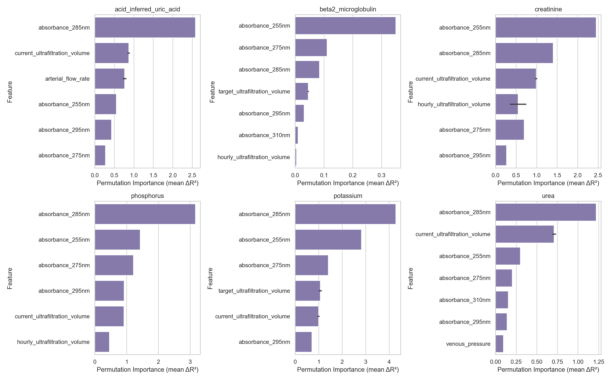
Feature Importance Analysis
Which features matter most for toxin prediction?
Key Findings
285 nm absorbance = top feature — not in the senior’s system
Machine parameters (UF volume, TMP) add meaningful signal
Feature selection improves interpretability, not always performance
Contrasts with senior’s claim that selection always helps
Notes:
特徵重要性分析揭示了哪些特徵對毒素預測貢獻最大。
285 nm吸光值是最重要的單一特徵，但它恰恰是前人研究中被忽略的波長之一。
機器參數（特別是超濾體積和跨膜壓力）也提供了有意義的預測信號。
不同毒素的最重要特徵有所不同——這支持了針對每種毒素分別選擇最佳特徵集的設計決策。
特徵選擇能提高可解釋性，但不一定能提升預測性能，與前人研究中的簡單結論不同。

Slide 20
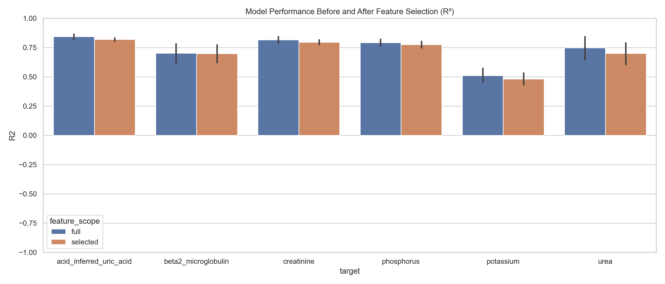
Feature Selection: Full vs. Selected Performance
Does selecting fewer features actually improve prediction?
Key insight: Feature selection improves interpretability but does not consistently outperform full features — unlike the senior’s clean narrative.
Notes:
這張對比圖展示了完整特徵與特徵選擇後在各毒素上的性能比較。
結果顯示：特徵選擇的效果因毒素而異——對某些毒素略有提升，對其他毒素則略有下降，並無一致的改進趨勢。
這與前人研究中「特徵選擇總能提升性能」的結論形成對比，說明在小型資料集上的特徵選擇效果難以預測。
特徵選擇的主要價值在於提升模型可解釋性和降低計算複雜度，而非保證更好的預測性能。
這一發現對臨床應用具有重要意義：在資料量有限的情況下，應謹慎對待特徵選擇的過度優化。

Slide 21
Systematic Comparison: My Work vs. Senior’s Paper
Dimension | Senior’s Paper | My Project
Wavelengths | 3 (255, 275, 310 nm) | 5 (added 285, 295 nm)
Models tested | SVR only | SVR, Linear Reg., Random Forest, KNN
CV strategy | Row-level 5-fold CV (leakage) | Session-level 5-fold GroupKFold (no leakage)
Leakage control | Not addressed | Strict session-level splitting throughout
Session grouping | Not used | All 30 sessions rotate as grouped test folds
Feature selection | ANOVA F-test + wrapper | Mutual info + permutation importance
Model persistence | Not described | Saved .joblib + metadata + manifest
Reproducibility | MATLAB, limited details | Full Python pipeline with unit tests
Audit & correction | Not applicable | 3 major corrections documented
Evaluation honesty | Single reported R² | Exploratory vs. grouped CV clearly separated
Notes:
這張系統性比較表清楚地呈現了本研究與前人研究在各個維度上的差異。
最關鍵的差異在於交叉驗證策略：前人研究使用行層級5折CV（存在洩漏），本研究使用session層級5折GroupKFold（無洩漏）。
前人研究未進行session分組，本研究的GroupKFold設計確保所有30個session都能輪流作為測試集，每個session恰好被測試一次。
在可重現性方面，本研究提供完整的Python管線、單元測試和版本化審計報告，遠超前人研究的MATLAB實現。
這種系統性比較有助於客觀評估本研究的方法論進步，同時也承認前人研究作為概念驗證的重要價值。

Slide 22
Discussion
What was learned from the full implementation process
What Changed vs. the Senior’s Paper
Issues Encountered & Resolved
Expanded to 5 wavelengths — 285 nm is the most important feature
Multi-model comparison: SVR wins Urea/Creatinine; RF wins Phosphorus/Potassium/B2M; LR wins Uric Acid
Session-level GroupKFold: more conservative and honest than row-level splits
All 30 sessions evaluated as unseen test — no single held-out set needed
Feature selection improves interpretability, not consistently performance
Scatter-plot R² ≠ CV R² → redesigned evaluation figures
Session leakage → GroupKFold by session_id throughout
Model selection bias → consistent best-model selected by max mean GroupKFold R²
‘Acid’ column ambiguous → documented as inferred uric acid
Unrealistic early predictions → traced to config error, fixed
Remaining Limitations:
Small dataset (9 patients, 30 sessions) | GroupKFold folds vary in size | ‘Acid’ mapping is inferred | Not a clinical product
Notes:
討論部分聚焦於本研究與前人研究的主要差異以及遇到的問題和解決方案。
在模型選擇結果方面，GroupKFold評估揭示了不同的最優模型：SVR在Urea和Creatinine上勝出，線性回歸在Uric Acid上取得最高R²，Random Forest在Phosphorus、Potassium和B2M上表現最佳。
三個主要問題得到了解決：散點圖R²與CV R²的混淆、session層級資料洩漏，以及模型選擇偏差。
剩餘局限性包括：小型資料集（9名患者）、GroupKFold各fold大小不均等，以及「Acid」列的語義映射仍為推斷。

Slide 23
Conclusion
Problem
6 uremic toxin targets from optoelectronic HD data — clinically meaningful multivariate regression
Method
AI-agent-assisted pipeline: 5 wavelengths, 4 models, session-level GroupKFold evaluation
Evaluation Rigor
GroupKFold ensures every session is tested unseen — eliminates row-level CV bias throughout
Key Result
Uric Acid R²=0.773, B2M=0.769, Creatinine=0.757, Urea=0.745 — all from grouped unseen sessions
Outcome
Evaluation discipline matters as much as model choice. Senior’s paper: solid concept; this project: stress-tested rigor.
Notes:
結論總結了本研究的四個核心成就：問題定義、方法論、評估嚴謹性和關鍵結果。
關鍵結果（正確的GroupKFold數值）：Uric Acid R²=0.773（最佳），B2M=0.769，Creatinine=0.757，Urea=0.745，均來自GroupKFold的unseen session評估。
這些數值低於前人研究報告的0.822至0.959，但它們是真正可信的性能估計——反映模型對未見session的實際泛化能力。
評估紀律與模型選擇同等重要：透過消除資料洩漏和模型選擇偏差，我們提供了可以信任的研究證據。

Slide 24
Future Work
Grounded in current project findings
Repeated GroupKFold / LOGO CV
Confirm ‘Acid’ semantics
Repeated GroupKFold or leave-one-patient-out for better variance estimates
Verify ‘Acid’ column maps to uric acid with clinical domain experts
Nested hyperparameter tuning
Time-series modeling
Nested CV for SVR kernel and regularization within each GroupKFold fold
Explore LSTM or temporal features — intra-session data has time structure
Larger patient cohort
Residual diagnostics
Expand to larger cohort — 9 patients limits generalizability
Per-session residual analysis to identify hardest-to-predict sessions
Notes:
六個未來研究方向均根植於當前研究的發現。
最直接的改進是使用重複GroupKFold或留一患者交叉驗證（LOGO CV），以獲得更穩健的性能估計和variance分析。
「Acid」列的語義確認需要臨床領域專家介入，以正式確認其映射到尿酸的正確性。
對於SVR，可以在每個GroupKFold fold內進行嵌套超參數調整，避免超參數選擇偏差。
時序建模（如LSTM）可以更好地利用透析過程中的時間動態信息。
擴大到更多患者（遠超9名）是提升模型泛化能力的最根本途徑。

Slide 25
Reflection & Final Takeaway
Trustworthy ML requires both predictive modeling skill and evaluation discipline
The AI agent accelerated not just coding, but the entire correction-and-learning cycle
The value is not R² scores — it’s the documented path from initial results to trustworthy evidence
Three corrections (figure framing, session leakage, consistent GroupKFold protocol) each added honesty
Senior’s paper: solid proof-of-concept. This project: stress-tested with implementation rigor.
Project Deliverables
GitHub Repository | Python pipeline | Unit tests | Saved models | Versioned reports | This presentation
Notes:
最後的反思強調了本研究最重要的學習：可信賴的機器學習同時需要預測建模技能和評估紀律。
AI代理人不僅加速了程式碼生成，更重要的是加速了整個「識別問題→修正→學習」的週期。
本研究的核心價值不在於R²數值本身，而在於從初步結果到可信證據的完整記錄路徑——包括三次重大修正及其背後的方法論思考。
前人研究提供了堅實的概念驗證基礎，本研究則通過嚴格的session層級GroupKFold評估對其進行了系統性的方法論壓力測試。
這種研究態度——願意主動識別並修正自身的評估缺陷——是科學研究誠信的核心體現。

