Slide 1
Security Operations: SSO CS-6967 Security Operations Jun Xu Fall 2022 Credits of some slides belong to https://slideplayer.com/slide/7996704/

Slide 2

Recap: the Network We Have Now
VirtualBox
WAN (External Network, simulating Internet)
Business needs of the Web Server in the LAN:
Only traffic to port numbers 22/8000/9001 is needed
22: SSH
8000: HTTP
9001: Database
Any traffic from anywhere to port number 8000 in the Web Server should be allowed
Only traffic from the LAN to port numbers 22/9001 is allowed
KALI Linux
Virtual Network
Adapter (NAT Network)
OpenWrt VM
(Router)
LAN (Internal Network, simulating business network)
WebGoat Server
VPN
Virtual Network
Adapter (Host-Only)
VPN Server

Slide 3
The Next Problem: Authentication of Multiple Applications
VirtualBox
WAN (External Network, simulating Internet)
Web App 1: Account Management
Web App 2: Cloud Storage
Web App 3: HR Systems
Web App 4: Emails
…
KALI Linux
Virtual Network
Adapter (NAT Network)
OpenWrt VM
(Router)
LAN (Internal Network, simulating business network)
WebGoat Server
Virtual Network
Adapter (Host-Only)
VPN Server

Slide 4
Consider U of U as an Example
https://portal.app.utah.edu/
https://gcloud.utah.edu/
https://utah.instructure.com/
https://ubenefits.app.utah.edu/
And more …
Every application can require authentication, creating a heavy burden for the application providers and the users

Slide 5
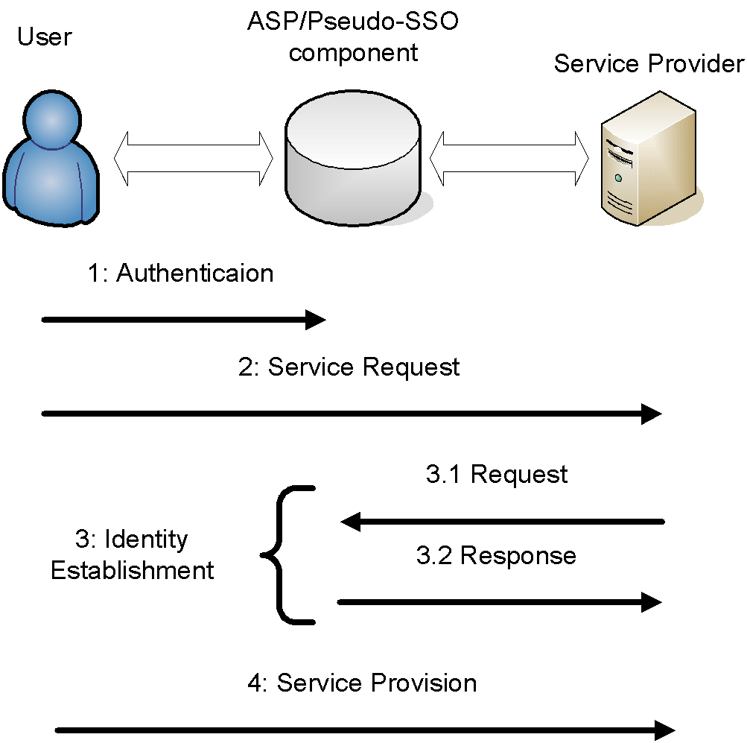
Solution: Single Sign-On (SSO)
Let users authenticate themselves once and access different applications without re-authentication
Increases the usability of the network
Centralizes the management of relevant system parameters
Two main type of SSO Systems: Pseudo-SSO and True-SSO

Slide 6
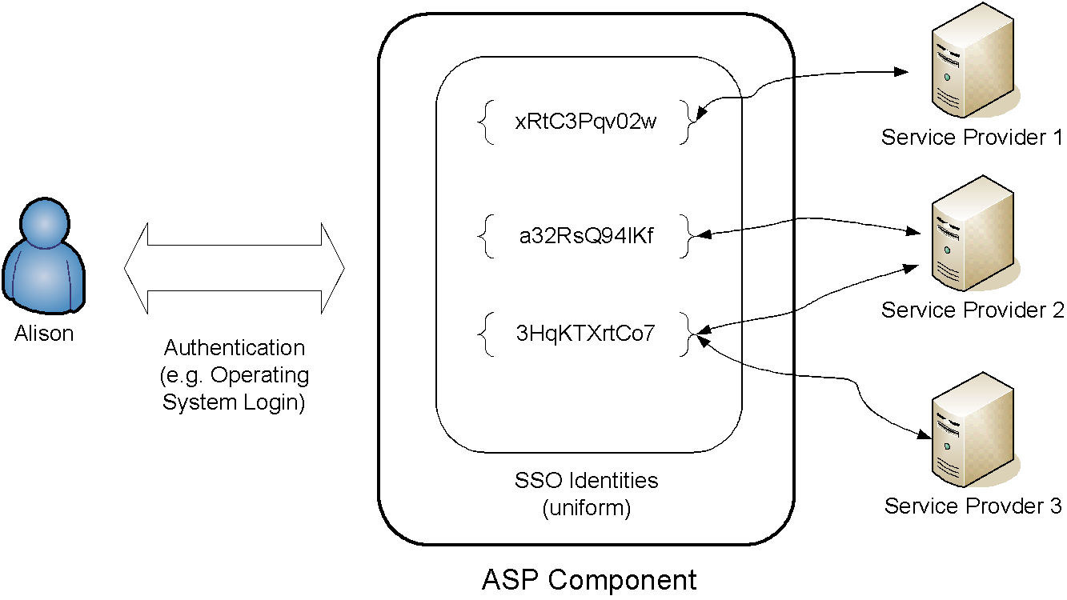
True SSO

Slide 7
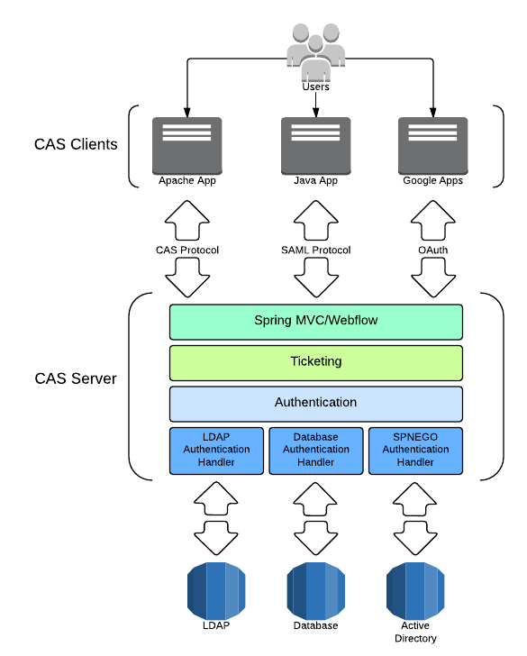
What Happens at Utah: Central Authentication Service (or What I Believe)

Slide 8
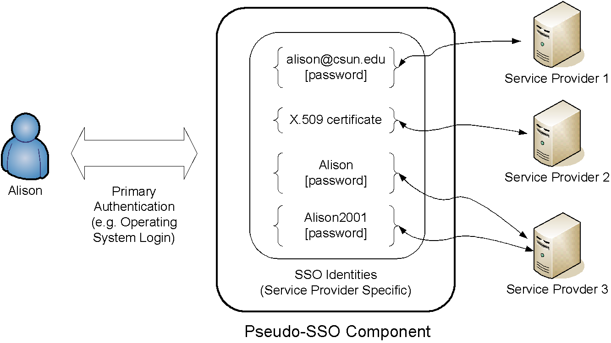
Pseudo-SSO

Slide 9
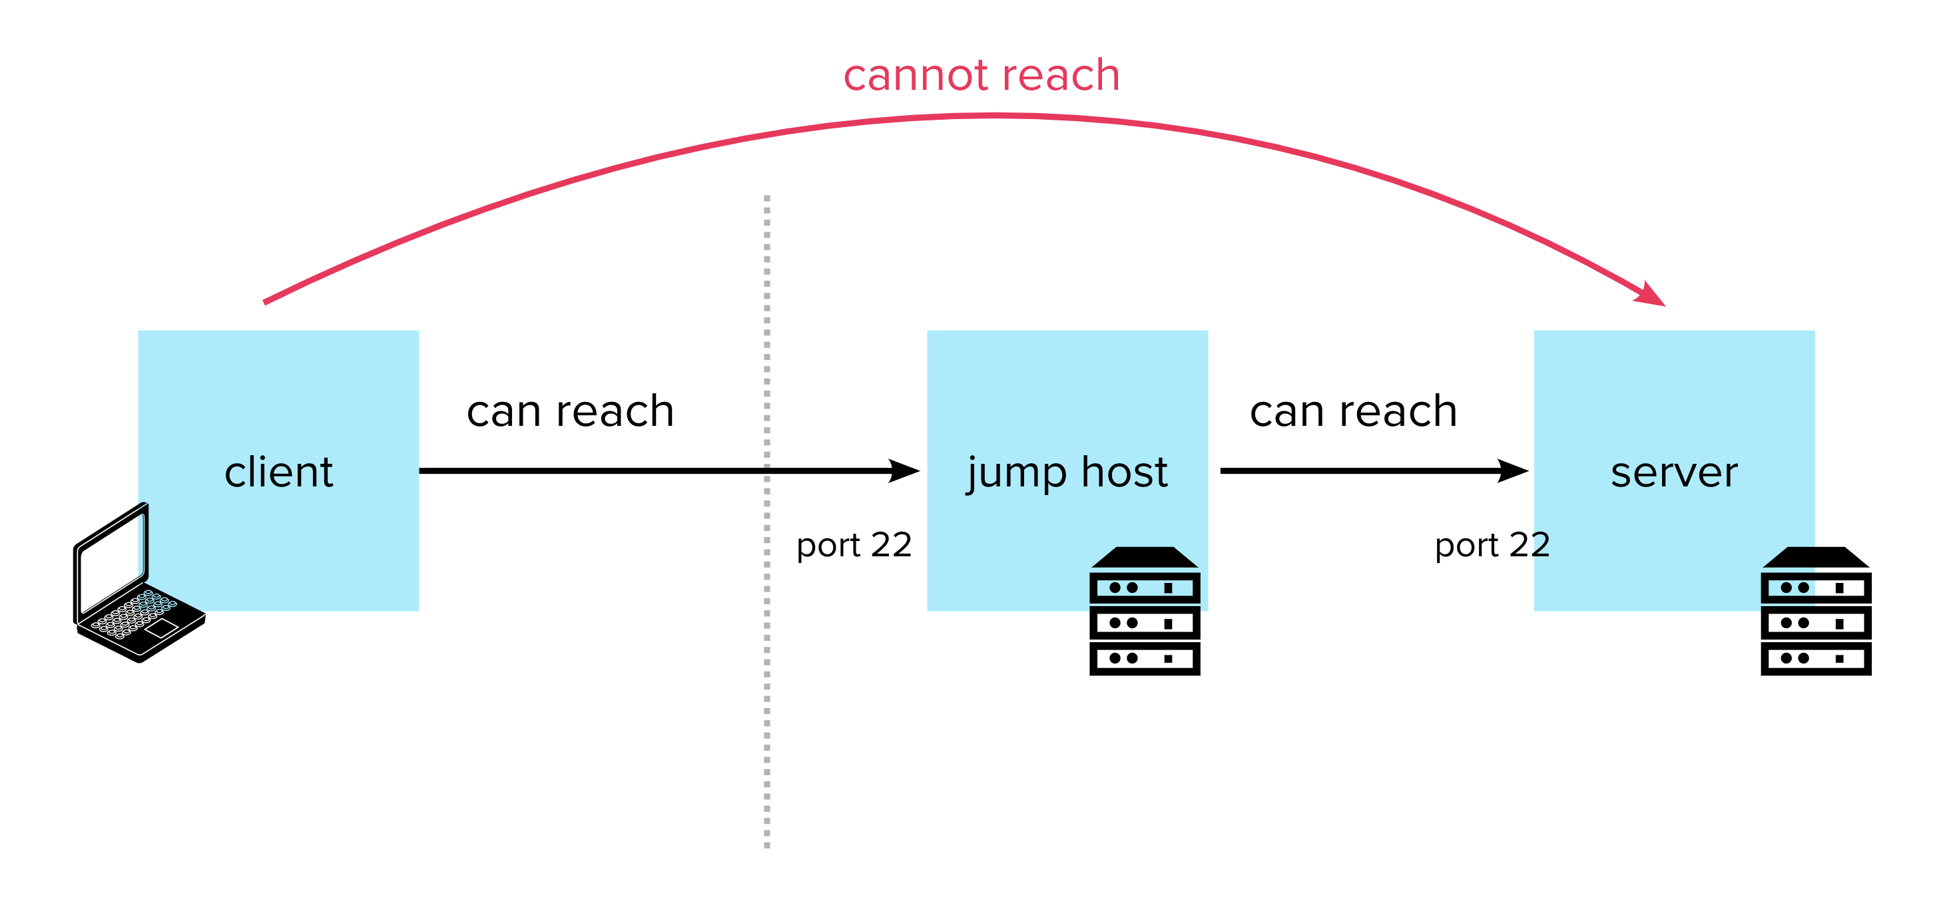
Jump Server: An Implementation of Pseudo-SSO (Our Focus in This Course)

Slide 10
Setting Up a Jump Server in Our LAN
VirtualBox
WAN (External Network, simulating Internet)
Everything that needs authentication can be authenticated by the Jump Server now
KALI Linux
Virtual Network
Adapter (NAT Network)
LAN (Internal Network, simulating business network)
Jump Server
OpenWrt VM
(Router)
Auto http
SSH
Emails
WebGoat Server
Non-auth
http
Virtual Network
Adapter (Host-Only)
VPN Server

Slide 11
Demo Time

