Slide 1
Introduction CS-6967 Security Operations Jun Xu Fall 2022

Slide 2
About the Course
CS-6967, Security Operations; A core course of the Secure Computing Master Track
Offered for the first time at U this semester (in fact, this course is rarely offered in colleges)
Canvas: https://utah.instructure.com/courses/802941
Lecture Time: Monday & Wednesday, 03:00PM-04:20PM
Lecture Location: WEB 1248 (Zoom concurrently; Check Canvas for details)
Syllabus: https://utah.instructure.com/courses/802941/pages/syllabus

Slide 3
About the Instructor
Jun Xu, Assistant Professor, SoC, https://sites.google.com/view/junxzm/home
Assistant Professor @ Stevens Institute of Technology, 2018 – 2021
Ph.D. from Penn State in 2018
Worked for the Security Team at FireEye and Samsung Research American
Research: Computer Security (vulnerabilities, attacks, defenses, malware)
Contact Info: Office MEB 3442, junxzm@cs.utah.edu
Office Hours: Monday 1:30PM - 2:30PM, MEB 3442 (my office is under work until )

Slide 4
Objectives of this Course
“This course introduces concepts, technologies, and tools on asset protection, integrity management, availability methodology, incident response, and other issues that the operational team needs to know to properly run security products and services in a live environment”
What does this mean???

Slide 5
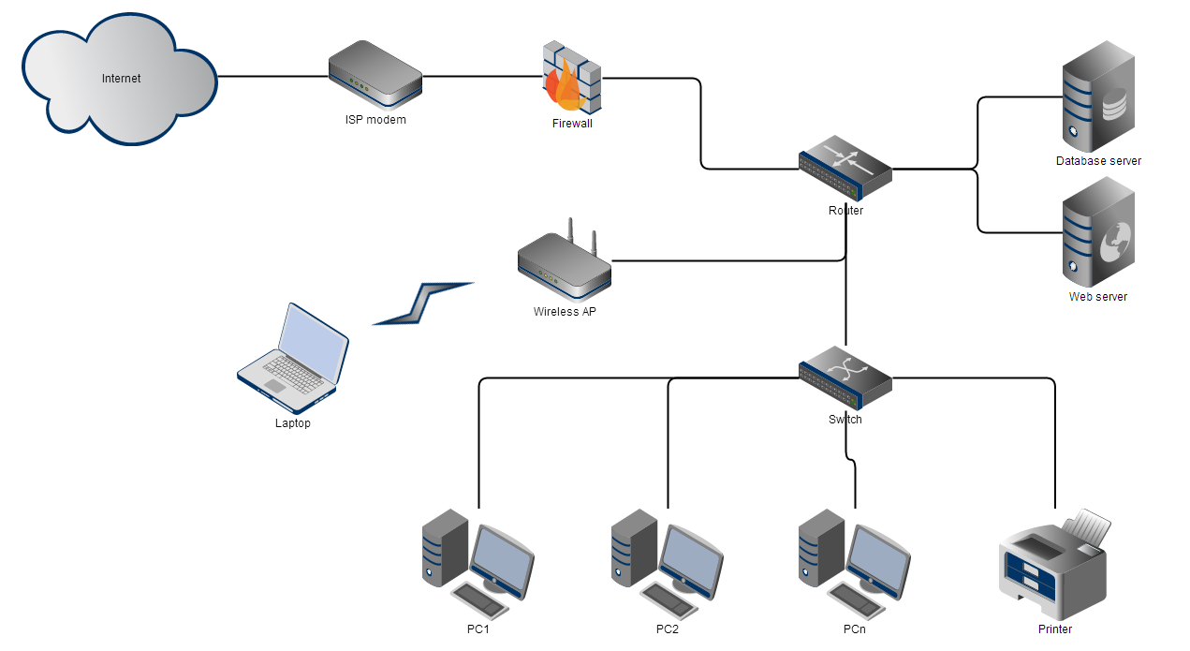
Let’s Consider this Small Business Network
We are going to build a similar network for this course!!!

Slide 6
Security Operations Aim to Ensure the CIA Model in the Network
Confidentiality
Definition: Information is not made available or disclosed to unauthorized individuals or entities
Examples in the network:
Information of clients in the database server cannot be seen by an arbitrary internet user
Emails owned by employee A on PC1 cannot be seen by another employee
…
Integrity
Definition: maintaining and assuring the accuracy and completeness of data over its entire lifecycle. This means that data cannot be modified in an unauthorized or undetected manner.
Examples in the network:
Contents returned to users should be intended when they visit the website hosted on the webserver
Documents printed by the printer should display the contents sent by the user
…
Availability
Definition: the computing systems and information must be available when they are needed
Examples in the network:
Data in the database server should always be available when the owner wants it
PC2 should be able to work when an authorized employee wants to use it
…
https://en.wikipedia.org/wiki/Information_security

Slide 7
But Not CIA Under Every Circumstance
CIA can be sabotaged in many ways
Earthquake, flood, and power outage can break availability
Hardware errors, such as bit flip in memory or disk, can break integrity
Lost of laptops or cell phones can break confidentiality
All the above are out of the scope of this course
Why???

Slide 8
Instead, CIA under An Adversarial Setting
Threat Model
Adversaries exist
External attackers
Insiders
Adversaries aim to break the C, I, or A
Adversaries can take many different actions
Protect CIA threatened by actions of the adversaries

Slide 9
What Makes this Course Special
Other security courses focus more on the concepts, the theories, and the techniques
After taking those courses, you know a lot; but you may not know how to approach security exactly (e.g., you know how firewall works but you do not know which tools to use and how to correctly install, configure, and manage them)
This course centers on the practice side
After taking this course, your knowledge body may not grow too much, but your skill sets applicable to the real world will be significantly extended (e.g., you will know how to setup a local, software-based firewall for a machine)
We hope this course can better prepare you for a position of security admin or CSO

