Slide 1
Security Operations: VPN CS-6967 Security Operations Jun Xu Fall 2022 Credits of many slides belong to Tse-Han Wang @ National Chiao Tung University

Slide 2


Recap: The Network and Configurations We Have Now
VirtualBox
WAN (External Network, simulating Internet)
Business needs of the Web Server in the LAN:
Only traffic to port numbers 22/8000/9001 is needed
22: SSH
8000: HTTP
9001: Database
Any traffic from anywhere to port number 8000 in the Web Server should be allowed
Only traffic from the LAN to port numbers 22/9001 is allowed
KALI Linux
Virtual Network
Adapter (NAT Network)
OpenWrt VM
(Router)
LAN (Internal Network, simulating business network)
SSH
WebGoat Server
You cannot SSH into the Web Server from the WAN!!!
Virtual Network
Adapter (Host-Only)
…

Slide 3
But in Reality
We often need to SSH into the web server from the LAN
E.g., the server is down but Admin is on travel
So, what can we do???

Slide 4
Let’s Add A VPN Server to Our Network
VirtualBox
WAN (External Network, simulating Internet)
Business needs of the Web Server in the LAN:
Only traffic to port numbers 22/8000/9001 is needed
22: SSH
8000: HTTP
9001: Database
Any traffic from anywhere to port number 8000 in the Web Server should be allowed
Only traffic from the LAN to port numbers 22/9001 is allowed
KALI Linux
Virtual Network
Adapter (NAT Network)
OpenWrt VM
(Router)
LAN (Internal Network, simulating business network)
WebGoat Server
Tunnel
Virtual Network
Adapter (Host-Only)
VPN Server

Slide 5
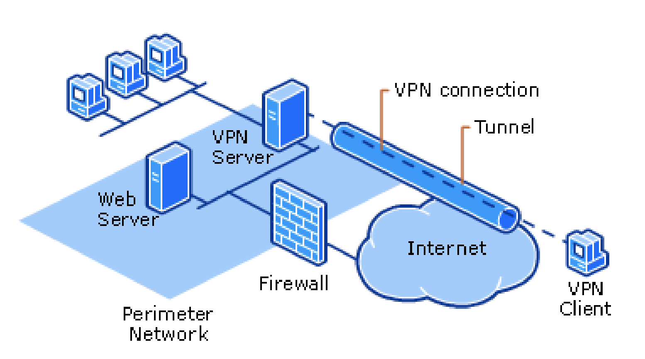
Virtual Private Network (VPN)
Extension of a private network that encompasses links across shared or public networks like the Internet.
Enable to send data between two computers across a shared or public internetwork in a manner that emulates the properties of a point-to-point private link.

Slide 6
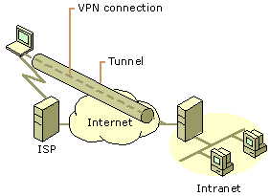
Common Uses of VPNs (1/3)
1. Remote Access Over the Internet

Slide 7
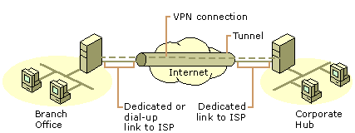
Common Uses of VPNs (2/3)
2. Connecting Networks Over the Internet (Site to Site VPN)

Slide 8
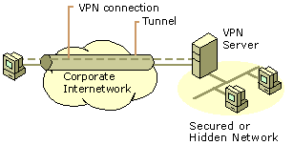
Common Uses of VPNs (3/3)
3. Connecting Computers over an Intranet (similar to 1.)

Slide 9
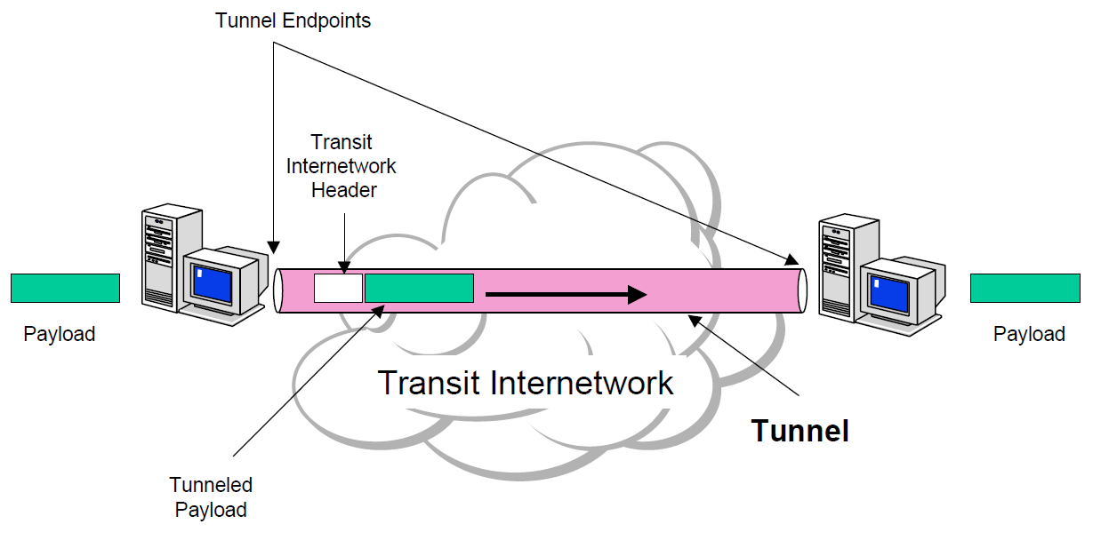
VPN Key Concept - Tunneling
VPN consists of a set of point-to-point connections tunneled over the Internet.
In order to achieve tunneling, the packets are encapsulated as the payload of packets.
Payloads, to and from addresses, port numbers and other standard protocol packet headers
As seen by the external routers carrying the connection

Slide 10
Basic VPN Requirements
User Authentication
Key Management
Address Management
Data Encryption

Slide 11
Basic VPN Requirements (1/2)
User Authentication
Verify the VPN client's identity and restrict VPN access to authorized users only.
Provide audit and accounting records to show who accessed what information and when.
X.509, pre-shared key, etc.
Key Management
Generate and refresh encryption keys for the client and the server.
Simple Key Management for IP: ISAKMP/Oakley, etc.

Slide 12
Basic VPN Requirements (2/2)
Address Management
Assign a VPN client's address on the intranet and ensure that private addresses are kept private
Data Encryption
No one outside the VPN can alter the VPN.
Data carried on the public network must be rendered unreadable to unauthorized clients on the network.

Slide 13
VPN Security
Authentication
Ensuring that the data originates from the source that it claims.
Access Control
Restricting unauthorized users from gaining admission to the network.
Confidentiality
Preventing anyone from reading or copying data as it travels across the Internet.
Data Integrity
Ensuring that no one tampers with data as it travels across the Internet.

Slide 14
Common Implementations
Based on PPP
Point-to-Point Tunneling Protocol (PPTP) (PPP + encryption + GRE)
Layer Two Tunneling Protocol (L2TP) (PPTP + L2F)
Based on TCP/IP
L2TP/IPsec
IPsec Tunnel mode [RFC 4301]
BGP/MPLS IP VPN [RFC 4364]
SSL/TLS
Secure Socket Tunneling Protocol (SSTP) (PPTP + SSL)
SSL VPN
OpenVPN

Slide 15
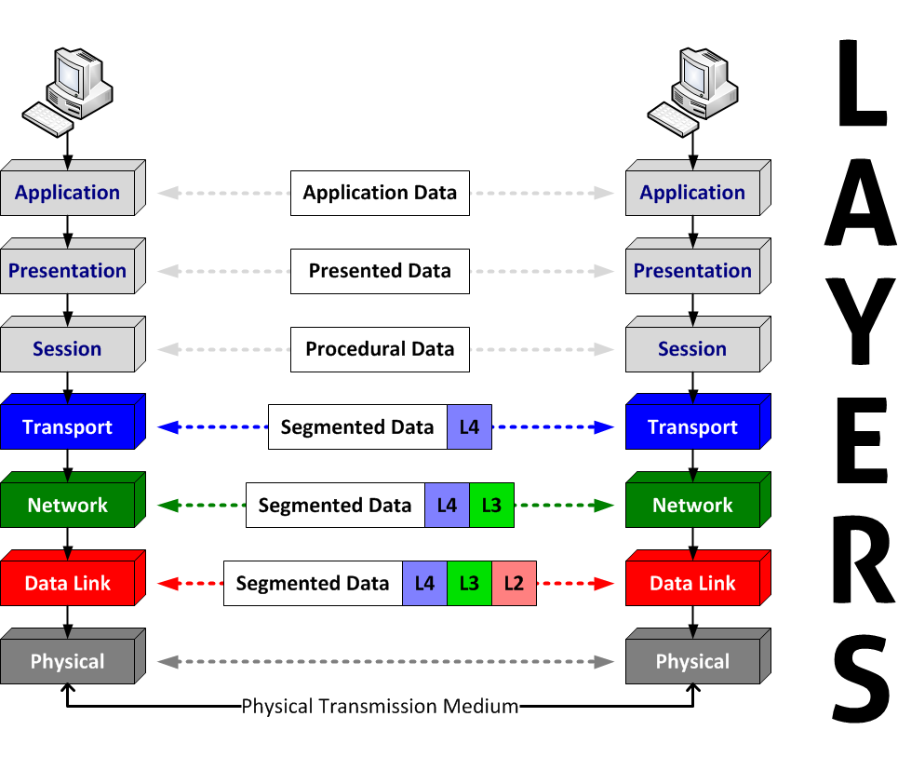
Firewalls Work On the Network, So Let’s Recap Some Network Knowledge
HTTP,
FTP,
DNS
TCP, UDP
IP
MAC
Open Systems Interconnection (OSI) model
Seven Layers

Slide 16
PPP - Point-to-Point Protocol
PPP [RFC 1661] provides a standard method for transporting multi-protocol datagrams over point-to-point (direct) links. => Data link layer (layer 2) protocol
Three components
Encapsulation (for transporting purpose)
Link Control Protocol (for data-link connectability)
Network Control Protocols (NCP) family (L3 management support)
Extra Options
Authentication: PAP, CHAP, EAP, MS-CHAP, MS-CHAPv2, etc.
Link Quality and error detection
Compression
Encryption: MPPC + MPPE, etc.
Multilink (MP, The PPP Multilink Protocol)

Slide 17
Tunneling Protocol
Allows a network user to access or provide a network service that the underlying network does not support or provide directly. (Wikipedia)
GRE (Generic Routing Encapsulation): Establish a virtual point-to-point connection between two networks.
IP as a delivery protocol
Virtual Tunnel: (Tunnel) IP header + GRE packet header
Encapsulation, not encryption

Slide 18
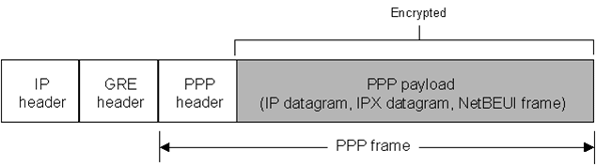
PPTP - Point-to-Point Tunneling Protocol
PPTP [RFC 2637] uses an enhanced GRE mechanism to provide a flow- and congestion-controlled (TCP) encapsulated datagram service for carrying PPP packets.
PPTP creates a GRE tunnel through which the PPTP GRE packets are sent.

Slide 19
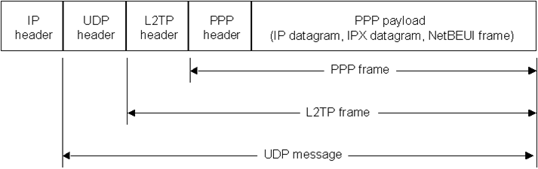
L2TP - Layer Two Tunneling Protocol
L2TP [RFC 2661]: PPTP + L2F (Layer Two Forwarding)
High level protocols (e.g., PPP) establish L2TP session (“call”) within the L2TP tunnel, and traffic for each session is isolated.
A tunnel can contain multiple connections at once.
L2TP over IP internetworks uses UDP and a series of L2TP messages for tunnel maintenance.
L2TPv3 provides additional security features, improved encapsulation, and the ability to carry data links other than simply PPP over an IP network. (Wikipedia)

Slide 20
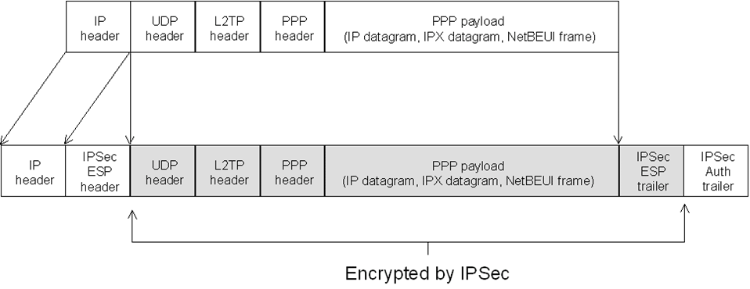
L2TP/IPsec
L2TP does not provide confidentiality or strong authentication.
Usually use IPsec ESP (Encapsulating Security Payload) to encrypt the L2TP packet.
Data encryption begins before the PPP connection process by negotiating an IPSec security association.
Require computer-level authentication using computer

Slide 21
IPsec
IPsec [RFC 4301] is a secure network protocol suite provides authentication and encryption ability over IPv4 network.
Two modes in IPsec
Transport mode: Insert IPsec header (AH/ESP) between IP and TCP header, then modify original IP header.
Tunnel mode: Encapsulate original packet, and prepend new IP and IPsec header.
Two functions that ensure confidentiality:
Authentication Header (AH)
Provide source authentication and integrity without encryption.
Encapsulating Security Payload (ESP)
Provide both data authentication, data integrity and data encryption.
Security Associations (SA) provides the parameters necessary for AH and/or ESP operations.
IKE (Internet Key Exchange): Provide authentication and key exchange. e.g., ISAKMP, OAKLEY

Slide 22
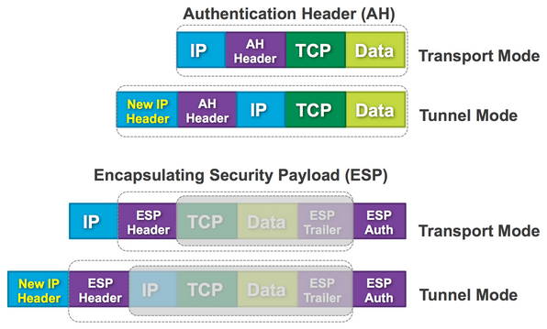
IPsec Modes
Source

Slide 23
SSL VPN
A form of VPN that can be used with a standard Web browser.
The traffic is encrypted with the SSL protocol or Transport Layer Security (TLS) protocol.

Slide 24
References
I Am Anonymous When I Use a VPN – 10 Myths Debunked
Virtual Private Networking: An Overview
BeyondCorp by Google: Protected connection from untrusted networks without the use of a VPN.
See also: Role-Based Access Control (RBAC)
Protocol reference
VPN
PPP / GRE / PPTP / L2TP
IPsec / IKE
IP protocol numbers

Slide 25
Let’s Add A VPN Server to Our Network
VirtualBox
WAN (External Network, simulating Internet)
Business needs of the Web Server in the LAN:
Only traffic to port numbers 22/8000/9001 is needed
22: SSH
8000: HTTP
9001: Database
Any traffic from anywhere to port number 8000 in the Web Server should be allowed
Only traffic from the LAN to port numbers 22/9001 is allowed
KALI Linux
Virtual Network
Adapter (NAT Network)
OpenWrt VM
(Router)
LAN (Internal Network, simulating business network)
WebGoat Server
VPN
Virtual Network
Adapter (Host-Only)
VPN Server

Slide 26
In-class Practice 3 on Wednesday
Set up a VPN server for our network

