Slide 1
Security Operations: Data Backup and Recovery CS-6967 Security Operations Jun Xu Fall 2022 Credits of some slides belong to Muskan Soni

Slide 2

Recap: the Network We Have Now
VirtualBox
WAN (External Network, simulating Internet)
Everything that needs authentication can be authenticated by the Jump Server now
KALI Linux
Virtual Network
Adapter (NAT Network)
LAN (Internal Network, simulating business network)
Jump Server
OpenWrt VM
(Router)
Auto http
SSH
Emails
WebGoat Server
Non-auth
http
Virtual Network
Adapter (Host-Only)
VPN Server

Slide 3
Discussion: Are We Perfectly Secure Now?
Now we have
Authentication
Access Control
Intrusion Detection
…

Slide 4
Things Can Still Go Wrong
Public access to the web server must be enabled
Hidden vulnerabilities can still exist in the web server
New attacks can happen without being detected
An embarrassing but needed mindset: things will go wrong no matter how much we do [the point of doing more: reducing the possibility that things will go wrong]

Slide 5
What Else Can/Should We Do?
Get prepared for attacks and damage!!! → The next part of this course
How?
When attacks happen, one or more of CIA (confidentiality, integrity, availability) properties are sabotaged. We will need to plan ahead to repair those properties
Confidentiality: cannot be recovered [what is lost is lost]; but we need to understand and assess what is lost
Integrity: we will need to reassure the integrity of data and computing resources
Availability: we will need to re-establish the availability of data and computing resources

Slide 6
Data Integrity/Availability
Demo: ransomware [the most common attack on data nowadays]
Discuss: what can we do to ensure data availability assuming that attacks like ransomware will happen

Slide 7
Data Backup and Recovery
Backup is an additional copy of data that can be used for restore and recovery purposes
The backup copy can be created by:
Simply coping data (there can be one or more copies)
Mirroring data (the copy is always updated with whatever is written to the primary

Slide 8
When Data Backup Can Help
Disaster Recovery
Restores production data to an operational state after disaster
Operational
Restore data in the event of data loss or logical corruptions that may occur during routine processing
Security Attacks
Data can be locked when ransomware infection occurs

Slide 9
Principles of Backup and Recovery
A backup is put in place to avoid permanent data loss to ensure the integrity/availability of stored data (i.e., can get back to a previous version and build up the data correctly if current data found to be in damage)
Pick backup scheme and scheduling based on business needs
A backup strategy needs a well documented and tested recovery procedure to ensure backup data is restored properly

Slide 10
Types of Backups
Full backups
Differential backups
Incremental backups

Slide 11





Full Backups
Full and complete backup of entire system
Su
Su
Su
Su
Su

Slide 12



























Differential Backups
Storage of all files that have changed or been added since last full backup
Su
M T W T F S
Su
M T W T F S
Su
M T W T F S
Su _{M}
T W T F S
Su

Slide 13




















Restoring from Differential Backup
Monday
Tuesday
Wednesday
Thursday
Friday
Files 1, 2, 3
File 4
Files 4, 5
Files 4, 5, 6
Files 1, 2, 3, 4, 5
Full
Backup
Cumulative
Cumulative
Cumulative
Production

Slide 14
Discussion: Full Backups v.s. Differential Backups

Slide 15





























Incremental Backups
Only archives data that have been modified that day
Su
M T W T F S
Su
M T W T F S
Su
M T W T F S
Su M
T W T F S
Su

Slide 16



















Incremental backup
Monday
Tuesday
Wednesday
Thursday
Frida y
Files 1, 2, 3
File 4
Updated File 3
File 5
Files 1, 2, 3, 4, 5
Full
Backup
Incremental
Incremental
Incremental
Production

Slide 17
Discussion: Differential Backups v.s. Incremental Backups

Slide 18
Backup Architecture and Process
Backup client
Sends backup data to backup server or storage node
Backup server
Manages backup operations and maintains backup catalog
Storage node
Responsible for writing data to backup device

Slide 19

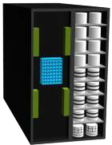


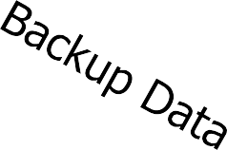

Backup Architecture and Process
Backup Data
Application Server/ Backup Client
Backup Server/ Storage Node
Backup Device

Slide 20
Backup Operation
Start the scheduled backup process
Backup data retrieves backup related information from backup catalog
Backup server instructs storage node to local backup media in backup device
Backup server instruct backup clients to send its metadata to the backup server and data to be backup to storage mode.
Backup clients send data to storage node
Storage node sends data to backup device
Storage node sends media information to backup servers
Backup server update and records the status

Slide 21


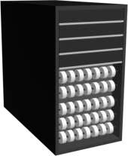
Backup Operation
Application Server and Backup Clients
3b
4
1
3a
5
2
6
7
Storage Node
Backup Device
Backup Server

Slide 22
Restore Operation
Backup server scans backup catalog to identify the data to be restore and the client that will receive data.
Backup servers instructs storage node to load backup media in backup device.
Data is read and send to backup client.
Storage node sends restore metadata to backup server.
Backup server updates catalog.

Slide 23
Restore Operation
Application Server and Backup Clients
3b
4
1
3a
5
2
6
7
Storage Node
Backup Device
Backup Server

Slide 24
Backup Topologies
There are 3 basic backup topologies:
Direct Attached Based Backup
LAN Based Backup
SAN Based Backup

Slide 25



Direct Attached Backups
Metadata
LAN
Data
Backup Device
Backup Server
Application Server and Backup Client and Storage Node

Slide 26



LAN Based Backups
Application Server
and Backup Client
Backup Server
LAN
Data
Storage Node
Backup Device

Slide 27





SAN Based Backups (LAN Free)
FC SAN
Data
Backup Device
LAN
Backup Server
Metadata
Application Server and Backup Client
Storage Node

Slide 28
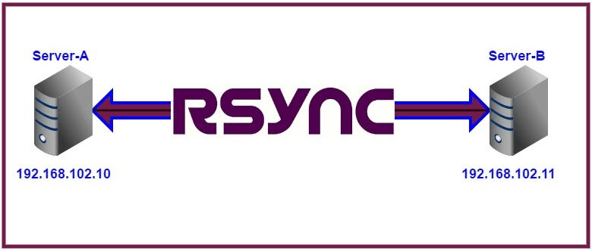
Focus this Course: Rsync
Rsync is a fast and extraordinarily versatile file copying tool.
It can copy locally, to/from another host over any remote shell, or to/from a remote rsync daemon.
It is famous for its delta-transfer algorithm, which reduces the amount of data sent over the network by sending only the differences between the source files and the existing files in the destination.
It finds files that need to be transferred using a "quick check" algorithm (by default) that looks for files that have changed in size or in last-modified time.
Any changes in the other preserved attributes (as requested by options) are made on the destination file directly when the quick check indicates that the file's data does not need to be updated.

Slide 29
Integrate Rsync into LAN
VirtualBox
WAN (External Network, simulating Internet)
LAN (Internal Network, simulating business network)
KALI Linux
Virtual Network
Adapter (NAT Network)
Backup Server
Jump Server
Rsync
Auto http
SSH
Emails
OpenWrt VM
(Router)
WebGoat Server
Non-auth
http
Virtual Network
Adapter (Host-Only)
VPN Server

Slide 30
Demo of Rsync

