Slide 1
Security Threats: The Problems We are Going to Solve CS-6967 Security Operations Jun Xu Fall 2022

Slide 2
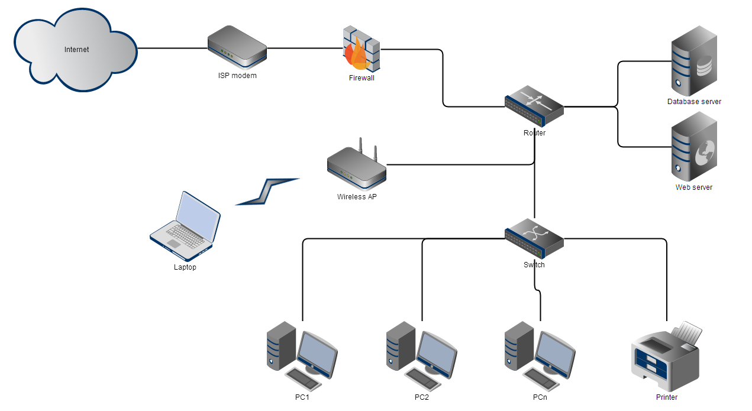
Discussion: What Security Threats Can Happen

Slide 3
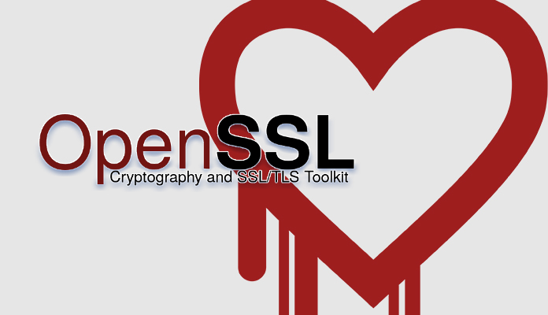
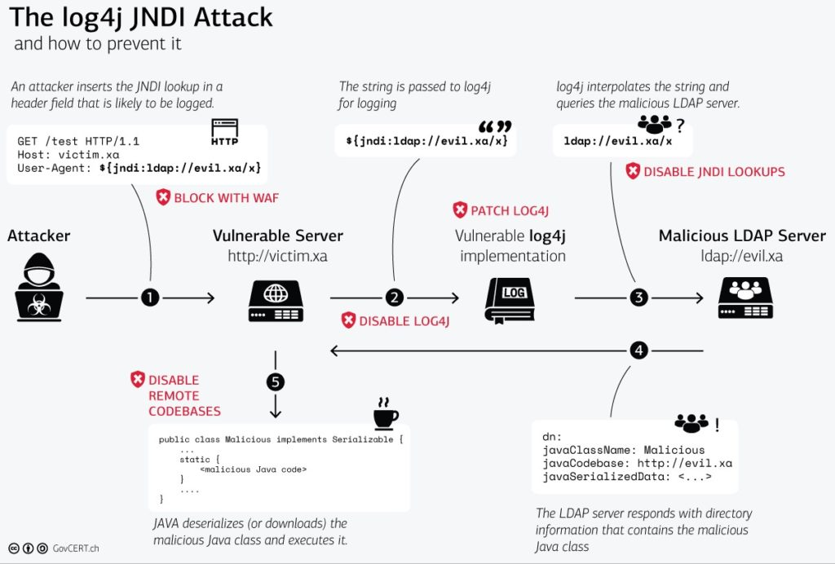
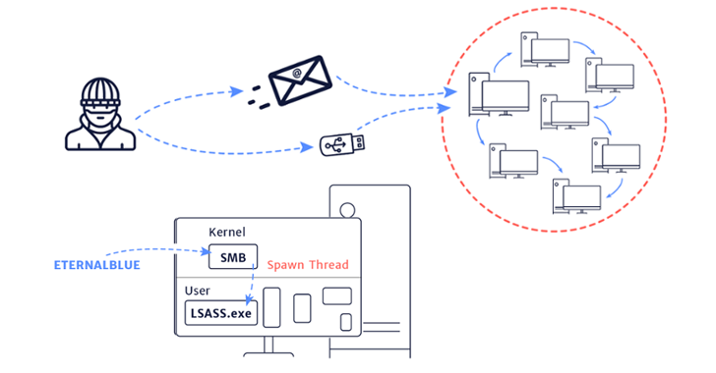
Common (Direct) Security Threats against Small Business Network
Vulnerabilities in the Software (e.g., web servers, database servers, MS Office, etc.)
Definition: Implementation defects that can be accessed and exploited for malicious goals
E.g., HearthBleed, Log4J, EternalBlue, etc.
https://heartbleed.com/
https://logging.apache.org/log4j/2.x/
https://www.malwarebytes.com/glossary/eternalblue

Slide 4
Common (Direct) Security Threats against Small Business Network
Social Engineering
Definition: The psychological manipulation of people into performing actions or divulging confidential information
E.g., spamming phone calls, phishing emails, Sha Zhu Pan (a.k.a., Pig Butchering Scams)
https://en.wikipedia.org/wiki/Social_engineering_(security)

Slide 5
Common (Direct) Security Threats against Small Business Network
Security Misconfiguration
Definition: The systems are not configured in the right way such that they can be intruded
E.g., using default/weak password for ssh
https://en.wikipedia.org/wiki/Application_security

Slide 6
Common (Direct) Security Threats against Small Business Network
Information Leakage
Definition: happens whenever a system that is designed to be closed to an eavesdropper reveals some information to unauthorized parties nonetheless
E.g., an employee (assuming to be benign) accidentally leaks his credentials for ssh into the web server or database server
https://en.wikipedia.org/wiki/Information_leakage

Slide 7
Common (Direct) Security Threats against Small Business Network
Insider
Definition: a malicious threat to an organization that comes from people within the organization, such as employees, former employees, contractors or business associates, who have inside information concerning the organization's security practices, data and computer systems
E.g., an employee steals private code to trade for money from competitors
https://en.wikipedia.org/wiki/Insider_threat

Slide 8
Common (Direct) Security Threats against Small Business Network
Denial-of-Service Attack
Definition: a cyber-attack in which the perpetrator seeks to make a machine or network resource unavailable to its intended users by temporarily or indefinitely disrupting services of a host connected to a network.
E.g., flooding the targeted machine or resource with superfluous requests in an attempt to overload systems and prevent some or all legitimate requests from being fulfilled
https://en.wikipedia.org/wiki/Denial-of-service_attack

Slide 9
Common (Indirect) Security Threats against Small Business Network
The direct security threats can lead to many other indirect security threats, which you may have heard a lot:
Data breach
Service outage
Malware
Virus
Ransomware
Spyware
…

Slide 10
Pre-class Practice 1
Due before the class on Wed (August 24th)
Check Canvas for details

