Slide 1
Security Operations: Firewalls CS-6967 Security Operations Jun Xu Fall 2022

Slide 2
Recap of Last Lecture
Simulated DoS/DDoS attacks against the toy web server
Set up iptables rules to block the connection from a specific machine to the web server

Slide 3
Today: Understand and Operate on Firewalls
What are Firewalls (knowledge)
How do Firewalls work (knowledge)
How to configure Firewalls (operations)
What to consider when configuring Firewalls (operations)

Slide 4
Today: Understand and Operate on Firewalls
What are Firewalls (knowledge)

Slide 5
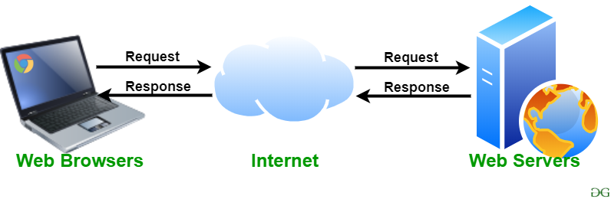

The Most Common Model
Why consider outgoing traffic?
A Firewall is a network security device that monitors and filters incoming and outgoing network traffic based on an organization’s established security policies. At its most basic, a firewall is essentially the barrier that sits between a private internal network and the public Internet [1].
[1] https://www.checkpoint.com/cyber-hub/network-security/what-is-firewall

Slide 6
Firewalls in Our Daily Life
Firewalls shipped with modern OSes
Linux: iptables (we have seen this)
Windows: https://support.microsoft.com/en-us/windows/turn-microsoft-defender-firewall-on-or-off-ec0844f7-aebd-0583-67fe-601ecf5d774f
Mac OS: https://support.apple.com/guide/mac-help/block-connections-to-your-mac-with-a-firewall-mh34041/mac
Firewalls embedded into your home router
http://10.17.206.58:8888/cgi-bin/luci/admin/system/system
Industry-grade firewalls
E.g., https://www.cisco.com/c/en/us/products/security/firepower-1000-series/index.html

Slide 7
Today: Understand and Operate on Firewalls
How do Firewalls work (knowledge)

Slide 8
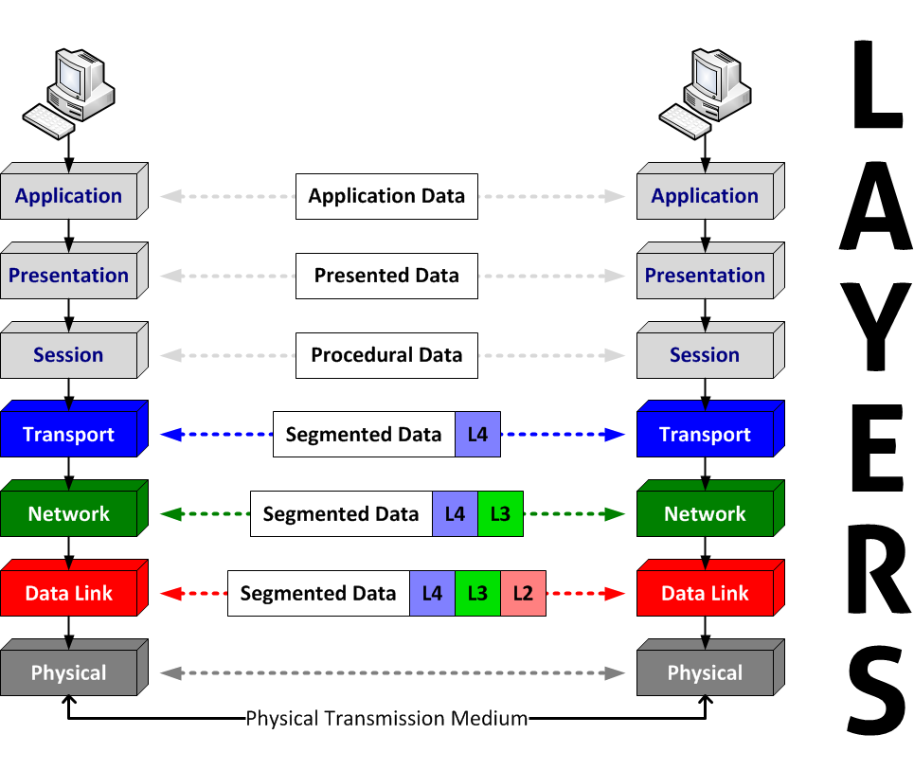
Firewalls Work On the Network, So Let’s Recap Some Network Knowledge
HTTP,
FTP,
DNS
TCP, UDP
IP
MAC
Open Systems Interconnection (OSI) model
Seven Layers

Slide 9
When You Want to Send a HTTP Request
MAC: 00:00:5e:00:53:af
IP: 10.0.0.1
TCP: Src Port; Dest Port; …
GET /hello.html HTTP/1.1
Contents
Data Link Layer
MAC Address (Typically used by the Switch)
Network Layer
IP Header (Typically used by the Router)
Transport Layer
TCP Header (Typically used by the OS kernel)
Application Layer:
HTTP Header (Used by your application)
Your Data (Used by you)

Slide 10
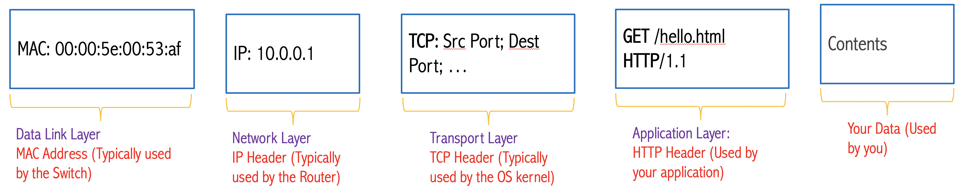
How Firewalls Work
Monitoring and Filtering
The Network Packets

Slide 11
Common Types of Firewalls
Depending on the working scheme, firewalls can be categorized into several types
Packet filters
Circuit-level gateway
Application-level gateway
…

Slide 12
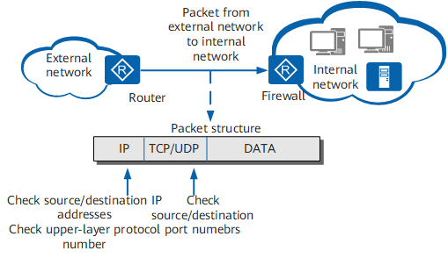
Packet Filters
Representative example: iptables
Work at the network level of the OSI model
Each packet (both directions) is compared to a set of criteria before it is forwarded
Filtering rules are based on information contained in a network packet: Source IP address, Destination IP address, port number, IP protocol, etc.
Packet filtering firewalls are low cost and low impact on network performance

Slide 13
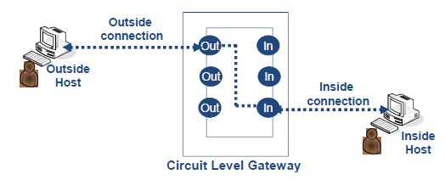
Circuit-level Gateway
The most important circuit-level gateway in use today is SOCKS.
The client needs to be modified to handle SOCKS interactions
SOCKS V5 supports username/password authentication
Circuit level gateways work at the session layer of the OSI model
Monitor TCP handshaking between packets to determine whether a requested session is legitimate.
The gateway does not permit an end-to-end TCP connection. Instead, it sets up two TCP connections, one between itself and a TCP user on an inner host and one between itself and a TCP user on an outside host
The security function consists of determining which connections will be allowed, based on destination IP address and/or port; source IP address and/or port; time of day; protocol; user; password, etc.
The gateway can incur high processing overhead when examining application data

Slide 14
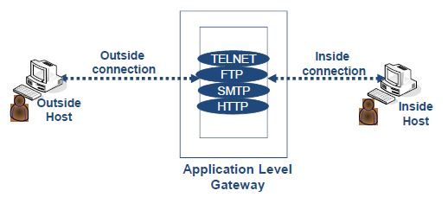
Application-level Gateway
An application-level gateway, also called a proxy server, acts as a relay of application-level traffic.
The user contacts the gateway using a TCP/IP application, such as Telnet or FTP, and the gateway asks the user for the name of the remote host to be accessed.
When the user responds and provides a valid user ID and authentication information, the gateway contacts the application on the remote host and relays TCP segments containing the application data between the two endpoints.
If the gateway does not implement the proxy code for a specific application, the service is not supported and cannot be forwarded across the firewall.
Further, the gateway can be configured to support only specific features of an application that the network administrator considers acceptable while denying all other features
The gateway can also incur high processing overhead when proxying the service

Slide 15
Circuit-level Gateway (CLG) v.s. Application-level Gateway (ALG)
CLG works at the session layer, which does not check the higher-level application date. It is also application-independent
ALG works at the application level, which checks the application data to enforce security policies (e.g., whether the client is using the desired HTTP version). It needs to offer application-specific implementations
In CLG, the server may not know the real client; In ALG, the server typically knows

Slide 16
Discussion
What security threats can firewalls address and why?

Slide 17
Today: Understand and Operate on Firewalls
How to configure Firewalls (operations)

Slide 18
Lectures: Packet Filters for the Single-node Network
Why We Put the Firewall on the Host Machine?
Internet
Host Machine
(Router)
Web Server VM
The Network We are Currently Working On
At this stage, we are going to focus on
this network
iptables
Packet Filters

Slide 19
Homework: Packet Filters for a “Real” Network
Host Machine
An Extended Network
Internet
OpenWrt VM
(Router)
Web Server VM
Databaset Server VM
…

Slide 20
Pre-class Practice for Wednesday
Install the VM for the toy web server we discussed in the first week
Configure the network of the VM as instructed
Test the web server can be accessed from somewhere that you can access the host machine
Detailed instructions are available in the syllabus page on Canvas
Make sure you have software-based firewalls available in your host machine
Linux-based host machine: iptables are installed by default but you’d better check
Go through this document: https://www.howtogeek.com/177621/the-beginners-guide-to-iptables-the-linux-firewall/
Windows-based host machine: firewalls are usually built-in with Windows defender, but you‘d better check
Go through this document: https://www.howtogeek.com/112564/how-to-create-advanced-firewall-rules-in-the-windows-firewall/
Mac OS-based host machine: ipfw is available in the older versions or PF in the newer versions (pfctl is the command)
Go through these documents:
https://murusfirewall.com/Documentation/OS%20X%20PF%20Manual.pdf
https://blog.neilsabol.site/post/quickly-easily-adding-pf-packet-filter-firewall-rules-macos-osx/

