Slide 1
Security Operations: Intrusion Detection Systems CS-6967 Security Operations Jun Xu Fall 2022 Credits of some slides belong to: Martin Roesch @ Sourcefire Inc. Arun Hodigere @ UT Dallas

Slide 2

Recap of Security Operations: Firewalls
VirtualBox
WAN (External Network, simulating Internet)
Business needs of the Web Server in the LAN:
Only traffic to port numbers 22/8000/9001 is needed
22: SSH
8000: HTTP
9001: Database
Any traffic from anywhere to port number 80 in the Web Server should be allowed
Only traffic from the LAB to port numbers 22/9001 is allowed
What Security Threats Can Still Arise???
KALI Linux
…
Virtual Network
Adapter (NAT Network)
OpenWrt VM
(Router)
LAN (Internal Network, simulating business network)
WebGoat Server
Virtual Network
Adapter (Host-Only)
…

Slide 3
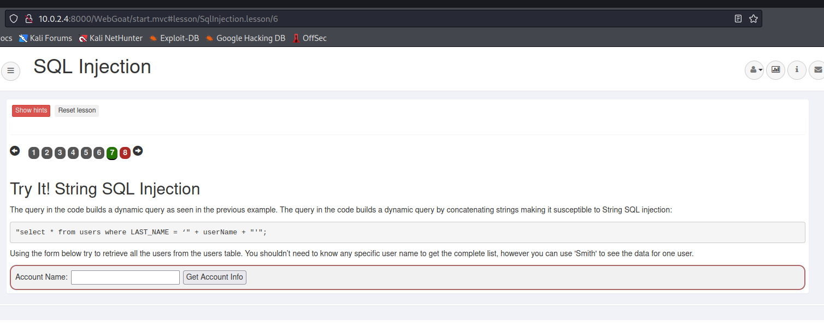
An Example Where Firewalls Cannot Help
Log into the Kali VM in the WAN
Visit 10.0.2.4:8000/WebGoat
Log into the website with “webgoat” + “webgoat” → Select “Injection Flaws” [on the left] → Select “SQL Injections” → Select “7”
At this point, you can launch an SQL Injection attack from the Kali VM to the Web Server VM

Slide 4
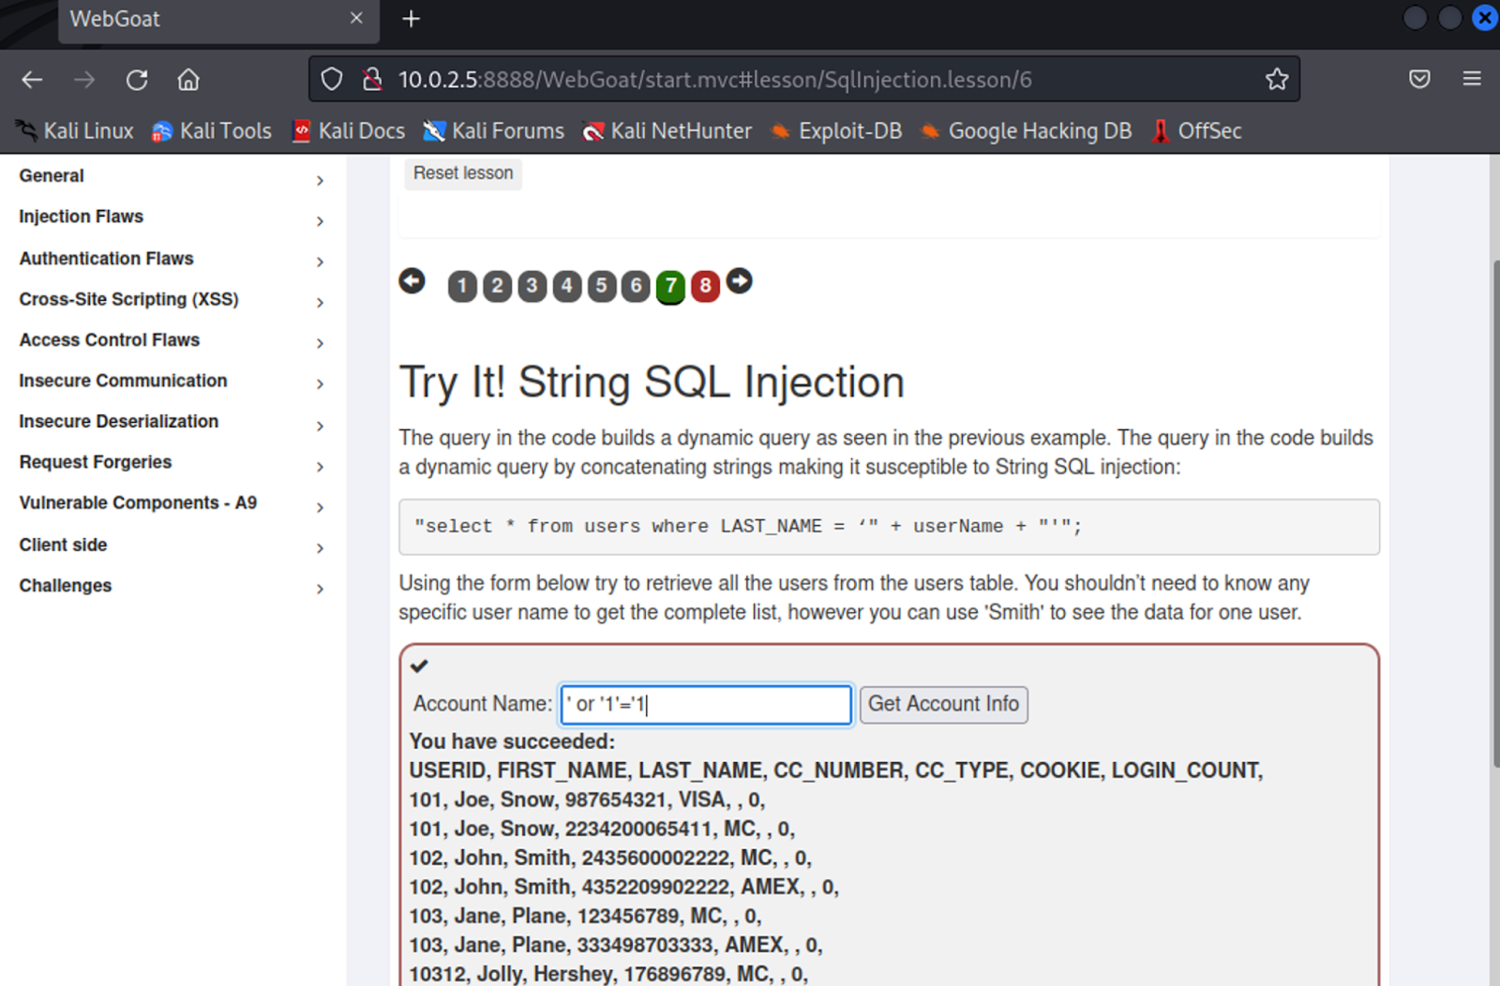
Attack Results

Slide 5
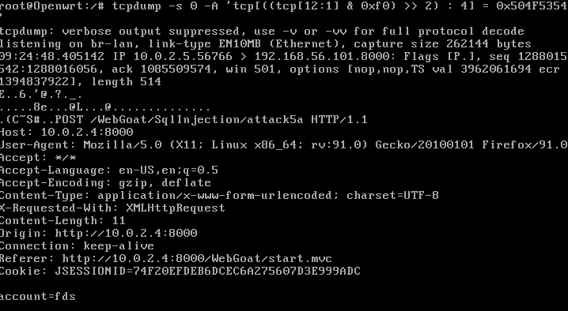
You Can Monitor the Traffic in the Router VM
Run
$: tcpdump -s 0 -A 'tcp[((tcp[12:1] & 0xf0) >> 2):4] = 0x504F5354'

Slide 6
So, What Else Can We Do?
The SQL Injection Attack in Our Example is an Intrusion
Attempts to break into or misuse the target system
Intruders may be from outside the network or legitimate users of the network
Intrusion can be a physical, system or remote intrusion
Different ways to intrude [by exploiting security holes in the system]
Code injections
Buffer overflows
Race conditions
…

Slide 7
Intrusion Detection Systems
Intrusion Detection Systems look for attack signatures, which are specific patterns that usually indicate malicious or suspicious intent
anomaly based
signature based
host based
network based

Slide 8
Anomaly based IDS
This IDS models the normal usage of the network as a noise characterization.
Anything distinct from the noise is assumed to be an intrusion activity.
E.g flooding a host with lots of packet.
The primary strength is its ability to recognize novel attacks.

Slide 9
Drawbacks of Anomaly detection IDS
Assumes that intrusions will be accompanied by manifestations that are sufficiently unusual so as to permit detection.
These generate many false alarms and hence compromise the effectiveness of the IDS.

Slide 10
Signature based IDS
This IDS possess an attacked description that can be matched to sensed attack manifestations.
The question of what information is relevant to an IDS depends upon what it is trying to detect.
E.g DNS, FTP etc.

Slide 11
Signature based IDS (contd.)
ID system is programmed to interpret a certain series of packets, or a certain piece of data contained in those packets,as an attack. For example, an IDS that watches web servers might be programmed to look for the string “phf” as an indicator of a CGI program attack.
Most signature analysis systems are based off of simple pattern matching algorithms. In most cases, the IDS simply looks for a sub string within a stream of data carried by network packets. When it finds this sub string (for example, the ``phf'' in ``GET /cgi-bin/phf?''), it identifies those network packets as vehicles of an attack.

Slide 12
Drawbacks of Signature based IDS
They are unable to detect novel attacks.
Suffer from false alarms
Have to programmed again for every new pattern to be detected.

Slide 13
Host based IDS
The host operating system or the application logs in the audit information.
These audit information includes events like the use of identification and authentication mechanisms (logins etc.) , file opens and program executions, admin activities etc.
This audit is then analyzed to detect trails of intrusion.

Slide 14
Drawbacks of the host based IDS
The kind of information needed to be logged in is a matter of experience.
Unselective logging of messages may greatly increase the audit and analysis burdens.
Selective logging runs the risk that attack manifestations could be missed.

Slide 15
Strengths of the host based IDS
Attack verification
System specific activity
Encrypted and switch environments
Monitoring key components
Near Real-Time detection and response.
No additional hardware

Slide 16
Network based IDS
This IDS looks for attack signatures in network traffic via a promiscuous interface.
A filter is usually applied to determine which traffic will be discarded or passed on to an attack recognition module. This helps to filter out known un-malicious traffic.

Slide 17
Strengths of Network based IDS
Cost of ownership reduced
Packet analysis
Evidence removal
Real time detection and response
Malicious intent detection
Complement and verification
Operating system independence

Slide 18
Our Focus: Snort
What is Snort?
Snort is a multi-mode packet analysis tool [integrate various types of IDS]
Sniffer
Packet Logger
Rules-based Detection
Forensic Data Analysis
Where did it come from?
Developed out of the evolving need to perform network traffic analysis in both real-time and for forensic post processing

Slide 19
Snort “Metrics”
Small (~800k source download)
Portable (Linux, Windows, MacOS X, Solaris, BSD, IRIX, Tru64, HP-UX, etc)
Fast (High probability of detection for a given attack on 100Mbps networks)
Configurable (Easy rules language, many reporting/logging options
Free (GPL/Open Source Software)

Slide 20
Detection Engine
Rules form “signatures”
Modular detection elements are combined to form these signatures
Wide range of detection capabilities
Stealth scans, OS fingerprinting, buffer overflows, back doors …
Rules system is very flexible, and creation of new rules is relatively simple

Slide 21
Using Snort
Three main operational modes
Sniffer Mode
Packet Logger Mode
NIDS Mode
Forensic Data Analysis Mode
Operational modes are configured via command line switches
Snort automatically tries to go into NIDS mode if no command line switches are given, looks for snort.conf configuration file in /etc

Slide 22
Using Snort – Sniffer Mode
Works much like tcpdump
Decodes packets and dumps them to stdout
BPF filtering interface available to shape displayed network traffic

Slide 23
What Do The Packet Dumps Look Like?
=+=+=+=+=+=+=+=+=+=+=+=+=+=+=+=+=+=+=+=+=+=+=+=+=+=+=+=+=+=+=+=+=+=+=+=+=+
11/09-11:12:02.954779 10.1.1.6:1032 -> 10.1.1.8:23
TCP TTL:128 TOS:0x0 ID:31237 IpLen:20 DgmLen:59 DF
***AP*** Seq: 0x16B6DA Ack: 0x1AF156C2 Win: 0x2217 TcpLen: 20
FF FC 23 FF FC 27 FF FC 24 FF FA 18 00 41 4E 53 ..#..'..$....ANS
49 FF F0 I..
=+=+=+=+=+=+=+=+=+=+=+=+=+=+=+=+=+=+=+=+=+=+=+=+=+=+=+=+=+=+=+=+=+=+=+=+=+
11/09-11:12:02.956582 10.1.1.8:23 -> 10.1.1.6:1032
TCP TTL:255 TOS:0x0 ID:49900 IpLen:20 DgmLen:61 DF
***AP*** Seq: 0x1AF156C2 Ack: 0x16B6ED Win: 0x2238 TcpLen: 20
0D 0A 0D 0A 53 75 6E 4F 53 20 35 2E 37 0D 0A 0D ....SunOS 5.7...
00 0D 0A 0D 00 .....
=+=+=+=+=+=+=+=+=+=+=+=+=+=+=+=+=+=+=+=+=+=+=+=+=+=+=+=+=+=+=+=+=+=+=+=+=+

Slide 24
Packet Logger Mode
Gee, it sure would be nice if I could save those packets to disk…
Multi-mode packet logging options available
Flat ASCII, tcpdump, XML, database, etc available
Log all data and post-process to look for anomalous activity

Slide 25
NIDS Mode
Wide variety of rules available for signature engine (~1300 as of June 2001, grow to ~2900 at May 2005)
Multiple detection modes available via rules and plug-ins
Rules/signature
Statistical anomaly
Protocol verification
Notes:
Uses all phases of Snort + plug-ins to analyze traffic for both misuse detection and anomalous activity
Can perform portscan detection, IP defragmentation, TCP stream reassembly, application layer analysis and normalization, etc

Slide 26
Snort Rules
Snort rules are extremely flexible and are easy to modify, unlike many commercial NIDS
Sample rule to detect SubSeven trojan:
alert tcp $EXTERNAL_NET 27374 -> $HOME_NET any (msg:"BACKDOOR subseven 22"; flags: A+; content: "|0d0a5b52504c5d3030320d0a|"; reference:arachnids,485; reference:url,www.hackfix.org/subseven/; sid:103; classtype:misc-activity; rev:4;)
Elements before parentheses comprise ‘rule header’
Elements in parentheses are ‘rule options’

Slide 27
Snort Rules
alert tcp $EXTERNAL_NET 27374 -> $HOME_NET any (msg:"BACKDOOR subseven 22"; flags: A+; content: "|0d0a5b52504c5d3030320d0a|"; reference:arachnids,485; reference:url,www.hackfix.org/subseven/; sid:103; classtype:misc-activity; rev:4;)
alert action to take; also log, pass, activate, dynamic
tcp protocol; also udp, icmp, ip
$EXTERNAL_NET source address; this is a variable – specific IP is ok
27374 source port; also any, negation (!21), range (1:1024)
-> direction; best not to change this, although <> is allowed
$HOME_NET destination address; this is also a variable here
any destination port

Slide 28
Snort Rules
alert tcp $EXTERNAL_NET 27374 -> $HOME_NET any (msg:"BACKDOOR subseven 22"; flags: A+; content: "|0d0a5b52504c5d3030320d0a|"; reference:arachnids,485; reference:url,www.hackfix.org/subseven/; sid:103; classtype:misc-activity; rev:4;)
msg:”BACKDOOR subseven 22”; message to appear in logs
flags: A+; tcp flags; many options, like SA, SA+, !R, SF*
content: “|0d0…0a|”; binary data to check in packet; content without | (pipe) characters do simple content matches
reference…; where to go to look for background on this rule
sid:103; rule identifier
classtype: misc-activity; rule type; many others
rev:4; rule revision number
other rule options possible, like offset, depth, nocase

Slide 29
Configure snort on our Web Server
Install the snort package:
sudo apt update && apt-get install snort
When you are asked for network interfaces, input:
enp0s3
Stop the snort service as we are going to write our custom rules and run snort manually:
sudo systemctl stop snort
sudo su -

Slide 30
Add A Rule to Detect the SQL Injection
cd /etc/snort/rules
vim local.rules
Add the following lines to the rule file. [Ref link]
alert tcp any any -> any 8000 (msg: "WEBGOAT SQL Injection Detected"; content: "'+or+'" ; sid:100001111; )
Run snort in cli:
sudo snort -A console -q -u snort -g snort -c /etc/snort/snort.conf -i enp0s3
Run the SQL Injection on Kali again

Slide 31
Other Built-in Snort Rules
bad-traffic.rules exploit.rules scan.rules
finger.rules ftp.rules telnet.rules
smtp.rules rpc.rules rservices.rules
dos.rules ddos.rules dns.rules
tftp.rules web-cgi.rules web-coldfusion.rules
web-frontpage.rules web-iis.rules web-misc.rules
web-attacks.rules sql.rules x11.rules
icmp.rules netbios.rules misc.rules
backdoor.rules shellcode.rules policy.rules
porn.rules info.rules icmp-info.rules
virus.rules local.rules attack-responses.rules

Slide 32
Snort Architecture

Slide 33
Data Flow
Packet Stream
Snort
Sniffing
Packet Decoder
Data Flow
Preprocessor
(Plug-ins)
Detection Engine
(Plug-ins)
Output Stage
(Plug-ins)
Alerts/Logs

Slide 34
Detection Engine: Rules
Rule Header
Rule Options
Alert tcp 1.1.1.1 any -> 2.2.2.2 any
(flags: SF; msg: “SYN-FIN Scan”;)
Alert tcp 1.1.1.1 any -> 2.2.2.2 any
(flags: S12; msg: “Queso Scan”;)
Alert tcp 1.1.1.1 any -> 2.2.2.2 any
(flags: F; msg: “FIN Scan”;)

Slide 35
Detection Engine: Internal Representation
Rule Node
Alert tcp 1.1.1.1 any -> 2.2.2.2 any
Option Node
(flags: SF; msg: “SYN-FIN Scan”;)
(flags: S12; msg: “Queso Scan”;)
(flags: F; msg: “FIN Scan”;)

Slide 36
Detection Engine: Fully Populated
Rule
Node
Rule
Node
Rule
Node
Rule
Node
Rule
Node
Option
Node
Option
Node
Option
Node
Option
Node
Option
Node
Option
Node
Option
Node
Option
Node
Option
Node
Option
Node
Option
Node

