Slide 1
Introduction to Systems Programming
Jun Xu
CS-392 Systems Programming
Spring 2019

Slide 2
About this Course
CS-392: Systems Programming
Instructor: Jun Xu
Meeting time:
Section A: 10:00 - 10:50 AM, Monday, Wednesday, Friday
Section B: 11:00 - 11:50 AM, Monday, Wednesday, Friday
Course website: https://sit.instructure.com/courses/29609
Syllabus: https://sit.instructure.com/courses/29609/pages/syllabus

Slide 3
About Me
Position: Assistant Professor @ Department of Computer Science
Research: Software, System & Security
Office: 204 North Building
Office Hour:
Section A: Monday 4:00 - 6:00 pm and by appointment
Section B: Monday 6:00 - 8:00 pm and by appointment
Contact: jxu69@stevens.edu & 201-216-5484

Slide 4
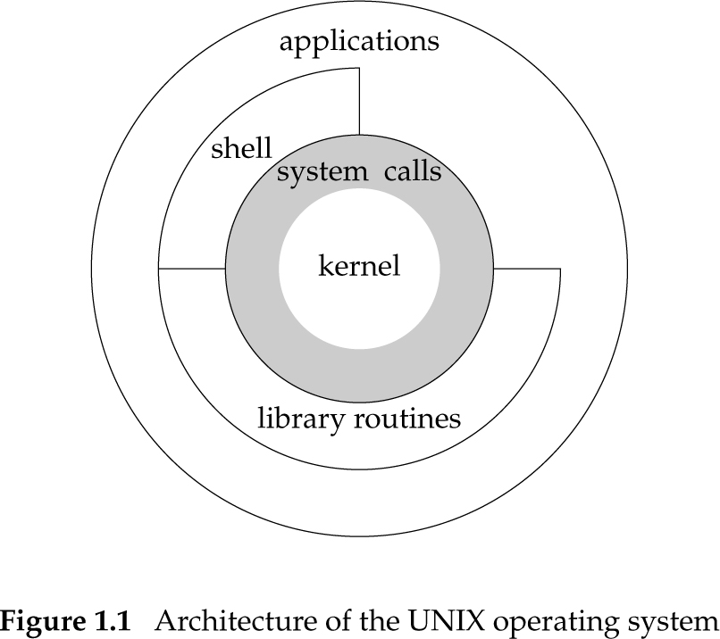
Computer Systems
Computer system
The complete computer made up of the CPU, memory and related electronics (main cabinet), all the peripheral devices connected to it and its operating system
Operating system
A software system that manages computer hardware and software resources and provides common services for computer programs

Slide 5
OS vs Kernel
The kernel is the central component of most computer operating systems. It is responsible for managing the hardware and offering services to applications that wish to use it
Some times OS is used to refer to the kernel
Sometimes a kernel’s name is used to refer to the whole OS
Example: Linux is the kernel of the GNU/Linux OS, frequently referred to simply as Linux

Slide 6
Systems Programming
Programming all kind of computer systems but…
Most commonly refers to programming the operating system
Viewed more broadly and OS includes applications, shells, libraries, utilities, and the kernel
No kernel-level programming in this course
A lot of programming using the kernel’s APIs on Linux, a UNIX-type OS
We code in C language

Slide 7
Programming: Before vs Now
Before
# Python code
import sys
print('Hello, world!’)
// Javas Code
public class HelloWorld {
public static void main(String[] args) {
System.out.println("Hello, World");
}
}
// C/C++ Code
#include<stdio.h>
int main(void){
printf(”Hellow World\n”);
return 1;
}
Now
# Python
def print(args):
…
…
…
// Javas
Void System.out.println(var_args){
…
…
…
}
// C/C++ Code
void printf(var_args);
….
…
…
}

Slide 8
An Idea of Learning
Learn: Understand background, concepts, and knowledge
E.g., Basics of Linux C language
Play: Build programs to apply new knowledge
E.g., A C version of “Hello World”
Make mistakes & Break things:
E.g., Try to write your own code & Try to vary your code with higher complexities
Correct mistakes & Fix things: Debugging
E.g., Why your code cannot compile/run & Why your changes break the code

Slide 9
What Is UNIX?
Unix is an operating system (OS)
Developed in 1969-1970 by Kenneth Thompson, Dennis Ritchie, and others at AT&T Bell Labs
Developed on a PDP-7
Notes:
1960s[edit]
DEC PDP-7, as used for initial work on Unix
Thompson received a Bachelor of Science in 1965 and a Master's degree in 1966, both in Electrical Engineering and Computer Science, from the University of California, Berkeley, where his master's thesis advisor was Elwyn Berlekamp.^{[2]}
Thompson with Dennis Ritchie(right)
Thompson was hired by Bell Labs in 1966.^{[3]} In the 1960s at Bell Labs, Thompson created a video game called Space Travel. In order to go on playing the game, Thompson found an old PDP-7 machine and rewrote Space Travel on it.^{[6]} Eventually, the tools developed by Thompson became the Unix operating system:
Around half a million calculation…
100 billion instructions

Slide 10
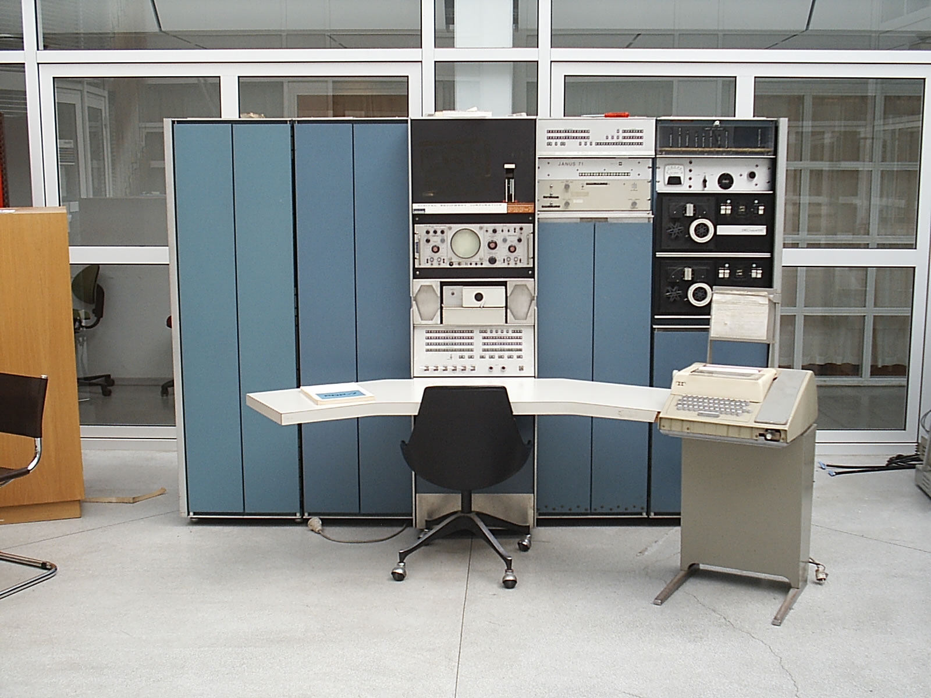
Notes:
The standard memory capacity is 4K words (9 KB) but expandable up to 64K words (144 KB).^{[1]}
The PDP-7 weighed about 1,100 pounds (500 kg).^{[7]}
WIKI: Minicomputer
0.2 million addition per second

Slide 11
What Is UNIX?
Unix is an operating system (OS)
Developed in 1969-1970 by Kenneth Thompson, Dennis Ritchie, and others at AT&T Bell Labs
Developed on a PDP-7
Based on the MULTICS OS
First OS to be written in C
A convoluted history
Notes:
What languages were used to build Oses before UNIX.

Slide 14
How to Access Linux (Required)
Install your own using a VM
A VirtualBox VM image is prepared. You can find every detail at https://sit.instructure.com/courses/29609/files/4510513/download?wrap=1
Default option for this course
Play/exercise in class
Assignment testing/grading
Communications

Slide 15
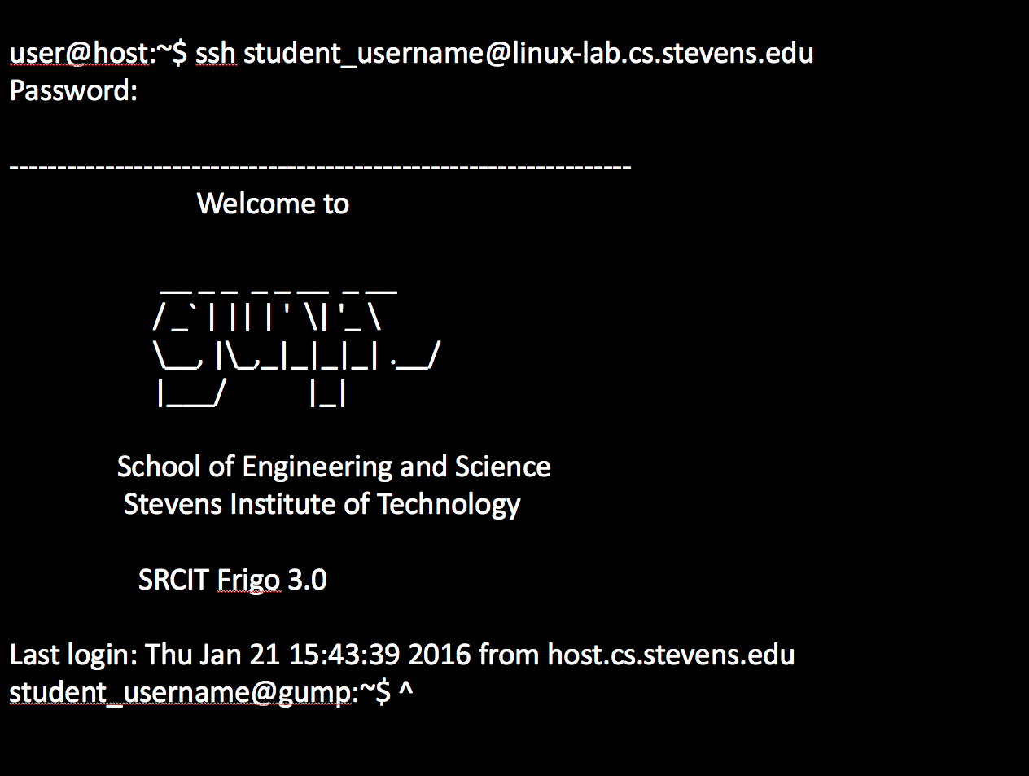
How to Access Linux (Optional)
The CS department runs the linux-lab, multiple PCs running linux accessible under a single hostname (linux-lab.cs.stevens.edu)
To obtain an account on the linux-lab send a request through http://sit.teamdynamix.com/TDClient/Requests/ServiceDet?ID=8231
Connect and access: https://www.srcit.stevens.edu/wiki/index.php/Linux_Lab

Slide 16
SSH Options
Windows
Install PuTTY
Use PuTTY to connect
Linux (e.g., debian)
Install SSH client package
Use terminal to connect
Windows
Install MinGW or Cygwin
Install SSH client package
Use terminal to connect

Slide 17
Connect to Linux-lab
Examples in slides will use $ to indicate a shell prompt
$ ssh student_username@linux-lab.cs.stevens.edu
Password:
Your password will never show (will not be echoed to screen)

Slide 18
Connect to Linux-lab
user@host:~$ ssh student_username@linux-lab.cs.stevens.edu
Password:
-----------------------------------------------------------------
Welcome to
__ _ _ _ _ __ _ __
/ _` | || | ' \| '_ \
\__, |\_,_|_|_|_| .__/
|___/ |_|
School of Engineering and Science
Stevens Institute of Technology
SRCIT Frigo 3.0
Last login: Thu Jan 21 15:43:39 2016 from host.cs.stevens.edu
student_username@gump:~$ ^
Examples in slides will use $ to indicate a shell prompt
$ ssh student_username@linux-lab.cs.stevens.edu
Password:
Your password will never show (will not be echoed to screen)

Slide 19
How to Access Linux (Required)
Install your own using a VM
A VirtualBox VM image is prepared. You can find every detail at https://sit.instructure.com/courses/29609/files/4510513/download?wrap=1
Default option for this course
Play/exercise in class
Assignment testing/grading
Communications

Slide 20
How to Interact with the VM
How do you write code now?
No GUI editors (such as eclipse)
How do you copy the files from the VM?
How can you submit your assignment code?
We create shared folder between the host and the VM

Slide 21
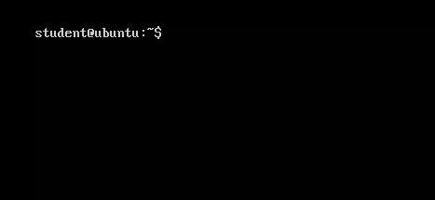
Console (Terminal) Environment
A system console internal to the Linux kernel
Console refers to the device;
Terminal more means the environment
Send text output to the user (monitor) and receive text input from the user (keyboard)
By default, we interact with the shell in Linux

Slide 22

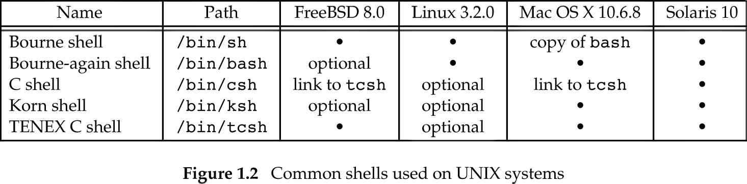
Work with Terminal: Shells
In our VM, the default shell is bash: https://www.gnu.org/software/bash/manual/bashref.html#What-is-a-shell_003f

Slide 23
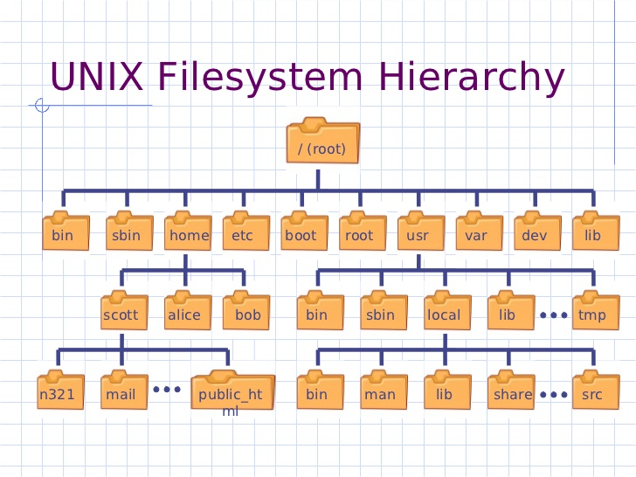
Getting Started
When you first login, shell places you in your home directory
/home/<username>

Slide 24
First Commands
The shell enables you to execute various commands
Available commands and options may differ across systems
All examples shown in the lecture will be based on Virtual Machine
My first commands
pwd - print path of current/working directory
ls - list directory contents

Slide 25
Two Types of Commands
Shell Built-in Commands
The shell implements them
Small in number
E.g., cd
User Commands
Programs installed in the system
Usually in /bin or /bin/usr
Frequently used
Many in number
Your shell needs to know where to find them

Slide 26
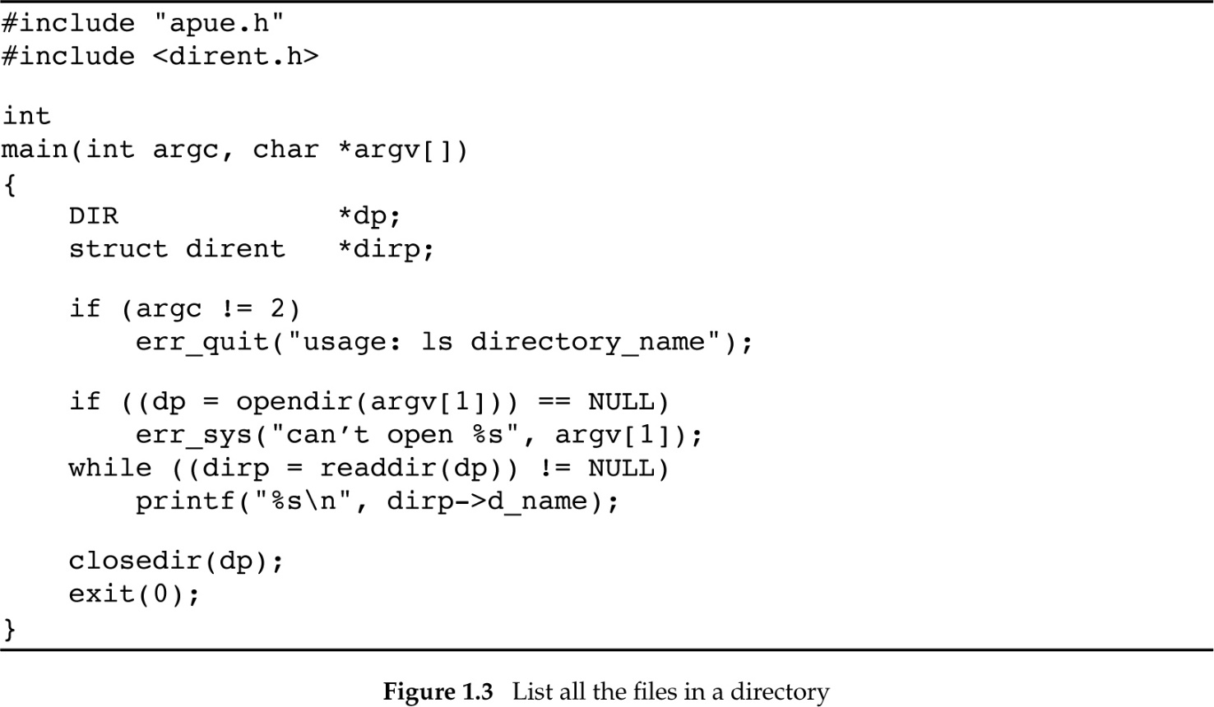
ls
Program that lists directory contents
Find the location of ls
whereis ls
LS does not work, any idea why?
Not so hard to build a simple version (in C)

Slide 27
Shell Variables
Start with symbol $
Example:
echo $PATH
/opt/bin:/usr/local/bin:/usr/sbin:/usr/bin:/sbin:/bin:/usr/games
The PATH variable contains a list of pathnames, where the shell searches for user commands
BTW, UNIX is case sensitive!

Slide 28
Directory Management
mkdir <directory name> -- Create a directory
cd <directory name> -- Change current directory
.. has a special meaning, it refers to the parent directory in the hierarchy
. has a special meaning, it refers to the current directory
rmdir <directory name> -- Delete empty directory
These commands have a lot of options that can make your life easier

Slide 29
Creating a File
Create an empty file
touch <file path name>
Use a command-line editor in VM (warning read on the editors first!)
vim
Emacs (not installed by default)
Copy a local file
cp <source pathname> <destination pathname>
Moving/renaming a file
mv <source pathname> <destination pathname>

Slide 30
Viewing a File
cat <pathname> – Just display contents in terminal
less <pathname> -- Display and paginate contents in terminal
more <pathname> -- Display and paginate (simpler) contents in terminal
head <pathname> -- Display first few lines of file in terminal
tail <pathname> -- Display last few lines of file in terminal

Slide 31
Deleting a File
rm <filename> -- Delete file
WARNING: Deleted files are lost forever! Really, you will lose that file forever!

Slide 32
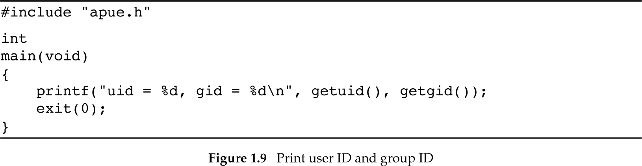
User Identification
User ID or UID
A numeric (positive) value that identifies a user to the system
Group ID or GID
A numeric (positive) value that identifies a group to the system
UIDs and GIDs are used to ensure that users can only access and execute only the resources allowed to them

Slide 33
/etc/passwd
/etc/passwd contains one line for each user account, with seven fields delimited by colons (“:”). These fields are:
· login name
· optional encrypted password
· numerical user ID
· numerical group ID
· user name or comment field
· user home directory
· optional user command interpreter
username:x:1000:1000:user real name,,,:/home/username:/bin/bash

Slide 34
/etc/groups
The /etc/group file is a text file that defines the groups on the system. There is one entry per line, with the following format:
group_name:password:GID:user_list
The fields are as follows:
group_name the name of the group.
password the (encrypted) group password. If this field is empty, no password is needed.
GID the numeric group ID.
user_list a list of the usernames that are members of this group,
separated by commas.
root:x:0:user1:user1,user2
daemon:x:1:
bin:x:2:
sys:x:3:
adm:x:4:

Slide 35
File Permissions
UNIX uses discretionary access control (DAC)
Every file has permissions for three entities, the owner/user of the file (U), the group owner of the file (G), and all others (O)
For each entity, permission can be given to read (R), write (W), and execute (X) the file
Example: check the permissions of your home directory by using ls –l
-rwx------ 1 user student 48 Sep 30 20:40 myfile.txt

Slide 36
Changing File Permissions
chmod -- change file mode bits
chmod u/g/o/a +/- rwx <file>
u – user
g – group
o – other
a – all
Example: chmod go-rwx myfile

Slide 37
Permissions in Octal (1)
Octal – base 8 number system [0..7]
Each permission triad can be represented by one octal number or three bits in binary
rwx
111
read
execute
write

Slide 38
Permissions in Octal (2)
Symbolic Notation | Numeric Notation | English
---------- | 0000 | no permissions
---x--x--x | 0111 | execute
--w--w--w- | 0222 | write
--wx-wx-wx | 0333 | write & execute
-r--r--r-- | 0444 | read
-r-xr-xr-x | 0555 | read & execute
-rw-rw-rw- | 0666 | read & write
-rwxrwxrwx | 0777 | read, write, & execute

Slide 39
Time
Calendar time
Time since the epoch 00:00:00 January 1, 1970, UTC
Process time
Clock ticks
50, 60, or 100 ticks/second
Measuring execution time
$ time –p ./myslowprogram
real 0.10
user 0.06
kernel 0.02

Slide 40
Time
Calendar time
Time since the epoch 00:00:00 January 1, 1970, UTC
Process time
Clock ticks
50, 60, or 100 ticks/second
Measuring execution time
$ time –p ./myslowprogram
real 0.09
user 0.06
kernel 0.02
Clock time or wall time
Time due to program instructions
Time due to kernel instructions

Slide 41
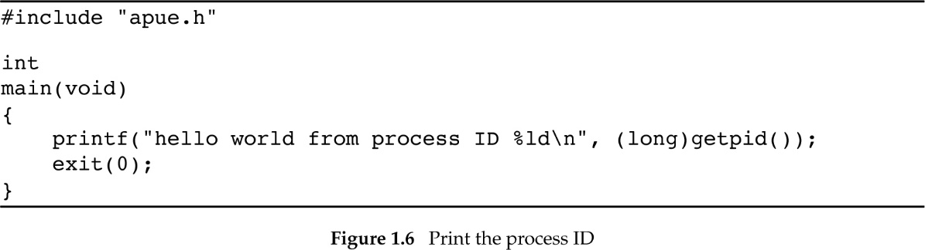
Processes and Programs
A program is an executable residing on disk in a directory
A process in an instance of a program executing
A program may spawn multiple processes
Each process is identified by an process ID or PID

Slide 42
Job Control in Bash
Appending & after a command puts the process in the background
<executable> arg1 arg2 … &
User command ps --- reports a snapshot of the current processes
Bash job control
fg --- move background job to foreground
Typing CTRL+C --- cancel/terminate foreground job
Typing CTRL+Z --- suspend/pause foreground job
bg --- move suspended job to background and resume
PID TTY TIME CMD
19575 pts/0 00:00:00 bash
21041 pts/0 00:00:00 ps

Slide 43
Standard I/O and Redirection
Every process has a standard input (stdin), output (stdout), and error (stderr)
Shells offer power full I/O redirections capabilities:
program1 | program2
Redirect program1’s stdout to program2’s stdin
program1 < myfile
Program1’s stdin is myfle
program1 > myfile
Program1’s output overwrites myfile
program1 >> myfile
Program1’s output is appended to myfile
And many more…

Slide 44
man
man is the most useful user command
Try man man
You do not need to supply the exact user command or man page you are interested in
Multiple results may exist
For example, try man open, then man 2 open
2 corresponds to the man pages section
man –k <term> searches for term in man pages and returns page with their section
Example: open (2)

Slide 45
Manual Page Sections
1 Executable programs or shell commands
2 System calls (functions provided by the kernel)
3 Library calls (functions within program libraries)
4 Special files (usually found in /dev)
5 File formats and conventions eg /etc/passwd
6 Games
7 Miscellaneous (including macro packages and conventions), e.g., man(7), groff(7)
8 System administration commands (usually only for root)
9 Kernel routines [Non standard]
Google is yet another man (better?)

Slide 46
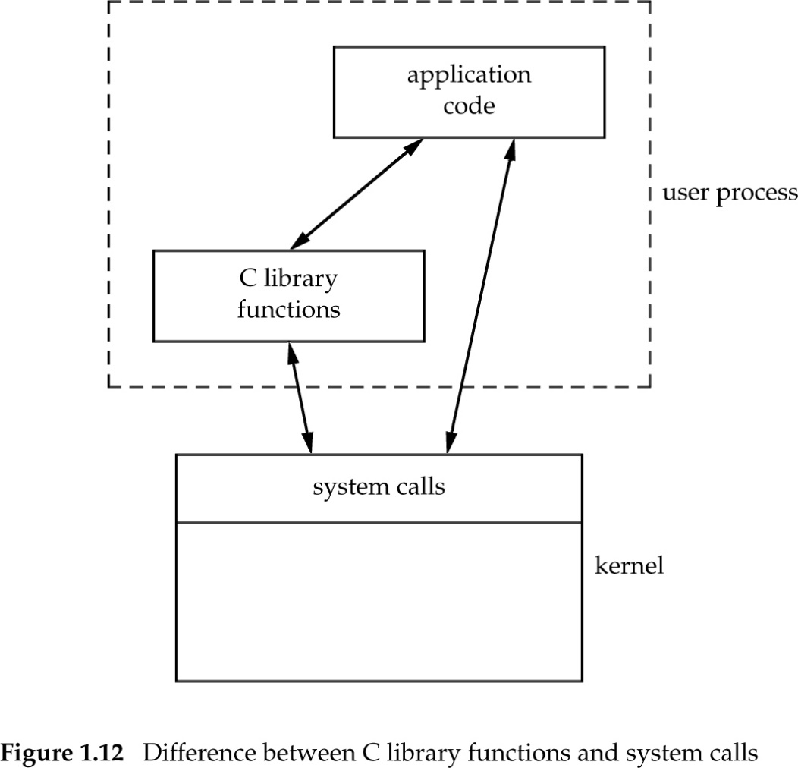
Function vs System Calls

