Slide 1
Basics of Linux C
CS-392 Systems Programming
Instructor: Jun Xu

Slide 2
Java vs C
Different philosophies!
Java – “Make it portable, provide a huge class library, and try to protect the programmer from doing stupid things.”
C -- “Make it efficient and simple, and let the programmer do whatever he wants”
C is preferred for systems programming, due to its better efficiency and low-level control.
Notes:
Why C language for system programming

Slide 3
If You Know C++
The syntax of C is almost identical to that of C++
Notable differences:
C is a procedural language
You build your algorithms and programs around procedures/functions and functionalities
Data are organized using structures instead of objects
Memory management is (even more) the job of the programmer
With great power comes great responsibility
No new or delete operators

Slide 4
Be Aware of Different Standards
ANSI C (ISO C)
Successive standards for the C programming language
C89, C90, C95, C99, C11, C18
POSIX --- Portable Operating System Interface
The application programming interface (API)
Standard C library
Single UNIX Specification
X/Open System Interfaces (XSI) enable additional interfaces in POSIX.1 systems
Notes:
published by the American National Standards Institute (ANSI) and the International Organization for Standardization (ISO).

Slide 5
First C Program
/* Every C program needs an entry point -- the main function*/
int main(int argc, char** argv){ //function type, name, arguments
return 1; //every statement ends with “;”
}

Slide 6
Declare/Define Variables
int main(int argc, char** argv){
char var0; // declare variable: type name (with letters, digits, “_”)
int var_1; // first Character should be alphabet or underscore
float Var_1; //variable names are case sensitive
var0 = ‘0’; //define variables
return 1;
}

Slide 7
Primitive Types
int – integer
float – floating point number
char -- character - a single byte (it is actually a number)
short -- short integer
long -- long integer
double -- double-precision floating point
Types can also by unsigned!
No bool type!

Slide 8
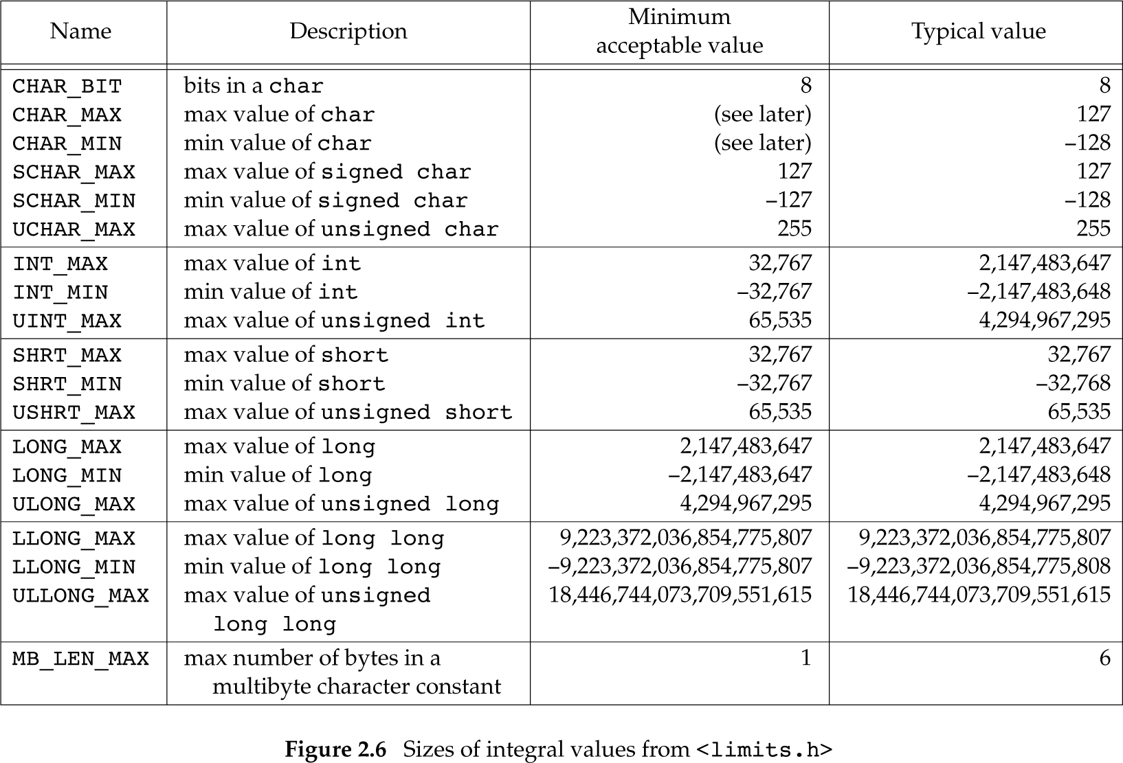
Typical Type Limits

Slide 9
Literals
85 /* decimal */
0213 /* octal */
0x4b /* hexadecimal */
30 /* int */
30u /* unsigned int */
30l /* long */
30ul /* unsigned long */
3.14159 /* double*/
314159E-5L /* double */
210.5f /* float */
‘c’ /* char */
“abcd” /* string */
This is one case where C is case insensitive

Slide 10
Implicit and Explicit Typecasts
int main(int argc, char** argv){
char var1 = 0x41; // typecast: 0x41 -> “A”
int var2 = 1.5; // typecast: 1.5 -> 1
unsigned int var3 = -1; // typecast: -1 -> 0xffffffff
float var4 = (float)1; // typecast: 1 -> 1.0
}
char c = 0x41424344;
What is the value of c?

Slide 11
Constants by Macro
Define using #define <name> <replacement text>
Example: #define PI 3.14
The pre-processor will replace every instance of PI with 3.14 before passing your source code to the compiler
#define PI 3.14
int main(int argc, char** argv){
float pi = PI; // pi = 3.14
return 1;
}

Slide 12
Enumerations
Organize multiple constants together
The first member has value 0, the next 1, and so on
Unless explicitly specified
Examples:
enum boolean { NO, YES };
Defines NO as 0 and YES as 1
enum months { JAN = 1, FEB, MAR, … };
enum escapes { BELL = ‘\a’, BACKSPACE = ‘\b’, … };

Slide 13
Use of enumeration
enum week { Sunday, Monday, Tuesday, Wednesday, Thursday, Friday, Saturday };
int main(int argc, char** argv){
enum week today;
today = Wednesday; // today = ?
return 1;
}

Slide 14
Unions
char
(1 byte)
Store different data types in the same
memory location
union my_union {
int i;
char c;
double d;
} ;
A union takes enough space to store the largest of its member
But only holds one piece of data: assignment to a member affects the other members
int
(4 bytes)
double
(8 bytes)

Slide 15
Use of Union
union my_union { int i; char c; double d;} ;
int main(int argc, char** argv){
union my_union test;
int var0;
test.i = 0;
test.c = ‘A’;
test.d = 1.0;
var0 = test.c // var0 = ‘A’?
}

Slide 16
Structures
Structure is a collection of variables (can be of different types) under a single type.
Similar to class in C++/Java/Python
There is no class in C
struct my_struct {
int x;
int y;
int z;
} ;

Slide 17
Use of struct
struct Books {
int year;
int month;
int book_id;
}; // do not forget about the “;” here
int main( ) {
struct Books Book1; // declare book1 of type Books
Book1.book_id = 100; //access members in struct
return 0;
}
How struct differs from union?

Slide 18
Arrays
An array is a collection of data items, all of the same type, accessed using a common name
Array can be multi-dimensional
int a[10]; // type name[size1]
char b[10][100];
struct my_struct c[10][100][1000];

Slide 19
Use of Array
int main( int argc, char ** argv) {
int array[10];
array[1] = 100;
array[2] = 200;
array[3] = array[1] + array[2];
array[0] = 1000; // Is this right?
array[10] = 1000; // Is this right?
}

Slide 20
Pointers
A pointer is a data object that stores the memory address of another data object located in computer memory.
int *intptr;
char *charptr;
struct my_struct *structptr;
int **intptrptr

Slide 21
Pointers
Pointer types store an address of memory
(Usually) an unsigned long integer
You can obtain a pointer to any variable using the & operator
Well, you can actually assign any integer to a pointer
int a, b, c, *p;
a = 1;
p = &a;
p = (int *) 1000;
&a
1
p
a
b
c

Slide 22
Pointers
Pointer types store an address of memory
(Usually) an unsigned long integer
When dereferenced (operator *) they return the contents of what they point to according to the pointer type
For example, an integer pointer returns an int
int a, b, c, *p;
a = 1;
p = &a;
*p = 2;
&a
2
p
a
b
c

Slide 23
Pointer Arithmetic
You can add or subtract an integer from a pointer
You can also use the ++ -- operators
You can subtract two pointers
int a[10], *pa, b;
pa = a;
b = *(pa + 1);
int a[10], *pa, b;
pa = &a[0];
b = a[1];
These are functionally equivalent.

Slide 24
Defining Your Own Types
typedef <type> <new type name>;
typedef unsigned int positive_integer_t;
typedef struct my_struct {
…
} my_struct_t;
typedef union {
int i;
char c;
double d;
char data[sizeof(double)];
} my_union_t;

Slide 25
Define your Own Type
typedef struct Books {
int year;
int month;
int book_id;
} struct_Books; // do not forget about the “;” here
int main( ) {
struct_Books Book1; // struct Books Book1;
Book1.book_id = 100;
return 0;
}

Slide 26
Variable Scope
Local – variables valid within functions
Defined within the function before use
Allocated in the program’s stack by the compiler
Prefer to define at the top of the function
int func1(int c){
int i;
i = 1;
}
int func2(int c){
i = 1; //Wrong scope
}

Slide 27
Variable Scope
Global – variables accessible by the entire program
Defined outside functions
int g_debug_level;
int func1(int c){
g_debug_level = 1;
}
int func2(int c){
g_debug_level = 2;
}
int func3(int c){
g_debug_level = 3;
}

Slide 28
Variable Scope
Static – variables accessible only within the file they were defined in
Defined outside functions
They can actually be accessed by the whole program, if it can find them. It is only programmatically that they are inaccessible to other files.
Can only be initialized by constants literals
Initialized as 0 if not explicitly assigned
static int g_debug_level; //file1.c
int func1(int c){ //file1.c
g_debug_level = 1; // OK
}
int func2(int c){ //file2.c
g_debug_level = 2; // Not OK
}
You may also see this:
int func3(int c){
int var_1 = 0
static int var_2 = 1;
}
How var_1 differs from var_2?
//var_2 only initializes once

Slide 29
Functions
Declaring functions is easy
Function visibility
Functions can be called from anywhere in the program
Unless the static keyword is used, which restricts visibility to the file defining them
int my_func(char arg1, int arg2, float arg3);
//return_type, function_name(arguments list)
static int my_func(char arg1, int arg2, float arg3)
…

Slide 30
Argument Passing (1)
C only does call by value
* Changes made by the child function will not affect the parent function
c is actually a local variable for callee() that gets a copy of i
int caller(int c){
int i;
i = 0;
callee(i); //i is not changed here
}
void callee(int c){
c = 10;
}

Slide 31
Argument Passing (2)
You can update a value through a procedure’s return value
int caller(int c){
int i;
i = callee(i); //this makes i = 10
}
Int callee(int c){
c = 10;
return c;
}

Slide 32
Argument Passing (3)
A pointer is still passed by value, but you can update what it points to!
int caller(int c){
int i;
i = 0
callee(&i); //this changes i to 10
}
void callee(int *c){
*c = 10; //change by dereference
}

Slide 33
Coding Style
For systems programming I recommend the Linux kernel’s style
https://www.kernel.org/doc/Documentation/process/coding-style.rst
Many other options available
May depend on preference, project you are contributing, the company you work at, etc.
Make sure that …
Your code is readable
You are consistent
Your code looks the same independently of the editor your are using

