Slide 1
IO Buffering
Jun Xu
CS-392 Systems Programming

Slide 2


About the Survey (1)

Slide 3

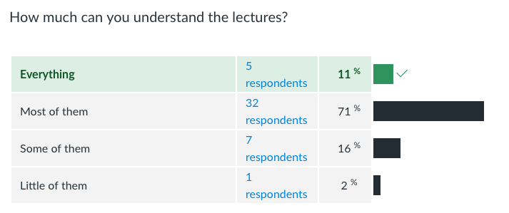
About the Survey (2)

Slide 4


About the Survey (3)

Slide 5


About the Survey (4)

Slide 6
Hint 1 about Assignment
Not every library function comes from <stdio.h>
For example, malloc and free are from stdlib.h
If you want to know the header file for “function”, google “header file function”

Slide 7
Hint 2 about Assignment
When you move the position indicator (reader or writer) of a data stream, IO operations are also affected
int sz;
FILE *fp = fopen(“test.txt”, “r”);
fseek(fp, 0, SEEK_END); // moves the position indicator to the end
sz = ftell(fp);
fread(fp, 1, sz, str); //you find you cannot read any data, why?

Slide 8
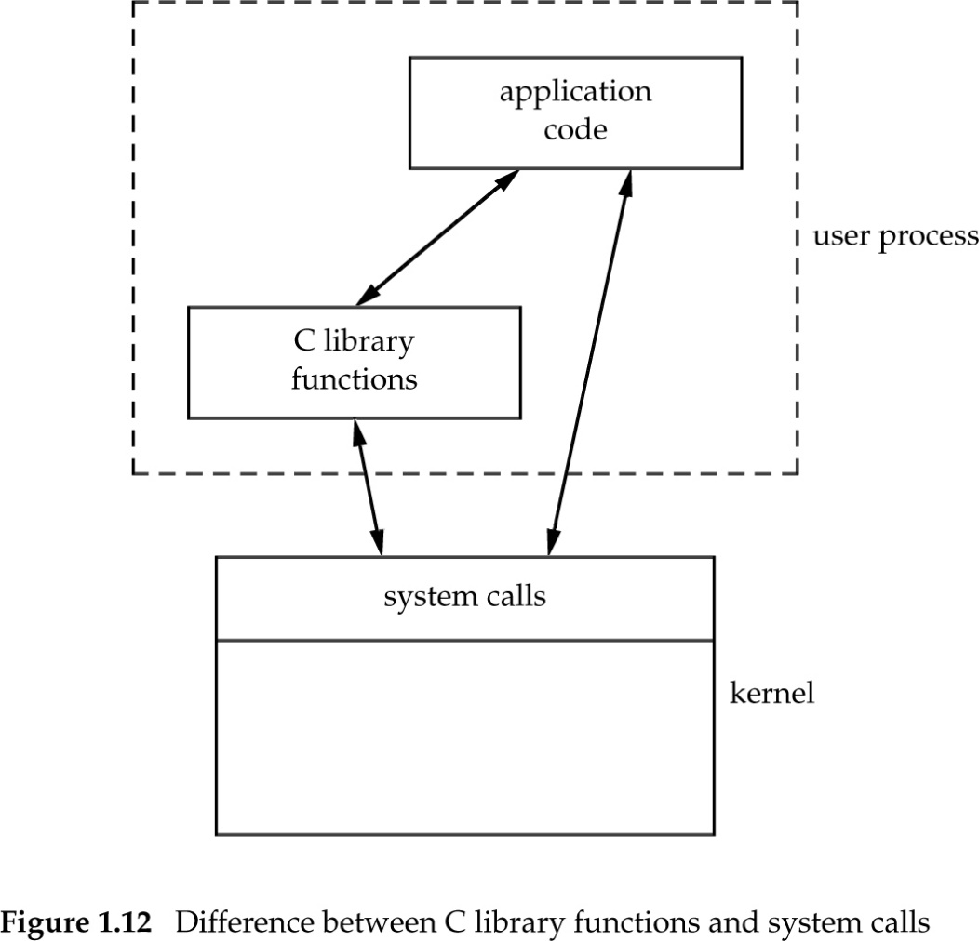
Buffering (1)
Buffer stream operations before sending them to the kernel
fgets(), fputs(), fgetc(), and friends
We do not want to as many system calls as the calls to these functions

Slide 9
Buffering (2)
C library
Application
fgets(), fputs(), fgetc(), and friends
buffer
Block of bytes
1 or small number bytes
I/O system calls
Kernel

Slide 10
Buffering (3)
The standard I/O library uses buffering
Three types of buffering are provided
Fully buffered
Actual write takes place when the buffer is full and reads are buffered
Line buffered
Actual write takes place when a ‘\n ‘ is written or when the buffer is full and reads are buffered
Unbuffered
I/O takes place immediately

Slide 11
Buffering (4)
ISO C mandates that
stdin and stdout are fully buffered when referring to files
stdin and stdout are line buffered when they refer to an interactive device such as a terminal
The standard error stream is not fully buffered

Slide 12
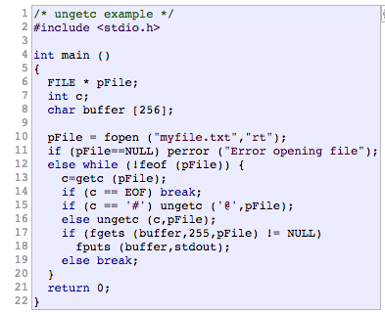
Fun Things with Buffered Streams
int ungetc(int c, FILE *stream);
Pushes c back to stream, cast to unsigned char, where it is available for subsequent read operations. Only one pushback is guaranteed!
This example opens an existing file called myfile.txt for reading and prints its lines, but first gets the first character of every line and puts it back into the stream replacing any starting # by an @.

Slide 13
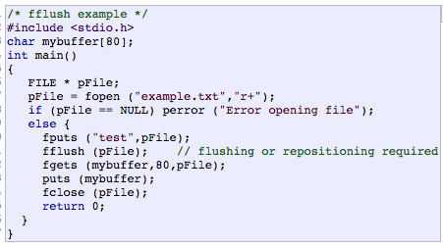
Fun Things with Buffered Streams
int fflush(FILE *stream);
For output streams, fflush() forces a write of all user-space buffered data for the given output or update stream via the stream's underlying write function. For input streams, fflush() discards any buffered data that has been fetched from the underlying file, but has not been consumed by the application. The open status of the stream is unaffected.

