Slide 1
Standard Error
Jun Xu
CS-392 Systems Programming
Spring 2019

Slide 2
Standard Error
In Unix-like operating systems, such as Linux, macOS X, and BSD, stderr is defined by the POSIX standard.
Its default file descriptor number is 2. In the terminal, standard error defaults to the user's screen.
stderr is a data stream defined in stdio.h for standard error
Libc: fprintf(stderr)
// error.c
#include<stdio.h>
int main(int argc, char ** argv){
fprintf(stderr, “Something Wrong\n”);
return 1;
}
Syscall: write(fd = 2)
Kernel: write(fd = 2)
Something Wrong

Slide 3
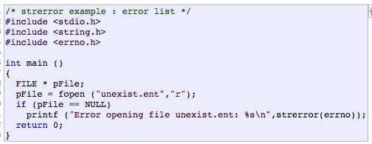
Errno (We have talked about it)
errno is a global integer variable set by libc functions
Whenever an error occurs it is set to a non-zero error number
It is never set to zero by libc, but you can modify it
Numbers are defined in errno.h
We can use errno -l to print the error message behind an error number
char *strerror(int errnum);
Return a pointer to a string describing the error behind errnum

Slide 4
perror()
void perror(const char *s);
Produces an error message including the string s, colon, and a description of the last error based on the error number stored in errno
perror(s) is equivalent to printf(“%s: %s\n”, s, strerror(errno));

Slide 5
Terminating a Process
void exit(int status);
In certain cases you may want to immediately terminate your process
For example, after a fatal error occurs
Process will exit with exit code status
All open streams will be flushed and closed
The C standard specifies two constants, EXIT_SUCCESS and EXIT_FAILURE, that may be passed to exit() to indicate successful or unsuccessful termination, respectively.

