Slide 1
Standard C libraries on Linux
Jun Xu
CS-392 Systems Programming
Spring 2019

Slide 2
Standard C library
A library of standard functions that can be used by all C programs (and sometimes by programs in other languages).
By far the most widely used C library on Linux is the GNU C Library ⟨http://www.gnu.org/software/libc/⟩, often referred to as glibc.
#include<stdio.h>
int main(int argc, char** argv){
printf(“Hello World\n”); //Where is printf
return 1;
}

Slide 3
Where is printf
Source code defined in glibc (by default for Linux)
https://github.com/lattera/glibc/blob/master/stdio-common/printf.c
When we compile a program, glibc is dynamically linked (by default for Linux)
Try to run: $ ldd /path/to/your/program
When we run a program, glibc will be loaded to memory
The Operating System will ensure that our program can find printf

Slide 4
Commonly Used Library Functions
Standard IO and Stream IO operations <stdio.h>
String operations <string.h>
General functions <stdlib.h>

Slide 5
Standard IO
int printf ( const char * format, ... );
int putchar ( int character );
int puts ( const char * str );
int scanf ( const char * format, ... );
int getchar ( void );
char * gets ( char * str );

Slide 6
Stream IO
FILE * fopen ( const char * filename, const char * mode );
int fclose ( FILE * stream );
int ferror ( FILE * stream );
int feof ( FILE * stream );
char * fgets ( char * str, int num, FILE * stream );
int fgetc ( FILE * stream );
int fscanf ( FILE * stream, const char * format, ... );
size_t fread ( void * ptr, size_t size, size_t count, FILE * stream );
int fputs ( const char * str, FILE * stream );
int fputc ( int character, FILE * stream );
size_t fwrite ( const void * ptr, size_t size, size_t count, FILE * stream );
int fprintf ( FILE * stream, const char * format, ... );

Slide 7
String Operations (1)
Copying:
void* memcpy (void* dest, void* src, size_t n);
copy n bytes of src into dest, return dest
char* strcpy(char* dest, char* src);
copy src string into dest, return dest (stop when encountering ‘\0’)
Concatenation:
char * strcat (char * dest, char* src);
append copy of src to end of dest, return dest (‘\0’ of dest is overwritten)
Comparison:
int strcmp (char * str1, char * str2);
compare str1, str2 by character (based on ASCII value of each character, then string length), return comparison result
str1 < str2: -1
str1 == str2: 0
str1 > str2: 1

Slide 8
String Operations (2)
Searching:
char* strstr (char * str1, char * str2);
return pointer to first occurrence of str2 in str1, else NULL
char* strtok (char * str, char * delimiters);
tokenize str according to delimiter characters provided in delimiters, return the next token per successive stroke call, using str = NULL
Other:
size_t strlen ( const char * str );
returns length of the string (up to, but not including the ‘\0’ character)
void * memset (void* ptr, int val, size_t n );
set first n bytes of memory block addressed by ptr to val

Slide 9
General Purpose Functions
Dynamic memory allocation:
malloc, calloc, free
String conversion:
int atoi(char* str);
parse string into integral value (return 0 if not parsed)
System Calls:
void exit(int status);
terminate calling process, return status to parent process
void abort();
aborts process abnormally

Slide 10
General Purpose Functions
Searching/Sorting:
void* bsearch (const void* key, const void* base, size_t num, size_t size, int (*compar)(const void*,const void*));
returns pointer to matching element in the array
void qsort (void* base, size_t num, size_t size, int (*compar)(const void*,const void*));
Sorts the array destructively
Function pointer: a pointer points to a function (pointer type must match the prototype)
Integer arithmetic:
int abs(int n);
returns absolute value of n

Slide 11
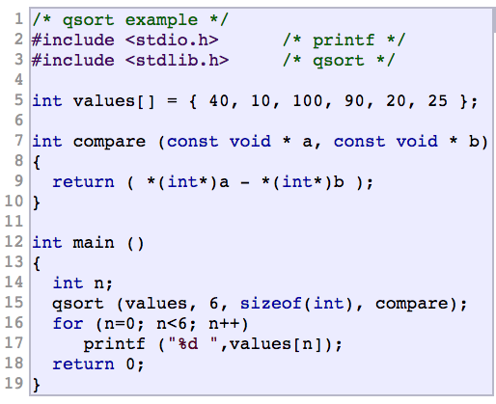
Example for qsort
Output: 10 20 25 40 90 100

