Slide 1
Compiling and Linking
Jun Xu
CS-392 Systems Programming
Spring 2019

Slide 2
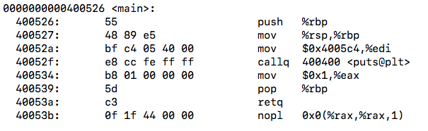
Compiling
Compiling is a process that transforms computer code written in one programming language (the source language) into another programming language (the target language).
For CS392, compiling is to transform Linux C code to binary code
#include<stdio.h>
int main(int argc, char** argv){
printf(“Hello World\n”);
return 1;
}
Source Code
Binary Code

Slide 3
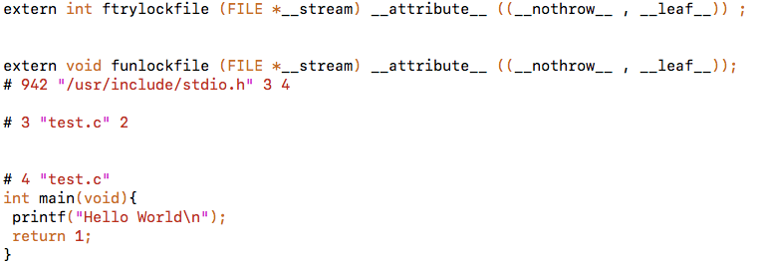
Compiling (1): Pre-processing
Pre-process the directives
Expand the #include and #define
Human readable source code
gcc main.c –E main.i or cpp main.c –o main.i
#include<stdio.h>
int main(int argc, char** argv){
printf(“Hello World\n”);
return 1;
}
main.i
main.c

Slide 4
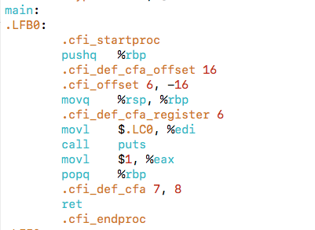
Compiling (2): Compilation
Translates the pre-processed source code into assembly code
Human readable machine code
gcc –S main.i –o main.s
main.i
main.s

Slide 5
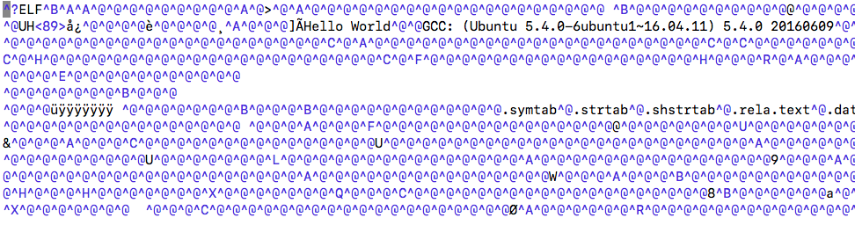
Compiling (3): Assemble
Translates the assembly code into machine code
Machine code
gcc -c main.s -o main.o or as main.s –o main.o
main.s
main.o

Slide 6
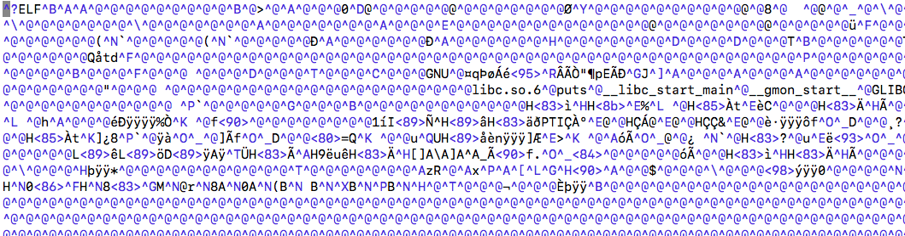
Compiling (4): Linking
Links object files to produce final executable file.
Executable machine code
gcc main.o -o main
main.o
main

Slide 7
Compiling A Program with Multiple Files
int sum(int *a, int n);
int array[2] = {1, 2};
int main()
{
int val = sum(array, 2);
return val;
}
int sum(int *a, int n)
{
int i, s = 0;
for (i = 0; i < n; i++) {
s += a[i];
}
return s;
}
main.c
sum.c

Slide 8
Compiling A Program with Multiple Files
main.c
sum.c
Source files
Translators
(cpp, cc1, as)
Translators
(cpp, cc1, as)
Separately compiled
relocatable object files
(gcc –c file.c –o file.o)
main.o
sum.o
Linker (ld)
Fully linked executable object file
(contains code and data for all functions
defined in main.c and sum.c)
prog

Slide 9
Why Linkers (1)
Reason 1: Modularity
Program can be written as a collection of smaller source files, rather than one monolithic mass
Can build libraries of common functions (more on this later)
e.g., Math library, standard C library

Slide 10
Why Linkers (2)
Reason 2: Efficiency
Time: Separate compilation
Change one source file, compile, and then relink
No need to recompile other source files
Space: Libraries
Common functions can be aggregated into a single file...
Yet executable files and running memory images contain only code for the functions they actually use

Slide 11
What does Linker do?
Step 1: Symbol resolution
Programs define and reference symbols (global variables and functions):
void swap() {…} /* define symbol swap */
swap(); /* reference symbol swap */
int *xp = &x; /* define symbol xp, reference x */
Symbol definitions are stored in object file (by assembler) in symbol table.
Symbol table is an array of structs
Each entry includes name, size, and location of symbol.
During symbol resolution step, the linker associates each symbol reference with exactly one symbol definition.

Slide 12
What does Linker do?
Step 1: Symbol resolution
Programs define and reference symbols (global variables and functions):
void swap() {…} /* define symbol swap */
swap(); /* reference symbol swap */
int *xp = &x; /* define symbol xp, reference x */
Symbol definitions are stored in object file (by assembler) in symbol table.
Symbol table is an array of structs
Each entry includes name, size, and location of symbol.
During symbol resolution step, the linker associates each symbol reference with exactly one symbol definition.

Slide 13
Step 1: Symbol Resolution
Referencing
a global…
…that’s defined here
int sum(int *a, int n);
int array[2] = {1, 2};
int main()
{
int val = sum(array, 2);
return val;
}
int sum(int *a, int n)
{
int i, s = 0;
for (i = 0; i < n; i++) {
s += a[i];
}
return s;
}
main.c
sum.c
Defining
a global
Referencing
a global…
Linker does not care
about i or s
Linker does not
care about val
…that’s defined here

Slide 14
What Do Linkers Do? (cont)
Step 2: Relocation
Merges separate code and data sections into single sections
Relocates symbols from their relative locations in the .o files to their final absolute memory locations in the executable
Updates all references to these symbols to reflect their new positions
Let’s look at these two steps in more detail….

Slide 15
Step 2: Relocation
Relocatable Object Files
Executable Object File
System code
.text
0
Headers
System data
.data
System code
main()
.text
main.o
swap()
main()
.text
.data
More system code
int array[2]={1,2}
System data
.data
sum.o
sum()
int array[2]={1,2}
.text
.symtab
.debug

Slide 16
How Linker Resolves Duplicate Symbol Definitions
Program symbols are either strong or weak
Strong: procedures and initialized globals
Weak: uninitialized globals
p1.c
p2.c
strong
int foo=5;
p1() {
}
int foo;
p2() {
}
weak
strong
strong

Slide 17
Linker’s Symbol Rules
Rule 1: Multiple strong symbols are not allowed
Each item can be defined only once
Otherwise: Linker error
Rule 2: Given a strong symbol and multiple weak symbols, choose the strong symbol
References to the weak symbol resolve to the strong symbol
Rule 3: If there are multiple weak symbols, pick an arbitrary one
Can override this with gcc –fno-common

Slide 18
Linker Puzzles
int x;
p1() {}
p1() {}
Link time error: two strong symbols (p1)
int x;
p1() {}
int x;
p2() {}
References to x will refer to the same
uninitialized int. Is this what you really want?
int x;
int y;
p1() {}
double x;
p2() {}
Writes to x in p2 might overwrite y!
Evil!
int x=7;
int y=5;
p1() {}
double x;
p2() {}
Writes to x in p2 will overwrite y!
Nasty!
int x=7;
p1() {}
int x;
p2() {}
References to x will refer to the same initialized
variable.

