Slide 1
Debugging - GDB
Jun Xu
CS-392 Systems Programming
Spring 2019

Slide 2
Debugging
What can debuggers do?
Run programs
Make the program stops on specified places or on specified conditions
Give information about current variables’ values, the memory and the stack
Let you examine the program execution step by step - stepping
Let you examine the change of program variables’ values - tracing
! To be able to debug your program, you must compile it with the -g option (creates the symbol table) !
CC –g my_prog

Slide 3

GDB - Freeware GNU Debugger
Starting GDB: gdb
Loading the symbol table:
file my_prog
/my_prog is executable file name!/
Exit GDB: quit
Executing shell commands: shell command args
make is a special case: make args
Start GDB and load the symbol table in one step:
gdb my_prog

Slide 4
GDB – Commands
Command names may be truncated if the abbreviation is unambiguous: s (for step), r (for run)
UNIX style TAB completion for the command names.
Alternative way: complete chars.
Ex.: complete h results in: handle
hbreak
help
Getting help:
help (or h) – lists all classes of commands.
h command - displays a short description of the command

Slide 5
GDB – Running Programs
Running a program:
run (or r) -- creates an inferior process that runs your program.
if there are no execution errors the program will finish and results will be displayed
in case of error, the GDB will show:
- the line the program has stopped on and
- a short description of what it believes has caused the error
There is a certain information that affects the execution of a program:
  program’s arguments
  program’s environment
  program’s working directory
  the standard input and output

Slide 6
GDB – Program’s arguments
Specifying arguments for your program:
As arguments to run: run arg1 arg2 …
With set args command: set args arg1 arg2 …
! run without arguments uses the same arguments used by the previous run.
! set args without arguments – removes all arguments.
! show args command shows the arguments your program has been started with.

Slide 7
GDB – Program’s environment
Changing the PATH environment variable:
path dir – add the directory dir at the beginning of the PATH variable. You may specify several directory names separated by ‘:’ or white space.
show paths – displays the search paths for executables.
Changing the working directory:
cd dir – to change the working directory
Redirecting output:
run > outfile direct the output to the file outfile.
Notes:
Environment variables are inherited from the shell. However, you can modify the environment when debugging.
In DDD – it ‘s better to start it from your working directory

Slide 8
GDB - Debugging an already-running process
From inside GDB:
attach process-id
/ To get the process ID use the UNIX command ps /
From outside GDB:
gdb my_prog process-id
! The first thing GDB does after arranging to debug the specified process is to stop it.
detach – detaches the currently attached process from the GDB control. A detached process continues its own execution.

Slide 9
GDB – Breakpoints and watchpoints
Breakpoints and watchpoints allow you to specify the places or the conditions where you want your program to stop.
break arg – stops when the execution reaches the specified line
/ arg – function name, line number, +/- offset /
watch expr – stops whenever the value of the expression changes
clear [arg]
Without arguments deletes any breakpoint at the next instruction to be executed in the current stack frame
delete [bnum]
Without arguments deletes all breakpoints.

Slide 10
GDB – Examining variables
! Global variables can be examined from every point in the source file.
! Local variables – can be examined only in their scope or using:
file::variable or function::variable
The variable type: ptype var
Current value: print var
Automatic display: display var - adds var to the automatic display list.
undisplay dnum
___________________________________________________
Specifying the output format (x, o, d, u, t, a, f, and c) :
print /t var - prints the value of var in binary format
Notes:
‘t’ comes from ‘two’

Slide 11
GDB – Value history
The value history keeps the values printed by the print command.
Previously printed values can be accessed by typing $ followed by their history number.
$ - refers to the most recent value and
$$n - refers to the n-th value from the end.
show values [n|+]
Without argument – the last 10 values.
n – 10 values centered around n
+ – 10 values after the last printed
Notes:
‘t’ comes from ‘two’

Slide 12
GDB – Stepping through the program
step [count] – program execution continue to next source line going into function calls.
next [count] – program execution continue to the next source line omitting function calls.
continue – resume program execution
until – continue until the next source line in the current stack frame is reached. /useful to exit from loops/

Slide 13
GDB – Altering execution
Returning from a function
finish - forced return
return [ret_value] – pops the current stack frame
Continuing at different address
jump line_num|*address
Altering the value of a variable
set i=256
Proceeding to a specified point:
until [line_num|*address |function_name]

Slide 14
GDB – The stack frame
Stack frames are identified by their addresses, which are kept in the frame pointer register.
Selecting a frame:
frame n|addr
up n
down n
Information about the current frame
frame – brief description
info args – shows function arguments
info locals – shows local variables
0
1
2
Notes:
Each frame contains the data associated with one call to one function. The frame contains the arguments given to the function, the local variables and the address at which the function is executing.

Slide 15
GDB – Convenience variables
Convenience variables are used to store values that you may want to refer later. Any string preceded by $ is regarded as a convenience variable.
Ex.: $table = *table_ptr
There are several automatically created convenience variables:
$pc – program counter
$sp – stack pointer
$fp – frame pointer
$ps – processor status
$_ - contains the last examined address
$__ - the value in the last examined address
$_exitcode - the exit code of the debugged program

Slide 16
DDD - The Data Display Debugger
DDD is a GUI debugger that can work with several inferior debuggers including GDB.
GDB commands can be typed in the debugger console window.
DDD sets some GDB settings automatically and will not work correctly if you change them. These are:
set height 0
set width 0
set verbose off
set prompt (gdb) !
Notes:
0 means unlimited

Slide 17
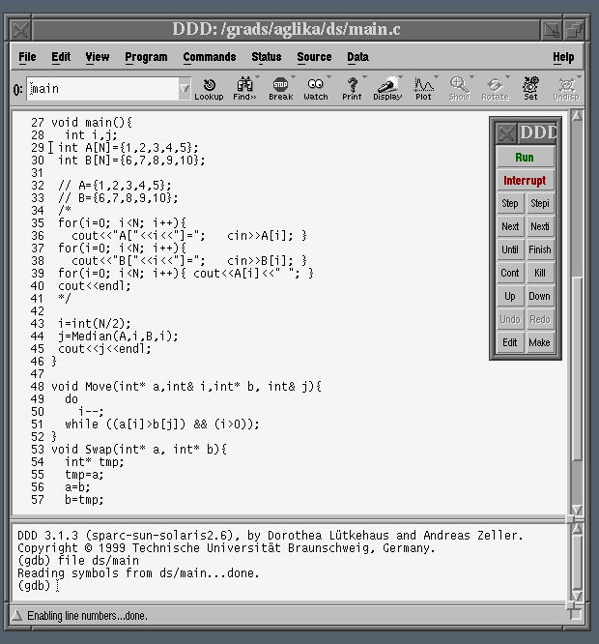
DDD – View
argument
field
source
window
debugger
console
command
tool
Notes:
0 means unlimited

Slide 18
DDD – GUI Advantages
Frequently used commands are on the toolbars, have assigned shortcut keys or can be done just with a mouse click.
Easy browsing through the source !
Examining current variables values directly – by placing the mouse pointer over them.
Possibility to graphically display the program data.
Help menu – What now? – very helpful !

Slide 19
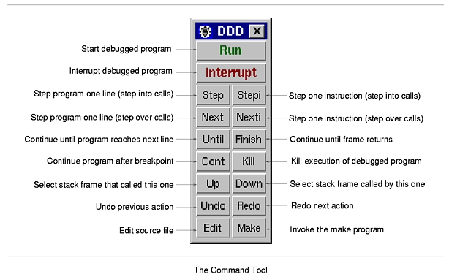
DDD – Command menu
Notes:
0 means unlimited

Slide 20
GDB – Examining memory
The x command (for “examine”):
x/nfu addr – specify the number of units (n), the display format (f) and the unit size (u) of the memory you want to examine, starting from the address addr. Unit size can be – b, h (half), w and g (giant).
x addr – start printing from the address addr, others default
x – all default
Registers
Registers names are different for each machine. Use info registers to see the names used on your machine.
GDB has four “standard” registers names that are available on most machines: program counter, stack pointer, frame pointer and processor status.

Slide 21
GDB – Additional process information
info proc – summarize available information about the current process.
info proc mappings – address range accessible in the program.
info proc times – starting time, user CPU time and system CPU time for your program and its children.
help info !
info signals – information about the system signals and how GDB handles them.

Slide 22
Using GDB under GNU Emacs
M-x gdb
M-s – step
M-n – next
C-c C-f – finish
M-c - continue
C-x SPC – set a breakpoint on the current line
Compiling from within Emacs:
1) Tools/ Compile…
2) Specify compiling command. (You may specify make, too.)
M - means the Meta key or the Esc key if you don’t have Meta key.

Slide 23
Questions
1. How you create a symbol table?
2. How you load the symbol table of a program to GDB?
3. Where breakpoints can be set?
4. How many breakpoints can be set for a program?
5. Which command(s) can be used to exit from loops?
6. Which command goes into function calls?
7. What causes segmentation faults and bus errors?
8. What programming errors cause access to forbidden memory addresses?
9. Which memory addresses are forbidden?

