Slide 1
Mid-term Overview
Jun Xu
CS-392 Systems Programming
Spring 2019

Slide 2
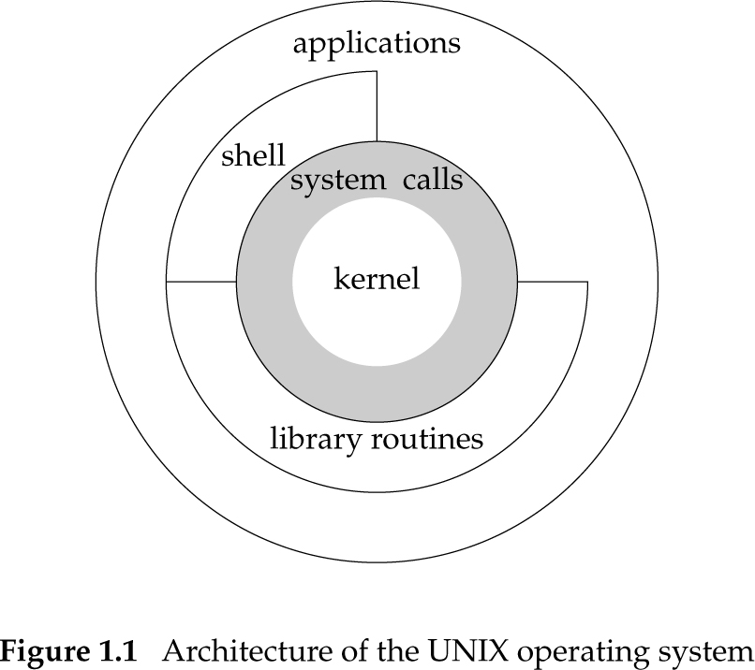
Systems Programming
Programming all kind of computer systems but…
Most commonly refers to programming the operating system
Viewed more broadly and OS includes applications, shells, libraries, utilities, and the kernel
No kernel-level programming in this course
A lot of programming using the kernel’s APIs on Linux, a UNIX-type OS
We code in C language

Slide 3
Linux C
C is a procedural language
You build your algorithms and programs around procedures/functions and functionalities
Data are organized using structures instead of objects
Memory management is (even more) the job of the programmer
With great power comes great responsibility
No new or delete operators

Slide 4
Primitive Types
int – integer
float – floating point number
char -- character - a single byte (it is actually a number)
short -- short integer
long -- long integer
double -- double-precision floating point
Types can also by unsigned!
No bool type!

Slide 5
Arrays
An array is a collection of data items, all of the same type, accessed using a common name
Array can be multi-dimensional
int a[10]; // type name[size1]
char b[10][100];
struct my_struct c[10][100][1000];

Slide 6
Strings in C Program
Or strings
Arrays of characters terminated by the null character ‘\0’
Also called null-terminated strings
Examples:
char str[10];
A string that fits 9 characters + the terminating null character
char str[] = “Hello, world!”
str is automatically allocated to hold the string + the terminating null character
char *str = “Hello, world!”
A constant string is created and str points to its beginning
It cannot be updated

Slide 7
Pointers
Pointer types store an address of memory
(Usually) an unsigned long integer
When dereferenced (operator *) they return the contents of what they point to according to the pointer type
For example, an integer pointer returns an int
int a, b, c, *p;
a = 1;
p = &a;
*p = 2;
&a
2
p
a
b
c

Slide 8
Dynamic Memory Allocation/Free
void *malloc(size_t size);
The malloc() function allocates size bytes and returns a pointer to the allocated memory. The memory is not initialized. If size is 0, then malloc() returns either NULL, or a unique pointer value that can later be successfully passed to deallocation
void free(void *ptr);
The free() function frees the memory space pointed to by ptr, which must have been returned by a previous call to malloc(), calloc() or realloc(). Otherwise, or if free(ptr) has already been called before, undefined behavior occurs. If ptr is NULL, no operation is performed.

Slide 9
Standard C library
A library of standard functions that can be used by all C programs (and sometimes by programs in other languages).
By far the most widely used C library on Linux is the GNU C Library ⟨http://www.gnu.org/software/libc/⟩, often referred to as glibc.
#include<stdio.h>
int main(int argc, char** argv){
printf(“Hello World\n”); //Where is printf
return 1;
}

Slide 10
String Operations
Copying:
void* memcpy (void* dest, void* src, size_t n);
copy n bytes of src into dest, return dest
char* strcpy(char* dest, char* src);
copy src string into dest, return dest (stop when encountering ‘\0’)
Concatenation:
char * strcat (char * dest, char* src);
append copy of src to end of dest, return dest (‘\0’ of dest is overwritten)
Comparison:
int strcmp (char * str1, char * str2);
compare str1, str2 by character (based on ASCII value of each character, then string length), return comparison result
str1 < str2: -1
str1 == str2: 0
str1 > str2: 1

Slide 11
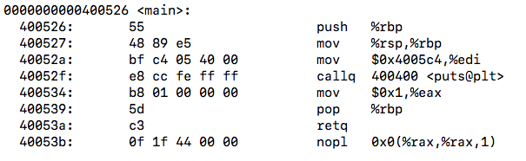
Compiling
Compiling is a process that transforms computer code written in one programming language (the source language) into another programming language (the target language).
For CS392, compiling is to transform Linux C code to binary code
#include<stdio.h>
int main(int argc, char** argv){
printf(“Hello World\n”);
return 1;
}
Source Code
Binary Code

Slide 12
Linking
main.c
sum.c
Source files
Translators
(cpp, cc1, as)
Translators
(cpp, cc1, as)
Separately compiled
relocatable object files
(gcc –c file.c –o file.o)
main.o
sum.o
Linker (ld)
Fully linked executable object file
(contains code and data for all functions
defined in main.c and sum.c)
prog

Slide 13
Dynamic Linking
main2.c
vector.h
unix> gcc -fPIC -shared -o libvector.so addvec.c multvec.c
Translators
(cpp, cc1, as)
libc.so
libvector.so
Relocatable
object file
main2.o
Relocation and symbol table info
Linker (ld)
unix> gcc –O0 -o prog2
main.o libvector.so
Partially linked
executable object file
prog2
Loader (execve)
libc.so
libvector.so
unix> export LD_LIBRARY_PATH=$PWD
Code and data
Fully linked
executable
in memory
unix> ./prog2
Dynamic linker (ld-linux.so)

Slide 14
Dynamic Linking
main2.c
vector.h
unix> gcc -fPIC -shared -o libvector.so addvec.c multvec.c
Translators
(cpp, cc1, as)
libc.so
libvector.so
Relocatable
object file
main2.o
Relocation and symbol table info
Linker (ld)
unix> gcc –O0 -o prog2
main.o libvector.so
Partially linked
executable object file
prog2
Loader (execve)
libc.so
libvector.so
unix> export LD_LIBRARY_PATH=$PWD
Code and data
Fully linked
executable
in memory
unix> ./prog2
Dynamic linker (ld-linux.so)

Slide 15
Sample makefile
Makefiles main element is called a rule:
Example:
my_prog : eval.o main.o
g++ -o my_prog eval.o main.o
eval.o : eval.c eval.h
g++ -c eval.c
main.o : main.c eval.h
g++ -c main.c
_________________________
# -o to specify executable file name
# -c to compile only (no linking)
target : dependencies
TAB commands #shell commands

