Slide 1
Processes
Jun Xu
CS-392 Systems Programming
Spring 2019

Slide 2
The Process
A process is an instance of a running program
The life of a process begins when it is executed
A process ends
when its main function returns
Or when a function/system call that terminates it is made

Slide 3
Start a Process (1)
argv
$ ./a.out arg1 arg2 3 4
NULL
arg1
arg2
3
4

Slide 4
Start a Process (2)
argv
$ ./a.out arg1 arg2 3 4
NULL
arg1
arg2
3
int main(int argc, char *argv[], char *envp[])
4
envp
NULL
HOME=/home/user
PATH=/bin:/usr/bin
SHELL=/bin/nash
USER=user

Slide 5
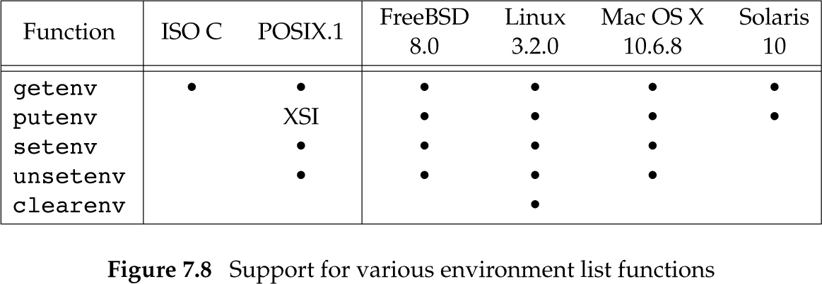
Environment Functions

Slide 6
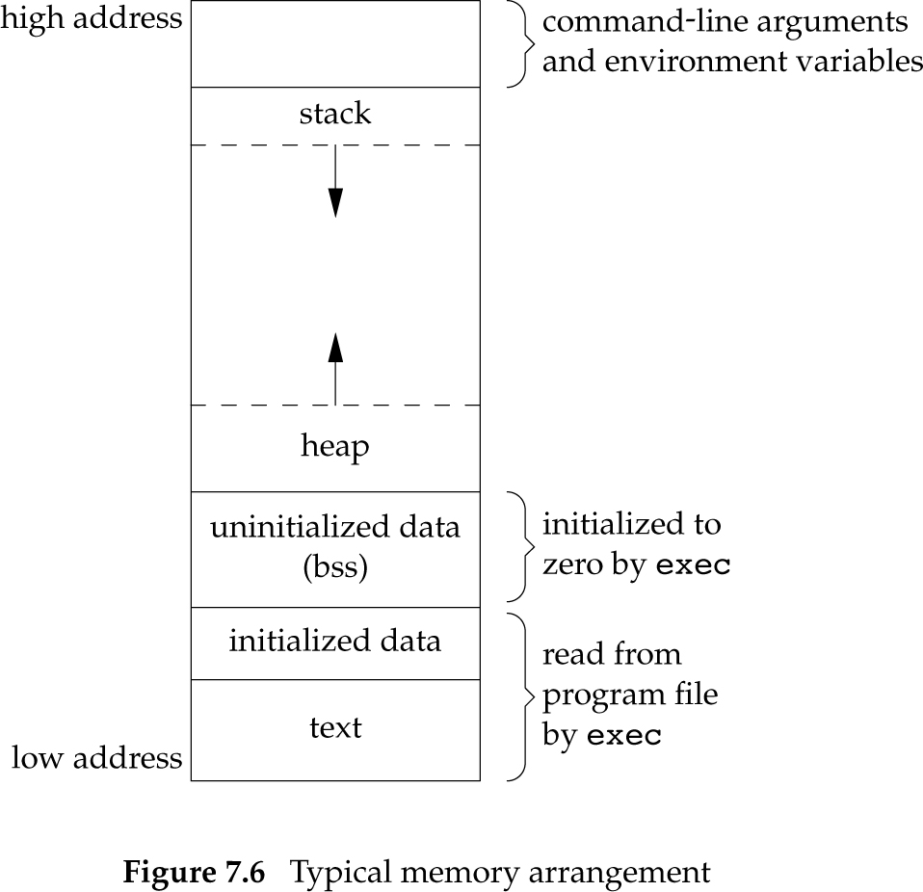
Memory Layout (without Libraries)

Slide 7
Shared Libraries
Libraries enable code-reuse
Shared libraries are loaded and linked at runtime
$ldd /bin/bash
linux-vdso.so.1 (0x00007fffb4fe8000)
libdl.so.2 => /lib/x86_64-linux-gnu/libdl.so.2 (0x00007f2eb3224000)
libc.so.6 => /lib/x86_64-linux-gnu/libc.so.6 (0x00007f2eb2e79000)
/lib64/ld-linux-x86-64.so.2 (0x00007f2eb3877000)

Slide 8
Memory Layout (with Libraries)
Shared Libraries (.so)

Slide 9
PIDs
Every process has a unique process ID (PID)
Non-negative integer
PID are assigned by the kernel
The ID of terminated process can be reused
The currently running processes can be listed using the ps command
$ ps
21271 pts/0 00:00:00 bash
21308 pts/0 00:00:00 ps

Slide 10
ps -aux
USER PID %CPU %MEM VSZ RSS TTY STAT START TIME COMMAND
root 1 0.0 0.0 176988 3264 ? Ss Feb26 0:03 /sbin/init
root 2 0.0 0.0 0 0 ? S Feb26 0:00 [kthreadd]
root 3 0.0 0.0 0 0 ? S Feb26 0:09 [ksoftirqd/0]
root 5 0.0 0.0 0 0 ? S< Feb26 0:00 [kworker/0:0H]
root 7 0.0 0.0 0 0 ? S Feb26 1:13 [rcu_sched]
root 8 0.0 0.0 0 0 ? S Feb26 0:00 [rcu_bh]
root 9 0.0 0.0 0 0 ? S Feb26 0:00 [migration/0]
user 14965 0.0 0.1 1039740 15852 ? Sl Feb29 0:05 texstudio --start-always
user 15626 0.0 0.0 128484 5144 ? S Feb29 0:00 orage
root 17886 0.0 0.0 86644 3728 ? Ss 07:35 0:00 /usr/sbin/cupsd -f
user 18016 4.1 7.8 1769348 639880 ? Sl 13:19 22:35 /usr/bin/iceweasel
user 18246 0.0 0.0 5964 396 ? S 13:23 0:00 cat

Slide 11
What’s my PID
pid_t getpid(void);
Return the process ID of the current process.
#include <stdlib.h> /* needed to define exit() */
#include <unistd.h> /* needed to define getpid() */
#include <stdio.h> /* needed for printf() */
int main(int argc, char **argv) {
printf("my process ID is %d\n", getpid());
exit(0);
}

Slide 12
Exit Functions
return <nr> from main is equivalent to exit(nr)
exit(int) is a libc function
Calls all handlers installed with atexit() and on_exit()
Closes I/O streams
Calls _exit() or _Exit()
_exit(int) or _Exit(int) is a system call
Tells the kernel to immediately close all files and terminate the process

Slide 13
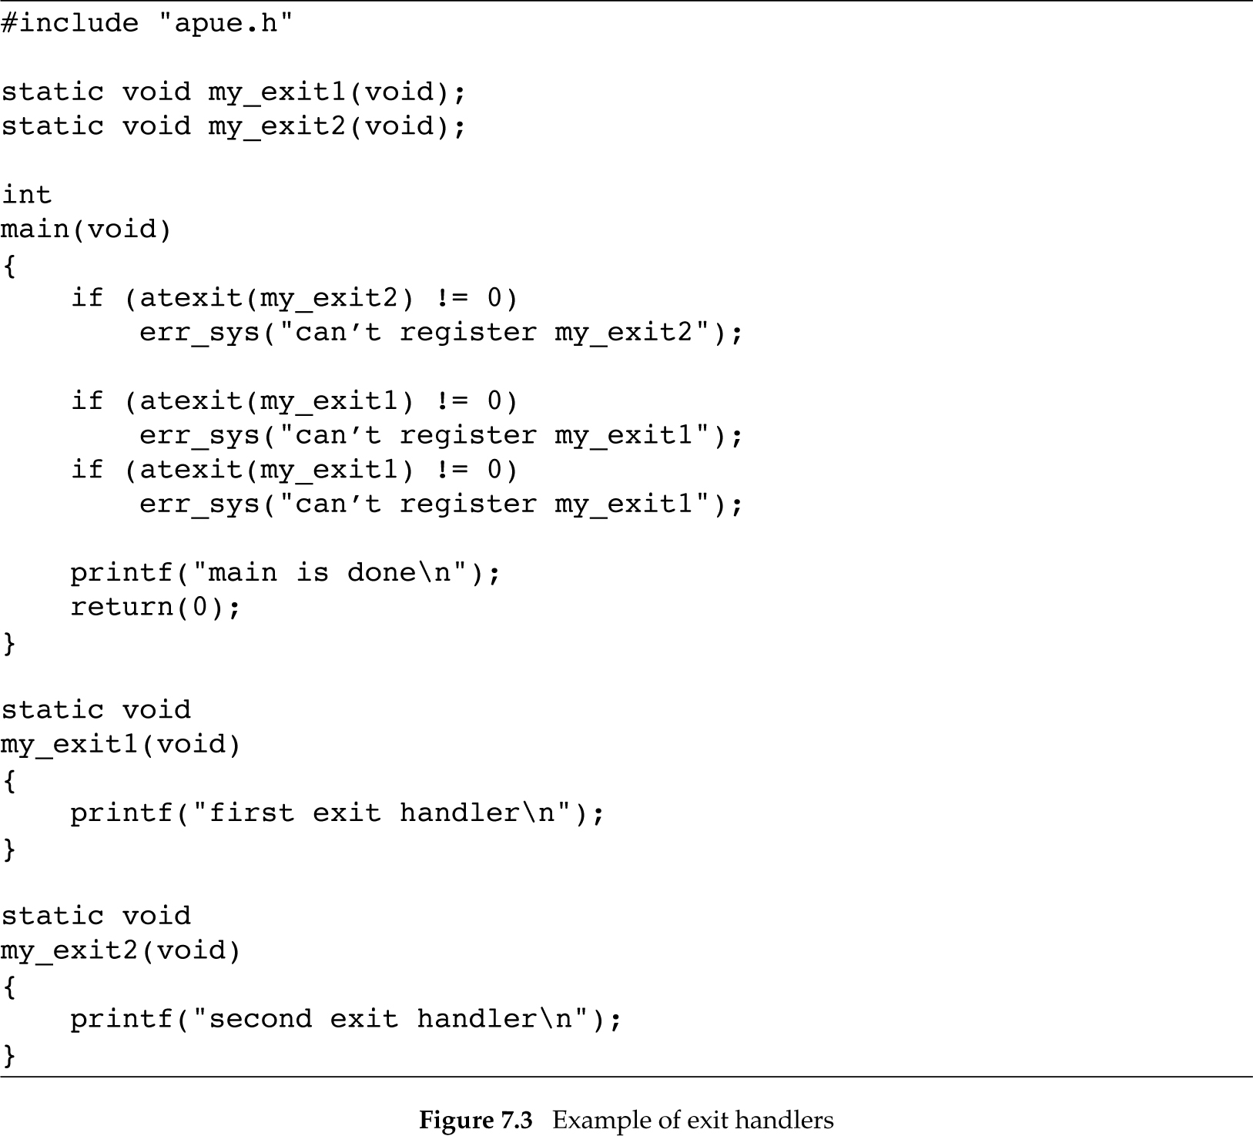
$ ./a.out
main is done
first exit handler
first exit handler
second exit handler

