Slide 1
Signals
Jun Xu
CS-392 Systems Programming
Spring 2019

Slide 2
Mid-term Survey
The instructor needs the following improvements
He needs to communicate better
Better oral English (😅)
Better presentation flow
He needs to prepare classes better
Better slides organization
Better rehearsal
He needs to have better availability
Better presence during office hour (KNOCK the DOOR please)
Quicker email response
He needs to increase depth of the course
He will
He needs to make assignments more challenging
He will
He should have made the mid-term much harder
He will do so for final exam
He needs to cover more on system, instead of C programming
He will

Slide 3
Pre-class Question
#include<stdio.h>
#include<unistd.h>
Int main(int argc, char ** argv){
while(1){
sleep(5);
printf(“Hello\n”);
}
return 0;
}
When you run the above program, what happens?
-- It will run forever and keep printing ”Hello”
How can you get your terminal back?
-- CTRL + C
But, what really happens?

Slide 4
A Signal Is
A notification of an event Event gains attention of the OS
Hardware generated faults/exceptions
Operating system/software generated faults/exceptions
Explicitly by a requesting process to another
What happens then
OS stops the application process immediately, sending it a signal
Signal handler executes to completion
Application process resumes where it left off

Slide 5
Examples
Hardware exceptions
Divide by zero ← value / 0
Page (segmentation) faults ← dereferencing a pointer that points to non-existent or inaccessible memory
Software faults
A user-set timer expires
Explicit
A process sends a signal to another process
unsigned int alarm(unsigned int seconds);
int kill(pid_t pid, int sig);

Slide 6
Uses of Signals
Handle Hardware Errors
Handle Software Errors
SIGSEGV
Inter Process Communication

Slide 7
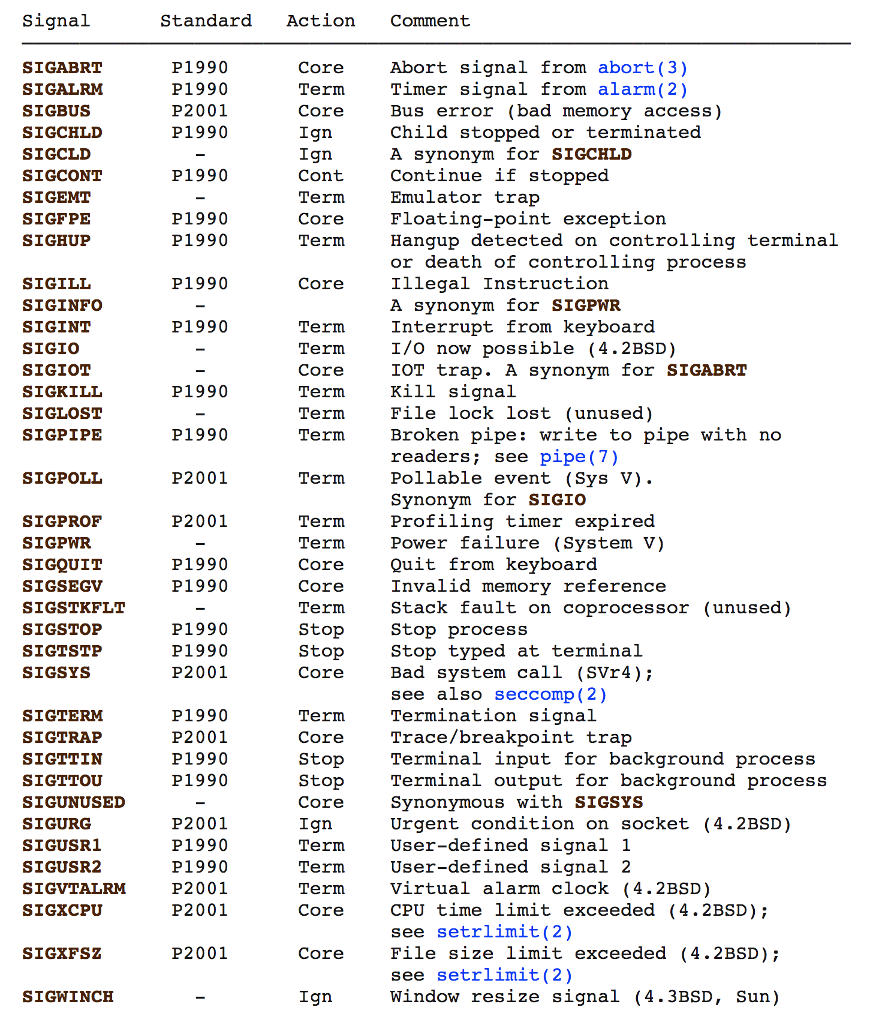

Slide 8
Default Actions
By default each signal has a default action associated with it
Default actions
Term Default action is to terminate the process.
Ign Default action is to ignore the signal.
Core Default action is to terminate the process and dump core.
Stop Default action is to stop the process.
Cont Default action is to continue the process if it is currently stopped.

Slide 9
Handling Signals: The Old Way
typedef void (*sighandler_t)(int);
sighandler_t signal(int signum, sighandler_t handler);
Call handler when signal signum is delivered. The signal number is passed to the handler
Return previous signal handler

Slide 10
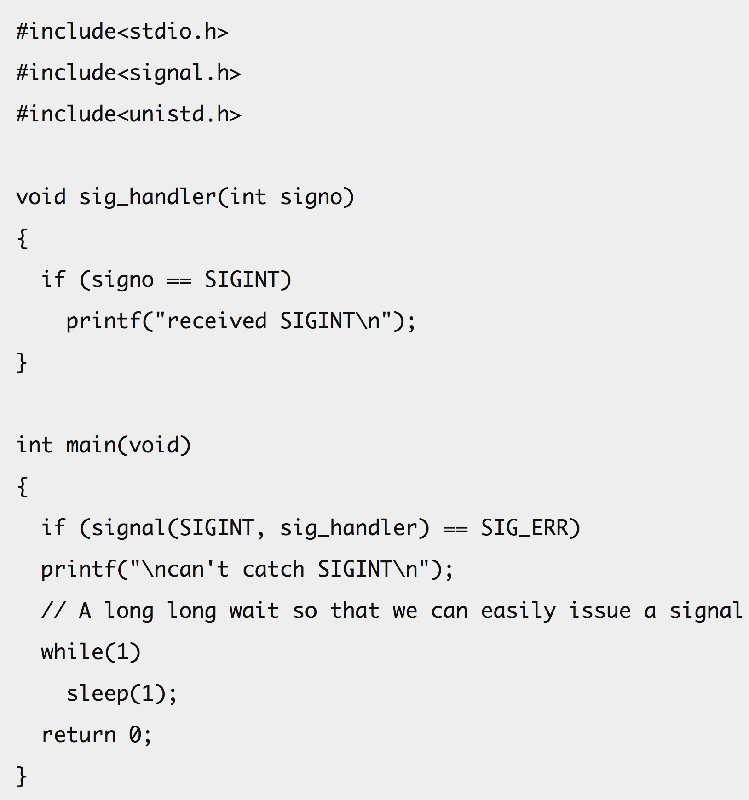
Example of Using signal()

Slide 11
The Modern Way
int sigaction(int signum, const struct sigaction *act, struct sigaction *oldact);
Examine and change the action to take on receipt of a signal signum
act → New action to take, if not null
oldact → Stores the previous action, if not null
struct sigaction {
void (*sa_handler)(int);
void (*sa_sigaction)(int, siginfo_t *, void *);
sigset_t sa_mask;
int sa_flags;
void (*sa_restorer)(void);
};

Slide 12
The Modern Way
int sigaction(int signum, const struct sigaction *act, struct sigaction *oldact);
Examine and change the action to take on receipt of a signal signum
act → New action to take, if not null
oldact → Stores the previous action, if not null
Function to be called when signal is received
struct sigaction {
void (*sa_handler)(int);
void (*sa_sigaction)(int, siginfo_t *, void *);
sigset_t sa_mask;
int sa_flags;
void (*sa_restorer)(void);
};

Slide 13
sa_sigaction
sa_flags is a set of bit flags
Setting SA_SIGINFO in sa_flags will cause the use sa_sigaction instead of sa_handler
Never set both sa_handler and sa_sigaction
struct sigaction {
void (*sa_handler)(int);
void (*sa_sigaction)(int, siginfo_t *, void *);
sigset_t sa_mask;
int sa_flags;
void (*sa_restorer)(void);
};
Notes:
If SA_SIGINFO is specified in sa_flags, then sa_sigaction (instead of
sa_handler) specifies the signal-handling function for signum. This
function receives the signal number as its first argument, a pointer to
a siginfo_t as its second argument and a pointer to a ucontext_t (cast
to void *) as its third argument. (Commonly, the handler function
doesn't make any use of the third argument. See getcontext(3) for fur-
ther information about ucontext_t.)

Slide 14
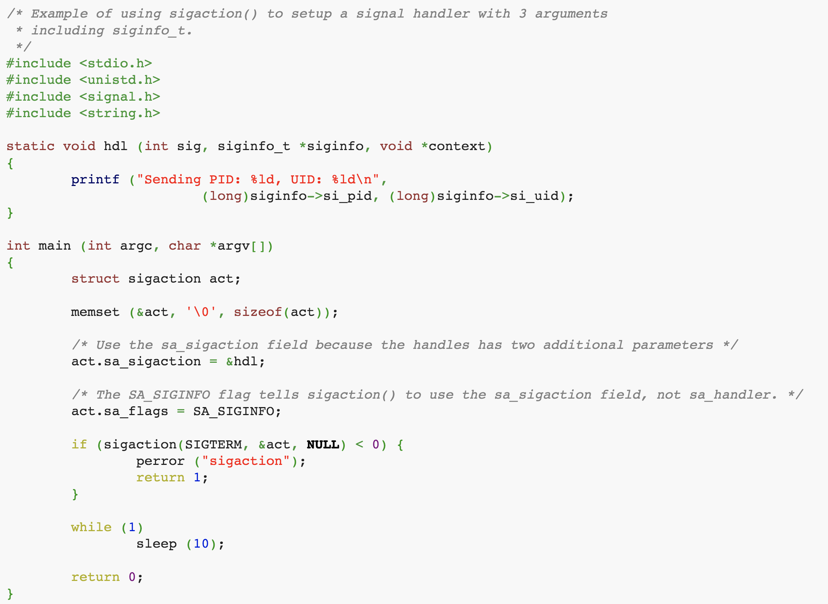
Example of Using sa_sigaction()

Slide 15
sa_mask
sa_mask specifies a set of signals which should be blocked while the signal handler is executing
The signal that caused entering the handler is always blocked, unless the SA_NODEFER option is specified
struct sigaction {
void (*sa_handler)(int);
void (*sa_sigaction)(int, siginfo_t *, void *);
sigset_t sa_mask;
int sa_flags;
void (*sa_restorer)(void);
};

Slide 16
Interrupted System Calls
Certain system calls are interrupted if a signal is delivered while executing them
EINTR is returned as error, or errno is set to EINTR
Some system calls can be automatically restarted (retried) after the signal handler finishes executing
By setting SA_RESTART in sa_flags
signal() essentially uses that option by default

Slide 17
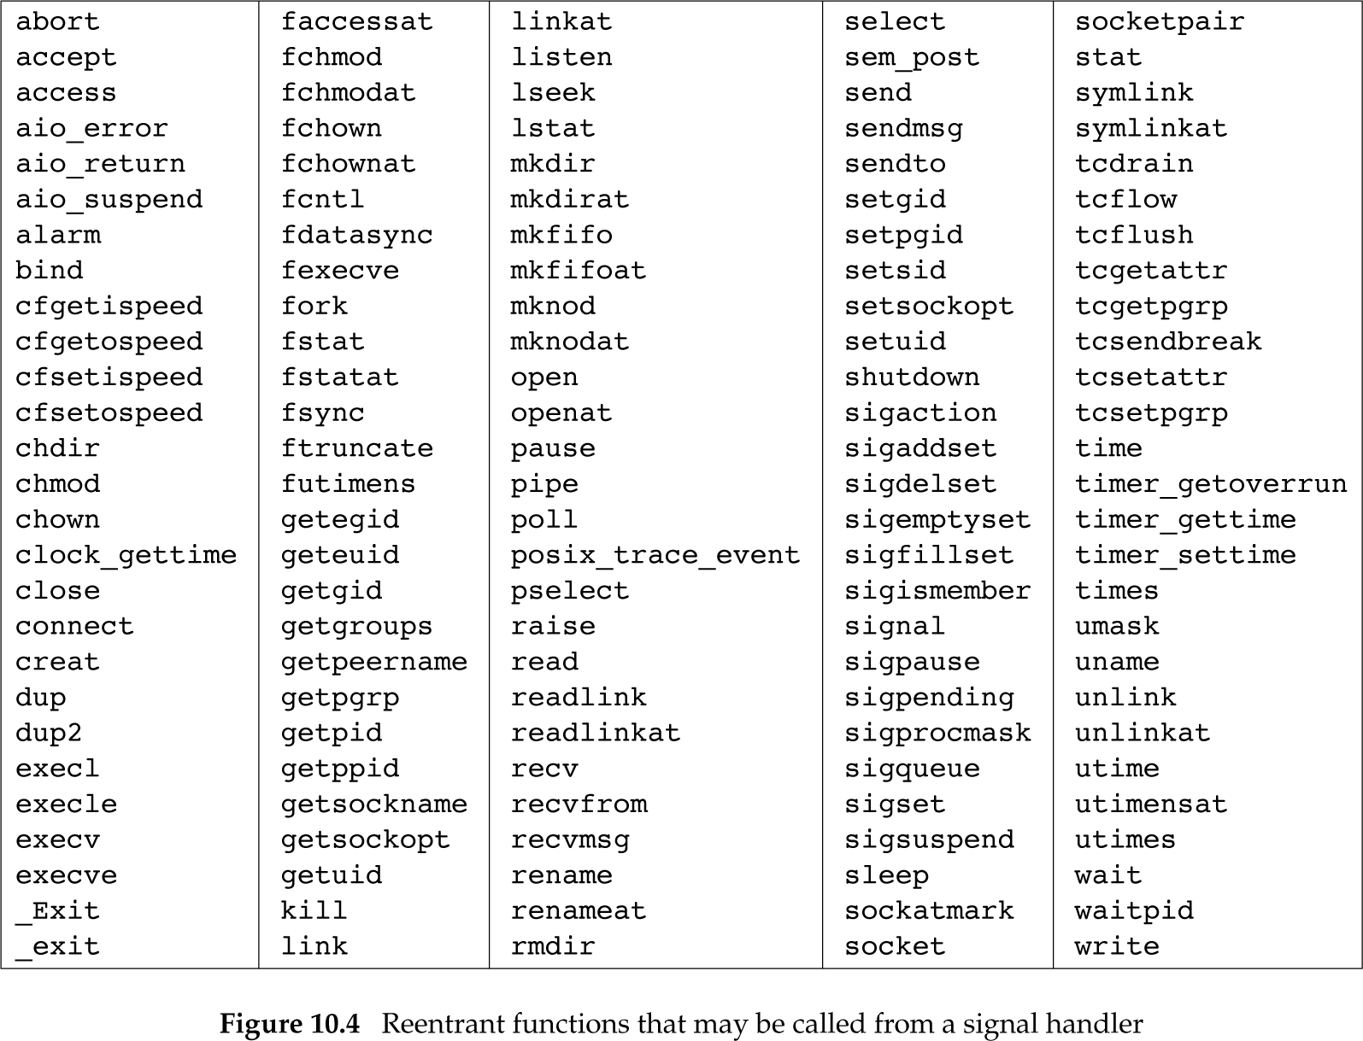
Reentrant Functions

Slide 18
Send Signal (1)
raise()
int raise(int iSig);
Commands OS to send a signal of type iSig to current process
Returns 0 to indicate success, non-0 to indicate failure
Example
int ret = raise(SIGINT); /* Process commits suicide. */
assert(ret != 0); /* Shouldn't get here. */
Note: C90 function

Slide 19
Send Signal (2)
kill()
int kill(pid_t iPid, int iSig);
Sends a iSig signal to the process whose id is iPid
Equivalent to raise(iSig) when iPid is the id of current process
Editorial comment: Better function name would be sendsig()
Example
pid_t iPid = getpid(); /* Process gets its id.*/
kill(iPid, SIGINT); /* Process sends itself a
SIGINT signal (commits
suicide?) */
Note: POSIX (not C90) function

