Slide 1
Inter-process Communication (IPC)
Jun Xu
CS-392 Systems Programming
Spring 2019

Slide 2
IPC
A set of programming interfaces that allows coordinated activities between processes

Slide 3
Why We Need IPC
Enables synchronization between processes
Enables data exchange between processes

Slide 4
Discussion
We have discussed two types of IPC interfaces. What are they?

Slide 5
Discussion
We have discussed two types of IPC interfaces
wait or waitpid
signals

Slide 6
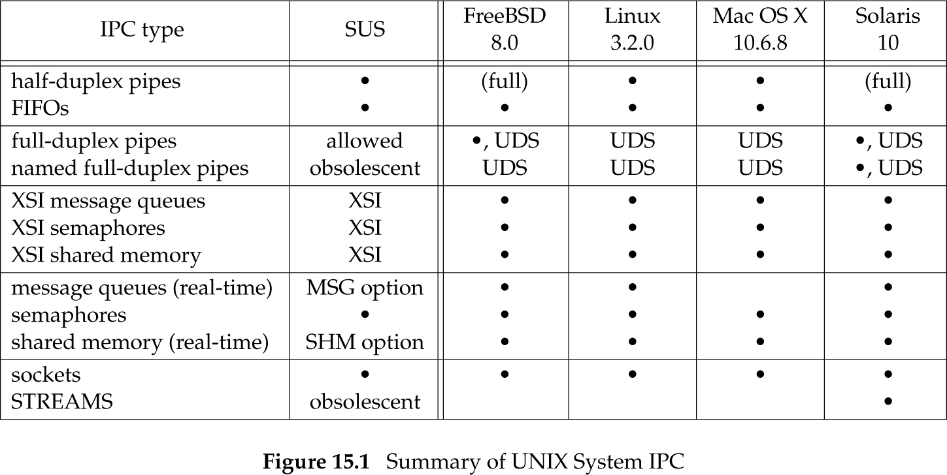
UNIX IPC

Slide 7
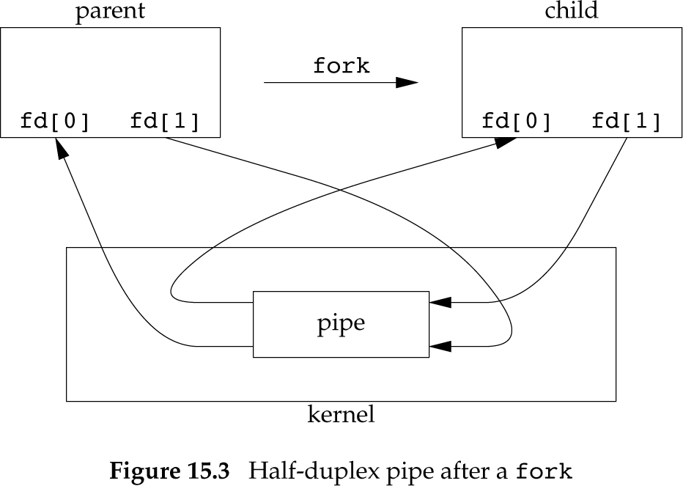
UNIX Pipes
Pipes are the oldest form of UNIX System IPC and are provided by all UNIX systems
Pipes can be used only between processes that have a common ancestor
Normally, a pipe is created by a process, that process calls fork, and the pipe is used between the parent and the child

Slide 8
Creating a Pipe
#include <unistd.h>
int pipe(int fd[2]);
Two file descriptors are returned through the fd argument:
fd[0] is open for reading
fd[1] is open for writing.
The output of fd[1] is the input for fd[0].

Slide 9
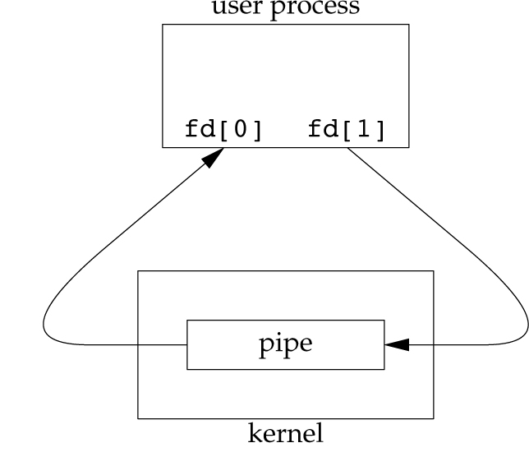
A Pipe is Provided by the OS
#include <unistd.h>
int pipe(int fd[2]);
Two file descriptors are returned through the fd argument:
fd[0] is open for reading
fd[1] is open for writing
The output of fd[1] is the input for fd[0].

Slide 10
A Pipe with A Fork
#include <unistd.h>
int pipe(int fd[2]);
Two file descriptors are returned through the fd argument:
fd[0] is open for reading
fd[1] is open for writing.
The output of fd[1] is the input for fd[0].

Slide 11
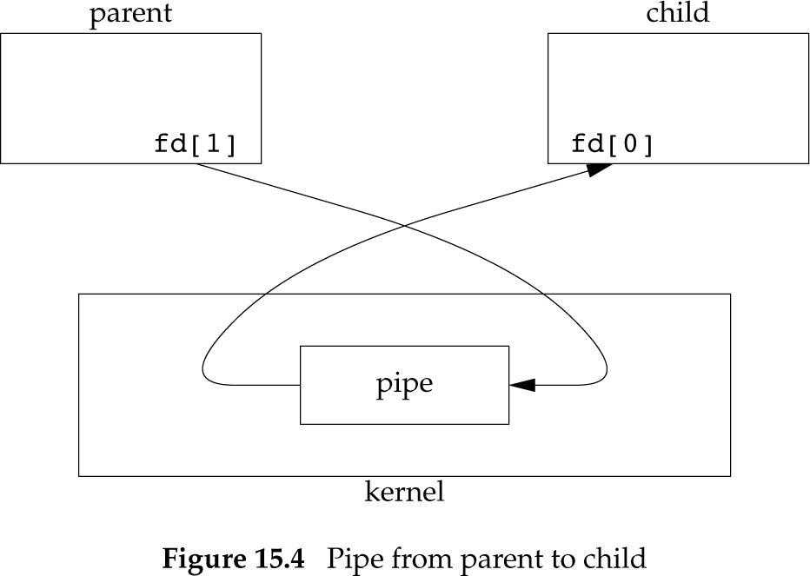
Half-duplex
Reading process should close fd[1] and use fd[0] for reading
Writing process should close fd[0] and use fd[1] for writing

Slide 12
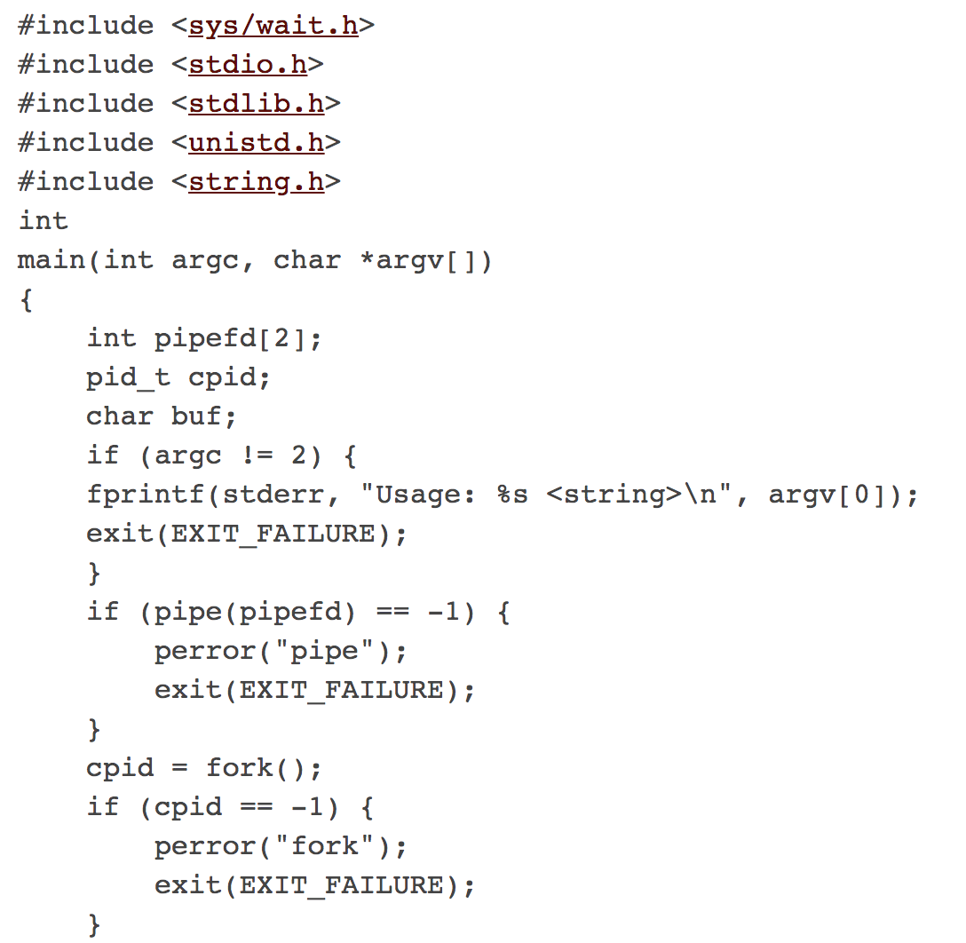
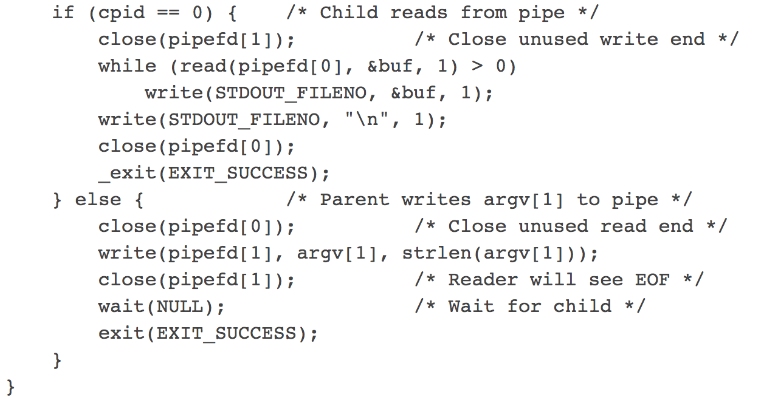
PIPE Example

Slide 13
Redirecting STDIO to a Pipe
Remember dup2()
#include <unistd.h>
int dup(int oldfd);
int dup2(int oldfd, int newfd);

Slide 14
Redirecting STDIO to a Pipe
dup2(fd[1], STDOUT_FILENO);
dup2(fd[0], STDIN_FILENO);

Slide 15
Pipelines in Shells
cat file.txt | sort
How pipe works with fork and exec?

Slide 16
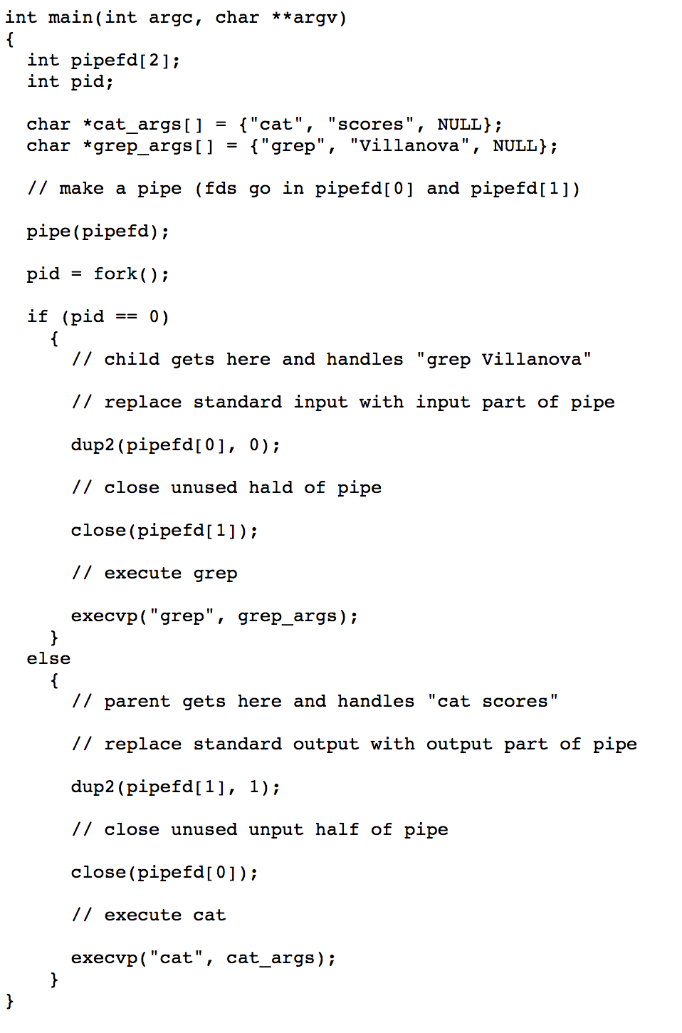

Slide 17
How to Create Full-duplex
Process A
Process B
http://www.cs.loyola.edu/~jglenn/702/S2005/Examples/dup2.html

Slide 18
popen()
FILE *popen(const char *command, const char *type);
Creates a pipe, forks, and invokes the shell to execute command
The type corresponds to the type of the pipe
Can be reading (“r”) or writing (“w”)
Writing to such a stream writes to the standard input of the command
Conversely, reading from the stream reads the command's standard output
int pclose(FILE *stream);
Waits for the process to terminate and returns exit status

Slide 19
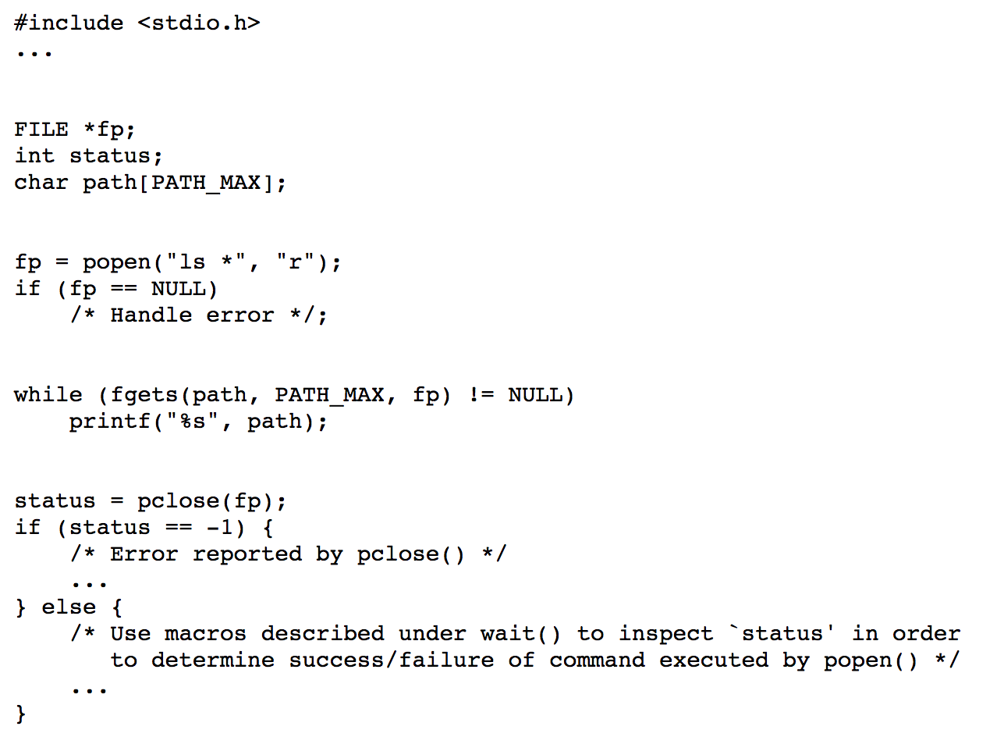
Popen Example

