Slide 1
Thread Synchronization
Jun xu
CS392 systems programming

Slide 2
Shared Address Space
Variables modified by one thread are visible to others
Global variables
Static variables
Heap data objects that are passed between threads

Slide 3
Pre-Class Question
#include <stdio.h>
#include <pthread.h>
int balance = 17;
void *compute() { balance++; }
int main() {
pthread_t thread1, thread2;
pthread_create(&thread1, NULL, compute, NULL);
pthread_create(&thread2, NULL, compute, NULL);
pthread_join( thread1, NULL);
pthread_join( thread2, NULL);
printf(“Your balance is %d\n”, balance); //What value will be printed here?
return 0;
}

Slide 4
Race Condition
A “race condition” arises if two or more threads access the same variables or objects concurrently and at least one does updates
The result is dependent on the thread scheduling algorithm, i.e. both threads are "racing" to access/change the data.

Slide 5
Mutex -- Avoid Race Conditions
A mutex is a program object that enables multithreaded programs to access a shared resource through mutual exclusion
POSIX threads support mutex variables which can be used as locks
Concurrency control is achieved by allowing only one thread to obtain a lock
pthread_mutex_t mutex_variable;
Mutex variables must be initialized before being used and destroyed when you are done with it

Slide 6
Mutex Variables Initialization
int pthread_mutex_init(pthread_mutex_t *restrict mutex, const pthread_mutexattr_t *restrict attr);
Initialises the mutex referenced by mutex with attributes specified by attr. If attr is NULL, the default mutex attributes are used
Attempting to initialise an already initialised mutex results in undefined behaviour.
E.g., pthread_mutex_init(&lock, NULL);

Slide 7
Destroying a Mutex Variable
int pthread_mutex_destroy(pthread_mutex_t *mutex);
Destroy the mutex object referenced by mutex; the mutex object becomes, in effect, uninitialized.
E.g., pthread_mutex_destroy(&lock);

Slide 8
How to Use an Initialized Mutex
Lock a mutex, block if another thread has locked it instead
int pthread_mutex_lock(pthread_mutex_t *mutex);
Lock a mutex, return 0 if mutex was successfully locked, an error code otherwise (e.g., mutex alredy locked)
Use when you do not want to block
int pthread_mutex_trylock(pthread_mutex_t *mutex);
Unlock/release a mutex
int pthread_mutex_unlock(pthread_mutex_t *mutex);

Slide 9
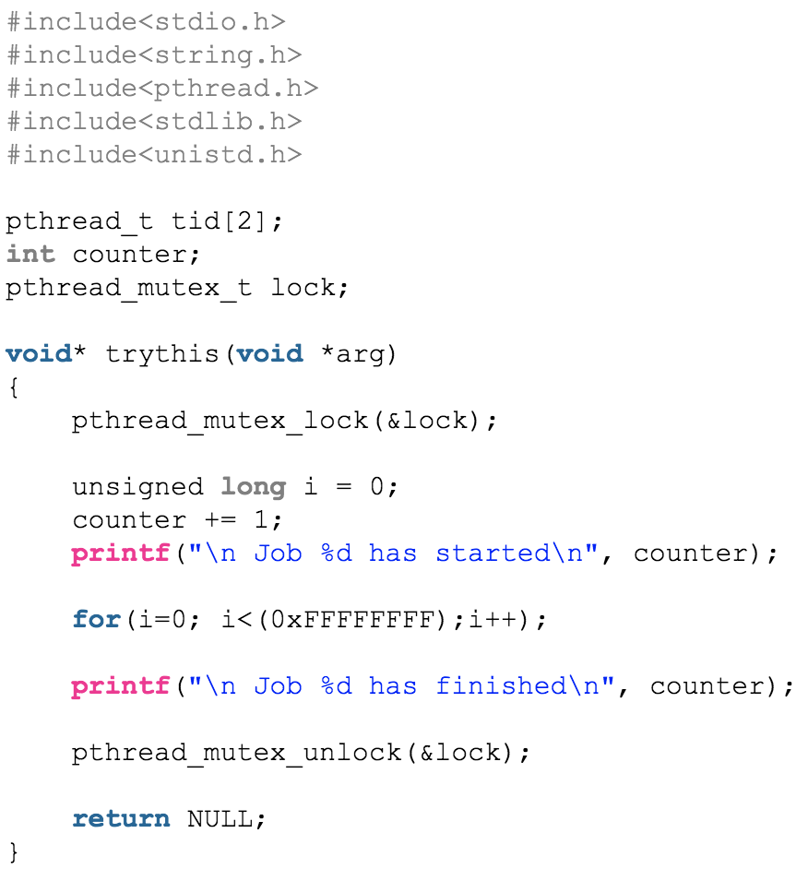
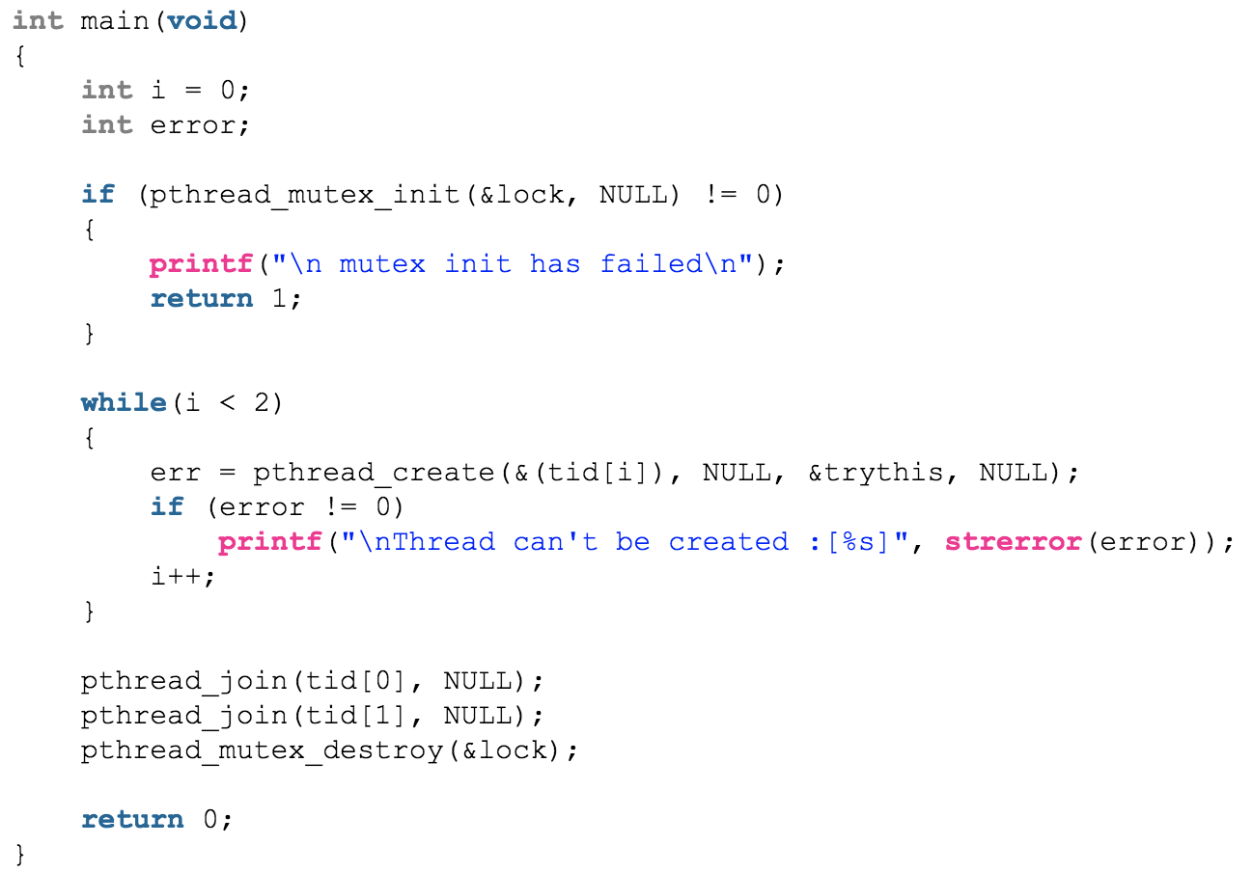
How to Use an Initialized Mutex

Slide 10
Deadlocks
A deadlock is a situation where no progress can be made because usually two actions are waiting for each other

Slide 11
Deadlocks
A deadlock is a situation where no progress can be made because usually two actions are waiting for each other
A deadlock can occur:
when the same thread attempts to lock the same mutex twice
pthread_mutex_lock(&st->lock);
…..
pthread_mutex_lock(&st->lock);
// Same Thread
The thread will block forever

Slide 12
Deadlocks
A deadlock is a situation where no progress can be made because usually two actions are waiting for each other
A deadlock can occur:
When the same thread attempts to lock the same mutex twice
But can be more complex when multiple locks are involved

Slide 13
Multiple Mutex Deadlocks
// Thread 1
// Thread 2
pthread_mutex_lock(&lock1);
…..
pthread_mutex_lock(&lock2);
pthread_mutex_lock(&lock2);
…..
pthread_mutex_lock(&lock1);
You should always lock mutexes using the same order

Slide 14
Spinlocks
Similar to mutex locks, but it usually is not backed by a system call
Spinlocks may be backed by test and set instructions and spin (loop) until they obtain the lock

Slide 15
Spinlocks
Similar to mutex locks, but it usually is not backed by an OS system call
Spinlocks may be backed by test and set instructions and spin (loop) until they obtain the lock
spinlock_init:
lock = 0;
spinlock_lock:
temp = 1
exhange temp, lock
if temp != 0 goto spinlock_lock
int pthread_spin_init(pthread_spinlock_t *lock, int pshared);
int pthread_spin_destroy(pthread_spinlock_t *lock);
int pthread_spin_lock(pthread_spinlock_t *lock);
int pthread_spin_trylock(pthread_spinlock_t *lock);
int pthread_spin_unlock(pthread_spinlock_t *lock);

Slide 16
Condition Variables
Condition variables are a mechanism for threads to signal each other
The most typical example is in producer-consumer models, where the producer needs to notify the consumer that data are available
The old way: The consumer keeps running even when no items in the queue
lock();
append_item(item);
unlock()
lock();
item = remove_item();
if (item)
process_item(item);
unlock()

Slide 17
Condition Variables
Condition variables provide a mechanism for thread to rendezvous or signal each other
The most typical example is in producer-consumer models, where the producer needs to notify the consumer that data are available
lock();
item = append_item();
unlock()
signal(cond)
lock();
item = remove_item();
while (!item)
wait_for_items(cond);
process_item(item);
unlock()

Slide 18
Condition Variables Interfaces
int pthread_cond_init(pthread_cond_t *restrict cond, const pthread_condattr_t *restrict attr);
int pthread_cond_destroy(pthread_cond_t *cond);
int pthread_cond_wait(pthread_cond_t *restrict cond, pthread_mutex_t *restrict mutex);
Atomically release mutex and cause the calling thread to block on the condition variable cond
It will be waken up by a subsequent call to pthread_cond_signal
Upon successful return, the mutex shall have been locked and shall be owned by the calling thread.
int pthread_cond_signal(pthread_cond_t *cond);
Wake up a thread that is blocking on the condition

Slide 19
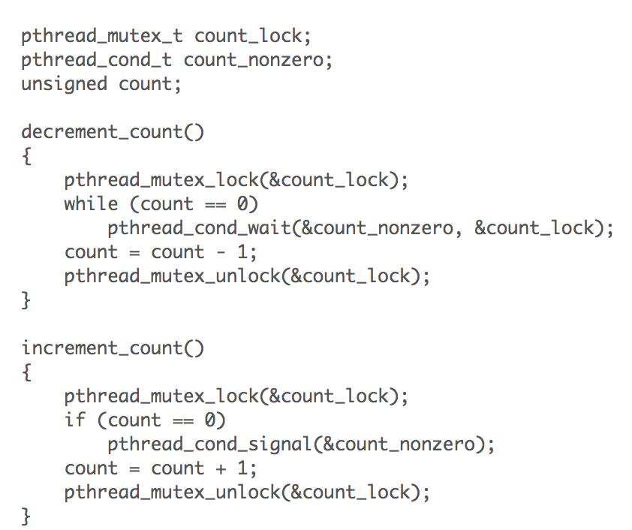

Slide 20
Thread In-class Practice
Write a program thread.c
Inside the program declare a global variable counter with initial value 0
Start two child threads with pthread_create(). Both of the two threads will run the following function:
void* run_thread(void * noarg){
int i = 0;
for( i = 0; i < 1000; i++){
counter++;
}
pthread_exit(NULL);
return NULL;
}
In the master thread, use pthread_join() to wait for the two threads to finish.
Print the final value of counter with printf()
Compile thread.c with gcc -O0 -g thread.c -o thread -pthread
Run thread multiple times, see what happens.
If time permits, change the program to enforce lock via mutex.

