Slide 1
Concurrent Sockets
Jun xu
CS-392 Systems Programming
Spring 2019

Slide 2
Socket Revisited
Client
Server
socket
socket
bind
open_listenfd
open_clientfd
listen
Connection
request
connect
accept
Client / Server
Session
write
read
read
write
close
EOF
read
close

Slide 3
Close the Socket
Don’t forget to close the socket descriptor, like a file
int close(int sockfd);
Now server can loop around and accept a new connection when the old one finishes
What’s wrong here?

Slide 4
What We Have Learned
client 1
server
client 2
call accept
call connect
ret connect
ret accept
call fgets
call read
Server blocks
waiting for
data from
Client 1
call connect
User goes
out to lunch
Client 1 blocks
waiting for user
to type in data
Client 2 blocks
waiting to complete
its connection
request until after
lunch!
Taken from D. Murray, R. Bryant, and G. Langale 15-441/213 slides

Slide 5
Better Design: Concurrent Servers
client 1
server
client 2
call accept
call connect
call connect
ret connect
ret accept
call fgets
call read (don’t block)
call accept
User goes
out to lunch
Client 1 blocks
waiting for user to type in data
ret connect
ret accept
call fgets
write
call read
call read
write
close
end read
close
Taken from D. Murray, R. Bryant, and G. Langale 15-441/213 slides

Slide 6
Choice of Concurrency
Threading
Easier to understand
Race conditions increase complexity
Select()
Explicit control flows, no race conditions
Explicit control more complicated

Slide 7
What is select()?
Monitor multiple descriptors
How does it work?
Setup sets of sockets to monitor
select(): blocking until something happens
“Something” could be
Incoming connection: accept()
Clients sending data: read()
Pending data to send: write()
Timeout

Slide 8
Use of select()
Monitor sockets with select()
int select(int maxfd, fd_set *readfds, fd_set *writefds, fd_set *exceptfds, const struct timespec *timeout);
maxfd
max file descriptor + 1
fd_set: bit vector with FD_SETSIZE bits
readfds: bit vector of read descriptors to monitor
writefds: bit vector of write descriptors to monitor
exceptfds: set to NULL
timeout
how long to wait without activity before returning

Slide 9
A Group of Helper Functions
void FD_ZERO(fd_set *fdset);
clear out all bits
void FD_SET(int fd, fd_set *fdset);
set one bit
void FD_CLR(int fd, fd_set *fdset);
clear one bit
int FD_ISSET(int fd, fd_set *fdset);
test whether fd bit is set

Slide 10
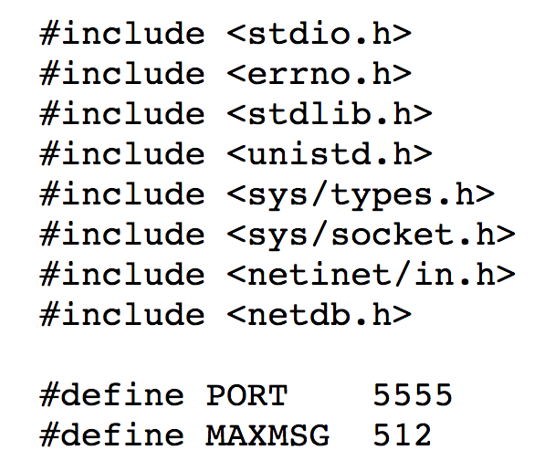
An Example of Concurrent Server

Slide 11
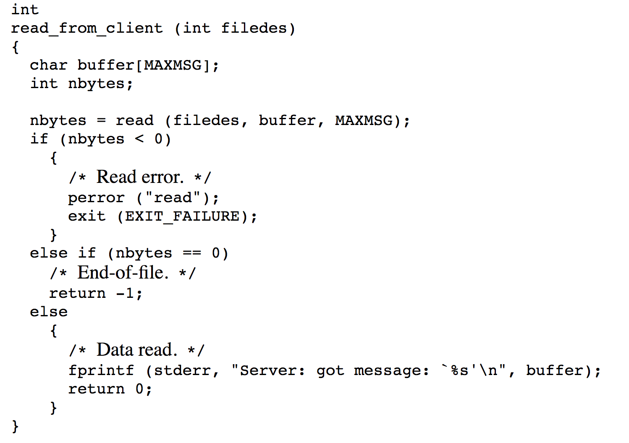
An Example of Concurrent Server

Slide 12
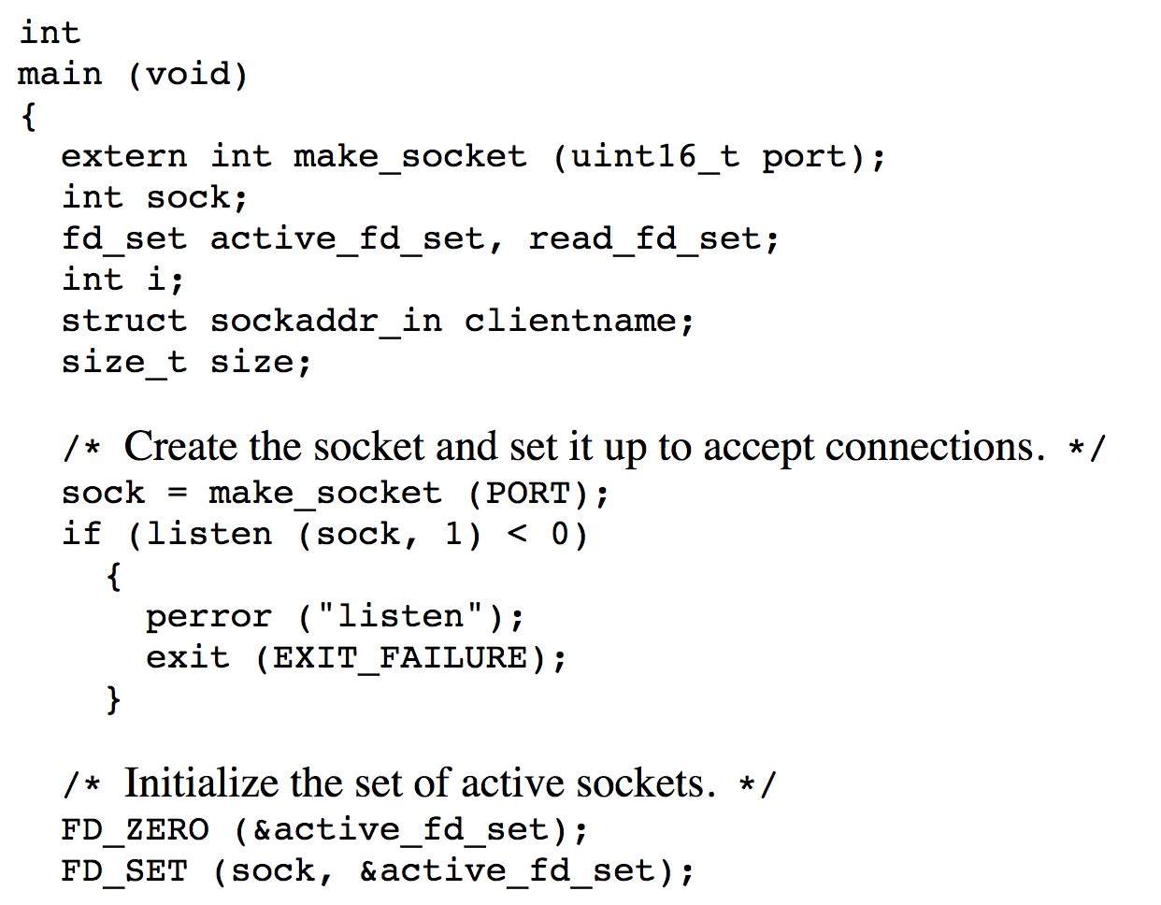
An Example of Concurrent Server

Slide 13
An Example of Concurrent Server
for (;;) {
// set listenfd and udpfd in readset
FD_SET(listenfd, &rset);
FD_SET(udpfd, &rset);
// select the ready descriptor
nready = select(maxfdp1, &rset, NULL, NULL, NULL);
// if tcp socket is readable then handle
// it by accepting the connection
if (FD_ISSET(listenfd, &rset)) {
len = sizeof(cliaddr);
connfd = accept(listenfd, (struct sockaddr*)&cliaddr, &len);

Slide 14
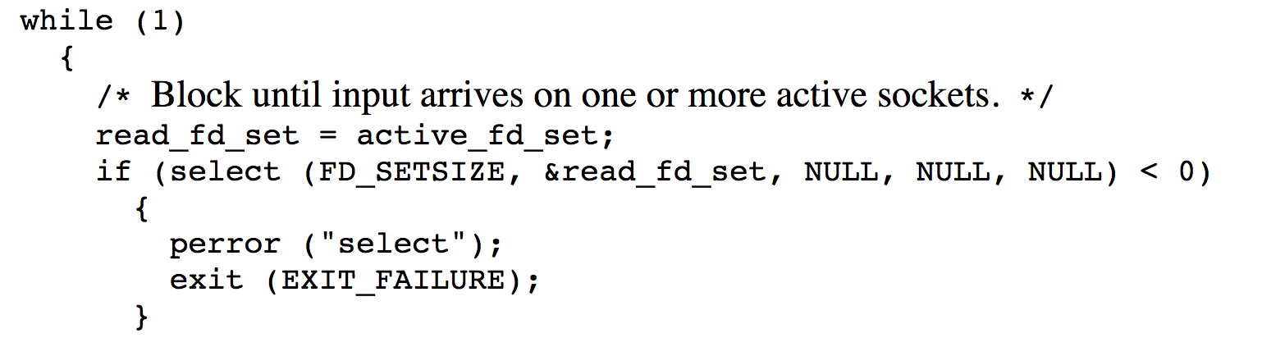
An Example of Concurrent Server

Slide 15
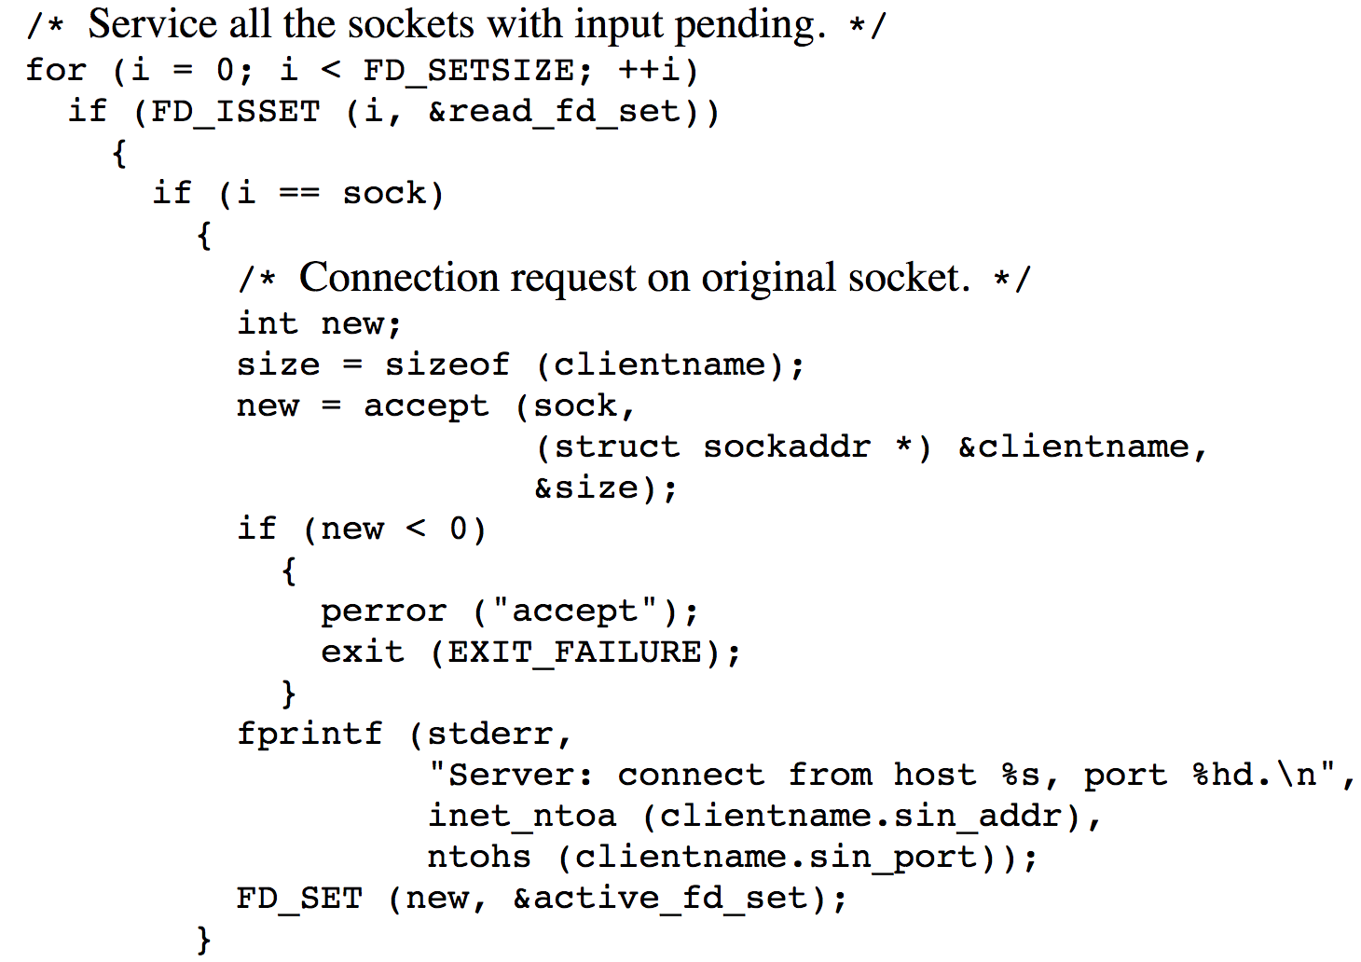
An Example of Concurrent Server

Slide 16
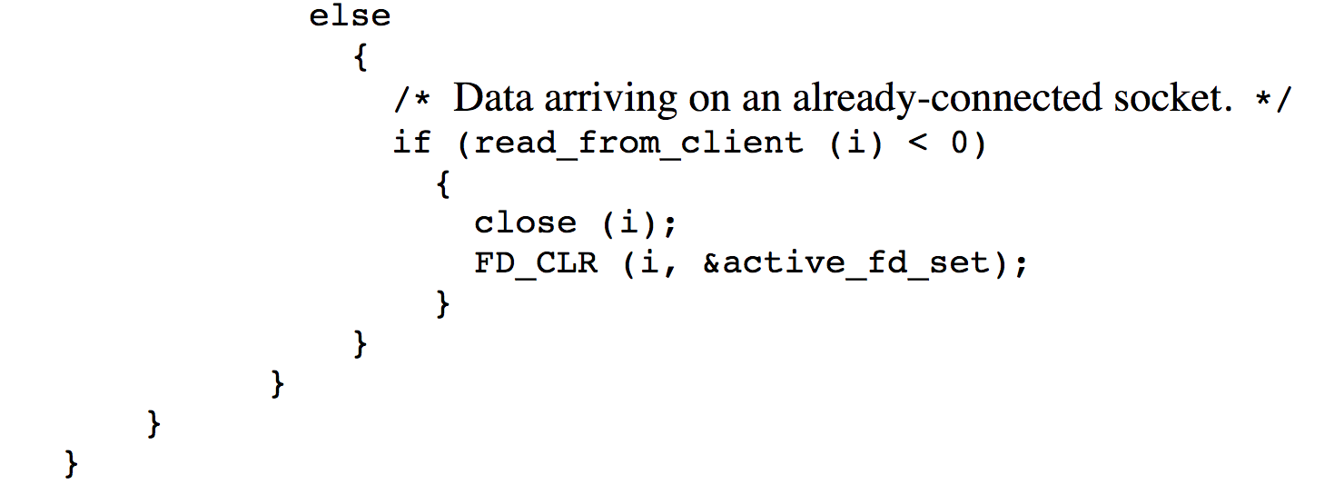
An Example of Concurrent Server

