Slide 1
User Permissions
Jun Xu
CS-392 Systems Programming
Spring 2019

Slide 2
User Permissions
Why
Mainly for security reasons
Goals today:
How Linux enforces access control with different users
Details of file permissions
Process permissions

Slide 3
Users and Groups
Linux maintains users by the schemes of Users and Groups
A user can belong to several groups

Slide 4
Users and Groups cont.
User information in /etc/passwd
Password info is in /etc/shadow
Group information is in /etc/group
/etc/passwd and /etc/group divide data fields using “:”
/etc/passwd:
joeuser:x:1000:1000:Joe User,,,:/home/joeuser:/bin/bash
/etc/group:
joeuser:x:1000:

Slide 5
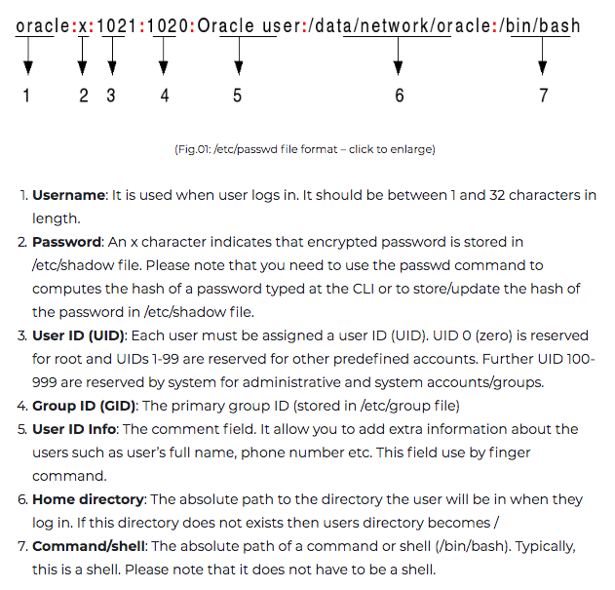
/etc/passwd

Slide 6
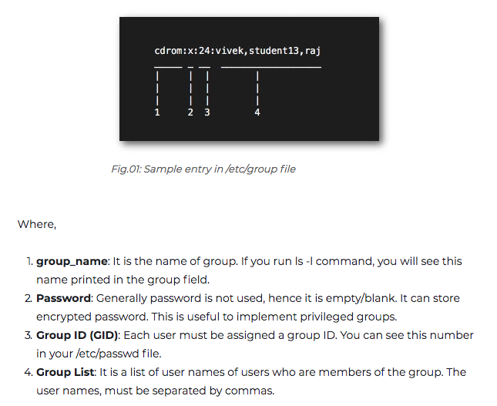
/etc/group

Slide 7
File Ownership
A file can belong to only one user and one group at a time
Only root can change the ownership of a file

Slide 8
File Permissions
Each file and directory has bits for..
Read, Write, Execute: rwx
Directories:
r → “can list files in a directory” (but not read a given file)
x → “read a file if you know the name” (easy if directory also has read)
w → “can create, change, delete files in directory”
Thus, you may only read a file IFF you:
Have read permissions to the file AND
Have execute permissions to that file’s directory
Files & Directories have 3 levels:
Owner, Group, and Everyone Else
aka. User, Group, Other: ugo

Slide 9
-r-xr-xr-x 1 root root 68524 2011-12-19 07:18 /usr/bin/top
---------- --- ------- ------- -------- ------------ -------------
| | | | | | |
| | | | | | File Name
| | | | | |
| | | | | +--- Modification Time/Date
| | | | |
| | | | +------------- Size (in bytes
| | | |
| | | +----------------------- Group
| | |
| | +-------------------------------- Owner
| |
| +-------------------------------------- “link count”
|
+---------------------------------------------- File Permissions
Group
The name of the group that has permissions in addition to the file's owner.
Owner
The name of the user who owns the file.
File Permissions
The first character is the type of file. A "-" indicates a regular (ordinary) file. A "d” indicate a directory. Second set of 3 characters represent the read, write, and execution rights of the file's owner. Next 3 represent the rights of the file's group, and the final 3 represent the rights granted to everybody else.
(Example modified from http://www.linuxcommand.org/lts0030.php)

Slide 10
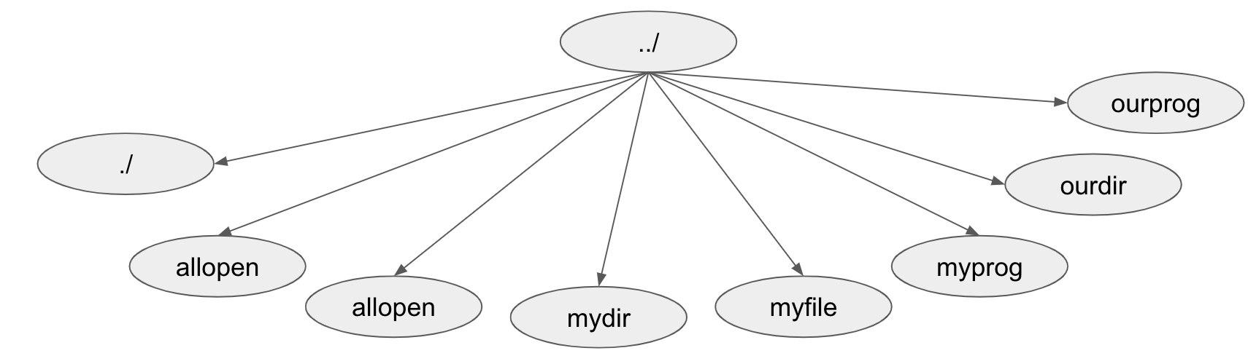
List permissions of a file: ls –l with some info removed from below in [...] drwx--x--- […] andy faculty […] . drwx------ […] andy faculty […] .. -rwxrwxrwx […] andy faculty […] allopen drwx------ […] andy faculty […] mydir -rw------- […] andy faculty […] myfile -rwx------ […] andy faculty […] myprog drwxrwx--- […] andy faculty […] ourdir -rwxrwx--- […] kenn faculty […] ourprog
Can kenn execute myprog?
No, because of file permissions.
Can both andy and kenn execute ourprog?
Yes. Everyone in faculty can read and execute ourprog
Can kenn read ourprog?
Yes. Directory has group x, file has group r
Can kenn list to find ourprog?
No. Directory listing is off.

Slide 11
chmod
Command to change permissions
Set (=), Add (+), Remove (-)
Set user to rw, not x: chmod u=rw .
Set user, groups to only rw: chmod ug=rw .
Set ug to only rx, recursively: chmod –R ug=rx .
Add “groups can rw”: chmod g+rw .
Add “others can rw”: chmod o+rw .
Add “everyone can read”: chmod a+r .
Remove write from group: chmod g-w .
Octal notation
e.g. chmod 755 file.txt
Good for setting, not adding/removing
1,2,3 are never used
rwx | --- | --x | -w- | -wx | r-- | r-x | rw- | rwx
Binary | 000 | 001 | 010 | 011 | 100 | 101 | 110 | 111
Decimal | 0 | 1 | 2 | 3 | 4 | 5 | 6 | 7

Slide 12
umask
When a file is created…
User mask (umask) is consulted for permissions
Owner = user who created the file
Subtract octally (“digit by digit”)
from 666 for files
from 777 for directories
e.g. 666-022=644, or rw-r--r--
Common default: rw-r--r– (or 022)
Common umask shared group stuff: rw-rw--– (or 007)
Programs can change their own umask
Blessing for good developers

Slide 13
Permissions in Program Run
A program may be run by a user, when the system starts or by another process.
Before the program can execute the kernel inspects several things:
Is the file containing the program accessible to the user or group of the process that wants to run it?
Does the file containing the program permit execution by that user or group (or anybody)?
In most cases, while executing, a program inherits the privileges of the user/process who started it.

Slide 14
setuid/setgid
int setuid(uid_t uid);
setuid() sets the effective user ID of the calling process. If the effective UID of the caller is root, the real UID and saved set-user-ID are also set.
int setgid(gid_t gid);
setgid() sets the effective group ID of the calling process. If the calling process is root: the real GID and saved set-group- ID are also set.

Slide 15
Example of setuid/setgid
if (getuid() == 0) { /* process is running as root, drop privileges */
if (setgid(groupid) != 0)
perror("setgid: Unable to drop group privileges: %s", strerror(errno));
if (setuid(userid) != 0)
perror("setuid: Unable to drop user privileges: %S", strerror(errno));
}

