Slide 1
System Security
Jun Xu
CS-392 Systems Programming
Spring 2019

Slide 2
Focus – Software Vulnerability
Software vulnerabilities are implementation flaws that can be exploited for malicious attentions

Slide 3
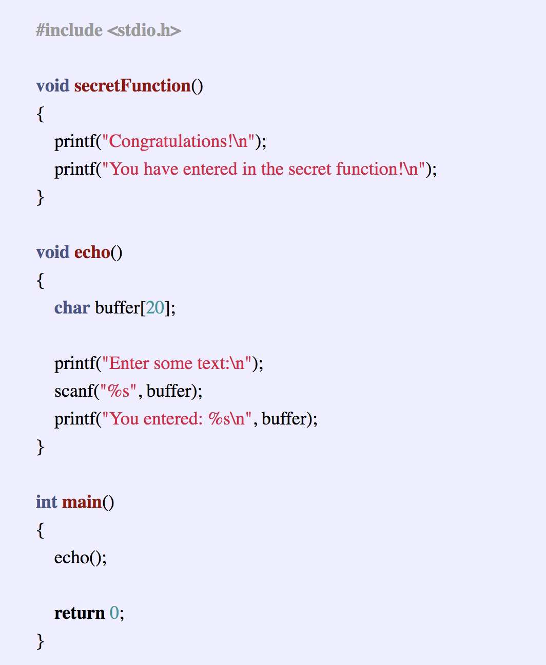
An Example
What will happen if you run this piece of code?

Slide 4
Memory Layout of a C program

Slide 5
Memory Layout of the Stack
Local var
Frame for main function
Return addr
Saved ebp
alignment
buffer
Frame for echo function
return
Return addr
Saved ebp

Slide 6
Similar Dangerous Errors
Head Buffer Overflow
You allocate a N bytes buffer, and later you try to access the Mth byte (M > N)
Use After Free
You allocate a buffer “buf”, you free it, and then you access “buf” again
Integer overflow
You declare an integer (32 bits), and you are assigning a value larger than 2^32 – 1 to this integer
Bad typecasting
You have a data structure of type A. You cast this data structure to type B, and sizeof(B) > sizeof(A)
Memory leakage
You allocate a buffer but never free it
Uninitialized memory
You use a variable before defining it
…

