Slide 1
Hot Topics: Privacy CS-4440 - Introduction to Computer Security Spring 2022 Jun Xu Slides adapted from CPS 96 by Eduardo Cuervo and Amre Shakimov at Duke

Slide 2
Context of this lecture …
What is privacy today?
What are the threats to privacy
Techniques for enhancing privacy
Privacy is hard!

Slide 3
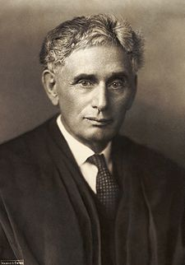
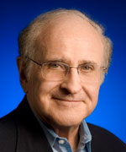
What do we mean by privacy?
Louis Brandeis (1890)
“right to be left alone”
protection from institutional threat
Alan Westin (1967)
“right to control, edit, manage, and delete information about themselves and decide when, how, and to what extent information is communicated to others”

Slide 4



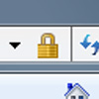
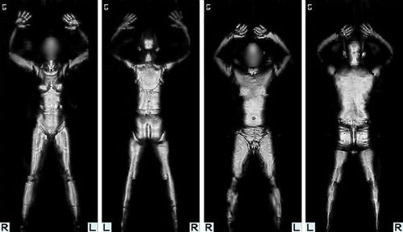
Privacy vs. security
Privacy: what information goes where?
Security: protection against unauthorized access
Security helps enforce privacy policies
Can be at odds with each other
e.g., invasive screening to make us more “secure” against terrorism

Slide 5
Privacy-sensitive information
Identity
name, address, SSN
Location
Activity
web history, contact history, online purchases
Health records
…and more

Slide 6
10 Reasons Why Privacy Matters
https://teachprivacy.com/10-reasons-privacy-matters
1. Limit on Power
Privacy is a limit on government power, as well as the power of private sector companies. The more someone knows about us, the more power they can have over us. Personal data is used to make very important decisions in our lives. Personal data can be used to affect our reputations; and it can be used to influence our decisions and shape our behavior. It can be used as a tool to exercise control over us. And in the wrong hands, personal data can be used to cause us great harm.
2. Respect for Individuals
Privacy is about respecting individuals. If a person has a reasonable desire to keep something private, it is disrespectful to ignore that person’s wishes without a compelling reason to do so. Of course, the desire for privacy can conflict with important values, so privacy may not always win out in the balance. Sometimes people’s desires for privacy are just brushed aside because of a view that the harm in doing so is trivial. Even if this doesn’t cause major injury, it demonstrates a lack of respect for that person. In a sense it is saying: “I care about my interests, but I don’t care about yours.”
3. Reputation Management
Privacy enables people to manage their reputations. How we are judged by others affects our opportunities, friendships, and overall well-being. Although we can’t have complete control over our reputations, we must have some ability to protect our reputations from being unfairly harmed. Protecting reputation depends on protecting against not only falsehoods but also certain truths. Knowing private details about people’s lives doesn’t necessarily lead to more accurate judgment about people. People judge badly, they judge in haste, they judge out of context, they judge without hearing the whole story, and they judge with hypocrisy. Privacy helps people protect themselves from these troublesome judgments.
…

Slide 7
Threats to Privacy

Slide 8

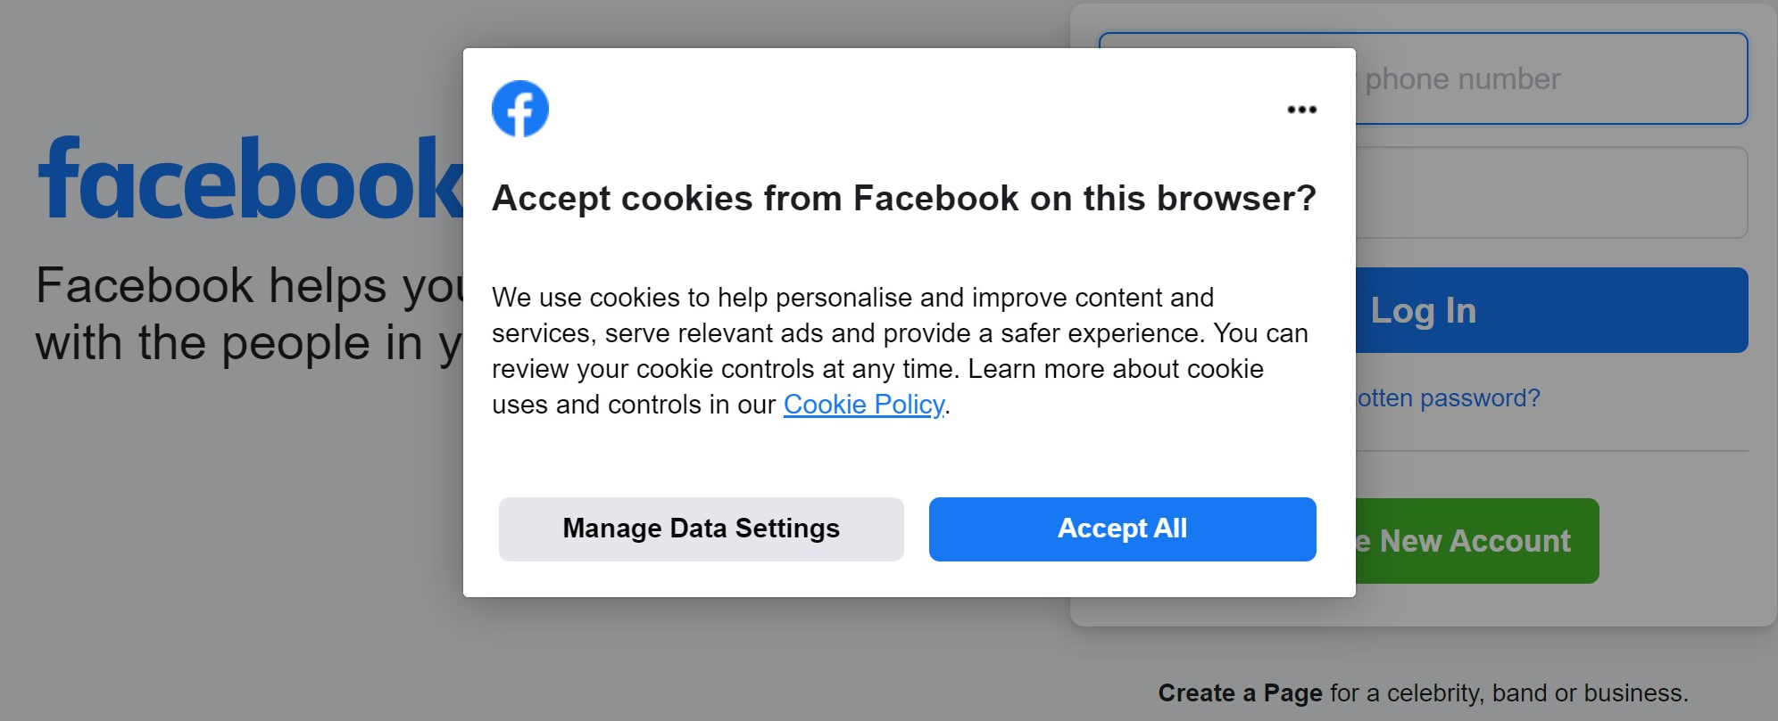

T1: Tracking on the web
IP address
Number identifying your computer on the Internet
Visible to site you are visiting
Not always permanent
Cookies
Text stored on your computer by site
Sent back to site by your browser
Used to save prefs, shopping cart, etc.
Can track you even if IP changes
72.21.214.128
_{Internet}
152.3.136.66

Slide 9

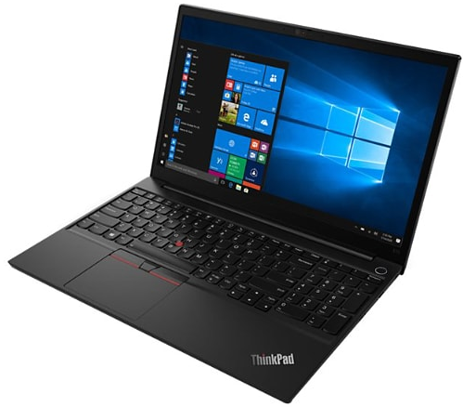

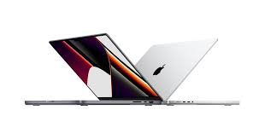
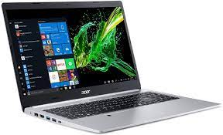



T2: Search Engines
Computer vendors
History book sellers
Computer History

Slide 10

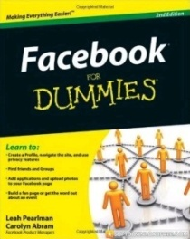
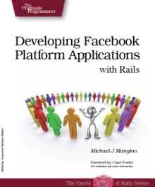


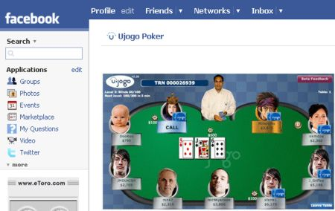
T3: Online Social Networks OSNs: State-of-the-Art
Fun
Popular
Platform

Slide 11
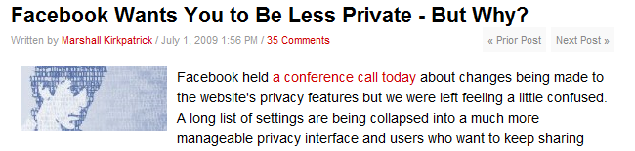
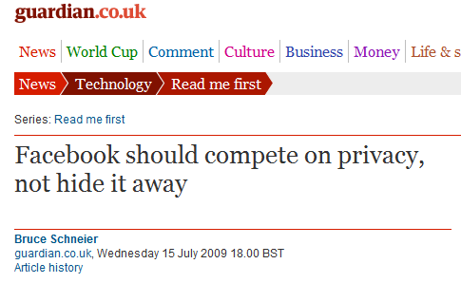
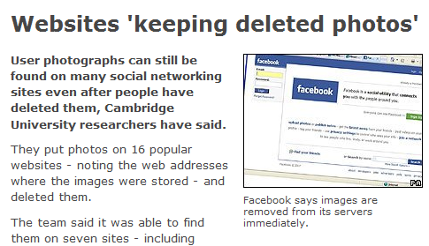
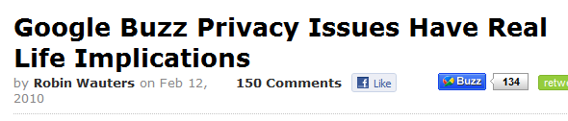
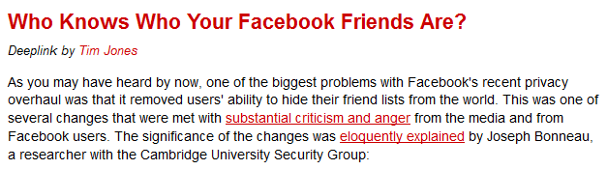
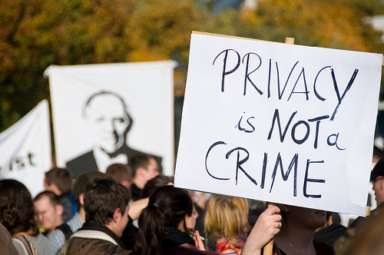
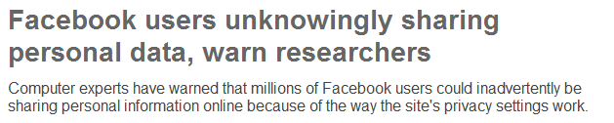
“Facebook Wants You To Be Less Private”

Slide 12
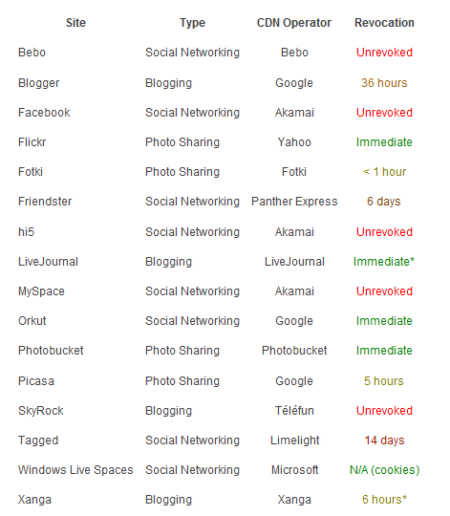
Attack of the Zombie Photos (photos that you “delete” but the sever does not)
https://www.lightbluetouchpaper.org/2009/05/20/attack-of-the-zombie-photos/

Slide 13
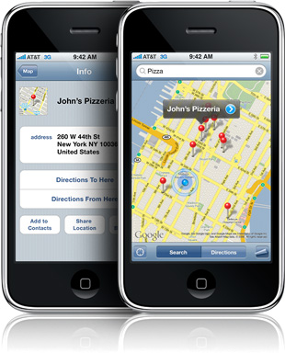
T4: Location privacy
Mobile phones:
Always in your pocket
Always connected
Always knows where it is: GPS
Location-based services
Location-based ads
What are we giving up?

Slide 14
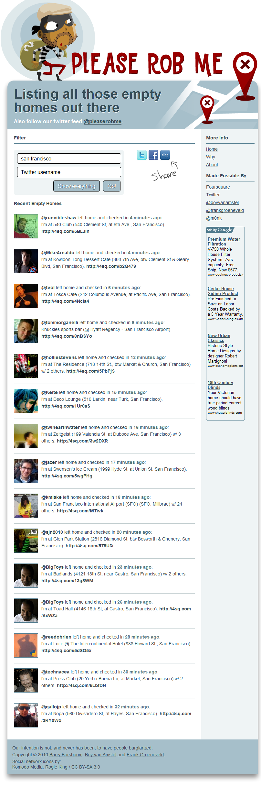
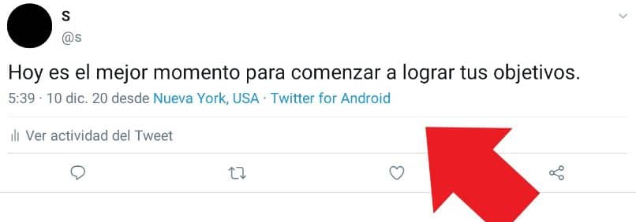
https://pleaserobme.com/
Use Twitter's search functionality to show location-based messages.

Slide 15
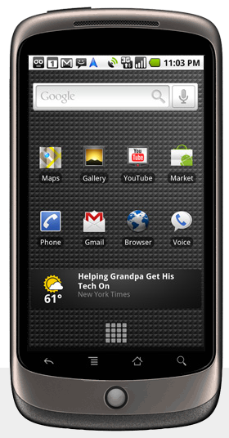
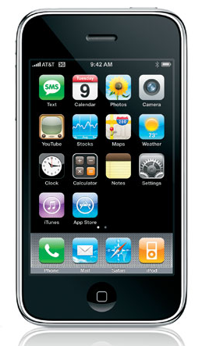
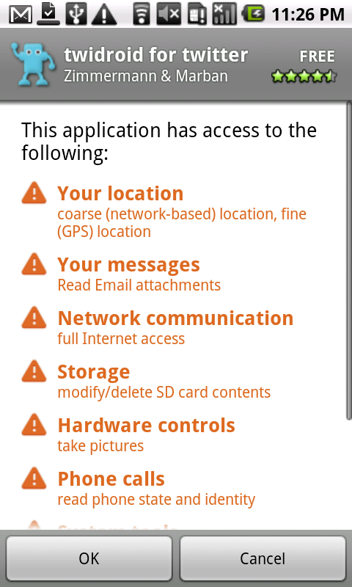
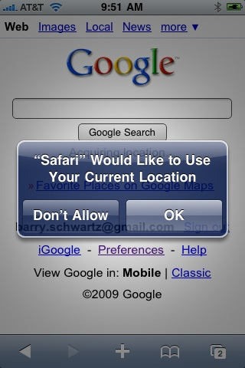
Mobile phones
Notes:
All-or-nothing permissions model
Once you grant access, you don’t know how an app is going to use (or misuse) sensitive data

Slide 16
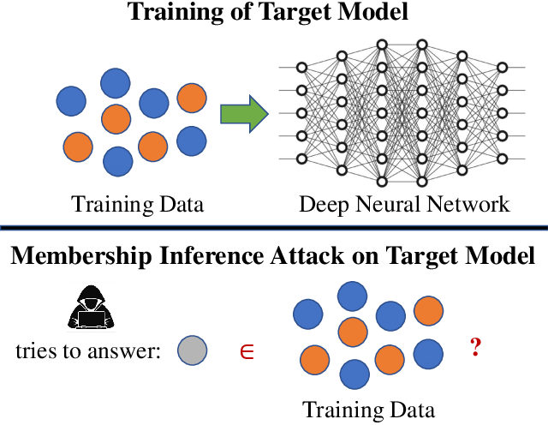
T5: Machine Learning

Slide 17
Privacy is Hard!!!

Slide 18
Why, when and what to disclose?
It is not a simple question!
Tradeoff between functionality
Also important whom to disclose it to?
Relatives
Co-workers
Friends

Slide 19
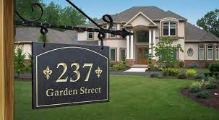
Sometimes, you are not even ware of the privacy issue
You visit your friend; take a picture like this; and upload this picture to your Facebook…
Now, your friend might be mad at you …

Slide 20
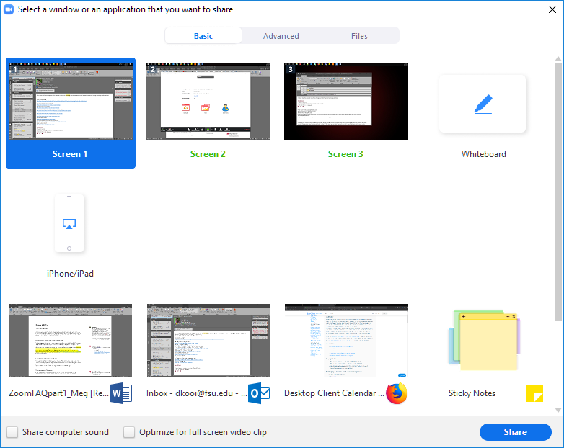
Sometimes, you are not even ware of the privacy issue
Are you sure about what you are going to share?
When you turn on your camera, are you sure about that the other people will see?

Slide 21
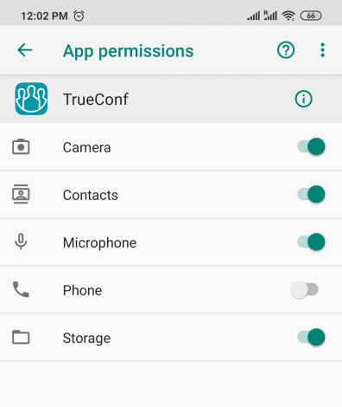
Sometimes, you are not even ware of the privacy issue

Slide 22
Techniques for enhancing privacy (1)
Limit the personal information you share on social media

Slide 23
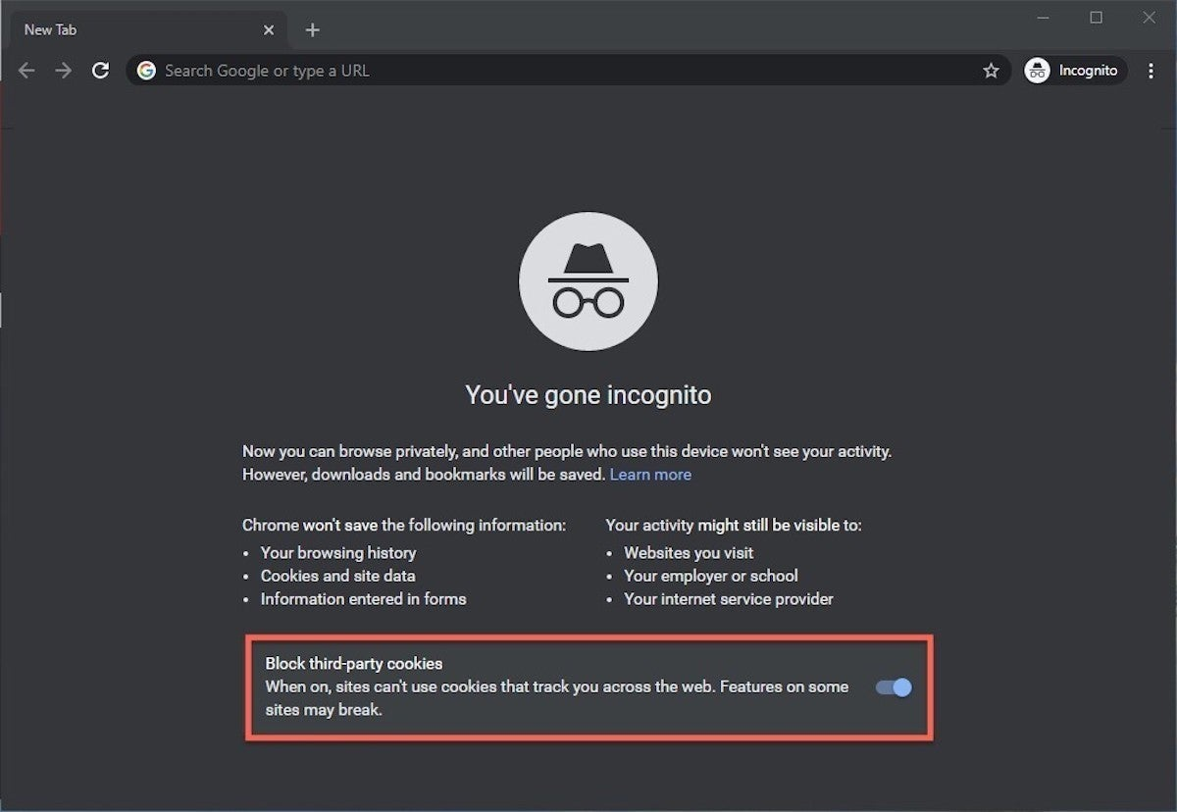
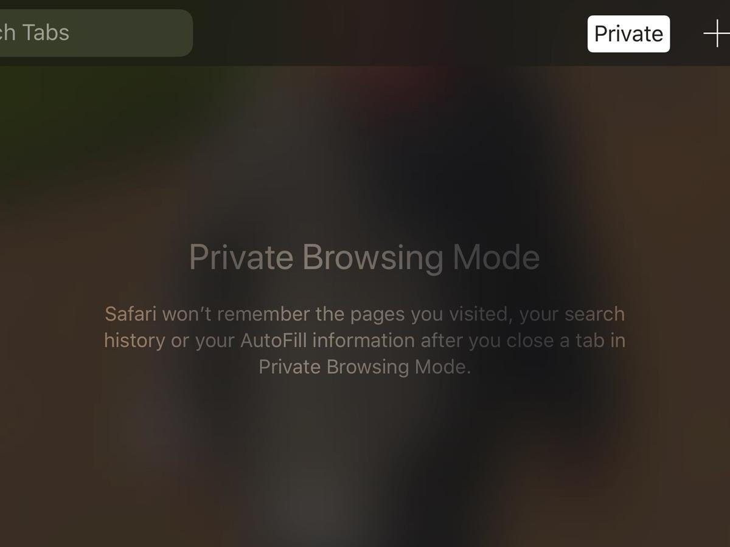
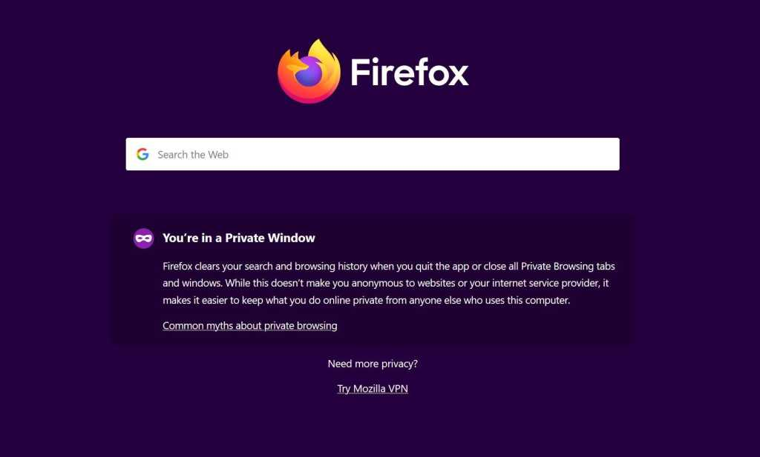
Techniques for enhancing privacy (2)
Browse in private mode

Slide 24
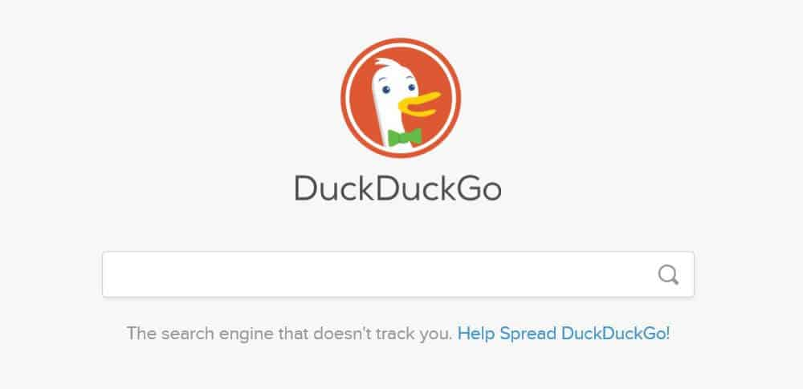
Techniques for enhancing privacy (3)
Use a different search engine
https://www.softwaretestinghelp.com/best-private-search-engines/

Slide 25

Techniques for enhancing privacy (4)
Use a virtual private network

Slide 26
Techniques for enhancing privacy (5)
Be careful where you click
We have talked a lot about this

Slide 27
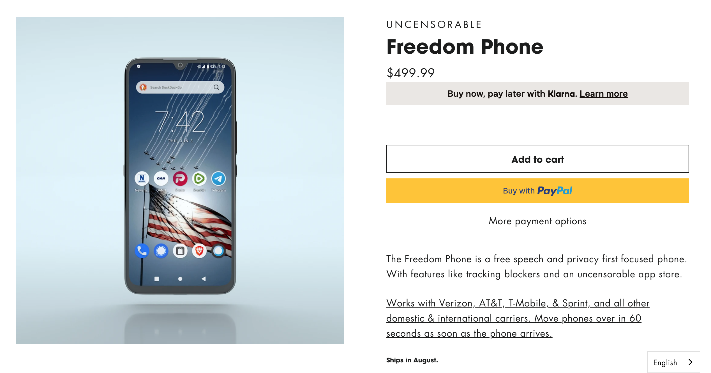
Techniques for enhancing privacy (6)
Secure your mobile devices, too
If you are crazy about privacy, maybe:
https://www.freedomphone.com/

