Slide 1
Communication Security: Message Integrity + Hash Functions; Message Authentication + MAC CS-4440 - Introduction to Computer Security Spring 2022 Jun Xu Slides adapted from Ninghui Li’s CS-526 at Purdue

Slide 2



Threat Model of Secure Communication
data, control messages
Alice
Bob
channel
sender
receiver
data
data
Eve
Eavesdropping
Manipulating
Camouflaging

Slide 3
Encryption: Defeating Eavesdropping
plaintext
encryption
algorithm
ciphertext
decryption
algorithm
plaintext
Eve
Encryption does not protect data from modification by another party.
Why?

Slide 4
Hash Function
“Randomized” mapping of inputs to shorter hash-values
A hash function is a three-tuple (X,Y,h), where
X is the set of possible messages
Y is a finite set of possible message digests
h is a function h(X)→Y

Slide 5
Hash: Aiming to Defeat Manipulation
plaintext
encryption
algorithm
ciphertext
hash
decryption
algorithm
plaintext
Eve
A hash value (of the plaintext) is attached to the ciphertext
Assuming the hash cannot be manipulated by Eve …

Slide 6
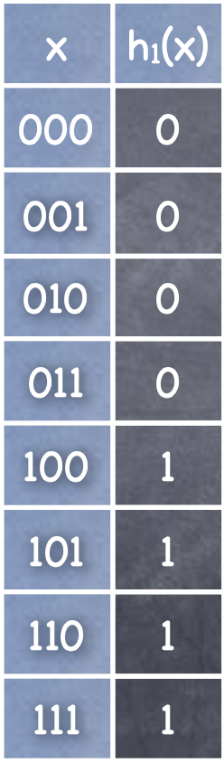
Hash Function Example
h:{0,1}→{0,1}
Can this hash function defeat manipulation?

Slide 7
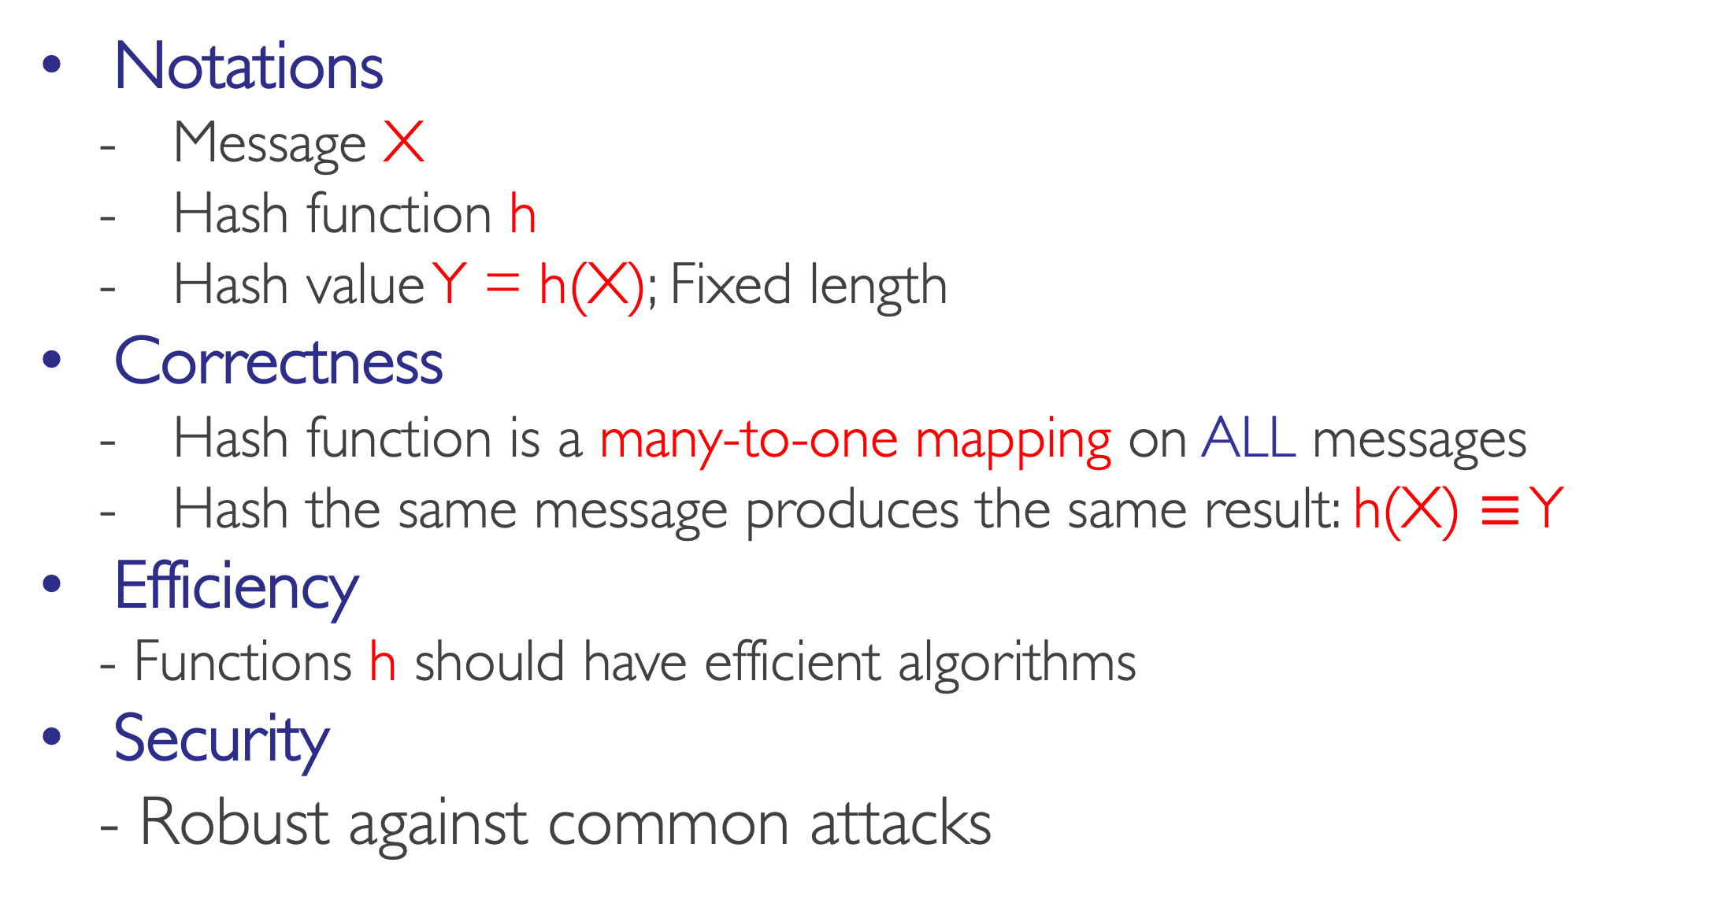
Desired Properties of Hash Functions
Notations
Message X
Hash function h
Hash value Y = h(X); Fixed length
Correctness
Hash function is a many-to-one mapping on ALL messages
Hash the same message produces the same result: h(X) $≡$ Y
Efficiency
- Functions h should have efficient algorithms
Security
- Robust against common attacks

Slide 8
Security Requirements for Hash Functions (theoretical schemes)
Given a function h: X →Y, then we say that h is:
preimage resistant (one-way):
- if given y ∈Y it is computationally infeasible to find a value x ∈X s.t. h(x) = y
2-nd preimage resistant (weak collision resistant):
- if given x ∈ X it is computationally infeasible to find a value x’ ∈ X, s.t. x’≠x and h(x’) = h(x)
collision resistant (strong collision resistant):
- if it is computationally infeasible to find two distinct values x’,x ∈ X, s.t. h(x’) = h(x)

Slide 9
Bruteforce Attacks on Hash Functions
Attacking one-wayness
Goal: given h:X→Y, y∈Y, find x such that h(x)=y
Algorithm:
pick a random value x in X, check if h(x)=y, if h(x)=y, returns x; otherwise iterate
after failing q iterations, return fail
The average-case success probability is
Let |Y|=2^{m}, to get ε to be close to 0.5, q ≈2^{m-1}

Slide 10
Bruteforce Attacks on Hash Functions
Attacking collision resistance
Goal: given h, find x, x’ such that h(x)=h(x’)
Algorithm: pick a random set X₀ of q values in X for each x∈X₀, computes y_{x}=h(x); if y_{x}=y_{x’} for some x’≠x then return (x,x’) else fail
The average success probability is
Let |Y|=2^{m}, to get ε to be close to 0.5, q ≈2^{m/2}
This is known as the birthday attack.
Notes:
Assuming |Y|=N. With q choices, the Prob that there is no collision is
P = (N-1)/N * (N-2)/N * … * (N-q+1)/N = Π_{[i=1 to q-1]} (1 – i/N)
1-i/N ≈ e^{-i/N}
P ≈ e^{- Σ _{[i=1 to q-1]} i/N} = e^{-q(q-1) / 2N }

Slide 11
Well Known (Cryptographic) Hash Functions
MD5 (the famous “md5sum” shell command)
output 128 bits
collision resistance completely broken by researchers in China in 2004
SHA1
output 160 bits
no collision found yet, but method exist to find collisions in less than 2^80
considered insecure for collision resistance
one-wayness still holds
SHA2 (SHA-224, SHA-256, SHA-384, SHA-512)
outputs 224, 256, 384, and 512 bits, respectively
No real security concerns yet

Slide 12
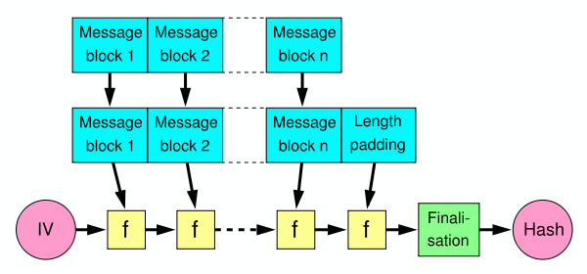
Merkle-Damgard Construction for Hash Functions
Message is divided into fixed-size blocks and padded
Uses a compression function f, which takes a chaining variable (of size of hash output) and a message block, and outputs the next chaining variable
Final chaining variable is the hash value
M=m₁m₂…m_{n}; C₀=IV, C_{i+1}=f(C_{i},m_{i}); H(M)=C_{n}
Foundation of MD5, SHA-1, and SHA-2

Slide 13
NIST SHA-3 Competition
NIST conducted competition for SHA-3, the next generation of standard hash algorithms
2007: Request for submissions of new hash functions
2008: Submissions deadline. Received 64 entries. Announced first-round selections of 51 candidates.
2009: After First SHA-3 candidate conference in Feb, announced 14 Second Round Candidates in July.
2010: After one year public review of the algorithms, hold second SHA-3 candidate conference in Aug. Announced 5 Third-round candidates in Dec.
2011: Public comment for final round
2012: October 2, NIST selected SHA3
Keccak (pronounced “catch-ack”) created by Guido Bertoni, Joan Daemen and Gilles Van Assche, Michaël Peeters

Slide 14
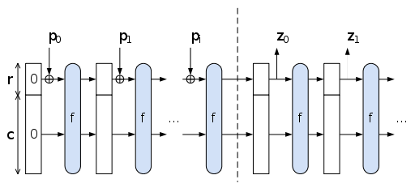
The Sponge Construction: Used by SHA-3
Each round, the next r bits of message is XOR’ed into the first r bits of the state, and a function f is applied to the state.
After message is consumed, output r bits of each round as the hash output; continue applying f to get new states
SHA-3 uses 1600 bits for state size

Slide 15
Choosing the length of Hash outputs
The Weakest Link Principle:
A system is only as secure as its weakest link.
Hence all links in a system should have similar levels of security.
Because of the birthday attack, the length of hash outputs in general should double the key length of block ciphers
SHA-224 matches the 112-bit strength of triple-DES (encryption 3 times using DES)
SHA-256, SHA-384, SHA-512 match the new key lengths (128,192,256) in AES
Notes:
Which hash function to use?

Slide 16
Limitation of Using Hash Functions
Require an authentic channel to transmit the hash of a message
Without such a channel, it is insecure, because anyone can compute the hash value of any message
Such a channel may not always exist
plaintext
encryption
algorithm
ciphertext
decryption
algorithm
plaintext
Eavesdropping
Manipulating
Camouflaging
Eve

Slide 17
How to Address This?
Use more than one hash functions
Use a key to select which one to use

Slide 18
Hash Function Family
A hash family is a four-tuple (X,Y,K,H), where
X is a set of possible messages
Y is a finite set of possible message digests
K is the keyspace
For each K∈K, there is a hash function h_{K}∈H . Each h_{K}: X →Y
Alternatively, one can think of H as a function K×X→Y

Slide 19
Message Authentication Code
A MAC scheme is a hash family, used for message authentication
MAC(K,M) = H_{K}(M)
The sender and the receiver share secret K
The sender sends (M, H_{k}(M))
The receiver receives (X,Y) and verifies that H_{K}(X)=Y, if so, then accepts the message as from the sender
To be secure, an adversary shouldn’t be able to come up with (X’,Y’) such that H_{K}(X’)=Y’.

Slide 20
Security Requirements for MAC
Resist the Existential Forgery under Chosen Plaintext Attack
Challenger chooses a random key K
Adversary chooses a number of messages M₁, M₂, .., M_{n}, and obtains t_{j}=MAC(K,M_{j}) for 1≤j≤n
Adversary outputs M’ and t’
Adversary wins if ∀j M’≠M_{j}, and t’=MAC(K,M’)
Basically, adversary cannot create the MAC for a message for which it hasn’t seen an MAC

Slide 21
Constructing MAC from Hash Functions
Let h be a one-way hash function that uses Merkle-Damgard Construction
MAC(K,M) = h(K || M), where || denote concatenation
Insecure as MAC
Because of the Merkle-Damgard construction for hash functions, given M and t=h(K || M), adversary can compute M’=M||Pad(M)||X and t’, such that h(K||M’) = t’
HOW???

Slide 22
HMAC: Constructing MAC from Cryptographic Hash Functions
HMAC_{K}[M] = Hash[(K⁺ ⊕ opad) || Hash[(K⁺ ⊕ ipad)||M)]]
K⁺ is the key padded (with 0) to B bytes, the input block size of the hash function
ipad = the byte 0x36 repeated B times
opad = the byte 0x5C repeated B times.
At high level, HMAC_{K}[M] = H(K || H(K || M))

Slide 23
HMAC Security
If used with a secure hash functions (e.g., SHA-256) and according to the specification (key size, and use correct output), no known practical attacks against HMAC

