Slide 1
Web & Network Security: Web Vulnerabilities CS-4440 - Introduction to Computer Security Spring 2022 Jun Xu Slides adapted from CSE 7330 by Timmothy Boyd at Southern Methodist University; Björn Kimminich at Kuehne + Nagel

Slide 2
Quiz 1: Example Questions
1. _____________________ defines what size of plain text should be encrypted in each step of algorithm.
A. Algorithm types
B. Stream cipher
C. Encryption mode
D. Block cipher
2. Assuming we have a function f = rand(). Can we use f as a hash function?
A. Yes
B. No
3. Assuming DES is not secure, which of the following encryption algorithms are certainly not secure?
An algorithm with the same algorithmic strength as DES and a 32-bit key
An algorithm with the same algorithmic strength as DES and a 55-bit key
An algorithm with the same algorithmic strength as DES and a 64-bit key

Slide 3
Vulnerability Stats: Web is “Winning”
Majority of vulnerabilities now found in web software
Source: MITRE CVE trends

Slide 4
The First Example
A typical database-supported login webpage https://www.codingame.com/playgrounds/154/sql-injection-demo/sql-injection

Slide 5







The Architecture of Our Example
Browser
POST / HTTP/1.0
Web
server
HTTP/1.1 200 OK
index.php
Database
server

Slide 6
Question
Can you log into the website without the right password???
Try It Again!
https://www.codingame.com/playgrounds/154/sql-injection-demo/sql-injection

Slide 7
SQL
Widely used database query language
Fetch a set of records
SELECT * FROM Person WHERE Username=‘Vitaly’
Add data to the table
INSERT INTO Key (Username, Key) VALUES (‘Vitaly’, 3611BBFF)
Modify data
UPDATE Keys SET Key=FA33452D WHERE PersonID=5
Query syntax (mostly) independent of vendor
Some notes:
Single quotations (‘) encapsulate DATA
-- means comments
Semicolon (;) means separating two SQL queries

Slide 8
Code of Our Example
var username = req.body.username;
var password = req.body.password;
var query = "SELECT name FROM user where username = '" + username + "' and password = '" + password + ”’”;
SELECT name FROM user where username = ' username ' and password = ‘ password ';
User Input
What could go wrong here ???

Slide 9
Normal Login
Enter
Username
and
Password
Web
browser
(Client)
Web
server
DB
SELECT name FROM user where username = ' username ' and password = ' password ';
username: admin
password: admin123
Both username and password are capsulated by single quotations

Slide 10
Malicious Login
Enter
Username
and
Password
Web
browser
(Client)
Web
server
DB
SELECT name FROM user where username = ' username ' and password = ' password ';
username: admin
password: unknown' or '1'=‘1
Now password becomes part of the CODE!!!
SELECT name FROM user where username = ‘ admin ' and password = 'unknown' or '1'='1';

Slide 11
Another Way to Bypass Password
To authenticate logins, server runs this SQL command against the user database:
SELECT * WHERE user=‘username’ AND pwd=‘password’
User enters ’ OR WHERE pwd LIKE ‘% as both name and passwd
Server executes
SELECT * WHERE user=‘’ OR WHERE pwd LIKE ‘%’
AND pwd=‘’ OR WHERE pwd LIKE ‘%’
Logs in with the credentials of the first person in the database (typically, administrator!)
Wildcard matches any password

Slide 12
There are way more can be done!

Slide 13
Pull Data From Other Databases
SELECT passwd FROM USERS WHERE uname IS ‘username’
User gives username
’ AND 1=0 UNION SELECT cardholder, number, exp_month, exp_year FROM creditcards
What happens?
Results of two queries are combined
Empty table from the first query is displayed together with the entire contents of the credit card database
https://www.w3schools.com/sql/sql_union.asp

Slide 14
More SQL Injection Attacks
SELECT passwd FROM USERS WHERE uname IS ‘username’
Create new users
’; INSERT INTO USERS (‘uname’,‘passwd’,‘salt’)
VALUES (‘hacker’,‘38a74f’, 3234);
Reset password
’; UPDATE USERS SET email=hcker@root.org WHERE email=victim@yahoo.com

Slide 15
Second-Order SQL Injection
Second-order SQL injection: data stored in database is later used to conduct SQL injection
For example, user manages to set uname to admin’ --
This vulnerability could exist if string escaping is applied inconsistently (e.g., strings not escaped)
UPDATE USERS SET passwd=‘cracked’ WHERE uname=‘admin’ --’ why does this work?

Slide 16

CardSystems Attack (June 2005)
CardSystems was a major credit card processing company
Put out of business by a SQL injection attack
Credit card numbers stored unencrypted
Data on 263,000 accounts stolen
43 million identities exposed

Slide 17
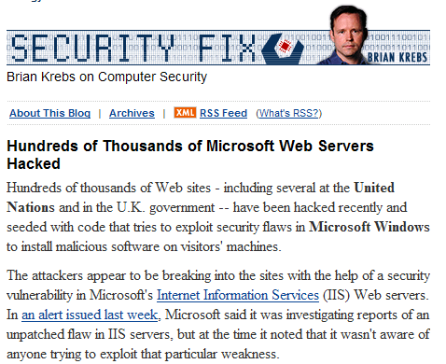
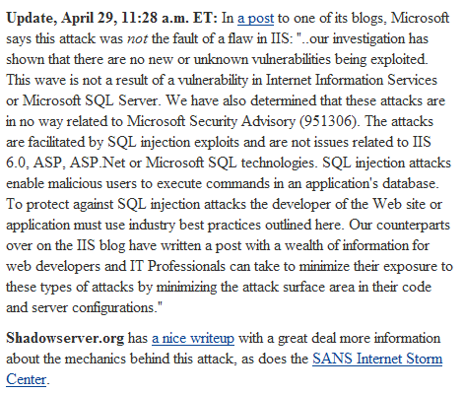
Attack on Microsoft IIS (April 2008)

Slide 18
Main Steps in April 2008 Attack
Use Google to find sites using a particular ASP style vulnerable to SQL injection
Use SQL injection to modify the pages to include a link to a site nihaorr1.com
Do not visit that site – it serves JavaScript that exploits vulnerabilities in IE, RealPlayer, QQ Instant Messenger
Attack used automatic tool; can be configured to inject whatever you like into vulnerable sites
There is some evidence that hackers may get paid for each victim’s visit to nihaorr1.com

Slide 19
Part of the SQL Attack String
DECLARE @T varchar(255),@C varchar(255)
DECLARE Table_Cursor CURSOR FOR select a.name,b.name from sysobjects a,syscolumns b where a.id=b.id and a.xtype='u' and
(b.xtype=99 or b.xtype=35 or b.xtype=231 or b.xtype=167)
OPEN Table_Cursor
FETCH NEXT FROM Table_Cursor INTO @T,@C WHILE(@@FETCH_STATUS=0) BEGIN
exec('update ['+@T+'] set ['+@C+']=rtrim(convert(varchar,['+@C+']))+'‘ ''')
FETCH NEXT FROM Table_Cursor INTO @T,@C
END CLOSE Table_Cursor DEALLOCATE Table_Cursor;
DECLARE%20@S%20NVARCHAR(4000);SET%20@S=CAST( %20AS%20NVARCHAR(4000));EXEC(@S);--

Slide 20
Preventing SQL Injection
Input validation
Filter
Apostrophes, semicolons, percent symbols, hyphens, underscores, …
Any character that has special meanings
Special encodings…
Allowlisting
Blocklisting “bad” characters doesn’t work
Forget to filter out some characters
Could prevent valid input (e.g., last name O’Brien)
Allow only well-defined set of safe values
Set implicitly defined through regular expressions
slide 20

Slide 21
Escaping Quotes
For valid string inputs use escape characters to prevent the quote becoming part of the query
Example: escape(o’connor) = o’’connor
Convert ’ into \’
Only works for string inputs
Different databases have different rules for escaping
slide 21

Slide 22
Prepared Statements
Metacharacters such as ’ in queries provide distinction between data and control
In most injection attacks data are interpreted as control – this changes the semantics of a query or a command
Bind variables: ? placeholders guaranteed to be data (not control)
Prepared statements allow creation of static queries with bind variables → preserves the structure of intended query
slide 22

Slide 23
Prepared Statement: Example
http://java.sun.com/docs/books/tutorial/jdbc/basics/prepared.html
PreparedStatement ps =
db.prepareStatement("SELECT pizza, toppings, quantity, order_day "
+ "FROM orders WHERE userid=? AND order_month=?");
ps.setInt(1, session.getCurrentUserId());
ps.setInt(2, Integer.parseInt(request.getParamenter("month")));
ResultSet res = ps.executeQuery();
Bind variable (data placeholder)
Query parsed without parameters
Bind variables are typed (int, string, …)
slide 23

Slide 24
The Second Example
https://xss-game.appspot.com/level1
(<script>alert(”Hello World”)</script>)
https://xss-game.appspot.com/level2
(<img src=‘x’ onerror=‘alert(”Hello World”)'>)

Slide 25
XSS: Cross-Site Scripting
Cross-Site Scripting (XSS) attacks are a type of injection, in which malicious scripts are injected into otherwise benign and trusted websites.
XSS attacks occur when an attacker uses a web application to send malicious code, generally in the form of a browser side script, to a different end user.
Flaws that allow these attacks to succeed are quite widespread and occur anywhere a web application uses input from a user within the output it generates without validating or encoding it.

Slide 26
XSS: Root Cause
Web applications vulnerable to XSS...
...include untrusted data (usually from an HTTP request) into dynamic content...
...that is then sent to a web user without previously validating for malicious content

Slide 27
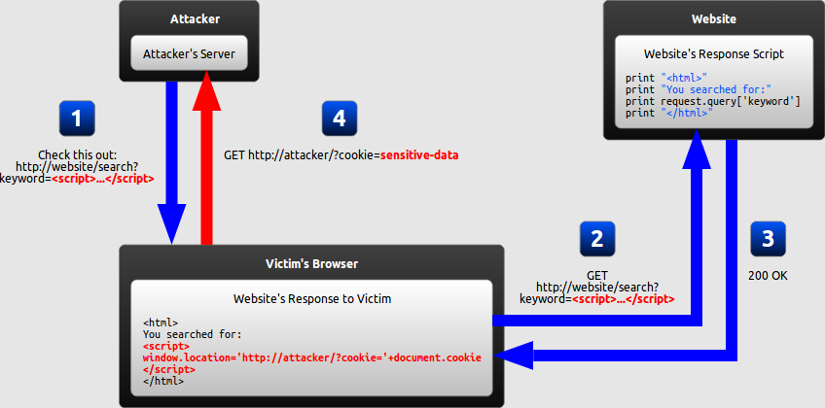
Reflected XSS

Slide 28
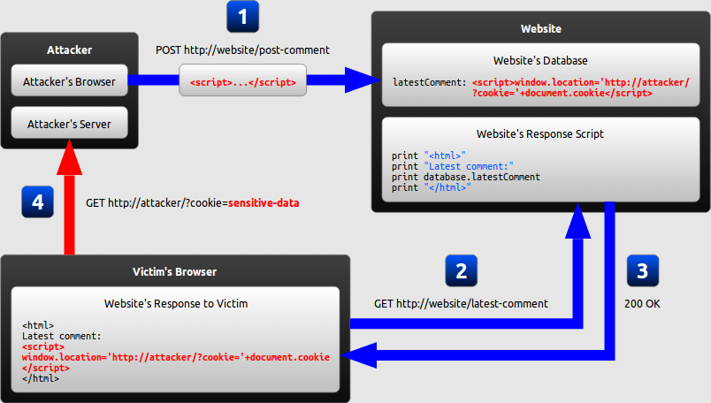
Stored XSS

Slide 29
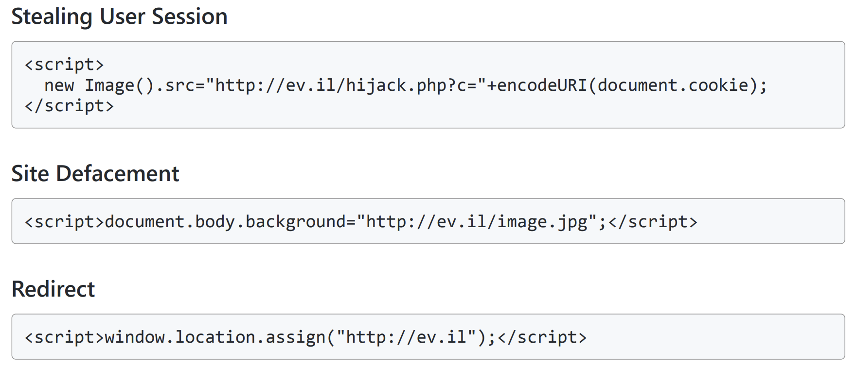
Typical Impact
Steal user's session
Steal sensitive data
Rewrite the web page
Redirect user to malicious website

Slide 30
XSS: Prevention
Do not include user supplied input in your output!
Output Encode all user supplied input
e.g., OWASP Java Encoder
Perform Allow List Input Validation on user input
Use an HTML Sanitizer for larger user supplied HTML chunks
e.g. ,OWASP Java HTML Sanitizer

Slide 31
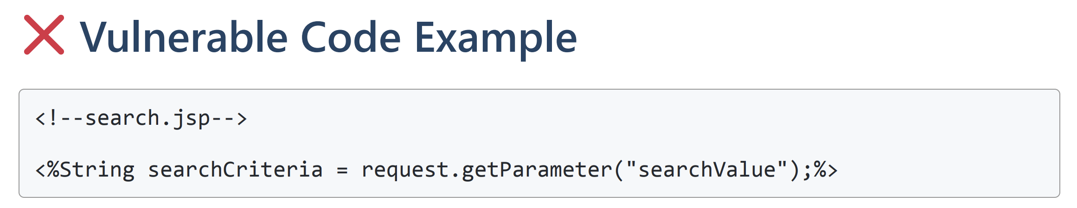
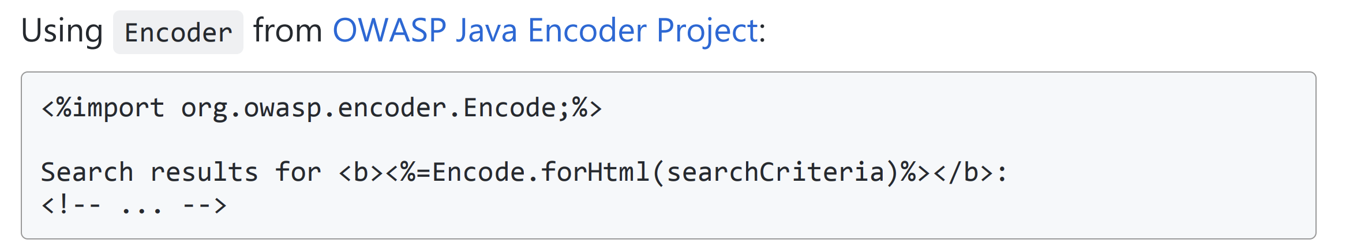
CSS Prevention: Encoding Contexts

Slide 32
CSS Prevention: Input Validation
Block List
"Allow what is not explicitly blocked!”
Example: Do not allow < , > , " , ; , ' and script in user input ( )
Can be bypassed by masking attack patterns
Must be updated for new attack patterns
= Negative Security Rule

Slide 33
CSS Prevention: Input Validation
Allow List
"Block what is not explicitly allowed!"
Example: Allow only a-z , A-Z and 0-9 in user input
Provide protection even against future vulnerabilities
Tend to get weaker over time when not carefully maintained
Can be quite effortsome to define for a whole application
= Positive Security Rule

