Slide 1
CS492 - Operating Systems Concurrency Part 1
Georgios Portokalidis & Jun Xu
Zybook 4.1, MOS 2.3.1-2.3.3
Slides credit: Antonio Barbalace

Slide 2
Inter Process Communication (IPC)

Slide 3
Inter Process Communication (IPC)
Why inter-process communication? → Processes need to share information or coordinate
Problems with inter-process communication
How one process can pass information to another
Processes do not get in each other’s way
Maintain proper sequencing when dependencies are present between processes
The same problems apply to inter-thread communication
By design, threads communicate via shared memory

Slide 4
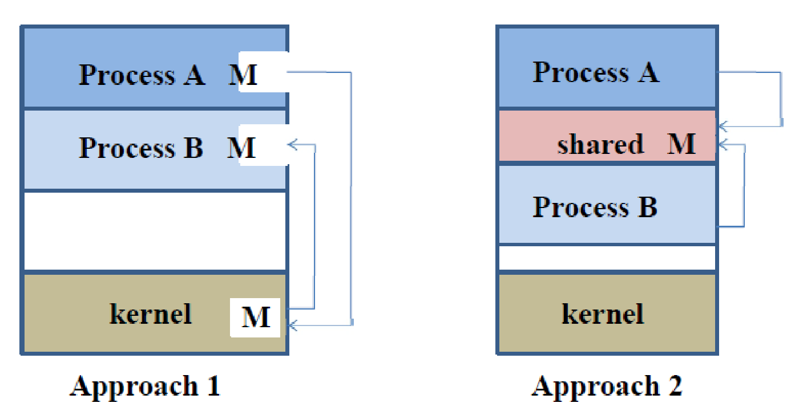
How One Process Can Pass Information to Another? (1)
By passing messages through the kernel
By sharing memory
By sharing a file
Through asynchronous signals or alerts
…
Process A
M
Process B
kernel
Approach 3

Slide 5
How One Process Can Pass Information to Another? (2)
By passing messages through the kernel
POSIX message queues
https://users.pja.edu.pl/~jms/qnx/help/watcom/clibref/mq_overview.html
System V message queues
https://www.softprayog.in/programming/interprocess-communication-using-system-v-message-queues-in-linux
UNIX Sockets
https://www.tutorialspoint.com/unix_sockets/
Pipes, network sockets, ...
By sharing memory
POSIX shared memory
http://www.cse.psu.edu/~deh25/cmpsc473/notes/OSC/Processes/shm.html
System V shared memory
https://docs.oracle.com/cd/E19683-01/806-4125/svipc-41256/index.html
…

Slide 6




IPC Problem Example: Bank Account (1)
Suppose two people share a bank account with a balance of $1500.00
What happens if both go to separate ATM machines, and simultaneously withdraw $100.00 from the account?

Slide 7
IPC Problem Example: Bank Account (2)
Consider the following program function to withdraw money from a bank account
int withdraw(account, amount)
{
int balance = get_balance(account);
balance -= amount;
put_balance(account, balance);
return balance;
}

Slide 8
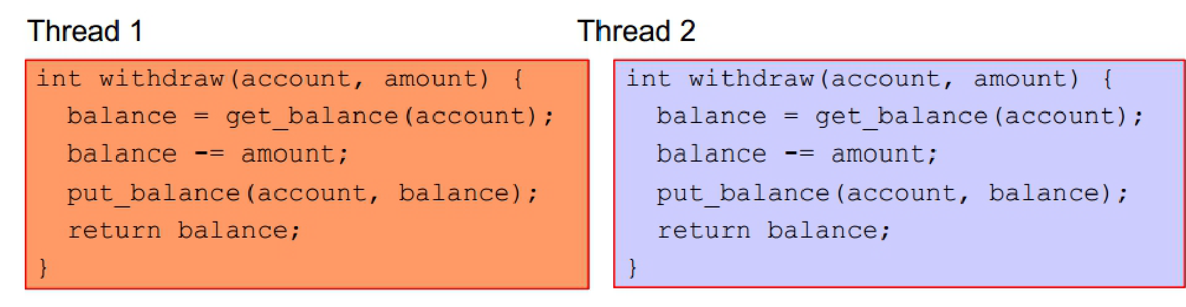
IPC Problem Example: Bank Account (3)
A separate thread for each ATM is running withdraw()
Both threads run on the same bank server system
What are the possible balance values after each thread runs?
Notes:
$1400, $1300

Slide 9
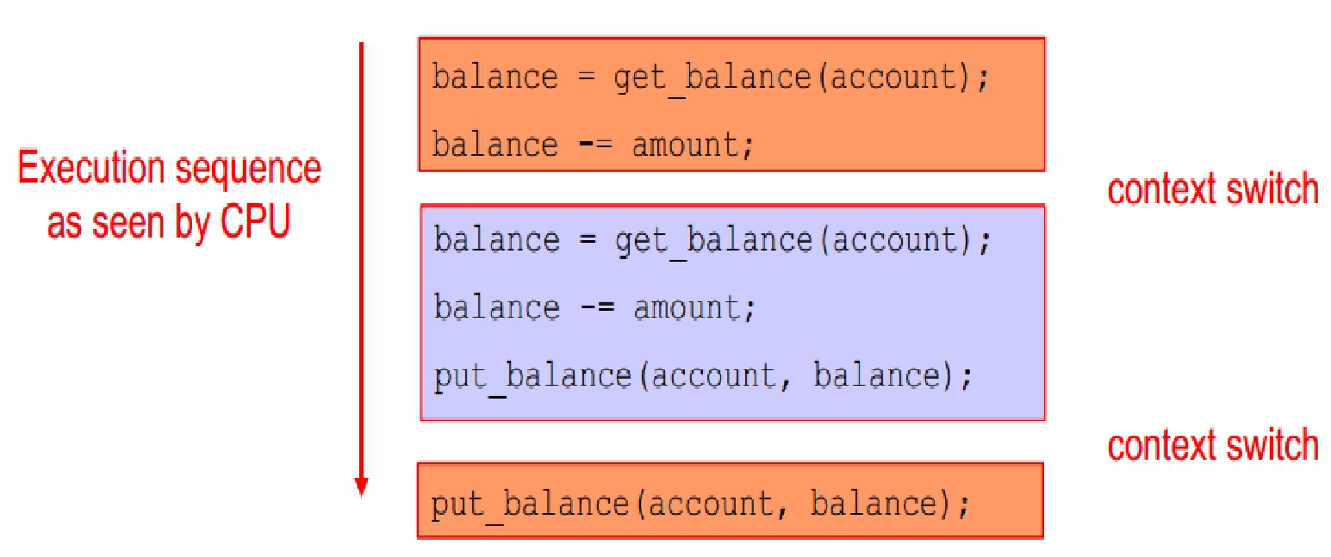
IPC Problem Example: Bank Account (4)
Assume each thread can context switch after each instruction
What’s the account balance after this sequence?
Notes:
$1400

Slide 10

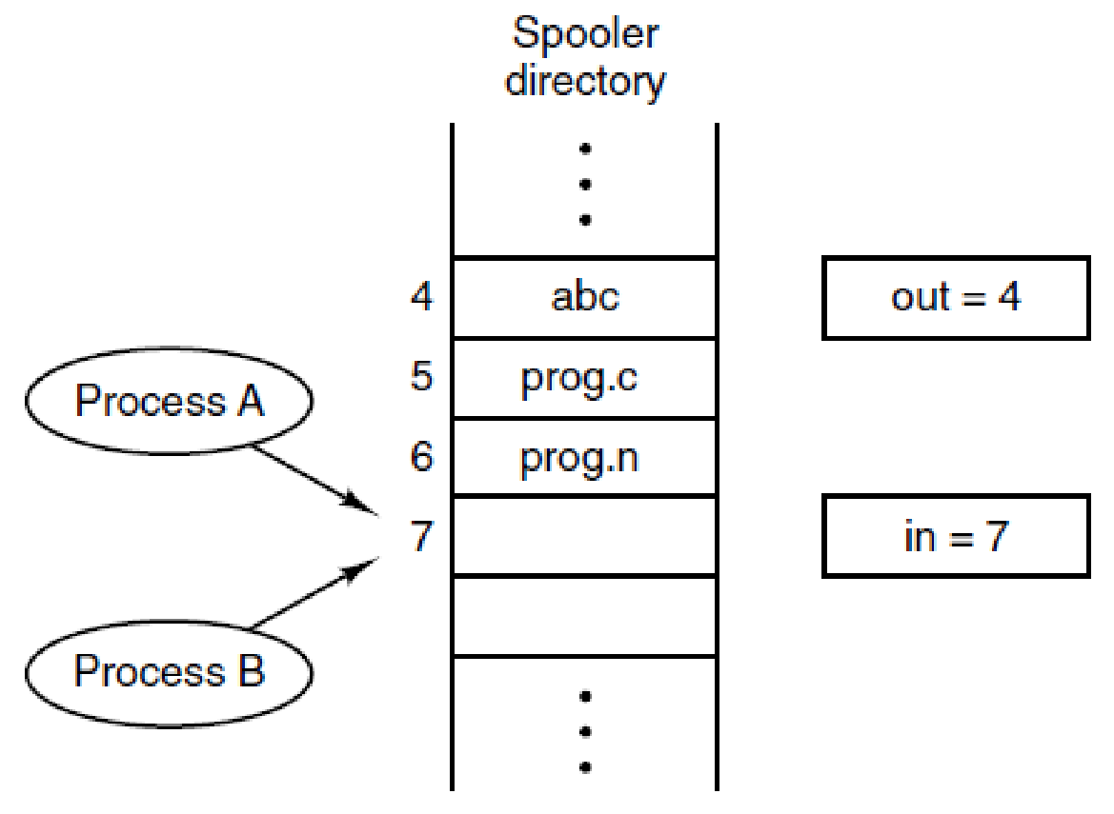
IPC Problem Example: Spooler Directory (1)
Shared
Variables
File
doc
To enqueue a document:
Read in
Put the document in spooler[in]
Increment in
Write in
Processes
wants to
queue jobs
pdf
Two processes want to access shared memory data at the same time.
(MOS Figure 2-21)

Slide 11
IPC Problem Example: Spooler Directory (2)
1
3
Shared
Variables
File
Shared
Variables
File
doc
read 7
doc
read 7
doc
write in=8
read 7
pdf
pdf
Shared
Variables
File
Shared
Variables
File
!
read 7
doc
read 7
doc
pdf
write in=8
read 7
read 7
pdf
pdf
2
4

Slide 12
IPC Problem Example: Producer-consumer Problem (1)
Also known as the bounded-buffer problem
Fixed-size buffer B (with n elements)
p producer processes
c consumer processes
Producer and consumer processes share the buffer B
Producer process puts data into the buffer B
Consumer process takes data out of the buffer B
Notes:
This is in 2.3.4

Slide 13
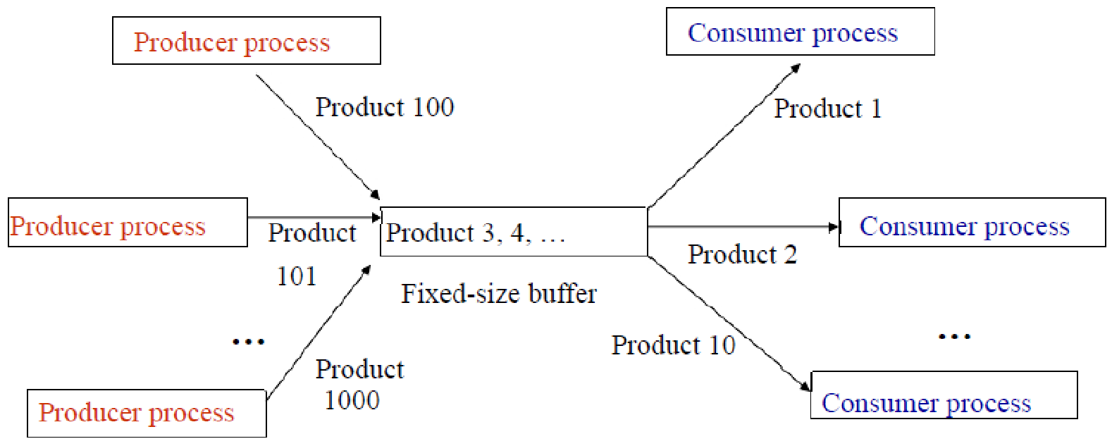
IPC Problem Example: Producer-consumer Problem (2)
n items
B
p processes
c processes
Notes:
The buffer can be circular

Slide 14
IPC Problem Example: Producer-consumer Problem (3)
Let’s focus on single-producer, single-consumer problem (p=1, c=1)
Shared Variables
const int size;
int count = 0;
item_t buffer[size];
Producer
Consumer
while (1) {
...
produce item A;
...
while (count == size) ;
insert(A);
count++;
}
while (1) {
while (count == 0) ;
A = remove_item();
count--;
...
consume item A;
}
Let’s assume these will work correctly

Slide 15
IPC Problem Example: Producer-consumer Problem (3)
Let’s focus on single-producer, single-consumer problem (p=1, c=1)
Shared Variables
const int size;
int count = 0;
item_t buffer[size];
Producer
Consumer
while (1) {
...
produce item A;
...
while (count == size) ;
insert(A);
count++;
}
while (1) {
while (count == 0) ;
A = remove_item();
count--;
...
consume item A;
}
More problems!

Slide 16
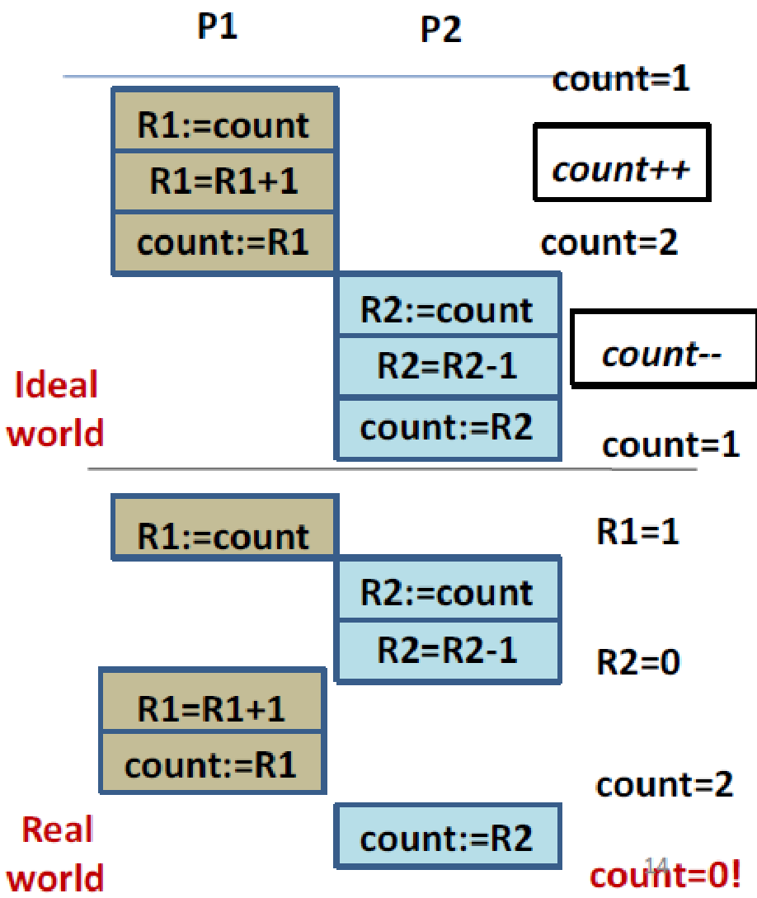
IPC Problem Example: Producer-consumer Problem (4)
Producer
Consumer
Possible Issues
count++; count--; instruction is not guaranteed to execute as a single machine instruction
count++; possible assembly implementation
R1: = count;
R1 = R1+1;
count:=R1;

Slide 17
IPC Problem Examples Summary
The results of concurrent access are non-deterministic
Results depends on
Timing
When context switches occurred
Which process/thread ran at context switch
What the processes/threads were doing

Slide 18
Race Conditions
Race condition
Two or more processes reading or writing shared data
The final result depends on who runs precisely when
How to avoid race conditions?

Slide 19
Solutions to Race Conditions

Slide 20

Modeling Programs to Solve Race Conditions
Critical Region or Section
Part of the program where the shared data is accessed
Uncoordinated read/write of the data in critical section may lead to races
Critical Region/Section
Notes:
Before seeing a solution to race condition let’s introduce the concept of critical region that is the part of the program where the shared data is accessed (read/modify/write)

Slide 21
Critical Region in Bank Example
From read to write the balance

Slide 22
Critical Region in Spooler Example
Shared
Variables
File
Access to shared file
Processes
wants to
query jobs
Two processes want to access shared memory data at the same time.
(MOS Figure 2-21)

Slide 23
Critical Region in Producer-consumer Example
Shared Variables
const int size;
int count = 0;
item_t buffer[size];
Producer
Consumer
while (1) {
...
produce item A;
...
while (count == size) ;
insert(A);
count++;
}
while (1) {
while (count == 0) ;
A = remove_item();
count--;
...
consume item A;
}
Access to the count variable
Assuming insert() & remote_item() work correctly here.

Slide 24
Avoid Race Conditions
Find some way to prohibit more than one process in its critical region(s) at the same time
Solution – Mutual exclusive access to critical regions
Some way of making sure that
If one process is using a shared variable or file
The other processes will be excluded from doing the same thing
Only one process or thread in a critical section at any time

Slide 25
Requirements to Avoid race Conditions
Critical Regions are not enough
No two processes may be simultaneously inside their critical regions
No assumptions may be made about speeds or the number of CPUs
No process running outside its critical region may block other processes
No process should have to wait forever to enter its critical region

Slide 26
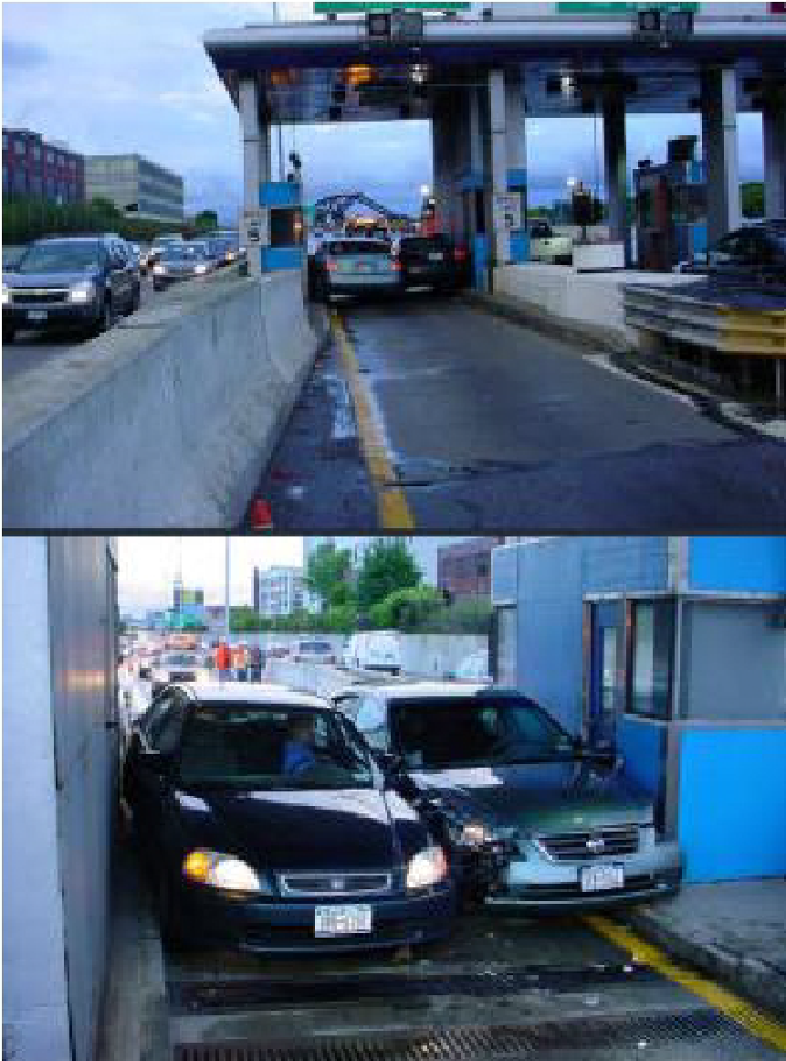
Mutual Exclusion (1)
This is not an example of mutual exclusion

Slide 27
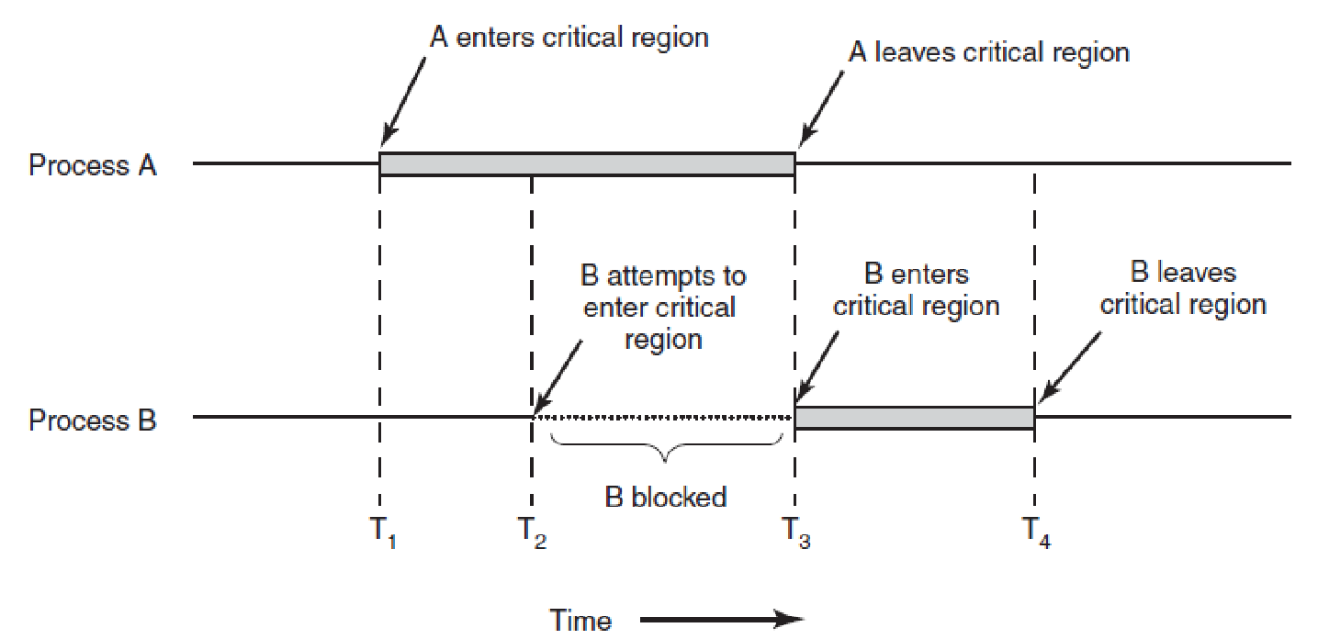
Mutual Exclusion (2)
Mutual exclusion using critical regions. (Figure 2-22)

Slide 28
Mutual Exclusion (2)
Mutual exclusion using critical regions. (Figure 2-22)

Slide 29
How a Critical Region Looks Like?
Pseudocode example
repeat
do other work /* do other work */
enter_critical /* enter critical region */
critical_region() /* access shared variables */
exit_critical /* leave critical region */
noncritical_region() /* do other work */
until condition
How to implement enter_critical, and exit_critical to guarantee mutual exclusion?

Slide 30
Mechanisms for Mutual Exclusion

Slide 31
Mechanisms for Mutual Exclusion
Hardware
Disabling interrupts
Busy waiting
Lock variable
Strict alternation
Peterson’s solution
Test-and-Set Lock (TSL) Instruction (hardware support)
Sleep and wakeup (Part 2)
sleep() and wakeup()
Semaphores
Mutexes
Monitors
Notes:
I AM NOT SURE 100% BUT THE FIRST GROUP DOESN’T STRICTLY REQUIRE AN OS
In this section we will examine various proposals for achieving mutual exclusion, so that while one process is busy updating shared memory in its critical region, no other process will enter its critical region and cause trouble.

Slide 32
Disabling Interrupts (1)
Idea
Right before entering the critical section, the process disables all interrupts
Leaving the critical section, the process reenables all interrupts
Effect
CPU is switched to other processes on interrupts
Timer, syscall, etc.
CPU cannot be switched to other processes when a process is in the critical section (unless a system call is made)
Notes:
REMEMBER FROM THE INITIAL CLASS that we can disable interrupts only in the OS itself, that is in kernel-mode where we have full privileges

Slide 33
Disabling Interrupts (2)
Disadvantages
Unwise to give user processes ability to turn off interrupts
What will happen if a process turns off interrupts and “forgets” to turn them back on?
Most architectures don’t provide this ability to non-privileged (userspace) code
Not suitable for multicore systems
The disable interrupt machine instruction works only on the core that invokes it → other cores can interfere
Used in the past on single-core machines for mutual exclusion in kernel space
Notes:
Single processor system because when you turn off the interrupts it is at the granularity of a CPU
Following the first disadvantage it is OK to use this technique in kernel because the kernel has the powers – it is the most powerful code in a computer; in fact, it was used in the kernel (also linux), but then with multicore they didn’t use it anymore

Slide 34
Lock Variables (1)
Idea → Use single shared variable (lock) between processes
Zero (0) means no process is in its critical region
One (1) mans that some process is in its critical region
Initially zero (0)
1 while (TRUE) {
2 while (lock != 0); /* loop */
3 lock = 1;
4 critical_region(); /* work */
5 lock = 0;
6 noncritical_region();
7 }
1 while (TRUE) {
2 while (lock != 0); /* loop */
3 lock = 1;
4 critical_region(); /* work */
5 lock = 0;
6 noncritical_region();
7 }
Process A
Process B

Slide 35
Lock Variables (2)
lock=0
lock=1
1 while (TRUE) {
2 while (lock != 0); /* loop */
3 lock = 1;
4 critical_region(); /* work */
5 lock = 0;
6 noncritical_region();
7 }
1 while (TRUE) {
2 while (lock != 0); /* loop */
3 lock = 1;
4 critical_region(); /* work */
5 lock = 0;
6 noncritical_region();
7 }
lock=1
Process A
Process B
1 while (TRUE) {
2 while (lock != 0); /* loop */
3 lock = 1;
4 critical_region(); /* work */
5 lock = 0;
6 noncritical_region();
7 }
1 while (TRUE) {
2 while (lock != 0); /* loop */
3 lock = 1;
4 critical_region(); /* work */
5 lock = 0;
6 noncritical_region();
7 }
lock=1
lock=0
Process A
Process B

Slide 36
Lock Variables (3)
Disadvantage → There is a race condition
Process A sees lock=0 moves to line 3
Process A is descheduled and Process B is scheduled
Process B sees lock=0, moves to line 3, sets lock =1, enters critical section
Process B is descheduled and Process A is scheduled
Process A sets lock=1, enters critical section
1 while (TRUE) {
2 while (lock != 0); /* loop */
3 lock = 1;
critical_region(); /* work */
5 lock = 0;
6 noncritical_region();
7 }
1 while (TRUE) {
2 while (lock != 0); /* loop */
3 lock = 1;
critical_region(); /* work */
5 lock = 0;
6 noncritical_region();
7 }
1
2
2
4
3
5
4
Process A
Process B
Notes:
Similar to the examples we saw at the beginning there is a race condition

Slide 37
Busy Waiting
Continuously testing a variable until some value appears
Use with caution, it wastes CPU time
A lock variable that uses busy waiting is called spinlock
Not busy waiting
while (TRUE) {
while (lock != 0); /* loop */
lock = 1;
critical_region(); /* critical work */
lock = 0;
noncritical_region();
}
Busy waiting
Notes:
Continuously testing a variable until some value appears is called busy waiting. It should usually be avoided, since it wastes CPU time. Only when there is a reasonable expectation that the wait will be short is busy waiting used. A lock that uses busy waiting is called a spin lock.

Slide 38
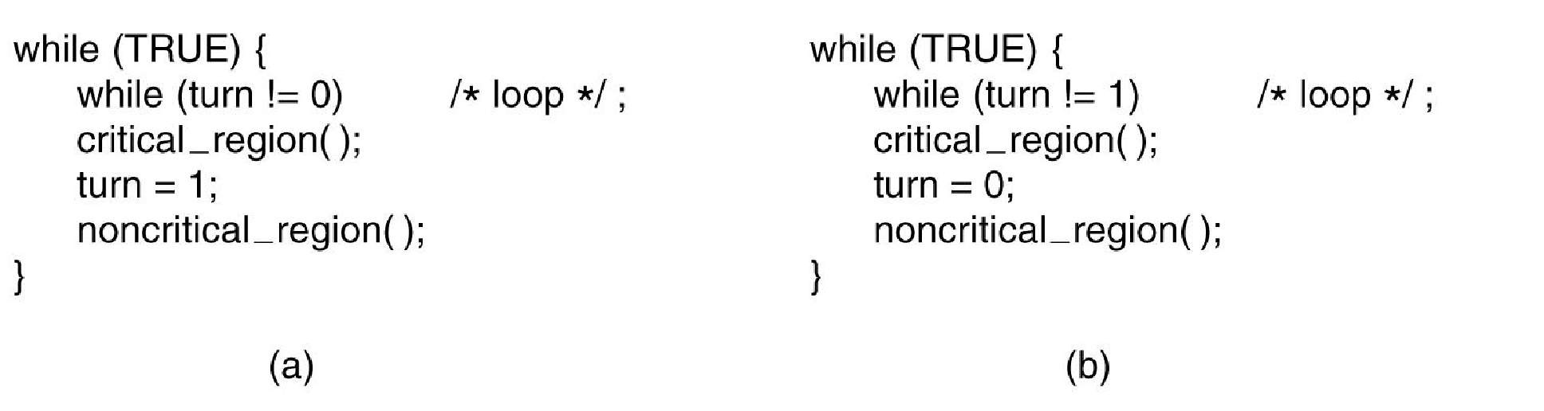
Strict Alternation (1)
Idea → Single shared variable (turn) between processes
Zero (0) means is the turn of process 0
One (1) means is the turn of process 1
Initially set with 0 or 1 based on who should start first
Processes strictly alternate
Each process runs different code
A proposed solution to the critical region problem. (a) Process 0. (b) Process 1. In both cases, be sure to note the semicolons terminating the while statements. (MOS Figure 2-23)

Slide 39
Strict Alternation (2)
lock=0
lock=0
lock=1
lock=1

Slide 40
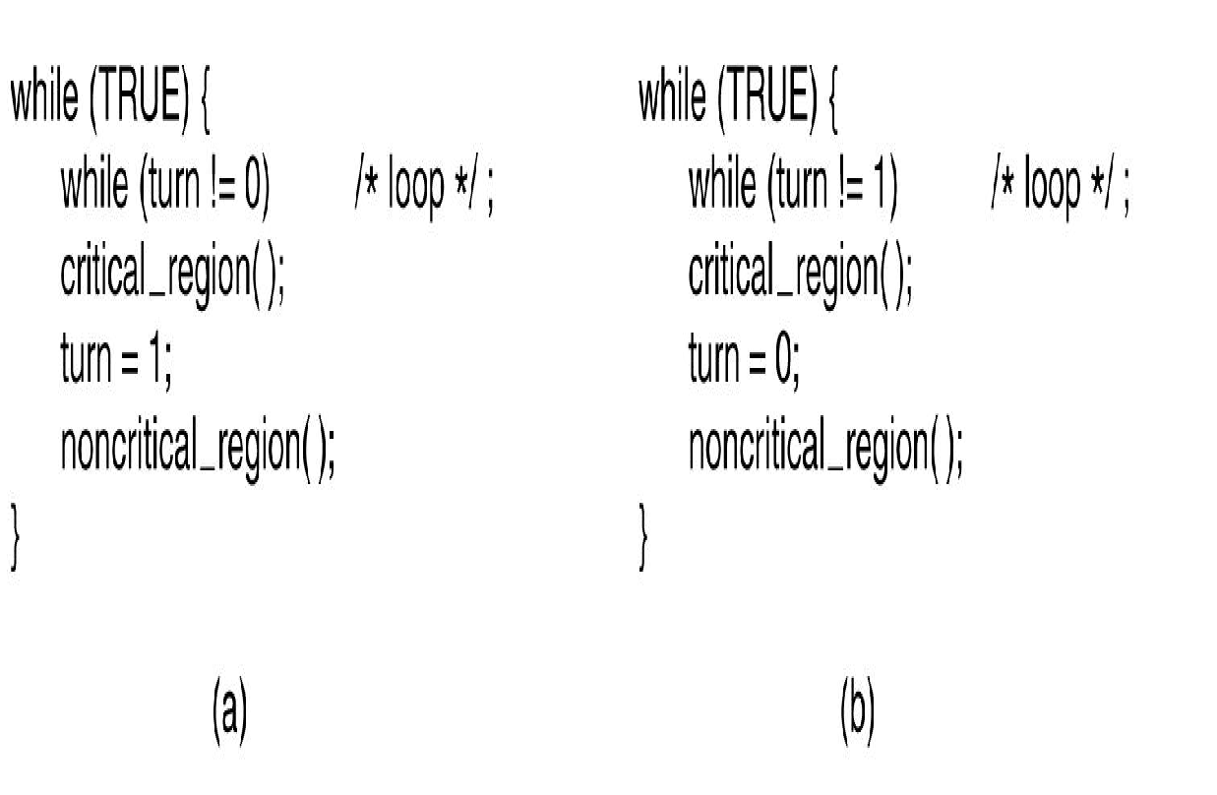

Strict Alternation (3)
a
b
while (TRUE) {
while (turn != 2) /* loop */;
critical_region( );
turn = 0;
noncritical_region( );
}
b
2
a
c
(c)

Slide 41
Strict Alternation (4)
Advantages → No races
Disadvantages → Violates condition 3 of Critical Regions
A process is being blocked by a process not in its critical region
turn = 2
while (TRUE) {
while (turn != 2) /* loop */;
critical_region( );
turn = 0;
noncritical_region( );
}
2
(c)

Slide 42
Peterson’s Solution (1)
Idea → Two shared variables (turn, flags[]) between processes
int turn impose an access order (FIFO in this case)
bool flags[] array specifies for each process its interest to enter the critical section
Initially, flags[2] = {FALSE, FALSE}
1 while (TRUE) {
2 flags[0] = TRUE;
3 turn = 0;
4 while (turn==0 && flags[1] == TRUE);
5 critical_region(); /* critical work */
6 flags[0] = FALSE;
7 noncritical_region();
8 }
1 while (TRUE) {
2 flags[1] = TRUE;
3 turn = 1;
4 while (turn==1 && flags[0] == TRUE);
5 critical_region(); /* critical work */
6 flags[1] = FALSE;
7 noncritical_region();
8 }
Process 0
Process 1
Notes:
Combines the previous two solutions in a single solution
1 – CASE WITHOUT CONCURRENCY
2 – CASE WITH CONCURRENCY

Slide 43
Peterson’s Solution (2)
Advantages
No races
Strict alternation free
Satisfies condition 3 of critical regions
Disadvantages
Generalization to multiple processes is rather complex

Slide 44
So Far … Busy Waiting Locks
Peterson’s Algorithm
Complex
Strict Alternation
Uncompliant (3rd condition)
Can we have lock variables that are race free and simple?
Hardware can help!

Slide 45
Test-and-Set Lock (TSL) Instruction
One single machine instruction
TSL register, memory_address
Reads and modifies the content of a memory word atomically
Returns in register the current value of the memory word at memory_address and then
Sets the value of the memory word at memory_address to TRUE (usually non-zero value)
Operations cannot be interrupted during execution
locks the memory bus (MOS book)
Implemented in the cache coherency protocol (reality)
Notes:
Instead of the Peterson’s solution may I solve the problem of the lock/strict alternation in another way? TSL is the solution

Slide 46
TSL Solution (1)
Idea
Single shared variable (lock in memory at LOCK_ADDR) between processes
Use TSL instead of while/assignment
1 while (TRUE) {
2 enter_region:
3 TSL REGISTER,LOCK_ADDR
4 CMP REGISTER,#0
5 JNE enter_region
6 critical_region(); /* work */
7 leave_region:
8 MOV LOCK_ADDR,#0
9 noncritical_region();
10}
1 while (TRUE) {
2 while (lock != 0); /* loop */
3 lock = 1;
4 critical_region(); /* work */
5 lock = 0;
6 noncritical_region();
7 }
Previous Lock Variables Code
Same code with TSL

Slide 47
TSL Solution (2)
1 while (TRUE) {
2 enter_region:
3 TSL REGISTER,LOCK_ADDR
4 CMP REGISTER,#0
5 JNE enter_region
6 critical_region(); /* work */
7 leave_region:
8 MOV LOCK_ADDR,#0
9 noncritical_region();
10}
1 while (TRUE) {
2 enter_region:
3 TSL REGISTER,LOCK_ADDR
4 CMP REGISTER,#0
5 JNE enter_region
6 critical_region(); /* work */
7 leave_region:
8 MOV LOCK_ADDR,#0
9 noncritical_region();
10}
Process A
Process B

Slide 48
TSL Solution (3)
Advantages
No races
Strict alternation free
Works for many processes as-is
Simple
Disadvantages
Scalability on multicores
Requires HW support
Notes:
Scalability is an advanced topic

Slide 49
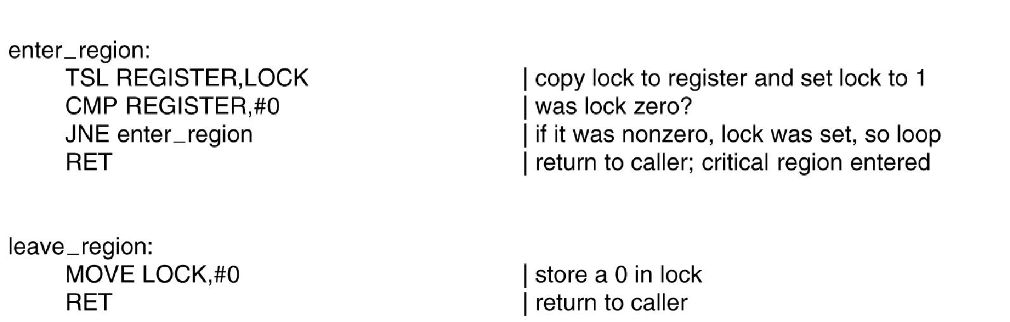
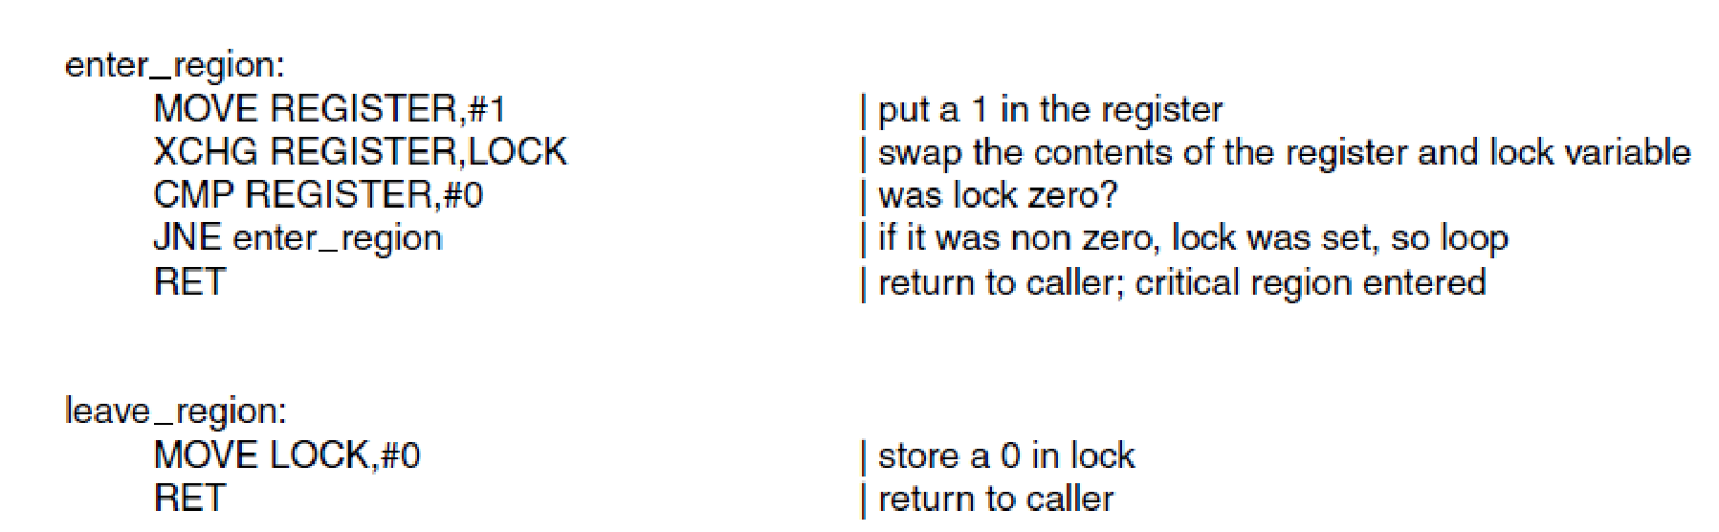
TSL vs XCHG
Entering and leaving a critical region using the TSL instruction. (MOS Figure 2-25)
Entering and leaving a critical region using the XCHG instruction (MOS Figure 2-26)

Slide 50
Discussion
Requirements for critical section solutions:
Guarantee mutual exclusion: Only one process may be executing within the CS.
Prevent lockout: A process not attempting to enter the CS must not prevent other processes from entering the CS.
Prevent starvation: A process (or a group of processes) must not be able to repeatedly enter the CS while other processes are waiting to enter.
Prevent deadlock: Multiple processes trying to enter the CS at the same time must not block each other indefinitely.
Busy waiting solutions: Lock variables, strict alternation, Peterson’s algorithm, TSL → Waste CPU time
Priority Inversion Problem
Process A (low prio) and Process B (high prio)
Process A enters its critical section
Process A descheduled, Process B scheduled
Process B busy waits for the critical section → The scheduler thinks B is using the processor (productively)
Process B will busy wait until Process A is scheduled back and exits its critical section

