Slide 1
CS492 - Operating Systems Concurrency Part 2
Georgios Portokalidis & Jun Xu
ZyBook 4.2-4.5, MOS 2.3.4-2.3.7
Slides credit: Antonio Barbalace

Slide 2
Mechanisms for Mutual Exclusion
Hardware (Part 1)
Disabling interrupts
Busy waiting (Part 1)
Lock variable
Strict alternation
Peterson’s solution
Test-and-Set Lock (TSL) Instruction (hardware support)
Sleep and wakeup
sleep() and wakeup()
Semaphores
Mutexes
Monitors

Slide 3
Busy Waiting Solutions
Disadvantages
Waste CPU time waiting
High priority jobs may hinder progress of low priority jobs
1 while (TRUE) {
2 enter_region:
3 TSL REGISTER,LOCK_ADDR
4 CMP REGISTER,#0
5 JNE enter_region
6 critical_region(); /* work */
7 leave_region:
8 MOV LOCK_ADDR,#0
9 noncritical_region();
10}
1 while (TRUE) {
2 while (lock != 0); /* loop */
3 lock = 1;
4 critical_region(); /* work */
5 lock = 0;
6 noncritical_region();
7 }
Lock Variable Solution
TSL Solution

Slide 4
Busy Waiting Solutions
Disadvantages
Waste CPU time waiting
High priority jobs may hinder progress of low priority jobs
Priority Inversion Problem
Process A and Process B
Process A enters its critical section
Process A descheduled, Process B scheduled
Process B busy waits for the critical section (depends on A)
Process B will busy wait until Process A is scheduled back and exits its critical section

Slide 5
sleep() and wakeup()
Instead of busy wait, let the process sleep
sleep() syscall
Callers give up the CPU for some duration of time or...
until other processes wake them up
wakeup() syscall
Callers wake up some sleeping process
In practice
Instead of sleep(), processes may call yield()
A process may be woken up by a signal
Notes:
This focuses on the wasting CPU time not on the priority inversion

Slide 6
Producer-consumer Problem with sleep() and wakeup() (1)
Producer
while (1){
produce an item A;
while(count==N); //full buffer
insert item;
count++;
}
Producer
while (1){
produce an item A;
if(count==N) //full buffer
sleep();
insert item;
count++;
if(count==1) //was buffer empty?
wakeup(consumer);
}
Consumer
while (1){
while(count==0) //empty buffer
remove item;
count--;
consume an item;
}
Consumer
while (1){
if(count==0) //empty buffer
sleep();
remove item;
count--;
if(count==N-1) //was buffer full?
wakeup(producer);
consume an item;
}
Previous code
New code

Slide 7
Producer-consumer Problem with sleep() and wakeup() (2)
Shared variables
const int N=100;
int count=0;
Producer
1 while (1){
2 produce an item A;
3 if(count==N) //full buffer
4 sleep();
5 insert item;
6 count++;
7 if(count==1) //was buffer empty?
8 wakeup(consumer);
9 }
Consumer
1 while (1){
2 if(count==0) //empty buffer
3 sleep();
4 remove item;
5 count--;
6 if(count==N-1) //was buffer full?
7 wakeup(producer);
8 consume an item;
9 }
Both Producer and Consumer may sleep forever
Buffer empty, Consumer is in line 2 count==0, moving to 3
Consumer descheduled, Producer scheduled
Producer adds one element, calls wakeup(), but the wakeup is lost
Producer fills up the buffer, and calls sleep() at line 4
Producer is descheduled, Consumer is scheduled, and calls sleep() at line 3
Notes:
This is because access to count is unconstrained (book) actually because it is not atomic with sleep/wakeup

Slide 8
Producer-consumer Problem with sleep() and wakeup() (2)
Shared variables
const int N=100;
int count=0;
Producer
1 while (1){
2 produce an item A;
3 if(count==N) //full buffer
4 sleep();
5 insert item;
6 count++;
7 if(count==1) //was buffer empty?
8 wakeup(consumer);
9 }
Consumer
1 while (1){
2 if(count==0) //empty buffer
3 sleep();
4 remove item;
5 count--;
6 if(count==N-1) //was buffer full?
7 wakeup(producer);
8 consume an item;
9 }
2
1
5
4
3
Both Producer and Consumer may sleep forever
Buffer empty, Consumer is in line 2 count==0, moving to 3
Consumer descheduled, Producer scheduled
Producer adds one element, calls wakeup(), but the wakeup is lost
Producer fills up the buffer, and calls sleep() at line 4
Producer is descheduled, Consumer is scheduled, and calls sleep() at line 3
Notes:
This is because access to count is unconstrained (book) actually because it is not atomic with sleep/wakeup

Slide 9
Producer-consumer Problem with sleep() and wakeup() (3)
Advantage
No busy-wait
Disadvantage
Race condition
A wakeup sent to a process that is not (yet) sleeping is lost
Decision to go to sleep and calling sleep() must be paired
Notes:
There is a race condition that than put the process in the condition to lose a wakeup

Slide 10
Semaphores

Slide 11
Introduction to Semaphores
Purpose
Solve the lost wakeup problem
Avoid race conditions
Ideas
Save the number of wakeups
Do check/update and sleep/wakeup atomically
How does it work?
Define a count variable, the semaphore
Only operations (can’t read or write variable, except initialization):
Down(semaphore) equivalent to consume (decrease) or sleep()
Up(semaphore) equivalent of produce (increase) and (potentially) wakeup()
Notes:
Save the number of wakeups, as well as doing a wake up for every count variation – or maybe this is not strictly necessary

Slide 12
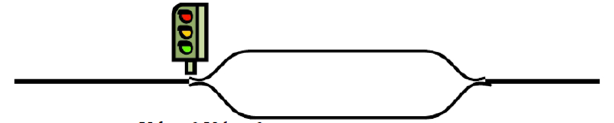
Railway Semaphores Analogy (1)
A semaphore initialized to 2 for resource control
C
B
A
sem = 2
C
B
down()
A
sem = 2
C
A
down()
B
sem = 1

Slide 13
Railway Semaphores Analogy (2)
A
down()
C
up()
B
sem = 0
down()
C
A
up()
wakeup()
sleep()
B
sem = 1
C
A
B
sem = 0
Notes:
Also in a computer everything is sequential when it happen to check a single variable – this is probably not he best example tho

Slide 14
Semaphores (2)
Invented by Dutch Computer Scientist E.W. Dijkstra, in 1965
Semaphore variable value
Negative or zero values → No resources available, pending wakeups
Positive values → Number of resources available, no pending wakeups
int value=1; /* protecting one resource */
Proberen (value) /* P, Down, “Try” in Dutch */
value--;
if (value < 0)
sleep(); /* sleep without completing down */
Verhogen (value) /* V, Up, “Raise” in Dutch */
value++;
if (value <= 0)
wakeup(); /* wakeup one sleeper with a policy */
Notes:
Dijkstra is Dutch
Proberen = try
Verhogen = raise, make higher
If one or more processes were sleeping on that semaphore, unable to complete an earlier down operation, one of them is chosen by the system (e.g., at random) and is allowed to complete its down.

Slide 15
Semaphores (3)
From algorithm to practice
unsigned int value=1; /* protecting one resource */
Proberen (value) /* P, Down, “Try” in Dutch */
if (value > 0)
value--;
else if (value == 0)
sleep(); /* sleep without completing down */
Verhogen (value) /* V, Up, “Raise” in Dutch */
if (sleeping_processes())
wakeup(); /* wakeup one sleeper with a policy */
else
value++;
sleeping_processes() returns true, if there are processes sleeping on the semaphore
Notes:
THIS IS CORRECT BUT IT DOESN’T SHOW WHAT IS REALLY GOING ON … IT REQUIRES THE CONCEPT OF SCHEDULING … BLOCKED PROCESSES ON A QUEUE ETC.
Dijkstra is Dutch
Proberen = try
Verhogen = raise, make higher
If one or more processes were sleeping on that semaphore, unable to complete an earlier down operation, one of them is chosen by the system (e.g., at random) and is allowed to complete its down.

Slide 16
Semaphores (4)
Down() and Up() are atomic→ Once the operation has started, no other process can access the semaphore until completed or blocked
Checking values, changing values, going to sleep, or wakeup, all is done as a single action
Implementation in kernel-mode
Disabling interrupts to avoid scheduling events
TSL/XCHG instructions to protect from other CPUs
Sleeping in Down() won’t miss wakeups from Up()
Atomicity is essential to solving synchronization problems and avoiding race conditions

Slide 17
Semaphores in the Linux Kernel
struct semaphore https://elixir.bootlin.com/linux/latest/source/include/linux/semaphore.h#L15
down() https://elixir.bootlin.com/linux/latest/source/kernel/locking/semaphore.c#L53
up() https://elixir.bootlin.com/linux/latest/source/kernel/locking/semaphore.c#L178

Slide 18
Producer-consumer Problem Semaphores (1)
Shared variables
const int N=100;
int count=0;
Shared variables
const int N=100;
semaphore empty=N, full=0;
Previous code
New code
In producer-consumer problem count controls two conditions
Buffer empty
count == 1 or count == 0
Buffer full
count == N or count == N-1
A semaphore controls a single condition on value
Two semaphores are needed
Notes:
Semaphore only controls one condition, instead count here it is used to control 2 conditions
Resources:
Empty -> available slots
full -> available items

Slide 19
Producer-consumer Problem Semaphores (2)
Shared variables
const int N=100;
int count=0;
Shared variables
const int N=100;
semaphore full=N, empty=0;
Producer
while (1){
produce an item A;
if(count==N) sleep();
insert item;
count++;
if(count==1) wakeup(consumer);
}
Producer
while (1){
produce an item A;
down(full);
insert item;
up(empty);
}
Full?
Empty?
Consumer
while (1){
if(count==0) sleep();
remove item;
count--;
if(count==N-1) wakeup(producer);
consume an item;
}
Consumer
while (1){
down(empty);
remove item;
up(full);
consume an item;
}
Previous code
New code

Slide 20
Producer-consumer Problem Semaphores (2)
Shared variables
const int N=100;
int count=0;
Shared variables
const int N=100;
semaphore full=N, empty=0;
Producer
while (1){
produce an item A;
if(count==N) sleep();
insert item;
count++;
if(count==1) wakeup(consumer);
}
Producer
while (1){
produce an item A;
down(full);
insert item;
up(empty);
}
Full?
How about these?
Empty?
Consumer
while (1){
if(count==0) sleep();
remove item;
count--;
if(count==N-1) wakeup(producer);
consume an item;
}
Consumer
while (1){
down(empty);
remove item;
up(full);
consume an item;
}
Shared resource is accessed
(code is in critical section)
Previous code
New code

Slide 21
Types of Semaphores
Counting semaphore ← Based on the number of controlled resources (defined at initialization)
value is any integer (in the Books & Linux kernel, only non-negatives)
Multiple processes are doing critical operations
Notes:
Not necessarily defined at initialization -> in fact there should be a cap on this in real implementation
MY BIGGEST CONCERN AT THIS POINT IS THAT PRODUCER CONSUMER DOESN’T SHOW MUTUAL EXCLUSION BUT AND EXCLUSION UP TO N, AND I AM AFRAID STUDENTS SHUOLDN’T SEE THE PRODUCER CONSUMER BEFORE … BUT I DON’T HAVE A BETTER IDEA FOR NOW

Slide 22
Types of Semaphores
Counting semaphore ← Based on the number of controlled resources (defined at initialization)
value is any integer (in the Books & Linux kernel, only non-negatives)
Multiple processes are doing critical operations
Binary semaphore ← Implements mutual exclusion, aka Mutex
value is either 0 (zero) or 1 (one)

Slide 23
Mutexes
Implementing mutual exclusion with binary semaphores
Two states
Locked 0 – critical region is not available
Unlocked 1 – critical region is available
Semaphore mutex = 1;
Repeat
Down(mutex);
Critical_section();
Up(mutex);
Non_Critical_section();
Until false
Mutex mutex = UNLOCKED;
Repeat
Mutex_lock(mutex);
Critical_section();
Mutex_unlock(mutex);
Exit_Critical_section();
Until false

Slide 24
Producer-consumer Problem Semaphores and Mutexes (1)
Shared variables
const int N=100;
int count=0;
Shared variables
const int N=100;
semaphore empty=N, full=0;
mutex mux=1;
sleep() & wakeup() code
New code
Multiple threads/process trying to add/remove different items on the buffer
Operations on the buffer are critical operation
Mutex to protect buffer operations
Avoid races
Notes:
Semaphore only controls one condition, instead count here it is used to control 2 conditions

Slide 25
Producer-consumer Problem Semaphores and Mutexes(2)
Shared variables
const int N=100;
int count=0;
Shared variables
const int N=100;
semaphore full=N, empty=0;
mutex mux=1;
Producer
while (1){
produce an item A;
if(count==N) sleep();
insert item;
count++;
if(count==1) wakeup(consumer);
}
Producer
while (1){
produce an item A;
down(full);
lock(mux); // down(mux)
insert item;
unlock(mux); // up(mux)
up(empty);
}
Consumer
while (1){
if(count==0) sleep();
remove item;
count--;
if(count==N-1) wakeup(producer);
consume an item;
}
Consumer
while (1){
down(empty);
lock(mux); // down(mux)
remove item;
unlock(mux); // up(mux)
up(full);
consume an item;
}
sleep()&wakeup() code
New code

Slide 26
Game of Orders (1)
The sequence of down and up operations:
Producer – down(full), down(mux), up(mux), up(empty)
Consumer – down(empty), down(mux), up(mux), up(full)
Is order of down() important? Yes!
Producer
while (1){
produce an item A;
down(mux);
down(full);
insert item;
up(mux);
up(empty);
}
Consumer
while (1){
down(mux);
down(empty);
remove item;
up(mux);
up(full);
consume an item;
}
Both processes may stay blocked forever!
Notes:
This material is in 2.3.7

Slide 27
Game of Orders (2)
The sequence of down and up operations:
Producer – down(empty), down(mux), up(mux), up(full)
Consumer – down(full), down(mux), up(mux), up(empty)
Is order of up() important? Yes!
Producer
while (1){
produce an item A;
down(full);
down(mux);
insert item;
up(empty);
up(mux);
}
Consumer
while (1){
down(empty);
down(mux);
remove item;
up(full);
up(mux);
consume an item;
}
What can happen here?

Slide 28
Warning!
A subtle error and everything comes to a halt
Deadlock (zyBook Chapter 9)
When two (or more) processes would stay blocked forever and no more work would ever be done

Slide 29
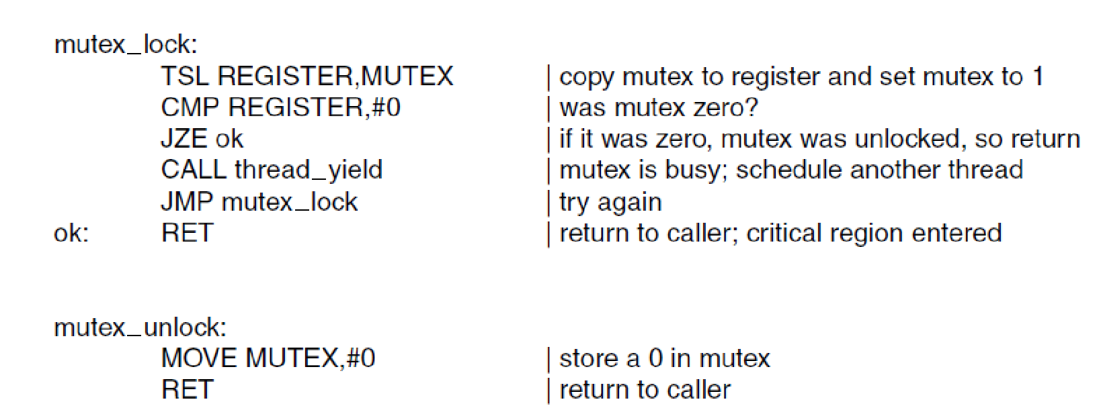
Mutex Implementation
MOS book says that mutexes can be implemented using a TSL instruction (with hardware support), but …
Implementation of mutex_lock and mutex_unlock. (MOS Figure 2-29)
Notes:
\

Slide 30
Mutex Implementation
MOS book says that mutexes can be implemented using a TSL instruction (with hardware support), but … this is busy wait
In Linux:
spinlocks → busy wait
mutexes → sleep/wakeup (but tries busy waiting for a bit)
Implementation of mutex_lock and mutex_unlock. (MOS Figure 2-29)
Notes:
\

Slide 31
Mutexes in the Linux Kernel
struct mutex https://elixir.bootlin.com/linux/v4.9/source/include/linux/mutex.h#L50
mutex_lock() https://elixir.bootlin.com/linux/v4.9/source/kernel/locking/mutex.c#L95
mutex_unlock() https://elixir.bootlin.com/linux/v4.9/source/kernel/locking/mutex.c#L423

Slide 32
Monitors
Notes:
IN MY OPINION THIS IS NOT OPERATING SYSTEM MATERIAL, IF NOT FOR PTHREAD CONDITIONAL VARIABLES
THE REAL THEORY ABOUT THIS SHOULD BE DONE IN CONCURRENCY CLASS – THIS IS A COMPILER/LANGUAGE VIRTUAL MACHINE CONSTRUCT

Slide 33
Monitors (1)
Motivation
Facilitate writing correct concurrent programs
Take complexity out of developers’ hands
Multiple critical sections are hard to handle
Idea → Introduce a higher-level primitive called Monitor
A programming language construct
The compiler implements it (and mutual exclusion)
Or a language virtual-machine (e.g., Java)

Slide 34
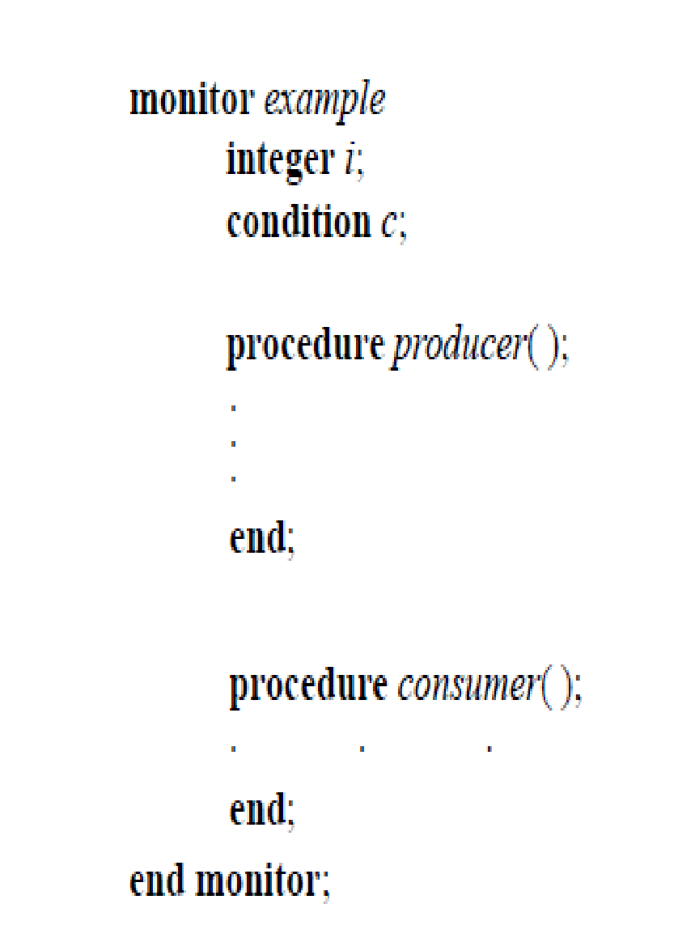
Monitors (2)
What is a Monitor? → a package or module (e.g., a class)
Consists of a collection of
Procedures
Variables
Data structures
Monitor Rules
Only one process can be active in a monitor at any time
Processes cannot access internal data of monitor
Put all critical sections inside monitor
A monitor. (MOS Figure 2-33)
Notes:
All rules are fundamental for the monitor

Slide 35
Monitors (3)
A construct inside which there is mutual exclusion
A Mutex is used to achieve mutual exclusion
Checked automatically at function invocation and return
A Condition Variable is used:
for processes to wait/block when attempting to enter a monitor (which is used)
to wake up waiting processes
Notes:
Wikipedia practically defines a monitor such as a construct defined by
Mutex (to enter and exit)
Conditional variable (to wait)

Slide 36
Condition Variables
Define a conditional variable, the condition
Operations
Wait(condition)
Add process to wait queue
Release mutex
Cause the calling process to block
Re-acquire mutex once process is woken
Signal(condition)
Wakes up one blocked process on the condition, if any
Exits the monitor, leaving critical section (releases mutex)
Rules
Must hold the Mutex before doing condition variable operations

Slide 37
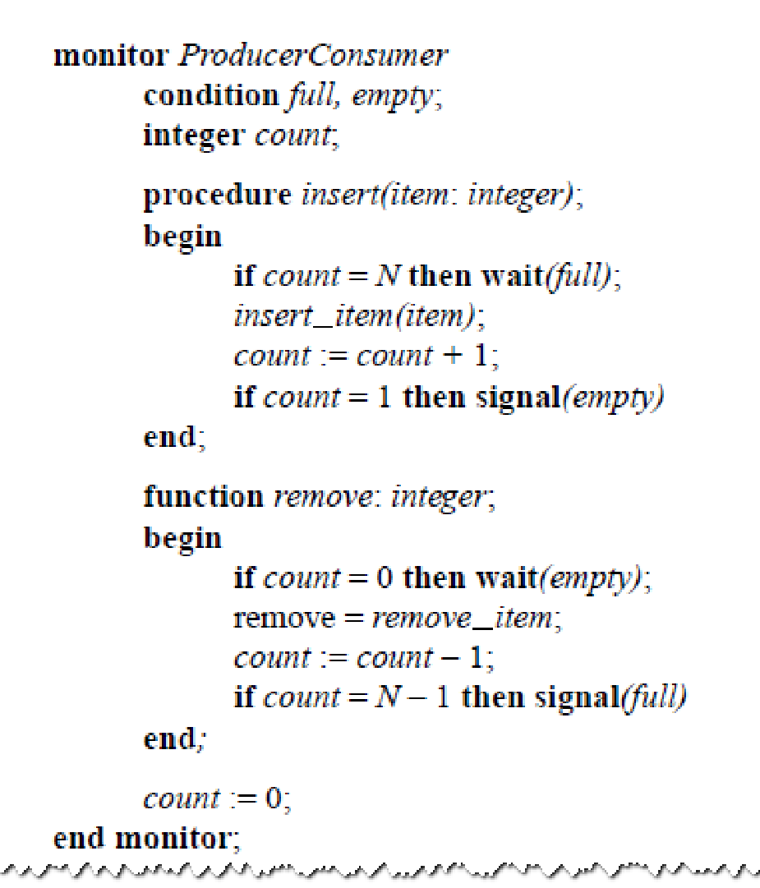
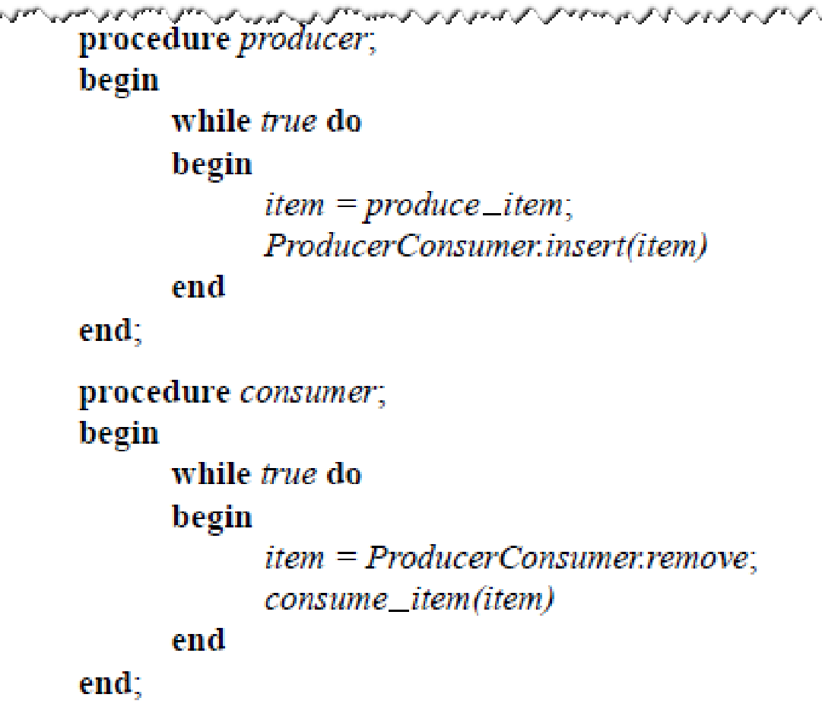
Monitors with Conditional Variables (1)

Slide 38
Monitors with Conditional Variables (2)
1
1
Wait for someone else to exit monitor
3
2
3

Slide 39
Monitors with Conditional Variables (3)
4
3
5
4
6
7
8
1
Gives up the monitor
2
1
9
Get back the monitor

Slide 40
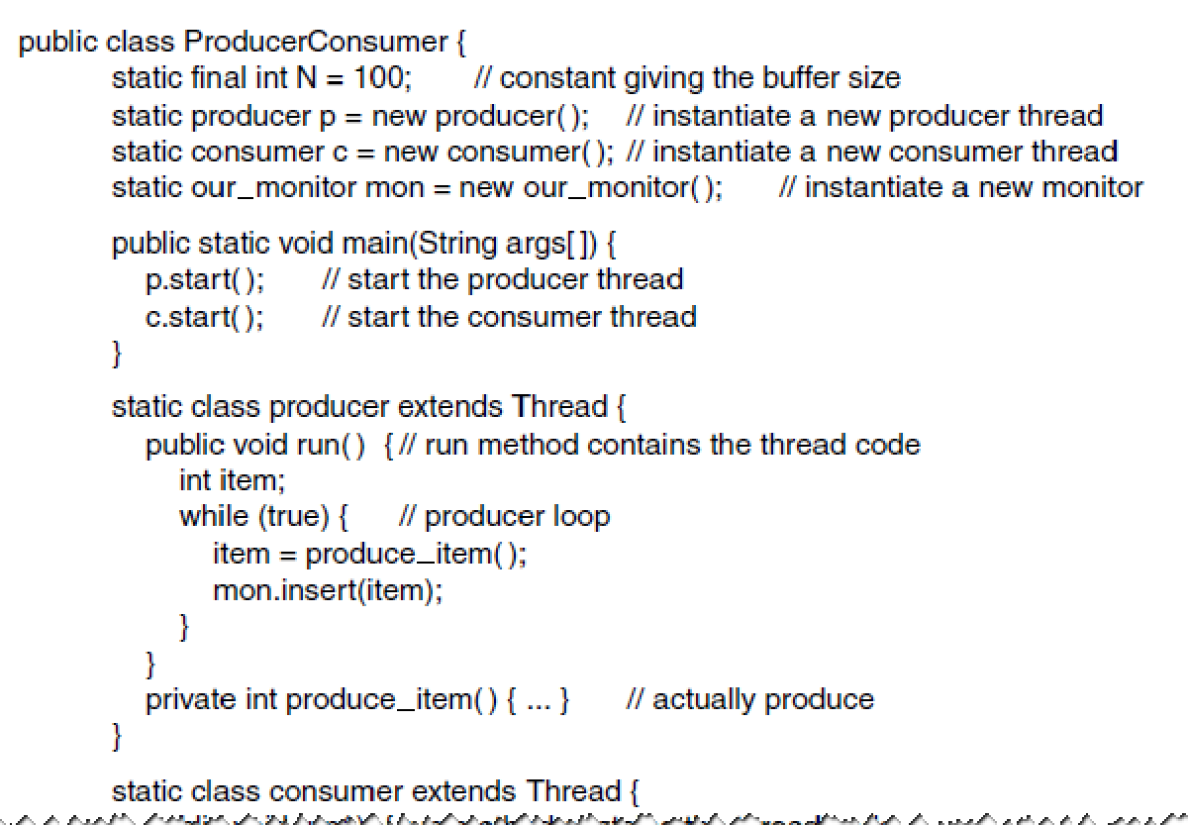
Monitors in Java (1)
A solution to the producer-consumer problem in Java. (MOS Figure 2-35)

Slide 41
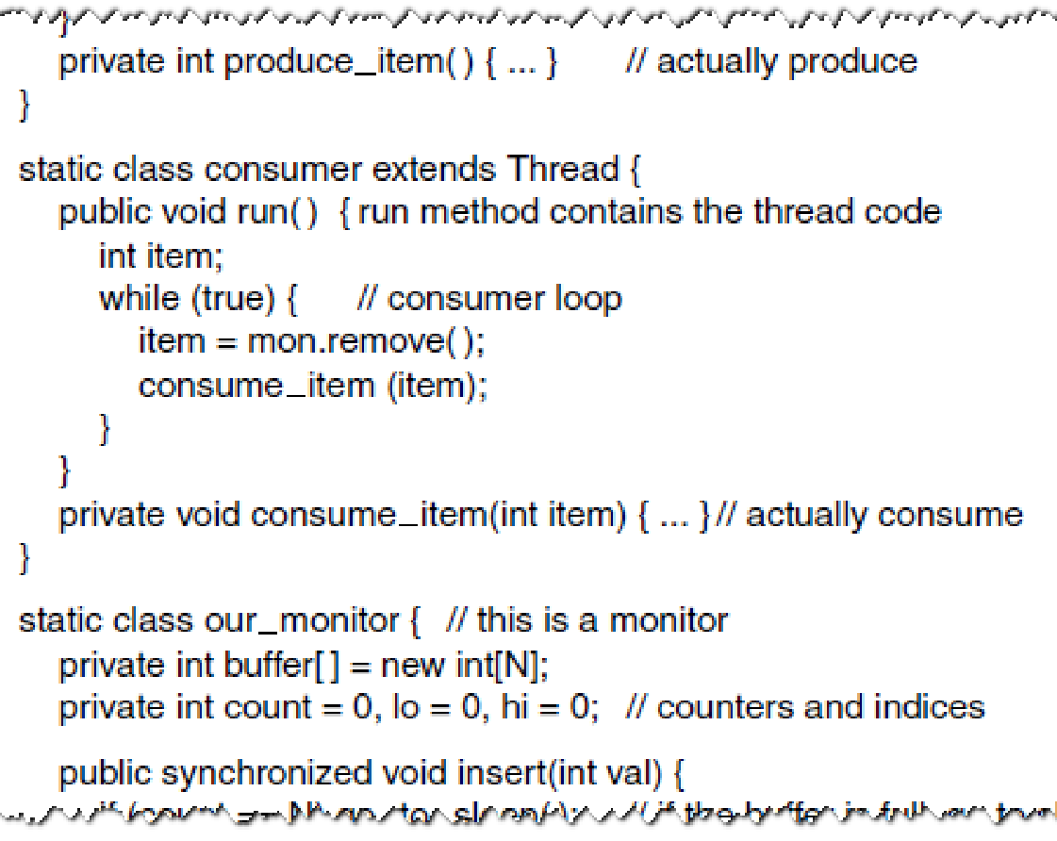
Monitors in Java (2)
A solution to the producer-consumer problem in Java. (MOS Figure 2-35)

Slide 42
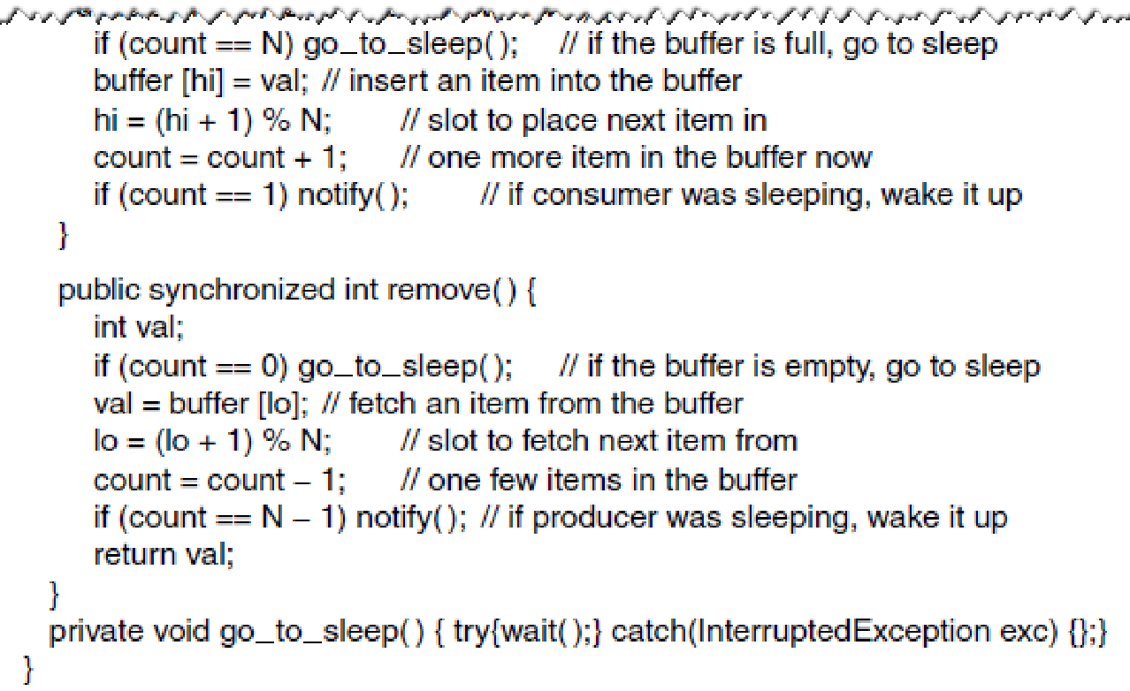
Monitors in Java (3)
A solution to the producer-consumer problem in Java. (MOS Figure 2-35)

Slide 43
Readers-Writers Problem

Slide 44
The Problem
Multiple threads need to access a shared resource concurrently
Some only need to read!
Mutual exclusion only allows one thread to access the resource at a time
Can we do better?

Slide 45
The Problem
Multiple threads need to access a shared resource concurrently
Some only need to read!
Mutual exclusion only allows one thread to access the resource at a time
Can we do better? → What if multiple readers can access it concurrently, but writers must access it with mutual exclusion

Slide 46

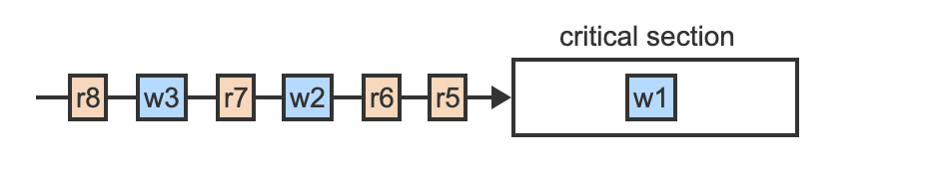
Example

Slide 47
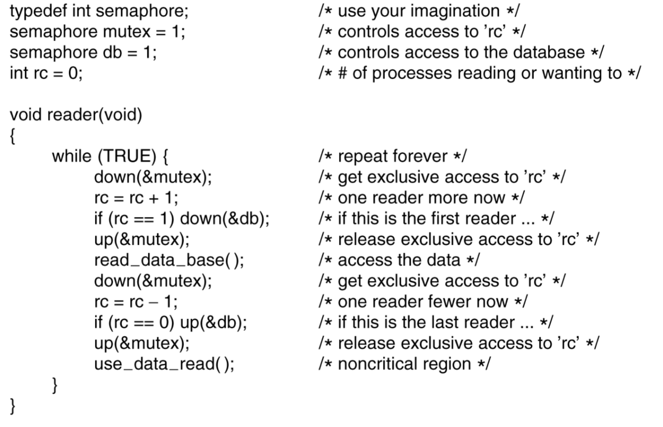
Reader
MOS Figure 2-47. A solution to the readers and writers problem.

Slide 48
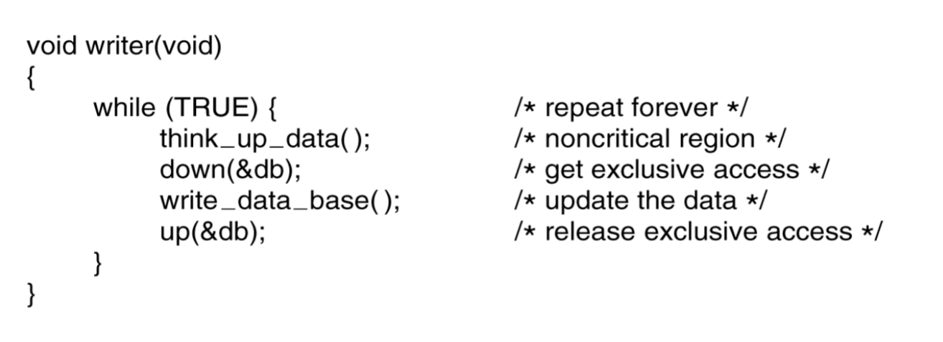
Writer
MOS Figure 2-47. A solution to the readers and writers problem.

Slide 49
Multiple Readers, Single Writer (MRSW) Locks
A solution to the readers-writers problem
rwlock_t
https://elixir.bootlin.com/linux/v4.9/source/include/linux/rwlock_types.h#L23
https://elixir.bootlin.com/linux/v4.9/source/include/linux/rwlock.h#L18
Separate reader/writer lock/unlock primitives

Slide 50
Linux Kernel
Lock Types and Their Rules
The kernel provides a variety of locking primitives which can be divided into three categories:
Sleeping locks
CPU local locks
Spinning locks
https://www.kernel.org/doc/html/latest/locking/locktypes.html

Slide 51
Other Concurrency Primitives?
Futex
https://en.wikipedia.org/wiki/Futex
Message passing
https://en.wikipedia.org/wiki/Message_passing
Barrier
https://en.wikipedia.org/wiki/Barrier_(computer_science)
Read-copy-update (RCU)
https://en.wikipedia.org/wiki/Read-copy-update
…

