Slide 1
CS492 Operating Systems Input/Output
Georgios Portokalidis & Jun Xu
ZyBook 8, MOS 5.1 - 5.2

Slide 2
Contents
I/O and the role of the Operating System
Communication Mechanisms between CPU and I/O Devices
Registers and buffers
DMA
Interrupts
Software I/O
Programmed I/O
Interrupt-driven I/O
I/O using DMA

Slide 3
Input/Output (I/O)
Operating System
Controls all the computer’s I/O devices
Issue commands to the devices
Catch and manages interrupts
Handle errors
Provides an interface between the devices and the software
Simple
Easy to use
Potentially the same for all devices (device independence)
…
The I/O code represents a significant fraction of the total operating system
Notes:
The key Operating System’s abstractions are process, address space, and file – additionally, the Operating Systems does control and provides an interface …
… == others, such as buffering, sharing and dedicated, synchronous and asynchronous

Slide 4
I/O Devices (1)
Block devices
Stores information in fixed-size blocks
Each block has its own address
Transfers are in units of entire blocks
Examples: hard disk, blu-ray disc, USB
Character devices
Delivers or accepts stream of characters, no block structure
Not strictly addressable, does not have any seek operation
Examples: printers, network interfaces, serial line, mouse
Some devices do not fit into this classification
Examples: clocks, memory-mapped screens
Notes:
Mice, rats <- nice joke from the book
Clocks, for example, are not block addressable. Nor do they generate or accept character streams. All they do is cause interrupts at well-defined intervals. Memory-mapped screens do not fit the model well either. Nor do touch screens, for that matter. ANTONIO: memory fits the memory model, i.e. not device ??? Still, the model of block and character devices is general enough that it can be used as a basis for making some of the operating system software dealing with I/O device independent. The file system, for example, deals just with abstract block devices and leaves the device-dependent part to lower-level software.

Slide 5
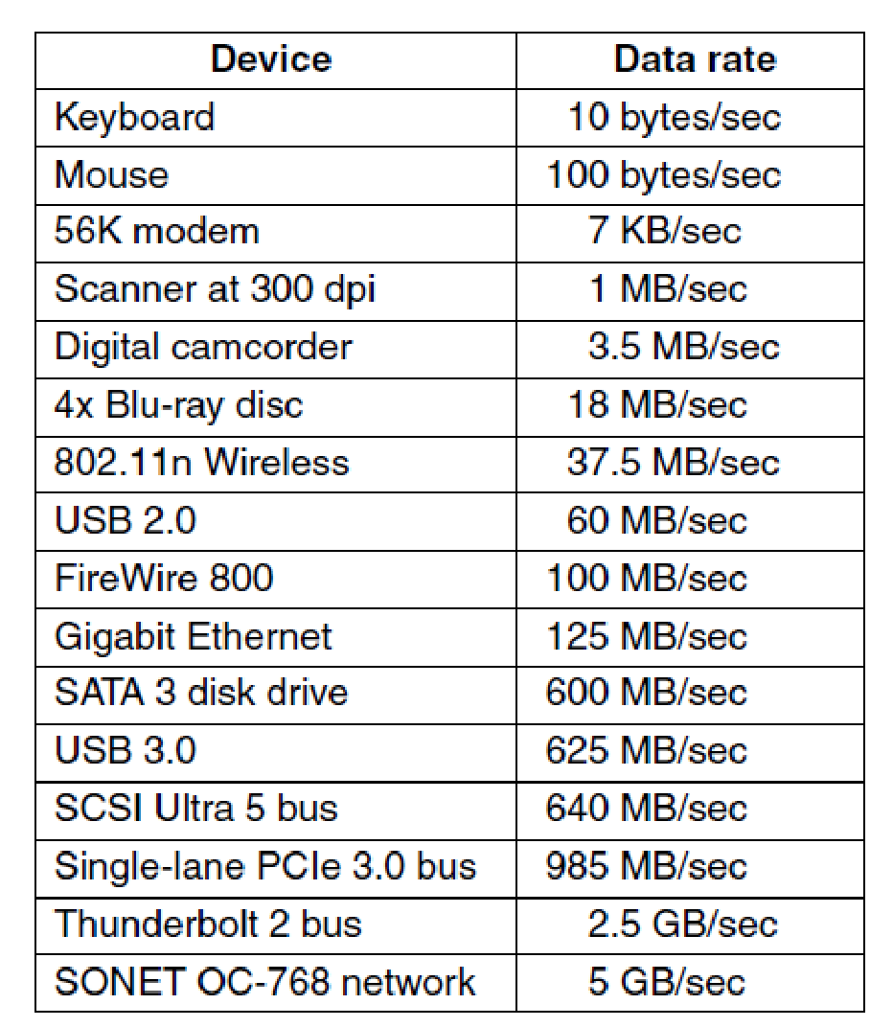
I/O Devices (2)
I/O devices cover a huge range in speeds
Considerable pressure on the software
to perform well over many orders of magnitude in data rates
Some typical device, network, and bus data rates. (MOS Figure 5-1.)
Notes:
Not really up to date but gives an idea

Slide 6
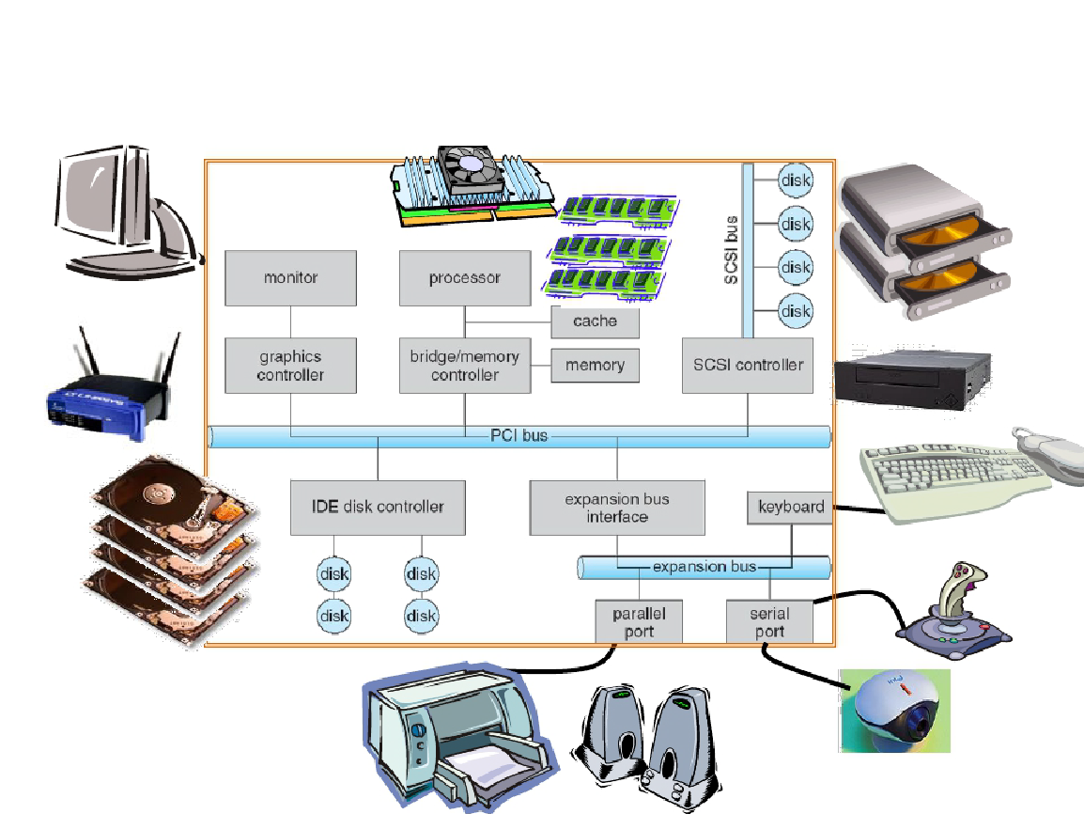
Computer Hardware

Slide 7
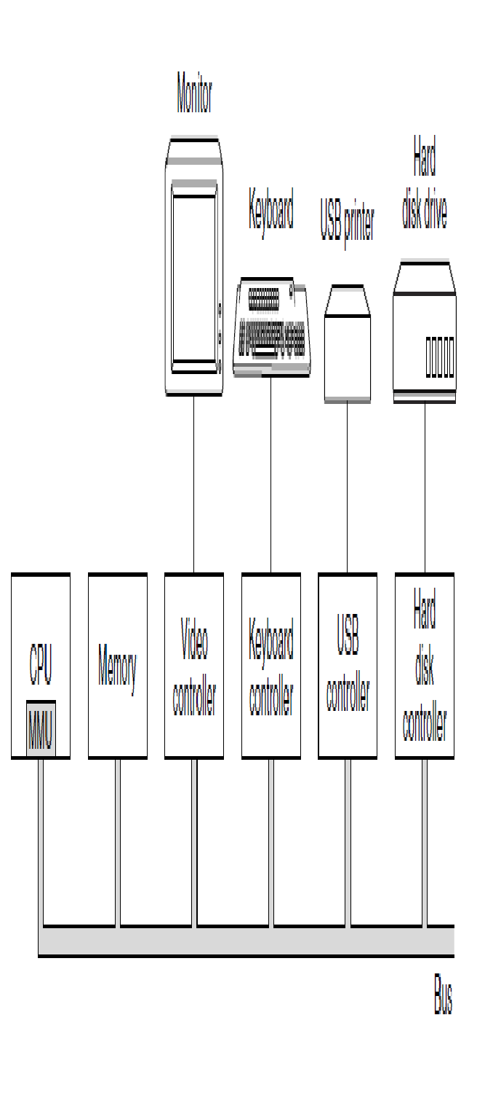
I/O Hardware (1)
device
device
port
Variety of I/O devices
Common concepts
Port
Connection point for device (e.g., USB, parallel, serial, Ethernet)
Bus
Peripheral buses (e.g., PCI/PCIe)
Expansion bus connects relatively slow devices
Device
Controller (host adapter)
Electronics that operate port, bus, device
Sometimes integrated
Sometimes separate circuit board (host adapter)
Contains processor, microcode, private memory, bus controller, etc.
port
PAST
PRESENT

Slide 8
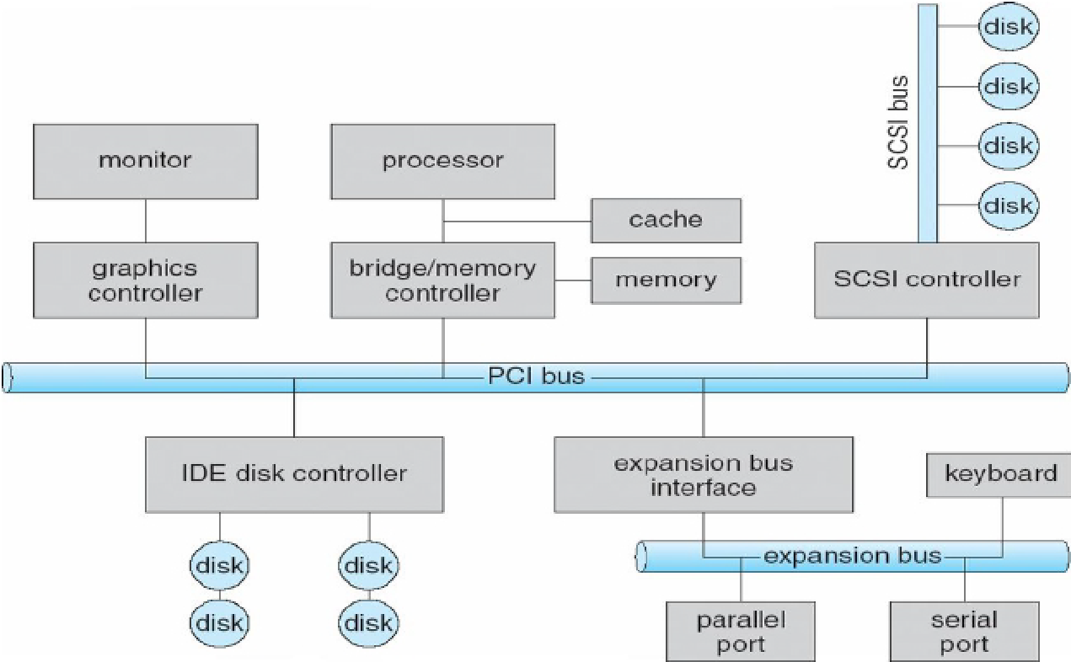
I/O Hardware (2)
Buses (cyan)
Handle the traffic between I/O devices and processor
Examples
PCI/PCIe
Connects with high speed graphics, networking, etc.
Connects to low speed buses
SCSI
Used to be for fast devices with large bandwidth (disks, scanners, etc.)

Slide 9
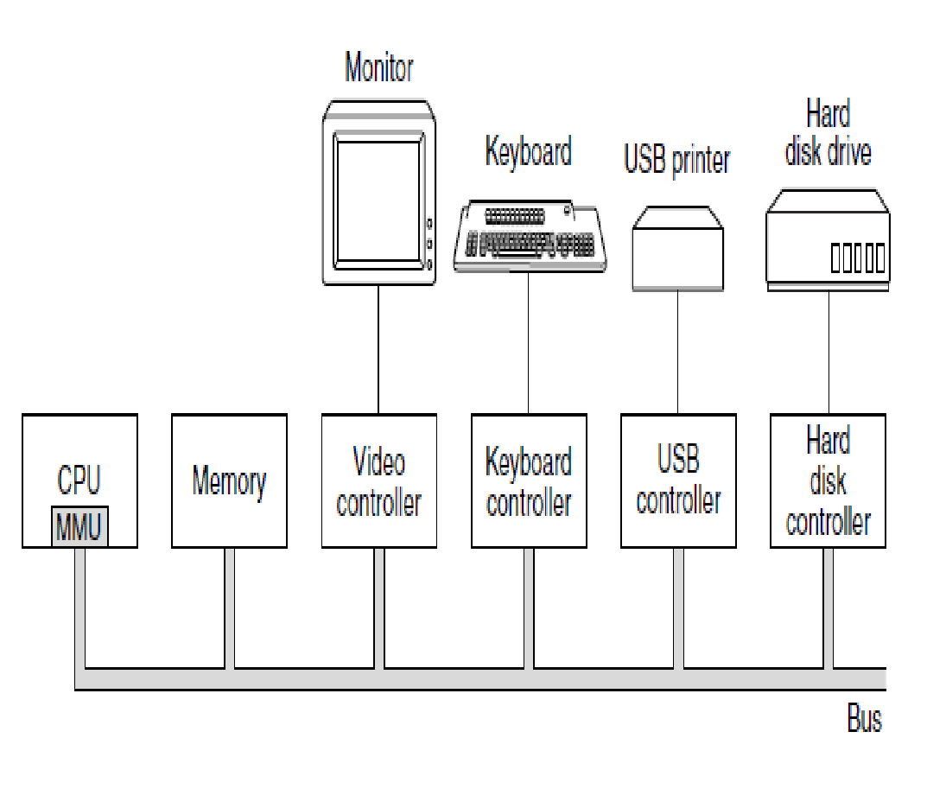
I/O Hardware (3)
Device
Mechanical component (the device itself)
Electronic component (a chip on the motherboard)
Controller (or host adapter)
May be able to handle multiple devices
Controller's tasks
Convert bit stream to bytes
Perform error correction as necessary
Move data to/from host memory
Is programmed by the processor
It exports a specific standardized interface
Etc.

Slide 10
I/O Hardware – Challenges for the Software and the User
Thousands of I/O devices, each slightly different
How to standardize the interfaces to these devices?
Devices are unreliable
How can we make them reliable?
Devices are time-unpredictable and/or slow
How can we manage them if we don’t know?

Slide 11
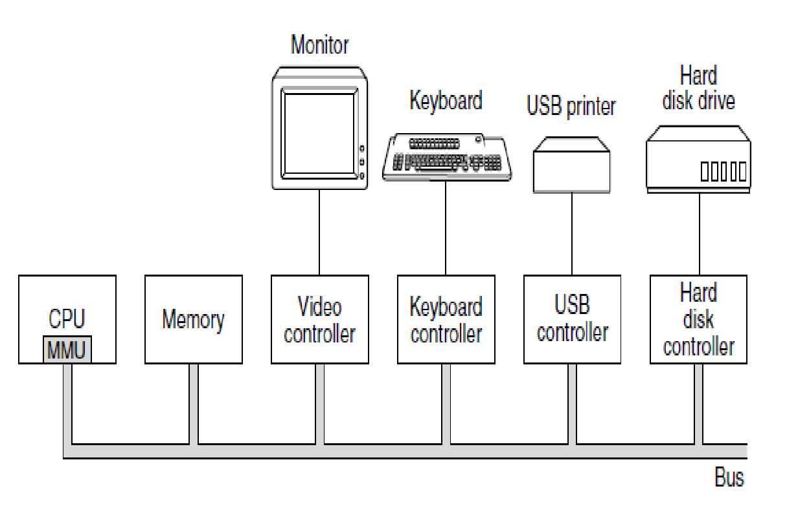
Question
Advances in chip technology have made it possible to put an entire controller, including all the bus access logic, on an inexpensive chip. How does that affect the model of this figure?

Slide 12
Answer
device
In the figure, we see controllers and devices as separate units. The reason is to allow a controller to handle multiple devices, and thus eliminate the need for having a controller per device. If controllers become almost free, then it will be simpler just to build the controller into the device itself. This design will also allow multiple transfers in parallel and thus give better performance.
port

Slide 13
Communication Mechanisms Between CPU and I/O Devs

Slide 14
Communication Mechanisms
CPU initiated communication
Register and buffers
Offloaded communication
DMA
I/O device notification
Interrupt
[Computer Architecture Review]

Slide 15
CPU Initiated Communication (1)
I/O Devices exposes
Registers
Software read/writes them to command the device to
Deliver data
Accept data
Switch itself on or off
Perform some action
Buffers (memory-like areas)
Software read/writes them to move data
E.g., video RAM, contains the monitor content
E.g., GPU RAM, contains data about the computation
Notes:
A controller has status and control registers
CPU writes to the control register: causes device action
CPU reads from the status register: get states of devices
A controller may also have data buffers
CPU reads/writes in the same way as registers

Slide 16
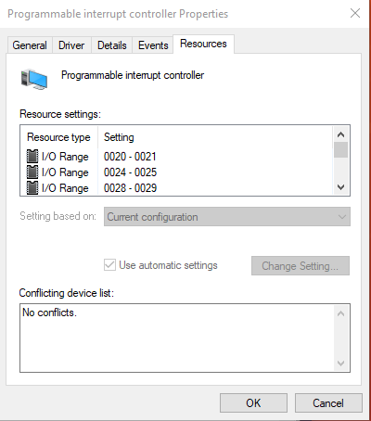
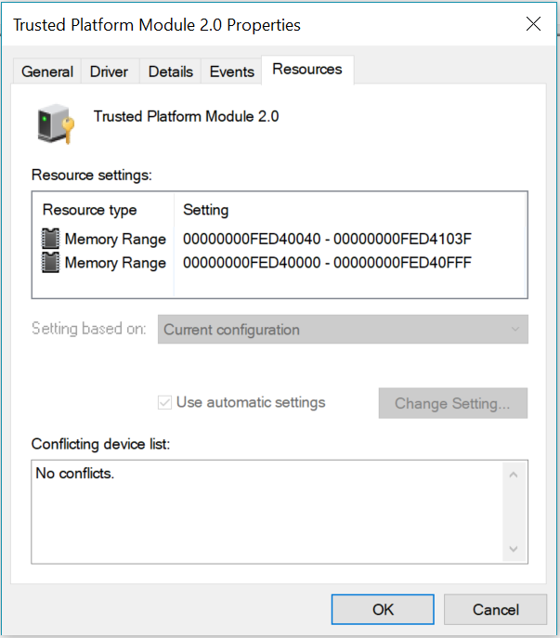
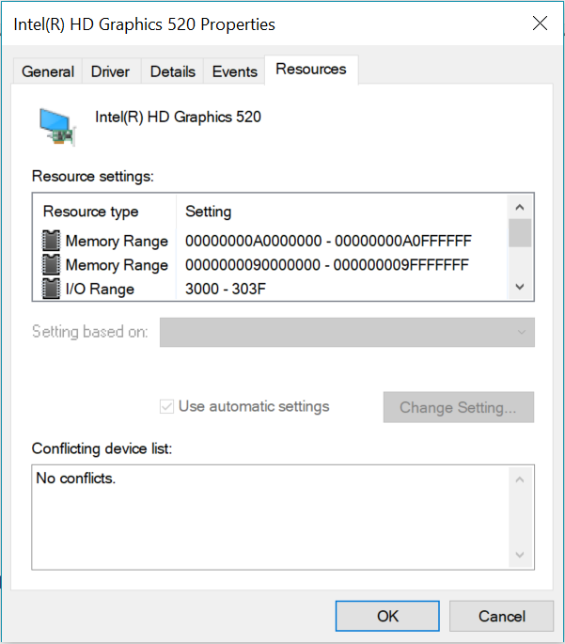
CPU Initiated Communication (2)
How to communicate with registers/buffers?
It is hardware dependent
I/O Ports and
Memory Mapped IO
I/O Ports
Memory Mapped I/O

Slide 17
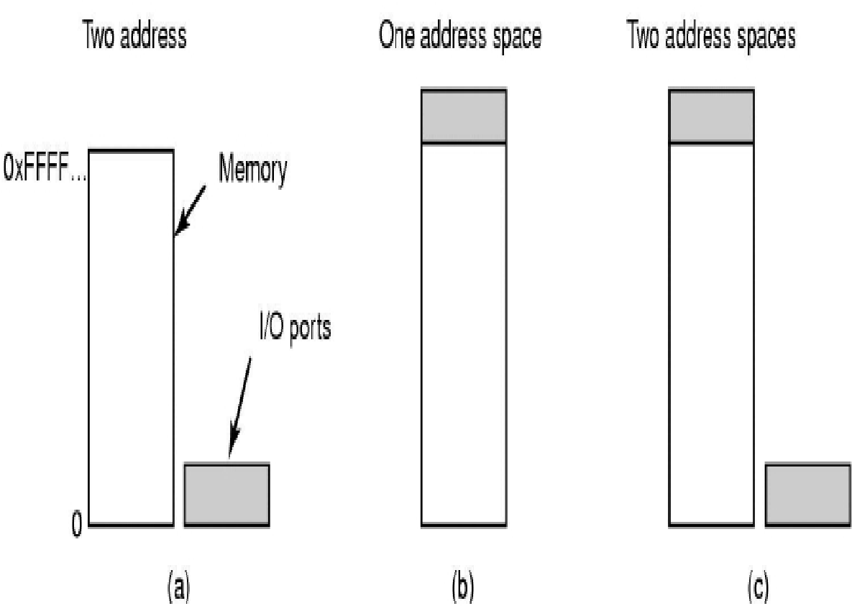
I/O Ports (1)
CPU Initiated Communication
Each control register an I/O port number
Special instructions to access the I/O port space
CPU reads in from device I/O PORT to CPU register
IN REG, PORT
CPU writes to device I/O PORT from CPU register
OUT PORT, REG
Instruction are privileged (OS kernel only)
Separate I/O port space and memory space
I/O instructions
IN R0, 4
OUT 4, R0
Similar memory access instruction
MOV R0, 4
MOV 4, R0
Two address spaces
RAM Memory

Slide 18
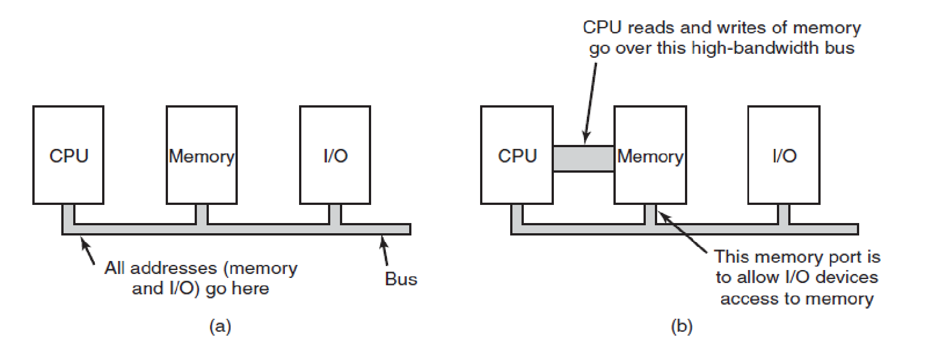
I/O Ports (2)
CPU Initiated Communication
Memory
I/O
Memory Addresses
bus
IO Addresses

Slide 19
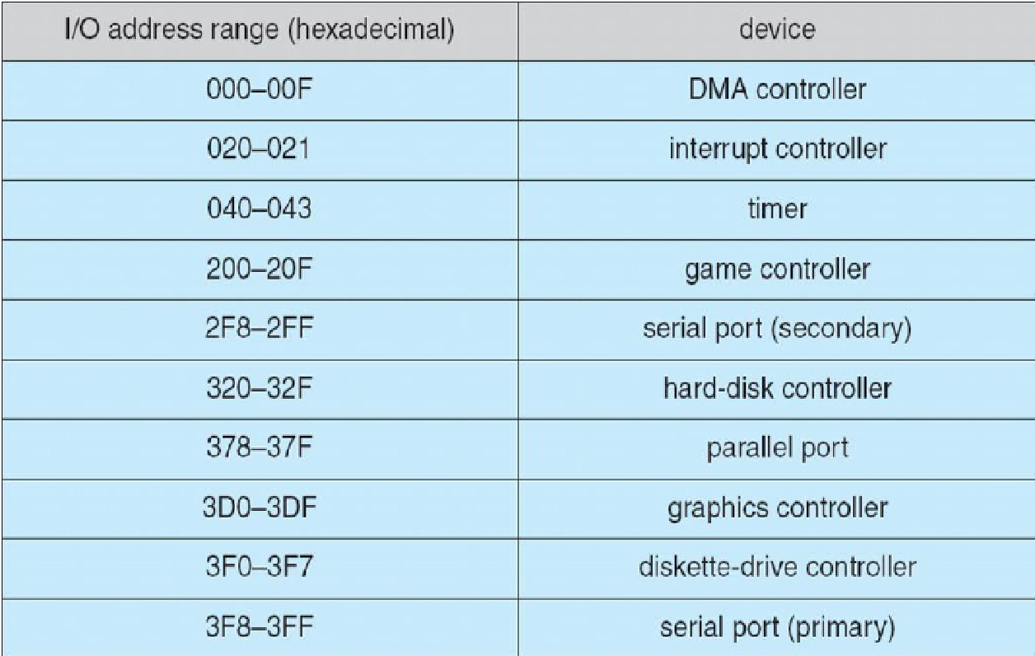
I/O Ports (3)
CPU Initiated Communication

Slide 20
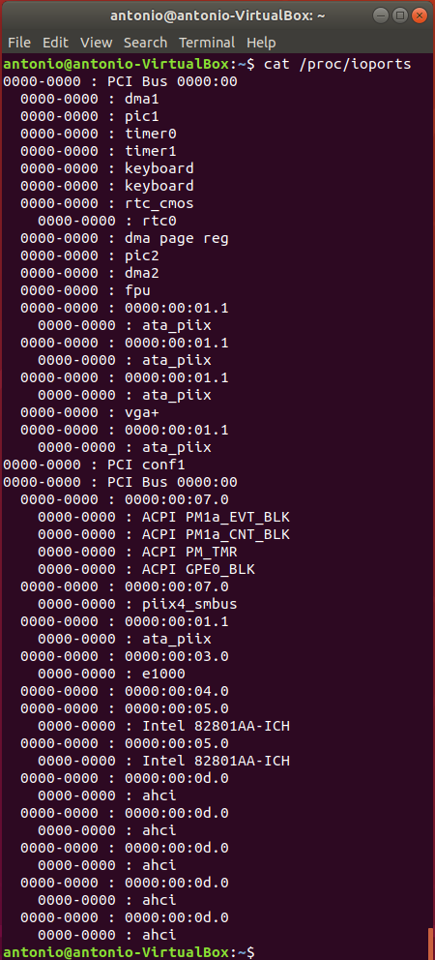
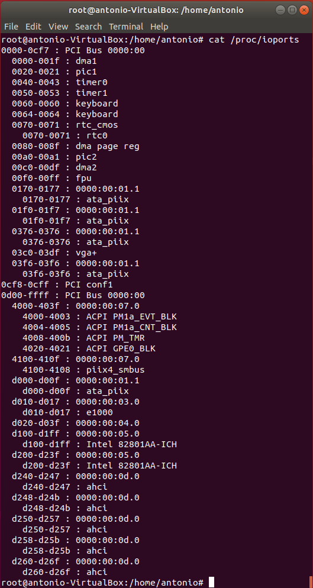
I/O Ports (4)
CPU Initiated Communication
You must be root!

Slide 21
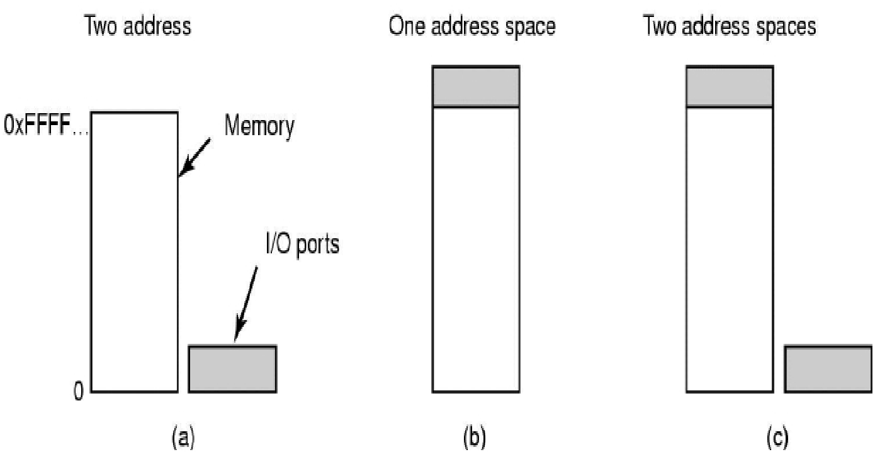
Memory-mapped I/O (1)
CPU Initiated Communication
All control registers and buffers into the memory space
Each control register is assigned a unique memory address
There is no actual RAM memory for this address
Such addresses may be at the top of the physical address space
Two address spaces
RAM Memory
Memory Mapped I/O
a) Separate I/O and memory space
b) Memory-mapped I/O
Notes:
Introduced with the PDP-11

Slide 22
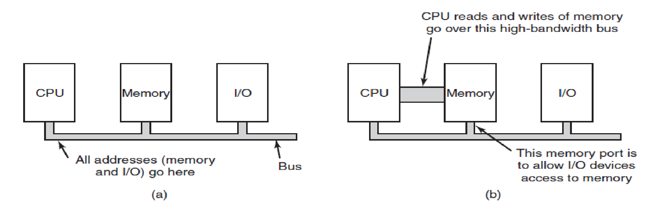
Memory-mapped I/O (2)
CPU Initiated Communication
bus
Memory
Address
Range
IO
Memory-mapped Address Range
Example 0 … 32GB 127.999TB … 128TB

Slide 23
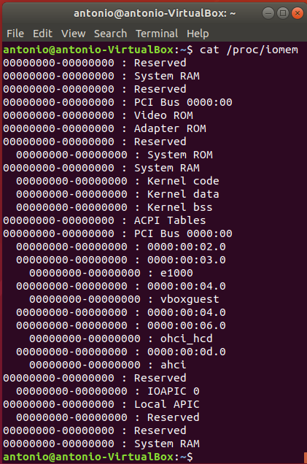
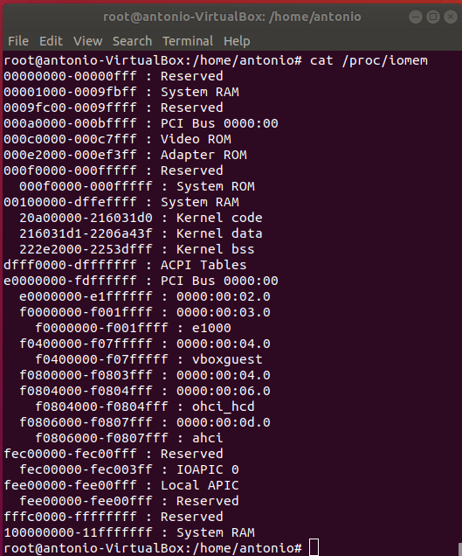

Memory-mapped I/O (3)
CPU Initiated Communication

Slide 24
Memory-mapped I/O (4)
CPU Initiated Communication
Advantages
Software can read/write to I/O Devices as to any other memory location
All memory instructions apply to I/O Devices’ as well
Ease to program, can be programmed in C/C++
Protection of I/O Devices’ registers and buffers is the same as memory protection
Can be accessed from kernel and user modes
Disadvantages
Need to disable caching to memory-mapped I/O
For one address, memory modules (memory controller) and I/O devices will examine all memory references
Notes:
Memory modules -> memory controller

Slide 25

Hybrid
CPU Initiated Communication
I/O ports and memory-mapped IO
Example
Memory-mapped I/O data buffers and separate I/O ports for the control registers
x86 CPUs, memory addresses 640K to 1M − 1 being reserved for device data buffers, in addition to I/O ports 0 to 64K − 1
Two address spaces
Separate I/O and memory space
Memory-mapped I/O
Hybrid

Slide 26
Hybrid
CPU Initiated Communication
CPU
Memory
IO
Memory bus
bridge
IO bus
IO
IO

Slide 27
How CPU Sends Data to I/O Device?
CPU Initiated Communication
CPU read a word, either from memory or I/O port
puts the address it needs on the bus’ address lines
asserts a READ signal on a bus’ control line
a second signal line to tell I/O space or memory space
If it is memory space, memory responds to request
If it is I/O space, I/O device responds to the request
If there is only memory space
Every memory module and every I/O device compares the address lines to the range of addresses that it services
If the address falls in its range, it responds to the request
Since no address is ever assigned to both memory and an I/O device, there is no ambiguity and no conflict

Slide 28
Offloaded Communication
The CPU can request data from an I/O controller one byte at a time
This wastes the CPU’s time
CPU offloads data transfers
DMA (Direct Memory Access) controller transfers data for the CPU
From/to an IO Device
Between IO Devices

Slide 29
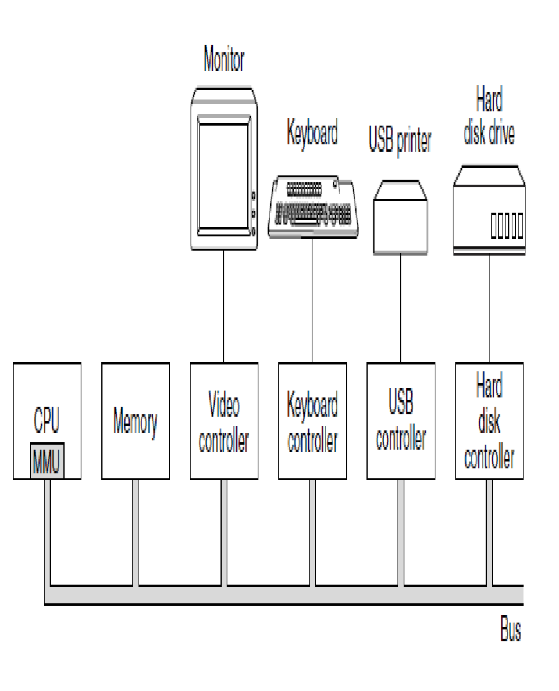
Direct Memory Access
device
device
Offloaded Communication
port
DMA Cntrl
DMA Cntrl
Requires a DMA controller
On the device host controller
On the motherboard
DMA controller contains registers to be read/written by the software
Memory address register
Byte count register
Control registers to
Direction of the transfer
Transfer unit
Byte burst size
…
port
PAST
PRESENT
DMA Cntrl
Notes:
No matter whether a CPU does or does not have memory-mapped I/O, it needs to address the device controllers to exchange data with them.

Slide 30
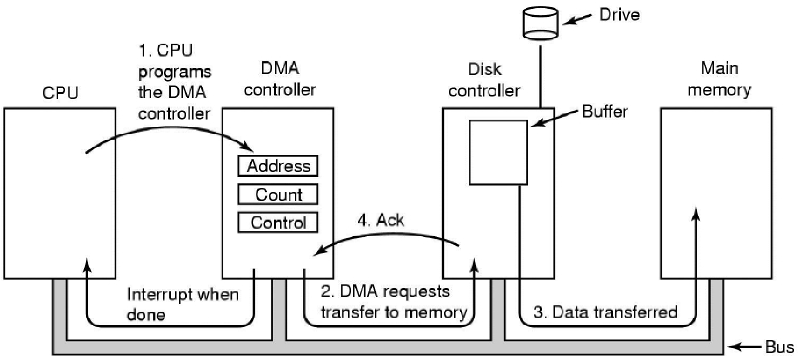
How Does DMA Work?
Offloaded Communication
CPU commands DMA controller by writing to control registers of DMA device
Example of a DMA transfer: transfer data from disk to memory (MOS Figure 5-4)
Notes:
The DMA controller initiates the transfer by issuing a read request over the bus to the disk controller (step 2). This read request looks like any other read request, and the disk controller does not know (or care) whether it came from the CPU or from a DMA controller. Typically, the memory address to write to is on the bus’ address lines, so when the disk controller fetches the next word from its internal buffer, it knows where to write it. The write to memory is another standard bus cycle (step 3). When the write is complete, the disk controller sends an acknowledgement signal to the DMA controller, also over the bus (step 4). The DMA controller then increments the memory address to use and decrements the byte count. If the byte count is still greater than 0, steps 2 through 4 are repeated until the count reaches 0. At that time, the DMA controller interrupts the CPU to let it know that the transfer is now complete. When the operating system starts up, it does not have to copy the disk block to memory; it is already there.

Slide 31
DMA Controller
Offloaded Communication
One data transfer at a time (1 channel)
Multiple data transfers at once (multiple channels)
Multiple sets of registers
One for each transfer channel
CPU loads all sets of registers
What request to serve next?
Round-robin
Priority schema
Notes:
the DMA controller decides which device to service next. It may be set up to use a round-robin algorithm, or it may have a priority scheme design to favor some devices over others. Multiple requests to different device controllers may be pending at the same time, provided that there is an unambiguous way to tell the acknowledgements apart. Often a different acknowledgement line on the bus is used for each DMA channel for this reason.

Slide 32
Data Transfer Bus Mode
Offloaded Communication
Word-at-a-time mode
DMA controller requests for transfer of one word
If the CPU wants the bus, it has to wait
Also called cycle stealing
Block mode
DMA controller acquires the bus, issues a series of transfers, and releases the bus
Also called burst mode
Advantage: takes less time for acquiring bus
Disadvantage: can block the CPU and other devices for a long time if a long burst
Notes:
Most DMA controllers use physical memory addresses for their transfers. OR IOMMU

Slide 33
Fly-by Mode vs Flow-through Mode
Offloaded Communication
Fly-by mode
DMA controller commands the device controller to transfer data directly to destination
Flow-through mode
Data transferred pass through the DMA controller
DMA controller first reads data into an internal buffer/register
and then writes it to the destination
This scheme requires an extra bus cycle per word transferred, but is more flexible, it can
perform device-to-device copies
memory-to-memory copies
Notes:
www.buzluca.info

Slide 34
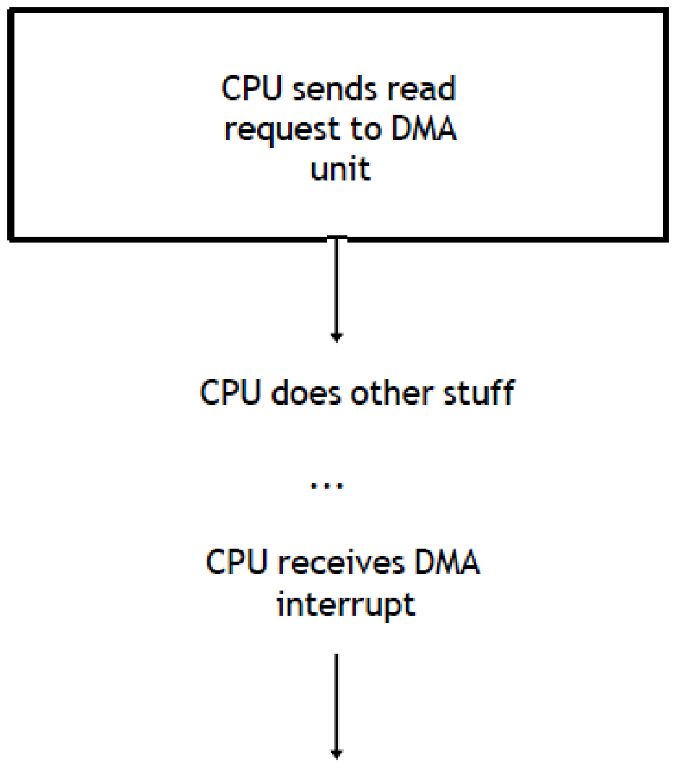
Why Is DMA Good?
Offloaded Communication
DMA controllers are able to read and write data directly from/to memory and/or IO devices
With no software intervention
DMA hardware enables the data transfer to be accomplished without using the CPU
If not for configuration
CPU notified DMA is finished

Slide 35
Question
Offloaded Communication
A DMA controller has five channels. The controller is capable of requesting a 32-bit word every 50 nsec. A response takes equally long. How fast does the bus have to be to avoid being a bottleneck?

Slide 36
Answer
Offloaded Communication
Each bus transaction has a request and a response, each taking 50 nsec, or 100 nsec per bus transaction. This gives 10 million bus transactions/sec. If each one is good for 4 bytes, the bus has to handle 40 MB/sec. The fact that these transactions may be sprayed over five I/O devices in round-robin fashion is irrelevant. A bus transaction takes 100 nsec, regardless of whether consecutive requests are to the same device or different devices, so the number of channels the DMA controller has does not matter. The bus does not know or care.

Slide 37
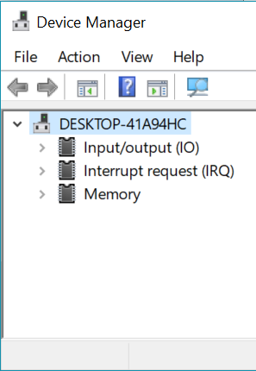
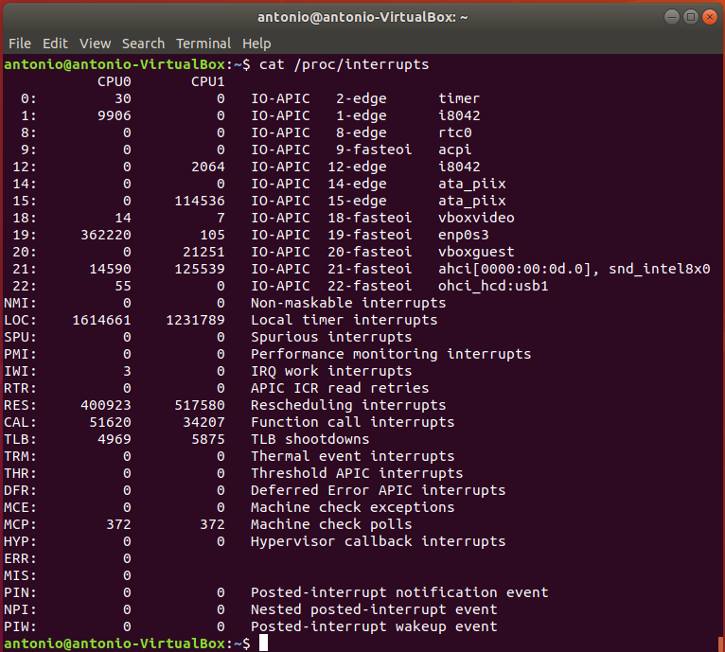
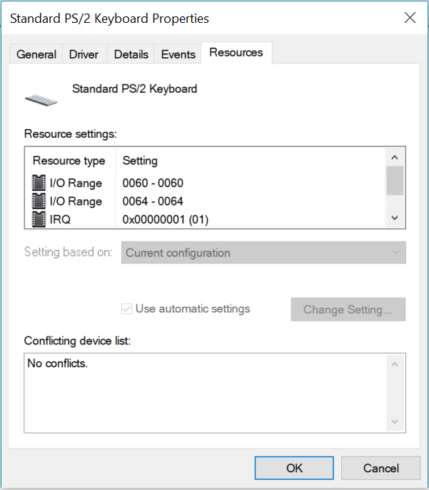
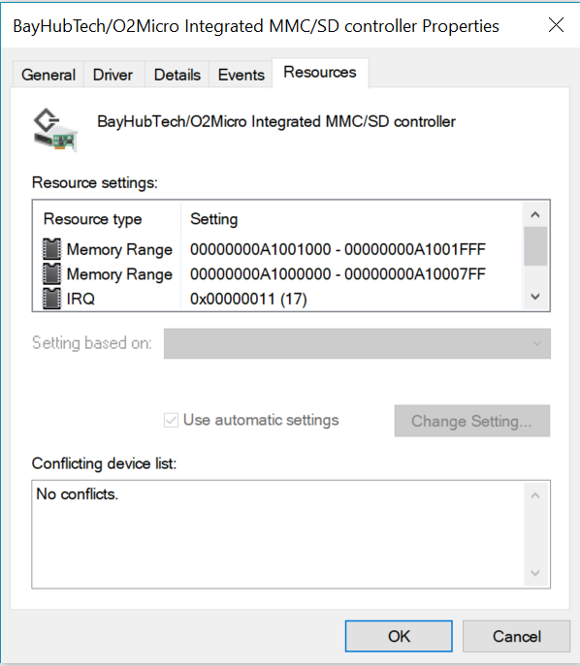
I/O Device Notification
Interrupts associated with IO Devices (but not only)
Windows
Linux
Notes:
IRQ numbering schema depends also on the OS

Slide 38
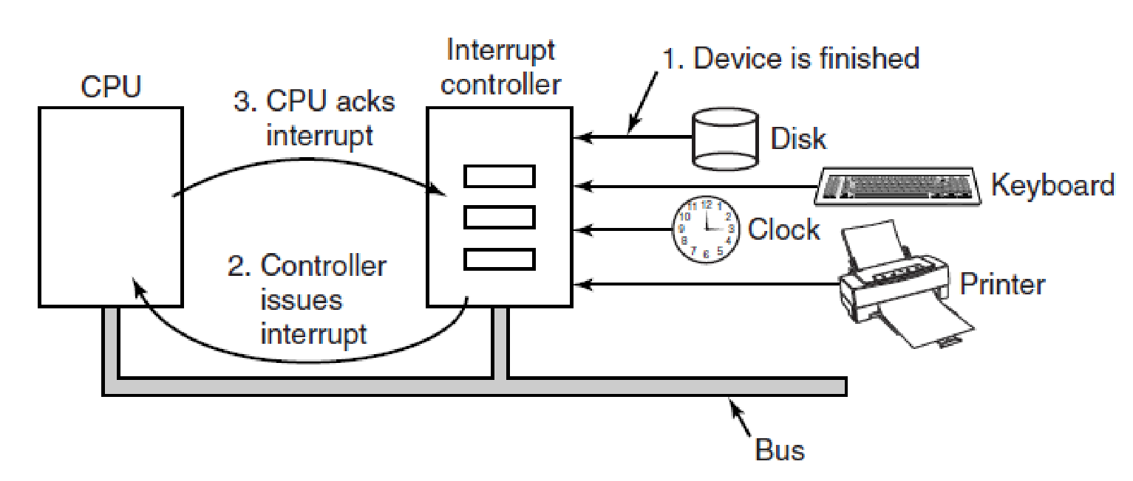
Interrupts
I/O Devices Notification
0. CPU configures
interrupt
How an interrupt happens. The connections between the devices and the interrupt controller actually use interrupt lines on the bus rather than dedicated wires. (MOS Figure 5-5. )
Notes:
At the hardware level, interrupts work as follows. When an I/O device has finished the work given to it, it causes an interrupt (assuming that interrupts have been enabled by the operating system). It does this by asserting a signal on a bus line that it has been assigned. This signal is detected by the interrupt controller chip on the parentboard, which then decides what to do. NEEDS UPDATES
If no other interrupts are pending, the interrupt controller handles the interrupt immediately. Howev er, if another interrupt is in progress, or another device has made a simultaneous request on a higher-priority interrupt request line on the bus, the device is just ignored for the moment. In this case it continues to assert an interrupt signal on the bus until it is serviced by the CPU.
To handle the interrupt, the controller puts a number on the address lines specifying which device wants attention and asserts a signal to interrupt the CPU.
The interrupt signal causes the CPU to stop what it is doing and start doing something else. The number on the address lines is used as an index into a table called the interrupt vector to fetch a new program counter. This program counter points to the start of the corresponding interrupt-service procedure. Typically traps and interrupts use the same mechanism from this point on, often sharing the same interrupt vector. The location of the interrupt vector can be hardwired into the machine or it can be anywhere in memory, with a CPU register (loaded by the operating system) pointing to its origin.
Shortly after it starts running, the interrupt-service procedure acknowledges the interrupt by writing a certain value to one of the interrupt controller’s I/O ports. This acknowledgement tells the controller that it is free to issue another interrupt. By having the CPU delay this acknowledgement until it is ready to handle the next interrupt, race conditions involving multiple (almost simultaneous) interrupts can be avoided. As an aside, some (older) computers do not have a centralized interrupt controller, so each device controller requests its own interrupts.

Slide 39
Types of Interrupts
I/O Devices Notification
Two types of interrupts
External Interrupts
Internal Interrupts
Processing any type of interrupt is almost identical
The interrupted program must be resumed after the interrupt is handled
Operating system is responsible to save the state
May introduce considerable overhead

Slide 40
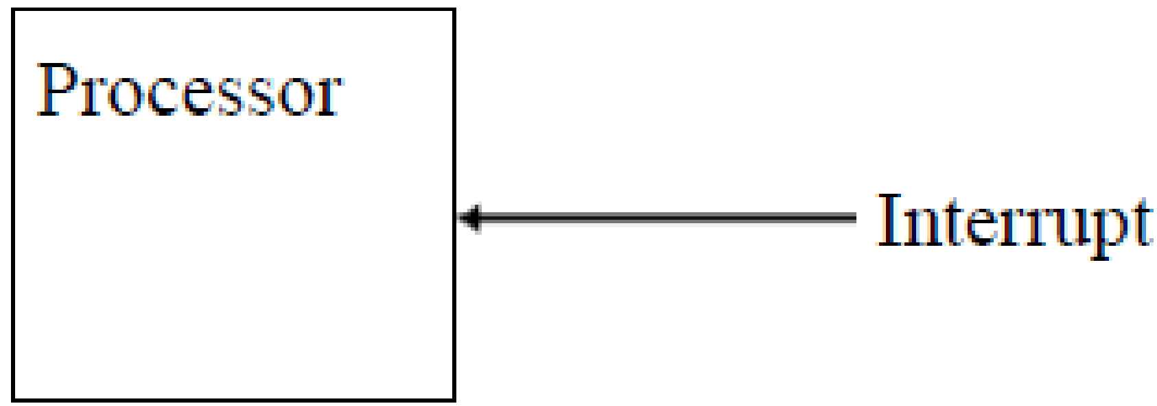
External Interrupts
I/O Devices Notification
To interact with I/O devices
Example: CPU requests a data transfer and the input device sends an interrupt when it is ready
External interrupts do not deal with CPU exceptions
They happen normally
All interrupts are recoverable

Slide 41
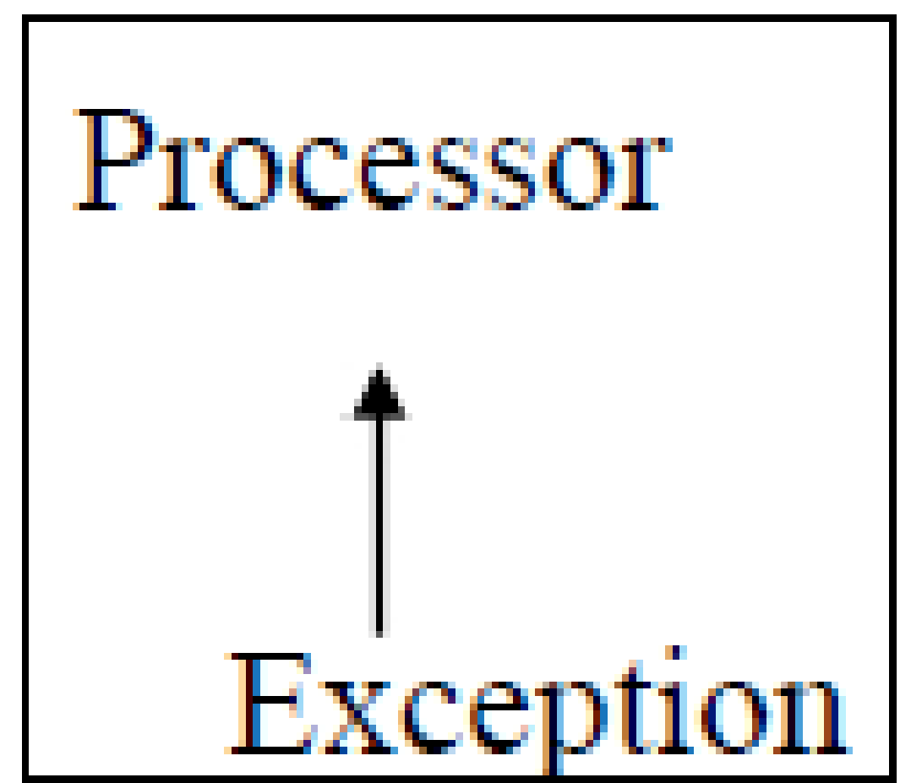
Internal Interrupts
I/O Devices Notification
Occurs entirely within the CPU
Used to handle exceptions that occur during the execution of invalid instructions; examples
Divide by zero exception
Arithmetic overflow
Page faults
Invalid instruction codes

Slide 42
Processing Interrupts
I/O Devices Notification
CPU “checks” interrupts after every instruction
In case of an interrupt, the hardware looks up the interrupt vector to fetch a new program counter
The new program counter is the interrupt handler (software interrupt service routine, ISR) is executed
CPU returns to where it left off in the previous program

Slide 43
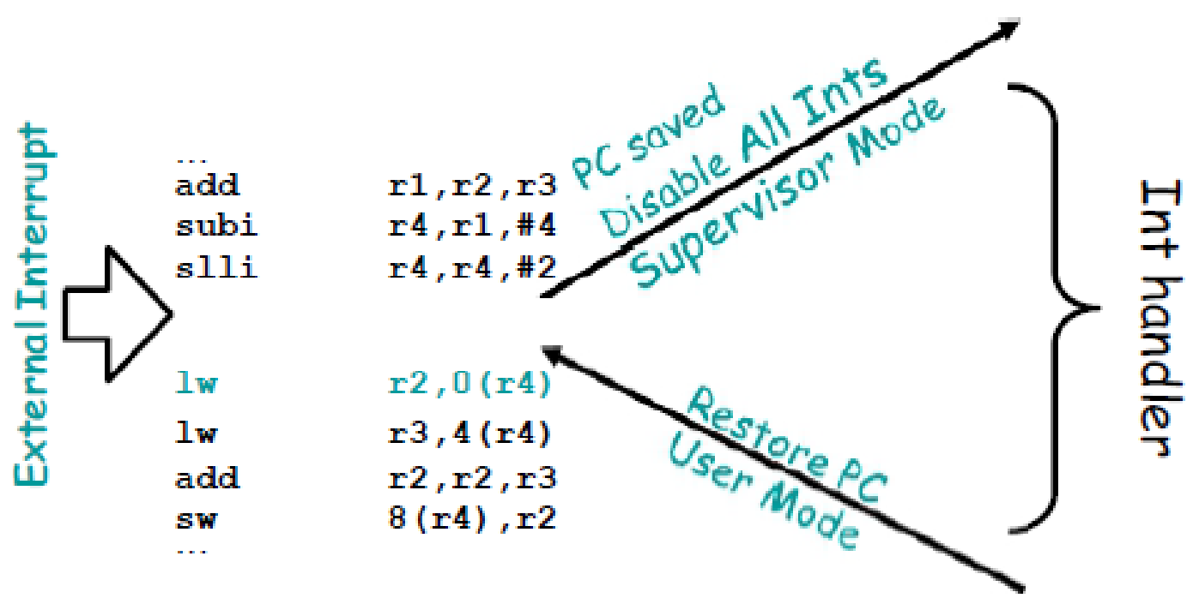
Precise Interrupts (1)
I/O Devices Notification
An interrupt is precise if there is a single instruction i for which
All instructions before i have committed
No instructions after i have executed at all
OS can restart execution at the interrupt point and “get the right answer”
Interrupt point is at first lw instruction

Slide 44
Precise Interrupts (2)
I/O Devices Notification
Leaves machine in well-defined state
Multiple properties (Walker and Cragon, 1995)
Program counter (PC) is saved in known place
All instructions before PC have been fully executed
No instruction beyond PC has been executed
State of instruction referenced by PC is known (executed or not)

Slide 45
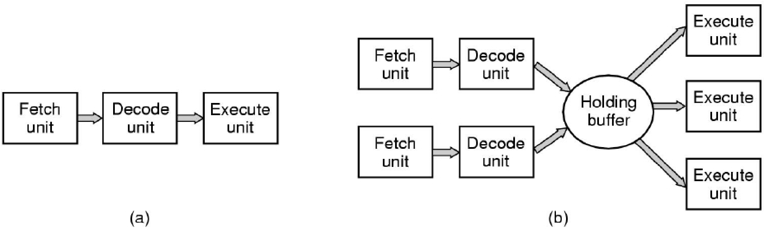
Pipelined and Superscalar CPUs
I/O Devices Notification
(a) A three-stage pipeline. Pipeline: execution multiple instructions at the same time
(b) A superscalar (internally parallel) CPU
Impact to interrupts: result in non-precise interrupts!

Slide 46
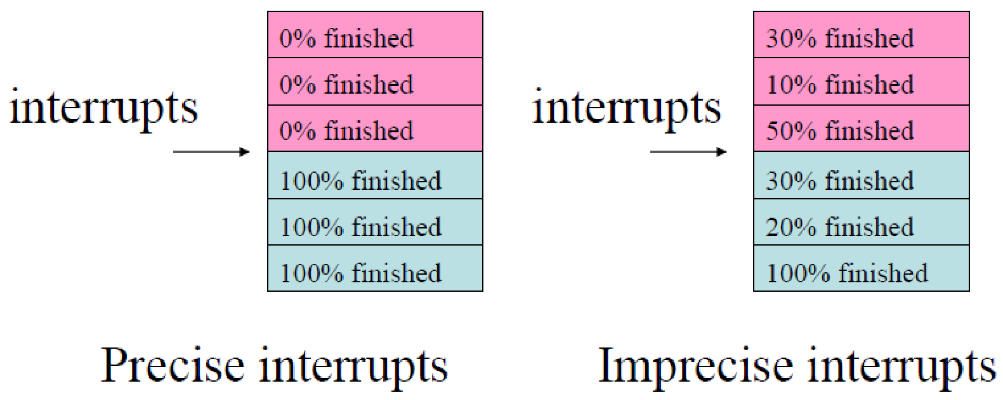
Imprecise Interrupts
I/O Devices Notification
An interrupt that is not ‘precise’
Because modern CPUs are pipelined or superscalar
Instructions may be partially executed, with different instructions being more or less complete
The program counter reflects the address of the next instruction to be fetched, NOT the address of the instruction that was just executed

Slide 47
What’s Out There?
I/O Devices Notification
CPUs may have precise and imprecise interrupts
CPU vendors found solutions to turn imprecise interrupts into precise ones
To help software handle interrupts consistently
Precise interrupts call for more complex pipeline/superscalar CPU implementation
In order to get performance as well as usability

Slide 48
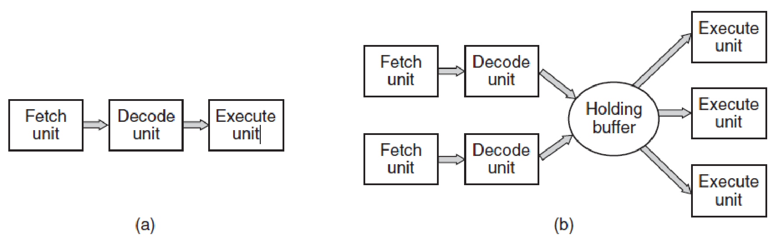
Question
I/O Devices Notification
A computer has a three-stage pipeline as shown in Fig. (a). On each clock cycle, one new instruction is fetched from memory at the address pointed to by the PC and put into the pipeline and the PC advanced. Each instruction occupies exactly one memory word. The instructions already in the pipeline are each advanced one stage. When an interrupt occurs, the current PC is pushed onto the stack, and the PC is set to the address of the interrupt handler. Then the pipeline is shifted right one stage and the first instruction of the interrupt handler is fetched into the pipeline. Does this machine have precise interrupts? Defend your answer.
(a) A three-stage pipeline. (b) A superscalar CPU.

Slide 49
Answer
I/O Devices Notification
Yes. The stacked PC points to the first instruction not fetched. All instructions before that have been executed and the instruction pointed to and its successors have not been executed. This is the condition for precise interrupts. Precise interrupts are not hard to achieve on machine with a single pipeline. The trouble comes in when instructions are executed out of order, which is not the case here.

Slide 50
What About the Software?

Slide 51
Goals I/O Software
Device Independence
Programs can access any IO device without having to specify the device in advance
Uniform Naming
Name of a file or device should be a string independently of device
Error Handling
Errors should be handled as close to the hardware as possible
Synchronous (blocking) vs asynchronous (interrupt-driven)
Most physical I/O is asynchronous
Buffering
involves considerable copying, may negatively impact I/O performance
Shareable vs Dedicated devices
Some I/O devices, like disks, can be used by many users at the same time
Other devices, such as printers, have to be dedicated to a single user
Notes:
For example, a program that reads a file as input should be able to read a file on a hard disk, a DVD, or on a USB stick without having to be modified for each different device.
If the controller discovers a read error, it should try to correct the error itself if it can. If it cannot, then the device driver should handle it, perhaps by just trying to read the block again

Slide 52
How Software Interacts with I/O?
Programmed I/O
CPU does all the work
Interrupt-driven I/O
CPU does the work
But interrupts tell when
I/O using DMA
DMA controller does all the work
It uses interrupts for notification
But CPU needs to program the DMA controller
Uses
I/O ports and/or memory-mapped I/O
Uses
I/O ports and/or memory-mapped I/O Interrupts
Uses
I/O ports and/or memory-mapped I/O Interrupts DMA

Slide 53
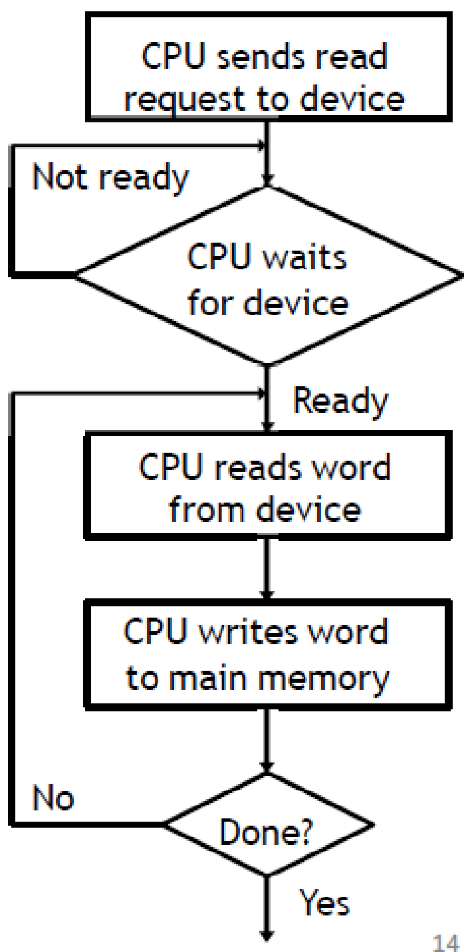
Programmed I/O (1)
CPU writes/reads a byte/word at a time
from/to main memory to/from device
CPU makes a request, then waits for the device to become ready
Buses are only byte/word wide, so the last few steps are repeated for large transfers
CPU time is wasted
If device is slow, the CPU may wait a long time
Applies to I/O Ports, Memory Mapped I/O, and Hybrid

Slide 54
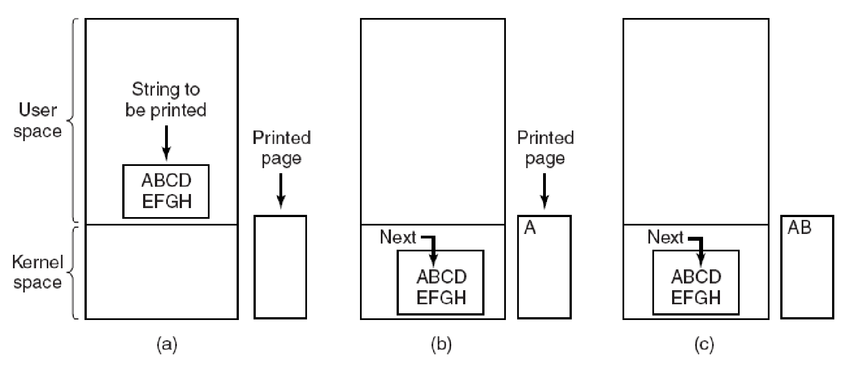
Programmed I/O (2)
Example
User process wants to print the string ‘‘ABCDEFGH’’ via a serial interface (one character at the time)
Steps in printing a string. (MOS Figure 5-7.)
Notes:
The software first assembles the string in a buffer in user space, as shown in Fig. 5-7(a).
The user process then acquires the printer for writing by making a system call to open it. If the printer is currently in use by another process, this call will fail and return an error code or will block until the printer is available, depending on the operating system and the parameters of the call. Once it has the printer, the user process makes a system call telling the operating system to print the string on the printer.
The operating system then (usually) copies the buffer with the string to an array, say, p, in kernel space, where it is more easily accessed (because the kernel may have to change the memory map to get at user space). It then checks to see if the printer is currently available. If not, it waits until it is. As soon as the printer is available, the operating system copies the first character to the printer’s data register, in this example using memory-mapped I/O. This action activates the printer. The character may not appear yet because some printers buffer a line or a page before printing anything. In Fig. 5-7(b), however, we see that the first character has been printed and that the system has marked the ‘‘B’’ as the next character to be printed.
As soon as it has copied the first character to the printer, the operating system checks to see if the printer is ready to accept another one. Generally, the printer has a second register, which gives its status. The act of writing to the data register causes the status to become not ready. When the printer controller has processed the current character, it indicates its availability by setting some bit in its status register or putting some value in it.

Slide 55
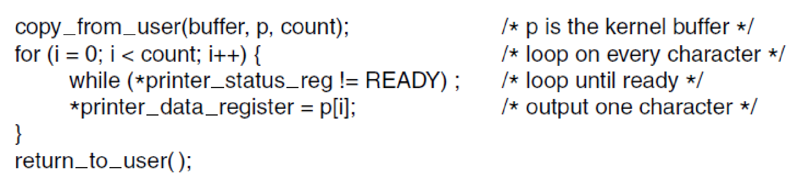
Programmed I/O (3)
CPU continuously polls the device to see if it is ready to accept another one
Polling or busy waiting
Figure 5-8. Writing a string to the printer using programmed I/O.
Is this using I/O port or memory-mapped I/O?

Slide 56
Programmed I/O (4)
Pros
Simple
Cons
CPU busy until I/O ends

Slide 57
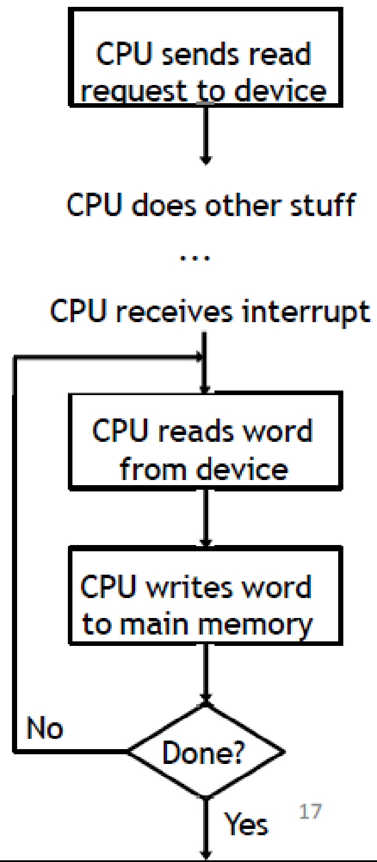
Interrupt-driven I/O (1)
Why interrupts?
I/O devices are slower than memory, or CPU
Uncertainty of when device will be ready
OS needs to know when
The I/O device has completed an operation
The I/O operation has encountered an error
Instead of waiting
The CPU continues with other computations
The device interrupts the processor when
Operation completes
There is an error

Slide 58
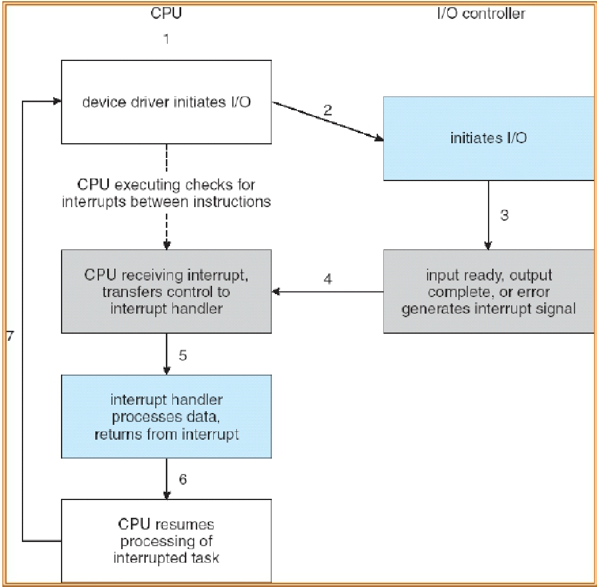
Interrupt-driven I/O (2)

Slide 59
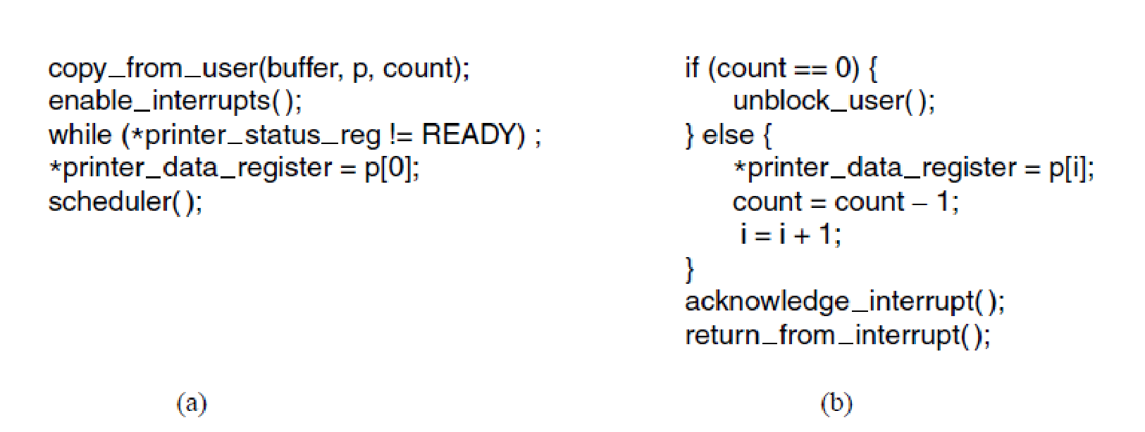
Interrupt-driven I/O (3)
Example
Printing on a printer that does not buffer characters but prints each one as it arrives (10ms/character)
Writing a string to the printer using interrupt driven I/O. (a) Code executed at the time the print system call is made. (b) Interrupt service procedure for the printer.
(MOS Figure 5-9.)
Notes:
If the printer can print, say 100 characters/sec, each character takes 10 msec to print. This means that after every character is written to the printer’s data register, the CPU will sit in an idle loop for 10 msec waiting to be allowed to output the next character. This is more than enough time to do a context switch and run some other process for the 10 msec that would otherwise be wasted.
The way to allow the CPU to do something else while waiting for the printer to become ready is to use interrupts. When the system call to print the string is made, the buffer is copied to kernel space, as we showed earlier, and the first character is copied to the printer as soon as it is willing to accept a character. At that point the CPU calls the scheduler and some other process is run. The process that asked for the string to be printed is blocked until the entire string has printed. The work done on the system call is shown in Fig. 5-9(a).
When the printer has printed the character and is prepared to accept the next one, it generates an interrupt. This interrupt stops the current process and saves its state. Then the printer interrupt-service procedure is run.
If there are no more characters to print, the interrupt handler takes some action to unblock the user. Otherwise, it outputs the next character, acknowledges the interrupt, and returns to the process that was running just before the interrupt, which continues from where it left off.

Slide 60
Interrupt-driven I/O (4)
Pros
Better than Programmed I/O
Cons
An interrupt occurs on every character
Interrupts take time, so it wastes CPU cycles

Slide 61
I/O Using DMA (1)
CPU sends read request to DMAC
Direct Memory Access (DMA)
Device read/write directly from/to memory
It has access to the system bus independent of the CPU
The CPU commands the operation
DMA does the transfer
When transfer is complete, DMAC notifies the CPU with an interrupt
CPU does other stuff
…
CPU receives interrupt

Slide 62
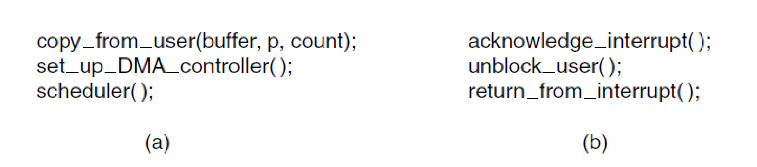
I/O Using DMA (2)
Syscall code
Interrupt handler code
Printing a string using DMA. (a) Code executed when the print system call is made. (b) Interrupt service procedure. (MOS Figure 5-10. )

Slide 63
Question
A typical printed page of text contains 50 lines of 80 characters each. Imagine that a certain printer can print 6 pages per minute and that the time to write a character to the printer’s output register is so short it can be ignored. Does it make sense to run this printer using interrupt-driven I/O if each character printed requires an interrupt that takes 50 μsec all-in to service?

Slide 64
Answer
The printer prints 50 x 80 x 6 = 24,000 characters/min, which is 400 characters/sec. Each character uses 50 μsec of CPU time for the interrupt, so collectively in each second the interrupt overhead is 20 msec. Using interrupt-driven I/O, the remaining 980 msec of time is available for other work. In other words, the interrupt overhead costs only 2% of the CPU, which will hardly affect the running program at all.

Slide 65
Summary

Slide 66
Summary (1)
Programmed I/O
Takes up a lot of CPU time!
Good for small data transfers
I/O Port
Devices and memory are accessed with different instructions
Different address spaces
Memory-mapped I/O
Each controller has registers and buffers that are part of the memory address space
Hybrid
I/O port and memory-mapped I/O on the same system

Slide 67
Summary (2)
Interrupt-driven I/O
CPU can do useful work while I/O is in operation
For each data transfer (word by word), the CPU need to intervene
Data transfer from I/O module to CPU then to memory (for read, vice versa for write)
The interrupt handling cost may be high
I/O using DMA
CPU gets interrupted at the end of the entire data transfer, but not for each data transfer
Good for large data transfers

