Slide 1
CS492 - Operating Systems Computer Hardware Review
Georgios Portokalidis & Jun Xu
Reading: MOS Ch 1.3
Slides credit: Antonio Barbalace

Slide 2
Content
Hardware Model
CPU
Memory
Cache
Multithread/Multicore CPUs
Disks
IO Devices, Interrupts
Buses

Slide 3
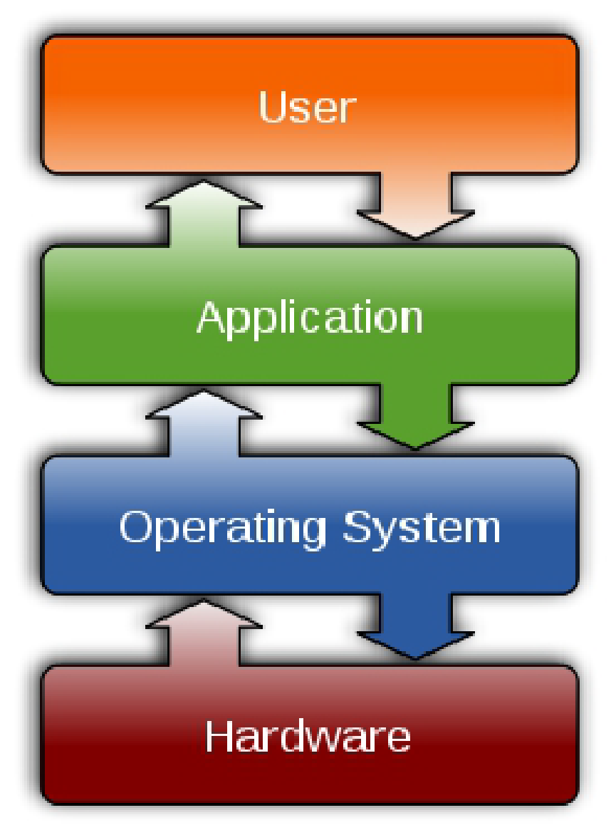
Why Computer Hardware Review?
The Operating System
Intimately tied to the hardware it runs on
Extends the computer’s instruction set and manages its resources
Syscalls
It must know a great deal about the hardware
at least about how the hardware appears to the programmer (abstractions)

Slide 4
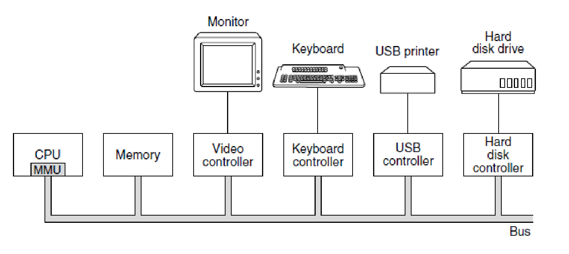
Hardware Model
Some of the components of a simple personal computer (MOS Figure 1-6)
Notes:
Very simplified and old view of computer hardware

Slide 5
Central Processing Unit (CPU) (1)
Brain of the computer
Fetches instructions from memory and executes them
Each CPU has a specific set of instructions (ISA)
An x86 processor cannot execute ARM programs
An ARM processor cannot execute x86 programs
CPU Registers
General registers
Program counter
Stack pointer
Program status word (PSW)
Notes:
Because fetching instructinos and data from memory takes a lot of time CPU operates on registers – internal memory location at the same speed of the CPU
Register are the fastest memory (faster than cache)
One of these is the program counter, which contains the memory address
of the next instruction to be fetched. After that instruction has been fetched,
the program counter is updated to point to its successor.
Another register is the stack pointer, which points to the top of the current
stack in memory. The stack contains one frame for each procedure that has been
entered but not yet exited. A procedure’s stack frame holds those input parameters,
local variables, and temporary variables that are not kept in registers.
Yet another register is the PSW (Program Status Word). This register contains
the condition code bits, which are set by comparison instructions, the CPU
priority, the mode (user or kernel), and various other control bits. User programs
may normally read the entire PSW but typically may write only some of its fields.
The PSW plays an important role in system calls and I/O.
The operating system must be fully aware of all the registers. When time multiplexing
the CPU, the operating system will often stop the running program to
(re)start another one. Every time it stops a running program, the operating system
must save all the registers so they can be restored when the program runs later.

Slide 6
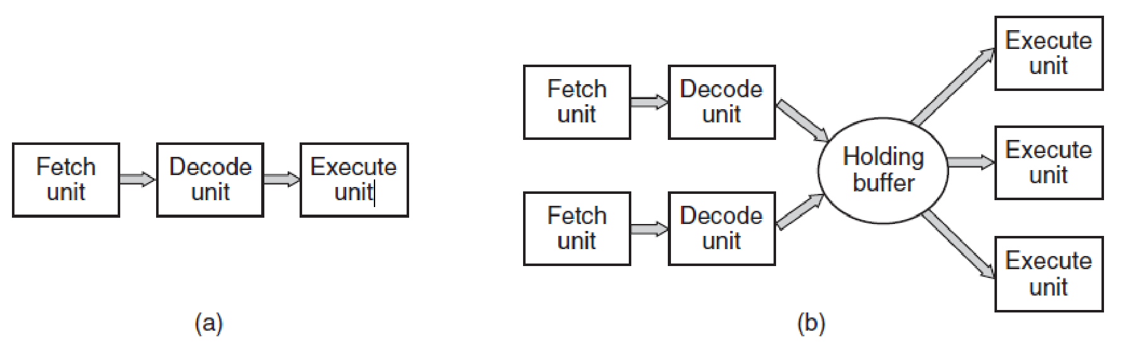
Central Processing Unit (CPU) (2)
CPU Code Execution
(a) A three-stage pipeline. (b) A superscalar CPU. (MOS Figure 1-7)
In-order execution
Out-of-order execution
Notes:
To improve performance, CPU designers have long abandoned the simple
model of fetching, decoding, and executing one instruction at a time. Many modern
CPUs have facilities for executing more than one instruction at the same time. For
example, a CPU might have separate fetch, decode, and execute units, so that while
it is executing instruction n, it could also be decoding instruction n + 1 and fetching
instruction n + 2. Such an organization is called a pipeline and is illustrated in
Fig. 1-7(a) for a pipeline with three stages. Longer pipelines are common. In most
pipeline designs, once an instruction has been fetched into the pipeline, it must be
executed, even if the preceding instruction was a conditional branch that was taken
Even more advanced than a pipeline design is a superscalar CPU, shown in
Fig. 1-7(b). In this design, multiple execution units are present, for example, one
for integer arithmetic, one for floating-point arithmetic, and one for Boolean operations.
Two or more instructions are fetched at once, decoded, and dumped into a
holding buffer until they can be executed. As soon as an execution unit becomes
available, it looks in the holding buffer to see if there is an instruction it can handle,
and if so, it removes the instruction from the buffer and executes it. An implication
of this design is that program instructions are often executed out of order. For
the most part, it is up to the hardware to make sure the result produced is the same
one a sequential implementation would have produced, but an annoying amount of
the complexity is foisted onto the operating system, as we shall see.

Slide 7
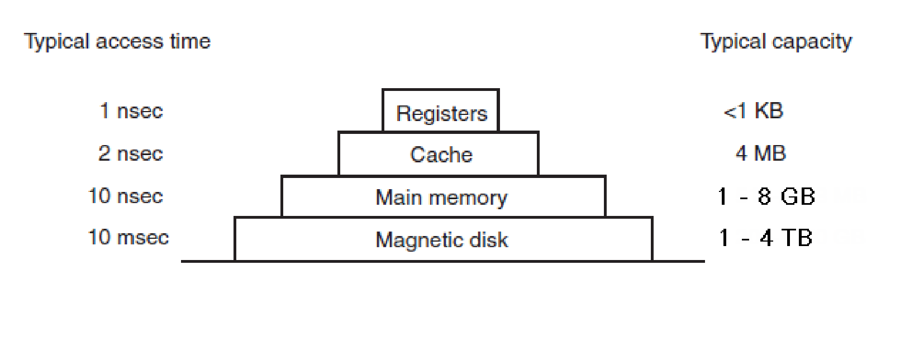
Memory (from the book)
Tape
A typical memory hierarchy. The numbers are very rough approximations. (MOS Figure 1-9)

Slide 8
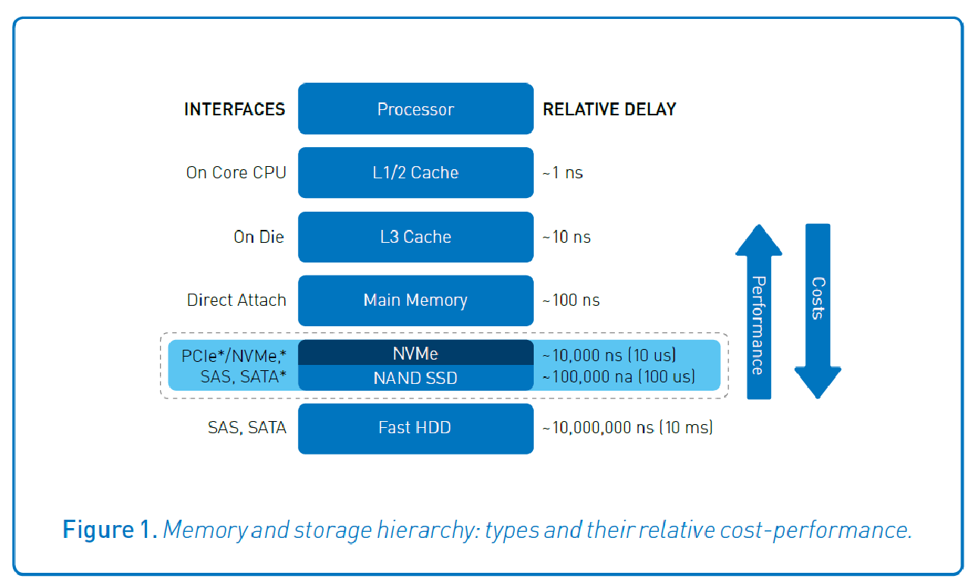
Memory (the reality)

Slide 9
Cache (1)
Temporarily holds a piece of data from a slower memory into a faster memory
Hardware cache
Software cache
Interface (when not transparent)
Get(), returns
Hit
Miss
Set()
Notes:
Hardware cache can be in the cpu cache but also in the disk cache (buffer cache)
Software cache there are million of example, we will se the page cache

Slide 10
Cache (2)
Questions when dealing with caches
When to put a new item into the cache?
Which cache slot to put the new item in?
Which item to remove from the cache when a slot is needed?
Where to put a newly evicted item in the larger memory?

Slide 11
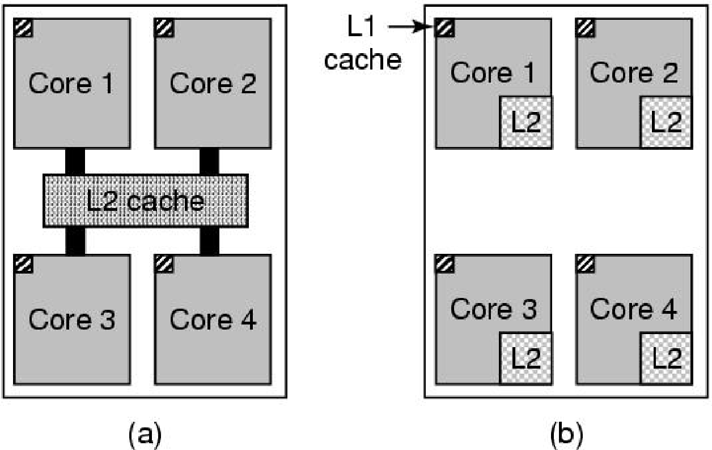
Multithreaded and Multicore Chips
(a) A quad-core chip with a shared L2 cache. (b) A quad-core chip with separate L2 caches. (MOS Figure 1-8)

Slide 12
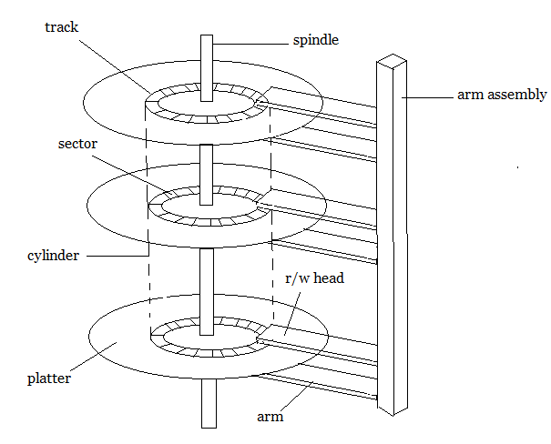
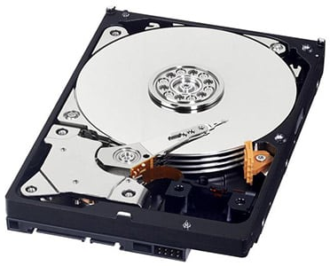
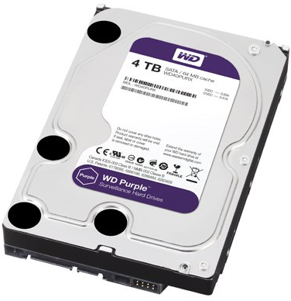
Disks (mechanical)
Hard Disk Drive (HDD)
https://www.studytonight.com/operating-system/images/secondary-storage-1.png
Notes:
A disk consists of one or more metal platters that rotate at 5400, 7200, 10,800 RPM or more.
Information is written onto the disk in a series of concentric circles. At any giv en
arm position, each of the heads can read an annular region called a track. Together,
all the tracks for a given arm position form a cylinder.
Each track is divided into some number of sectors, typically 512 bytes per sector.
On modern disks, the outer cylinders contain more sectors than the inner ones.
Moving the arm from one cylinder to the next takes about 1 msec. Moving it to a
random cylinder typically takes 5 to 10 msec, depending on the drive.

Slide 13
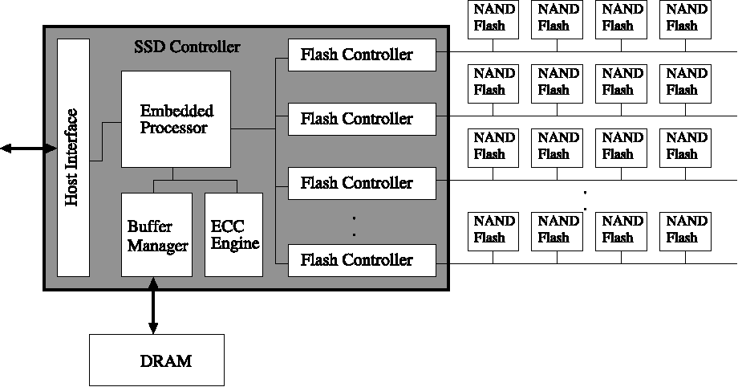
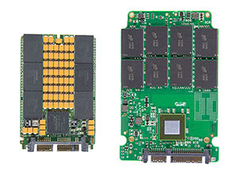
Disk (flash)
Solid State Disk (SSD)

Slide 14
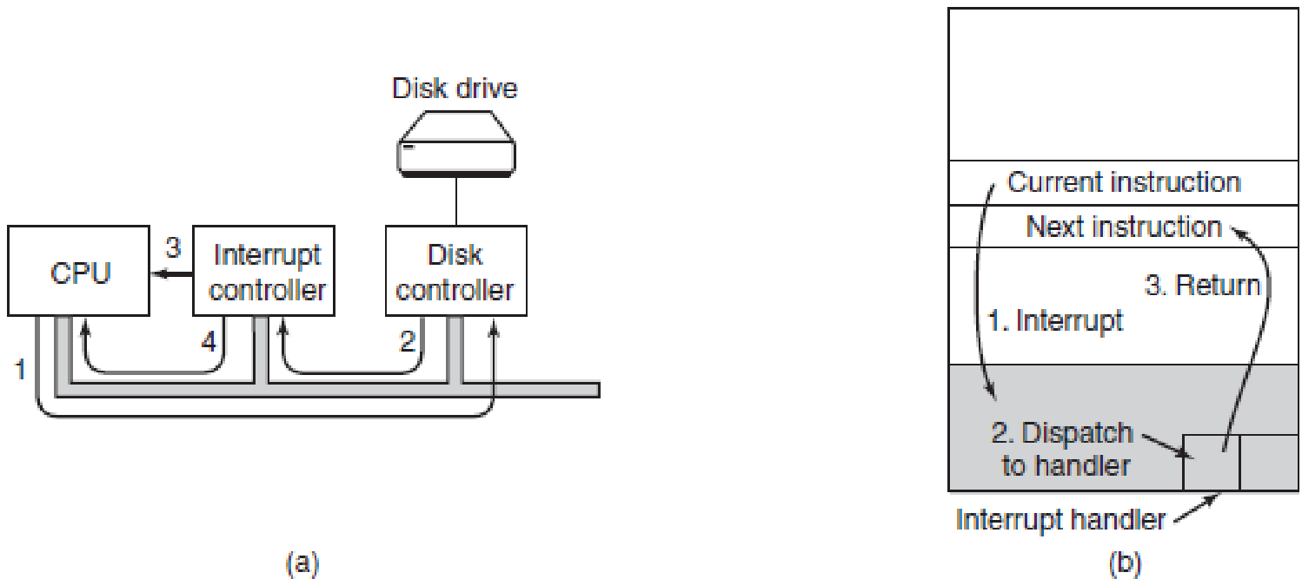
IO Devices
User
Kernel
(a) The steps in starting an I/O device and getting an interrupt. (b) Interrupt processing involves taking the interrupt, running the interrupt handler, and returning to the user program. (MOS Figure 1-11)

Slide 15
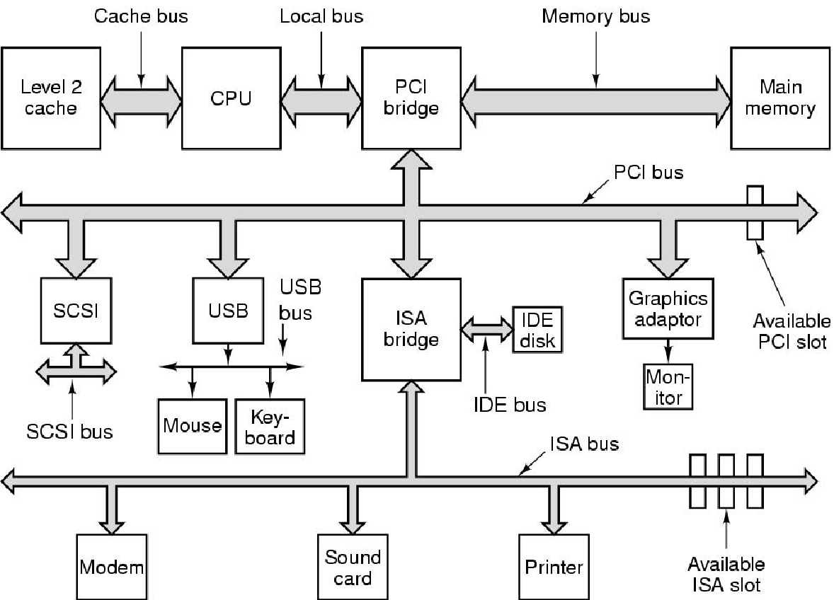
Buses (1)
Figure 1-12. The structure of a large Pentium system (MOS v3 Figure 1-12)

Slide 16
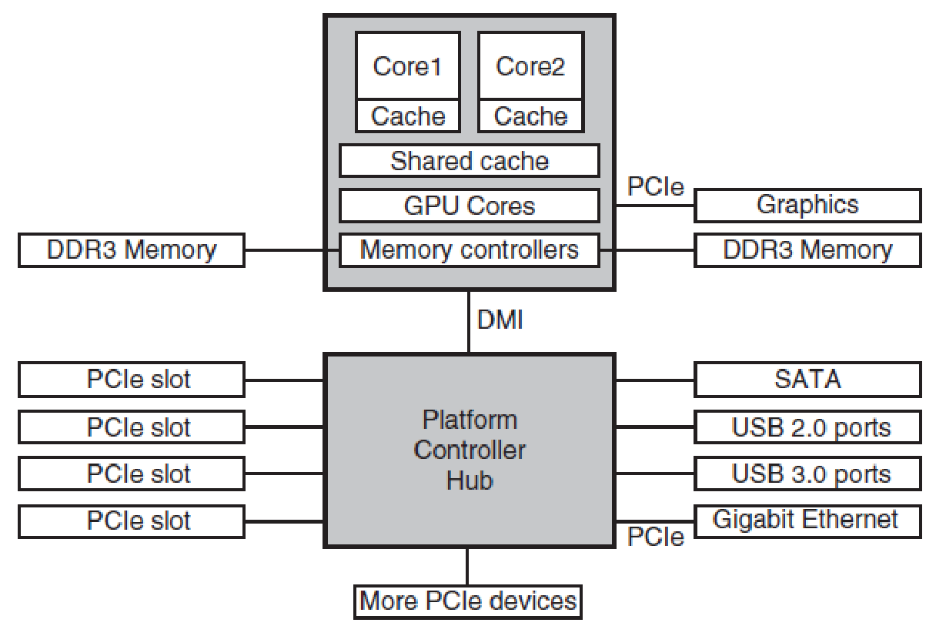
Buses (2)
Direct Media Interface (Intel’s proprietary protocol)
Figure 1-12. The structure of a large Pentium system (MOS v3 Figure 1-12)
Notes:
DMI: Direct Media Interface ? Front side bus, QPI, Hyper Transport, new versions of it

