Slide 1
CS492 - Operating Systems Scheduling
Georgios Portokalidis & Jun Xu
Zybook Ch. 3 MOS Ch. 2.4, 2.4.1-2.4.4
Slides credit: Antonio Barbalace

Slide 2
Concepts
The scheduling problem
How scheduling works
Properties and characteristics of scheduling algorithms
Scheduling algorithms for
Batch systems
Interactive systems
Real-time systems
Studying scheduling algorithms

Slide 3
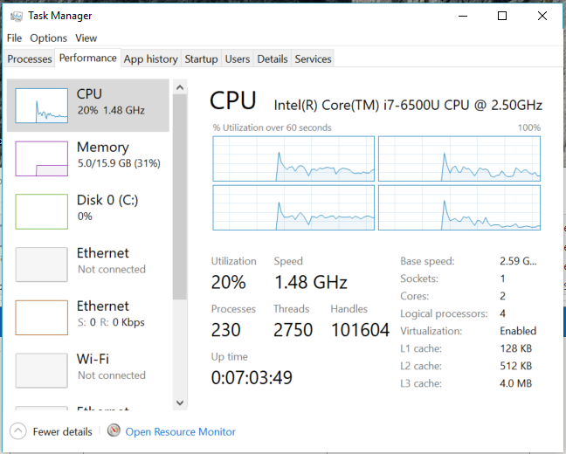
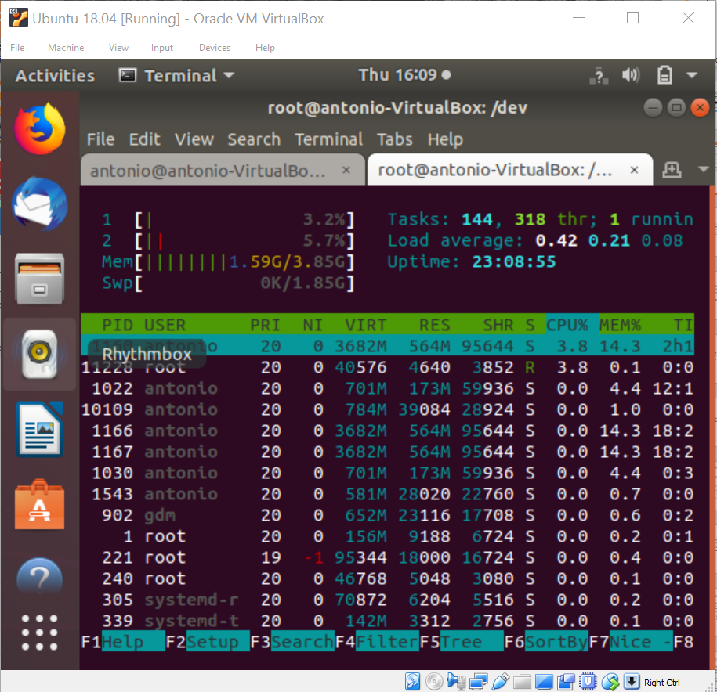
How Many Processes or Threads Are Running On My Computer?
UNIX’s htop
Windows’ Task Manager

Slide 4
Who is Running Next?
Multiple processes and threads are ready to run
Scheduling (the scheduler) decides who is next
In a single-CPU scenario one process or thread can be picked
In a multi-CPU scenario is much more complicated
K>1 processes or threads ready
N≥1 CPUs ( N may be < K)
Which processes or threads to assign to which CPU(s)?

Slide 5
Who is Running Next?
Multiple processes and threads are ready to run
Scheduling (the scheduler) decides who is next
In a single CPU scenario one process or thread can be picked
In a multi CPU scenario is much more complicated
K>1 processes or threads ready
N≥1 CPUs ( N may be < K)
Which processes or threads to assign to which CPU(s)?
Focus of This Slideset

Slide 6
Example Schedule (1 CPU)
Thread 1
Thread 2
Thread 3
Thread 4
Time
Waiting for CPU
Currently running
Blocked

Slide 7
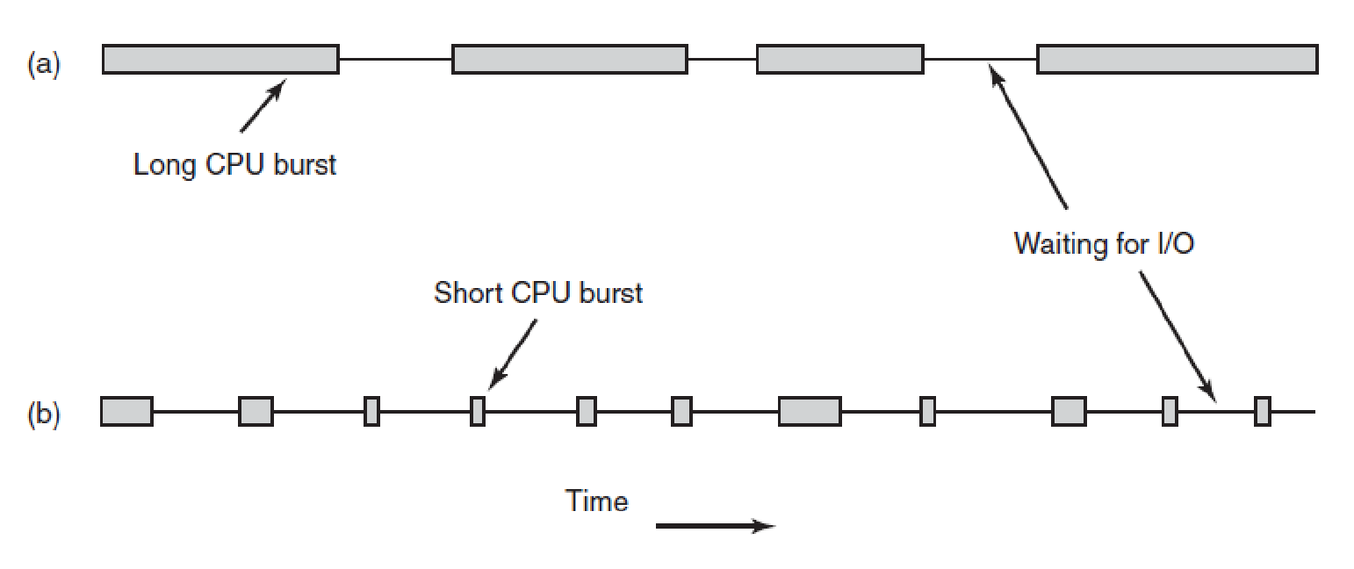
Process Behavior
Bursts of CPU usage alternate with periods of waiting for I/O.
(a) A CPU-bound process. (b) An I/O-bound process. (MOS Figure 2-39)
Notes:
A process is CPU-bound because it does a lot of compute and doesn’t call much IO operations. A process is IO-bound because it does few compute and calls IO operations a lot. But this is independent of the duration of the IO.

Slide 8
Process Behavior
Bursts of CPU usage alternate with periods of waiting for I/O.
(a) A CPU-bound process. (b) An I/O-bound process. (MOS Figure 2-39)
Notes:
A process is CPU-bound because it does a lot of compute and doesn’t call much IO operations. A process is IO-bound because it does few compute and calls IO operations a lot. But this is independent of the duration of the IO.

Slide 9
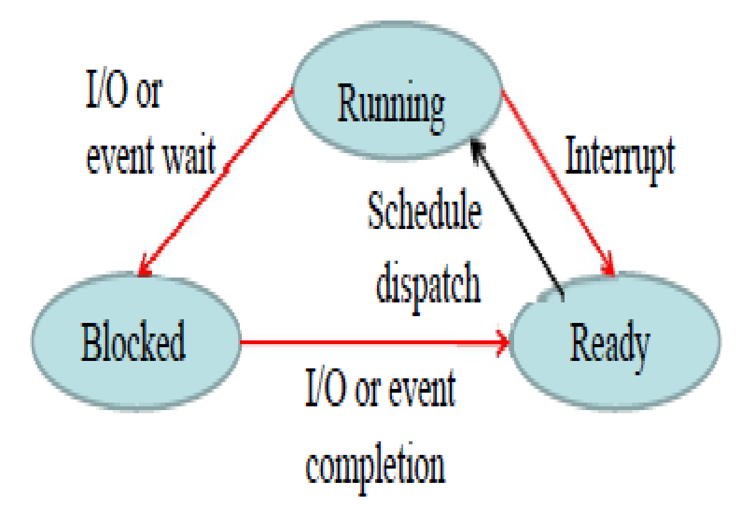
When to Schedule
Scheduling decisions may take place when a process/thread
Is created
At exits of running state
Blocks on I/O, or an event
Switch from Running to Blocked
Scheduling decisions may take place when an interrupt occurs
Clock interrupt
Switch from Running to Ready
I/O interrupt, or (unblocking) syscall
Switch from Blocked to Ready
Notes:
THIS GRAPH IS OF A TOY SYSTEM NOT A REAL ONE
When a process is created, should I run the parent or the child first?
When a process exits, because it will not run anymore, another must be selected; if no one exists, there’re is a system supplied one, the idle

Slide 10
Clock Interrupts
Scheduling takes place at clock interrupts
A way for a system to keep track of time
Interrupt at periodic intervals (clock tick), e.g., 1msec
Implemented using a hardware clock interrupt
High priority
However, Ivan Sutherland - Asynchronous Hardware
http://www.cs.virginia.edu/~robins/Computing_Without_Clocks.pdf

Slide 11
Non-preemptive vs Preemptive Scheduling
Non-preemptive scheduling
Processes execute until completion or until they want
Voluntary process switch
Process switch on blocking calls
The scheduler gets involved only at exit or on request
For every clock interrupt, running process keeps going
Preemptive scheduling
While a process executes, its execution may be paused, and another process resumes its execution, etc.
Involuntary process switch
For every clock interrupt, running process may be suspended and switched with another process (if there is any)

Slide 12
Categories of Scheduling Algorithms
Different environments require different scheduling algorithms
Different application areas have different goals
Environments
Batch Systems
Interactive Systems
Real-time Systems

Slide 13
Scheduling Algorithms Goals
All systems
Fairness - giving each process a fair share of the CPU
Policy enforcement - seeing that stated policy is carried out
Balance - keeping all parts of the system busy
Batch systems
Throughput - maximize jobs per hour
Turnaround time - minimize time between submission and termination
CPU utilization - keep the CPU busy all the time
Interactive systems
Response time - respond to requests quickly
Proportionality - meet user expectations
Real-time systems
Meeting deadlines - avoid losing data
Predictability - avoid quality degradation in multimedia systems

Slide 14
Basic Scheduling Algorithms
Batch Systems
First-come First-served (or First-in First-out)
Shortest Job First and Shortest Remaining Time Next
Interactive Systems
Round Robin
Priority (zyBook Multilevel Scheduling)
Multiple Queues (zyBook Multilevel with Feedback)
Shortest Process Next, Guarantee, Lottery, Fair-share
Real-time Systems
Fixed Priority
Dynamic Priority

Slide 15
Scheduling for Batch Systems

Slide 16
Scheduling in Batch Systems
Assumptions
How much time is needed to complete a job is maybe known ahead of time (necessary for SJF)
Scheduling goals
Throughput – maximize jobs per unit time (hour)
Turnaround time – minimize time user wait time for jobs
CPU utilization – keep the CPU as busy as possible
Algorithms
First-Come First-Served (FCFS)
Shortest job first (SJF)
Notes:
Batch systems - off-line, jobs come with resource estimates PLEASE THIS IS NOT TRUE!!!
EXPLAIN THAT THIS ASSUMPTION IS IN GENERAL WRONG

Slide 17
First-come First-served (FCFS)
Processes are assigned to the CPU in the order they request it (or they arrive)
Non-preemptive
Notes:
It is also fair in the same sense that allocating scarce concert
tickets or brand-new iPhones to people who are willing to stand on line starting at
2 A.M. is fair.
Unfortunately, first-come, first-served also has a powerful disadvantage. Suppose
there is one compute-bound process that runs for 1 sec at a time and many
I/O-bound processes that use little CPU time but each have to perform 1000 disk
reads to complete. The compute-bound process runs for 1 sec, then it reads a disk
block. All the I/O processes now run and start disk reads. When the compute-
bound process gets its disk block, it runs for another 1 sec, followed by all the
I/O-bound processes in quick succession.

Slide 18
FCFS Example (1)
Arrival order for the processes
P1, P2, P3
Process | CPU Time
P1 | 24
P2 | 3
P3 | 3

Slide 19
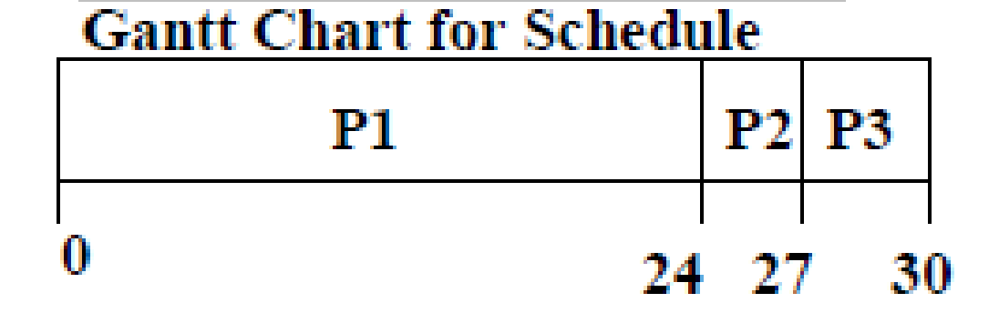
FCFS Example (1)
Arrival order for the processes
P1, P2, P3
Turnaround time
P1 = 24
P2 = 27
P3 = 30
Average turnaround time
(24+27+30)/3 = 27
Short process delayed by long process
Convoy effect
Process | CPU Time
P1 | 24
P2 | 3
P3 | 3
Turnaround Time – average time taken by a job to complete after submission

Slide 20
FCFS Example (2)
Arrival order for the processes
P2, P3, P1
Process | CPU Time
P2 | 3
P3 | 3
P1 | 24
Notes:
Previous slide it was 27

Slide 21
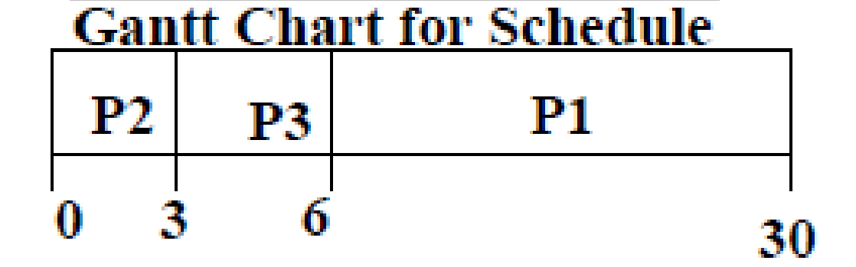
FCFS Example (2)
Arrival order for the processes
P2, P3, P1
Turnaround time
P1 = 30
P2 = 3
P3 = 6
Average turnaround time
(30+3+6)/3 = 13
Much better than the previous case
Process | CPU Time
P2 | 3
P3 | 3
P1 | 24
Notes:
Previous slide it was 27

Slide 22
Shortest Job First (SJF)
Associate with each process the length of its CPU time
Use the CPU time length to schedule the process with the shortest CPU time first
Two variations
Non-preemptive – once CPU is given to the process, it cannot be taken away until completion (or blocking)
Preemptive – if a new process arrives with CPU time less than the remaining time of current executing process, preempt. (Shortest Remaining Time Next, SRTN)

Slide 23
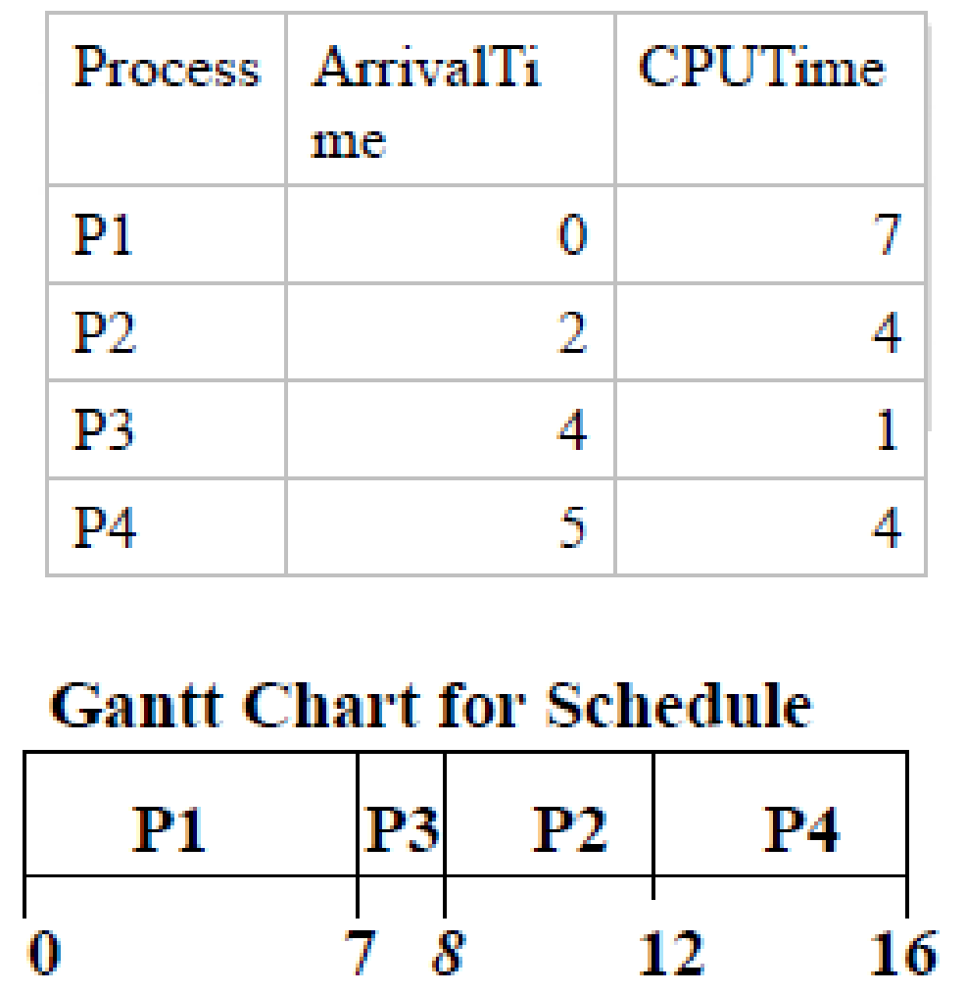
Non-Preemptive SJF Example
Arrival time for the processes
P1 at 0, P2 at 2, P3 at 4, P4 at 5

Slide 24
Non-Preemptive SJF Example
Arrival time for the processes
P1 at 0, P2 at 2, P3 at 4, P4 at 5
Turnaround time
P1 = 7
P2 = 12 – 2 = 10
P3 = 8 – 4 = 4
P4 = 16 – 5 = 11
Average turnaround time
(7+10+4+11)/4 = 8
3 ctx switches

Slide 25
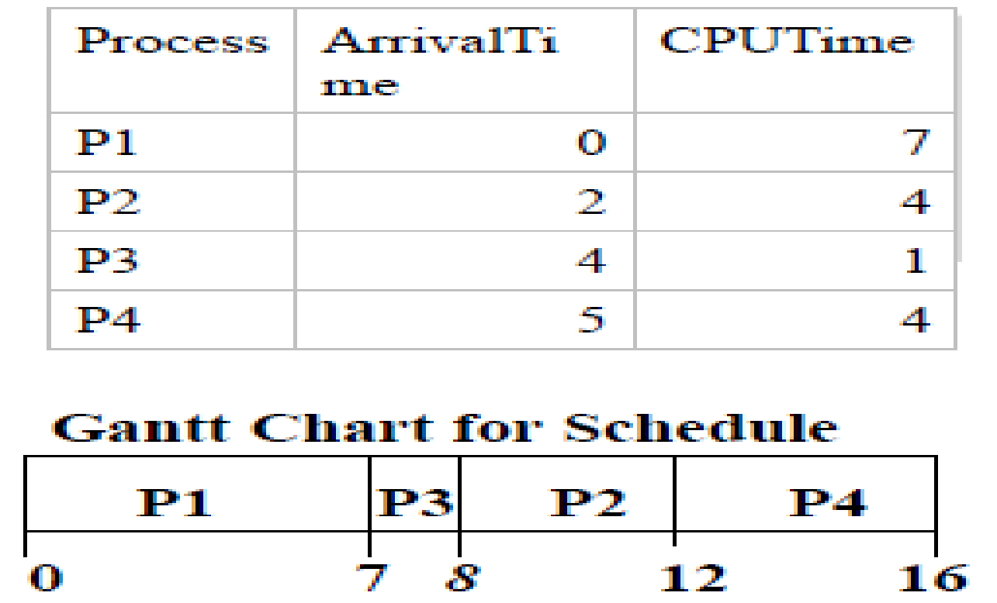
Preemptive SJF Example
Arrival time for the processes
P1 at 0, P2 at 2, P3 at 4, P4 at 5
Notes:
Better average but more context switches
?Preemptive SJF is optimal – gives minimum average turnaround time for a given set of processes.
Can use non-preemptive algorithms since this reduces process switching

Slide 26
Preemptive SJF Example
Arrival time for the processes
P1 at 0, P2 at 2, P3 at 4, P4 at 5
P1
0
2
Notes:
Better average but more context switches
?Preemptive SJF is optimal – gives minimum average turnaround time for a given set of processes.
Can use non-preemptive algorithms since this reduces process switching

Slide 27
Preemptive SJF Example
Arrival time for the processes
P1 at 0, P2 at 2, P3 at 4, P4 at 5
P1
P2
0
2
4
Notes:
Better average but more context switches
?Preemptive SJF is optimal – gives minimum average turnaround time for a given set of processes.
Can use non-preemptive algorithms since this reduces process switching

Slide 28
Preemptive SJF Example
Arrival time for the processes
P1 at 0, P2 at 2, P3 at 4, P4 at 5
P1
P2
P3
0
2
4
5
Notes:
Better average but more context switches
?Preemptive SJF is optimal – gives minimum average turnaround time for a given set of processes.
Can use non-preemptive algorithms since this reduces process switching

Slide 29
Preemptive SJF Example
Arrival time for the processes
P1 at 0, P2 at 2, P3 at 4, P4 at 5
P1
P2
P3
P2
0
2
4
5
7
Notes:
Better average but more context switches
?Preemptive SJF is optimal – gives minimum average turnaround time for a given set of processes.
Can use non-preemptive algorithms since this reduces process switching

Slide 30
Preemptive SJF Example
Arrival time for the processes
P1 at 0, P2 at 2, P3 at 4, P4 at 5
P1
P2
P3
P2
P4
0
2
4
5
7
11
Notes:
Better average but more context switches
?Preemptive SJF is optimal – gives minimum average turnaround time for a given set of processes.
Can use non-preemptive algorithms since this reduces process switching

Slide 31
Preemptive SJF Example
Arrival time for the processes
P1 at 0, P2 at 2, P3 at 4, P4 at 5
P1
P2
P3
P2
P4
P1
0
2
4
5
7
11
16
Notes:
Better average but more context switches
?Preemptive SJF is optimal – gives minimum average turnaround time for a given set of processes.
Can use non-preemptive algorithms since this reduces process switching

Slide 32
Preemptive SJF Example
Arrival time for the processes
P1 at 0, P2 at 2, P3 at 4, P4 at 5
Turnaround time
P1 = 16
P2 = 7 – 2 = 5
P3 = 5 – 4 = 1
P4 = 11 – 5 = 6
Average turnaround time
(16+5+1+6)/4 = 7
5 ctx switches
P1
P2
P3
P2
P4
P1
0
2
4
5
7
11
16
Notes:
Better average but more context switches
?Preemptive SJF is optimal – gives minimum average turnaround time for a given set of processes.
Can use non-preemptive algorithms since this reduces process switching

Slide 33
Preemptive SJF Example
Starvation
A process may be starved of the processor if short processes keep arriving
In this example P1
P1
P2
P3
P2
P4
0
2
4
5
7
11
P5 | 11 | 2
P6 | 13 | 2
... | ... | ...
Notes:
Better average but more context switches
?Preemptive SJF is optimal – gives minimum average turnaround time for a given set of processes.
Can use non-preemptive algorithms since this reduces process switching

Slide 34
Scheduling in Interactive Systems

Slide 35
Scheduling in Interactive Systems
Assumptions
none
Scheduling goals
Response time – respond quickly to user’s requests
Proportionality – meet users’ expectations
Algorithms
Round-robin Scheduling
Priority Scheduling (zyBook Multilevel Scheduling)
Multiple Queues (zyBook Multilevel with Feedback)

Slide 36
Round-robin (RR)
Each process is allowed to run for a specified time interval
Called quantum
After this time has elapsed
The process is preempted
And added to the end of the ready queue
The next process is scheduled
If the process terminates or blocks before this time
The next process is scheduled
Notes:
One of the oldest, simplest, fairest, and most widely used algorithms is round
robin.

Slide 37
Round-robin Example
Process | CPU time
P1 | 53
P2 | 8
P3 | 68
P4 | 24
Time Quantum = 20

Slide 38
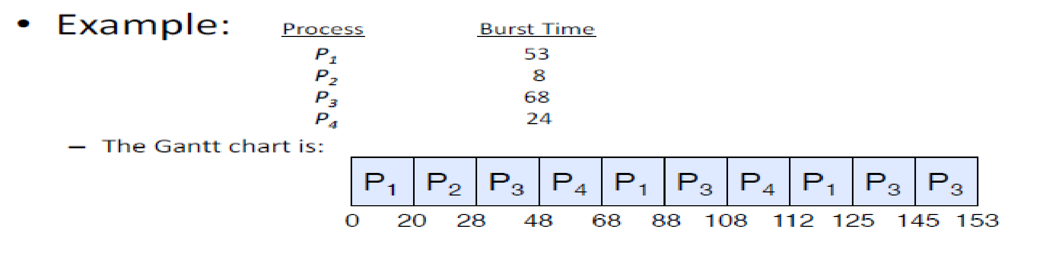
Round-robin Example
Process | CPU time
P1 | 53
P2 | 8
P3 | 68
P4 | 24
Time Quantum = 20

Slide 39
Round-robin Example
Process | CPU time
P1 | 53
P2 | 8
P3 | 68
P4 | 24
Time Quantum = 20
Waiting time for
P1=(68-20)+(112-88)=72
P2=(20-0)=20
P3=(28-0)+(88-48)+(125-108)=85
P₄=(48-0)+(108-68)=88
Average waiting time (72+20+85+88)/4=66.25
Average turnaround time (125+28+153+112)/4=104.5

Slide 40
What About the Time Quantum?
Context switching may impact the choice of the time quantum
Example:
Context switch is 1ms
Time quantum is 4ms
20% of the time is thrown away context switching
Typical numbers
Context switch is in the order of ms
Timeslice/quantum is 100Hz-250Hz (10ms-25ms)
When there are a lot of processes, a long time quantum causes a poor response time
Notes:
To improve the CPU efficiency, we could set the quantum to, say, 100 msec.
Now the wasted time is only 1%.
But consider what happens on a server system if
50 requests come in within a very short time interval and with widely varying CPU
requirements. Fifty processes will be put on the list of runnable processes. If the
CPU is idle, the first one will start immediately, the second one may not start until
100 msec later, and so on. The unlucky last one may have to wait 5 sec before getting
a chance, assuming all the others use their full quanta.

Slide 41
Example: Time Quantum = 100ms
If a context switch takes 1ms, waste is approx 1%
Good!
However, consider a server system where 50 requests arrive within a short time interval and they all use their time quantum
When will the 50th process get to start running?
Notes:
To improve the CPU efficiency, we could set the quantum to, say, 100 msec.
Now the wasted time is only 1%.
But consider what happens on a server system if
50 requests come in within a very short time interval and with widely varying CPU
requirements. Fifty processes will be put on the list of runnable processes. If the
CPU is idle, the first one will start immediately, the second one may not start until
100 msec later, and so on. The unlucky last one may have to wait 5 sec before getting
a chance, assuming all the others use their full quanta.

Slide 42
Example: Time Quantum = 100ms
If a context switch takes 1ms, waste is approx 1%
Good!
However, consider a server system where 50 requests arrive within a short time interval and they all use their time quantum
When will the 50th process get to start running?
5 seconds!
Notes:
To improve the CPU efficiency, we could set the quantum to, say, 100 msec.
Now the wasted time is only 1%.
But consider what happens on a server system if
50 requests come in within a very short time interval and with widely varying CPU
requirements. Fifty processes will be put on the list of runnable processes. If the
CPU is idle, the first one will start immediately, the second one may not start until
100 msec later, and so on. The unlucky last one may have to wait 5 sec before getting
a chance, assuming all the others use their full quanta.

Slide 43
What About Round-robin?
Advantages
Solution to fairness and starvation
Fair allocation of CPU across jobs
Low average waiting time when job lengths vary
Good for responsiveness (interactivity) if small number of jobs
Disadvantages
Context-switching time may add up for long jobs
Notes:
The conclusion can be formulated as follows: setting the quantum too short
causes too many process switches and lowers the CPU efficiency, but setting it too
long may cause poor response to short interactive requests. A quantum around
20–50 msec is often a reasonable compromise.

Slide 44
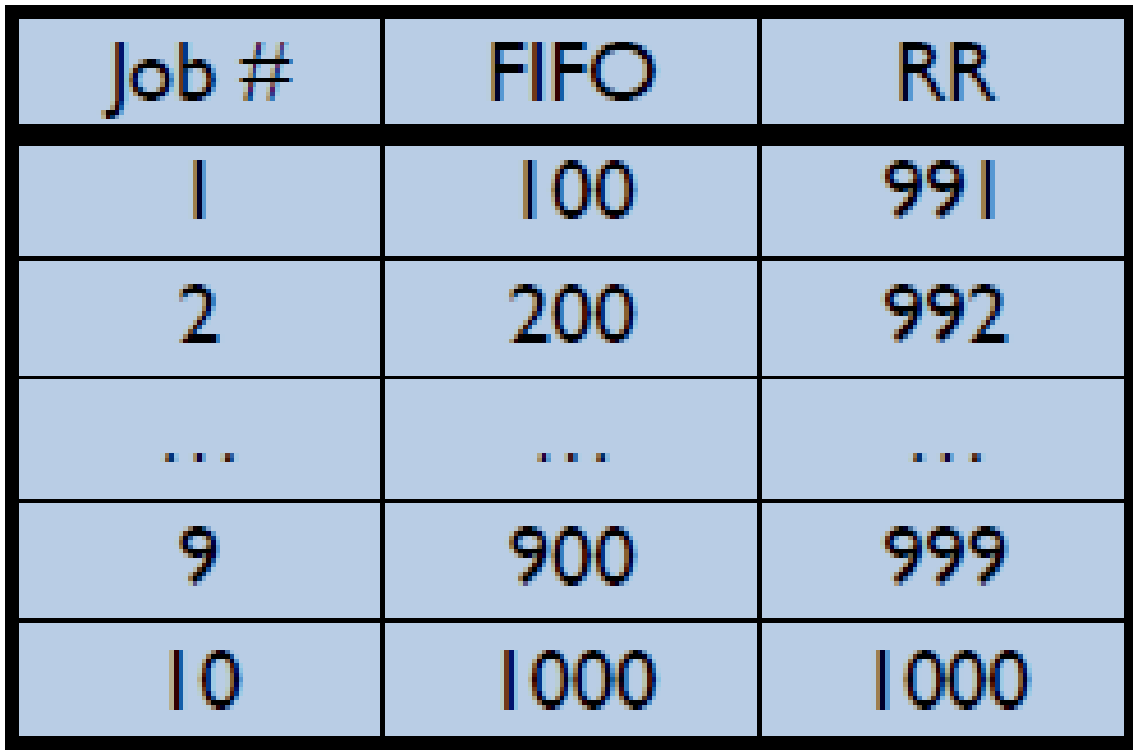
FCFS vs RR
Assuming zero-cost context-switching time, is RR better than FCFS?
Simple example
10 jobs, each take 100s of CPU time
RR scheduler quantum of 1s
All jobs start at the same time
Turnaround Times
Both RR and FCFS finish at the same time
Average turnaround time is much worse under RR
Bad when all jobs are the same length
Cache state must be shared between all jobs (may slow down RR execution)
Total time for RR longer even for zero-cost switch

Slide 45
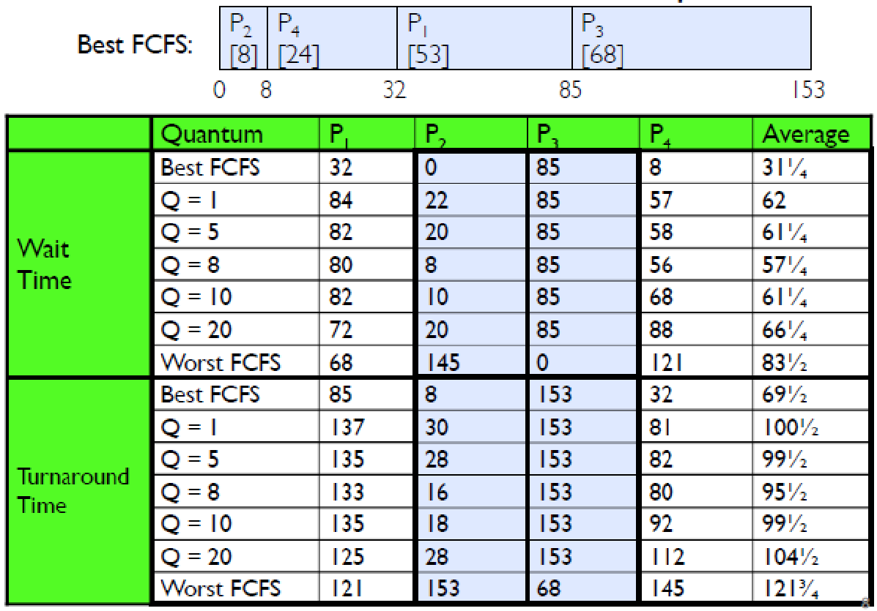
FCFS vs RR with Different Quantums

Slide 46
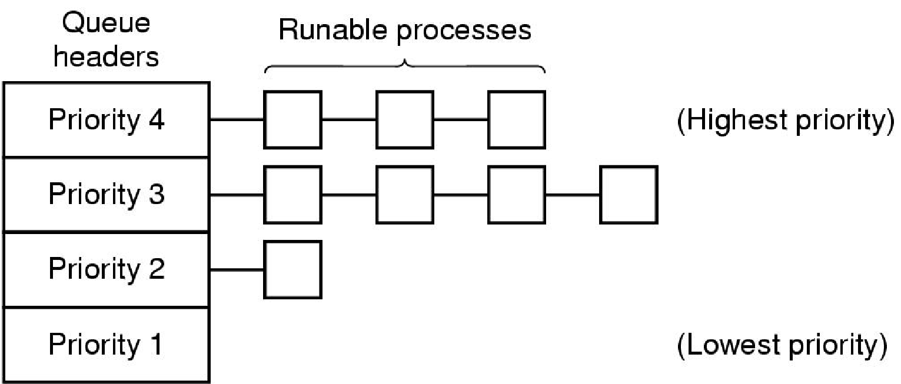
Priority (PRIO) (1)
(Round-robin)
1
2
3
4
A scheduling algorithm with four priority classes. (MOS Figure 2-42)

Slide 47
Priority (PRIO) (2)
Execution Plan
Always execute highest-priority runnable jobs to completion
Each queue processed in Round-Robin fashion with a time quantum
Problems
Starvation
Lower priority jobs don’t get to run because higher priority tasks always running
Deadlock
Priority Inversion
Not strictly a problem with priority scheduling
Happens when low priority task has lock needed by high-priority task (busy waiting)

Slide 48
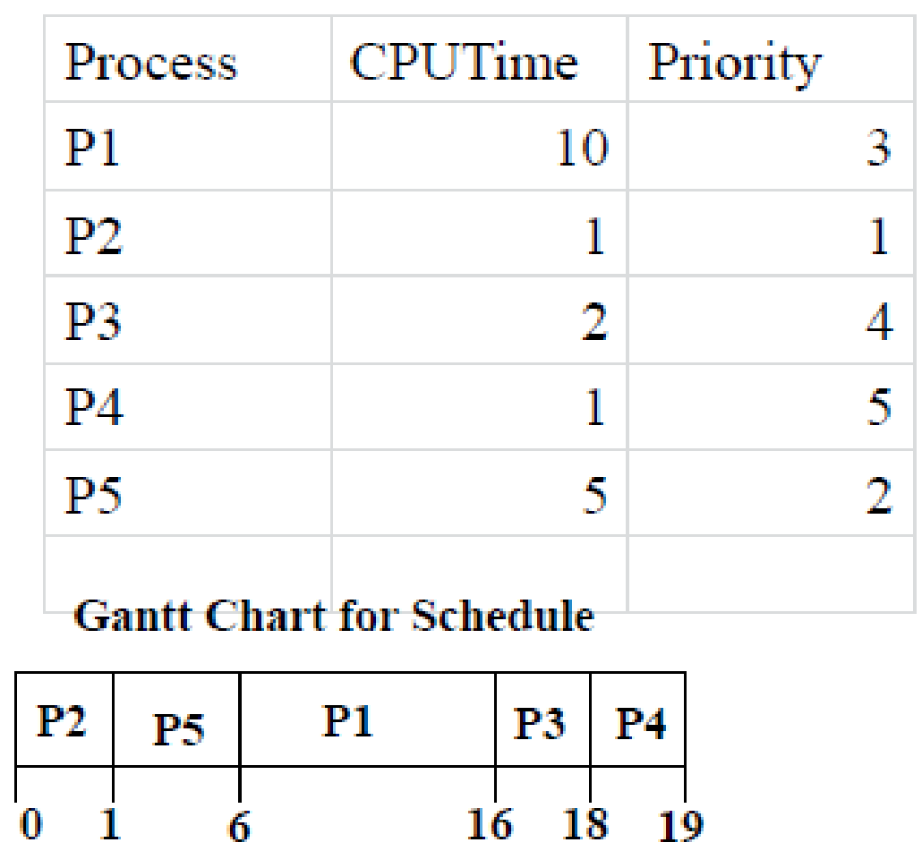
Priority Example (1)

Slide 49
Priority Example (1)

Slide 50
Priority Example (1)
Turnaround time
P1 = 16
P2 = 1
P3 = 18
P4 = 19
P5 =6
Average turnaround time (16+1+18+19+6)/5 = 12

Slide 51
Priority Example (2)
Turnaround time
P1 = 19
P2 = 1
P3 = 10
P4 = 11
P5 = 6
Average turnaround time (19+1+10+11+6)/5 = 9.4
Process | CPU time | Priority
P1 | 10 | 3
P2 | 1 | 1
P3 | 2 | 3
P4 | 1 | 3
P5 | 5 | 2
P2
P5
P1
P3
P4
P1
0
1
6
8
10
11
19
Quantum = 2

Slide 52
How to Assign Priorities?
Statically, based on
Process type
User
How much the user paid
Dynamically, based on how much they run vs I/O
Priority = 1/f
f = size of quantum used last
The longer a process ran, the lower its priority
The process that runs the shortest gets highest priority to run next
Notes:
- Process type, just group the processes in priority classes
- User, in the sense that if you are in a school the president max priority, than the provost … dean … student
- There can be a cloud model in which each user may pay to be executed at a certain priority
- Dynamically based on how much they run vs how much they do IO, and this is the 1/f model

Slide 53
Multiple Queues (MQ) (1)
Execution Plan
Same as Priority scheduling
But each queue has a different time quantum
Shortest for high-prio
Longer for low-prio
Processes start at the highest priority
When a process exceeds its quanta is moved to the lower priority
When a process becomes interactive is moved to higher priority
Problem
If the user discovers how to make his/her tasks interactive he/she can play the system

Slide 54
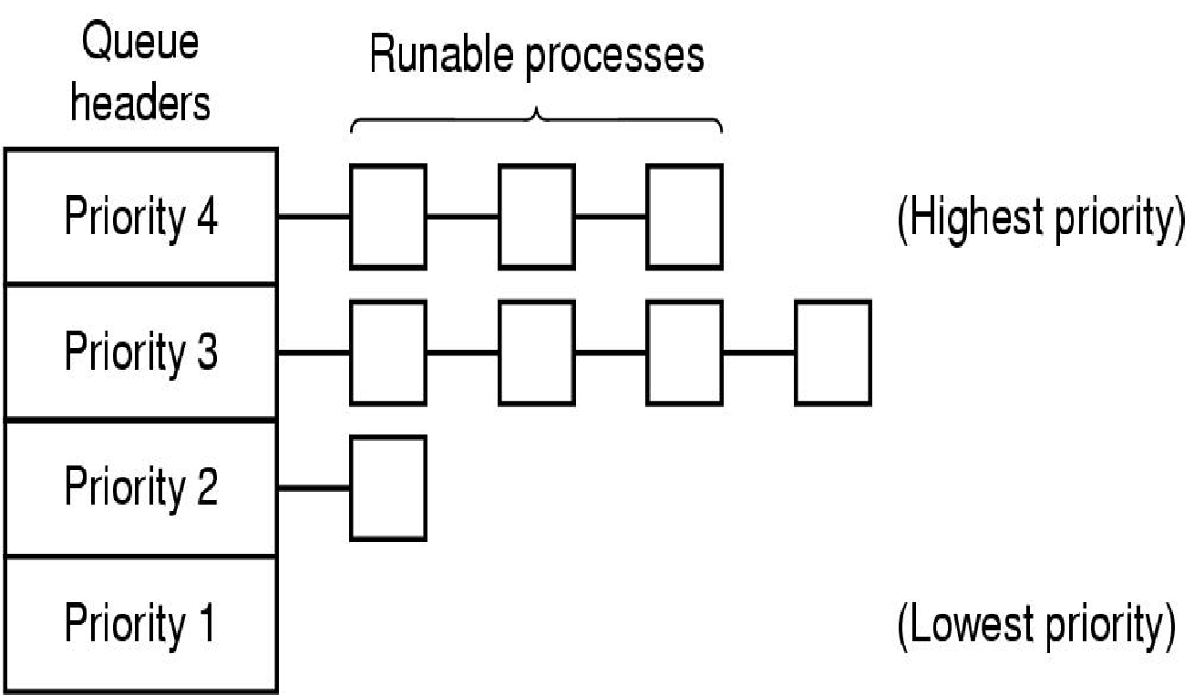
Multiple Queues (MQ) (2)
(Round-robin)
1
1 time Quantum
2
2 time Quantum
3
4 time Quantum
4
8 time Quantum

Slide 55
MQ Example
Turnaround time
P1 = 102
P2 = 3
Average turnaround time (102+3)/2 = 52.5
8 Context Switches
vs 101 context switches with fixed quantum
Process | CPU time
P1 | 100
P2 | 2
P1
P2
P2
P1
P1
P1
P1
P1
P1
0
1
2
3
5
9
17
33
65
102
Min Quantum = 1
(1, 2, 4, 8, 16, 32)
Notes:
ADVANTAGES : less switching overhead IF

Slide 56
Other Schedulers for Interactive Systems
Shortest Process Next (basically, SJF)
Guaranteed Scheduling (scheduler makes promises)
Lottery Scheduling (probabilistic scheduling)
Fair-share Scheduling (RR across users)
…
Notes:
Guaranteed scheduling example: each of N processes get 1/N time of the CPU
Probabilistic scheduling: issue each task a number of tickers and randomly pick the ticket that will be scheduled next. approximates algorithms. Can give more tickets to priority processes

Slide 57
Scheduling in Real-time Systems

Slide 58
Real-time Systems
Time plays an essential role
One or more physical devices external to the computer generate stimuli
The computer must react appropriately to them within a fixed amount of time
If the computer reacts too late, it is as bad as not reacting
Examples
Music player
Patient monitoring in a hospital intensive-care unit
Autopilot in an aircraft
Robot control in an automated factory

Slide 59
Scheduling in Real-time Systems (1)
Goals
Meet deadlines - avoid losing data
Predictability - avoid quality degradation (e.g., in multimedia systems)
Categorization
Hard real-time
There are absolute deadlines that must be met
Soft real-time
Missing an occasional deadline is undesirable but tolerable
Notes:
Meeting deadlines - avoid losing data
Predictability - avoid quality degradation in multimedia systems

Slide 60
Scheduling in Real-time Systems (2)
Assumptions - Process behavior is predictable and known in advance
Task timing is known
Release time (R_{i}) - earliest time when a task can start execution
Execution time (C_{i}) - expected execution time for a task
Deadline (D_{i}) - time by which processing must be completed
Periodicity is known
Periodic process (P_{i})
Sporadic process (aperiodic, hard deadlines)
Aperiodic process (aperiodic, soft deadlines)
Notes:
Meeting deadlines - avoid losing data
Predictability - avoid quality degradation in multimedia systems

Slide 61
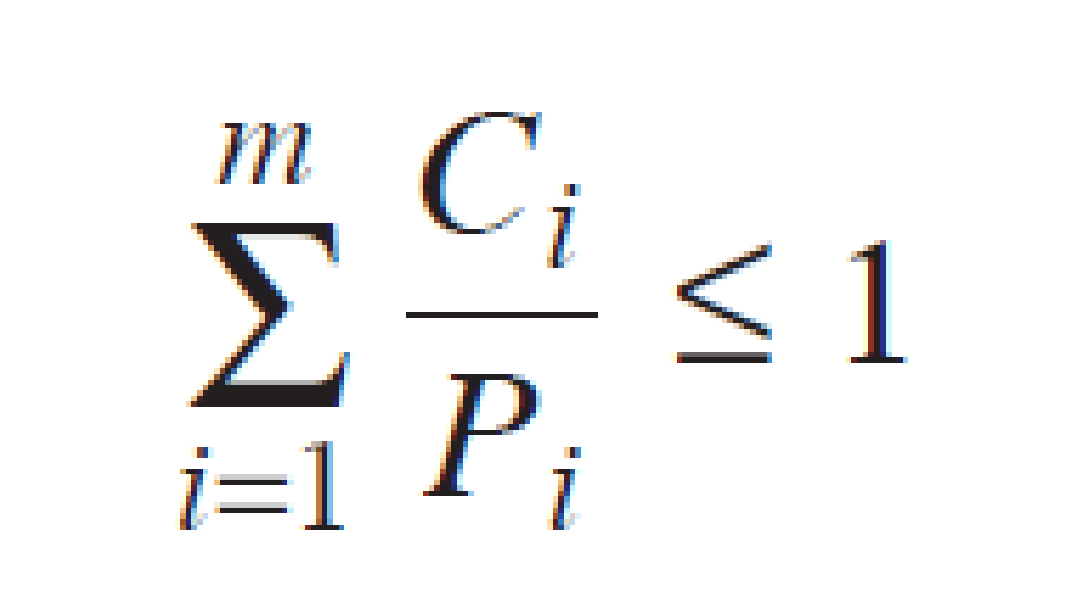
Scheduling Periodic Processes
How many periodic processes are schedulable?
“can fit/run on a processor” – single CPU
All combination of processes that satisfy the formula
m periodic events
Event i occurs
with period P_{i}
requires C_{i} time on the CPU
Notes:
As an example, consider a soft real-time system with three periodic events,
with periods of 100, 200, and 500 msec, respectively. If these events require 50,
30, and 100 msec of CPU time per event, respectively, the system is schedulable
because 0. 5 + 0. 15 + 0. 2 < 1. If a fourth event with a period of 1 sec is added, the
system will remain schedulable as long as this event does not need more than 150
msec of CPU time per event. Implicit in this calculation is the assumption that the
context-switching overhead is so small that it can be ignored

Slide 62
Example: Scheduling Periodic Processes
Events (in ms)
Period | CPU time
100 | 50
200 | 30
500 | 100
Is this system schedulable?
Notes:
As an example, consider a soft real-time system with three periodic events,
with periods of 100, 200, and 500 msec, respectively. If these events require 50,
30, and 100 msec of CPU time per event, respectively, the system is schedulable
because 0. 5 + 0. 15 + 0. 2 < 1. If a fourth event with a period of 1 sec is added, the
system will remain schedulable as long as this event does not need more than 150
msec of CPU time per event. Implicit in this calculation is the assumption that the
context-switching overhead is so small that it can be ignored

Slide 63
Example: Scheduling Periodic Processes
Events (in ms)
Period | CPU time
100 | 50
200 | 30
500 | 100
Is this system schedulable?
0.5 + .15 + 0.2 < 1 → yes
If we add a 4th event with P = 1s, what can its max CPU time be to fit on the processor?
Notes:
As an example, consider a soft real-time system with three periodic events,
with periods of 100, 200, and 500 msec, respectively. If these events require 50,
30, and 100 msec of CPU time per event, respectively, the system is schedulable
because 0. 5 + 0. 15 + 0. 2 < 1. If a fourth event with a period of 1 sec is added, the
system will remain schedulable as long as this event does not need more than 150
msec of CPU time per event. Implicit in this calculation is the assumption that the
context-switching overhead is so small that it can be ignored

Slide 64
RT Scheduling Algorithms
Fixed priority (the schedule is precomputed - static)
Scheduling executive (or cyclic scheduler) - based on priorities
Rate monotonic (RM) - based on period
Deadline monotonic (DM) - based on deadlines
…
Dynamic priority (dynamic)
Earliest deadline first (EDF)
Least laxity first (or Least Slack Time first, LST)
Utility based scheduling
…
Notes:
Scheduling executive based on priorities (as we saw before)
Rate monotonic based on period
Deadline monotonic based on deadline
DYNAMIC PRIO allow higher utilization of the processors – you can pack more processes
Real-time scheduling algorithms can be static or dynamic. The former make
their scheduling decisions before the system starts running. The latter make their
scheduling decisions at run time, after execution has started. Static scheduling
works only when there is perfect information available in advance about the work
to be done and the deadlines that have to be met. Dynamic scheduling algorithms
do not have these restrictions.

Slide 65
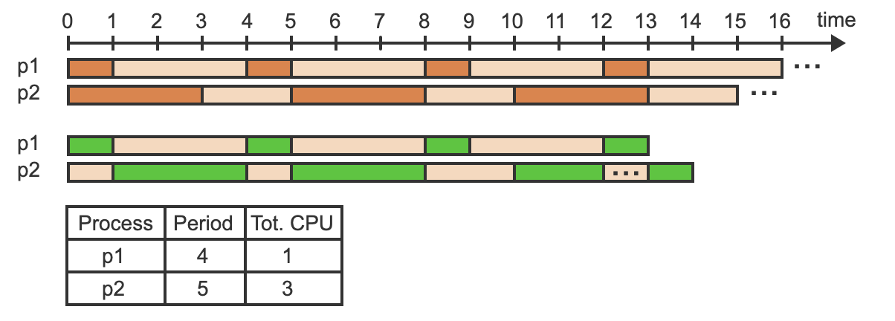
Rate Monotonic Scheduling
Preemptive algorithm, where the shorter the period, the higher the priority.

Slide 66
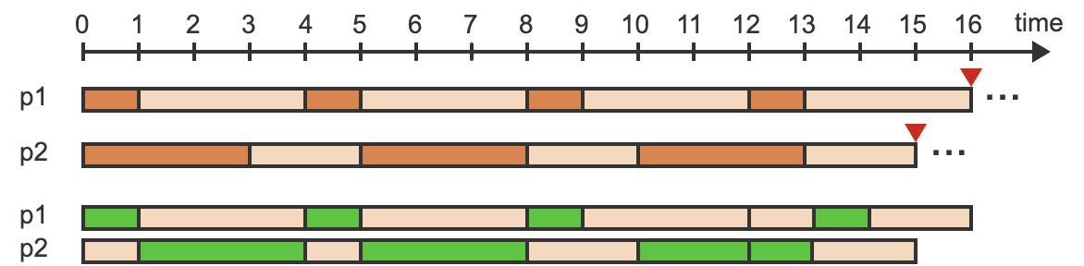
Earliest Deadline First Scheduling
Schedules processes according to the shortest remaining time until the deadline.
The shorter the remaining time, the higher the priority.

Slide 67
Studying Scheduling Algorithms

Slide 68
How to Evaluate a Scheduling Algorithm?
Deterministic modeling
takes a predetermined workload and compute the performance of each algorithm for that workload
Queueing models
Mathematical approach for handling stochastic workloads
Implementation/Simulation
Build system which allows actual algorithms to be run against actual data – most flexible/general

Slide 69
Scheduling in Linux
Linux uses a Completely Fair Scheduling (CFS) algorithm
An implementation of weighted fair queueing (WFQ)
https://blog.acolyer.org/2016/04/26/the-linux-scheduler-a-decade-of-wasted-cores

