Slide 1
Runtime: How Software Executes
-- Open Your Machine as a Whitebox
CS-577-A, Fall 2021
Jun Xu

Slide 2
What is Runtime
Runtime provides an environment in which programs run. This environment may address a number of issues including:
the management of application memory
how the program accesses variables
mechanisms for passing parameters between procedure
interfacing with the operating system
etc
-- https://en.wikipedia.org/wiki/Runtime_system

Slide 3
Why We Need to Know About Runtime
Because it is part of the binary’s behaviors … Let’s see the motivations throughout an example

Slide 4
Let’s Start with a Pre-built Binary
JX built the binary, named crackme, from several lines of C code and stripped the binary
The binary can be downloaded from https://drive.google.com/file/d/1P9vEPeT1NeNv0rrYShLdT4iIoZ397QiV/view?usp=sharing
Please upload it to your remnux Virtual Machine
Now Let’s Try to Understand Run-time Concurrently with the Learning of Debugging

Slide 5
Step 1: Start the Binary
Let’s start the binary through the gdb debugger (the default debugger we are going to use in this course)
How (inside terminal):
$: gdb /path/to/crackme
Q: What happened during this step? A: Nothing

Slide 6
Step 2: Run the Binary
Let’s run the binary and stop at the first ever instruction --- this is not the entry point in our binary; we are not there yet
How (inside gdb):
gdb: starti
Q: What happened during this step? A: The loading process

Slide 7
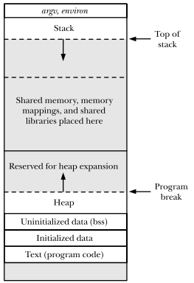
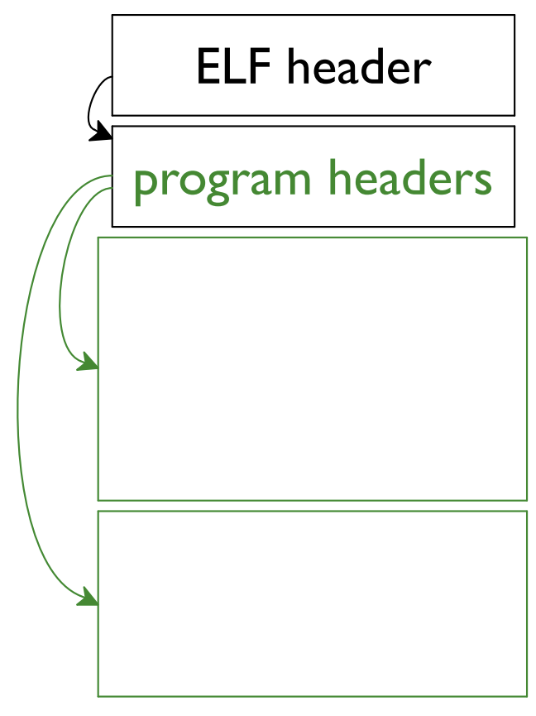
What Happens in Step 2
The loading process
-- Loading of the binary
-- Loading of the dynamic linker (???)
Code
load
Code
Data
load
/lib64/ld-linux-x86-64.so.2
Data
crackme
Runtime Memory
After this step, what we have now is a process inside the OS; and we should switch to a runtime mindset

Slide 8
Step 3: Continue Running the Binary Until the Entry Point
Let’s run the binary and break at the entry point
How (inside gdb):
gdb: info files
gdb: break *0xXXXXXXX (the program entry)
gdb: continue
Q: What happened during this step? A: More loading operations

Slide 9
What Happens in Step 3
The loading process
-- Loading of the shared library
-- Switch the execution to the program entry
Code
load
Data
/lib/x86_64-linux-gnu/libc.so.6
Runtime Memory

Slide 10
Step 4: Continue Running the Binary Until the Main Function
Let’s run the binary and break at the main function
How to find the main function (inside gdb):
gdb: x/20si $pc
gdb: look at the address moved to RDI right before an indirect call
gdb: break at the address found above
Q: What happened during this step? A: Executing __libc_start_main from libc

Slide 11
What Happens in Step 4
At the high level, running the __libc_start_main function, but
Internally:
performing any necessary security checks if the effective user ID is not the same as the real user ID.
initialize the threading subsystem.
registering the rtld_fini to release resources when this dynamic shared object exits (or is unloaded).
registering the fini handler to run at program exit.
calling the initializer function (*init)().
calling main() with appropriate arguments

Slide 12
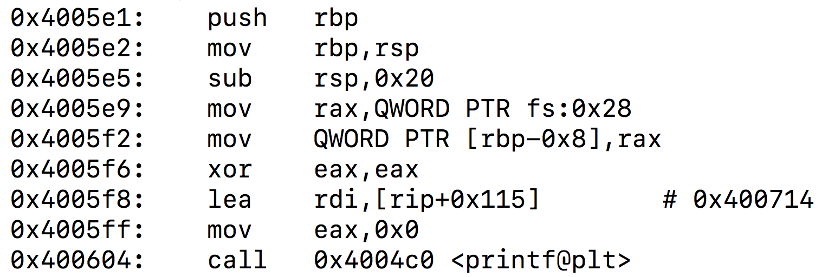
Step 5: Let’s Read and Execute Through the Main Function (the first 2 instructions)
Step 1: look at the first several (say 20) assembly instructions of main
gdb: x/20si $pc
Step 2: let go through the first 2 instructions
gdb: si
gdb: si

Slide 13
What Happens in Step 5
Instructions:
0x4005e1: push rbp
0x4005e2: mov rbp, rsp
Semantics (maintenance of the stack):
save the frame pointer (rbp) to the stack
update the stack pointer (rsp) with the current frame pointer
Q: who decides which registers are frame pointer and stack pointer?
A: ABI + Compiler

Slide 14
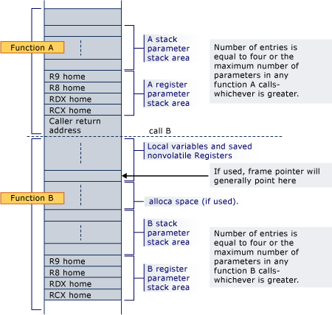
Extra point related to Step 5: the Stack
RBP (assuming Function B is running)
In computer science, a call stack is a stack data structure that stores information about the active subroutines of a computer program.
Each function that has not returned will have a piece of region allocated on the stack, i.e., the stack frame
When the function is running, frame pointer points to the top of the stack frame, stack pointer points to somewhere inside the stack frame
RSP (assuming Function B is running)
Growing
Downwards

Slide 15
Extra point related to Step 5: Why save RBP
When the current function returns, we need to recover the frame pointer used by its parent function …
For example, when Function B returns, the execution will go back to Function A and the execution will need to recover the frame pointer of Function A
We will talk about the recovery process of the frame pointer later

Slide 16
Step 6: Let’s Read and Execute Through More Instructions until a Child Function
gdb: si: sub rsp,0x20
gdb: si: mov rax,QWORD PTR fs:0x28
gdb: si: mov QWORD PTR [rbp-0x8],rax
gdb: si: xor eax,eax
gdb: si: lea rdi,[rip+0x115]
gdb: si: mov eax,0x0
Let’s stop before the instruction of “call 0x4004c0 <printf@plt>”

Slide 17
What Happens in Step 6 (instruction 1)
Instructions: sub rsp,0x20
Return address
Semantics:
-- decrease the stack by 0x20 or 32 bytes → allocate 32 bytes as temporary stack memory for the current function, namely our “main” function (growing downwards, remember?)
-- the stack memory will later be used to support the execution of the ”main” function, such as storing the local varaibles
RBP
32 bytes
Stack frame
of main

Slide 18
What Happens in Step 6 (instruction 2-4)
Instructions:
--- mov rax,QWORD PTR fs:0x28
--- mov QWORD PTR [rbp-0x8],rax
--- xor eax,eax
Return address
Semantics:
-- Move the value at offset 0x28 to segment fs to rax
-- Save rax to the location rbp-0x8 in the current stack frame
-- Eliminate the value in eax (make eax equal to 0)
Secret: this is a piece of code to do stack-buffer-overflow protection, namely stack canary…
RBP
RBP-0x8
32 bytes
Value at fs:0x28
Stack frame
of main

Slide 19
What Happens in Step 6 (instruction 5-6)
Instructions:
--- lea rdi,[rip+0x115]
--- mov eax,0x0
Semantics:
-- Move the value of rip + 0x115 to rdi
-- Move the value of 0 to eax
What are the secrets of the two instructions?
-- The first instruction prepares the first argument to the child function we are going to call (i.e., printf). As mandated by the x64 ABI, the first argument to a child function is saved to rdi
-- We can check the first argument with gdb: x/si $rdi (after the first instruction is executed). And we can see the result is “Enter number 1:”. That means we are going to do something like “printf(“Enter number 1:”)”
-- The second instruction indicates the number of vector registers that are used to pass arguments to ”printf” (this is a special case because printf is a variable argument function). This is a point that we can skip for now.

Slide 20
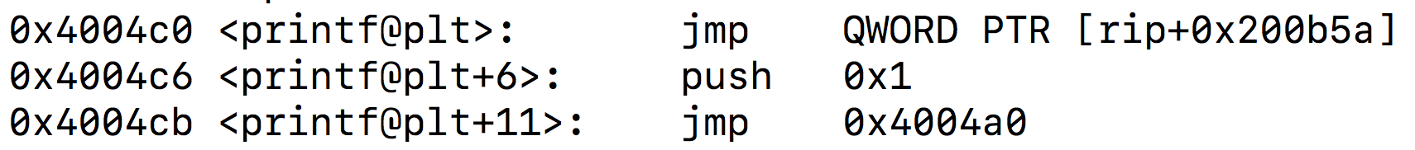
Step 7: Let’s run through the call to printf
Some notes and questions
--- this is the first time we call printf
--- our code does not contain a printf function. So where is it?
--- If we follow the execution to the child function, we will see:
0x4004c0: jmp QWORD PTR [rip+0x200b5a]
0x4004c6: pushq 0x1
0x4004cb: jmp 0x4004a0
Are these instructions from the printf function? Nop

Slide 21
What Happens in Step 7: where is printf
The function of “printf” is from the standard C library: GLIBC

Slide 22
What Happens in Step 7: how can the execution go to printf: Sub-Step 1: Jump to PLT of printf
0x4004c0: jmp QWORD PTR [rip+0x200b5a]
0x4004c6: push 0x1
0x4004cb: jmp 0x4004a0
PLT of printf
The first instruction retrieve an address from rip+0x200b5a (i.e., 0x601020), which is inside the .got.plt section. The memory at that address supposes to contain the address of the target, namely the printf
However, at this moment, the address of printf is unknown. Therefore, instead, the memory at that address actually contains an address of the second instruction in the PLT (i.e., 0x4004c6: push 0x1). This is intended because we are going to trigger the lookup of printf

Slide 23
What Happens in Step 7: how can the execution go to printf: Sub-Step 2: Go back to the PLT of printf
0x4004c0: jmp QWORD PTR [rip+0x200b5a]
0x4004c6: push 0x1
0x4004cb: jmp 0x4004a0
PLT of printf
The second instruction push 0x1 into the stack, which is the identify of the symbol “printf” (what we are going to look for)
The third instruction jumping to jmp 0x4004a0, which is the start of the .plt section. Details are in the next slide

Slide 24
What Happens in Step 7: how can the execution go to printf: Sub-Step 3: Jump to the lookup process
0x4004a0: push QWORD PTR [rip+0x200b62] # 0x601008
0x4004a6: jmp QWORD PTR [rip+0x200b64] # 0x601010
0x4004ac: nop DWORD PTR [rax+0x0]
Begin of PLT
The first instruction pushes the value in the memory location 0x601008 to the stack. Let’s skip this details (too low-level for now).
The second instruction jump to the address saved at the memory location 0x601010. The address is 0x00007ffff7dec6d0, which comes from .text in /lib64/ld-linux-x86-64.so.2. As such, the execution will go to the ld dynamic linker, which will go through a complicated look-up process to find the address of “printf” and switch the execution to the ”printf” function.
Important note: when ld find the address of “printf”, it will fill up the entry for the “printf” function in the .got.plt section. So that next time “printf” is called, no look-up is needed!!!

Slide 25
What Happens in Step 7: execution of “printf”
printf("Enter number 1: ");

