Slide 1
Understanding the Reverse Engineering Tools
CS-577-A, Fall 2021
Jun Xu

Slide 2
Topics today
We will look at the key tools we use for reverse engineering
Instead of simply looking at how to use them, we will also look at the internals of the tools

Slide 3
Why we need to look at the internals of tools
Understand how the tools work internally
---- Help you truly understand the behaviors and outputs of the tools
---- When the tools make mistakes, you can identify and fix them
---- You will be able to customize, improve, or extend those tools.

Slide 4
Tools we will look at
File
Readelf
Objdump
Ghidra
GDB

Slide 5
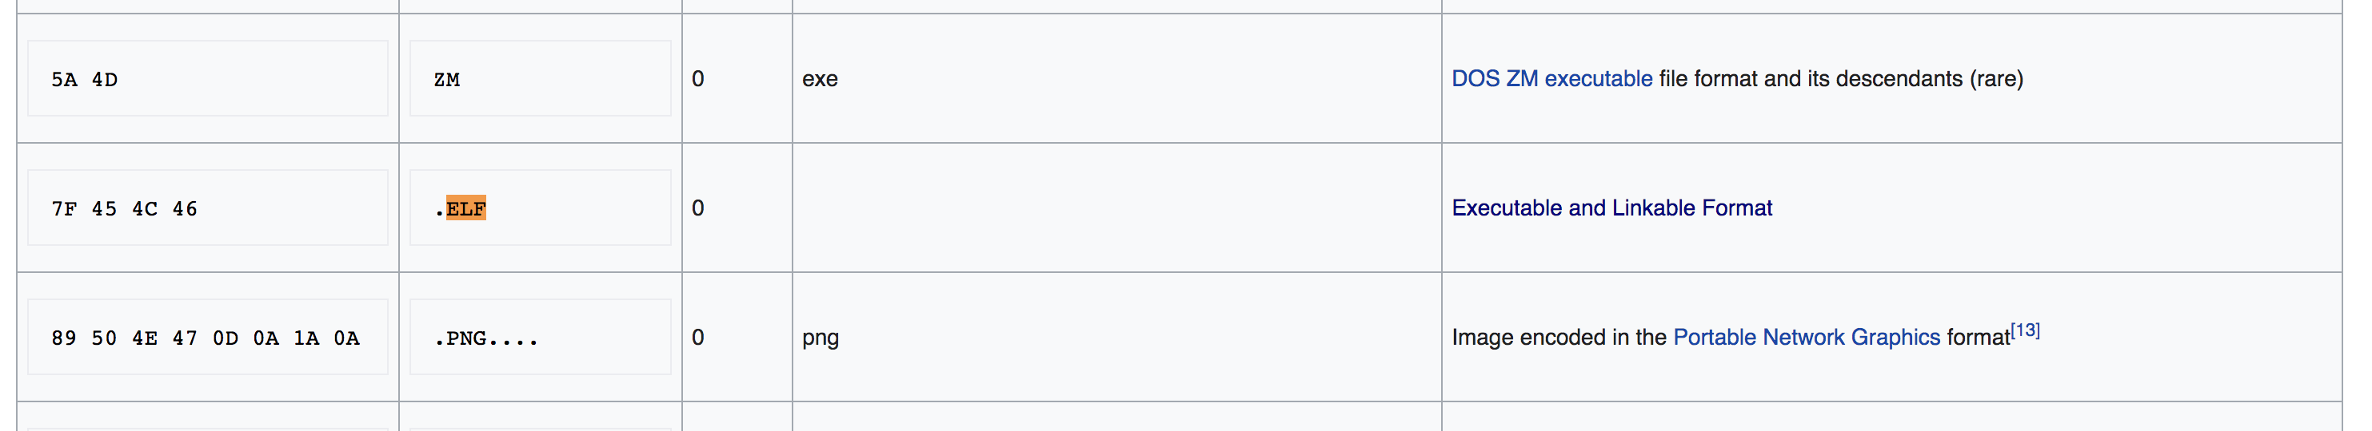
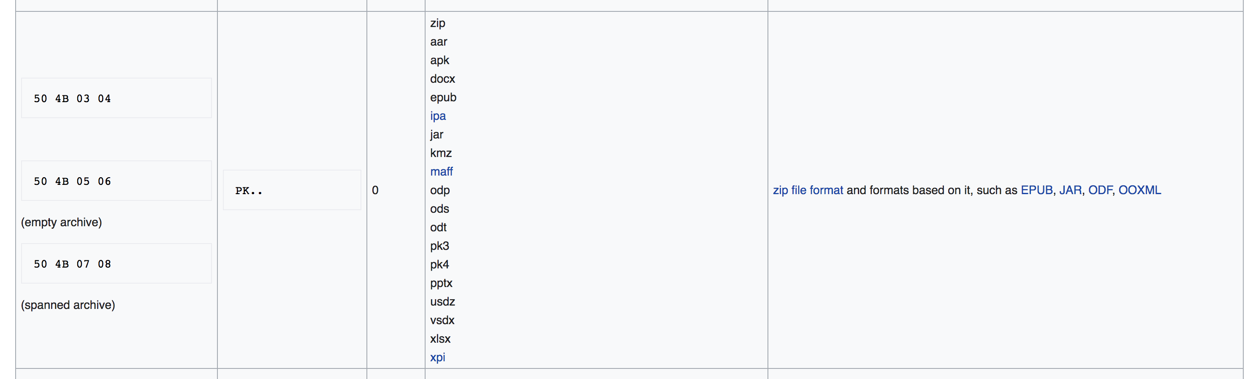
How ”file” works
Check the magic number in the target file
--- What is a magic number: A group of binary bytes in the begin of a file to indicate the type of the file
You can also directly check the magic number with hexedit

Slide 6
How ”file” works
Now assuming no one tells you how “file” works. Can you figure it out and how?
--- Solution 1: Look at the available documents: e.g., https://man7.org/linux/man-pages/man1/file.1.html
The cheaper solution, but you may not always find a document with all the details you need
--- Solution 2: Look at the source code
The more expensive solution, but you can get first-hand, all-sided details
For solution 2, how do we get the source code for “file”
--- Download the source code via package manager: “apt-get source file“
--- You may see problems saying “you must put some source …”
--- Open ” /etc/apt/sources.list” (as root) and un-comment the statements starting with “deb-src”
--- Run “sudo apt-get update”

Slide 7
How ”readelf” works
Readelf provides different results when you give it different options
-h --file-header Display the ELF file header
--- This is done by reading and parsing the ELF header in the file
-l --program-headers Display the program headers
--- This is done by reading and parsing the program headers in the file
-S --section-headers Display the sections' header
--- This is done by reading and parsing the section headers in the file
-s --syms Display the symbol table
--- This is done by reading and parsing the “symbol” section in the file
There are many more options, but the key point is to read and parse related headers or sections in the binary file.

Slide 8
How ”readelf” works
Now assuming no one tells you how “readelf” works, you want to figure it out by reading the source code
--- If you follow what we did for “file” by running “apt-get source readelf” to get the source code
--- It will not work: readelf is not an independent project; it is a part of the ”binutils” project
--- So you need to download the source code for ”binutils” (try ”apt-get source binutils”)

Slide 9
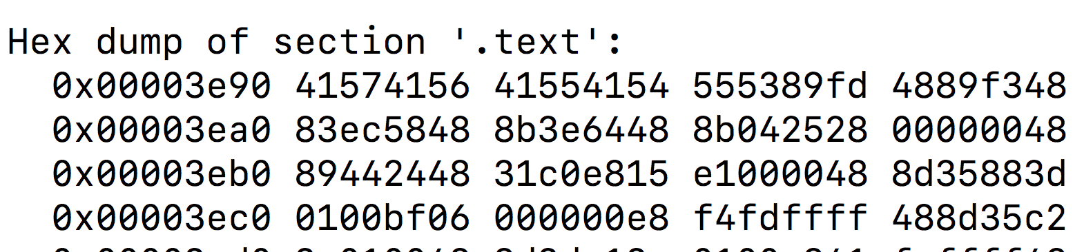
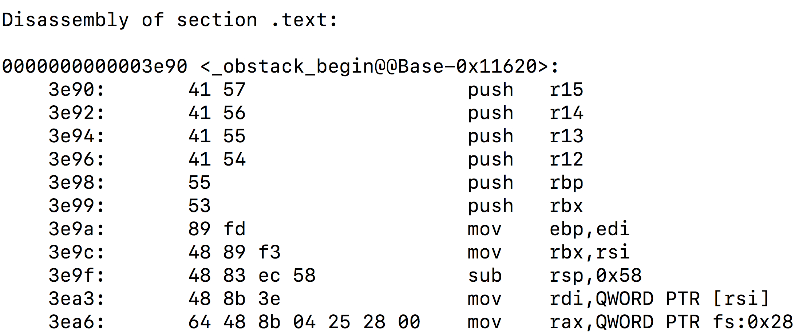
How ”objdump” works
Objdump also provides different results when you give it different options
Many options of Objdump overlap with Readelf’s options, and the internal mechanism is also to read and parse related headers, segments, or sections.
We will focus on the “-d” option by Objdump.
--- What it does?
--- It extract the “.text” section and ”disassemble” the machine code inside to assembly code

Slide 10
How ”objdump” works
Linear Sweep
Go to the first byte in the .text section
Decode the byte sequence from the first byte into an (x64) instruction
--- x64 instructions have different lengths
--- x64 instructions are uniquely encoded → decoding from a fixed byte can only produce a unique instruction or an invalid instruction → no ambiguity during decoding
After decoding the first instruction, go to the next instruction and repeat this process until the end

Slide 11
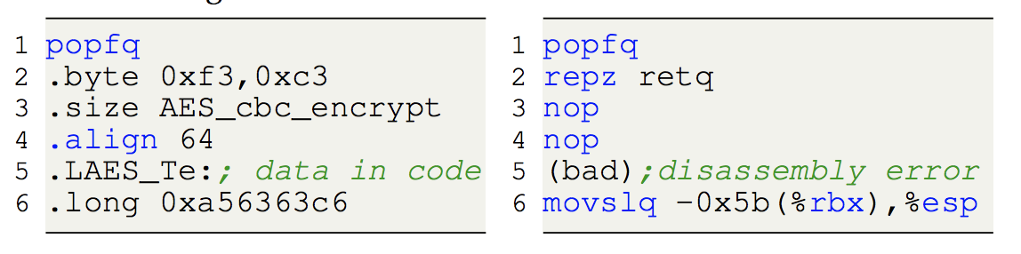
How ”objdump (-d)” works
Can the approach used by objdump make mistakes?
--- Yes, in certain cases, some pieces of data can be embedded in code (between different instructions)
--- Objdump cannot differ data from code and thus, will also decode the data as instructions
--- This is a fundamental problem in disassembly
Decode data as instructions

Slide 12
How ”objdump (-d)” works
What happens when objdump encounters an error and cannot decode anymore
--- Objdump simply skips the current byte and resumes the decoding from the next byte
Decode data as instructions

Slide 13
How ”objdump (-d)” works
Besides potential errors due to data-in-code, what are the other problems with using the results of objdump?
Functions are not labeled, so you cannot do intra-procedural understanding or analysis
Control flow, namely the connection between different code blocks, is not recovered, so you do not know how the execution will go through the entire program
labels are not provided, like labels of functions and code blocks

Slide 14
How ”Ghidra” works
Ghidra provides a magnitude of options. We are not going to cover how each option works; we are going to talk about how Ghidra performs ”disassembly” --- namely, how it produces the outputs you see in the window for “assembly code”

Slide 15
How ”Ghidra” works
Recursive disassembly
Does Ghidra use the same approach as Objdump to produce the assembly code?
--- No, Ghidra uses another approach called recursive disassembly
Ghidra start the decoding process like Objdump from a remaining symbol or the address of a known function. In cases where no symbols exist, Ghidra will start from the entry point.
Ghidra keeps decoding the instructions, but when it reaches the end of a basic block, it will go to the successor(s) of the basic block and resume decoding, instead of directly decoding the next byte

Slide 16
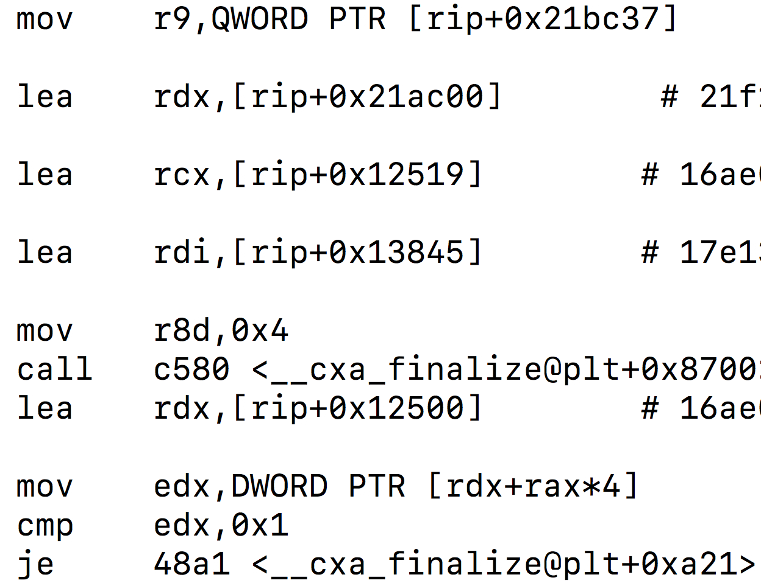
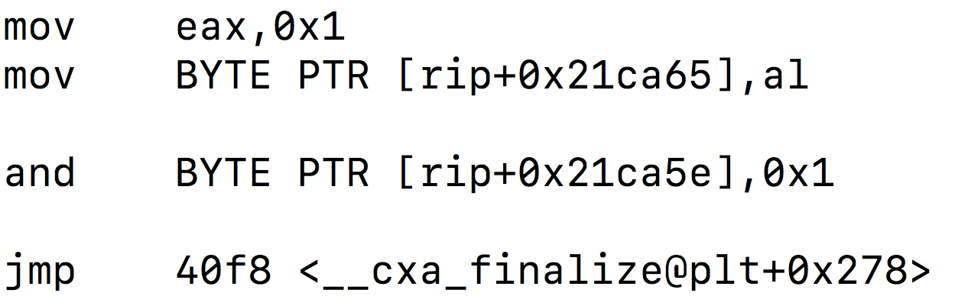
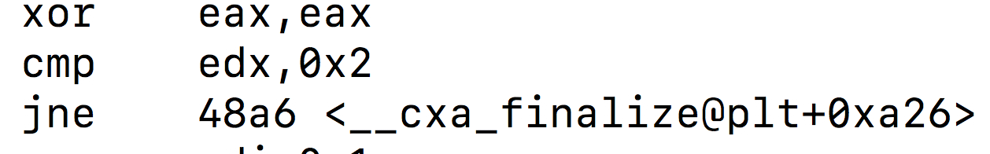
How ”Ghidra” works
What is a basic block?
--- A sequential block of instructions that have a single entry and a single exit
--- Entry: the position where execution from another basic block transfers to this basic block
--- Exit: the position where the execution transfers from this basic block to another basic block
Basic Block 1
Basic Block 3
Sequential code
Basic Block 2

Slide 17
How ”Ghidra” works
Recursive disassembly
Ghidra will first decode basic block 1
Then Ghidra will decode either basic block 2 or basic block 3
Basic Block 1
Basic Block 3
Sequential code
Basic Block 2

Slide 18
How ”Ghidra” works
Why Ghidra does not make mistakes as objdump does?
No control flow can reach this part of code … so no decoding here

Slide 19
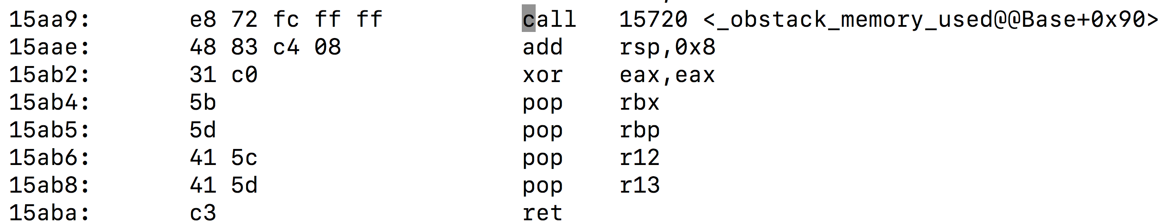
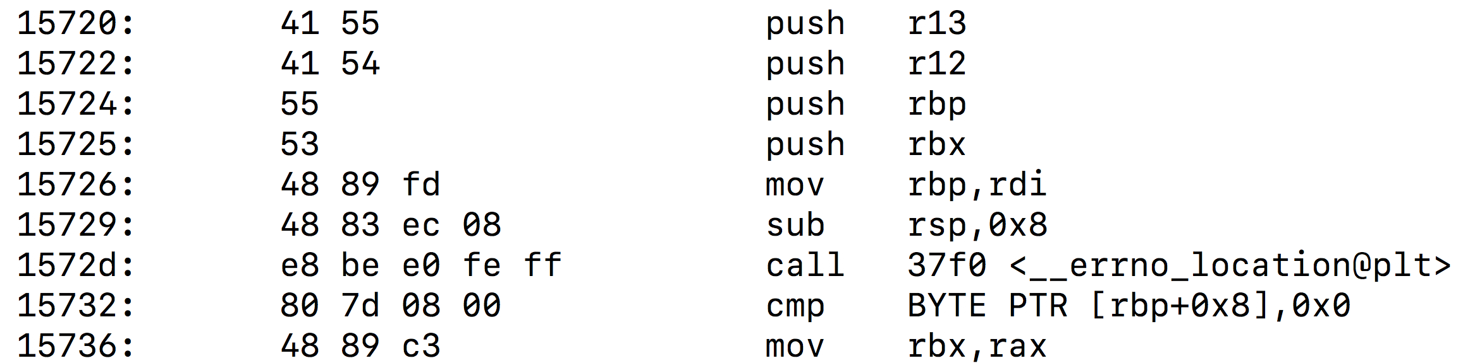
How ”Ghidra” works
Ghidra also marks boundaries of functions
Consider the target of every call instruction as a function start
From that function start, follow the control flow (without considering child functions) until an ”ret” or a call to a non-returning function (i.e.. a function that does not return, e.g., exit)
All the code between the function start and a “ret” or a call to a non-returning function is considered belonging to the function
Marked as a function start

Slide 20
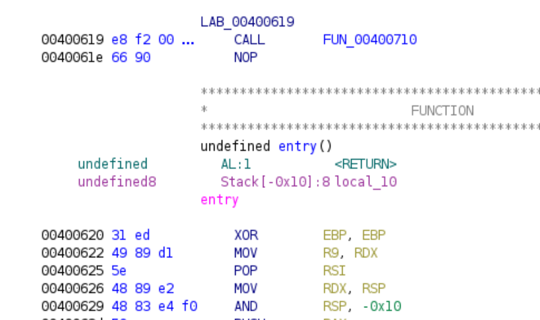
How ”Ghidra” works
Does Ghidra make mistakes?
Yes, and in fact a lot, in particular when handling large-size, highly-optimized binary code
A function that does not return
Function 1
Function 1
Ghidra will wrongly include code from function 2 to function 1
Function 2

Slide 21
How ”GDB” works
Let’s switch to another slide

