Slide 1
Recap and De-compilation
CS-577-A, Fall 2021
Jun Xu

Slide 2
Topics Today
Recap what we have studied thus far
Talk about de-compilation: the last piece of skill that you will need to do reverse engineering independently

Slide 3
What we have studied so far
Internals of ELF files
--- Structure of ELF
--- The functionality of each segment
How the knowledge about ELF files helps reverse engineering
--- When you want to find something, you know how to do it (simply knowing how to use the tools cannot help you do this)
--- e.g., you want to find the entry point, you know where to find it

Slide 4
What we have studied so far
Assembly code
--- How to extract assembly code from an ELF binary
--- Format and structure of assembly instructions
--- Semantics of assembly code
How the knowledge about assembly code helps reverse engineering
--- When you want to understand the functionality or behaviors of the binary, you know how to do it

Slide 5
What we have studied so far
Run-time of binary code
--- How an ELF binary gets executed
--- How the binary code interacts with the operating systems (such as library functions)
How the knowledge about run-time helps reverse engineering
--- When you want to dynamically trace/modify some parts of the execution, you know how to do it
--- You will be able to understand the ”true behaviors” of many special pieces of assembly code

Slide 6
What we have studied so far
Many important reverse engineering tools
--- file: check the type of a file: whether it is an ELF; whether it is PIE; whether it is stripped, etc.
--- objdump: dump the assembly code from an ELF file
--- Ghidra: analyze an ELF file to present its assembly code and source code (this has not been talked about yet)
--- GDB: dynamic trace the execution of an ELF file to understand the behaviors

Slide 7
So, you guys can already do reverse engineering by yourself
However, now, the reserve engineering you can do is to understand the binary behaviors by looking at the assembly code (statically or dynamically). The workload is just too high.
Can we make the process easier?
Yes, we can lift the assembly code to more higher-level representations like pseudo-C code.

Slide 8
There are two types of de-compilers
Virtual-Machine based de-compilation: McSEMA
--- Use higher-level representations like LLVM IR or C code to simulation the effect of each assembly code
--- This does not really help reverse engineering, since you are still understanding equivalent semantics of the assembly code
Inference-based de-compilation: IDA Pro, Binary Ninja, and Ghidra
--- Infer the original source code that produce the binary code
--- Very helpful for reverse engineering
--- It strips away low-level architecture dependent details
--- It presents the logic with easier-to-understand abstract representation (C code)

Slide 9
Our First Example of De-compilation
Let’s reverse engineer the binary file from our last lecture: https://drive.google.com/file/d/1P9vEPeT1NeNv0rrYShLdT4iIoZ397QiV/view?usp=sharing
but let’s do it with de-compilation this time.
How to do it:
Run “ghidra” in your terminal to start Ghidra
Open a new project (if you have not done so)
Import the file of our ELF binary (if you have done so)
Right click on the ELF binary and run the default tool
Pick a function in the window for assembly code, then the de-compiled source code will show up in the right-side window
--- Let’s run the “main” function as an example. Do not ask me again how to find ”main”.
If you accidentally closed the source-code window, it will not automatically pop up. You will need to click on an icon in the tool bar at the top:

Slide 10
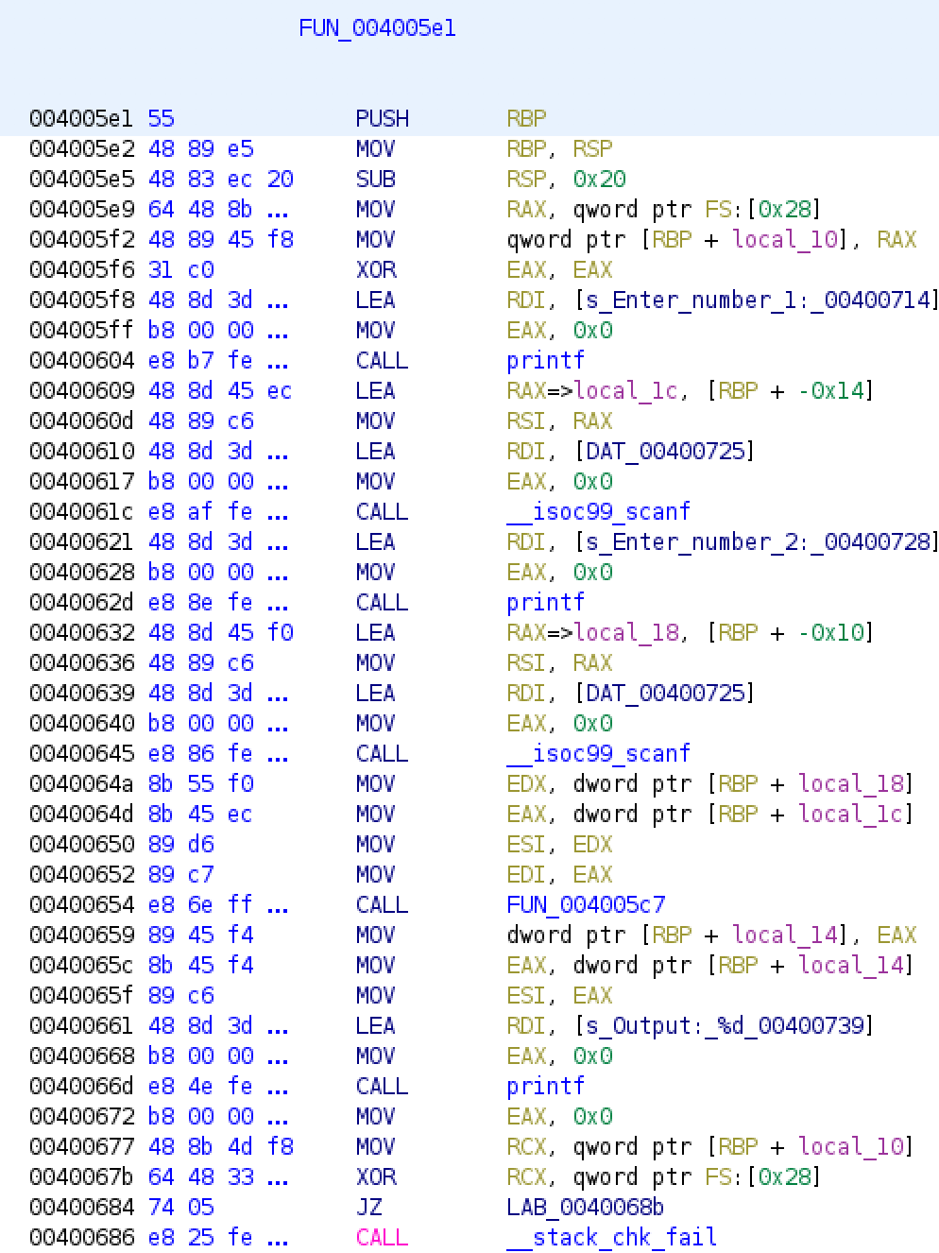
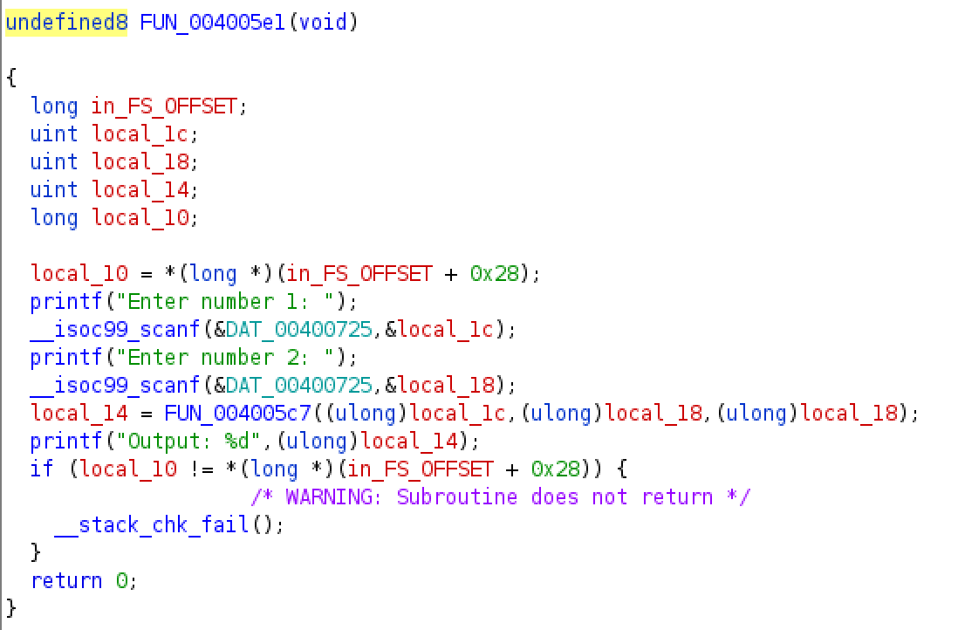
De-compiled source code V.S. assembly code

Slide 11
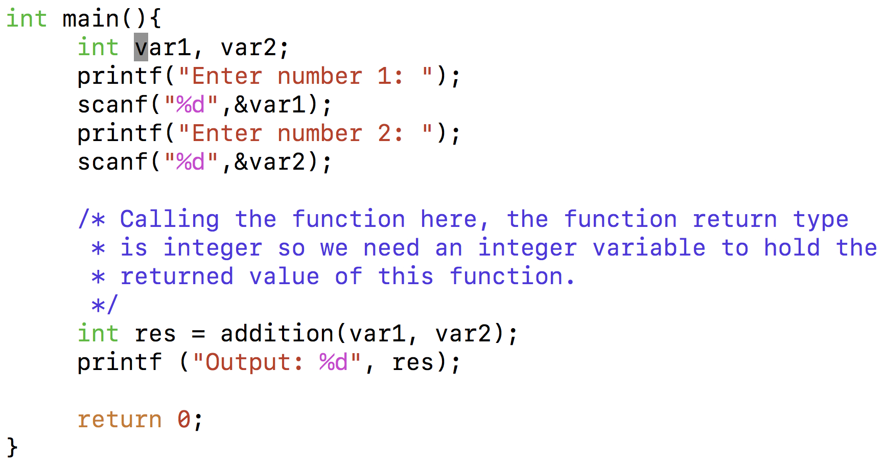
But, the de-compiled C code is not as easy as the original source code?

Slide 12
Reverse engineering with de-compiled code is very convenient, but still needs many efforts
The de-compiled code contains many bloat code pieces
The de-compiled code can carry missing information in comparison to the original source code. Such information is oftentimes critical to reverse engineering
The de-compiled code can contain ERRORS which derive from either the disassembly phase or the de-compilation phase.

Slide 13
The de-compiled code can contain many bloat code pieces
Such code pieces are not relevant to the understanding of the code, and they can be very misleading
An un-initialized variable
We will need to be able to recognize such code and eliminate them during reverse engineering
Stack canary check;
It does not appear in the original source code

Slide 14
The de-compiled code can still carry missing information in comparison to the original source code. Such information is oftentimes critical to reverse engineering
This should be a format string like “%x”, but here what you have is ”&DAT_00400725”.
The format string is critical for understanding what happens at this library call.
So we will need to figure out the format string behind

Slide 15
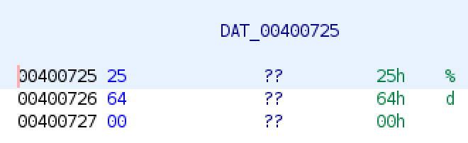
The de-compiled code can still carry missing information in comparison to the original source code. Such information is oftentimes critical to reverse engineering (cont.)
Double click on it
Now you know the format string is “%d”, but of course that requires you to know that strings in C code end with ‘\0’ or basically 0x00

Slide 16
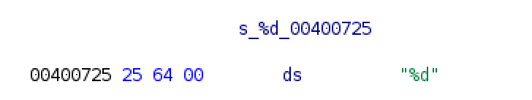
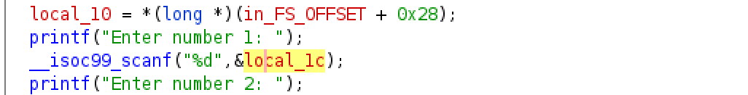
The de-compiled code can still carry missing information in comparison to the original source code. Such information is oftentimes critical to reverse engineering (cont.)
Can we change the representation?
YES
Double click on it
Right click on it
Click on the “Data” icon in the menu
Click “string”

Slide 17
The de-compiled code can still carry missing information in comparison to the original source code. Such information is oftentimes critical to reverse engineering (cont.)
This case represents a common problem of de-compiled code:
The de-compiler cannot accurately recover the types of data
Why: because data types are lost during the compilation process

Slide 18
The de-compiled code can still carry missing information in comparison to the original source code. Such information is oftentimes critical to reverse engineering (cont.)
The function name is missing, even if you know it is “main”
Right click on it
Click on the “rename function” icon in the menu
Type the name you want (like “name” in this case)
In this case, renaming seemly brings less benefit since ”main” is not called anywhere. But for functions that are called in many places, making its name intuitive can be extremely helpful
For instance, if you know the real name of function “FUN_004005c7” is “addition”, you can probably already know the semantic of the code even if you did not look into the internals of the function

Slide 19
The de-compiled code can still carry missing information in comparison to the original source code. Such information is oftentimes critical to reverse engineering (cont.)
A systematic summarization is available at https://initrd.net/stuff/ghidra/GhidraDocs/GhidraClass/Advanced/improvingDisassemblyAndDecompilation.pdf

