Slide 1
Welcome!
CS-577-A, Fall 2021
Jun Xu

Slide 2
Who am I
Jun Xu
Assistant Professor @ CS of Stevens
PhD from PSU on Cybersecurity
Research on breaking and fixing things
Gateway North 246
jxu69@stevens.edu
201-216-5484

Slide 3
About This Course
Reverse Engineering & Application Analysis
Happens every Wednesday from 6:30 to 9:00 PM
North Building 103
Syllabus: https://sit.instructure.com/courses/50069/pages/syllabus

Slide 4

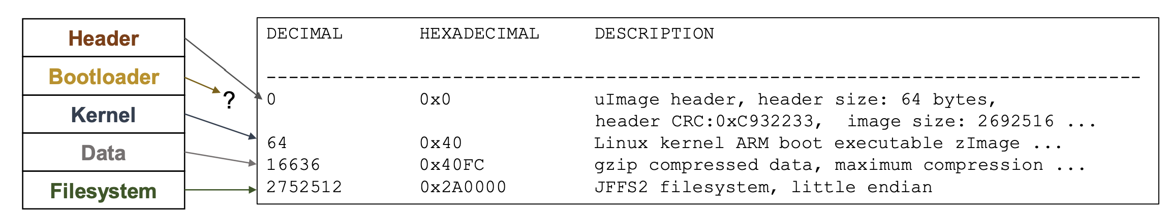
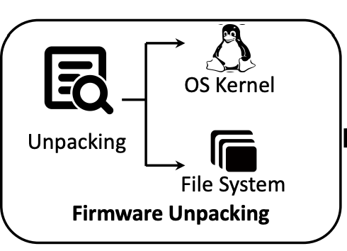
Plan for Course Work
Every student will get a unique firmware from a real-world embedded device
Weak Password
Unpatched Vulnerability
Unsecured Communication
…

