Slide 1
SF Rent Board Housing Inventory
Cleaning assessment and 3NF relational database model
Professor: [Professor Name]
Team: [Team Name]
Team members: [Add names here]
DATA 201 | Database design and normalization project

Slide 2
Project overview
Build a reliable relational database from a large, messy housing-inventory export.
Clean inconsistent labels, ranges, dates, utilities, and duplicate filings.
Organize the data into a 3NF schema with clear primary keys and foreign keys.
Validate that the database preserves the original 550,201 unit records.
550,201 records
28 columns
21 tables
3NF design
SF Rent Board Housing Inventory | DATA 201 | 2

Slide 3
Dataset selection and motivation
The data describes one rental-unit record from one annual filing.
It is complex enough for database design because it includes categories, ranges, dates, utilities, history, and quality problems.
The project supports questions about filing years, occupancy, rent bands, utilities, and data quality.
Rent and square footage are bands, so midpoint assumptions must be stated clearly.
Goal: turn a wide flat file into a clean, auditable relational model
SF Rent Board Housing Inventory | DATA 201 | 3

Slide 4
What cleaning was needed
Bedroom and bathroom fields contained spelling variations, numeric text, categories, and unparseable labels.
Monthly rent and square footage were stored as ranges rather than exact numeric values.
Utility information was spread across checkboxes and a multi-valued free-text field.
Invalid dates were preserved through quality flags instead of being silently dropped.
Identical non-key records were tagged as duplicate groups.
SF Rent Board Housing Inventory | DATA 201 | 4

Slide 5
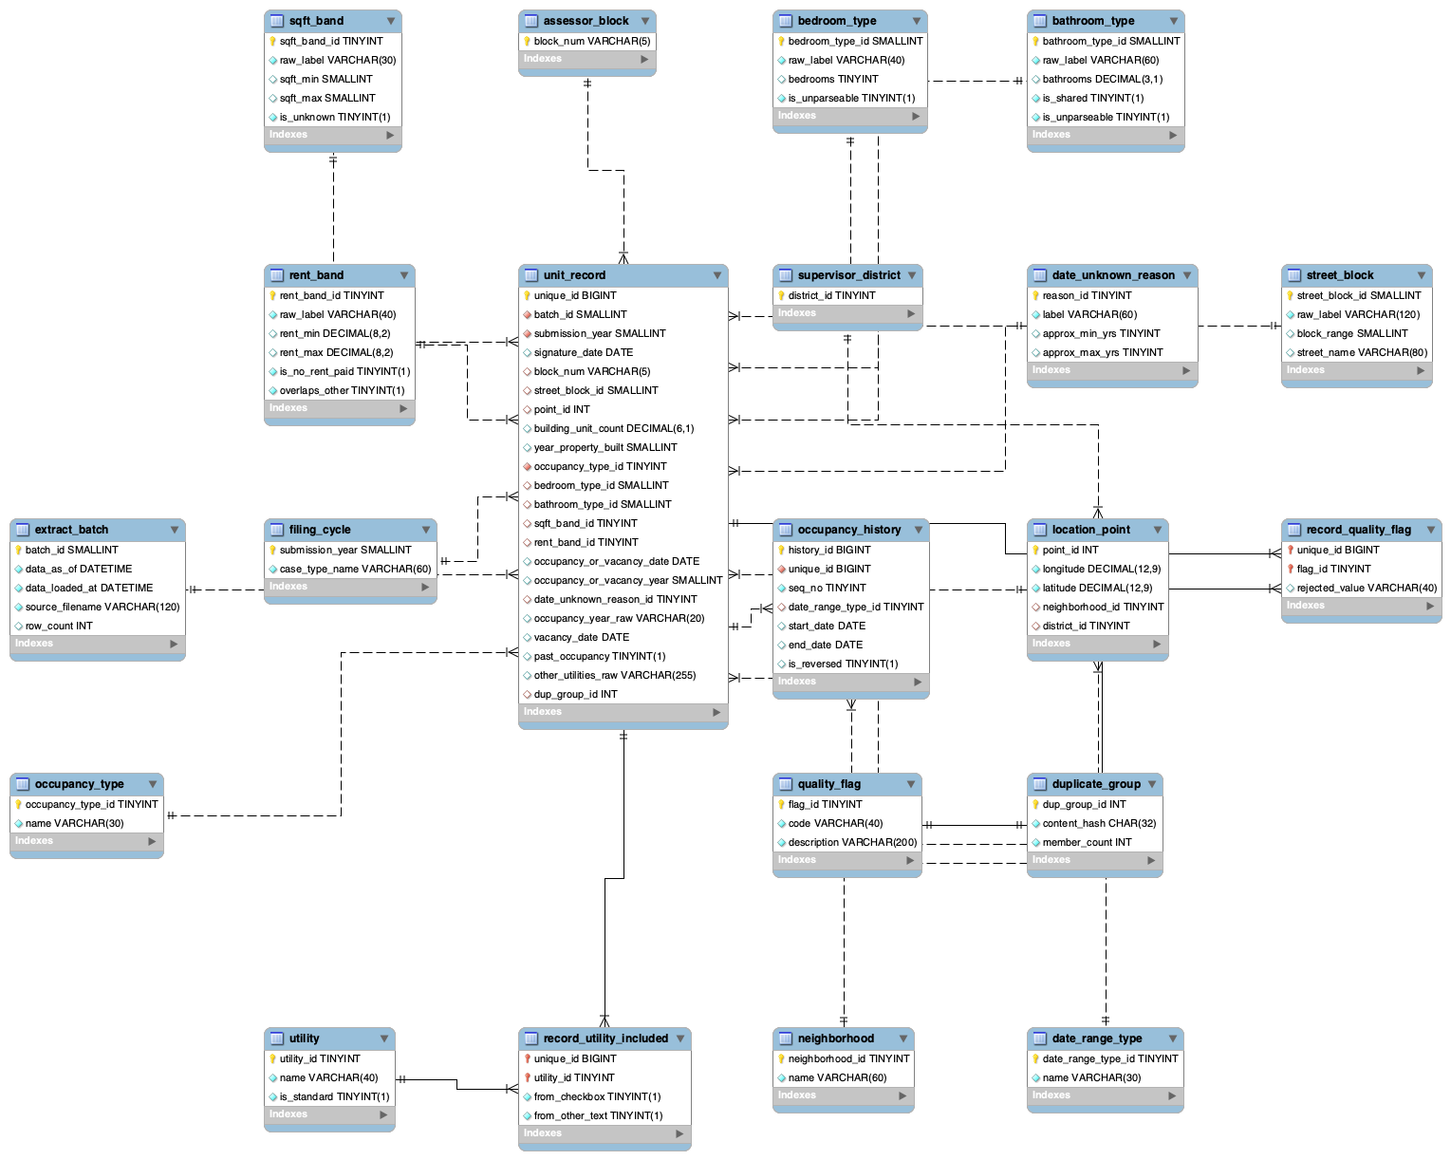
Entity-relationship diagram
SF Rent Board Housing Inventory | DATA 201 | 5

Slide 6
Normalization: 1NF, 2NF, and 3NF
1NF
Utilities and occupancy history were moved into separate rows so values are atomic.
2NF
unit_record uses the single-column key unique_id, so partial dependencies cannot occur.
3NF
Repeated descriptions and derived attributes were moved into lookup tables such as rent_band and occupancy_type.
Result: less repetition, clearer relationships, easier validation
SF Rent Board Housing Inventory | DATA 201 | 6

Slide 7
Database design
unit_record is the central fact table and uses unique_id as its primary key.
Lookup tables store reusable descriptions for filing cycles, occupancy, bedrooms, bathrooms, rent, and square footage.
record_utility_included and record_quality_flag are junction tables because one record can have many related values.
occupancy_history is a child table because one unit record may have multiple history entries.
Primary keys and foreign keys make the relationships explicit.
SF Rent Board Housing Inventory | DATA 201 | 7

Slide 8
Loading and validation evidence
550,201
81,004
700,552
0
unit records
history records
utility links
duplicate unique IDs
The loader stages TSV files, loads tables in foreign-key order, and records quality issues instead of dropping them.
Validation checks row counts, uniqueness, foreign-key relationships, and occupancy-date representations.
SF Rent Board Housing Inventory | DATA 201 | 8

Slide 9
Analysis questions and findings
How many records were filed in each year?
How are records distributed across occupancy types?
Which rent and square-footage bands are most common?
Which utilities are included in base rent?
Which records contain invalid dates or other quality problems?
Insert SQL result screenshots here
SF Rent Board Housing Inventory | DATA 201 | 9

Slide 10
Limitations and conclusion
The supplied local flat CSV has blank block, neighborhood, and supervisor-district labels.
Rent and square footage are ranges, not exact measurements.
The source does not provide a stable unit identifier across years.
The normalized database preserves the source records while making cleaning decisions visible and auditable.
Normalization makes a complex housing dataset easier to query, explain, and validate.
SF Rent Board Housing Inventory | DATA 201 | 10

