Slide 1
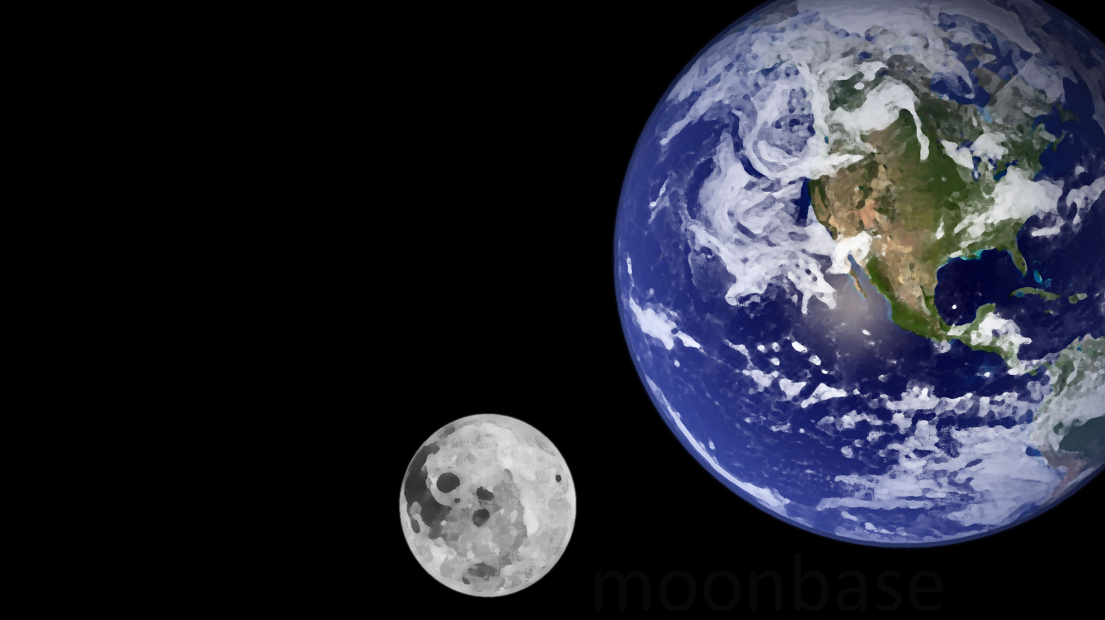
moonbase
a Java Swing exploration platformer game
Notes:
To use this title animation slide with a new image simply 1) move the top semi-transparent shape to the side, 2) delete placeholder image, 3) click on the picture icon to add a new picture, 4) Move semi-transparent shape back to original position, 5) Update text on slide.

Slide 2
Design Philosophy
Exploration-Focused
Experience as much or as little as you want.
A story-centric platformer.
Networked Multiplayer
Play solo or with a friend on separate clients.
Set in Space
Automatically cool.

Slide 3
Outside Topics
Section One
seven topics from outside the curriculum
!

Slide 4

Outside Topics
Artistic Aspects
Technical Aspects
Organizational Aspects
Version Control
Coordinating pushes.
Good communication.
Music Composition
Soundtrack enhances the mood.
Soundtrack is impressive without being overpowering.
Data Organization
Repeated resources (tiles, music, etc.) should be reused rather than reloaded.
Each frame must be processed in ~15 milliseconds.
GUIs
Java Swing!
Team Organization
Routine meetings.
Effective meetings.
Effective time between meetings.
Illustration and Animation
Graphics are thematically consistent.
Graphics look good.
Level Design
Progression is intuitive but not boringly so.
Movement feels “weighty” and satisfying.
Game Networking
Player information is sent and received quickly.
Information from one player influences the world of the other.

Slide 5
Outside Software / Tools
Section Two
ten pieces of outside software/tools
!

Slide 6





Production Tools
MuseScore
Photoshop
Wireshark
Audacity
Inkscape

Slide 7



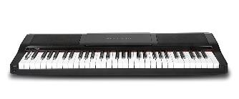

Organizational / Hardware
Discord
GitHub
Tablet
Keyboard
Router

Slide 8
Outside Classes
Section Three
five outside classes
!

Slide 9
Outside Classes
PSYC 355
Social Psychology
Motivating People
PSYC 339
Origins of the Mind
Perception of Agents
PSYC 305
Learning and Memory
Principles of Reward
BUAD 302
Business Communications
Structuring group presentations
MPGU 120A
Beginning Guitar
Music Composition

Slide 10
Data Structures
Section Four
five data structures
!

Slide 11
Data Structures
Vector/ArrayList
E.g. List of GameStates, list of ServerThreads…
Stack
E.g. Checkpoints that the players have reached
Map
E.g. Map<String, Clip> of soundtrack names to their clips
Array
E.g. Tile[] to hold tiles
E.g. byte[] to send data
Queue
E.g. messages sent from clients to server

Slide 12
Multithreading, Networking, Login / Guest Functionality
Section Five
!

Slide 13
Multithreading
Networking
Multiple ServerThreads
GameWindow is a Thread
Send / Receive Player Data each Frame
Login / Registration

Slide 14

Users
Log in / Register on Client
Guest users can play 1P
Registered users can play 2P

Slide 15
Project Design and Teamwork
Section Six
what went well? what didn’t?
!

Slide 16
The Good
Communication
Responsive on chat
Met weekly without fail
Enthusiasm
Excitement about project
Willingness to go the extra mile
Group Coding Sessions
In person
Over Discord
Manageable
Project was not too ambitious
Project was not boringly simple
Crisis Management
Things go wrong. But then you fix them.

Slide 17
The Bad
Tasks split too cleanly
Problems putting parts together not found until late.
Busy schedules
Near the deadline, accountability declines.
Took people at their word
Should have demo’d every week instead of just talking about progress.
Unforeseen circumstances
Teammate dropped.
Had to learn new technologies last-minute.
Coding isn’t everything
Game development requires a lot of skills beyond just coding.

Slide 18
moonbase
a Java Swing exploration platformer game
DEMONSTRATION
Notes:
To use this title animation slide with a new image simply 1) move the top semi-transparent shape to the side, 2) delete placeholder image, 3) click on the picture icon to add a new picture, 4) Move semi-transparent shape back to original position, 5) Update text on slide.

